Slide 1


Zustand: Deep Dive
Notes:
Let me introduce you to Zustand, a state management library designed for React.
Unlike Redux, Zustand emphasizes simplicity and speed, making it lightweight, fast, and easy to integrate.
It’s an excellent alternative if you’re looking to avoid complex boilerplate while managing your application's state.

Slide 2
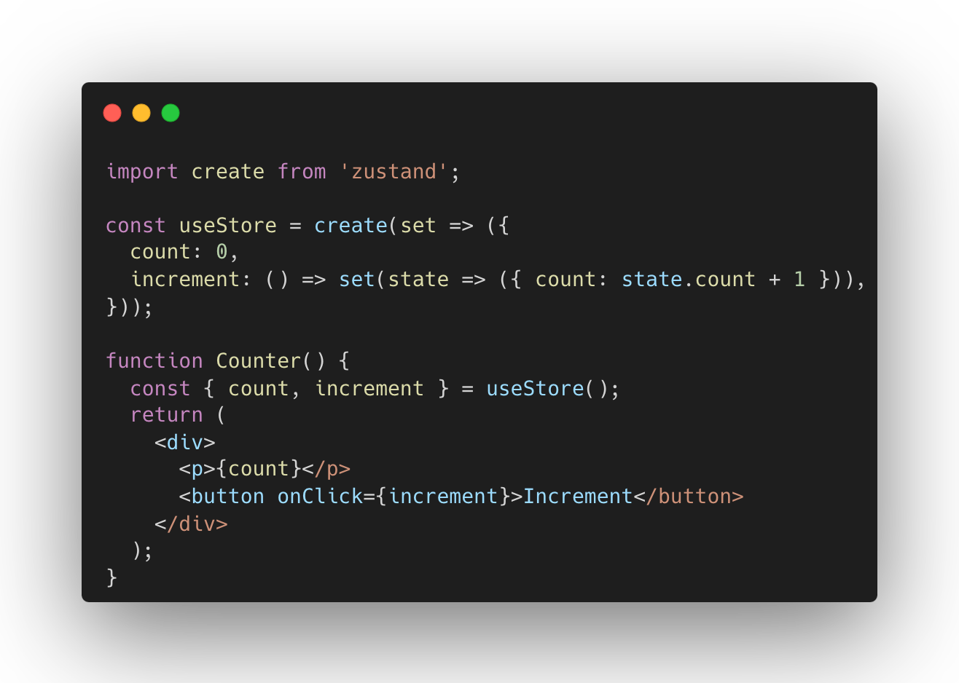
How Zustand Works
1
Create Store
Define state and actions in a single function.
2
Use Store
Components subscribe to specific state changes.
3
Update State
Trigger actions to modify state directly.
Notes:
So, how does Zustand work?
It uses a centralized store, where all your state is managed in one place, and components can subscribe to changes in the store.
This allows us to avoid the limitations of useState and useReducer, especially when dealing with larger applications.
As we can see from this code snippet, Zustand makes it really easy to define state and update it without unnecessary complexity.

Slide 3
Zustand Architecture
Single Store
Minimal Re-renders
Simple API
Centralized state management for entire application.
Optimized performance with selective component updates.
No actions or reducers required.
Notes:
Let’s talk about Zustand’s architecture. It follows a single store pattern, meaning all state is managed centrally.
This is different from libraries like Redux, which introduce actions, reducers, and a more opinionated flow for handling state updates.
Zustand takes a more minimalist approach, which leads to fewer re-renders and better performance optimization.
While Redux enforces strict separation between actions and reducers, Zustand simplifies this by allowing direct state mutation.

Slide 4
Pros of Zustand
1
Lightweight
2
Minimal Boilerplate
Only ~1KB gzipped, minimal impact on bundle size.
Simple API reduces code complexity.
3
Direct Access
4
Scalable
No Provider wrapping, easy integration with components.
Effortlessly manages complex state trees.
Notes:
Let’s dive into the pros of using Zustand.
First, it’s incredibly lightweight. At just around 1KB gzipped, it doesn’t bloat your project.
It’s also easy to integrate into your application. You don’t need complex setup or extensive boilerplate to start managing your state.
Another benefit is that Zustand doesn’t require wrapping components in providers, unlike Redux. You can access the state directly.
Finally, it scales really well. Even with large state trees, Zustand’s performance holds up efficiently.

Slide 5
Cons of Zustand
Smaller Ecosystem
Less Structure
Smaller Community
Limited middleware and tools compared to Redux.
Lack of opinionated architecture may challenge some teams.
Less support and resources than larger libraries.
Notes:
Of course, with every solution, there are cons. Zustand is no different.
One limitation is the smaller ecosystem. Unlike Redux, Zustand doesn’t have a wide variety of middleware or tools to extend functionality.
Also, it’s a less structured solution, which might not be ideal for teams looking for a more formal and opinionated setup like Redux.
And lastly, being a newer library, the community is smaller, which means you might find fewer resources or support for more complex issues.

Slide 6




Trade-offs
Simplicity
Zustand offers extreme ease of use.
vs
Trade-off between simplicity and structure.
Advanced Tooling
Redux provides more robust development tools.
Notes:
There are several trade-offs to consider when using Zustand.
On one hand, it’s incredibly easy to use and set up. You avoid a lot of boilerplate code, which saves time.
However, with that simplicity comes a lack of structure. If you prefer a more organized flow with actions and reducers, you might miss that in Zustand.
Another important trade-off is performance vs. tooling. While Zustand performs very well due to its lightweight nature, it doesn’t have some of the advanced tooling that Redux offers, like Redux DevTools, which is useful for debugging large apps.

Slide 7
Comparison with Other Libraries
Feature
Zustand
Redux
Context API
Ease of Use
High
Medium
Medium
Performance
High
Medium
Low
Flexibility
High
High
Medium
Notes:
Now, let’s compare Zustand with other state management libraries.
First, compared to Redux: Zustand offers a much simpler API. In Redux, you have actions, reducers, and types, whereas in Zustand, you work directly with the state.
Zustand also avoids the boilerplate that Redux requires, making it a more attractive choice for smaller projects or teams looking for simplicity.
Compared to React’s Context API, Zustand performs better when managing complex state trees, as Context API often triggers unnecessary re-renders across components.

Slide 8



Conclusion
Fast Setup
High Performance
Scalable Solution
Minimal configuration for quick project integration.
Optimized for efficient state management in React apps.
Suitable for small to medium-sized projects.
Notes:
In conclusion, Zustand is a powerful, lightweight alternative for managing state in React applications.
It’s ideal for developers who want minimal setup and high performance, without the need for complex boilerplate.
That said, for larger teams or more complex applications, the structure and tooling provided by libraries like Redux might still be preferable.
Zustand strikes a great balance between flexibility and performance, making it a valuable tool in the React ecosystem.

