Slide 1

Zustand: Deep Dive

Slide 2

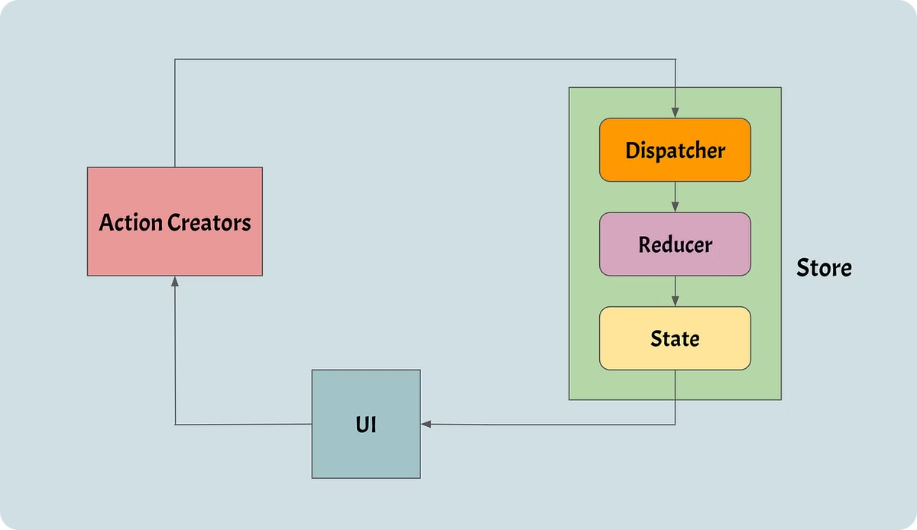
How Zustand Works
1
Create Store
Define state and actions in a single function.
2
Use Store
Components subscribe to specific state changes.
3
Update State
Trigger actions to modify state directly.

Slide 3
Zustand Architecture
Single Store
Minimal Re-renders
Simple API
Centralized state management for entire application.
Optimized performance with selective component updates.
No actions or reducers required.

Slide 4
Pros of Zustand
1
Lightweight
2
Minimal Boilerplate
Only ~1KB gzipped, minimal impact on bundle size.
Simple API reduces code complexity.
3
Direct Access
4
Scalable
No Provider wrapping, easy integration with components.
Effortlessly manages complex state trees.

Slide 5
Cons of Zustand
Smaller Ecosystem
Less Structure
Smaller Community
Limited middleware and tools compared to Redux.
Lack of opinionated architecture may challenge some teams.
Less support and resources than larger libraries.

Slide 6




Trade-offs
Simplicity
Zustand offers extreme ease of use.
vs
Trade-off between simplicity and structure.
Advanced Tooling
Redux provides more robust development tools.

Slide 7
Comparison with Other Libraries
Feature
Zustand
Redux
Context API
Ease of Use
High
Medium
Medium
Performance
High
Medium
Low
Flexibility
High
High
Medium

Slide 8



Conclusion
Fast Setup
High Performance
Scalable Solution
Minimal configuration for quick project integration.
Optimized for efficient state management in React apps.
Suitable for small to medium-sized projects.

