Slide 1

KV.js: Lightweight Key-Value Storage
A Simple and Efficient In-Memory Key-Value Store
Notes:
Welcome everyone! Today, we’re going to talk about KV.js, a lightweight and efficient key-value
storage library for JavaScript. Whether you need caching, session storage, or temporary persistence,
KV.js provides a simple and powerful solution. Let’s explore its key features and how it can be useful for your projects!

Slide 2
What is KV.js?
1
JavaScript Library
2
Lightweight
3
Versatile
Fast key-value storage.
No dependencies, high performance.
Browsers, Node.js, Edge Computing.
Notes:
So, what exactly is KV.js? It’s a minimalist library that allows you to store and retrieve
values quickly using keys. Since it's extremely lightweight and dependency-free, it fits
perfectly in web applications, Node.js environments, and even edge computing scenarios.

Slide 3




Why Use KV.js?
Simplicity
High Performance
Zero Dependencies
Versatile
Easy-to-use API.
Fast in-memory storage.
Lightweight projects.
Any JavaScript environment.
Notes:
Why should you consider KV.js? First, it’s incredibly simple and easy to use.
It also delivers high performance by storing data directly in memory. Since it has no dependencies,
it’s ideal for projects that need to be fast and lightweight. And the best part? It works in any JavaScript runtime!

Slide 4
Key Features
Volatile Storage
Key Expiration (TTL)
Serialization Support
Event Monitoring
Ultra-fast access.
Listen for changes.
Set time-to-live.
Store objects, arrays.
Notes:
KV.js comes packed with useful features, including volatile storage for quick reads,
built-in TTL support for expiring keys, serialization of objects, and event listeners for
monitoring data changes. This makes it a flexible tool for various applications.

Slide 5
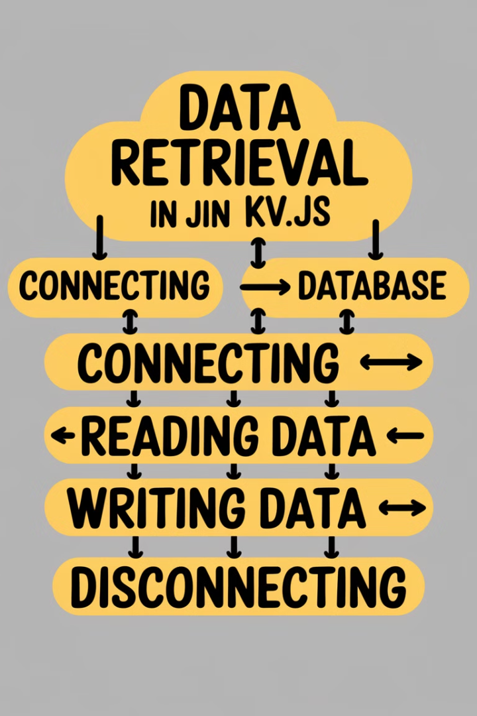




How It Works?
get(key)
Retrieve value.
set(key, value, ttl?)
Store data.
delete(key)
Remove item.
keys()
List all keys.
Notes:
KV.js is incredibly intuitive. You can retrieve a value using get(key), store data with set(key, value),
delete items using delete(key), and list all stored keys with keys(). Simple, yet highly efficient!

Slide 6
Comparison with Other Solutions
Feature
KV.js
LocalStorage
Redis
IndexedDB
Performance
⚡ Fast
Medium
⚡ Fast
Slow
Expiration TTL
✅ Yes
❌ No
✅ Yes
❌ No
Server-Side
✅ Yes
❌ No
✅ Yes
❌ No
Dependencies
❌ None
❌ None
✅ Yes
❌ None
Notes:
Now, let’s compare KV.js with other popular solutions. It has the speed of Redis but
without the setup complexity. Unlike LocalStorage and IndexedDB, it allows key expiration
and can be used both client-side and server-side without extra dependencies.

Slide 7
Pros & Cons
Pros
Cons
✔️ Fast and efficient.
❌ Temporary storage only.
✔️ Simple, dependency-free.
❌ Not a persistent solution.
✔️ Caching, temporary storage.
✔️ Supports key expiration.
Notes:
KV.js offers many advantages, such as speed, simplicity, and key expiration
support. However, it’s not a replacement for databases since the data is volatile
and won’t persist after the application restarts.

Slide 8
Conclusion & Key Takeaways
Powerful Solution
Ideal Uses
Efficient key-value storage.
Caching, session management.
Great Option
Optimize Project
Lightweight applications.
Consider using KV.js!
Notes:
In summary, KV.js is a powerful tool for fast key-value storage in JavaScript.
It’s ideal for caching, session management, and temporary data storage, offering high
performance with simplicity. If you’re looking for a lightweight and efficient solution, KV.js is
definitely worth considering!

