Slide 1

Implementation of “An exact reduction technique for the k-Colour Shortest Path Problem”
Lorenzo Martin Diaz Avalos
Matteo Alessandro Fumis

Slide 2
k-Colour Shortest Path Problem (k-CSPP)
The k-Colour Shortest Path Problem is a variant of the classic Shortest Path Problem
This problem consists of finding a shortest path on a weighted edge-coloured graph, where the maximum number of different colours used in a feasible solution is fixed to be 𝑘
Applications: Network reliability
Overview Formulation Proposed Algorithms Results

Slide 3
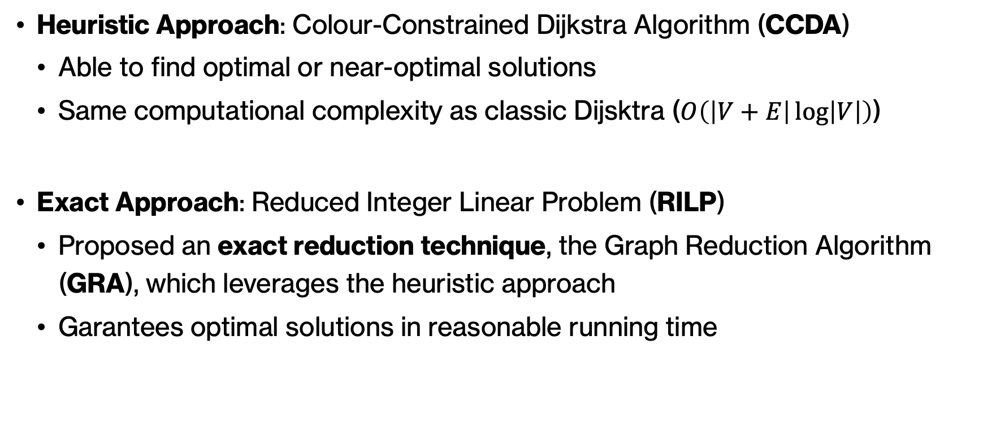
Explored Approaches
Heuristic Approach: Colour-Constrained Dijkstra Algorithm (CCDA)
Able to find optimal or near-optimal solutions
Same computational complexity as classic Dijsktra ($O\left(\left|V+E\right|\log\left|V\right|\right)$)
Exact Approach: Reduced Integer Linear Problem (RILP)
Proposed an exact reduction technique, the Graph Reduction Algorithm (GRA), which leverages the heuristic approach
Garantees optimal solutions in reasonable running time
Overview Formulation Proposed Algorithms Results

Slide 4
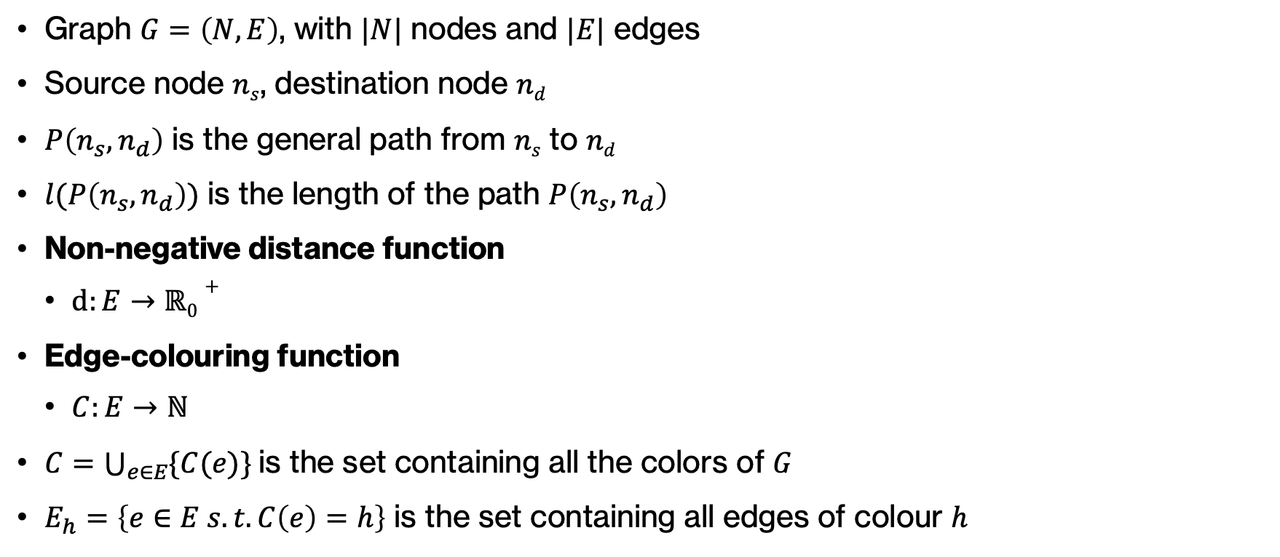
Mathematical Model
Graph $G=\left(N,E\right)$, with $|N|$ nodes and $|E|$ edges
Source node $ns$, destination node $nd$
$P\left(n_{s}, n_{d}\right)$ is the general path from $ns$ to $nd$
$l(P\left(n_{s}, n_{d}\right))$ is the length of the path $P\left(n_{s}, n_{d}\right)$
Non-negative distance function
$d:E→ℝ0+$
Edge-colouring function
$C:E→ℕ$
$C=\bigcup_{e∈E}{\{C(e)\}}$is the set containing all the colors of $G$
$E_{h}=\left\{e∈E s.t. C\left(e\right)=h\right\}$ is the set containing all edges of colour $h$
Overview Formulation Proposed Algorithms Results

Slide 5
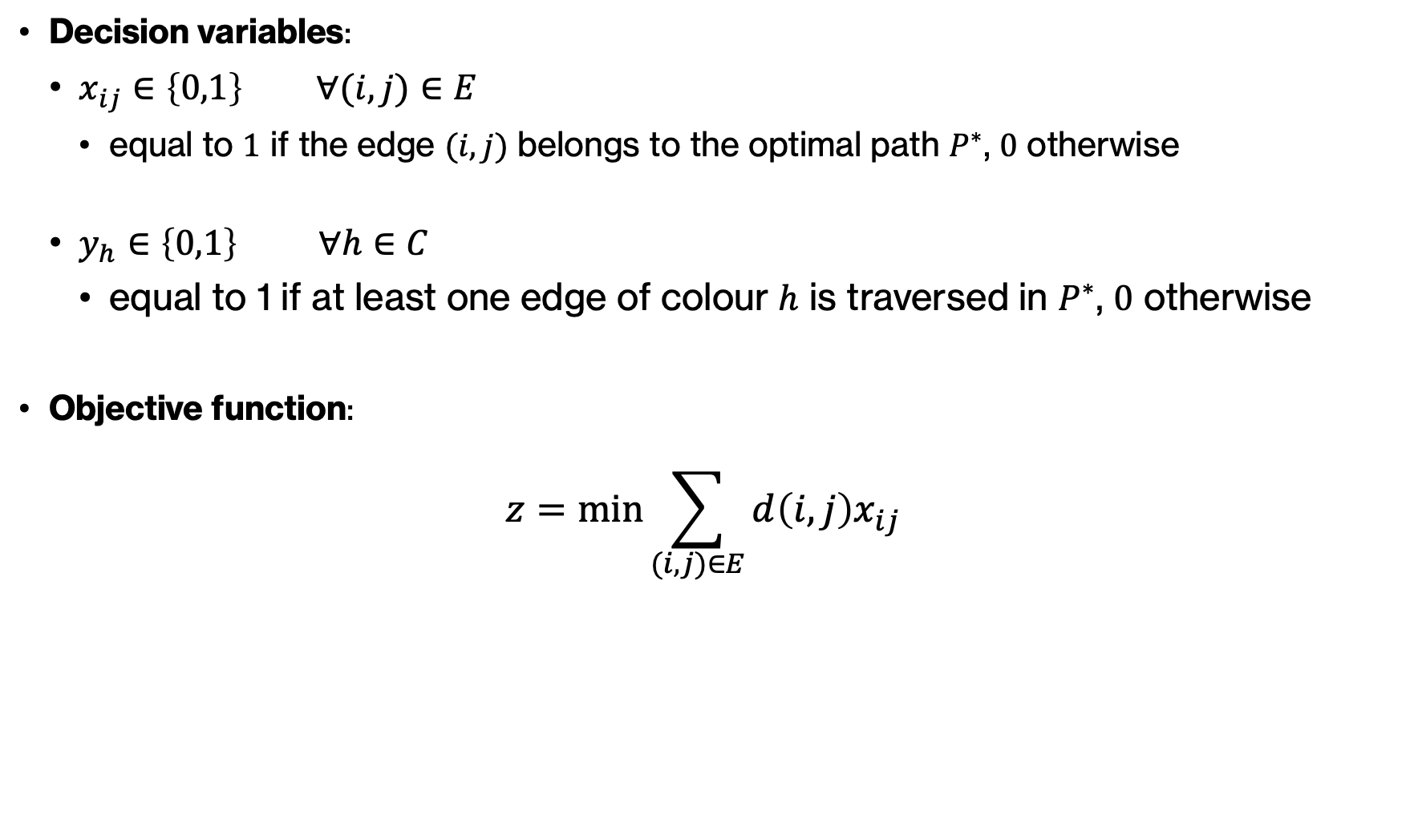
k-CSPP – Formulation
Decision variables:
$x_{ij}∈\left\{0,1\right\} ∀(i,j)∈E$
equal to $1$ if the edge $(i,j)$ belongs to the optimal path $P^{∗}$, $0$ otherwise
$y_{h}∈\left\{0,1\right\} ∀h∈C$
equal to 1 if at least one edge of colour $h$ is traversed in $P^{∗}$, $0$ otherwise
Objective function:
$$z=\min{\sum_{(i,j)∈E}{d\left(i,j\right)x_{ij}}}$$
Overview Formulation Proposed Algorithms Results

Slide 6

k-CSPP – Formulation
Constraints:
$$1) \sum_{(j,i)∈E}{x_{ji}}−\sum_{(i,j)∈E}{x_{ij}=b_{i}} ∀i∈N$$
$$b_{i}=\left\{\begin{aligned}−1 if i=n_{s} \\ +1 if i=n_{d} \\ 0 otherwise \end{aligned}\right.$$
$${2) x}_{ij}≤y_{h} ∀h∈C, ∀(i,j)∈E_{h}$$
$$3) \sum_{h∈C}{y_{h}}≤k$$
Overview Formulation Proposed Algorithms Results

Slide 7
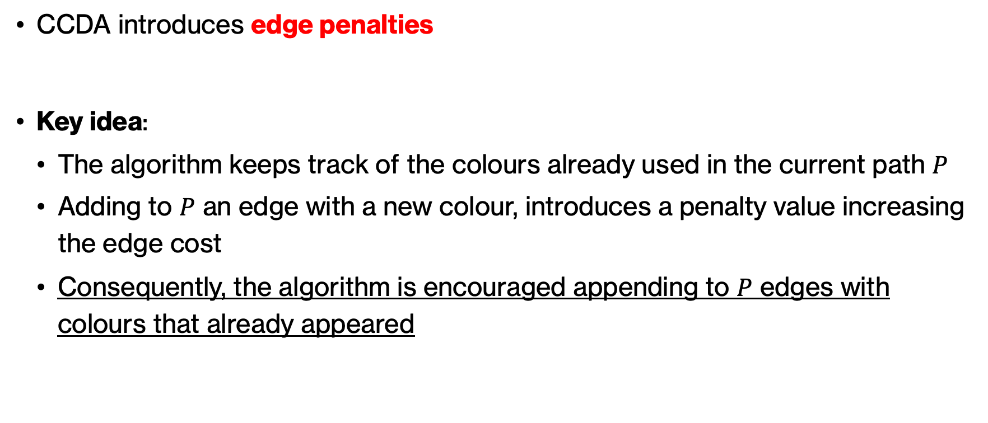
Colour-Constrained Dijkstra Algorithm (CCDA)
CCDA introduces edge penalties
Key idea:
The algorithm keeps track of the colours already used in the current path $P$
Adding to $P$ an edge with a new colour, introduces a penalty value increasing the edge cost
Consequently, the algorithm is encouraged appending to $P$ edges with colours that already appeared
Overview Formulation Proposed Algorithms Results

Slide 8
Colour-Constrained Dijkstra Algorithm (CCDA)
TODO: Scenario CCDA

Slide 9
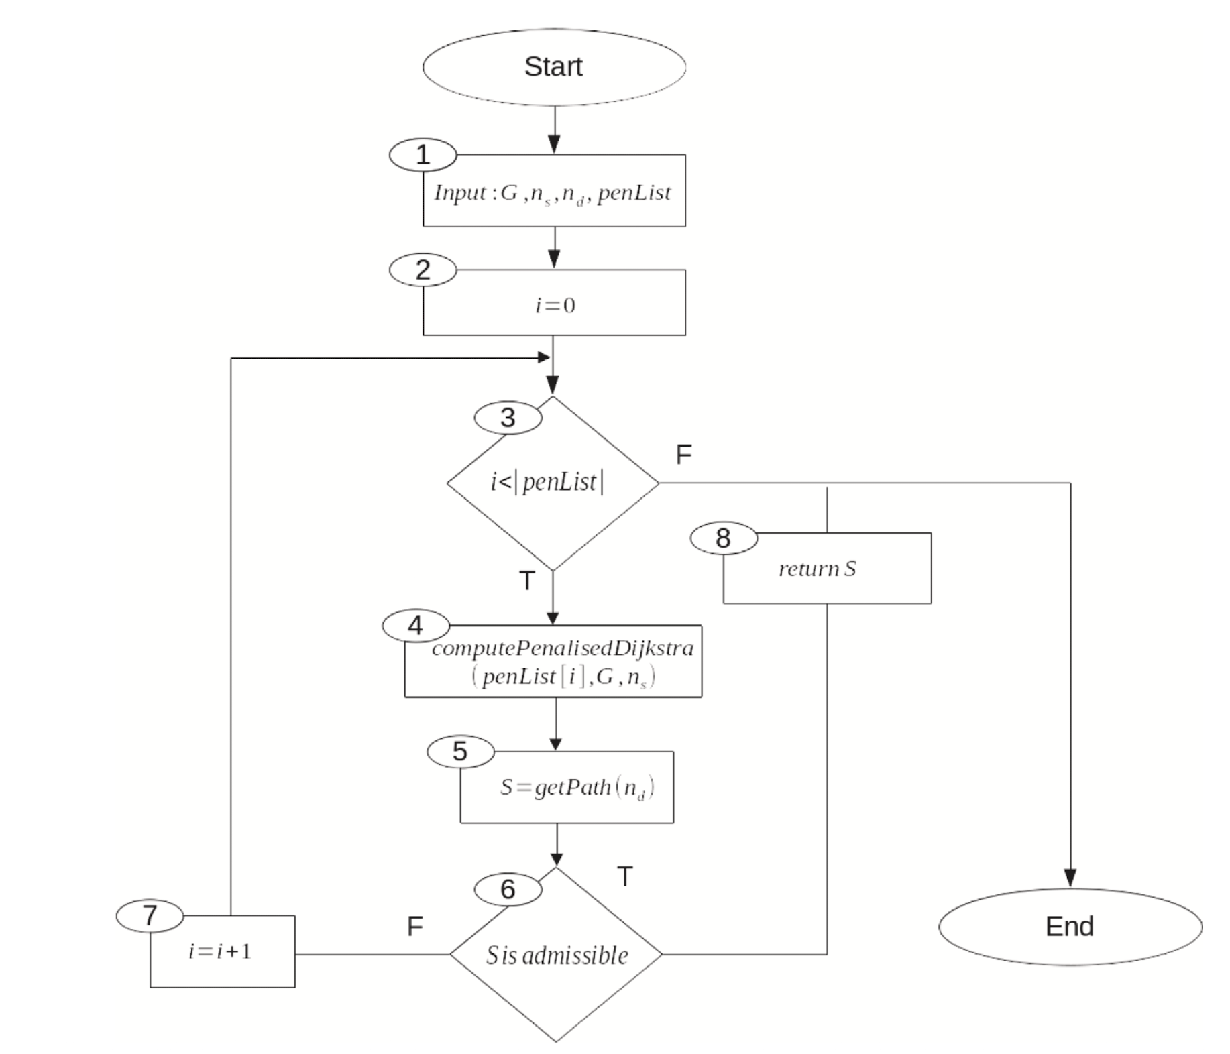
Colour-Constrained Dijkstra Algorithm (CCDA)
CCDA iterates through a list of different predefined penalty values
At each iteration, calls the Penalised Dijkstra Algorithm using current penalty value
Increasing the penalty value, the algorithm is more forced to append edges with already seen colours
Overview Formulation Proposed Algorithms Results

Slide 10
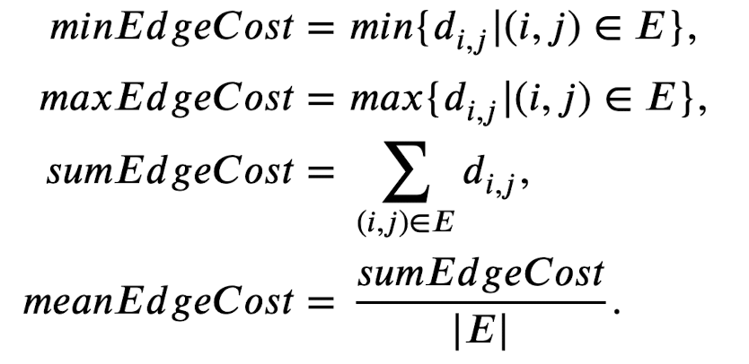
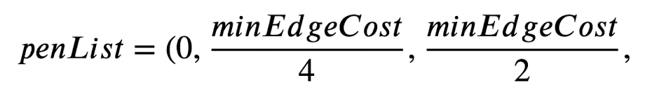

Penalty Values
Overview Formulation Proposed Algorithms Results

Slide 11
Graph Reduction Algorithm (GRA)
Computational complexity:
SPP: grows polynomially with input size
k-CSPP: grows exponentially with input size
For exact approaches (ILP solution), is necessary to reduce the input size as possible
Overview Formulation Proposed Algorithms Results

Slide 12
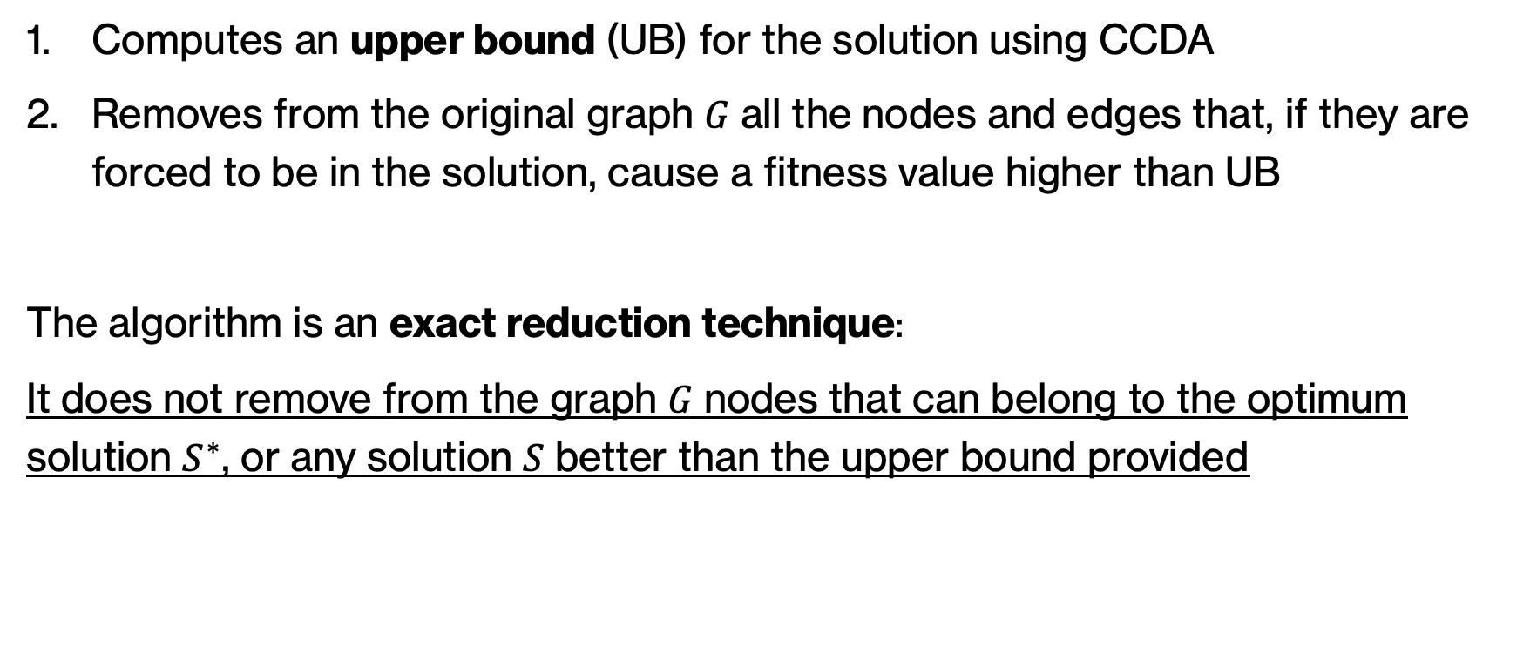
Graph Reduction Algorithm (GRA)
Computes an upper bound (UB) for the solution using CCDA
Removes from the original graph 𝐺 all the nodes and edges that, if they are forced to be in the solution, cause a fitness value higher than UB
The algorithm is an exact reduction technique:
It does not remove from the graph 𝐺 nodes that can belong to the optimum solution $S^{∗}$, or any solution 𝑆 better than the upper bound provided
Overview Formulation Proposed Algorithms Results

Slide 13
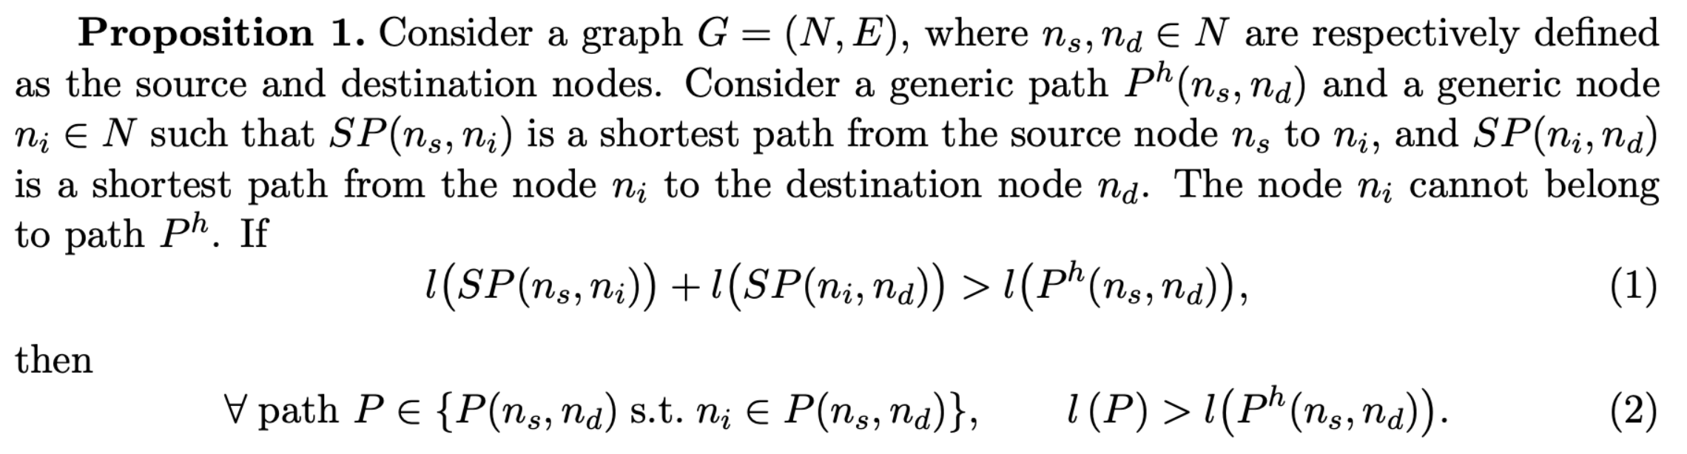
Graph Reduction Algorithm (GRA) – Theoretical Proof
Overview Formulation Proposed Algorithms Results

Slide 14
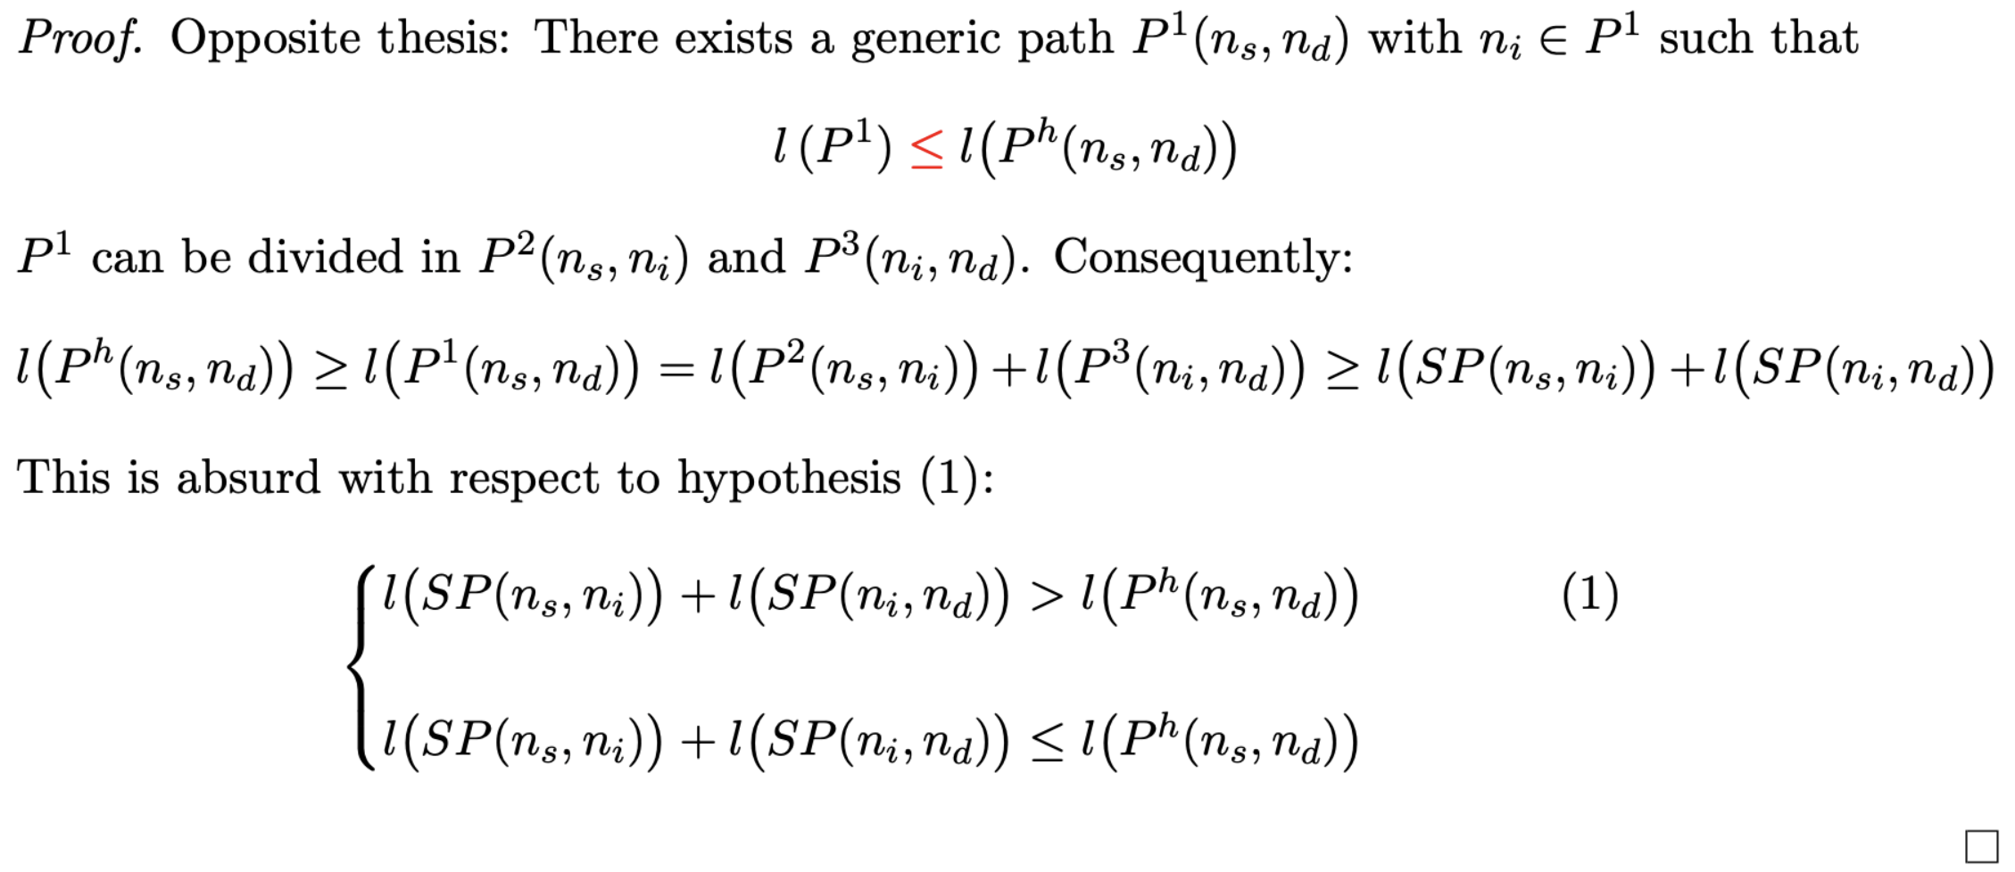
Graph Reduction Algorithm (GRA) – Theoretical Proof
Overview Formulation Proposed Algorithms Results

Slide 15
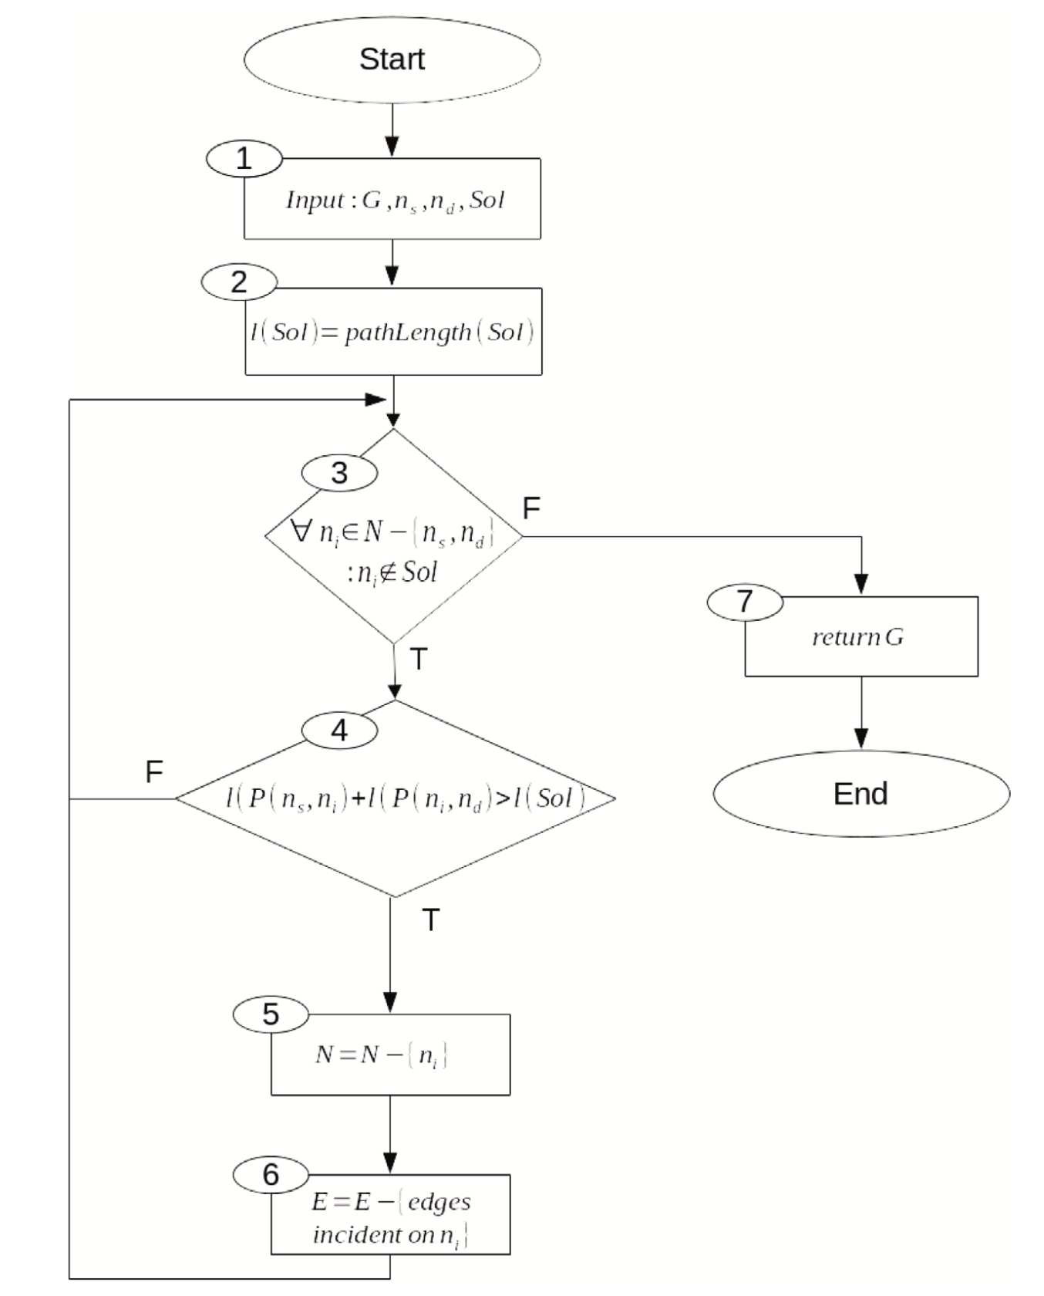
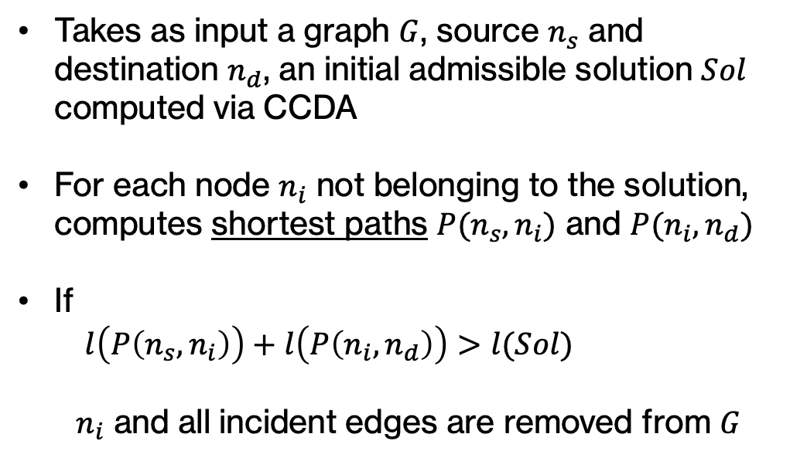
Graph Reduction Algorithm (GRA)
Takes as input a graph $G$, source $n_{s}$ and destination $n_{d}$, an initial admissible solution $Sol$ computed via CCDA
For each node $n_{i}$ not belonging to the solution, computes shortest paths $P(n_{s}, n_{i})$ and $P(n_{i}, n_{d})$
If
$l\left(P\left(n_{s},n_{i}\right)\right)+l\left(P\left(n_{i},n_{d}\right)\right)>l(Sol)$
$n_{i}$ and all incident edges are removed from $G$
Overview Formulation Proposed Algorithms Results

Slide 16
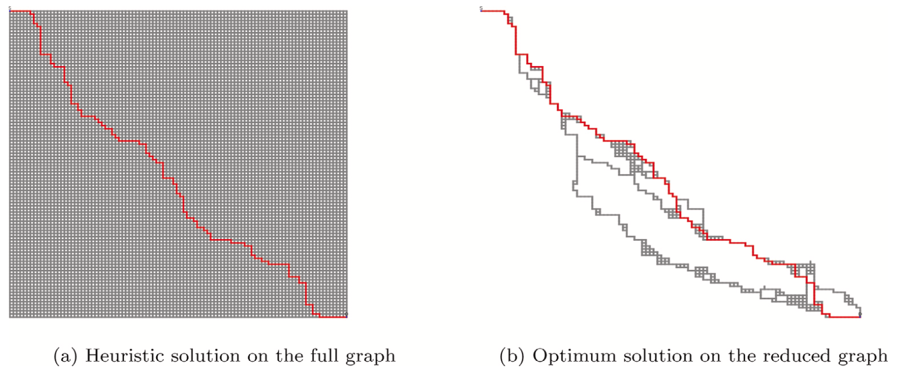

Graph Reduction Algorithm (GRA)
Overview Formulation Proposed Algorithms Results

Slide 17
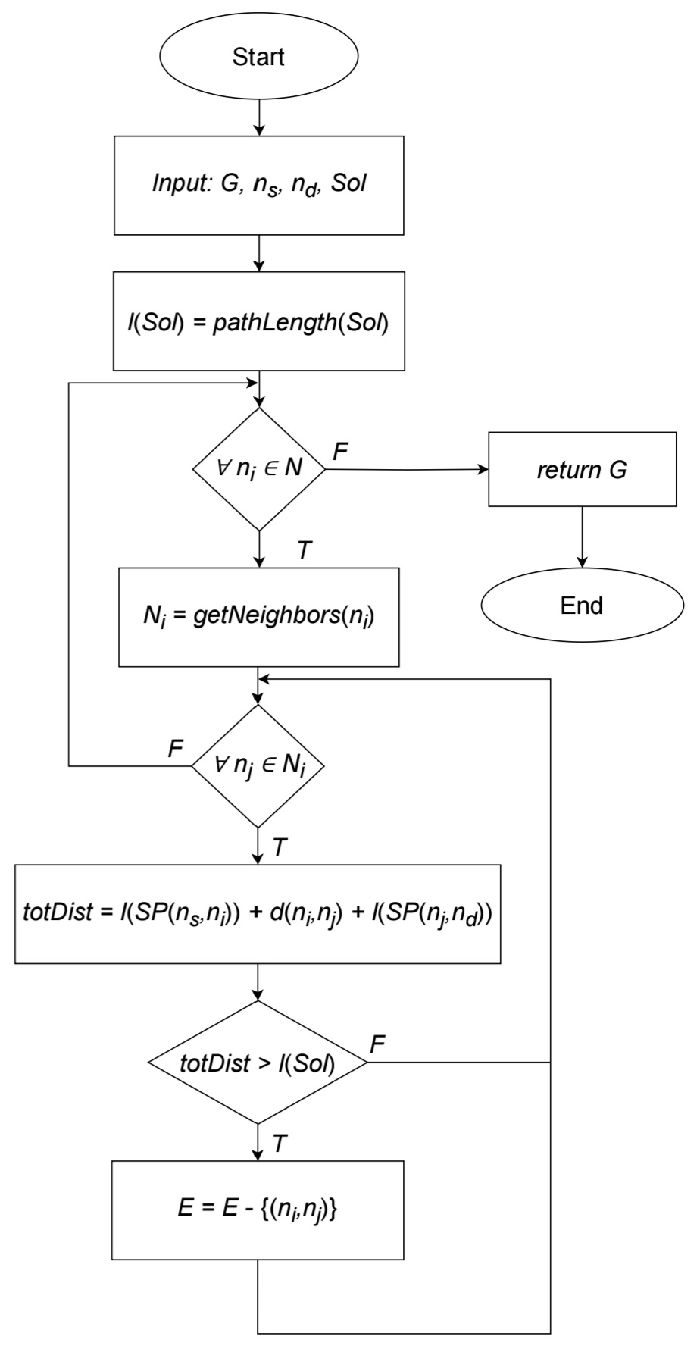
Even more reduced graph…
We present an additional reduction focusing on “hidden edges” - edges that have not been removed from GRA, but whose traversal would inevitably lead to a higher fitness function value
Overview Formulation Proposed Algorithms Results

Slide 18
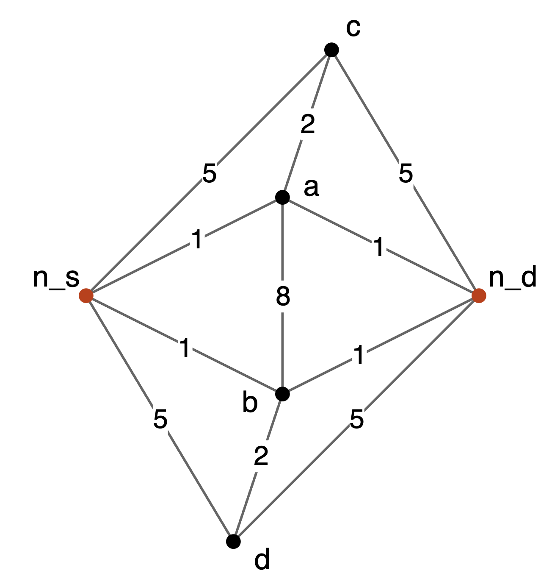
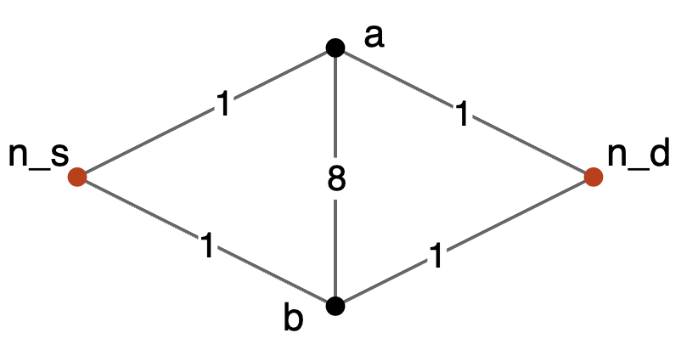
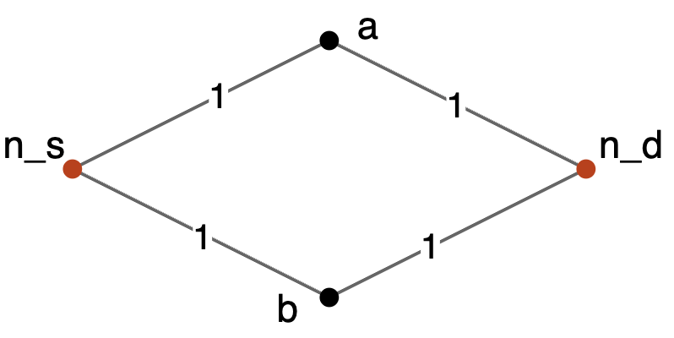







Even more reduced graph…
Initial solution: $n_{s}→a →n_{d}$
l(Sol) = 3
GRA
$$n_{d}$$
$$n_{s}$$
$$n_{d}$$
$$n_{s}$$
$$n_{d}$$
$$n_{s}$$
Overview Formulation Proposed Algorithms Results

Slide 19
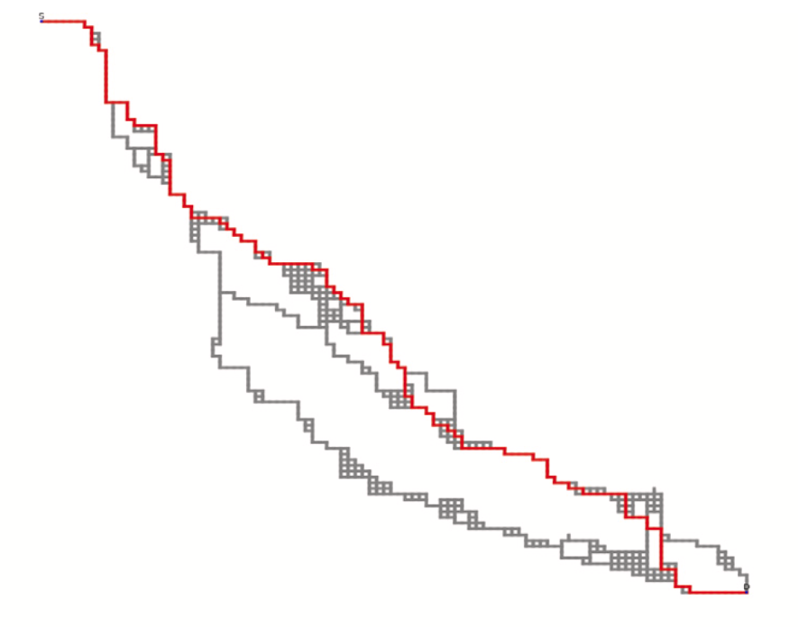
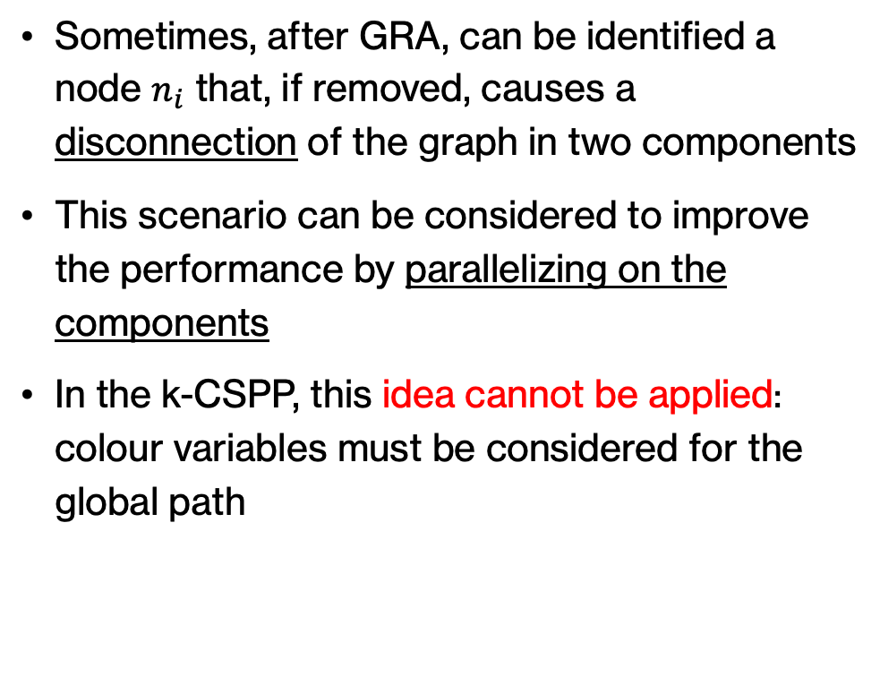
Graph Reduction Algorithm (GRA)
Sometimes, after GRA, can be identified a node $n_{i}$ that, if removed, causes a disconnection of the graph in two components
This scenario can be considered to improve the performance by parallelizing on the components
In the k-CSPP, this idea cannot be applied: colour variables must be considered for the global path
Overview Formulation Proposed Algorithms Results

Slide 20
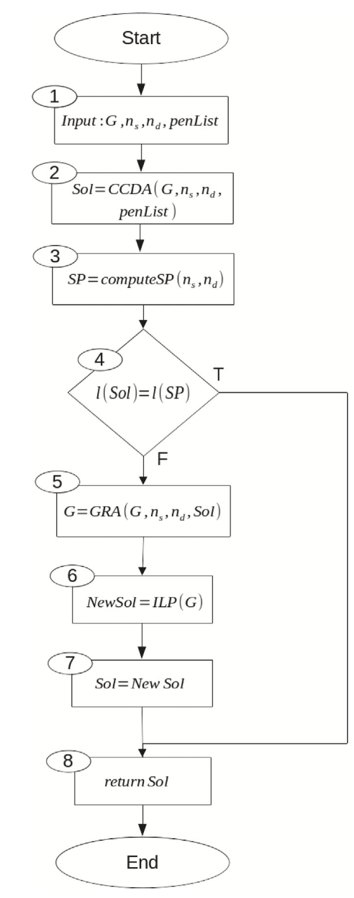
Reduced ILP Algorithm
Combination of the effectiveness of the ILP formulation and the speed of the heuristic algorithm:
Computation of admissible solution using CCDA
If the solution is optimal w.r.t. the SPP, the algorithm stops
Graph reduction using the admissible solution found as upper bound
Gurobi solver applied to the formulation of the reduced instance
Overview Formulation Proposed Algorithms Results

Slide 21

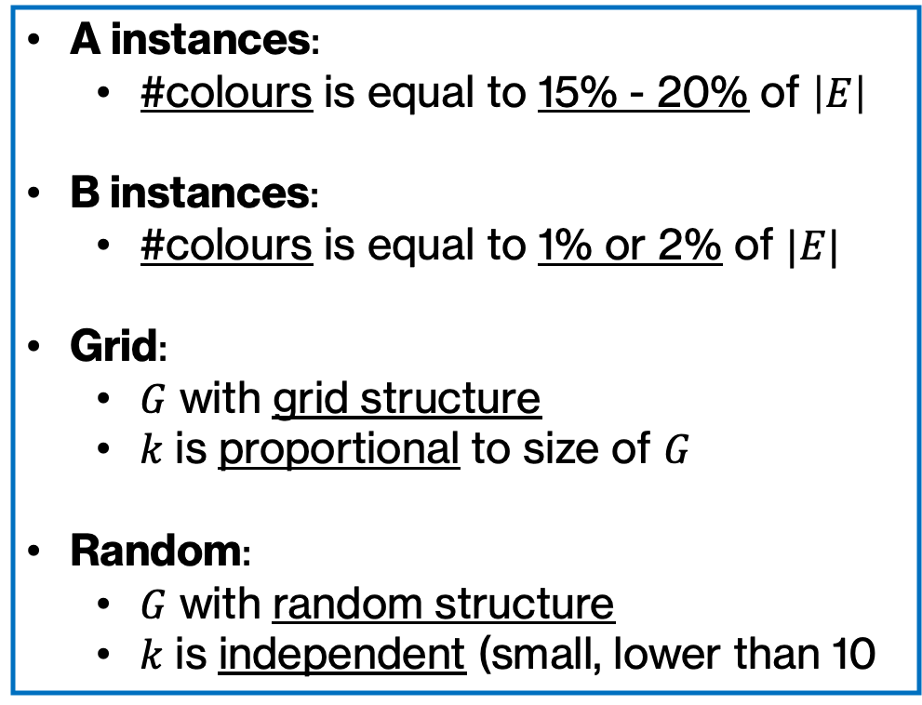
Experiments- Instances
A instances:
#colours is equal to 15% - 20% of $\left|E\right|$
B instances:
#colours is equal to 1% or 2% of $|E|$
Grid:
$G$ with grid structure
$k$ is proportional to size of $G$
Random:
$G$ with random structure
$k$ is independent (small, lower than 10
4 sets of instances:
A – Grid
B – Grid
A – Random
B – Random
Overview Formulation Proposed Algorithms Results

Slide 22
Experiments – Formulation: A-Grid
Instance | ILP |  |  | RILP
 | FF | Time (s) | #Opt | FF | Time (s) | #Opt
A-G1 | 6264.50 | 22.95 | 8 | 6264.50 | 1.315 | 8
A-G2 | 6264.50 | 25.00 | 8 | 6264.50 | 0.47 | 8
A-G3 | 9640.25 | 115.88 | 8 | 9640.25 | 0.46 | 8
A-G4 | 9627.88 | 145.26 | 8 | 9627.88 | 5.79 | 8
A-G5 | - | TL | - | 15331.75 | 4.02 | 8
A-G6 | - | TL | - | 15342.00 | 1.41 | 8
A-G7 | - | TL | - | 23827.25 | 2.35 | 8
A-G8 | - | TL | - | 23851.5 | 1.86 | 8
A-G9 | - | TL | - | 30768.5 | 8.06 | 8
A-G10 | - | TL | - | 30786.5 | 9.05 | 8
A-G11 | - | TL | - | 47749.75 | 42.46 | 8
A-G12 | - | TL | - | 47782.75 | 30.16 | 8
Overview Formulation Proposed Algorithms Results

Slide 23
Experiments – Formulation: B-Grid
Instance | ILP |  |  | RILP
 | FF | Time (s) | #Opt | FF | Time (s) | #Opt
B-G1 | 6277.4 | 17.26 | 10 | 6277.4 | 0.21 | 10
B-G2 | 6275.6 | 17.55 | 10 | 6275.6 | 0.40 | 10
B-G3 | 9633.0 | 68.87 | 10 | 9633.0 | 1.93 | 10
B-G4 | 9634.5 | 75.46 | 10 | 9634.5 | 1.68 | 10
B-G5 | 15355.4 | 518.33 | 10 | 15355.4 | 2.21 | 10
B-G6 | 15358.7 | 536.03 | 10 | 15358.7 | 2.70 | 10
B-G7 | - | TL | - | 23838.0 | 2.44 | 10
B-G8 | - | TL | - | 23837.5 | 2.59 | 10
B-G9 | - | TL | - | 30781.1 | 5.22 | 10
B-G10 | - | TL | - | 30781.5 | 5.30 | 10
B-G11 | - | TL | - | 47758.0 | 34.34 | 10
B-G12 | - | TL | - | 47754.4 | 35.06 | 10
Overview Formulation Proposed Algorithms Results

Slide 24
Experiments – Formulation: A-Random
Instance | ILP |  |  | RILP
 | FF | Time (s) | #Opt | FF | Time (s) | #Opt
A-R1 | - | TL | - | 131.83 | 0.21 | 6
A-R2 | - | TL | - | 132.13 | 0.40 | 8
A-R3 | - | TL | - | 120.0 | 1.93 | 8
A-R4 | - | TL | - | 111.38 | 1.68 | 8
A-R5 | - | TL | - | 95.0 | 2.21 | 8
A-R6 | - | TL | - | 97.38 | 2.70 | 8
A-R7 | - | TL | - | 129.63 | 2.44 | 8
A-R8 | - | TL | - | 153.16 | 2.59 | 8
A-R9 | - | TL | - | 112.36 | 5.22 | 8
A-R10 | - | TL | - | 105.36 | 5.30 | 8
A-R11 | - | TL | - | 90.0 | 34.34 | 8
A-R12 | - | TL | - | 92.57 | 35.06 | 7
Overview Formulation Proposed Algorithms Results

Slide 25
Experiments – Formulation: B-Random
Instance | ILP |  |  | RILP
 | FF | Time (s) | #Opt | FF | Time (s) | #Opt
B-R1 | - | TL | - | 125.22 | 2.64 | 9
B-R2 | - | TL | - | 125.22 | 2.76 | 9
B-R3 | - | TL | - | 121.2 | 7.90 | 10
B-R4 | - | TL | - | 121.2 | 7.80 | 10
B-R5 | - | TL | - | 100.56 | 10.69 | 9
B-R6 | - | TL | - | 100.56 | 10.82 | 9
B-R7 | - | TL | - | 158.0 | 494.43 | 10
B-R8 | - | TL | - | 141.9 | 434.75 | 10
B-R9 | - | TL | - | 115.3 | 9.64 | 10
B-R10 | - | TL | - | 115.3 | 9.82 | 10
B-R11 | - | TL | - | 115.3 | 669.10 | 10
B-R12 | - | TL | - | 115.3 | 711.46 | 10
Overview Formulation Proposed Algorithms Results

Slide 26
Experiments – CCDA: A-Grid
Instance | FF (RILP) | CCDA
 |  | GAP (%) | Time (s) | #Opt
A-G1 | 6264.50 | 0.79 | 0.15 | 4
A-G2 | 6264.50 | 0.46 | 0.15 | 6
A-G3 | 9640.25 | 0.02 | 0.27 | 5
A-G4 | 9627.88 | 0.60 | 0.37 | 2
A-G5 | 15331.75 | 0.13 | 1.27 | 3
A-G6 | 15342.00 | 0.01 | 0.95 | 6
A-G7 | 23827.25 | 0.03 | 1.80 | 5
A-G8 | 23851.5 | 0.01 | 1.53 | 6
A-G9 | 30768.5 | 0.03 | 5.05 | 6
A-G10 | 30786.5 | 0.03 | 5.56 | 5
A-G11 | 47749.75 | 0.02 | 25.93 | 4
A-G12 | 47782.75 | 0.01 | 25.89 | 4
Overview Formulation Proposed Algorithms Results

Slide 27
Experiments – CCDA: B-Grid
Instance | FF (RILP) | CCDA
 |  | GAP (%) | Time (s) | #Opt
B-G1 | 6277.4 | 0.23 | 0.07 | 5
B-G2 | 6275.6 | 0.43 | 0.1 | 2
B-G3 | 9633.0 | 0.34 | 0.19 | 6
B-G4 | 9634.5 | 0.48 | 0.24 | 4
B-G5 | 15355.4 | 0.17 | 0.89 | 3
B-G6 | 15358.7 | 0.21 | 0.81 | 7
B-G7 | 23838.0 | 0.05 | 1.69 | 7
B-G8 | 23837.5 | 0.05 | 1.84 | 6
B-G9 | 30781.1 | 0.01 | 4.09 | 7
B-G10 | 30781.5 | 0.01 | 4.01 | 7
B-G11 | 47758.0 | 0.05 | 23.91 | 5
B-G12 | 47754.4 | 0.04 | 28.81 | 2
Overview Formulation Proposed Algorithms Results

Slide 28
Experiments – CCDA: A-Random
Instance | FF (RILP) | CCDA
 |  | GAP (%) | Time (s) | #Opt
A-R1 | 131.83 | 3.14 | 2.76 | 5
A-R2 | 132.13 | 0.00 | 2.14 | 8
A-R3 | 120.0 | 0.00 | 3.08 | 8
A-R4 | 111.38 | 0.00 | 2.63 | 8
A-R5 | 95.0 | 5.99 | 2.56 | 7
A-R6 | 97.38 | 5.99 | 3.15 | 7
A-R7 | 129.63 | 9.77 | 4.64 | 4
A-R8 | 153.16 | 1.26 | 4.42 | 5
A-R9 | 112.36 | 3.20 | 5.00 | 6
A-R10 | 105.36 | 1.11 | 3.84 | 7
A-R11 | 90.0 | 0.0 | 3.14 | 8
A-R12 | 92.57 | 0.0 | 3.38 | 7
Overview Formulation Proposed Algorithms Results

Slide 29
Experiments – CCDA: B-Random
Instance | FF (RILP) | CCDA
 |  | GAP (%) | Time (s) | #Opt
B-R1 | 125.22 | 0.0 | 2.01 | 9
B-R2 | 125.22 | 0.0 | 2.10 | 9
B-R3 | 121.2 | 0.0 | 3.22 | 10
B-R4 | 121.2 | 0.0 | 3.22 | 10
B-R5 | 100.56 | 1.32 | 4.40 | 8
B-R6 | 100.56 | 1.32 | 4.46 | 8
B-R7 | 158.0 | 3.34 | 5.12 | 7
B-R8 | 141.9 | 3.34 | 4.19 | 7
B-R9 | 115.3 | 2.56 | 5.71 | 8
B-R10 | 115.3 | 2.56 | 5.83 | 8
B-R11 | 115.3 | 1.6 | 8.43 | 9
B-R12 | 115.3 | 1.6 | 8.31 | 9
Overview Formulation Proposed Algorithms Results

Slide 30
Experiments – Graph Reduction: A-Grid
Instance | %Reduct Nodes | %Reduct Edges | %Reduct Edges Extra | Time (s)
A-G1 | 84.63 | 86.10 | 5.23 | 0.03
A-G2 | 89.72 | 91.63 | 6.34 | 0.03
A-G3 | 96.44 | 97.59 | 4.60 | 0.08
A-G4 | 86.24 | 87.63 | 8.04 | 0.10
A-G5 | 95.42 | 96.33 | 8.22 | 0.28
A-G6 | 97.79 | 98.55 | 8.53 | 0.22
A-G7 | 98.63 | 99.08 | 8.03 | 0.37
A-G8 | 98.88 | 99.29 | 8.59 | 0.25
A-G9 | 98.28 | 98.68 | 4.55 | 0.86
A-G10 | 98.31 | 98.76 | 5.86 | 1.14
A-G11 | 98.30 | 98.67 | 5.45 | 2.90
A-G12 | 99.46 | 99.69 | 5.41 | 3.65
Overview Formulation Proposed Algorithms Results

Slide 31
Experiments – Graph Reduction: B-Grid
Instance | %Reduct Nodes | %Reduct Edges | %Reduct Edges Extra | Time (s)
B-G1 | 91.80 | 94.03 | 11.00 | 0.03
B-G2 | 92.47 | 94.45 | 5.95 | 0.05
B-G3 | 89.57 | 90.92 | 8.75 | 0.06
B-G4 | 88.40 | 90.14 | 8.53 | 0.08
B-G5 | 96.71 | 97.52 | 7.63 | 0.30
B-G6 | 93.99 | 94.91 | 5.29 | 0.18
B-G7 | 97.94 | 98.43 | 7.55 | 0.30
B-G8 | 98.39 | 98.83 | 6.37 | 0.39
B-G9 | 98.30 | 99.60 | 5.10 | 0.93
B-G10 | 98.83 | 99.25 | 7.05 | 0.69
B-G11 | 98.59 | 98.90 | 6.51 | 2.93
B-G12 | 99.24 | 99.52 | 6.47 | 4.67
Overview Formulation Proposed Algorithms Results

Slide 32
Experiments – Graph Reduction: A-Random
Instance | %Reduct Nodes | %Reduct Edges | %Reduct Edges Extra | Time (s)
A-R1 | 99.74 | 99.97 | 1.51 | 1.58
A-R2 | 99.84 | 99.33 | 11.49 | 1.26
A-R3 | 99.87 | 99.99 | 0.35 | 2.17
A-R4 | 99.04 | 99.99 | 0.2 | 1.76
A-R5 | 49.05 | 71.79 | 72.45 | 0.86
A-R6 | 74.50 | 85.89 | 36.23 | 1.53
A-R7 | 94.58 | 98.73 | 18.52 | 1.85
A-R8 | 98.58 | 99.77 | 5.70 | 2.34
A-R9 | 99.72 | 99.97 | 1.82 | 3.85
A-R10 | 99.96 | 99.98 | 0.16 | 3.23
A-R11 | 99.93 | 99.99 | 0.00 | 0.83
A-R12 | 99.93 | 99.99 | 0.00 | 0.95
Overview Formulation Proposed Algorithms Results

Slide 33
Experiments – Graph Reduction: B-Random
Instance | %Reduct Nodes | %Reduct Edges | %Reduct Edges Extra | Time (s)
B-R1 | 99.76 | 99.97 | 1.31 | 0.84
B-R2 | 99.76 | 99.97 | 1.31 | 0.87
B-R3 | 98.06 | 99.60 | 7.53 | 2.56
B-R4 | 98.06 | 99.60 | 7.53 | 2.50
B-R5 | 96.04 | 99.12 | 16.19 | 2.12
B-R6 | 96.04 | 99.12 | 16.19 | 2.12
B-R7 | 83.04 | 89.85 | 21.73 | 2.66
B-R8 | 86.01 | 90.54 | 15.73 | 2.20
B-R9 | 99.35 | 99.92 | 4.77 | 3.70
B-R10 | 99.35 | 99.92 | 4.77 | 3.76
B-R11 | 81.76 | 91.72 | 33.87 | 5.06
B-R12 | 81.76 | 91.72 | 33.87 | 5.23
Overview Formulation Proposed Algorithms Results

