Slide 1

Implementation of “An exact reduction technique for the k-Colour Shortest Path Problem”
Lorenzo Martin Diaz Avalos
Matteo Alessandro Fumis

Slide 2
k-Colour Shortest Path Problem (k-CSPP)
The k-Colour Shortest Path Problem is a variant of the classic Shortest Path Problem
Given a weighted edge-coloured graph, this problem consists of finding a shortest path from a source to a destination where the maximum number of different colours used in a feasible solution is fixed to be 𝑘
Application: Network Infrastructures
Overview Formulation Proposed Algorithms Results

Slide 3
Explored Approaches
Heuristic Approach: Colour-Constrained Dijkstra Algorithm (CCDA)
Able to find optimal or near-optimal solutions
Same computational complexity as classic Dijsktra
Exact Approach: Reduced Integer Linear Programming (RILP)
Proposed an exact reduction technique, the Graph Reduction Algorithm (GRA), which leverages the heuristic approach
Garantees optimal solutions in reasonable running time
Overview Formulation Proposed Algorithms Results

Slide 4
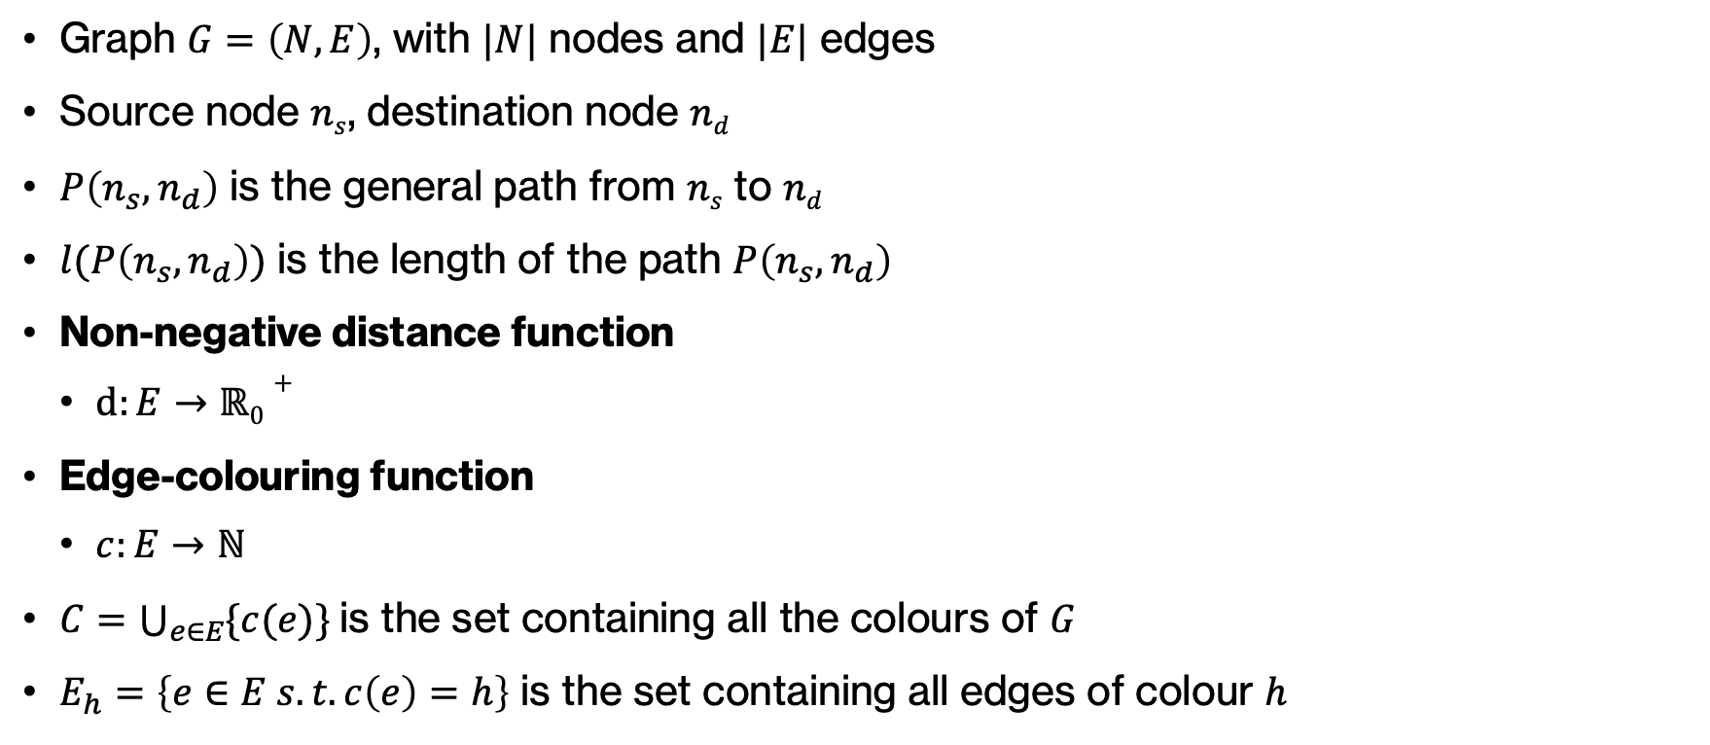
Mathematical Model
Graph $G=\left(N,E\right)$, with $|N|$ nodes and $|E|$ edges
Source node $ns$, destination node $nd$
$P\left(n_{s}, n_{d}\right)$ is the general path from $ns$ to $nd$
$l(P\left(n_{s}, n_{d}\right))$ is the length of the path $P\left(n_{s}, n_{d}\right)$
Non-negative distance function
$d:E→ℝ0+$
Edge-colouring function
$c:E→ℕ$
$C=\bigcup_{e∈E}{\{c(e)\}}$is the set containing all the colours of $G$
$E_{h}=\left\{e∈E s.t. c\left(e\right)=h\right\}$ is the set containing all edges of colour $h$
Overview Formulation Proposed Algorithms Results

Slide 5
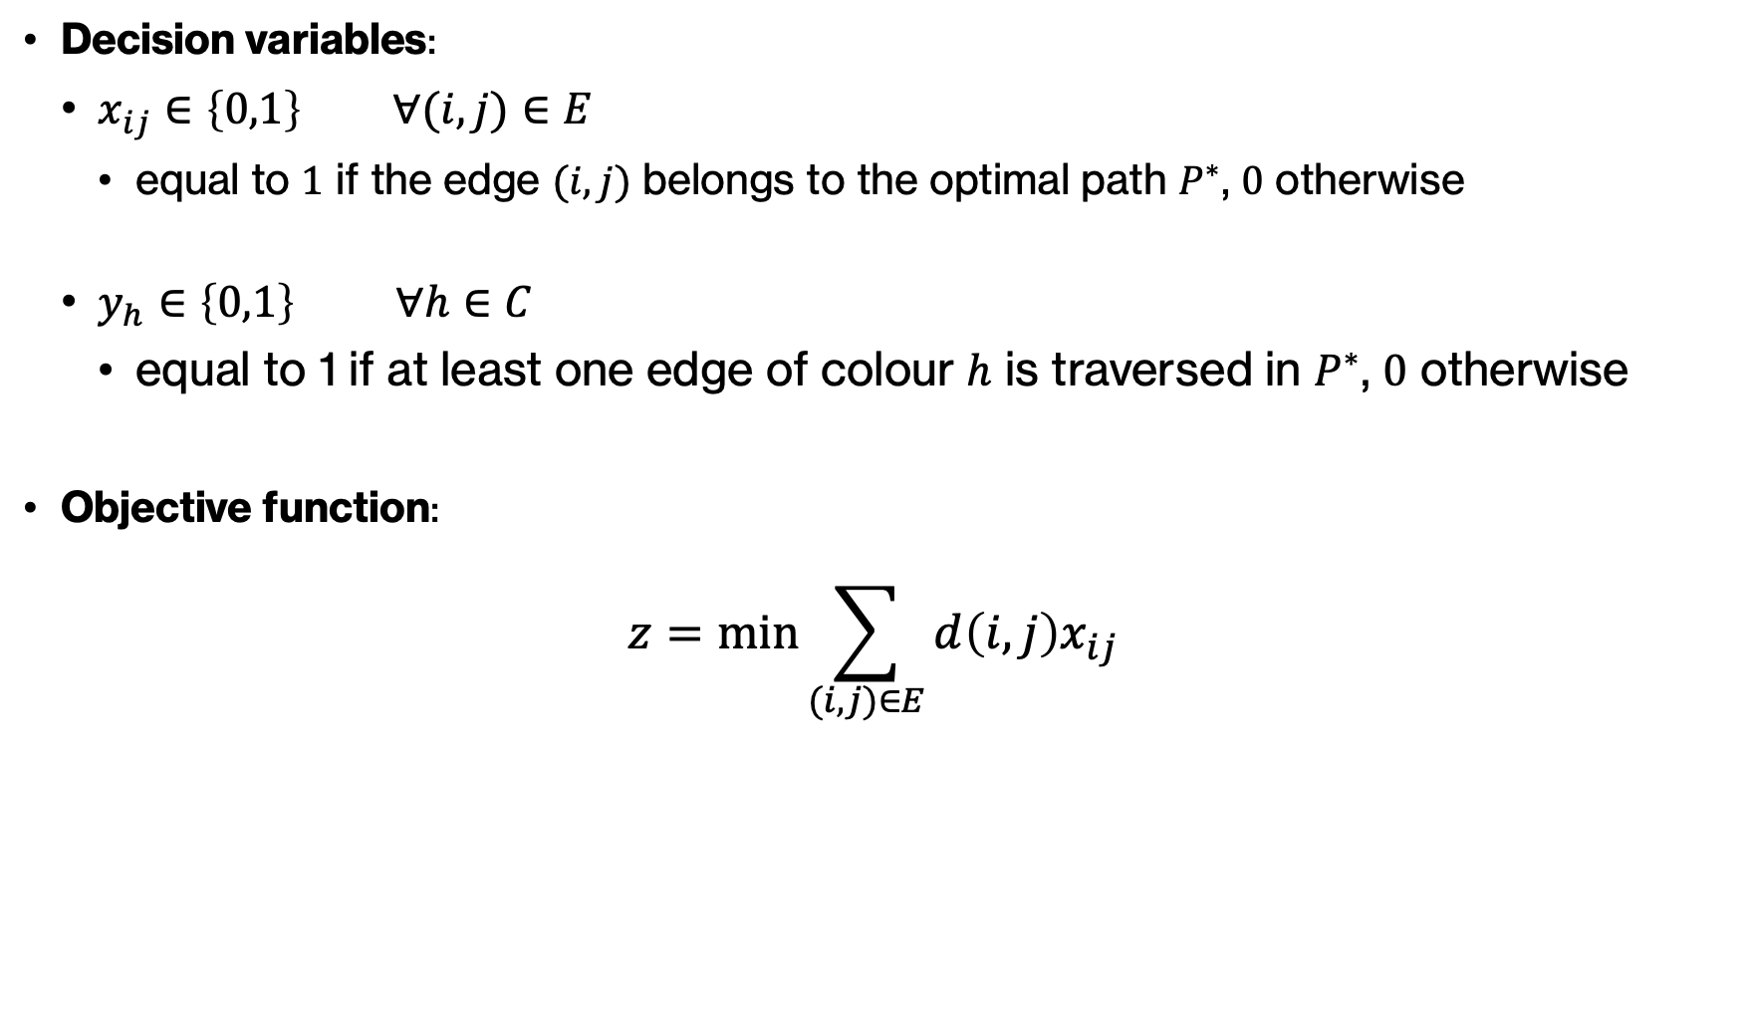
k-CSPP – Formulation
Decision variables:
$x_{ij}∈\left\{0,1\right\} ∀(i,j)∈E$
equal to $1$ if the edge $(i,j)$ belongs to the optimal path $P^{∗}$, $0$ otherwise
$y_{h}∈\left\{0,1\right\} ∀h∈C$
equal to 1 if at least one edge of colour $h$ is traversed in $P^{∗}$, $0$ otherwise
Objective function:
$$z=\min{\sum_{(i,j)∈E}{d\left(i,j\right)x_{ij}}}$$
Overview Formulation Proposed Algorithms Results

Slide 6
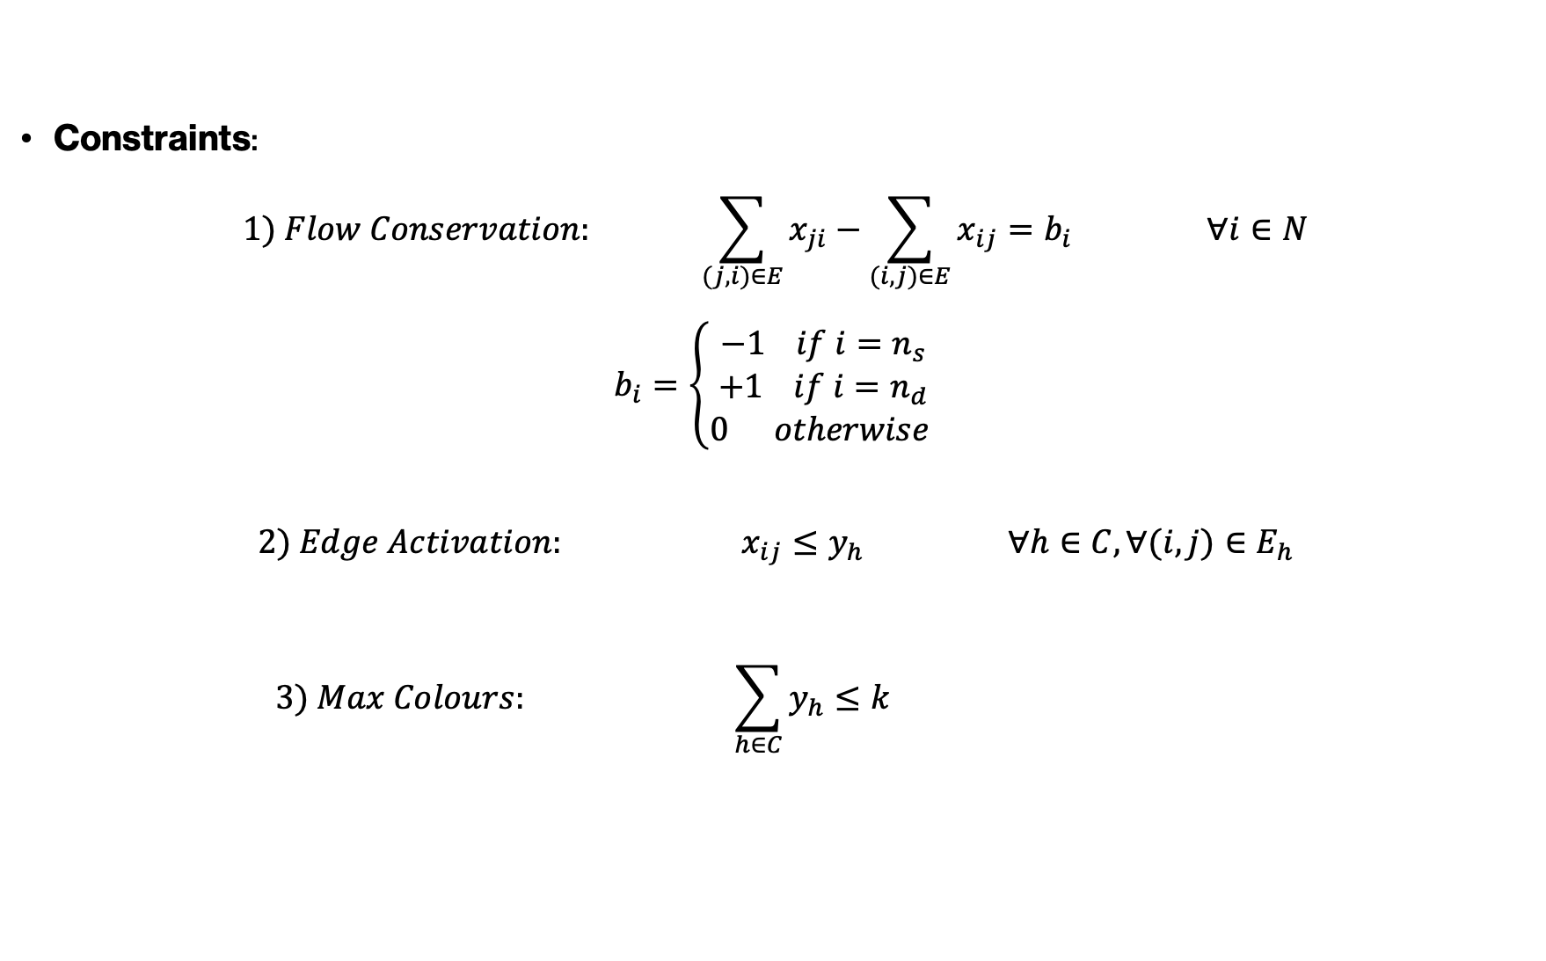
k-CSPP – Formulation
Constraints:
$$1) Flow Conservation: \sum_{(j,i)∈E}{x_{ji}}−\sum_{(i,j)∈E}{x_{ij}=b_{i}} ∀i∈N$$
$$b_{i}=\left\{\begin{aligned}−1 if i=n_{s} \\ +1 if i=n_{d} \\ 0 otherwise \end{aligned}\right.$$
$${2) Edge Activation: x}_{ij}≤y_{h} ∀h∈C, ∀(i,j)∈E_{h}$$
$$3) Max Colours: \sum_{h∈C}{y_{h}}≤k$$
Overview Formulation Proposed Algorithms Results

Slide 7
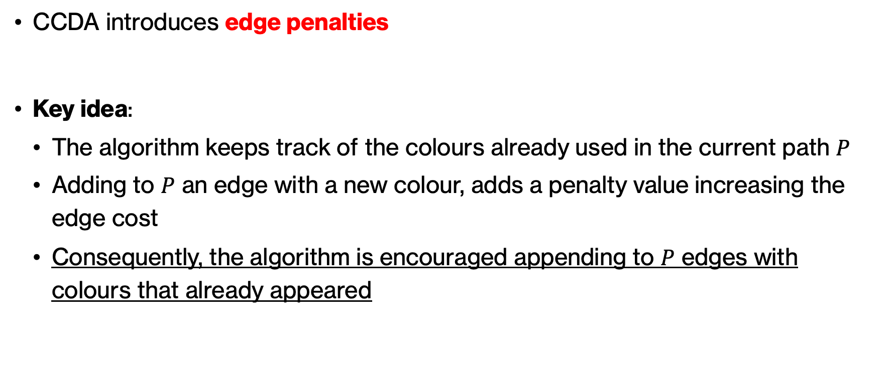
Colour-Constrained Dijkstra Algorithm (CCDA)
CCDA introduces edge penalties
Key idea:
The algorithm keeps track of the colours already used in the current path $P$
Adding to $P$ an edge with a new colour, adds a penalty value increasing the edge cost
Consequently, the algorithm is encouraged appending to $P$ edges with colours that already appeared
Overview Formulation Proposed Algorithms Results

Slide 8
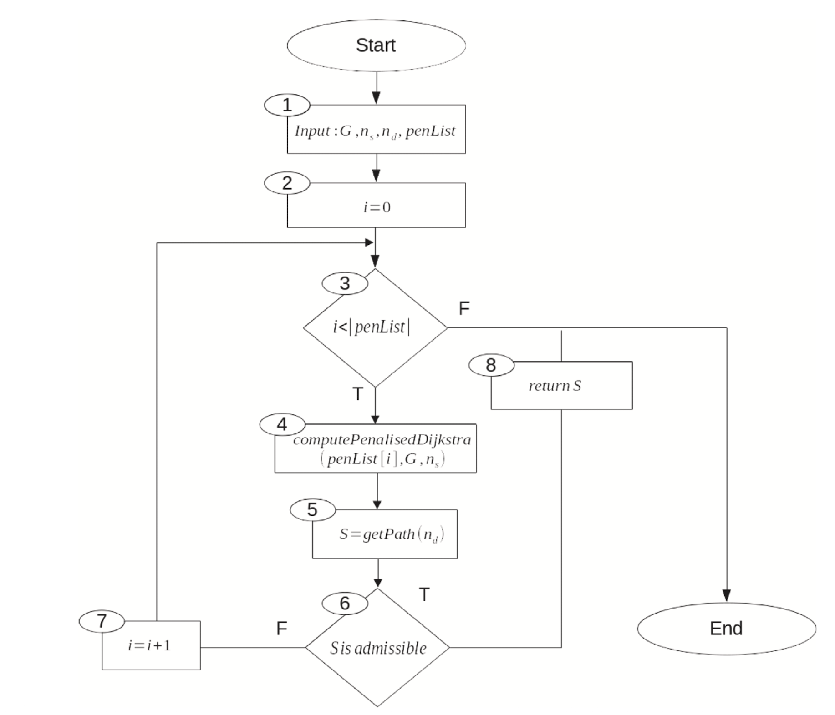
Colour-Constrained Dijkstra Algorithm (CCDA)
CCDA iterates through a list of different predefined penalty values
At each iteration, calls the Penalised Dijkstra Algorithm using current penalty value
The algorithm stops after finding an admissible solution
Overview Formulation Proposed Algorithms Results

Slide 9
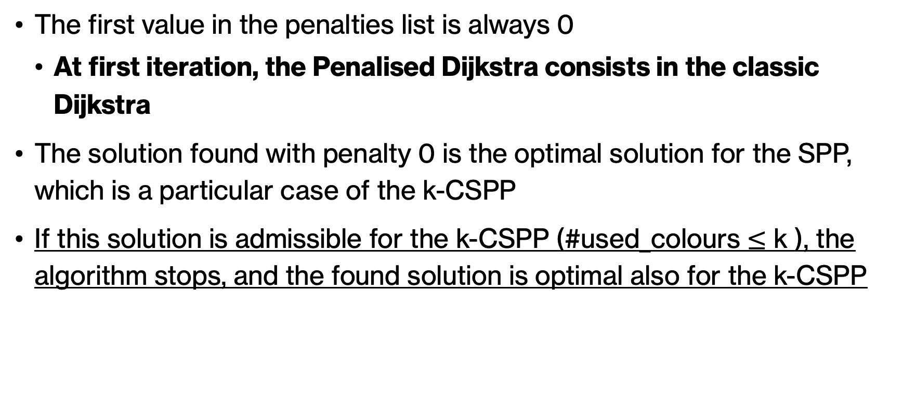
Colour-Constrained Dijkstra Algorithm (CCDA)
The first value in the penalties list is always 0
At first iteration, the Penalised Dijkstra consists in the classic Dijkstra
The solution found with penalty 0 is the optimal solution for the SPP, which is a particular case of the k-CSPP
If this solution is admissible for the k-CSPP (#used_colours $≤$ k ), the algorithm stops, and the found solution is optimal also for the k-CSPP
Overview Formulation Proposed Algorithms Results

Slide 10
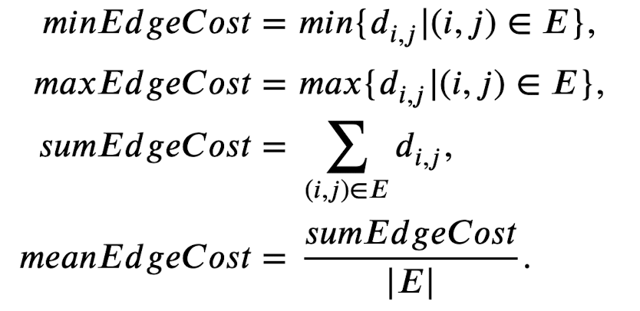
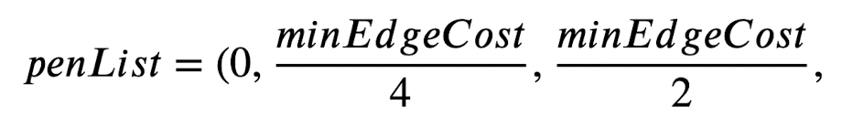

Penalty Values
Overview Formulation Proposed Algorithms Results

Slide 11
Graph Reduction Algorithm (GRA)
Computational complexity:
SPP: grows polynomially with input size
k-CSPP: grows exponentially with input size
For exact approaches (ILP solution), is necessary to reduce the input size as possible
Overview Formulation Proposed Algorithms Results

Slide 12
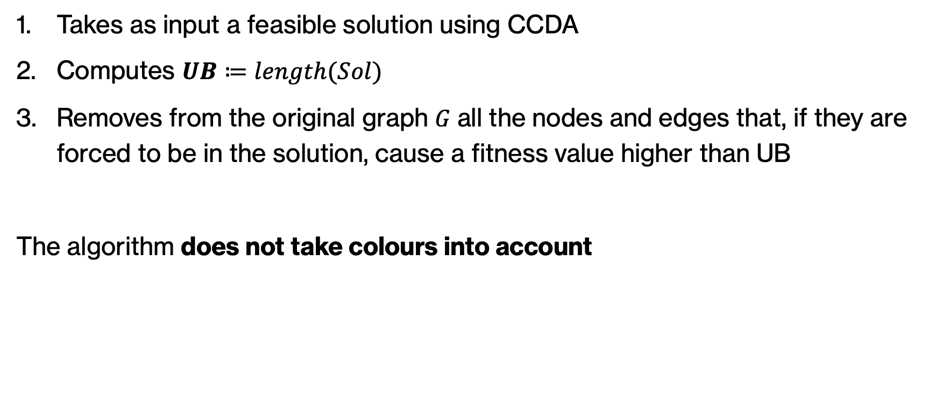
Graph Reduction Algorithm (GRA)
Takes as input a feasible solution using CCDA
Computes $UB≔length(Sol)$
Removes from the original graph 𝐺 all the nodes and edges that, if they are forced to be in the solution, cause a fitness value higher than UB
The algorithm does not take colours into account
Overview Formulation Proposed Algorithms Results

Slide 13
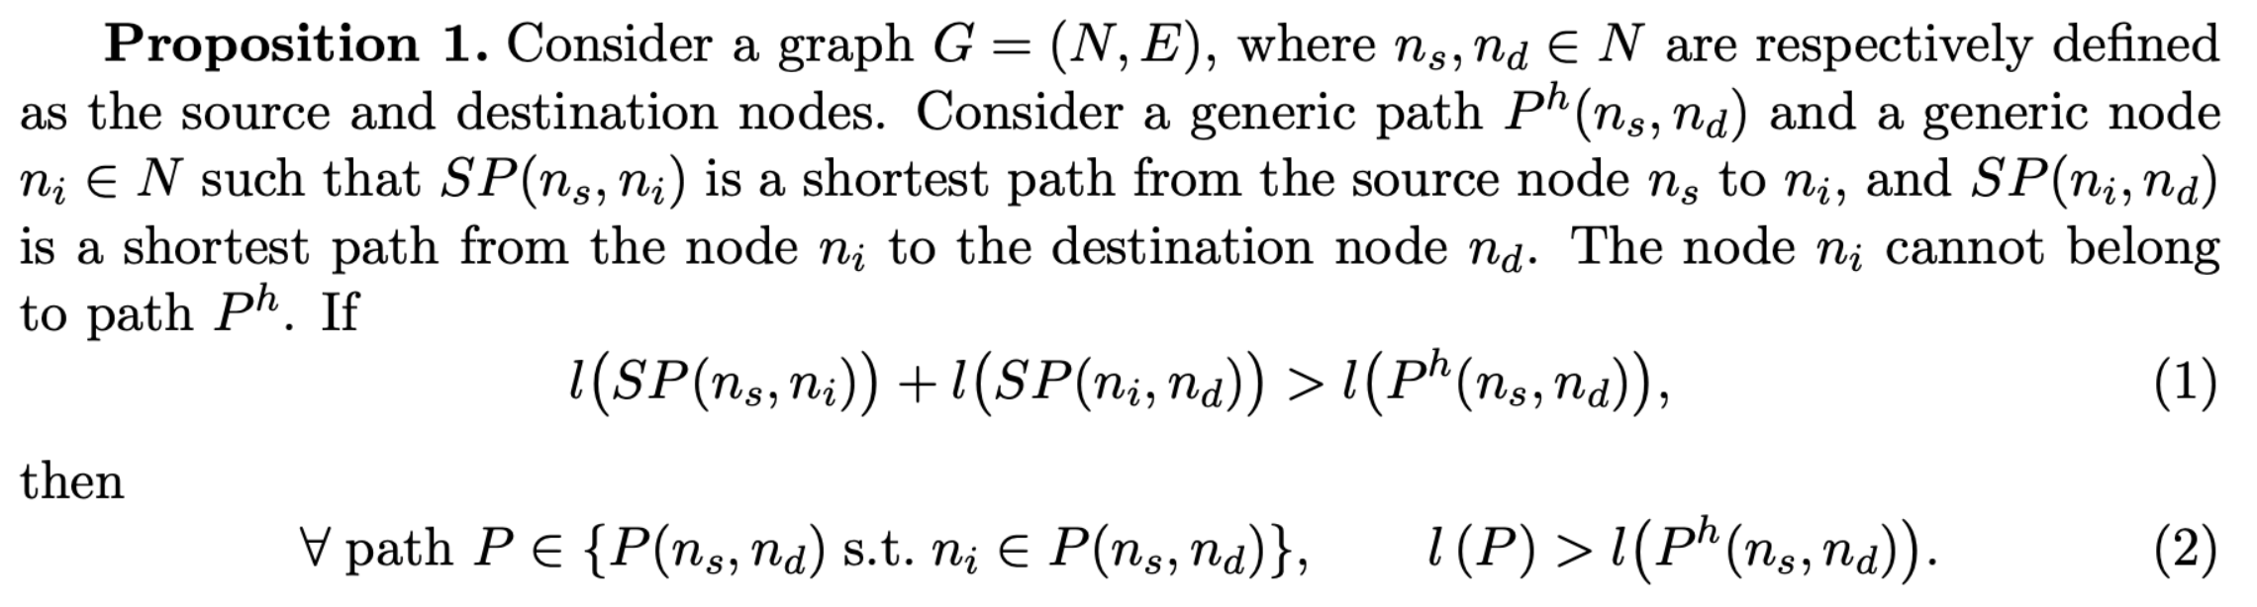
Graph Reduction Algorithm (GRA) – Theoretical Proof
Overview Formulation Proposed Algorithms Results

Slide 14
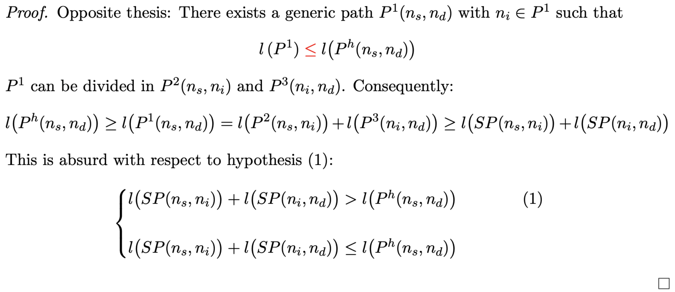
Graph Reduction Algorithm (GRA) – Theoretical Proof
Overview Formulation Proposed Algorithms Results

Slide 15
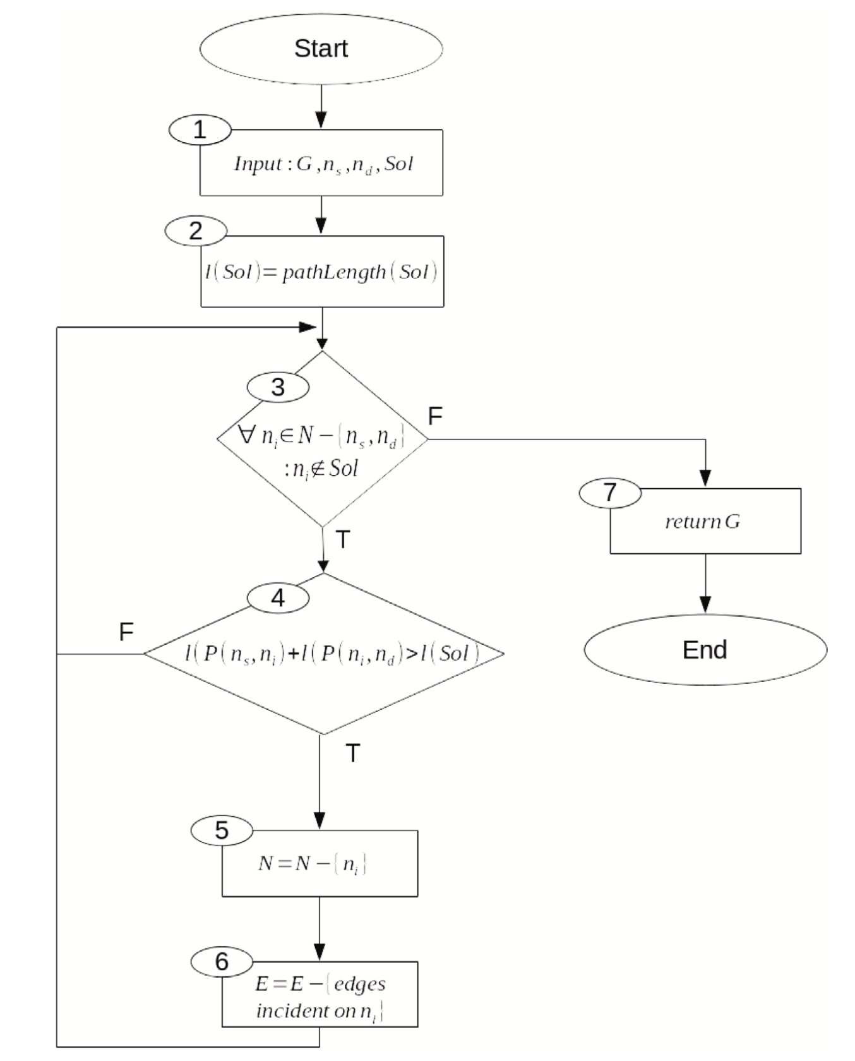
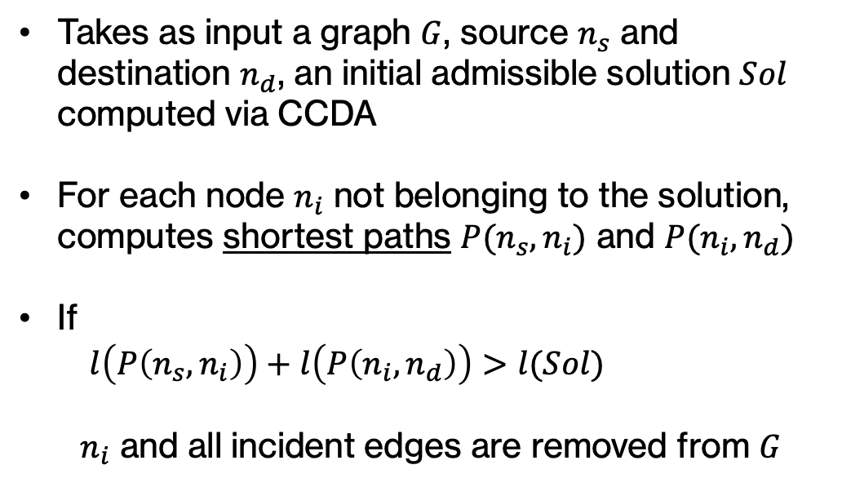
Graph Reduction Algorithm (GRA)
Takes as input a graph $G$, source $n_{s}$ and destination $n_{d}$, an initial admissible solution $Sol$ computed via CCDA
For each node $n_{i}$ not belonging to the solution, computes shortest paths $P(n_{s}, n_{i})$ and $P(n_{i}, n_{d})$
If
$l\left(P\left(n_{s},n_{i}\right)\right)+l\left(P\left(n_{i},n_{d}\right)\right)>l(Sol)$
$n_{i}$ and all incident edges are removed from $G$
Overview Formulation Proposed Algorithms Results

Slide 16
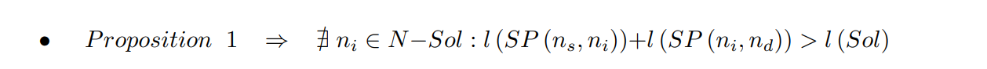
Observation on GRA
Overview Formulation Proposed Algorithms Results

Slide 17
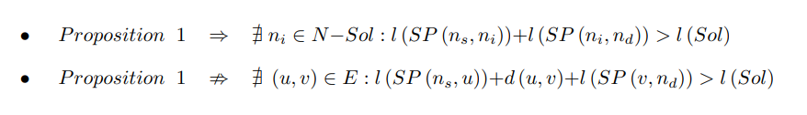
Observation on GRA
Overview Formulation Proposed Algorithms Results

Slide 18
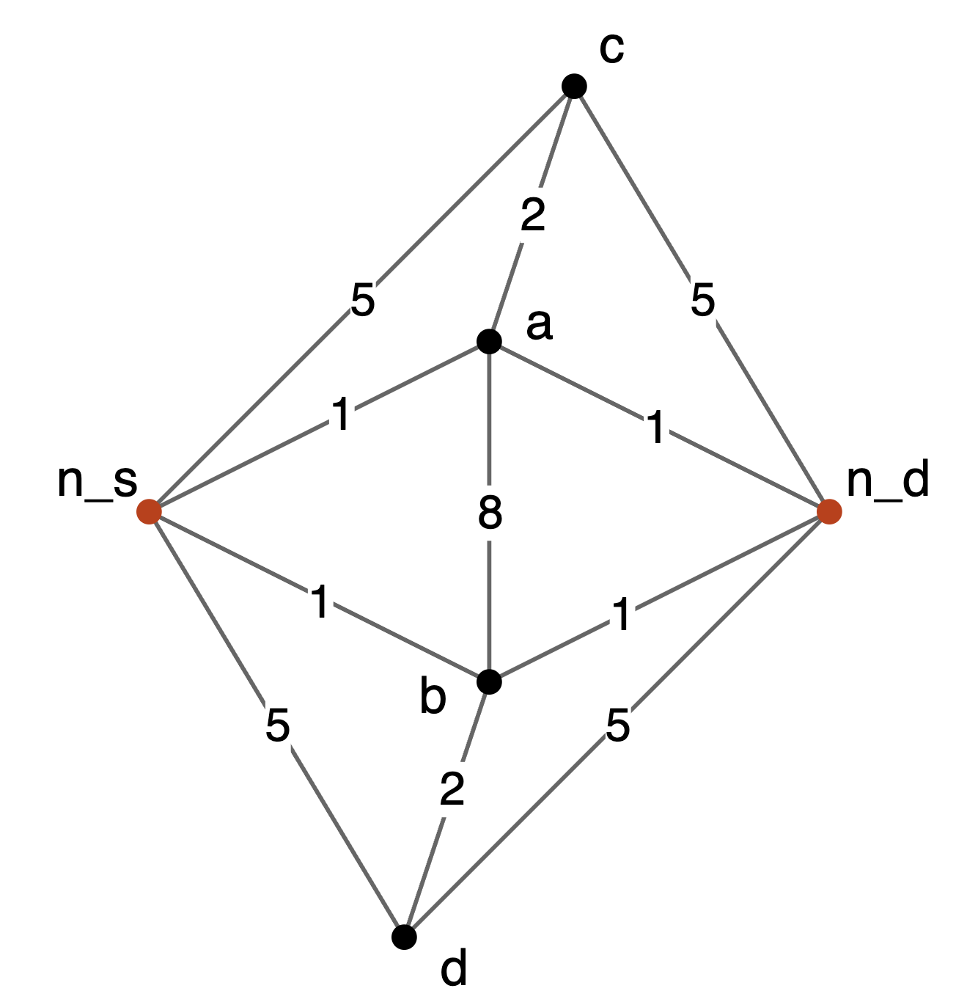
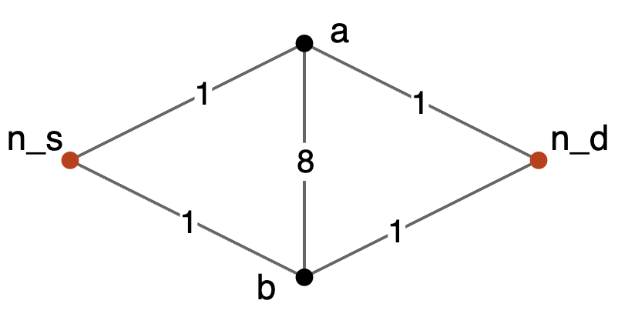
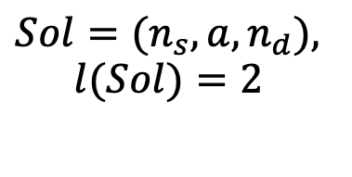




Observation on GRA
$${Sol=(n}_{s}, a, n_{d}),$$
$$l(Sol)=2$$
$$n_{d}$$
$$n_{s}$$
$$n_{d}$$
$$n_{s}$$
GRA
Overview Formulation Proposed Algorithms Results

Slide 19
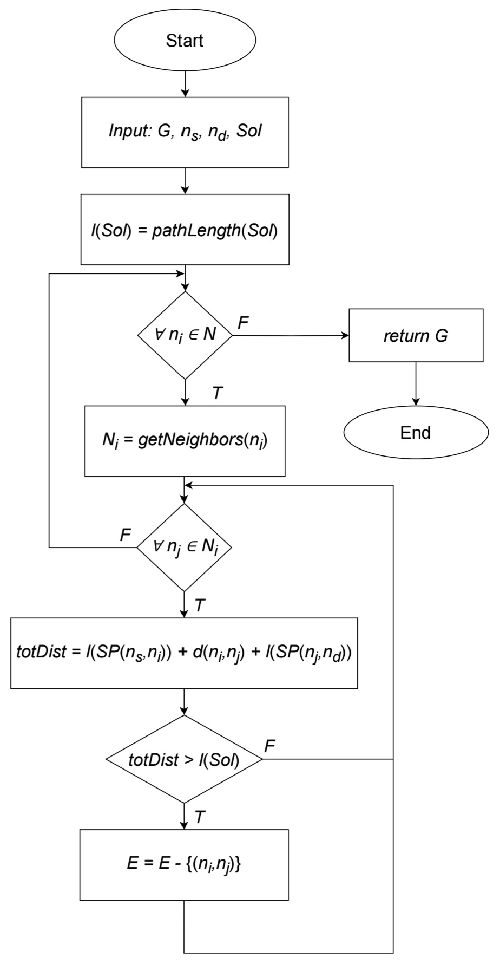

Even more reduced graph…
We present an additional reduction focusing on “hidden edges” - edges that have not been removed from GRA, but whose traversal would inevitably lead to a higher fitness function value
Overview Formulation Proposed Algorithms Results

Slide 20
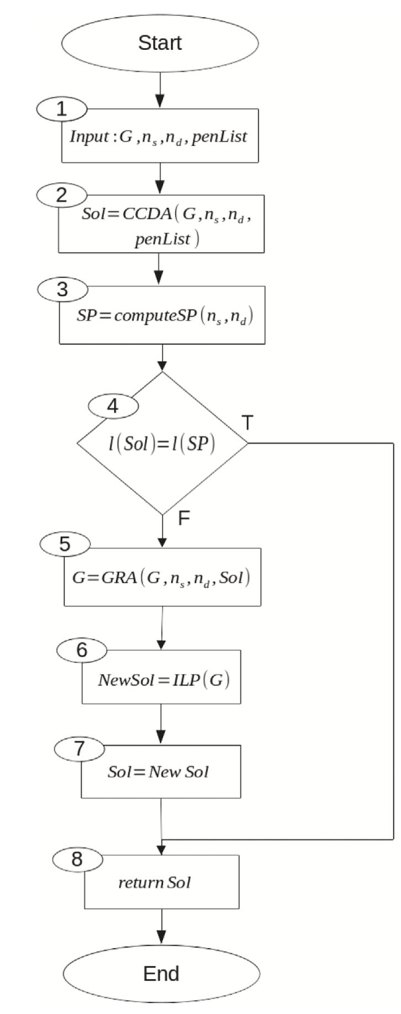
Reduced ILP Algorithm
Combination of the effectiveness of the ILP formulation and the speed of the heuristic algorithm:
Computation of admissible solution using CCDA
If the solution is optimal w.r.t. the SPP, the algorithm stops
Graph reduction using the admissible solution found as upper bound
Gurobi solver applied to the formulation of the reduced instance
Overview Formulation Proposed Algorithms Results

Slide 21
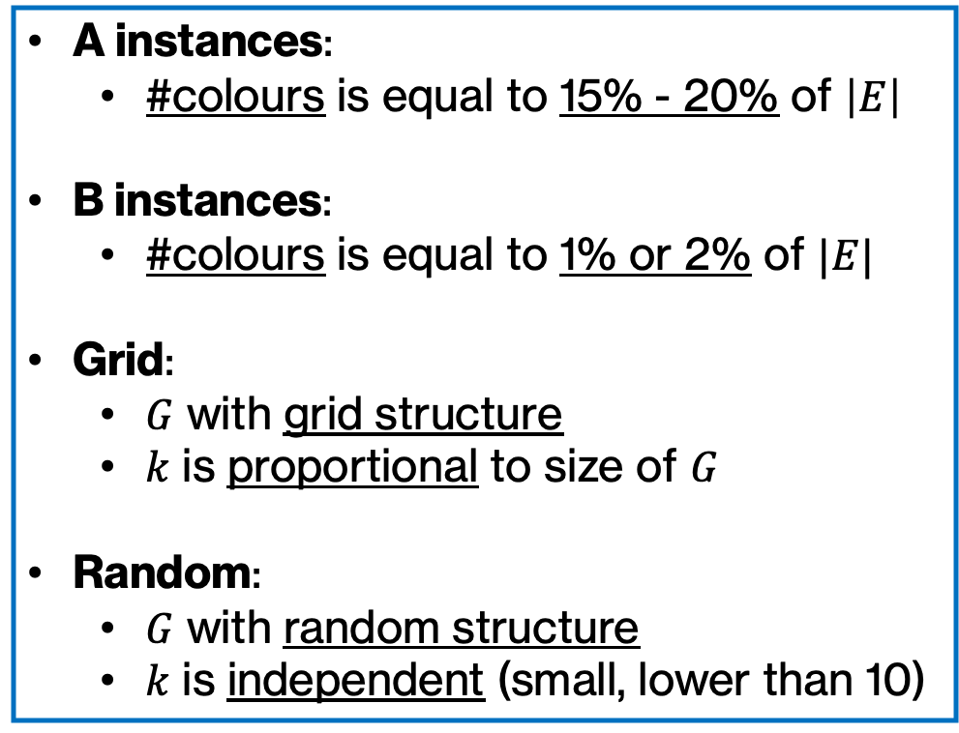
Experiments – Instances
A instances:
#colours is equal to 15% - 20% of $\left|E\right|$
B instances:
#colours is equal to 1% or 2% of $|E|$
Grid:
$G$ with grid structure
$k$ is proportional to size of $G$
Random:
$G$ with random structure
$k$ is independent (small, lower than 10)
4 sets of instances:
A – Grid
B – Grid
A – Random
B – Random
Overview Formulation Proposed Algorithms Results

Slide 22
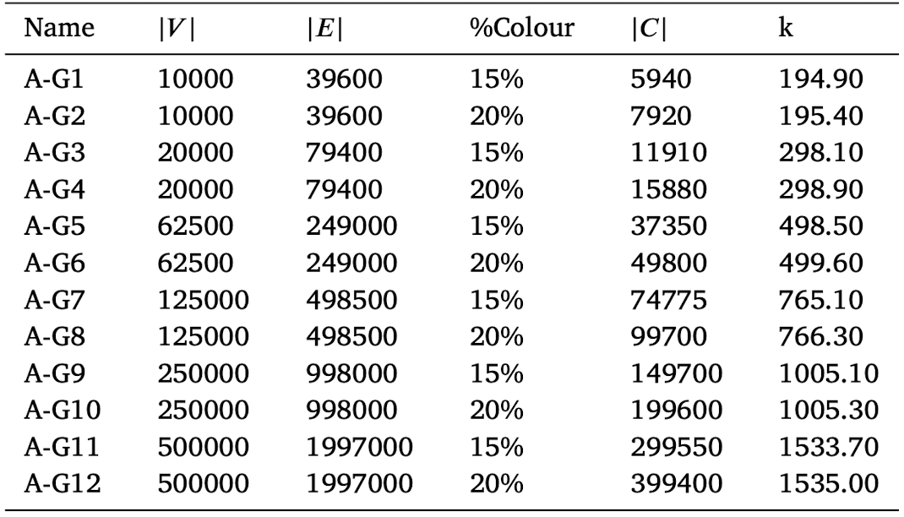
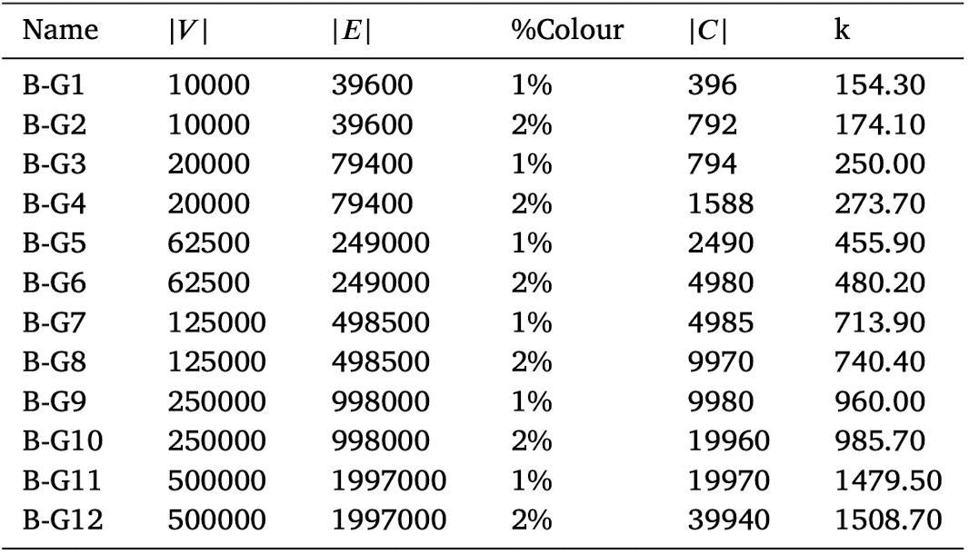
Experiments – Instances
A-Grid
B-Grid
Overview Formulation Proposed Algorithms Results

Slide 23
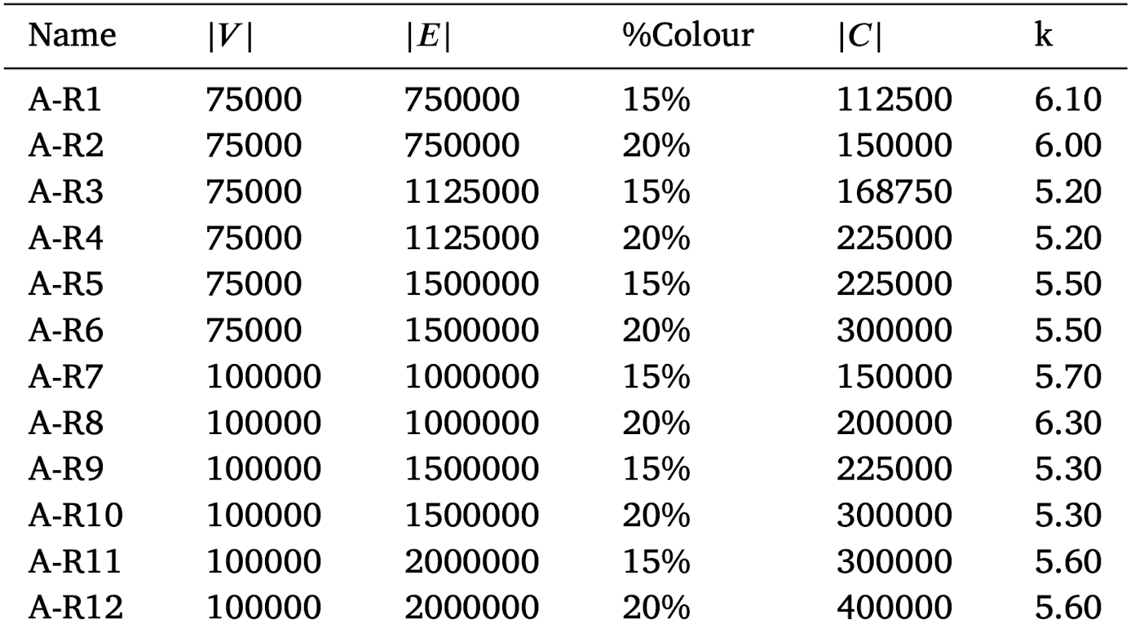
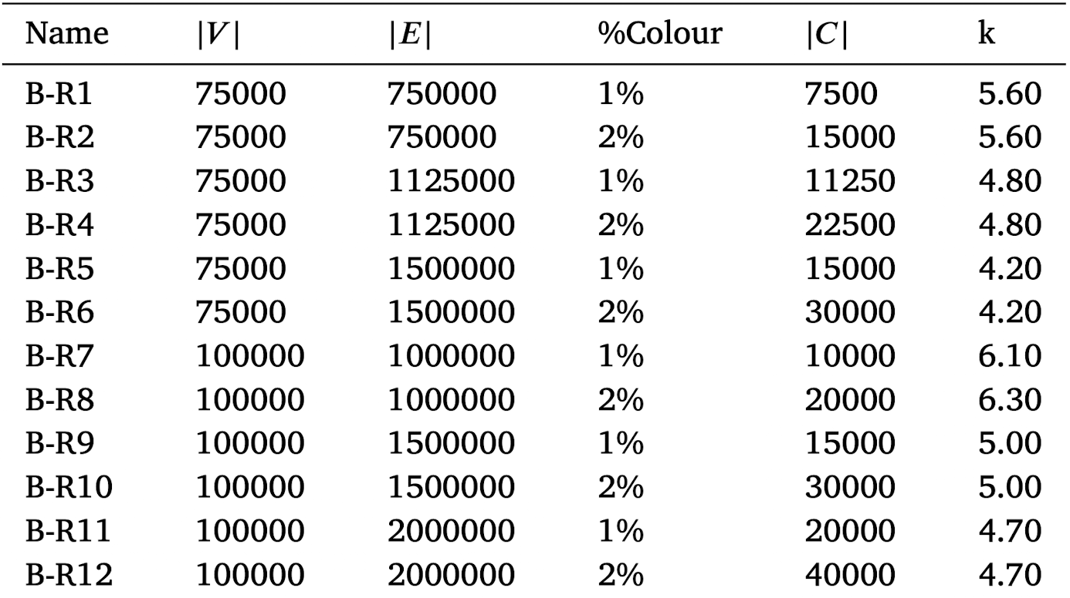
Experiments – Instances
A-Random
B-Random
Overview Formulation Proposed Algorithms Results

Slide 24
Experiments – Formulation: A-Grid
Instances | ILP |  |  | RILP
 | FF | Time (s) | #Opt (tot=8) | FF | Time (s) 2R | Time (s) 1R | #Opt (tot=8)
A-G1 | 6264.50 | 22.95 | 8 | 6264.50 | 1.315 | 1.23 | 8
A-G2 | 6264.50 | 25.00 | 8 | 6264.50 | 0.47 | 0.45 | 8
A-G3 | 9640.25 | 115.88 | 8 | 9640.25 | 0.46 | 0.44 | 8
A-G4 | 9627.88 | 145.26 | 8 | 9627.88 | 5.79 | 5.83 | 8
A-G5 | - | TL | - | 15331.75 | 4.02 | 4.12 | 8
A-G6 | - | TL | - | 15342.00 | 1.41 | 1.45 | 8
A-G7 | - | TL | - | 23827.25 | 2.35 | 2.42 | 8
A-G8 | - | TL | - | 23851.5 | 1.86 | 1.92 | 8
A-G9 | - | TL | - | 30768.5 | 8.06 | 8.02 | 8
A-G10 | - | TL | - | 30786.5 | 9.05 | 9.43 | 8
A-G11 | - | TL | - | 47749.75 | 42.46 | 41.78 | 8
A-G12 | - | TL (> 1 night) | - | 47782.75 | 30.16 | 29.77 | 8
Overview Formulation Proposed Algorithms Results

Slide 25
Experiments – Formulation: A-Random
Instances | ILP |  |  | RILP
 | FF | Time (s) | #Opt (tot=8) | FF | Time (s) 2R | Time (s) 1R | #Opt (tot=8)
A-R1 | - | TL | - | 131.83 | 4.37 | 4.76 | 6
A-R2 | - | TL | - | 132.13 | 9.72 | 11.29 | 8
A-R3 | - | TL | - | 120.0 | 5.28 | 6.19 | 8
A-R4 | - | TL | - | 111.38 | 4.41 | 5.04 | 8
A-R5 | - | TL | - | 95.0 | 219.79 | 295.67 | 8
A-R6 | - | TL | - | 97.38 | 273.85 | 275.27 | 8
A-R7 | - | TL | - | 129.63 | 11.86 | 12.39 | 8
A-R8 | - | TL | - | 153.16 | 7.21 | 7.4 | 8
A-R9 | - | TL | - | 112.36 | 8.93 | 9.48 | 8
A-R10 | - | TL | - | 105.36 | 7.01 | 7.56 | 8
A-R11 | - | TL | - | 90.0 | 3.97 | 4.30 | 8
A-R12 | - | TL | - | 92.57 | 4.34 | 4.65 | 7
Overview Formulation Proposed Algorithms Results

Slide 26
Experiments – Formulation: B-Grid
Instances | ILP |  |  | RILP
 | FF | Time (s) | #Opt (tot=10) | FF | Time (s) 2R | Time (s) 1R | #Opt (tot=10)
B-G1 | 6277.4 | 17.26 | 10 | 6277.4 | 0.21 | 0.42 | 10
B-G2 | 6275.6 | 17.55 | 10 | 6275.6 | 0.40 | 0.47 | 10
B-G3 | 9633.0 | 68.87 | 10 | 9633.0 | 1.93 | 4.00 | 10
B-G4 | 9634.5 | 75.46 | 10 | 9634.5 | 1.68 | 2.80 | 10
B-G5 | 15355.4 | 518.33 | 10 | 15355.4 | 2.21 | 3.06 | 10
B-G6 | 15358.7 | 536.03 | 10 | 15358.7 | 2.70 | 6.15 | 10
B-G7 | - | TL | - | 23838.0 | 2.44 | 5.81 | 10
B-G8 | - | TL | - | 23837.5 | 2.59 | 4.87 | 10
B-G9 | - | TL | - | 30781.1 | 5.22 | 8.63 | 10
B-G10 | - | TL | - | 30781.5 | 5.30 | 10.75 | 10
B-G11 | - | TL | - | 47758.0 | 34.34 | 55.34 | 10
B-G12 | - | TL | - | 47754.4 | 35.06 | 40.76 | 10
Overview Formulation Proposed Algorithms Results

Slide 27
Experiments – Formulation: B-Random
Instances | ILP |  |  | RILP
 | FF | Time (s) | #Opt (tot=10) | FF | Time (s) | #Opt (tot=10)
B-R1 | - | TL | - | 125.22 | 2.64 | 9
B-R2 | - | TL | - | 125.22 | 2.76 | 9
B-R3 | - | TL | - | 121.2 | 7.90 | 10
B-R4 | - | TL | - | 121.2 | 7.80 | 10
B-R5 | - | TL | - | 100.56 | 10.69 | 9
B-R6 | - | TL | - | 100.56 | 10.82 | 9
B-R7 | - | TL | - | 158.0 | 494.43 | 10
B-R8 | - | TL | - | 141.9 | 434.75 | 10
B-R9 | - | TL | - | 115.3 | 9.64 | 10
B-R10 | - | TL | - | 115.3 | 9.82 | 10
B-R11 | - | TL | - | 115.3 | 669.10 | 10
B-R12 | - | TL | - | 115.3 | 711.46 | 10
Overview Formulation Proposed Algorithms Results

Slide 28
Experiments – CCDA: A-Grid
Instances | FF (RILP) | CCDA
 |  | GAP (%) | Time (s) | #Opt (tot=8)
A-G1 | 6264.50 | 0.79 | 0.15 | 4
A-G2 | 6264.50 | 0.46 | 0.15 | 6
A-G3 | 9640.25 | 0.02 | 0.27 | 5
A-G4 | 9627.88 | 0.60 | 0.37 | 2
A-G5 | 15331.75 | 0.13 | 1.27 | 3
A-G6 | 15342.00 | 0.01 | 0.95 | 6
A-G7 | 23827.25 | 0.03 | 1.80 | 5
A-G8 | 23851.5 | 0.01 | 1.53 | 6
A-G9 | 30768.5 | 0.03 | 5.05 | 6
A-G10 | 30786.5 | 0.03 | 5.56 | 5
A-G11 | 47749.75 | 0.02 | 25.93 | 4
A-G12 | 47782.75 | 0.01 | 25.89 | 4
Overview Formulation Proposed Algorithms Results

Slide 29
Experiments – CCDA: B-Grid
Instances | FF (RILP) | CCDA
 |  | GAP (%) | Time (s) | #Opt (tot=10)
B-G1 | 6277.4 | 0.23 | 0.07 | 5
B-G2 | 6275.6 | 0.43 | 0.1 | 2
B-G3 | 9633.0 | 0.34 | 0.19 | 6
B-G4 | 9634.5 | 0.48 | 0.24 | 4
B-G5 | 15355.4 | 0.17 | 0.89 | 3
B-G6 | 15358.7 | 0.21 | 0.81 | 7
B-G7 | 23838.0 | 0.05 | 1.69 | 7
B-G8 | 23837.5 | 0.05 | 1.84 | 6
B-G9 | 30781.1 | 0.01 | 4.09 | 7
B-G10 | 30781.5 | 0.01 | 4.01 | 7
B-G11 | 47758.0 | 0.05 | 23.91 | 5
B-G12 | 47754.4 | 0.04 | 28.81 | 2
Overview Formulation Proposed Algorithms Results

Slide 30
Experiments – CCDA: A-Random
Instances | FF (RILP) | CCDA
 |  | GAP (%) | Time (s) | #Opt (tot=8)
A-R1 | 131.83 | 3.14 | 2.76 | 5
A-R2 | 132.13 | 0.00 | 2.14 | 8
A-R3 | 120.0 | 0.00 | 3.08 | 8
A-R4 | 111.38 | 0.00 | 2.63 | 8
A-R5 | 95.0 | 5.99 | 2.56 | 7
A-R6 | 97.38 | 5.99 | 3.15 | 7
A-R7 | 129.63 | 9.77 | 4.64 | 4
A-R8 | 153.16 | 1.26 | 4.42 | 5
A-R9 | 112.36 | 3.20 | 5.00 | 6
A-R10 | 105.36 | 1.11 | 3.84 | 7
A-R11 | 90.0 | 0.0 | 3.14 | 8
A-R12 | 92.57 | 0.0 | 3.38 | 7
Overview Formulation Proposed Algorithms Results

Slide 31
Experiments – CCDA: B-Random
Instances | FF (RILP) | CCDA
 |  | GAP (%) | Time (s) | #Opt (tot=10)
B-R1 | 125.22 | 0.0 | 2.01 | 9
B-R2 | 125.22 | 0.0 | 2.10 | 9
B-R3 | 121.2 | 0.0 | 3.22 | 10
B-R4 | 121.2 | 0.0 | 3.22 | 10
B-R5 | 100.56 | 1.32 | 4.40 | 8
B-R6 | 100.56 | 1.32 | 4.46 | 8
B-R7 | 158.0 | 3.34 | 5.12 | 7
B-R8 | 141.9 | 3.34 | 4.19 | 7
B-R9 | 115.3 | 2.56 | 5.71 | 8
B-R10 | 115.3 | 2.56 | 5.83 | 8
B-R11 | 115.3 | 1.6 | 8.43 | 9
B-R12 | 115.3 | 1.6 | 8.31 | 9
Overview Formulation Proposed Algorithms Results

Slide 32
Experiments – Graph Reduction: A-Grid
Instances | %Reduct Nodes | %Reduct Edges | %Reduct Edges Extra | Time (s)
A-G1 | 84.63 | 86.10 | 5.23 | 0.03
A-G2 | 89.72 | 91.63 | 6.34 | 0.03
A-G3 | 96.44 | 97.59 | 4.60 | 0.08
A-G4 | 86.24 | 87.63 | 8.04 | 0.10
A-G5 | 95.42 | 96.33 | 8.22 | 0.28
A-G6 | 97.79 | 98.55 | 8.53 | 0.22
A-G7 | 98.63 | 99.08 | 8.03 | 0.37
A-G8 | 98.88 | 99.29 | 8.59 | 0.25
A-G9 | 98.28 | 98.68 | 4.55 | 0.86
A-G10 | 98.31 | 98.76 | 5.86 | 1.14
A-G11 | 98.30 | 98.67 | 5.45 | 2.90
A-G12 | 99.46 | 99.69 | 5.41 | 3.65
Overview Formulation Proposed Algorithms Results

Slide 33
Experiments – Graph Reduction: B-Grid
Instances | %Reduct Nodes | %Reduct Edges | %Reduct Edges Extra | Time (s)
B-G1 | 91.80 | 94.03 | 11.00 | 0.03
B-G2 | 92.47 | 94.45 | 5.95 | 0.05
B-G3 | 89.57 | 90.92 | 8.75 | 0.06
B-G4 | 88.40 | 90.14 | 8.53 | 0.08
B-G5 | 96.71 | 97.52 | 7.63 | 0.30
B-G6 | 93.99 | 94.91 | 5.29 | 0.18
B-G7 | 97.94 | 98.43 | 7.55 | 0.30
B-G8 | 98.39 | 98.83 | 6.37 | 0.39
B-G9 | 98.30 | 99.60 | 5.10 | 0.93
B-G10 | 98.83 | 99.25 | 7.05 | 0.69
B-G11 | 98.59 | 98.90 | 6.51 | 2.93
B-G12 | 99.24 | 99.52 | 6.47 | 4.67
Overview Formulation Proposed Algorithms Results

Slide 34
Experiments – Graph Reduction: A-Random
Instances | %Reduct Nodes | %Reduct Edges | %Reduct Edges Extra | Time (s)
A-R1 | 99.74 | 99.97 | 1.51 | 1.58
A-R2 | 99.84 | 99.33 | 11.49 | 1.26
A-R3 | 99.87 | 99.99 | 0.35 | 2.17
A-R4 | 99.04 | 99.99 | 0.2 | 1.76
A-R5 | 49.05 | 71.79 | 72.45 | 0.86
A-R6 | 74.50 | 85.89 | 36.23 | 1.53
A-R7 | 94.58 | 98.73 | 18.52 | 1.85
A-R8 | 98.58 | 99.77 | 5.70 | 2.34
A-R9 | 99.72 | 99.97 | 1.82 | 3.85
A-R10 | 99.96 | 99.98 | 0.16 | 3.23
A-R11 | 99.93 | 99.99 | 0.00 | 0.83
A-R12 | 99.93 | 99.99 | 0.00 | 0.95
Overview Formulation Proposed Algorithms Results

Slide 35
Experiments – Graph Reduction: B-Random
Instances | %Reduct Nodes | %Reduct Edges | %Reduct Edges Extra | Time (s)
B-R1 | 99.76 | 99.97 | 1.31 | 0.84
B-R2 | 99.76 | 99.97 | 1.31 | 0.87
B-R3 | 98.06 | 99.60 | 7.53 | 2.56
B-R4 | 98.06 | 99.60 | 7.53 | 2.50
B-R5 | 96.04 | 99.12 | 16.19 | 2.12
B-R6 | 96.04 | 99.12 | 16.19 | 2.12
B-R7 | 83.04 | 89.85 | 21.73 | 2.66
B-R8 | 86.01 | 90.54 | 15.73 | 2.20
B-R9 | 99.35 | 99.92 | 4.77 | 3.70
B-R10 | 99.35 | 99.92 | 4.77 | 3.76
B-R11 | 81.76 | 91.72 | 33.87 | 5.06
B-R12 | 81.76 | 91.72 | 33.87 | 5.23
Overview Formulation Proposed Algorithms Results

Slide 36
Conclusions
We implemented all algorithms proposed in the chosen paper
Overview Formulation Proposed Algorithms Results

Slide 37
Conclusions
We implemented all algorithms proposed in the chosen paper
We improved the Graph Reduction Algorithm
Overview Formulation Proposed Algorithms Results

Slide 38
Conclusions
We implemented all algorithms proposed in the chosen paper
We improved the Graph Reduction Algorithm
We tested the performance of our implementation, proving the effectiveness of the proposed solutions
Overview Formulation Proposed Algorithms Results

Slide 39
Thanks for
your attention!

