Slide 1

Implementation of “An exact reduction technique for the k-Colour Shortest Path Problem”
Lorenzo Martin Diaz Avalos
Matteo Alessandro Fumis

Slide 2
k-Colour Shortest Path Problem (k-CSPP)
The k-Colour Shortest Path Problem is a variant of the classic Shortest Path Problem
This problem consists of finding a shortest path on a weighted edge-coloured graph, where the maximum number of different colours used in a feasible solution is fixed to be 𝑘
Applications: Network reliability
Overview Formulation Proposed Algorithms Results

Slide 3
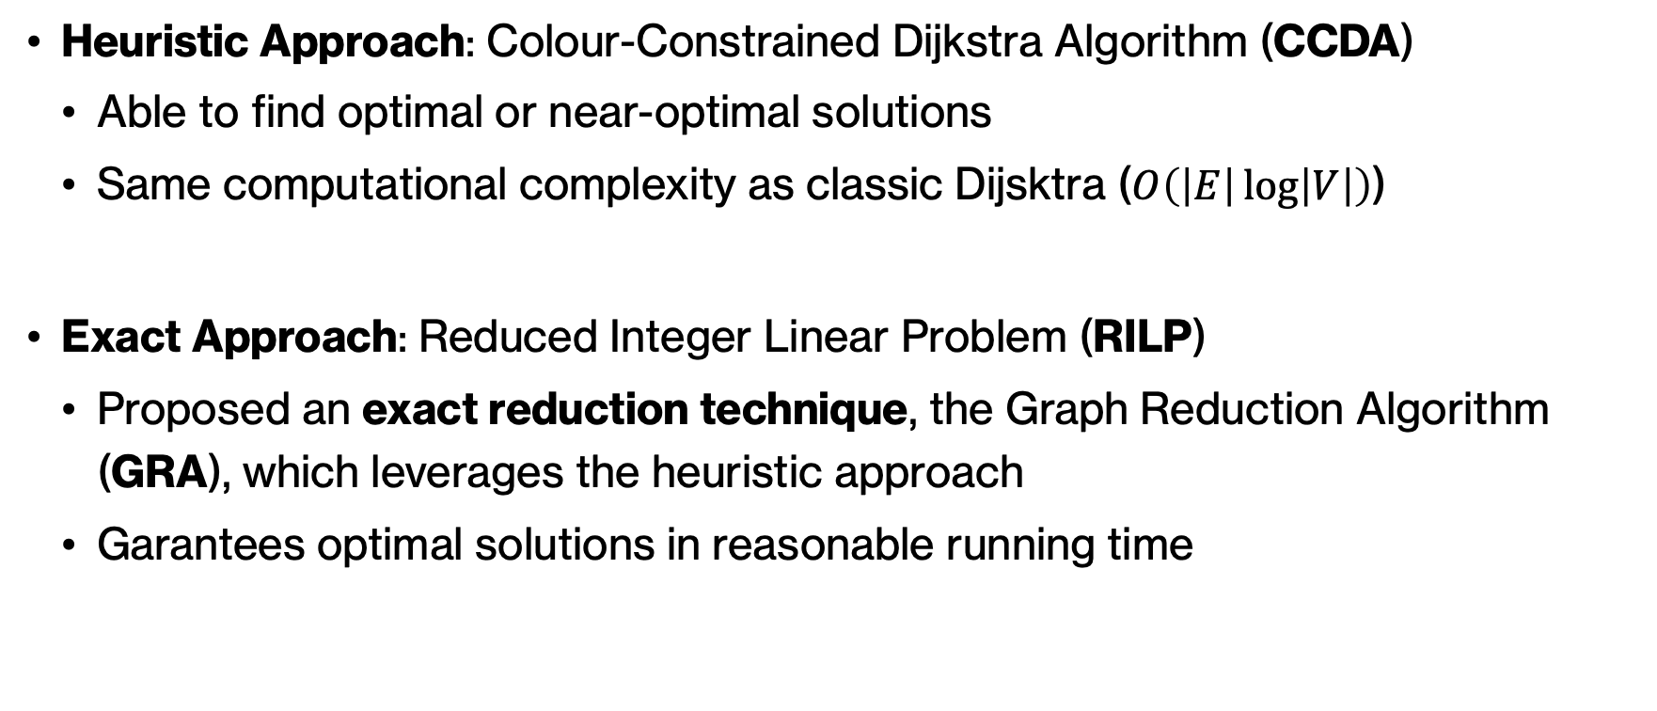
Explored Approaches
Heuristic Approach: Colour-Constrained Dijkstra Algorithm (CCDA)
Able to find optimal or near-optimal solutions
Same computational complexity as classic Dijsktra ($O\left(\left|E\right|\log\left|V\right|\right)$)
Exact Approach: Reduced Integer Linear Problem (RILP)
Proposed an exact reduction technique, the Graph Reduction Algorithm (GRA), which leverages the heuristic approach
Garantees optimal solutions in reasonable running time
Overview Formulation Proposed Algorithms Results

Slide 4
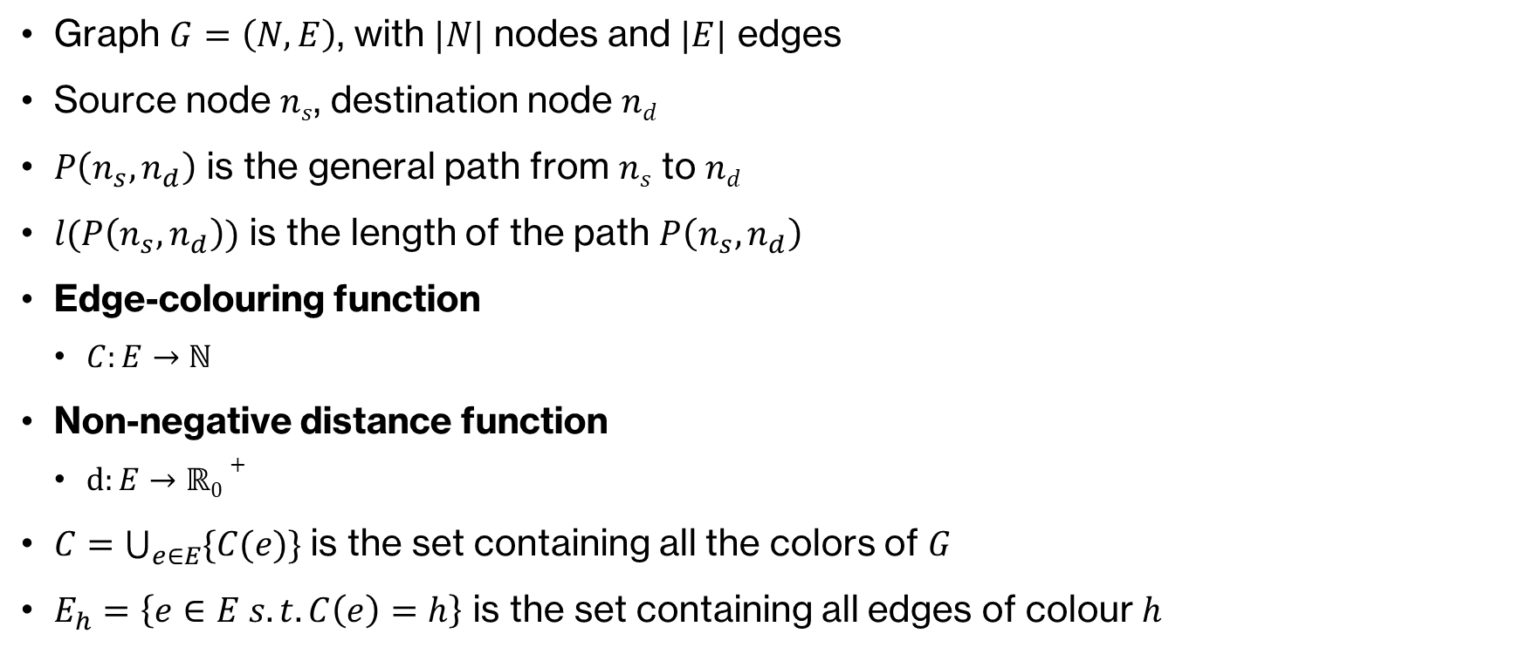
Mathematical Model
Graph $G=\left(N,E\right)$, with $|N|$ nodes and $|E|$ edges
Source node $ns$, destination node $nd$
$P\left(n_{s}, n_{d}\right)$ is the general path from $ns$ to $nd$
$l(P\left(n_{s}, n_{d}\right))$ is the length of the path $P\left(n_{s}, n_{d}\right)$
Edge-colouring function
$C:E→ℕ$
Non-negative distance function
$d:E→ℝ0+$
$C=\bigcup_{e∈E}{\{C(e)\}}$is the set containing all the colors of $G$
$E_{h}=\left\{e∈E s.t. C\left(e\right)=h\right\}$ is the set containing all edges of colour $h$
Overview Formulation Proposed Algorithms Results

Slide 5
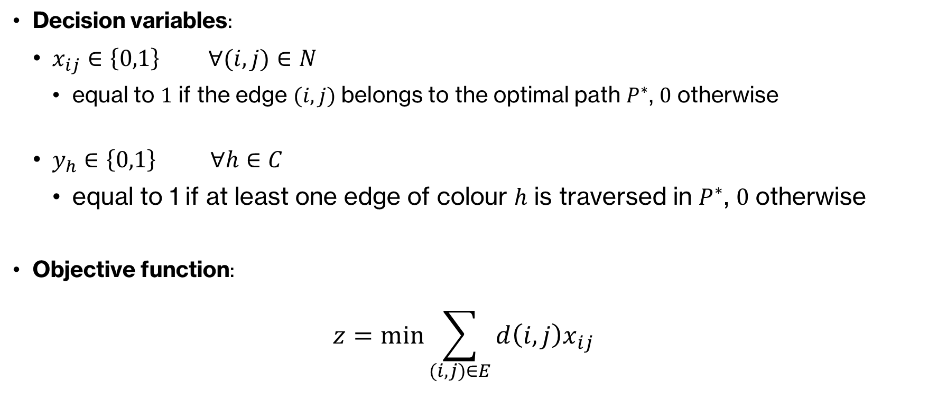
k-CSPP – Formulation
Decision variables:
$x_{ij}∈\left\{0,1\right\} ∀(i,j)∈N$
equal to $1$ if the edge $(i,j)$ belongs to the optimal path $P^{∗}$, $0$ otherwise
$y_{h}∈\left\{0,1\right\} ∀h∈C$
equal to 1 if at least one edge of colour $h$ is traversed in $P^{∗}$, $0$ otherwise
Objective function:
$$z=\min{\sum_{(i,j)∈E}{d\left(i,j\right)x_{ij}}}$$
Overview Formulation Proposed Algorithms Results

Slide 6

k-CSPP – Formulation
Constraints:
$$1) \sum_{(j,i)∈E}{x_{ji}}−\sum_{(i,j)∈E}{x_{ij}=b_{i}} ∀i∈N$$
$$b_{i}=\left\{\begin{aligned}−1 if i=n_{s} \\ +1 if i=n_{d} \\ 0 otherwise \end{aligned}\right.$$
$${2) x}_{ij}≤y_{h} ∀h∈C, ∀(i,j)∈E_{h}$$
$$3) \sum_{h∈C}{y_{h}}≤k$$
Overview Formulation Proposed Algorithms Results

Slide 7
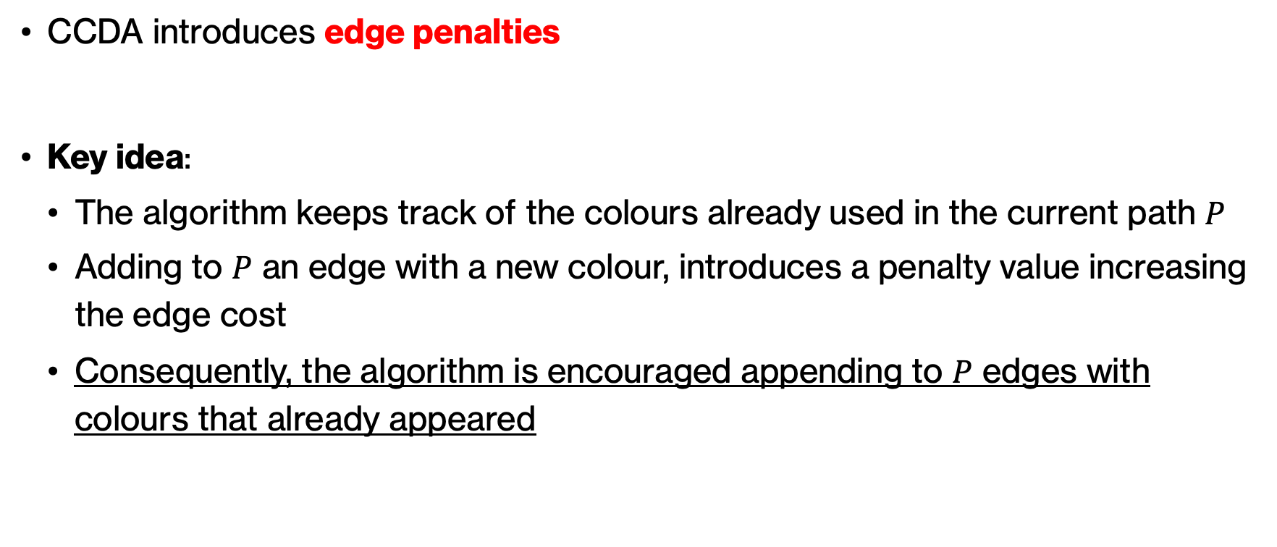
Colour-Constrained Dijkstra Algorithm (CCDA)
CCDA introduces edge penalties
Key idea:
The algorithm keeps track of the colours already used in the current path $P$
Adding to $P$ an edge with a new colour, introduces a penalty value increasing the edge cost
Consequently, the algorithm is encouraged appending to $P$ edges with colours that already appeared
Overview Formulation Proposed Algorithms Results

Slide 8
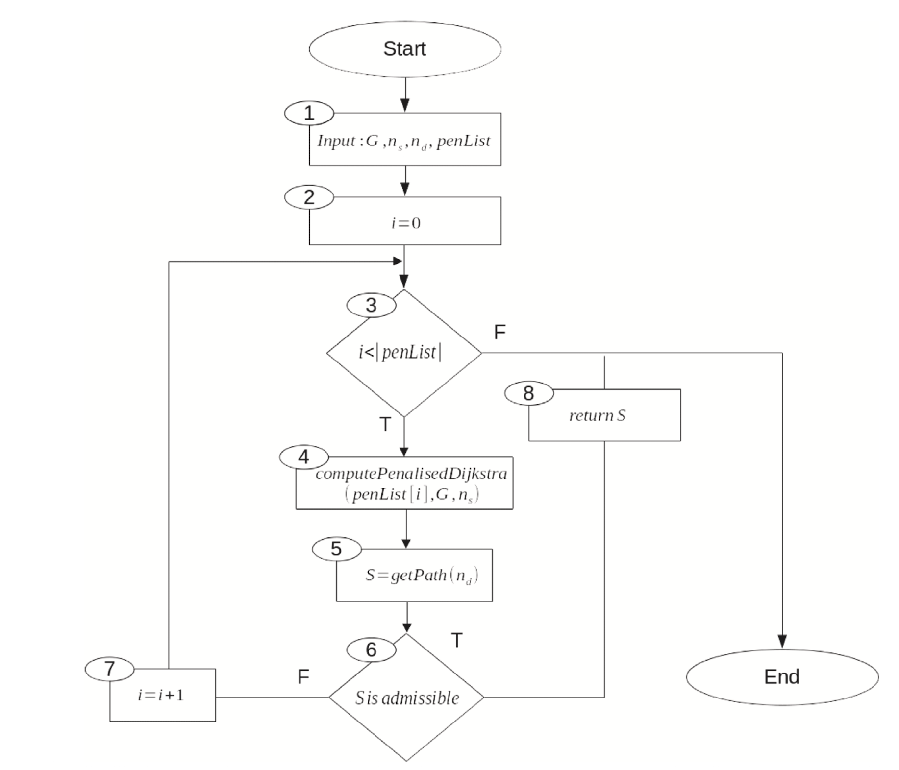
Colour-Constrained Dijkstra Algorithm (CCDA)
CCDA iterates through a list of different predefined penalty values
At each iteration, calls the Penalised Dijkstra Algorithm using current penalty value
Increasing the penalty value, the algorithm is more forced to append edges with already seen colours
Overview Formulation Proposed Algorithms Results

Slide 9
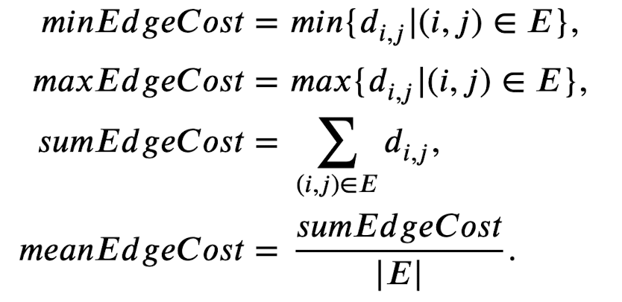
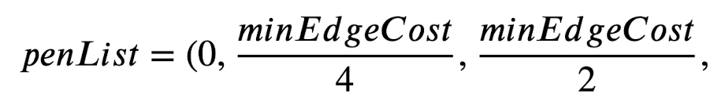

Penalty Values
Overview Formulation Proposed Algorithms Results

Slide 10
Graph Reduction Algorithm (GRA)
Computational complexity:
SPP: grows polynomially with input size
k-CSPP: grows exponentially with input size
For exact approaches (ILP solution), is necessary to reduce the input size as possible
Overview Formulation Proposed Algorithms Results

Slide 11
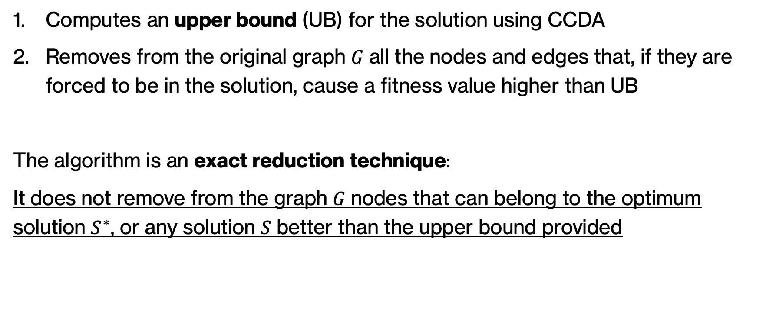
Graph Reduction Algorithm (GRA)
Computes an upper bound (UB) for the solution using CCDA
Removes from the original graph 𝐺 all the nodes and edges that, if they are forced to be in the solution, cause a fitness value higher than UB
The algorithm is an exact reduction technique:
It does not remove from the graph 𝐺 nodes that can belong to the optimum solution $S^{∗}$, or any solution 𝑆 better than the upper bound provided
Overview Formulation Proposed Algorithms Results

Slide 12
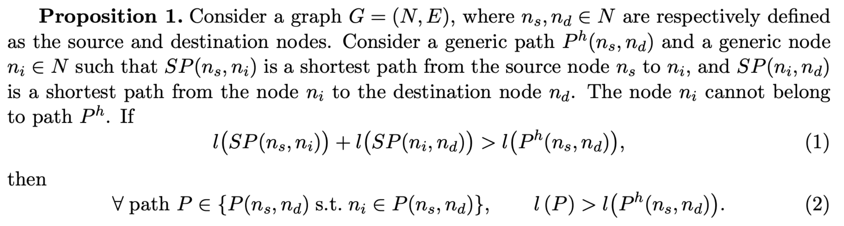
Graph Reduction Algorithm (GRA) – Theoretical Proof
Overview Formulation Proposed Algorithms Results

Slide 13
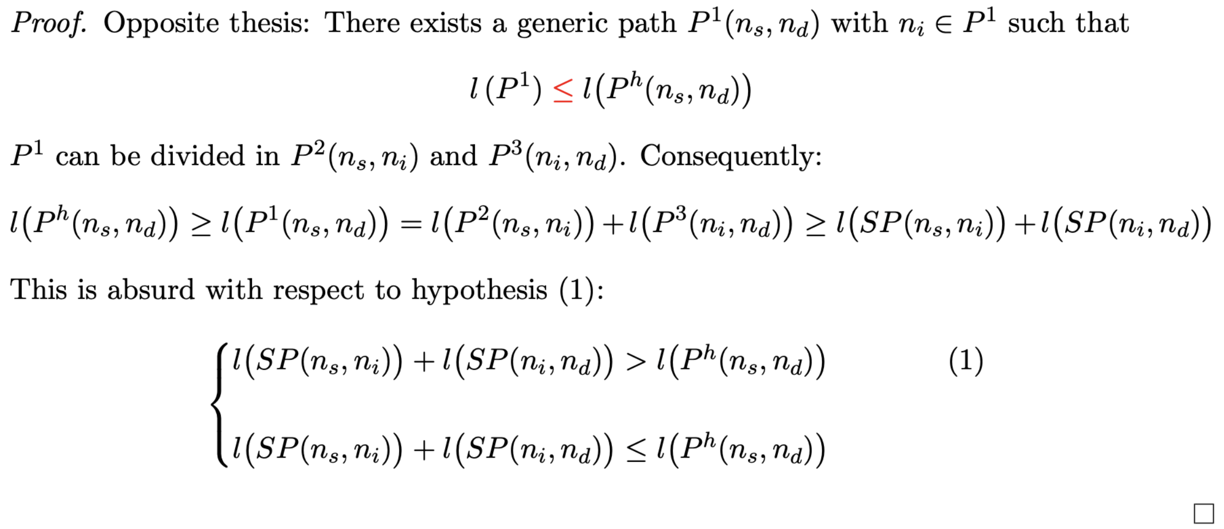
Graph Reduction Algorithm (GRA) – Theoretical Proof
Overview Formulation Proposed Algorithms Results

Slide 14
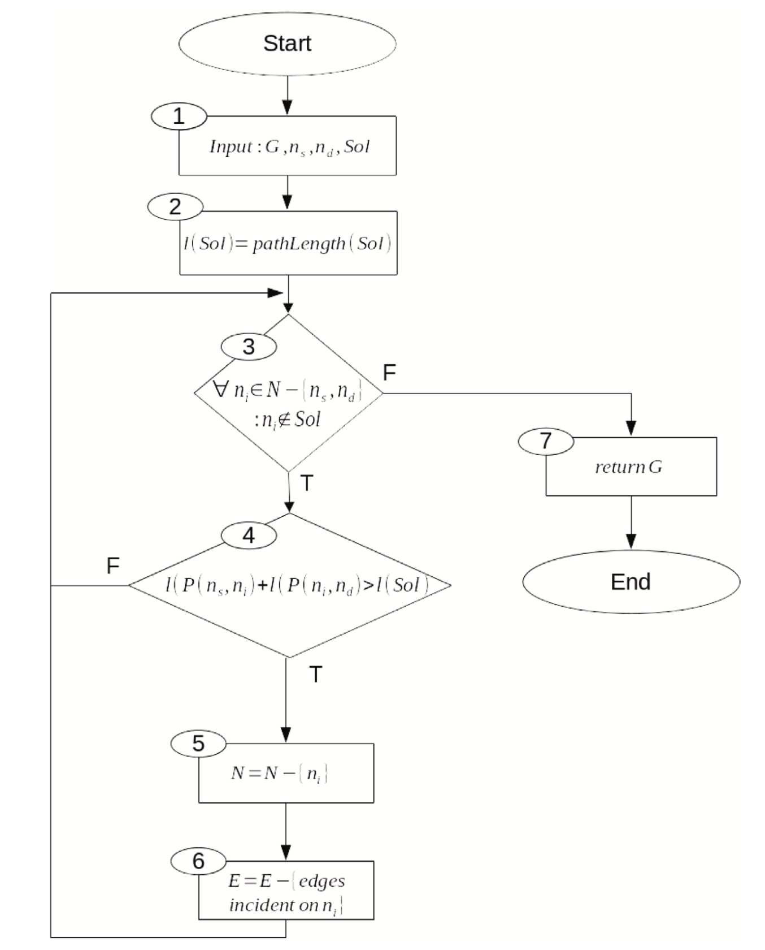
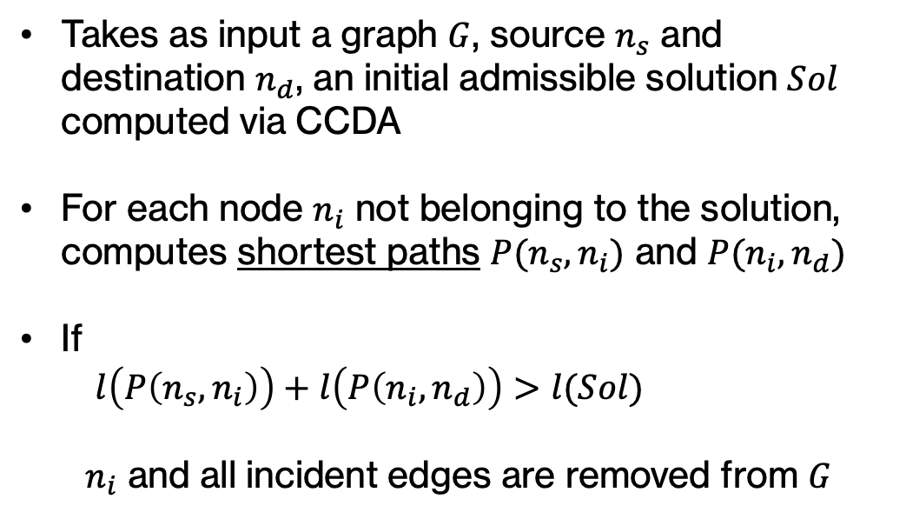
Graph Reduction Algorithm (GRA)
Takes as input a graph $G$, source $n_{s}$ and destination $n_{d}$, an initial admissible solution $Sol$ computed via CCDA
For each node $n_{i}$ not belonging to the solution, computes shortest paths $P(n_{s}, n_{i})$ and $P(n_{i}, n_{d})$
If
$l\left(P\left(n_{s},n_{i}\right)\right)+l\left(P\left(n_{i},n_{d}\right)\right)>l(Sol)$
$n_{i}$ and all incident edges are removed from $G$
Overview Formulation Proposed Algorithms Results

Slide 15
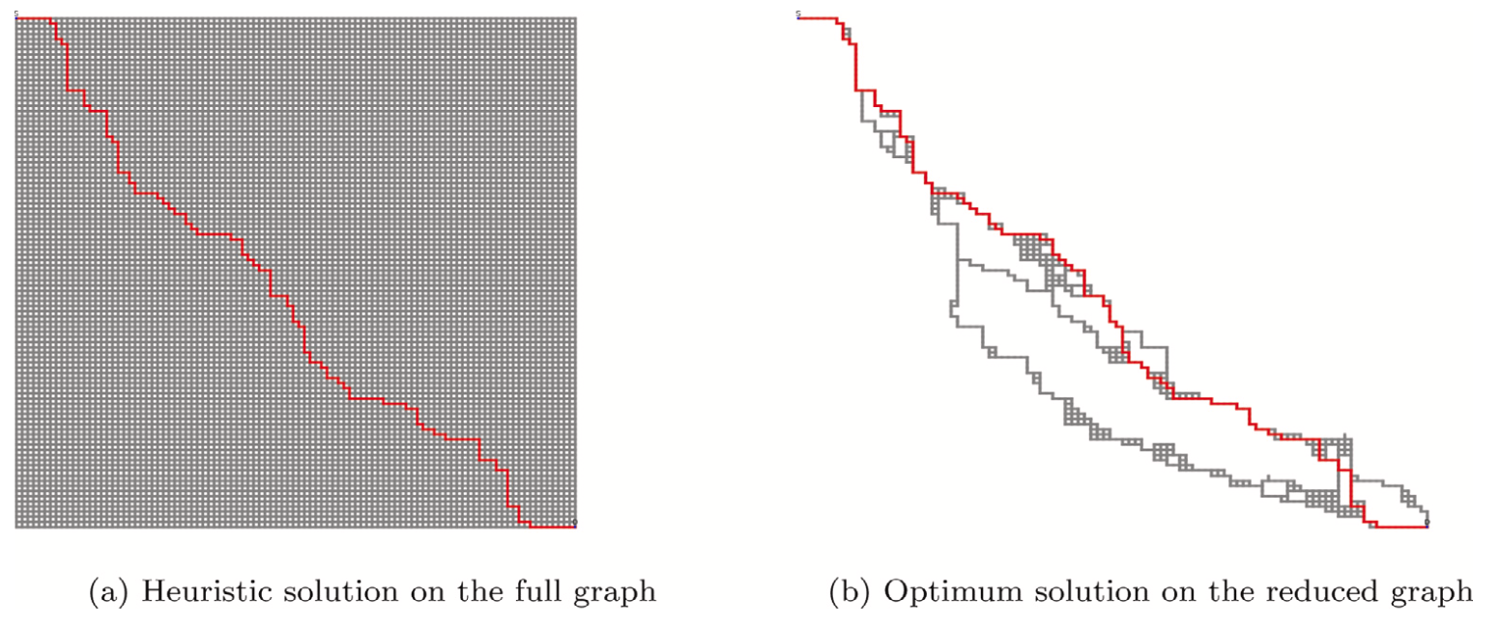

Graph Reduction Algorithm (GRA)
Overview Formulation Proposed Algorithms Results

Slide 16
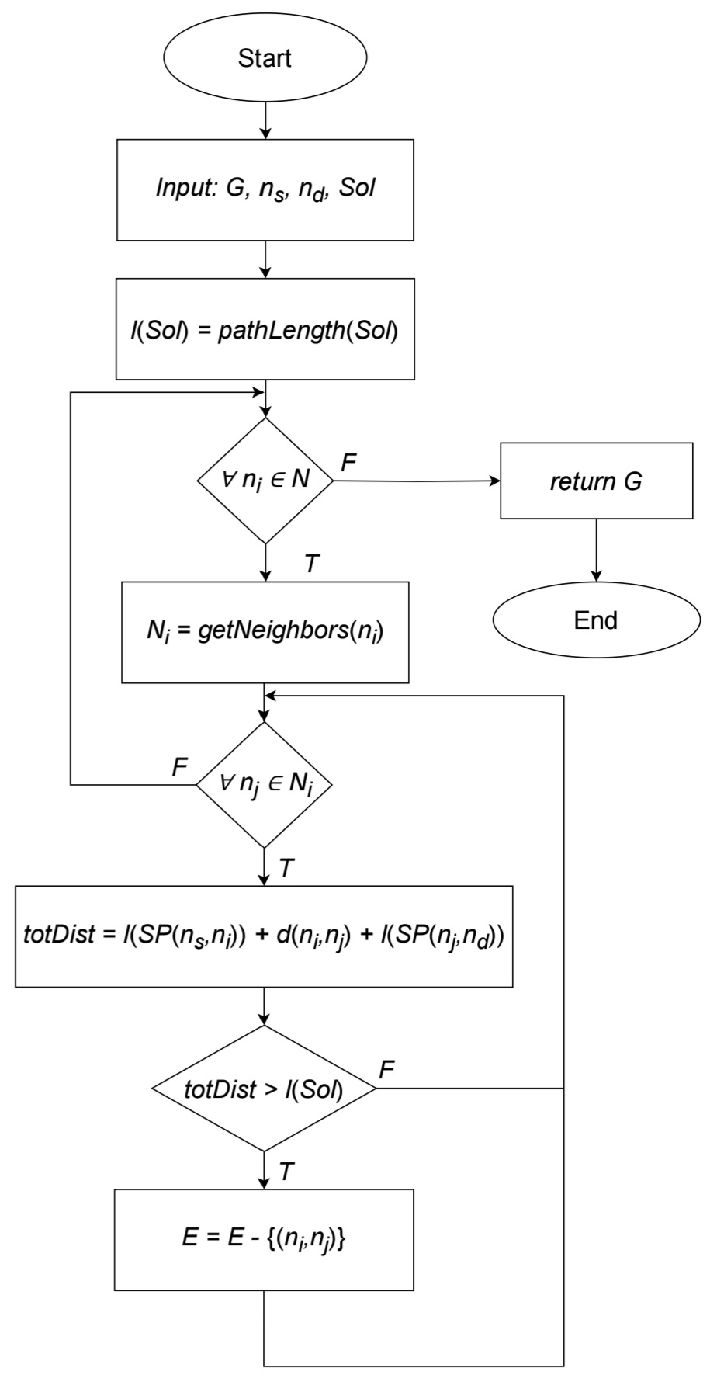
Even more reduced graph…
We present an additional reduction focusing on “hidden edges” - edges that have not been removed from GRA, but whose traversal would inevitably lead to a higher fitness function value
Overview Formulation Proposed Algorithms Results

Slide 17
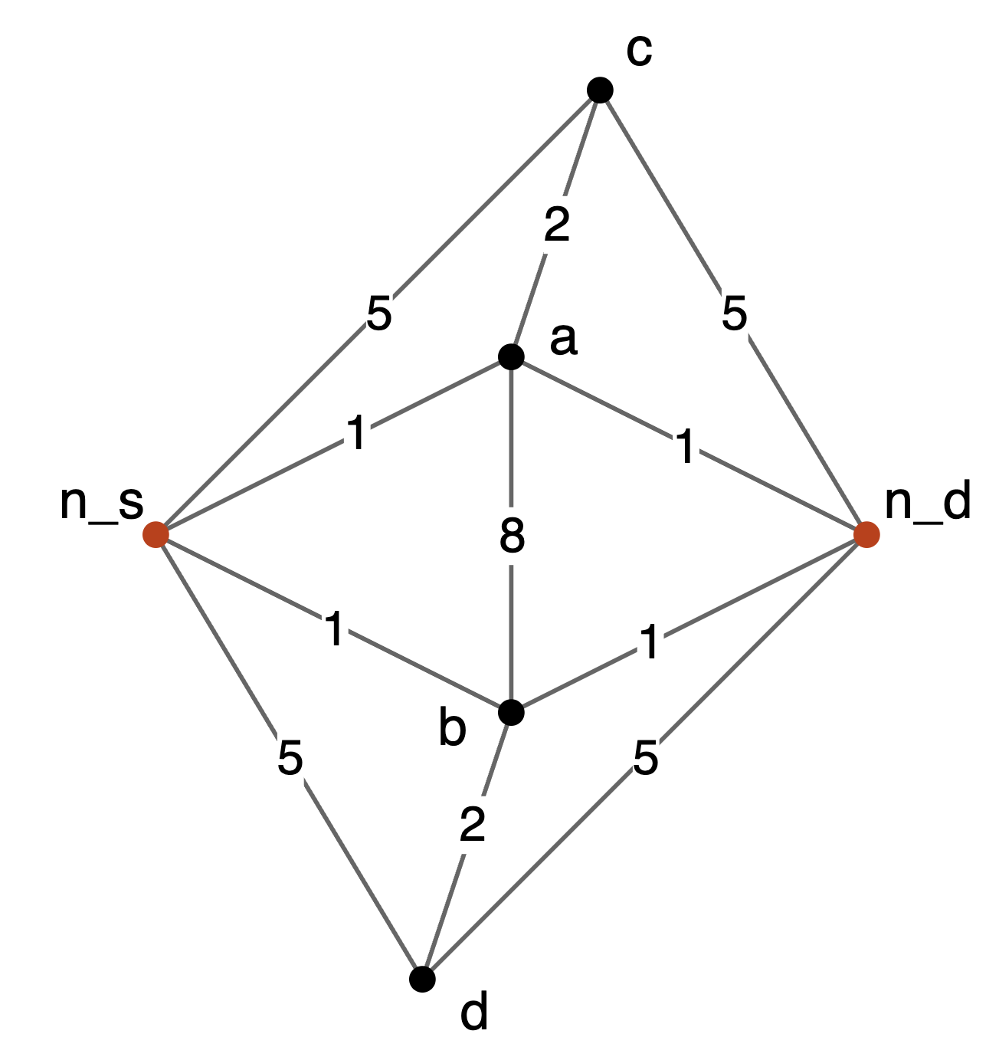
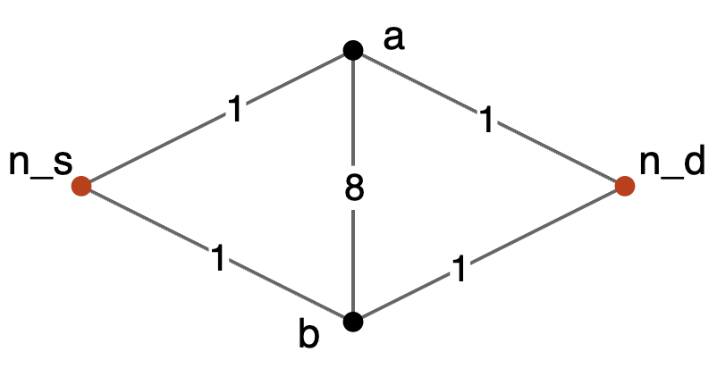
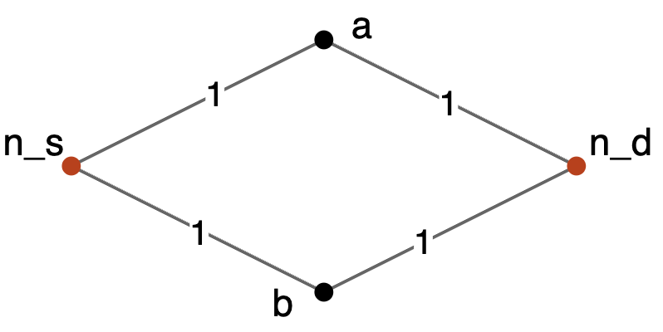







Even more reduced graph…
Initial solution: $n_{s}→a →n_{d}$
l(Sol) = 3
GRA
$$n_{d}$$
$$n_{s}$$
$$n_{d}$$
$$n_{s}$$
$$n_{d}$$
$$n_{s}$$
Overview Formulation Proposed Algorithms Results

Slide 18
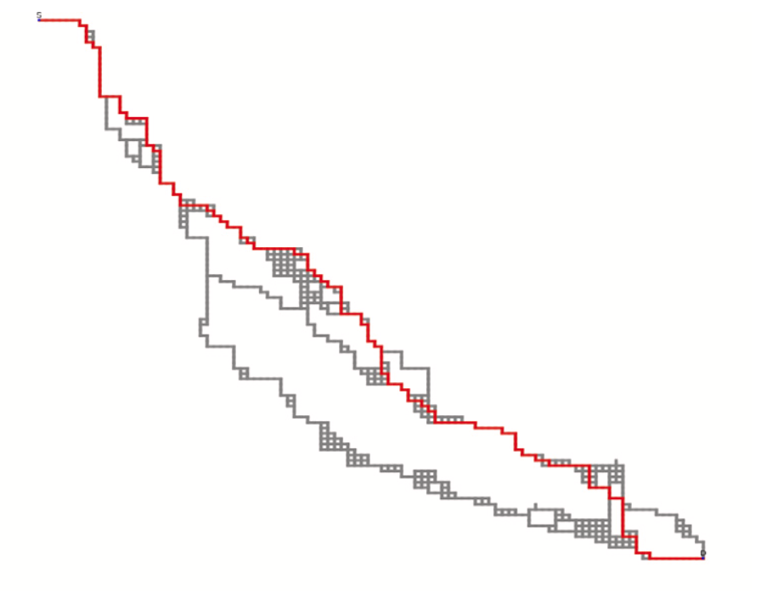
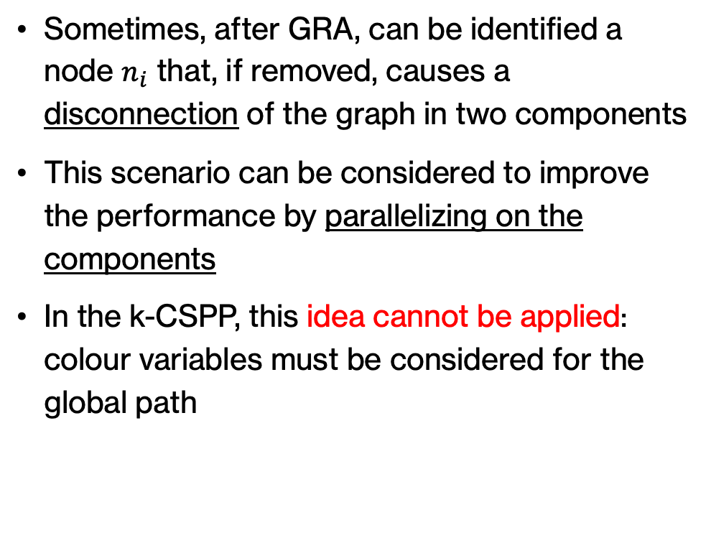
Graph Reduction Algorithm (GRA)
Sometimes, after GRA, can be identified a node $n_{i}$ that, if removed, causes a disconnection of the graph in two components
This scenario can be considered to improve the performance by parallelizing on the components
In the k-CSPP, this idea cannot be applied: colour variables must be considered for the global path
Overview Formulation Proposed Algorithms Results

Slide 19
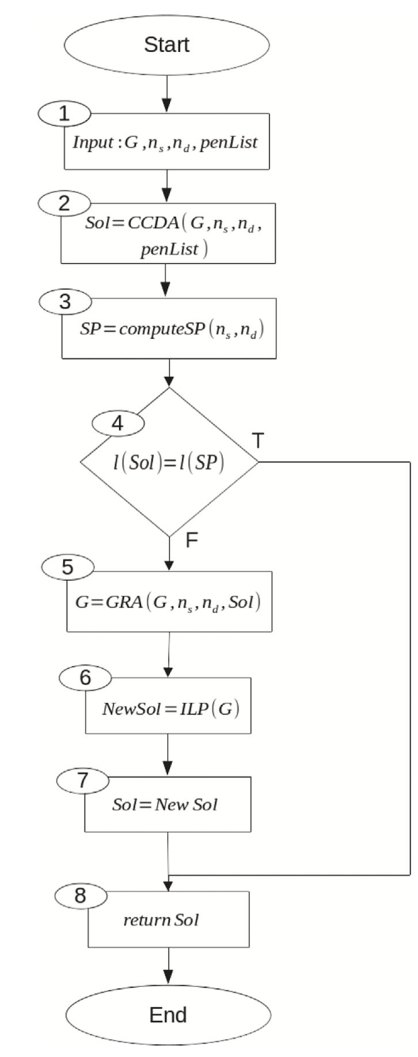
Reduced ILP Algorithm
Combination of the effectiveness of the ILP formulation and the speed of the heuristic algorithm:
Computation of admissible solution using CCDA
If the solution is optimal w.r.t. the SPP, the algorithm stops
Graph reduction using the admissible solution found as upper bound
Gurobi solver applied to the formulation of the reduced instance
Overview Formulation Proposed Algorithms Results

Slide 20
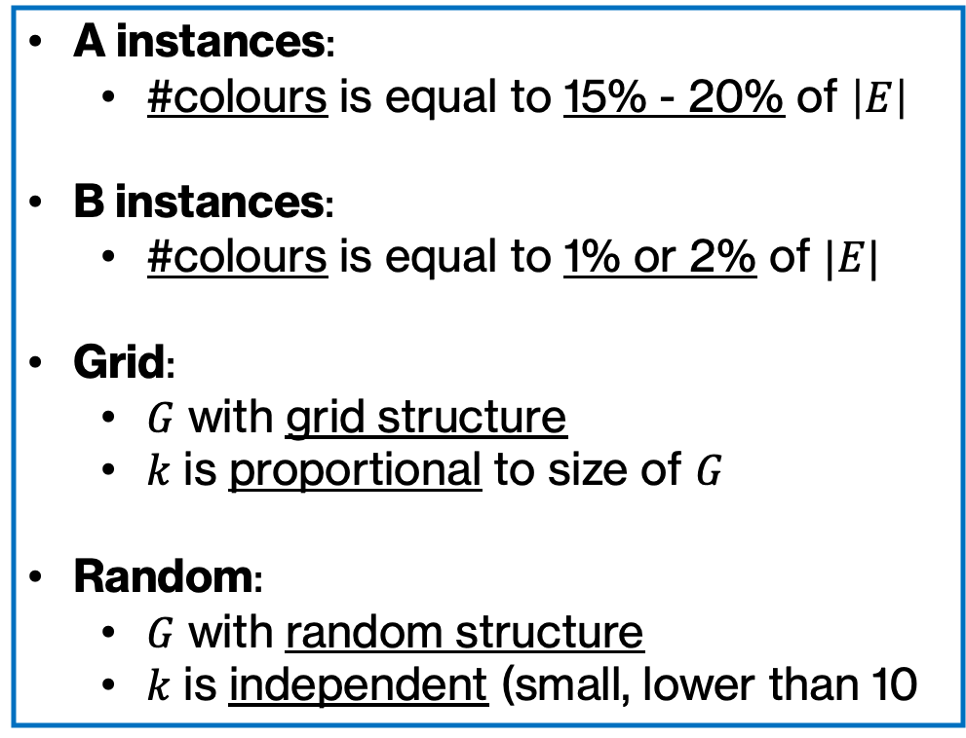
Experiments- Instances
A instances:
#colours is equal to 15% - 20% of $\left|E\right|$
B instances:
#colours is equal to 1% or 2% of $|E|$
Grid:
$G$ with grid structure
$k$ is proportional to size of $G$
Random:
$G$ with random structure
$k$ is independent (small, lower than 10
4 sets of instances:
A – Grid
A – Random
B – Grid
B – Random
Overview Formulation Proposed Algorithms Results

Slide 21
Experiments - Instances

