Slide 1




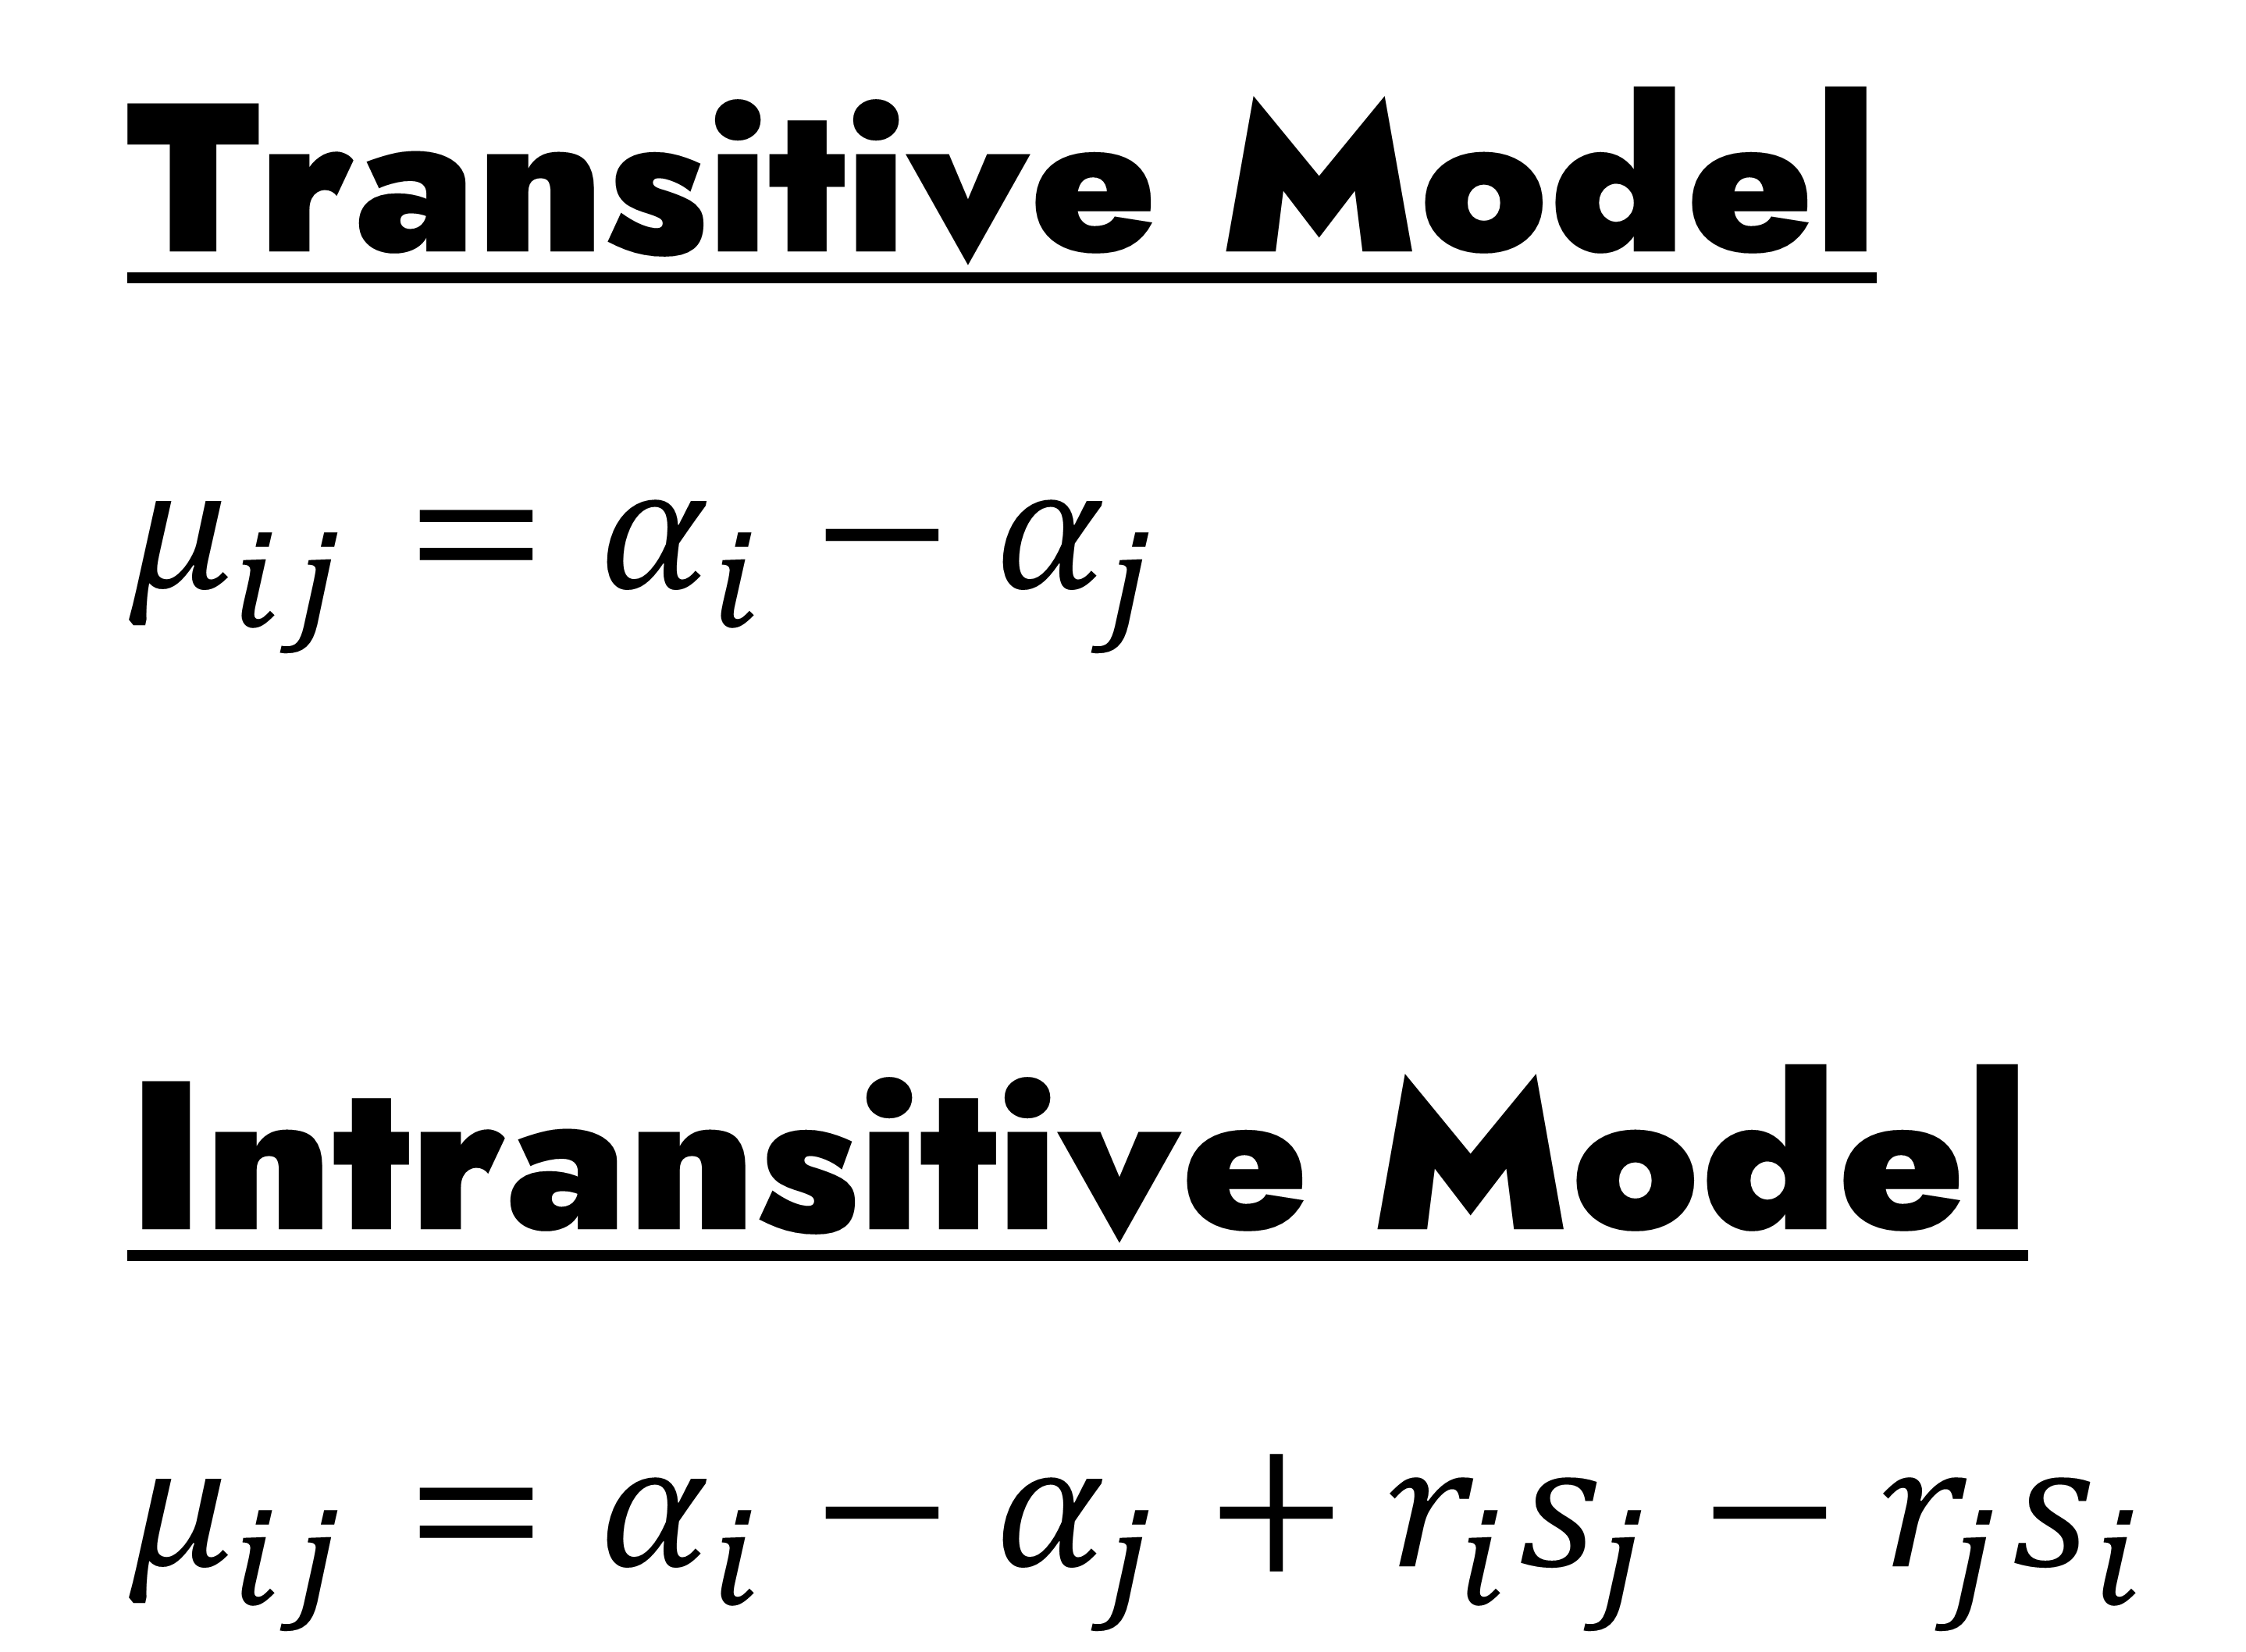
Transitive Model
$μ_{ij}=α_{i}−α_{j}$
Intransitive Model
$μ_{ij}=α_{i}−α_{j}+r_{i}s_{j}−r_{j}s_{i}$
3.36
2.98
0.60
0.83
0.62
3.81
0.91
3.68
17.13

Slide 2



@math_mcshane
@math–mcshane
math.mcshane@gmail.com
Open to ’22–’23 Positions

