Slide 1
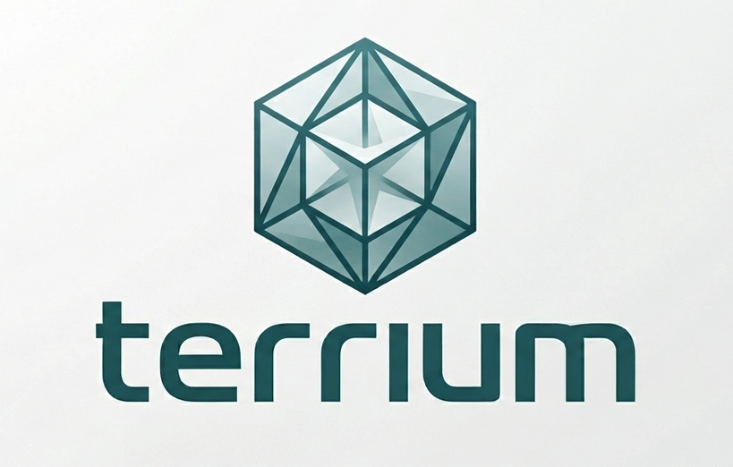
terrium
An AI agent pipeline that runs the science.
Seed Pitch | July 2026 | Smyan Reddy

Slide 2
THE PROBLEM
Teaching labs are stuck between two bad options.
Generic AI chat
Legacy simulation tools
ChatGPT/Claude answer confidently, cite nothing, and hallucinate constants a student has no way to check.
COPASI, NEURON, GROMACS work, but need a install, a syntax manual, and a TA who already knows the software.
The result: students either get answers they can't trust, or tools they can't use.
02

Slide 3
THE SOLUTION
Ask a real question. Get a real, cited simulation.
Terrium resolves scientific parameters from the literature, runs the simulation in the browser, and shows every citation behind every number -- so a student asking “what's a typical Km for hexokinase” gets a real answer, checked, not guessed.
1
2
3
4
Ask
Resolve
Verify
Simulate
Plain-language question, no syntax to learn
→
Literature-backed parameters, not invented ones
→
A second model checks the first before anything ships
→
Runs live in the browser -- no install
03

Slide 4
THE TRUST LAYER
Every answer passes through six checks before a student sees it.
This is the actual product moat: a different model checks the first model's claim before it ships, using a different provider so the same blind spot can't pass itself.
1
Model-Picker
2
Configuration
3
Hallucination-Check
Identifies which of the six domains the question belongs to
Resolves the real parameter from BRENDA / KEGG / PubMed
A different model re-verifies the citation actually supports the claim
4
Critique
5
Correctness-Verification
6
Polish
Checks the source's scope actually matches how it's being used
Range-checks against known plausible bounds for that quantity
Formats the final answer -- forbidden from removing any flag
04

Slide 5
PRODUCT SCOPE
Six domains, one trust layer.
Every domain shares the same agent chain -- new domains are configuration, not new infrastructure.
Enzyme Kinetics
Epidemiology
PCR Amplification
Michaelis-Menten
SIR / SEIR modeling
Exponential growth models
Tier 2
Tier 2
Tier 1
Monte Carlo
Population Genetics
Molecular Dynamics
Statistical simulation
Hardy-Weinberg dynamics
GROMACS setup-assist
Tier 1
Tier 1
Tier 3
05

Slide 6
PROOF, NOT PROMISES
The literature and simulation layers are already built and tested.
382
13/13
1
automated tests passing
deliberate scientific bugs caught by mutation testing
real trust-boundary bug found and fixed pre-launch
What “verified” actually means here
Every simulated number is checked against a closed-form analytic solution or an independent solver (scipy), not against itself. When the literature layer flagged a Km value as implausible but the simulation layer's bound didn't match it, that gap -- a real hole in the trust boundary -- was caught before launch, not after a student hit it.
06

Slide 7
WHY NOW
The pieces this needed didn't all exist two years ago.
Multi-model orchestration is finally cheap
Routing different steps to different providers -- so one model can check another -- is only practical now that inference cost has fallen far enough to run six agents per question.
In-browser scientific computing matured
Pyodide and WebAssembly make it realistic to run real ODE solvers client-side, removing the install/infrastructure burden that killed past classroom sim tools.
AI-in-the-classroom trust is the live debate
Instructors are actively deciding how much to trust AI tools right now -- landing with a citation-checked, teaching-scoped product ahead of that decision matters.
07

Slide 8
MARKET
Undergraduate STEM labs are the wedge, not the ceiling.
TAM ~$2.1B
Global STEM lab & simulation software spend
SAM ~$180M
US/UK computational-lab courses
SOM ~$4-6M
SOM
Reachable via direct pilot outreach
Figures are our estimate from public university enrollment and ed-tech spending data; not third-party sourced.
08

Slide 9
WHY NOT JUST USE...
We are deliberately not competing where the giants already win.
Terrium
Claude Science / general AI research tools
Legacy sim software (COPASI, GROMACS, NEURON)
Audience
Undergrad teaching labs
Biopharma & computational-bio researchers
Trained researchers
Infra
Runs in-browser, no install
Runs on your own lab infrastructure
Local install + config
Trust layer
Built-in, citation-checked by design
Research workbench, not classroom-scoped
None -- correctness is on the user
Learning curve
Plain-language questions
Assumes research fluency
Steep -- syntax + domain expertise
09

Slide 10
BUSINESS MODEL
Per-course pilot pricing, expanding to per-seat institutional licenses.
Pilot
Course License
Institutional
Free
$299 /course /semester
$2,500 /dept /year
First cohort of courses, direct instructor relationships, feedback drives Phase 2 domain priority
Full six-domain access, instructor dashboard, priced against the TA-hours it replaces
Department- or university-wide, admin controls, the target once usage data picks the flagship domain
Illustrative pricing based on comparable TA-hour and campus ed-tech license costs; not finalized.
10

Slide 11
WHERE WE ARE
Product proof is done. Market proof is in motion.
✓
Live GitHub repo
BRENDA/KEGG scraper + simulation engine, CI running, 382 tests passing
→
Academic validation outreach
Outreach underway to domain-expert faculty for pilot validation
✓
Compute & tier architecture
Six-domain execution model (browser-only, hybrid, server-assist) decided and documented
→
First paying pilot
Targeted for Phase 3 of the build, ahead of a December MVP
11

Slide 12
ROADMAP
Gated, not just dated -- MVP complete by December 2026.
Phase 0
Phase 1
Phase 2
Phase 3
Jul - Aug
Aug - Sep
Sep - Nov
Nov - Dec
Foundation & Validation
Prove One Domain
Expand to Six Domains
First Paying Pilot
Close validation loops, decide the compute story
Full trust-layer chain working end-to-end on kinetics
Same pipeline, five more configurations
Real course, real students, hardening for scale
12

Slide 13
TEAM
Domain expertise and execution, in the same room.
SR
S
?
Smyan Reddy
Shanmuka
Backend / Infra
Product & Domain Lead
AI/ML Lead
Role open
Closes validation loops with domain experts; owns product direction and brand
Builds the full agent trust chain -- model routing, hallucination-check, critique
Owns FastAPI, Postgres/Redis, and the in-browser notebook execution environment
13

Slide 14
THE ASK
$2,000 to carry the team through Phase 0-1 while the December MVP comes together.
Compute & APIs
LiteLLM/model inference costs and literature-source API access through Phase 1
Validation outreach
Small incentives/logistics for the first faculty pilot conversations
Runway to the next raise
Extends the build far enough to bring a priced seed round real traction to show
Let's build the greatest scientific computing tool a classroom has ever had.
14

