Slide 1
Interpretable Intercept
How to understand what the intercept means
when the regression represents predictors that don’t make sense at 0.

Slide 2

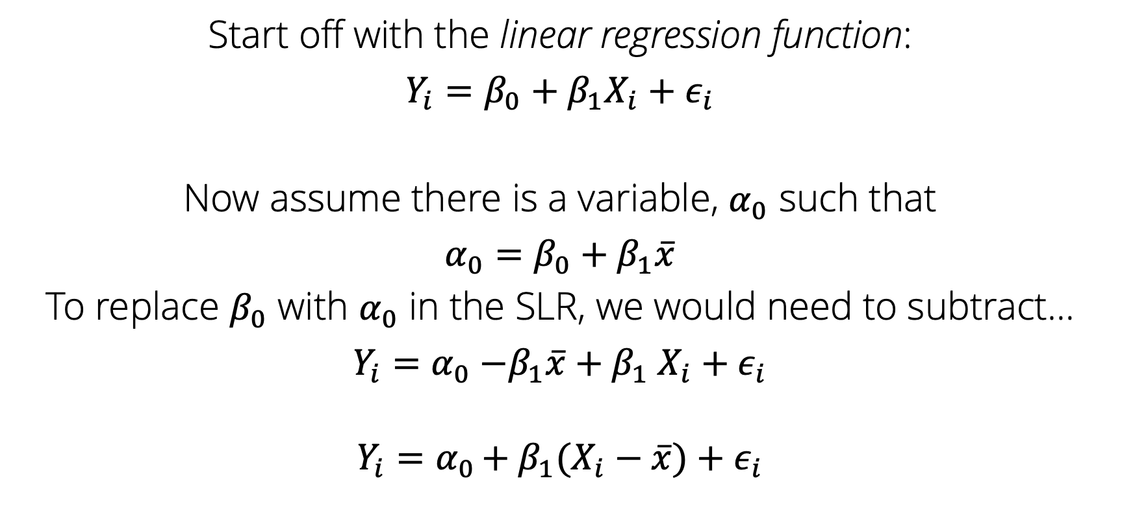
Part 1: Rewrite the SLR to include $α_{0}$
Start off with the linear regression function:
$Y_{i}=β_{0}+β_{1}X_{i}+ε_{i}$
Now assume there is a variable, $α_{0}$ such that
$α_{0}=$ $β_{0}+β_{1}\overline{x}$
To replace $β_{0}$ with $α_{0}$ in the SLR, we would need to subtract…
$Y_{i}=α_{0}{−β_{1}\overline{x}+β}_{1}X_{i}+ε_{i}$
$$Y_{i}=α_{0 }{{+ β}_{1}(X}_{i}−\overline{x})+ε_{i}$$

Slide 3

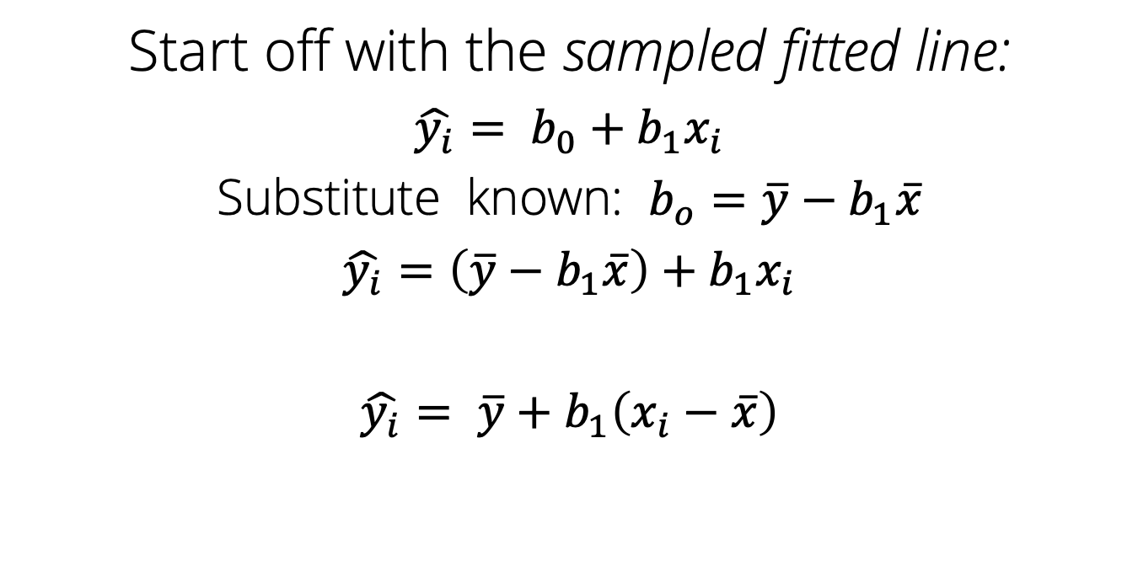
Part 2: Show that sampled fitted line can be rewritten to include $\overline{y}$
Start off with the sampled fitted line:
$\hat{y_{i}}= b_{0}+b_{1}x_{i}$
Substitute known: $b_{o}=\overline{y}−b_{1}\overline{x}$
$\hat{y_{i}}=\left(\overline{y}−b_{1}\overline{x}\right)+b_{1}x_{i}$
$\hat{y_{i}}= \overline{y}+b_{1}\left(x_{i}−\overline{x}\right)$
Notes:
What is the sampled fitted line yhat equal to?

Slide 4
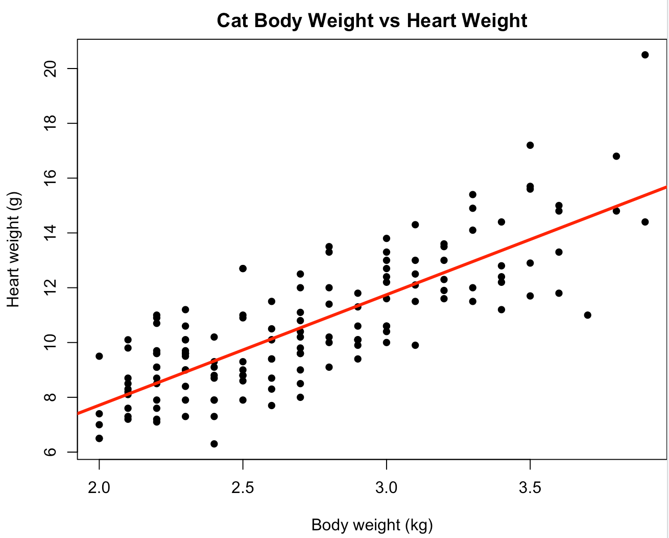
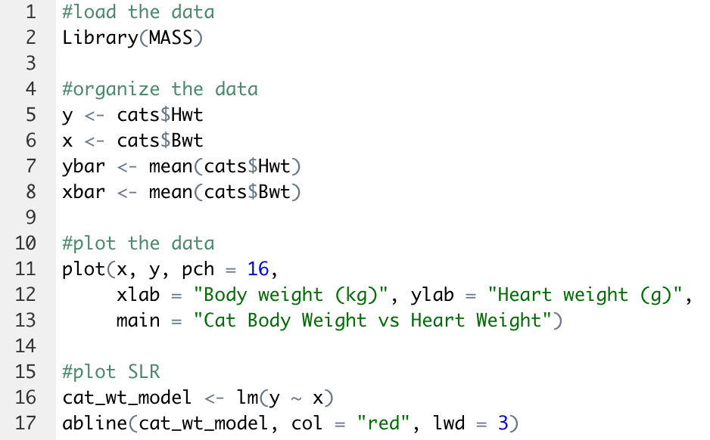
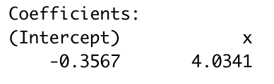
Part 3: Connect part a and b using a data set with non-zero predictor
For every increase in 1 kg in cat body weight,
their heart weighs an extra 4.03g
Notes:
If the x-axis is the body weight of the cat in kg, and the y axis is the cat’s heart weight in g, can anyone define our slope, b₁?

Slide 5
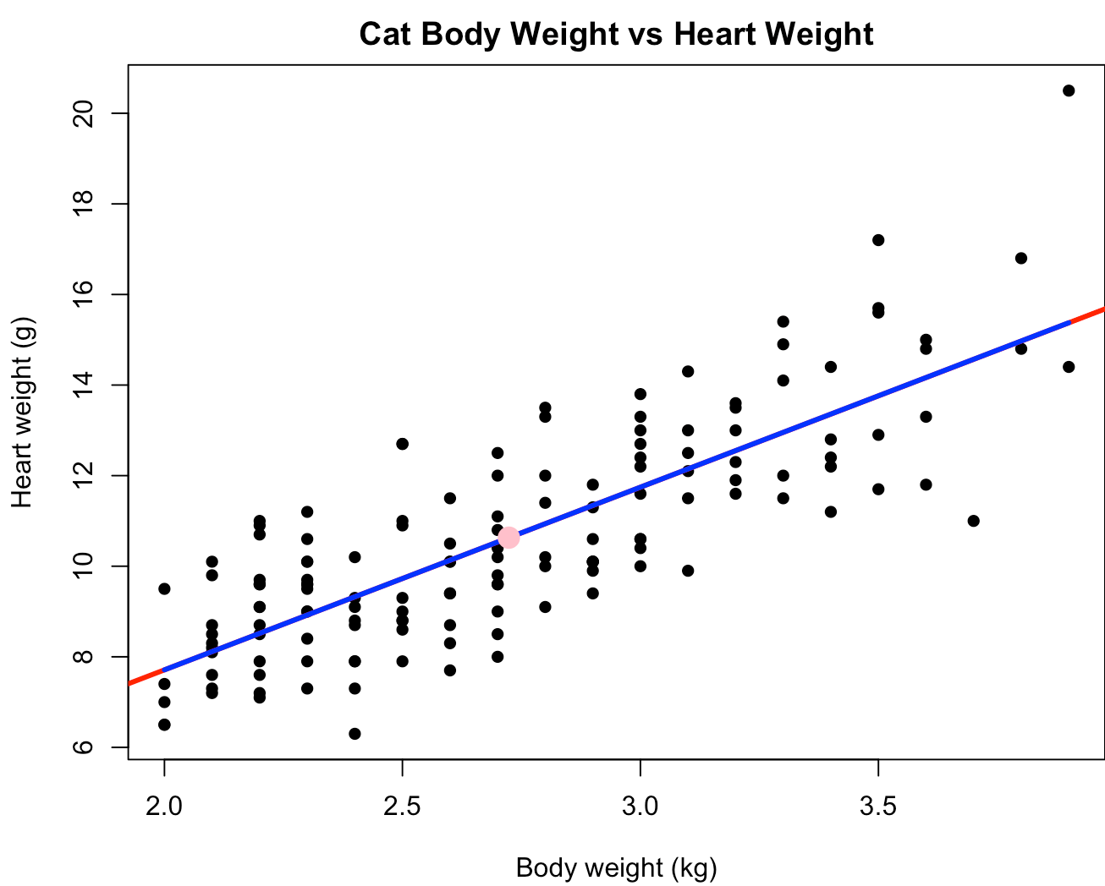
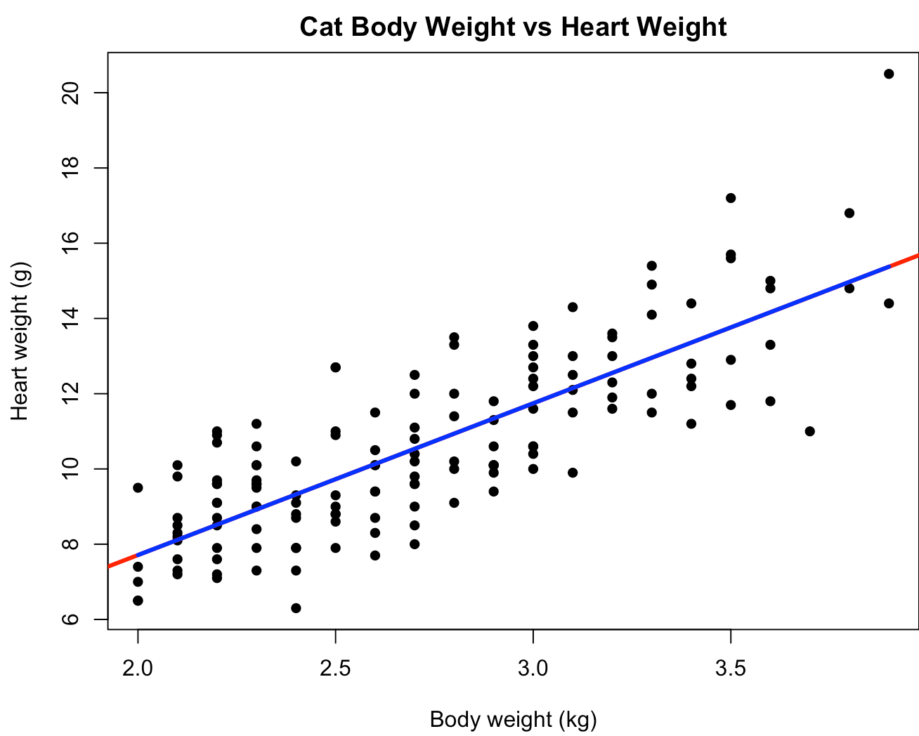
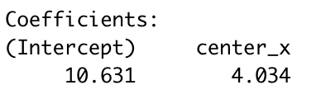
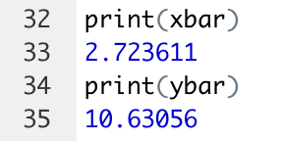
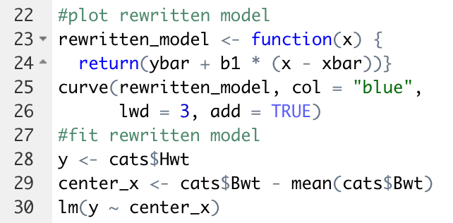
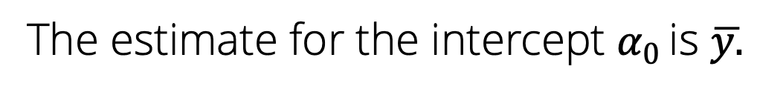

Part 3: Connect part a and b using a data set with non-zero predictor
$\hat{y_{i}}= \overline{y}+b_{1}\left(x_{i}−\overline{x}\right)$
$$Y_{i}=α_{0 }{{+ β}_{1}(X}_{i}−\overline{x})+ε_{i}$$
The estimate for the intercept $α_{0 }$is $\overline{y.}$
The intercept becomes meaningful when the model is rewritten. In this case, the intercept is when that cat has an average heart weight and average body weight.
Notes:
What is the predictor for the alpha_0 y-intercept according to these equations?
When the model is rewritten this way, the intercept becomes meaningful. It is the predicted mean response value when x is at its average value. This equation is about the distance from the average.

Slide 6
Notes:
Logo Slide Marquette Blue: This layout should never be used with additional information or content added. The best use for this is either as the final slide of your presentation or as the first slide that will be on screen before starting.

