Slide 1
No-intercept Model
Rachel Cutlan

Slide 2
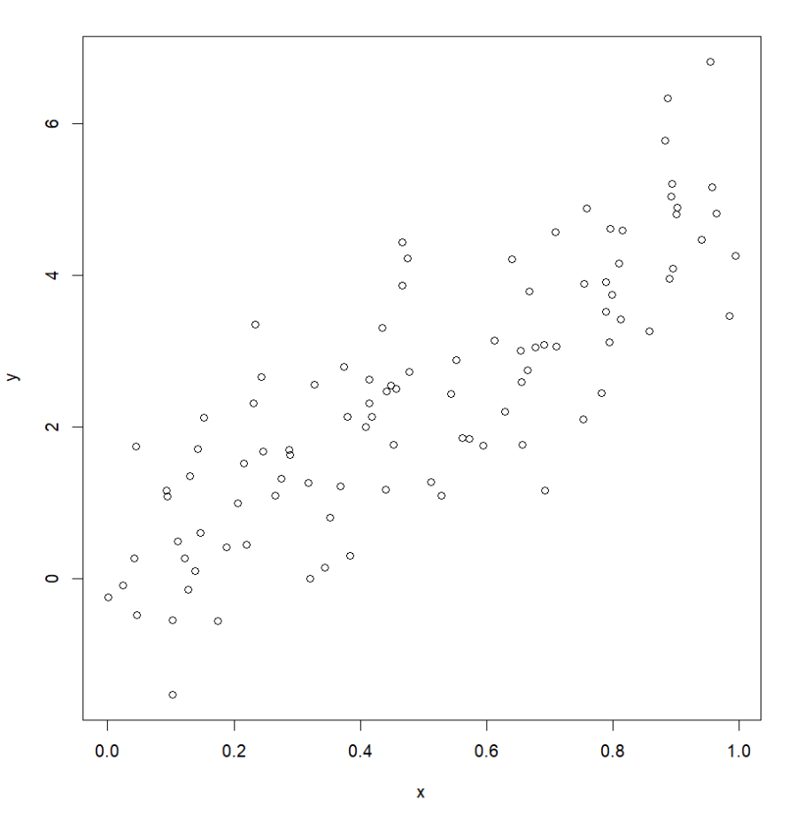
Just looking at this data, what do we think the slope and intercept might be?
Intercept: 0
Slope: 5

Slide 3
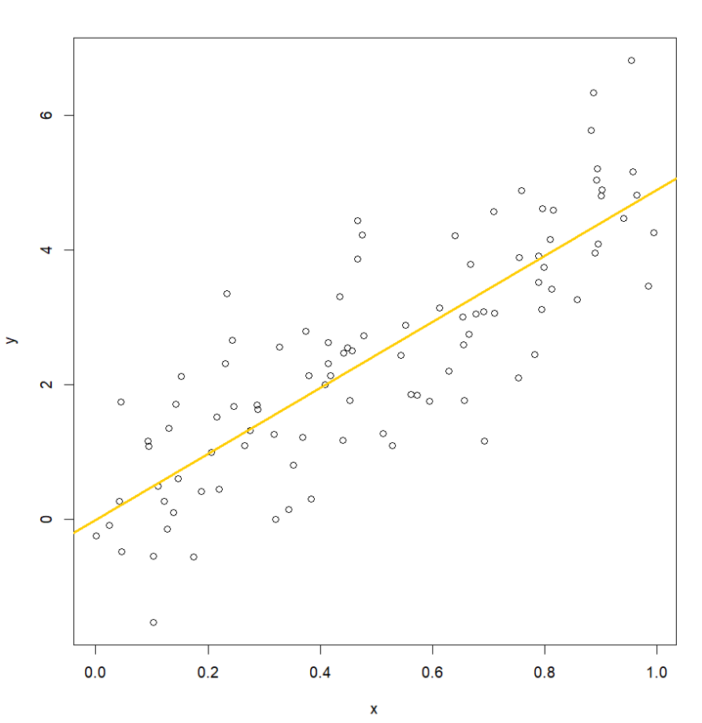
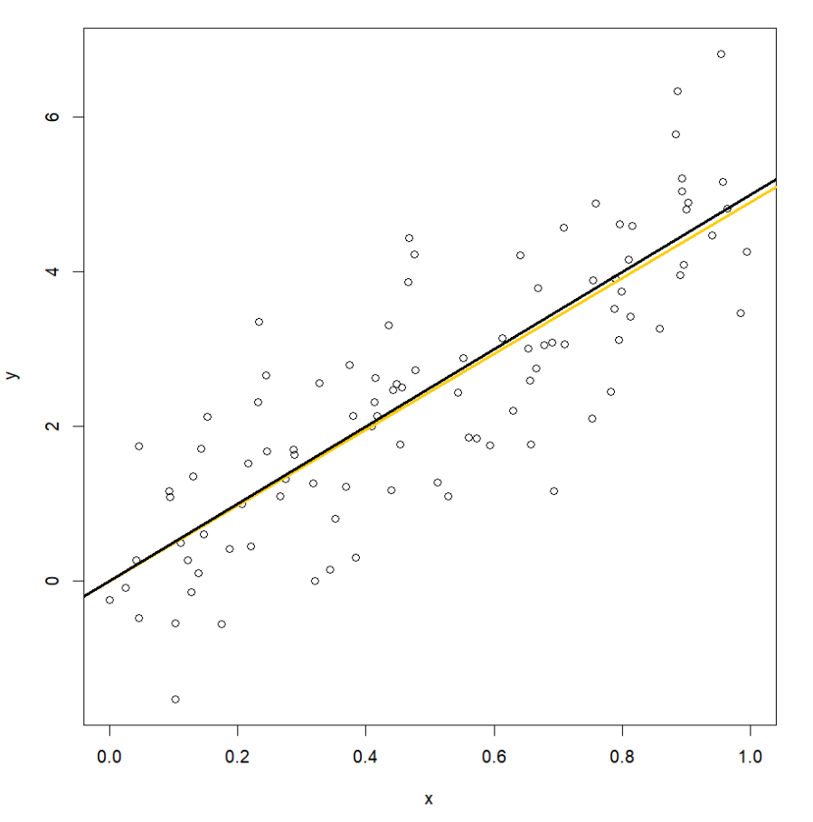

reg_fit <- lm(formula = y ~ x)

Slide 4
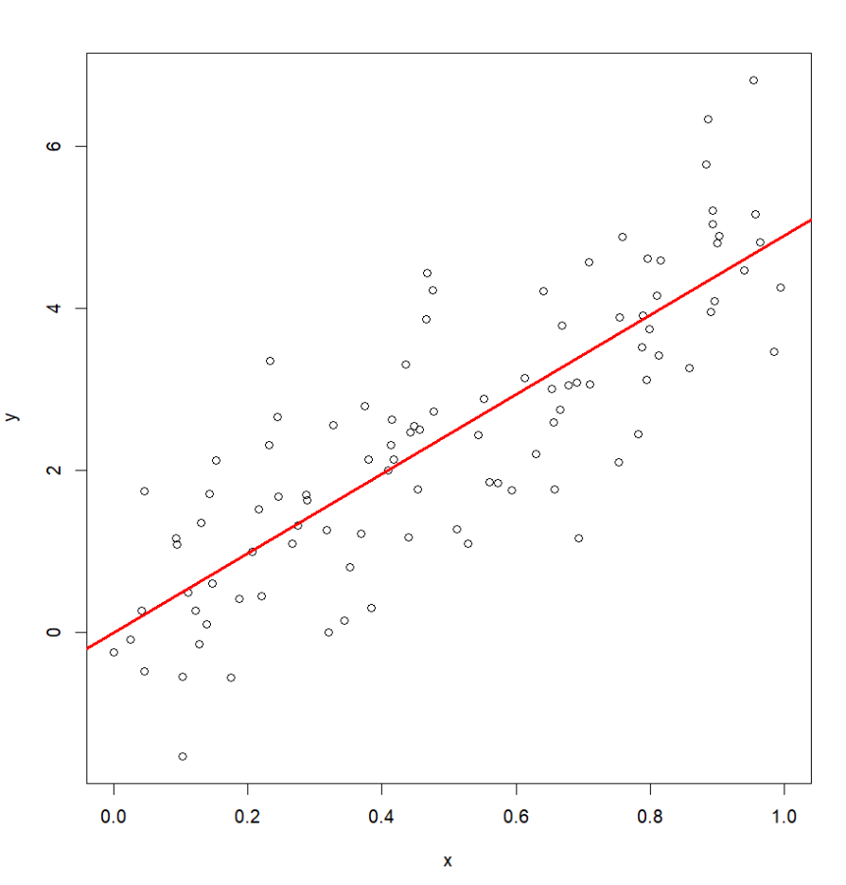

reg_fit2 <- lm(formula = y ~ x + 0)
What if know some information about the dataset to guide our regression?
Can you think of an example of data where we might know the intercept beforehand?
What is this?
Residual
What if we know our intercept should be 0?

Slide 5
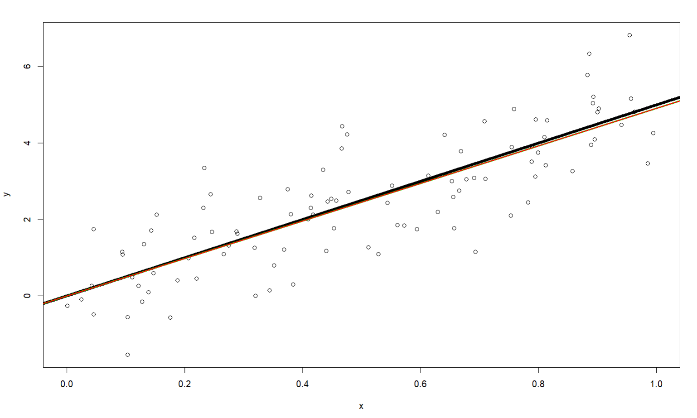
 | Without intercept | With intercept
Confidence Interval | 4.23-5.59 (1.36) | 4.56-5.23 (0.67)
So what? These look basically the same
Black: y = 5x
Green: Lin Reg
Red: Lin Reg with intercept = 0

Slide 6
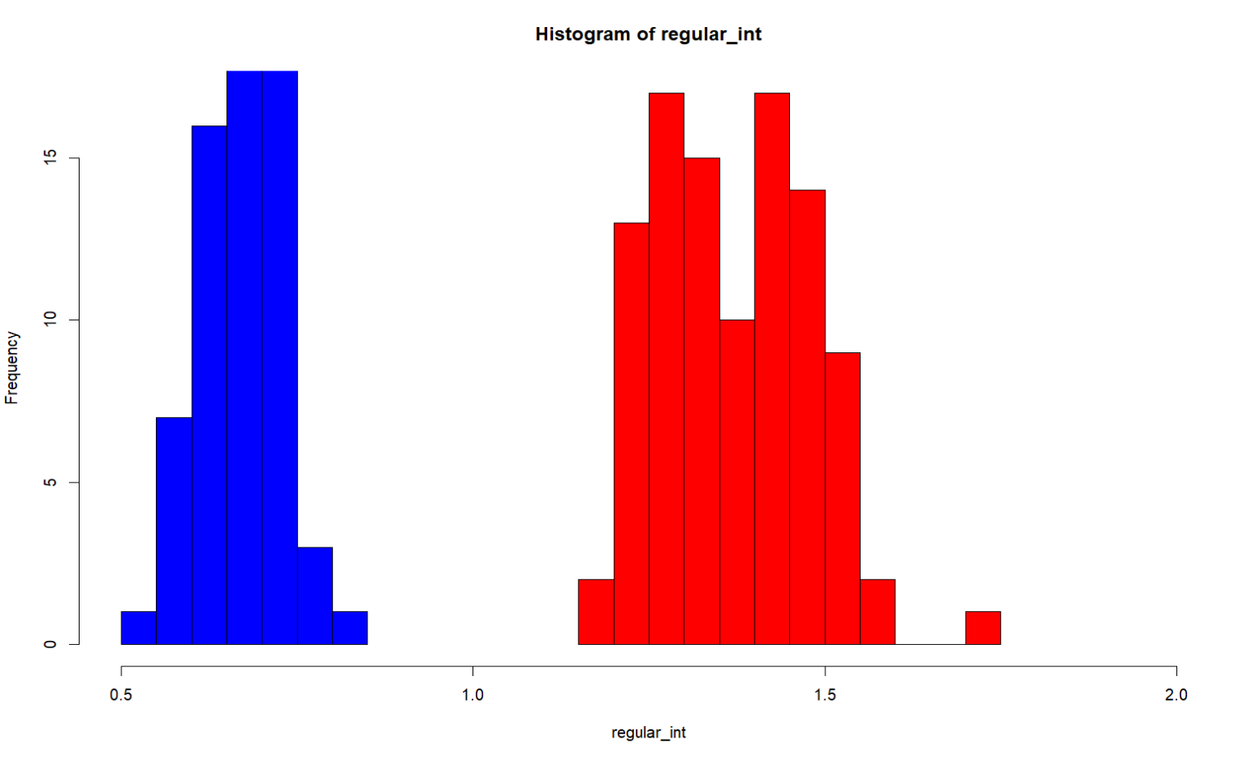
What do the confidence intervals look like for β1?
With intercept defined
Without intercept defined
Almost twice as wide of an interval

