Slide 1
Least Absolute Deviation Regression
Timothy Goodwin: MSSC 5780

Slide 2

What is LAD Regression
Least Absolute Deviation Regression
Minimize the absolute value of the residuals.
LAD Regression is useful when dealing with skewed and outlier-prone datasets.
Q1: Why is the effect of outliers less in LAD compared to Ordinary Least Squares?
MARQUETTE UNIVERSITY | Mathematical and Statistical Sciences

Slide 3
Pros and Cons of LAD
Pros
More robust to outliers
Pass through k + 1 points
k = # of independent variables
Deals with Non-Normal Data
For datasets with skewed or non-normally distributed variables.
Cons
Can have non-unique solution
Harder to find the unique solution
Simplex (Lin. Prog)
Iteratively reweighted least-squares (IRLS)
Can be less efficient
When the data is normally distributed and lacks outliers
Typically, less efficient and a higher variance.
MARQUETTE UNIVERSITY | Mathematical and Statistical Sciences

Slide 4
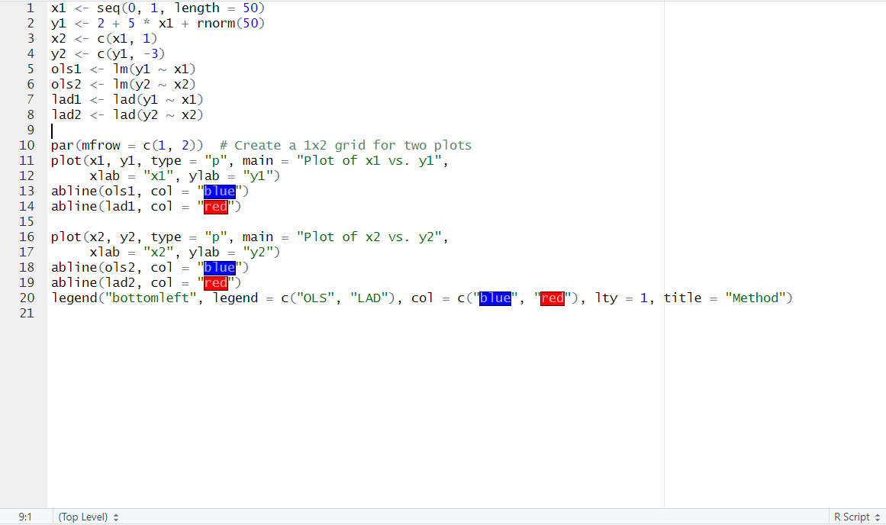
Simulation of LAD and OLS
Q2: Based on the code, what would you expect the values for the coefficients of the intercept and x1 to be?
MARQUETTE UNIVERSITY | Mathematical and Statistical Sciences

Slide 5
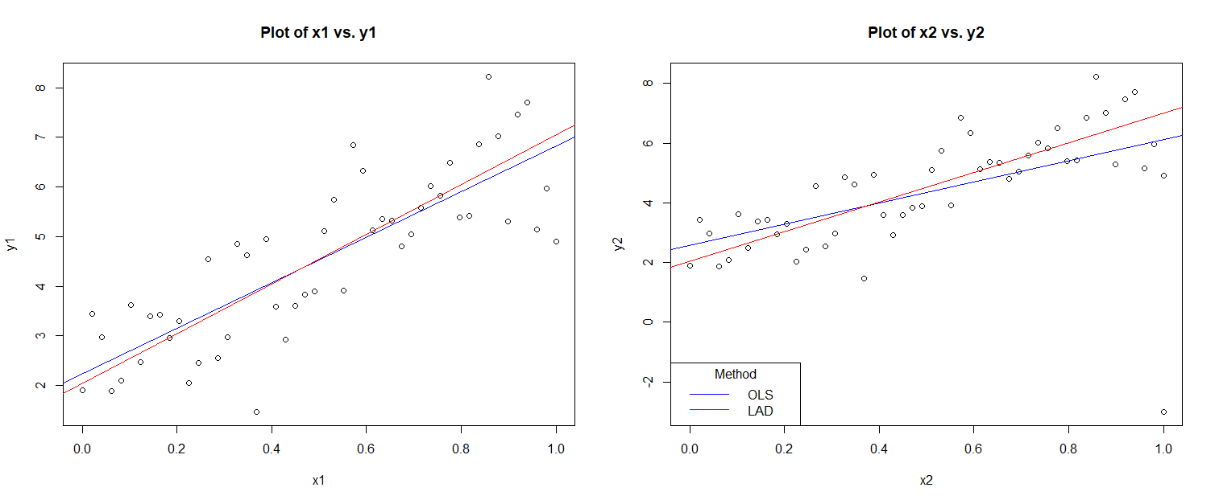

Slide 6
Notes:
Logo Slide Gold Corner: This layout should never be used with additional information or content added. The best use for this is either as the final slide of your presentation or as the first slide that will be on the screen before starting.

