Slide 1
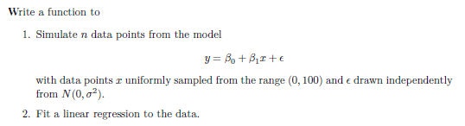
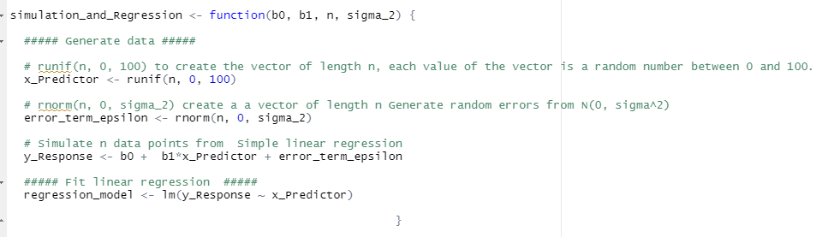
IN-CLASS Activity 1 Programming Simulation by David Aguilera

Slide 2

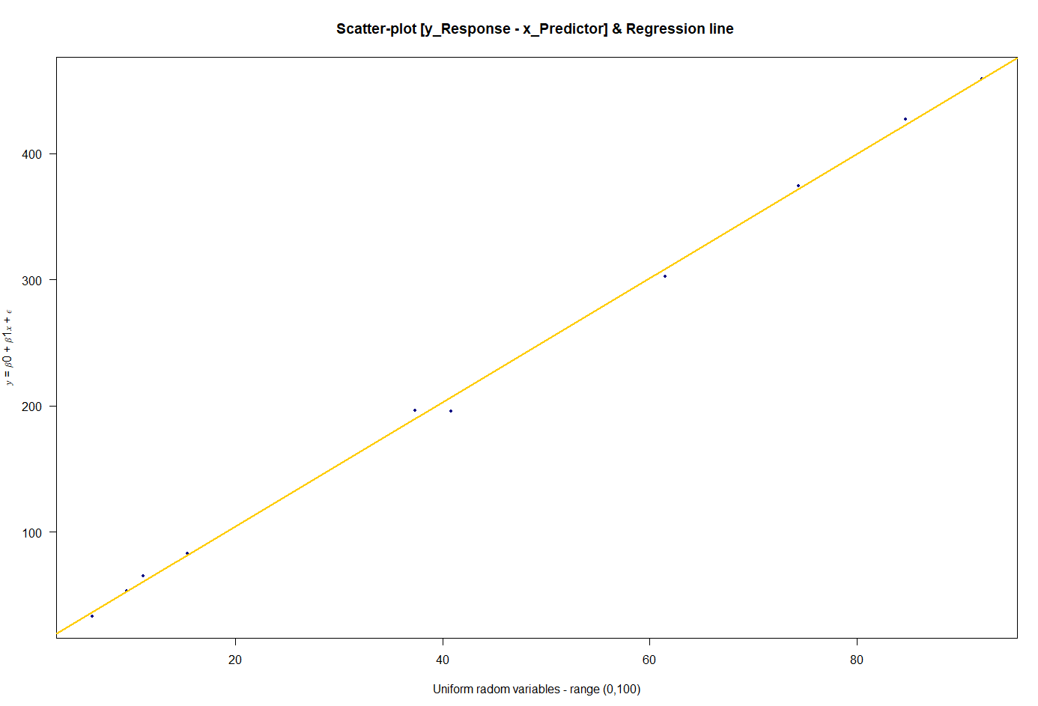
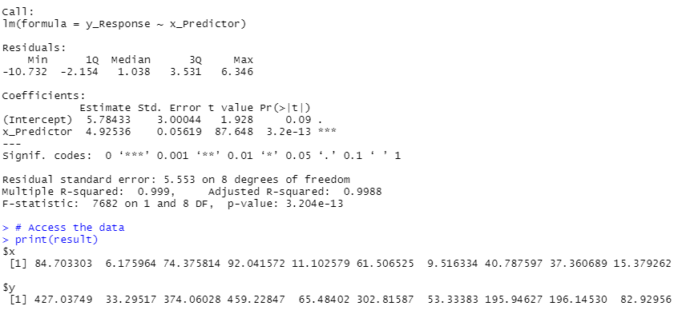

Argument inputs ( b0,b1,n,sigma)

Slide 3



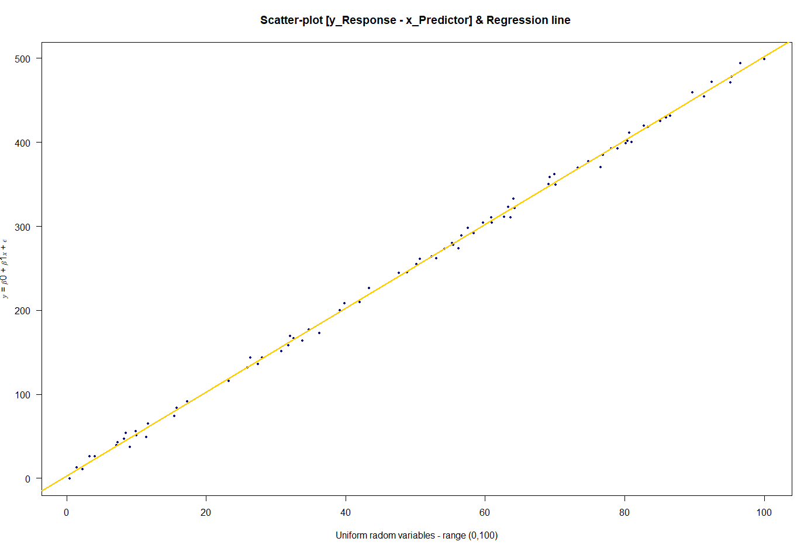
Argument inputs ( b0,b1,n=increase sample size, sigma)

Slide 4



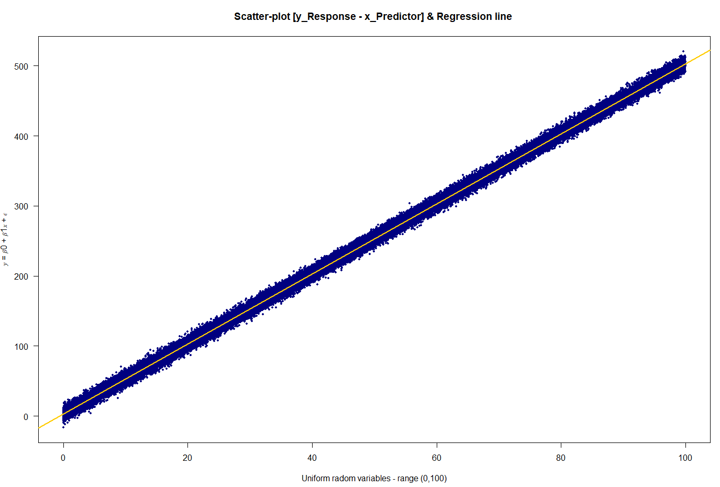
Argument inputs ( b0,b1,n=increase sample size, sigma)

Slide 5
What happens to the parameter estimates when the sample size (n) is increased?

Slide 6

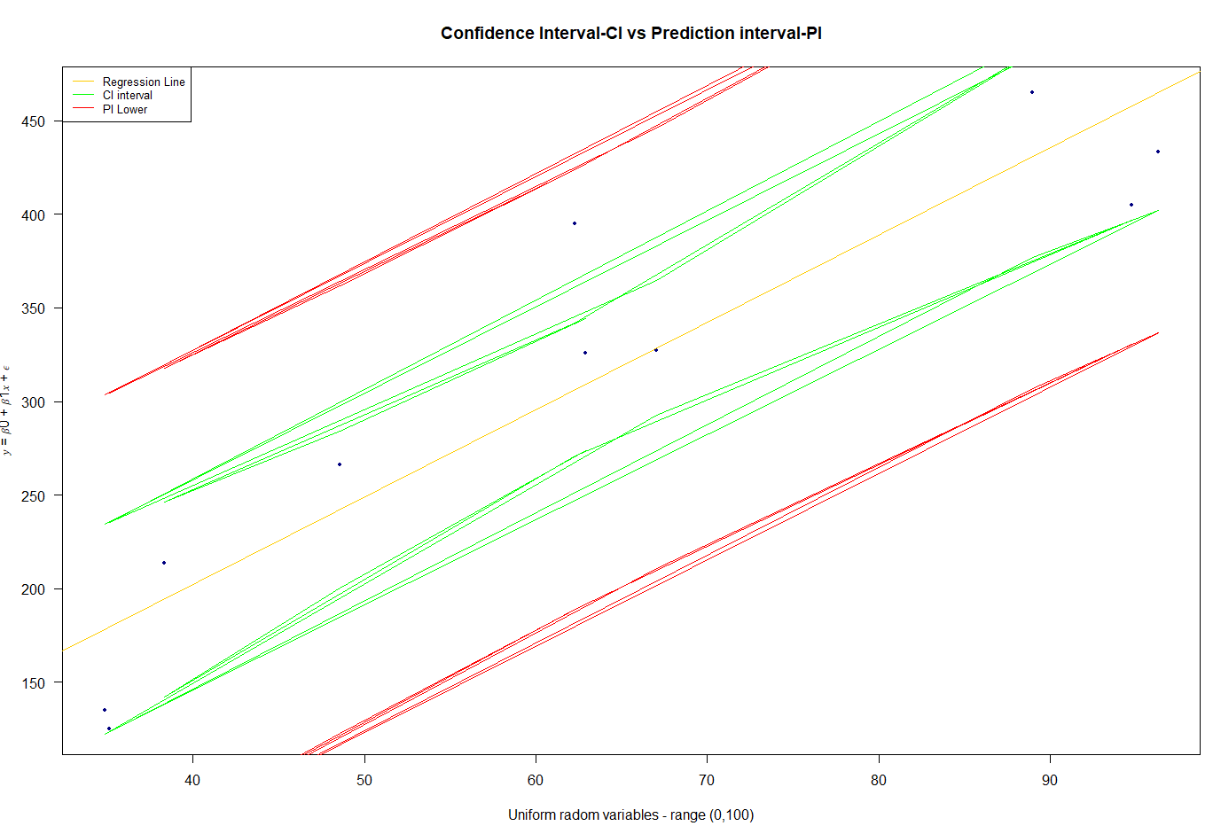

Argument inputs ( b0,b1,n,sigma=increase)
Original Argument inputs
uncertainty, or variability, in the parameters (b0 and b1) and the observed data (y) is inherent because these values can differ from one sample to another sample. As a result, this variability affects results.

Slide 7


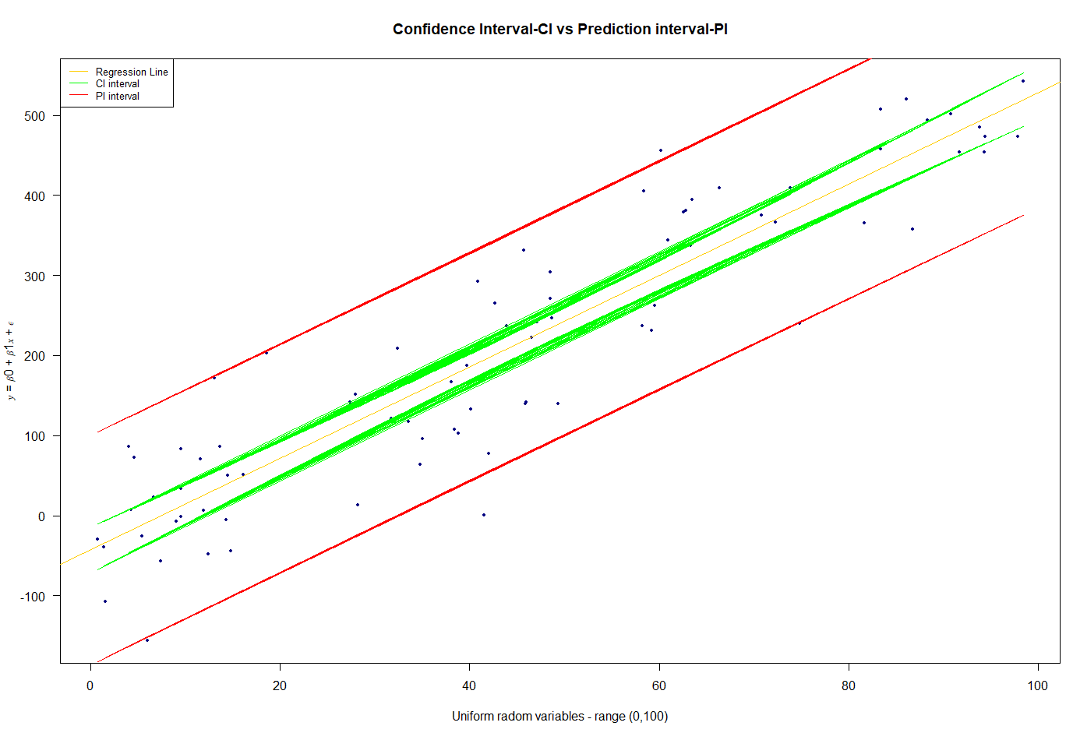
Argument inputs ( b0,b1,n,sigma=increase)
Original Argument inputs

Slide 8

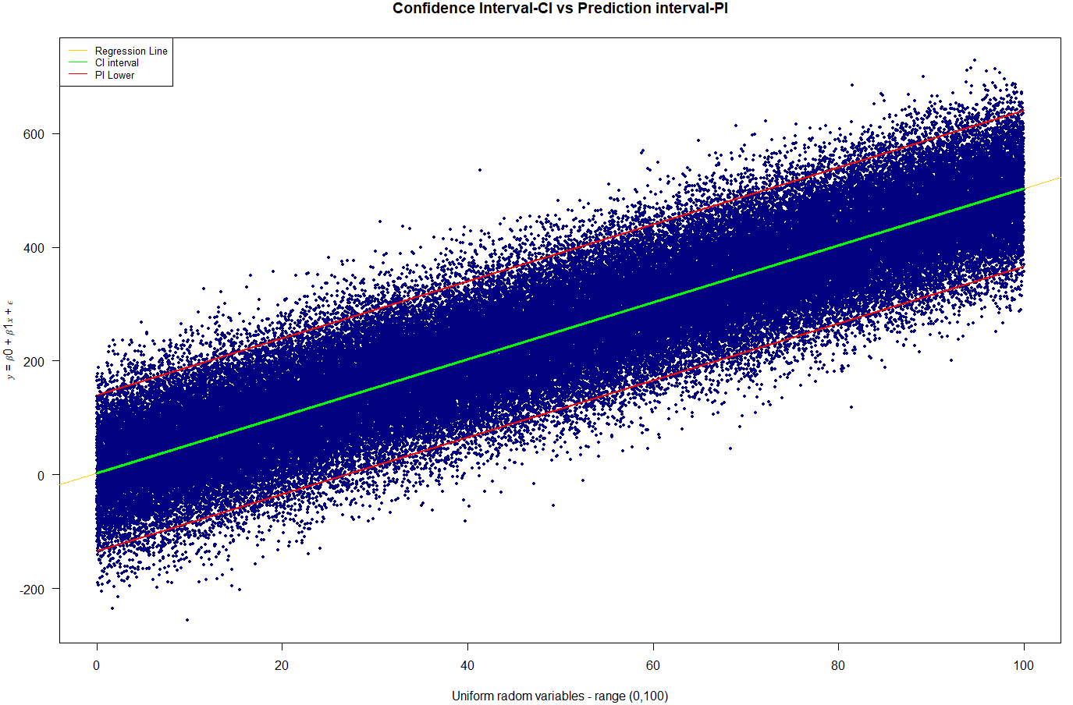
Argument inputs ( b0,b1,n,sigma=increase)
Original Argument inputs

Slide 9
What happens to the uncertainty when the sample size (n) is increased?

Slide 10
Thank you

