Slide 1

Regression to the Mean
MSSC 5780: Activity 5
Adam Reeson

Slide 2
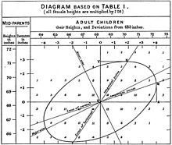
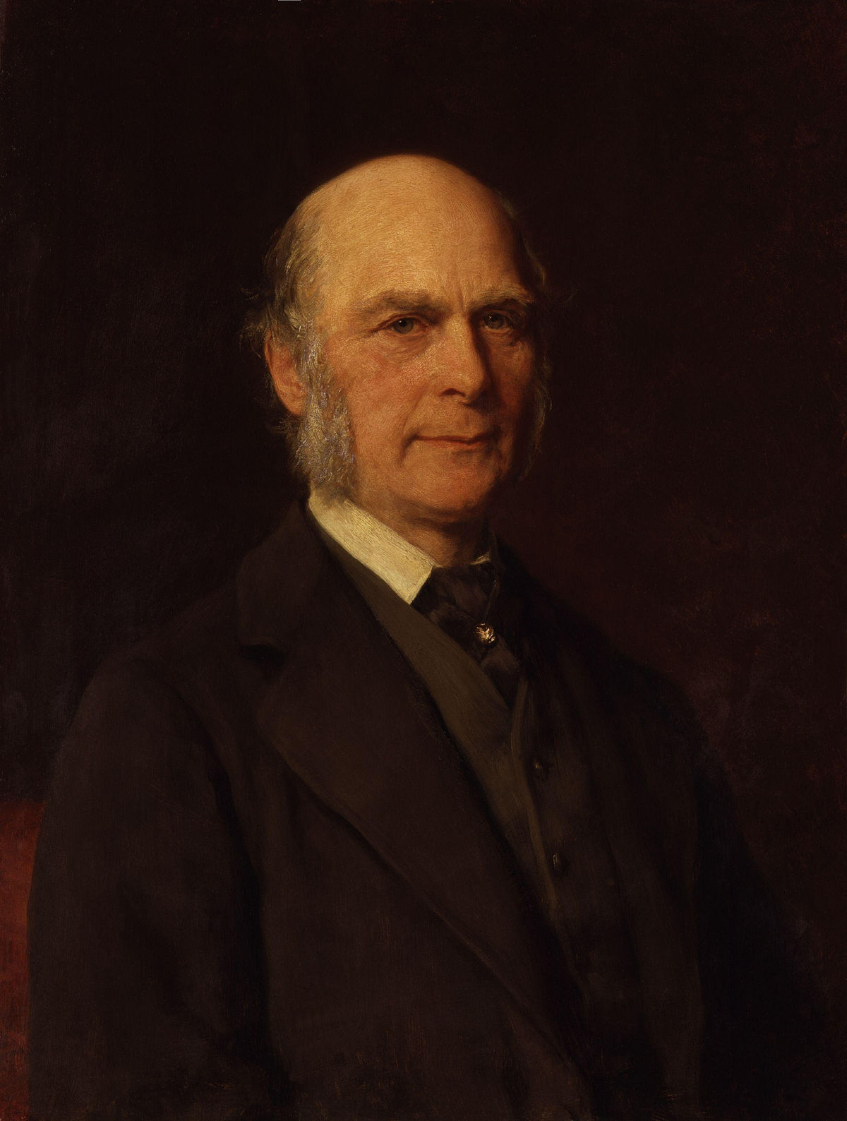
History of Regression
Francis Galton (1822-1911)
British polymath – one of the first quantitative social scientists
Introduced concepts that paved the way for future work in statistics
Interested in the hereditary of human traits (e.g., height)
What Galton observed:
Extreme heights (tall/short) in parents did not necessarily result in extreme heights in children
Children heights tended toward their parent height but were closer to the mean population height
Galton coined the term “regression” to describe this phenomenon

Slide 3
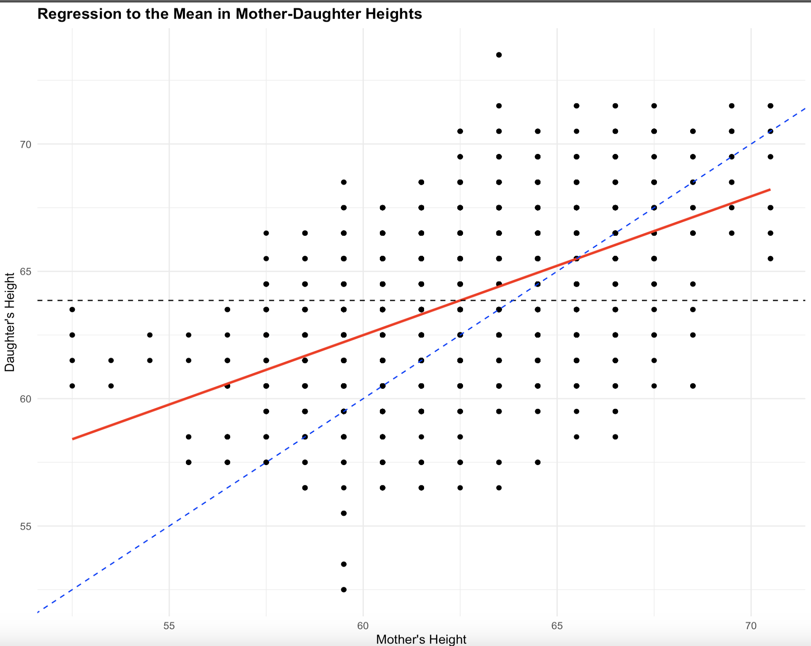
Visualizing this Concept with Data
Regression line is closer to the mean for extreme values of Mother’s Height
Effect is more noticeable for more extreme values
NOT a strict rule but an overall trend
Q: How would an increase in correlation between Mother’s Height & Daughter’s Height impact regression to the mean effect?
A: Decreased regression to the mean effect
– E(y|x)
-- y=x
-- mean

Slide 4

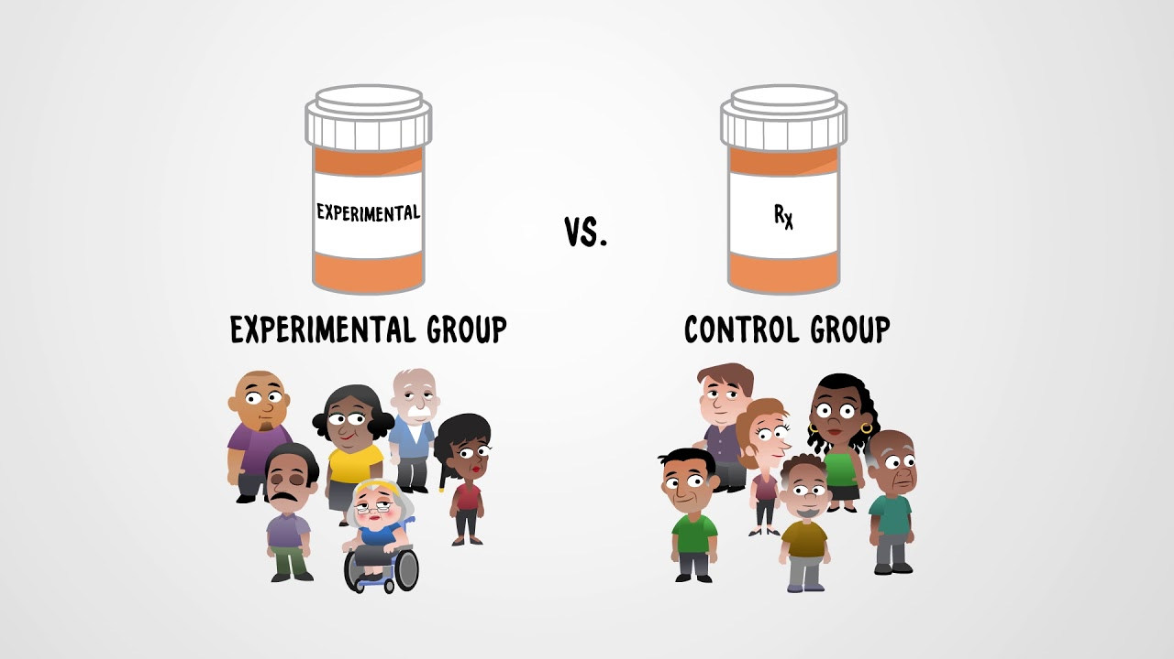
Common Misunderstandings
Regression to the mean is due to natural variation or chance
It can be observed in everyday life, especially in scenarios that focus on the most extreme cases or events
Athletes tend to perform worse after MVP season
Sick patients take a drug and condition likely improves
Establish baseline measurement or control group to minimize false conclusions
Q: If regression to the mean is true, does that mean tall parents will have shorter kids, who will have shorter kids, etc., until everyone is average height? Why or why not?
A: No. RTM is a statistical trend, not a deterministic rule.

Slide 5
Thank you.
Questions?

