Slide 1
BACSE202: Database Systems Lab
Interface the Database with Front Ends using ODBC and JDBC

Slide 2
Oracle SQL*Plus vs JDBC
SQL*Plus
  Used to create tables and database objects.
  Used to insert initial/sample data.
  Used to test SQL statements directly.
  Used to execute COMMIT, ROLLBACK, etc.
JDBC
  Used by Java applications to connect to Oracle.
  Java sends SQL statements to Oracle.
  ResultSet handles retrieved rows.
  PreparedStatement handles parameterized SQL.
  executeUpdate() handles INSERT/UPDATE/DELETE.

Slide 3
Database Application Architecture
Front end: user interface/application that accepts input and displays results.
Database server: stores tables, constraints, views, procedures and data.
Connectivity/API layer: provides the interface between the application and database.
ODBC: language-independent database connectivity API based on drivers.
JDBC: Java API for connecting Java applications to relational databases.
Typical flow: User → Front End → Connectivity API → Driver → Database Server → Result → Front End.

Slide 4
Why Front-End Database Connectivity?
Typical applications
Need for connectivity
Student management systems
Hospital and patient systems
Banking applications
Library management
Inventory and e-commerce systems
Payroll and HR applications
Applications need persistent data stored in a DBMS.
Users should not directly issue database commands.
Front ends can validate input and present user-friendly output.
Applications can perform CRUD operations through controlled SQL.

Slide 5
ODBC – Overview
ODBC stands for Open Database Connectivity.
ODBC provides a standard interface for applications to access different database management systems.
An application uses ODBC calls rather than database-vendor-specific programming interfaces.
The ODBC driver translates ODBC calls into database-specific operations.
ODBC can be used by applications written in different programming languages when an appropriate ODBC driver is available.

Slide 6
ODBC Architecture
Application: front-end program that requests database services.
ODBC Driver Manager: manages ODBC drivers and routes requests.
ODBC Driver: database-specific software that implements the ODBC interface.
Data Source / DSN: identifies connection information such as server, database/service and authentication details.
Database Server: executes SQL and returns results.
Application
↓
ODBC API Calls
↓
ODBC Driver Manager
↓
Database-specific ODBC Driver
↓
Database Server
↓
Result Set / Status / Error
↑
Application

Slide 7
ODBC – Important Terms
Terms
DSN categories
User DSN – available to a particular user.
System DSN – available to users/services on the system.
File DSN – connection information stored in a file.
Exact configuration options depend on the operating system and installed driver.
ODBC API – functions used by an application.
Driver Manager – selects/manages drivers.
ODBC Driver – communicates with a specific DBMS.
DSN – named data source configuration.
Connection – active session between application and DB.

Slide 8
ODBC Connection Workflow
1. Install the DBMS ODBC driver.
2. Create/configure the DSN or connection configuration.
3. Start the front-end application.
4. Allocate an ODBC environment/connection handle as required by the API.
5. Connect to the data source.
6. Prepare/execute SQL.
7. Fetch result rows for SELECT operations.
8. Commit/rollback DML when transaction control is required.
9. Close statements/result sets and disconnect.
10. Release ODBC resources.

Slide 9
ODBC – Generic Retrieval Logic
Connect to DSN
↓
Execute: SELECT ...
↓
Check execution status
↓
Fetch first row
↓
WHILE rows are available
Read column values
Display/process row
Fetch next row
END WHILE
↓
Close statement
Disconnect

Slide 10
ODBC – Generic DML Logic
INSERT: send a parameterized INSERT statement and supply input values.
UPDATE: identify rows using a WHERE condition and inspect affected-row count where supported.
DELETE: use a precise WHERE condition and verify the intended rows are affected.
Transactions: group related DML operations and COMMIT when correct; ROLLBACK when changes must be undone.
Use parameter binding instead of concatenating untrusted input into SQL.

Slide 11
ODBC – Pseudocode Example
connection = connect("MY_DSN", user, password)
statement = prepare(connection, "SELECT SID, SNAME, CGPA FROM STUDENT")
execute(statement)
while fetch(statement):
print(SID, SNAME, CGPA)
close(statement)
disconnect(connection)

Slide 12
ODBC – DML Pseudocode
connection = connect("MY_DSN", user, password)
stmt = prepare(connection, "UPDATE STUDENT SET CGPA = ? WHERE SID = ?")
bind(stmt, 1, new_cgpa)
bind(stmt, 2, student_id)
execute(stmt)
commit(connection)
close(stmt)
disconnect(connection)

Slide 13
ODBC – Advantages and Limitations
Advantages
Limitations / considerations
Standardized database connectivity interface.
Applications can work with multiple DBMS products through appropriate drivers.
Useful for native applications and languages with ODBC support.
Centralized driver/data-source configuration can simplify deployment.
Requires an appropriate ODBC driver.
DSN/driver configuration can be platform and environment dependent.
Driver versions and DBMS features may affect portability.
Connection/resource management must be handled carefully.

Slide 14
JDBC – Overview
JDBC stands for Java Database Connectivity.
JDBC is the standard Java API for accessing relational and tabular data sources.
Java applications use JDBC interfaces/classes to establish connections, execute SQL and process results.
A JDBC driver implements the communication between JDBC and a particular database.
JDBC supports retrieval, DML, transaction control and metadata operations.

Slide 15
JDBC Architecture
Java Front-End Application
↓
JDBC API
↓
JDBC DriverManager
↓
JDBC Driver
↓
Database Server
↓
ResultSet / Update Count / SQLException
↑
Java Application

Slide 16
JDBC Driver Types
Type 1 – JDBC-ODBC Bridge: historical architecture; obsolete in modern Java and removed from the JDK in Java 8.
Type 2 – Native-API driver: partly Java and partly native database-specific code.
Type 3 – Network protocol / middleware driver: communicates through a middleware server.
Type 4 – Thin / pure Java driver: communicates directly with the database protocol and is commonly used in modern applications.
For an Oracle database, the Oracle JDBC Thin driver is a common Type 4 approach.

Slide 17
JDBC Core Interfaces / Classes
Core objects
DriverManager – obtains database connections.
Connection – represents an active database session.
Statement – executes static SQL.
PreparedStatement – executes parameterized/precompiled SQL.
CallableStatement – invokes stored procedures/functions.
Result / metadata
ResultSet – cursor-like result of a SELECT query.
ResultSetMetaData – information about result columns.
DatabaseMetaData – information about the database and driver.
SQLException – database/JDBC error information.

Slide 18
JDBC Programming Steps
1. Add/import JDBC classes.
2. Ensure the correct JDBC driver is available to the application.
3. Obtain a Connection.
4. Create Statement or PreparedStatement.
5. Execute SQL.
6. For SELECT, process ResultSet using next().
7. For INSERT/UPDATE/DELETE, inspect executeUpdate() result.
8. Commit or rollback the transaction when required.
9. Close ResultSet, Statement and Connection resources.

Slide 19
JDBC – Connection Example
import java.sql.*;
public class DBConnect {
public static void main(String[] args) {
String url = "jdbc:oracle:thin:@localhost:1521/XEPDB1";
String user = "system";
String password = "password";
try (Connection con =
DriverManager.getConnection(url, user, password)) {
System.out.println("Database connected");
} catch (SQLException e) {
e.printStackTrace();
}
}
}

Slide 20
JDBC – Retrieval using Statement
String sql = "SELECT SID, SNAME, DEPT, CGPA FROM STUDENT";
try (Statement st = con.createStatement();
ResultSet rs = st.executeQuery(sql)) {
while (rs.next()) {
int sid = rs.getInt("SID");
String name = rs.getString("SNAME");
String dept = rs.getString("DEPT");
double cgpa = rs.getDouble("CGPA");
System.out.println(
sid + " " + name + " " + dept + " " + cgpa);
}
}

Slide 21
ResultSet – Important Methods
next() moves the cursor to the next row; returns false when no row remains.
getInt(), getString(), getDouble(), getDate() retrieve typed column values.
Columns can be accessed by column label or column index.
wasNull() can be checked after retrieving a nullable column.
ResultSet represents the rows returned by the SELECT statement and should be closed when no longer required.

Slide 22
JDBC – INSERT with PreparedStatement
String sql = "INSERT INTO STUDENT(SID,SNAME,DEPT,CGPA) " + "VALUES(?,?,?,?)";
try (PreparedStatement ps = con.prepareStatement(sql)) {
ps.setInt(1, 101);
ps.setString(2, "Anitha");
ps.setString(3, "CSE");
ps.setDouble(4, 8.75);
int rows = ps.executeUpdate();
System.out.println("Rows inserted = " + rows);
}

Slide 23
JDBC – UPDATE Operation
String sql = "UPDATE STUDENT SET CGPA=? WHERE SID=?";
try (PreparedStatement ps = con.prepareStatement(sql)) {
ps.setDouble(1, 9.10);
ps.setInt(2, 101);
int rows = ps.executeUpdate();
System.out.println("Rows updated = " + rows);
}

Slide 24
JDBC – DELETE Operation
String sql = "DELETE FROM STUDENT WHERE SID=?";
try (PreparedStatement ps = con.prepareStatement(sql)) {
ps.setInt(1, 101);
int rows = ps.executeUpdate();
System.out.println("Rows deleted = " + rows);
}

Slide 25
PreparedStatement – Why Use It?
Uses placeholders (?) for input values.
Separates SQL structure from supplied values.
Reduces the risk of SQL injection compared with string-concatenated SQL.
Convenient for repeated execution with different parameter values.
Supports type-specific setters such as setInt(), setString(), setDouble() and setDate().
Use executeQuery() for statements that return a ResultSet, such as SELECT.
Use executeUpdate() for INSERT, UPDATE and DELETE and inspect the returned affected-row count.

Slide 26
JDBC Transactions
con.setAutoCommit(false);
try {
// DML operation 1
// DML operation 2
con.commit();
} catch (SQLException e) {
con.rollback();
throw e;
}
Auto-commit mode commits each statement automatically when enabled.
Disable auto-commit when several DML statements must succeed or fail as one logical unit.
COMMIT makes the transaction permanent; ROLLBACK undoes uncommitted changes.

Slide 27
JDBC Exception Handling
try {
// JDBC operations
} catch (SQLException e) {
System.out.println("Message: " + e.getMessage());
System.out.println("SQLState: " + e.getSQLState());
System.out.println("ErrorCode: " + e.getErrorCode());
}
Typical causes: invalid SQL, connection failure, authentication failure, constraint violation or datatype mismatch.
Record the SQLState/error code during laboratory debugging.

Slide 28
Resource Management – try-with-resources
JDBC resources should be closed after use.
try-with-resources automatically closes AutoCloseable JDBC objects.
Typical hierarchy: Connection → PreparedStatement/Statement → ResultSet.
This reduces resource leaks and makes application code safer and cleaner.
try (Connection con = DriverManager.getConnection(url,user,pwd);
PreparedStatement ps = con.prepareStatement(sql);
ResultSet rs = ps.executeQuery()) {
while (rs.next()) {
System.out.println(rs.getString("SNAME"));
}
}A

Slide 29
ODBC vs JDBC
JDBC
ODBC
Java Database Connectivity.
Java-specific standard API.
Uses JDBC interfaces and a JDBC driver.
Type 4 drivers are common in modern Java applications.
PreparedStatement, ResultSet and transaction APIs are integrated with Java.
Open Database Connectivity.
Language/API independent connectivity model.
Uses ODBC Driver Manager and ODBC drivers.
DSN-based configuration is common.
Useful for applications/languages supporting ODBC.

Slide 30
Retrieval + DML – End-to-End Scenario
Scenario: A university front end maintains STUDENT records.
Screen 1: Display all students – SELECT + ResultSet.
Screen 2: Search by department – parameterized SELECT.
Screen 3: Add student – INSERT + PreparedStatement.
Screen 4: Edit CGPA – UPDATE + PreparedStatement + affected-row count.
Screen 5: Delete student – DELETE + confirmation + transaction control.
Screen 6: Display operation status and database errors to the user.
The same business operations can be implemented using ODBC or JDBC depending on the front-end technology.

Slide 31
Suggested STUDENT Table
CREATE TABLE STUDENT (
SID NUMBER(5) PRIMARY KEY,
SNAME VARCHAR2(30) NOT NULL,
DEPT VARCHAR2(10),
CGPA NUMBER(3,2),
EMAIL VARCHAR2(50),
DOB DATE
);
INSERT INTO STUDENT
VALUES (101,'Anitha','CSE',8.75,'anitha@mail.com',
DATE '2005-06-12');
INSERT INTO STUDENT
VALUES (102,'Bharath','ECE',7.90,'bharath@mail.com',
DATE '2004-11-08');
COMMIT;

Slide 32
Step by step Procedure
Recommended Workflow
SQL*Plus: create/verify the database objects and initial data.
Configure the Oracle JDBC driver in the Java project.
Connect the Java front end to Oracle.
Perform SELECT using ResultSet.
Perform INSERT, UPDATE and DELETE using PreparedStatement.
Demonstrate COMMIT and ROLLBACK.
Configure an ODBC DSN if required.
Verify the final state from SQL*Plus.

Slide 33
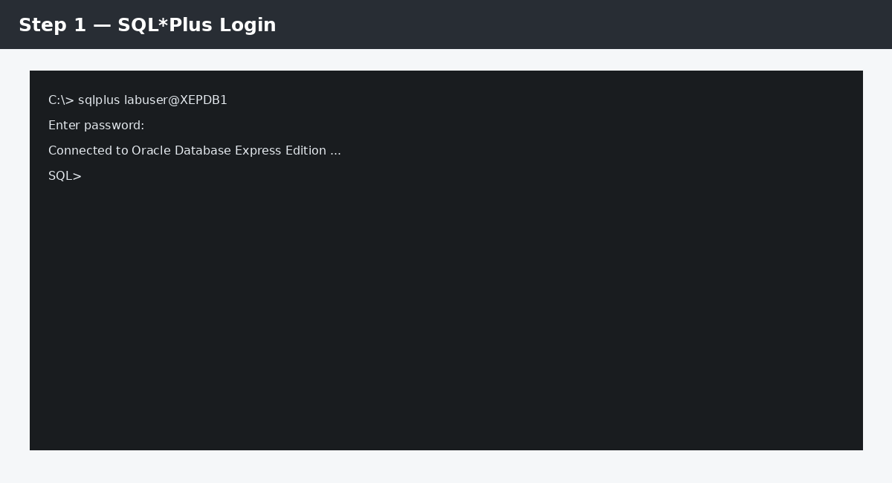
Step 1 — SQL*Plus Login
Connect using the database account supplied for your laboratory. The service name is environment-dependent.

Slide 34
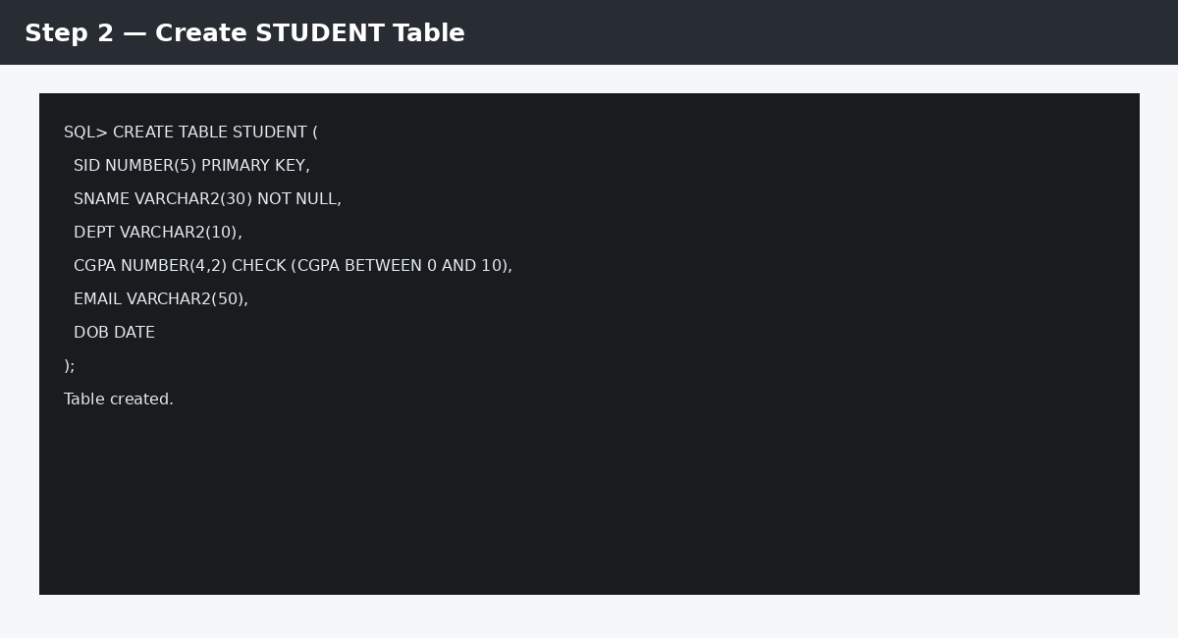
Step 2 — Create STUDENT Table
Create the STUDENT table before front-end operations.

Slide 35
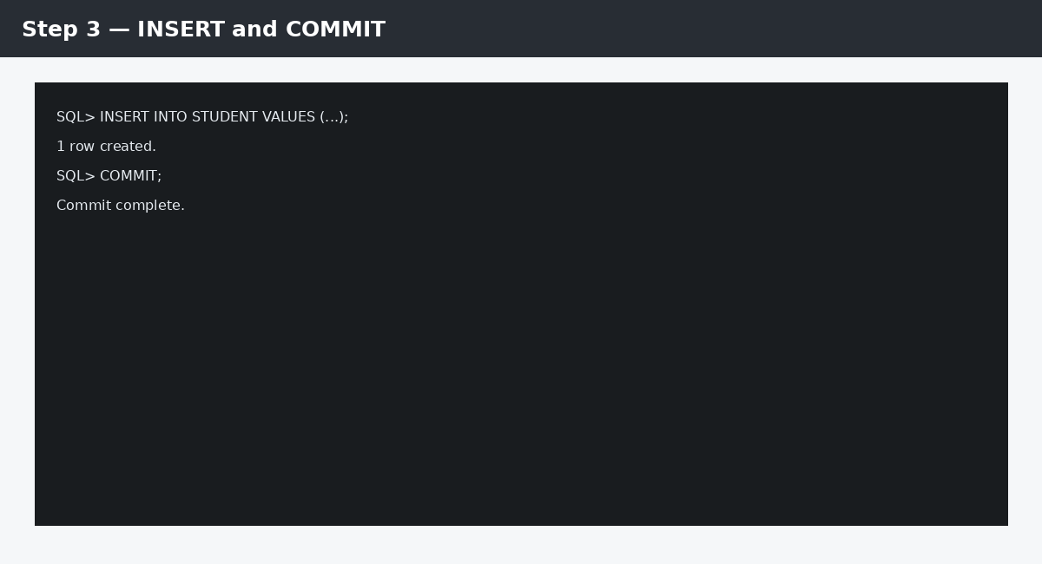
Step 3 — INSERT and COMMIT
Insert the initial sample records and commit them.

Slide 36
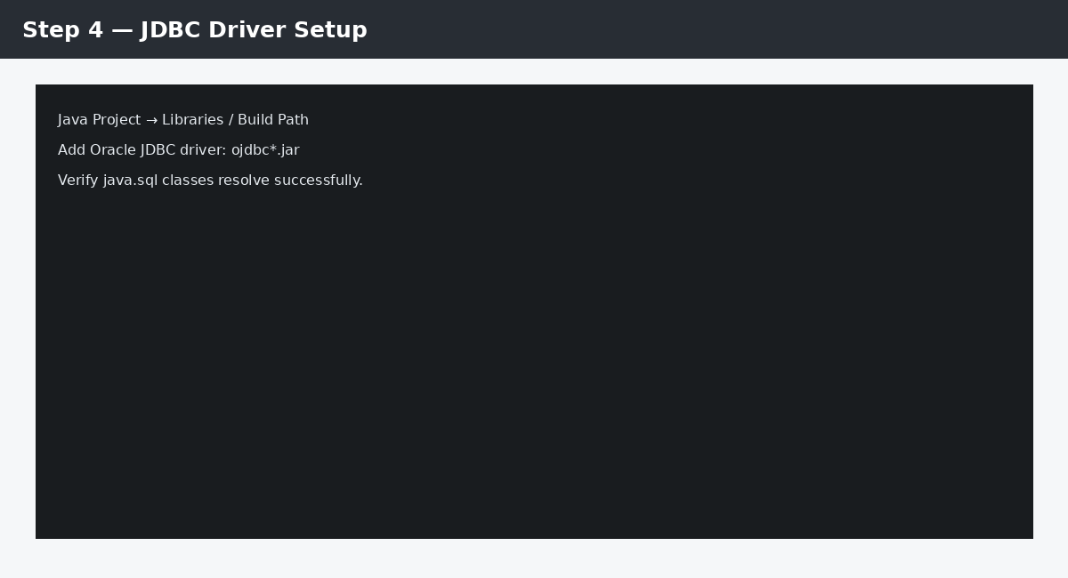
Step 4 — JDBC Driver Setup
Add the Oracle JDBC driver (ojdbc*.jar or your lab-specified dependency).

Slide 37
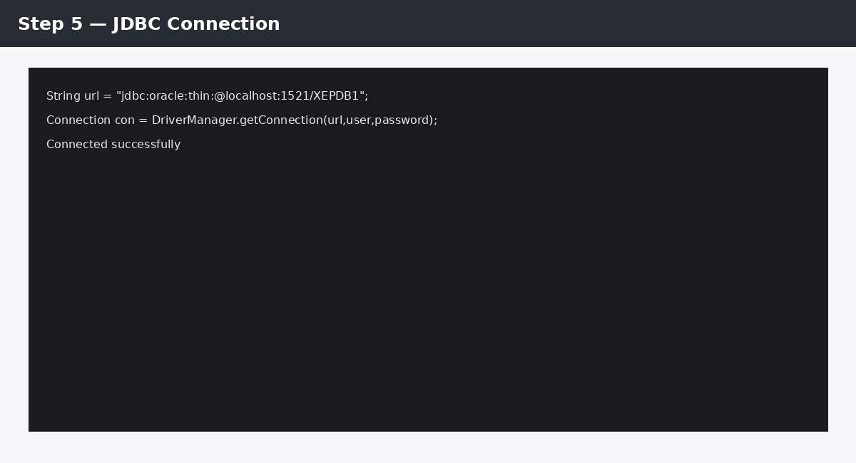
Step 5 — JDBC Connection
Use the JDBC URL appropriate to your Oracle installation. XEPDB1 is an example.

Slide 38
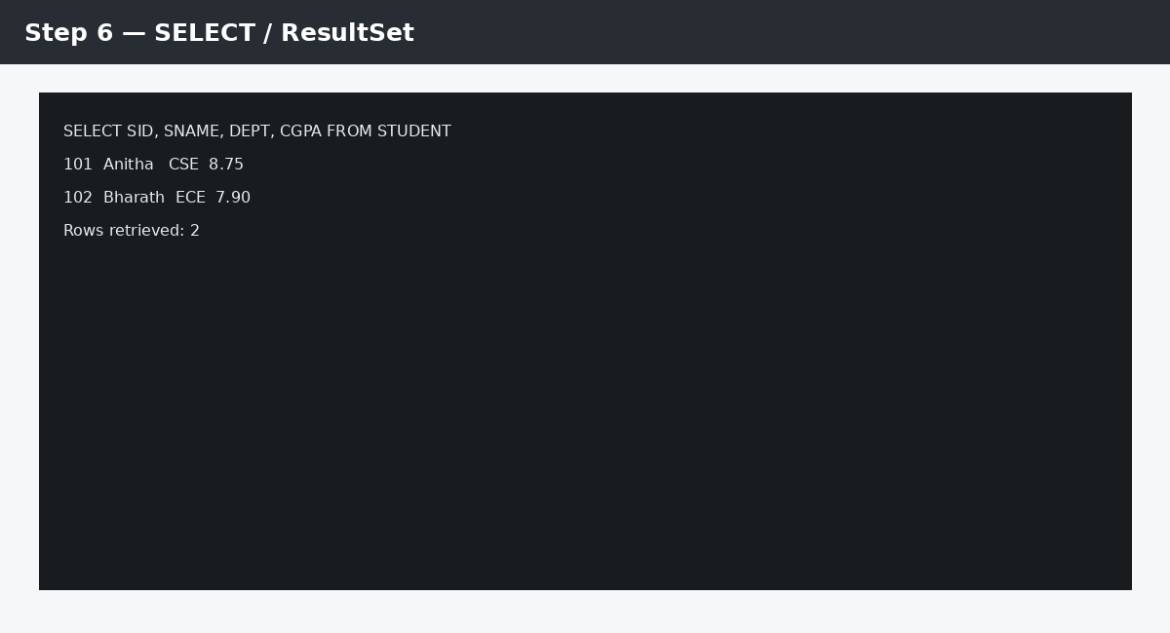
Step 6 — SELECT / ResultSet
Execute SELECT and iterate through ResultSet.

Slide 39
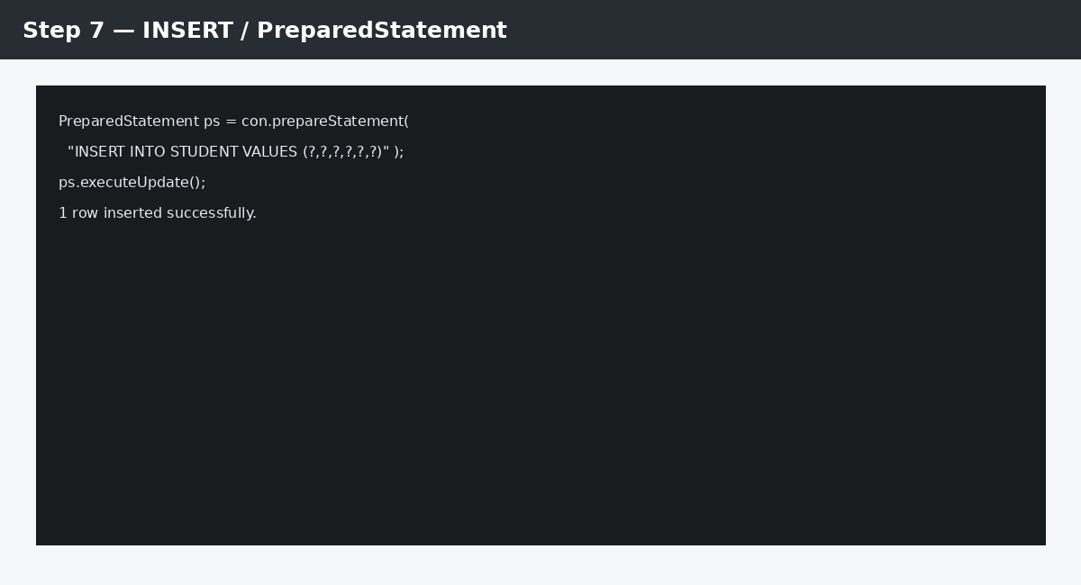
Step 7 — INSERT / PreparedStatement
Use PreparedStatement for values supplied by the front end.

Slide 40
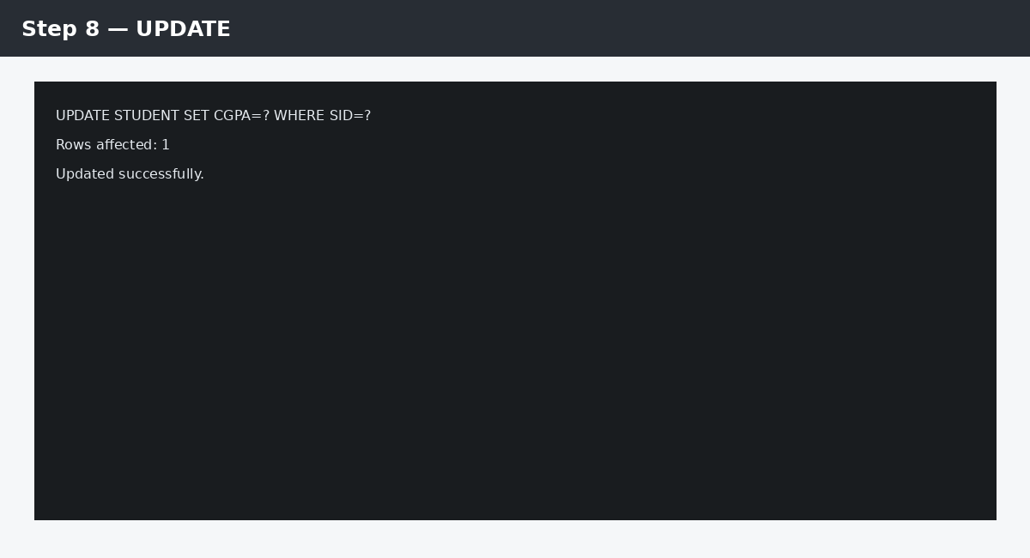
Step 8 — UPDATE
Use a parameterized UPDATE and check affected rows.

Slide 41
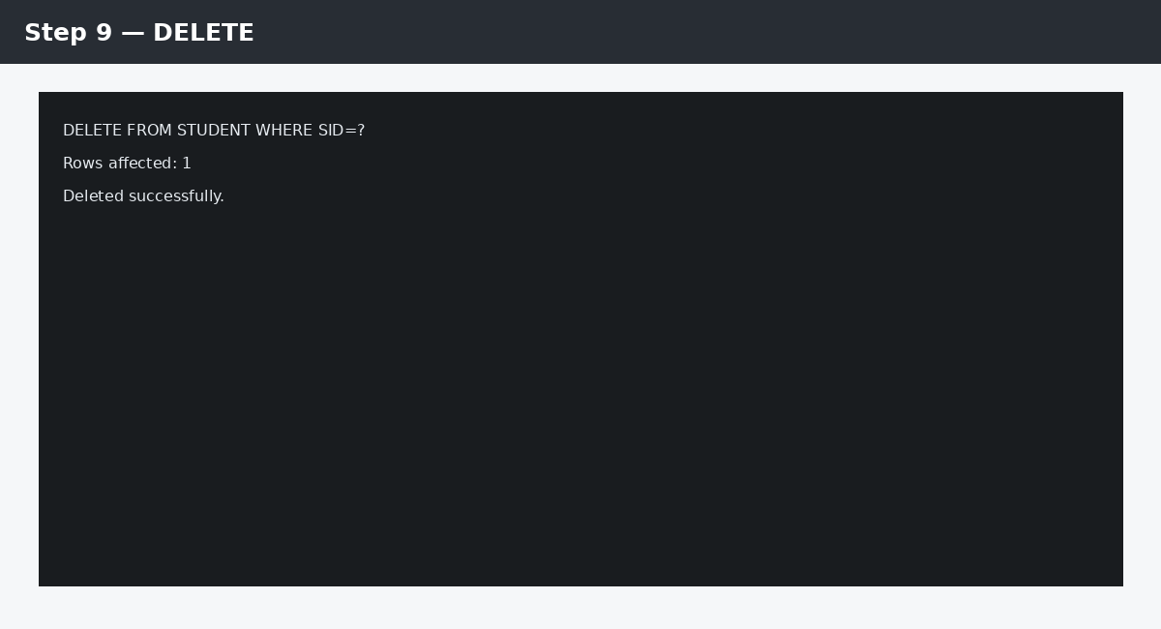
Step 9 — DELETE
Use a parameterized DELETE and verify the target SID.

Slide 42
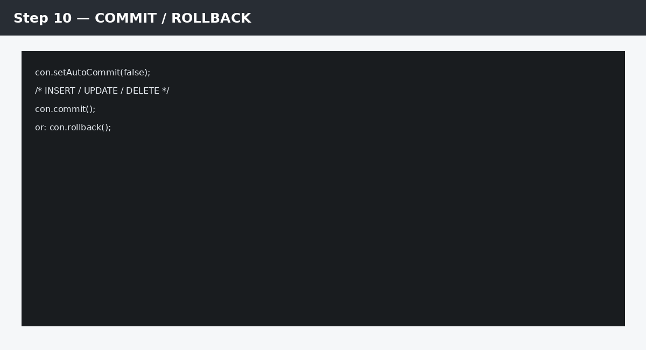
Step 10 — COMMIT / ROLLBACK
Use setAutoCommit(false), commit on success, and rollback on failure.

Slide 43
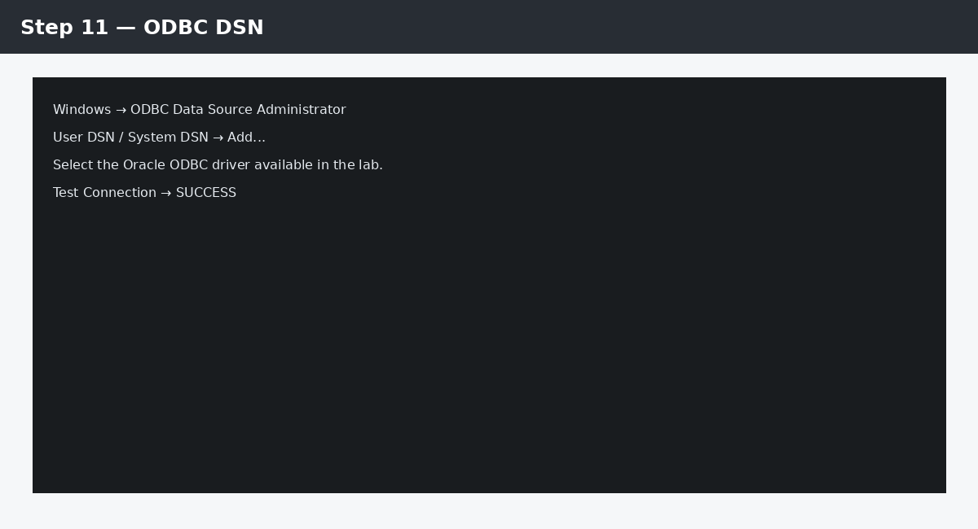
Step 11 — ODBC DSN
Configure an ODBC DSN using the Oracle ODBC driver available in the lab.

Slide 44
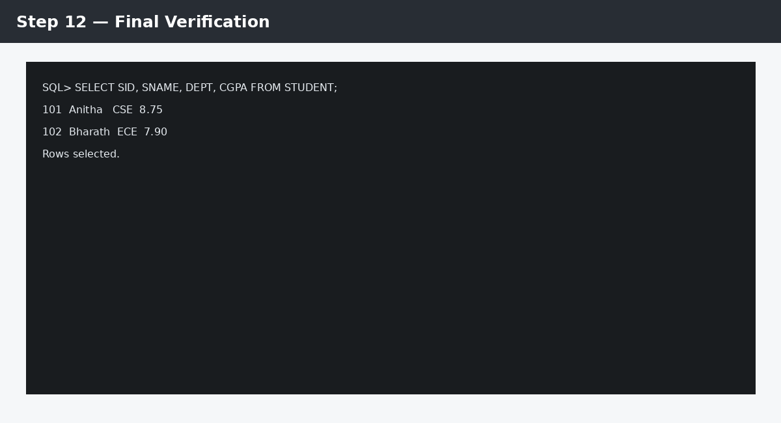
Step 12 — Final Verification
Return to SQL*Plus and verify the final database state.

Slide 45
Front-End Retrieval Task
Create a front-end screen/program that displays SID, SNAME, DEPT and CGPA.
Connect to the database using JDBC or ODBC.
Execute a SELECT statement.
Fetch and display all rows.
Add a department input and display only matching students.
Display a suitable message when no matching rows are returned.
Capture the SQL/Java source and output for the laboratory record.

Slide 46
Front-End DML Task
INSERT: accept student details from the front end and insert a new row.
UPDATE: accept SID and new CGPA; display the number of rows updated.
DELETE: accept SID after confirmation and display the number of rows deleted.
Validate required fields before sending SQL.
Use PreparedStatement/parameter binding.
Commit successful operations and rollback when an operation fails as part of a transaction.

Slide 47
Scenario-Based Challenging Tasks
1. Student Search: build a parameterized search by department and minimum CGPA.
2. Student Registration: insert a new student and reject duplicate SID/invalid values.
3. Student Update: modify CGPA and show old/new values in the front end.
4. Student Deletion: delete by SID and report whether a row actually existed.
5. Department Report: retrieve students ordered by CGPA descending.
6. Transaction Challenge: insert a student and a related enrollment record; commit only when both operations succeed.
7. Error Handling: deliberately violate a constraint and display a user-friendly message while preserving database consistency.
8. Dual Implementation: implement the same retrieval and one DML operation using both ODBC and JDBC and compare the code.

Slide 48
Advanced Challenges
Create a front-end login/search workflow without embedding user input directly into SQL.
Implement UPDATE using PreparedStatement and display executeUpdate() result.
Implement a transaction containing INSERT + UPDATE and demonstrate ROLLBACK.
Use ResultSetMetaData to display column names dynamically.
Create a reusable database utility class for opening connections and handling exceptions.
Add validation for NULL/blank input and invalid numeric values before database execution.
Compare a Statement-based implementation with PreparedStatement and explain the security/design difference.
Test connection failure, invalid SQL, constraint violation and no-result scenarios.

Slide 49
Laboratory Procedure – JDBC
Install/configure the appropriate JDBC driver in the Java project.
Create the STUDENT table and sample data in Oracle.
Create a Java project and configure the JDBC driver.
Write and test the connection program.
Write SELECT retrieval using ResultSet.
Write parameterized INSERT using PreparedStatement.
Write parameterized UPDATE and display affected rows.
Write parameterized DELETE and display affected rows.
Test COMMIT/ROLLBACK.
Record successful output and at least two error-handling cases.

Slide 50
Laboratory Procedure – ODBC
Install the database vendor's ODBC driver appropriate to the operating system.
Create/configure the required DSN.
Verify that the front-end language/tool can access the DSN.
Open an ODBC connection.
Execute a SELECT and fetch/display rows.
Execute parameterized INSERT/UPDATE/DELETE using the facilities of the chosen ODBC language/API.
Check affected-row counts and transaction status.
Disconnect and release resources.
Record DSN/driver configuration separately; do not expose passwords in the lab record.

Slide 51
Common Errors and Troubleshooting
Connection refused / listener unavailable → verify database service, host, port and service name.
Authentication failure → verify username/password and database account status.
JDBC driver not found → verify the JDBC driver dependency/classpath.
Invalid SQL → test the SQL separately in SQL*Plus/SQL Developer.
Constraint violation → validate keys, NOT NULL and CHECK conditions.
No rows displayed → check ResultSet processing and the SELECT condition.
UPDATE/DELETE affects 0 rows → verify the WHERE condition and report affected-row count.
ODBC connection failure → verify driver installation and DSN configuration.
Transaction confusion → check auto-commit, COMMIT and ROLLBACK.

Slide 52
Summary
ODBC provides a standardized connectivity interface through drivers and driver-management components.
JDBC provides Java applications with a standard API for database connectivity.
Both approaches allow front ends to issue SQL and process database results.
SELECT operations require result-set processing.
INSERT, UPDATE and DELETE require careful parameter handling and transaction control.
Prepared/parameterized statements are preferred for user-supplied values.
Good front-end database programs validate input, handle errors, manage transactions and release resources.

Slide 53
Thank You!..

