Slide 1
Accelerate Reconstruction by Implementing ADMM in FPGA
University of North Dakota EE department
EECSXXX, Ray Duran
Prof Bo Liang
8/19/22

Slide 2
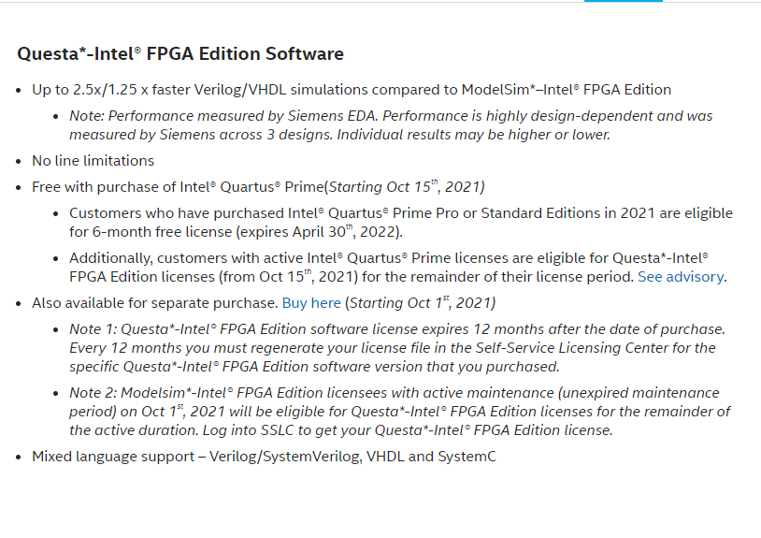
Agenda

Slide 3
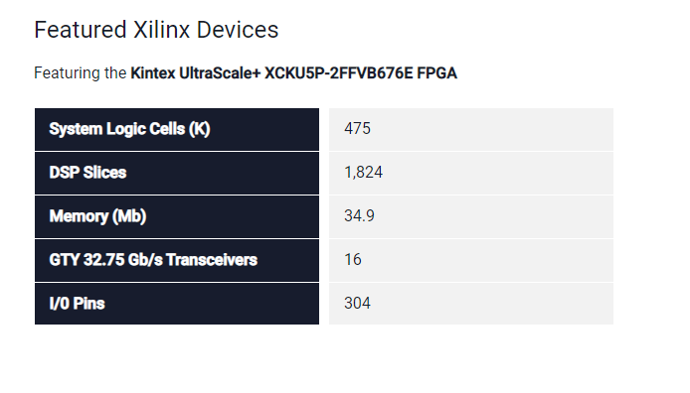
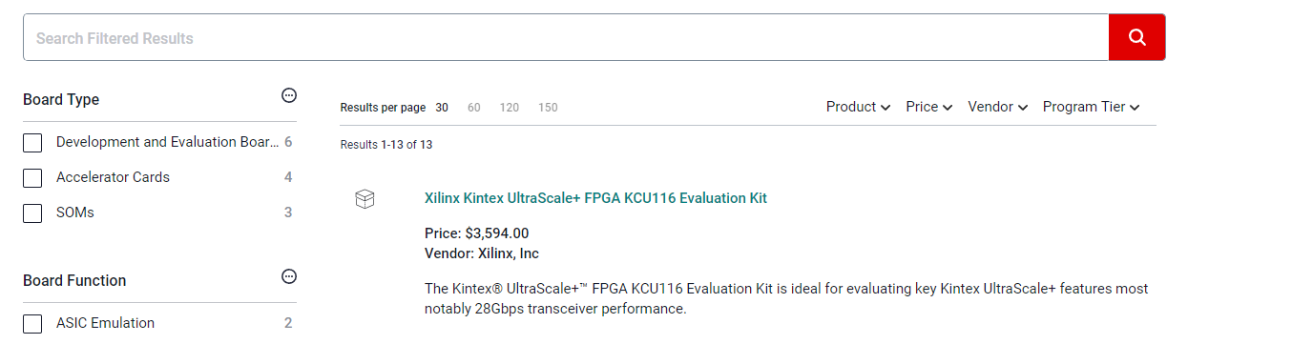
Xilinx Part and Board
https://www.xilinx.com/products/boards-and-kits/device-family/nav-kintex-ultrascale-plus.html 14nm and 16nm

Slide 4
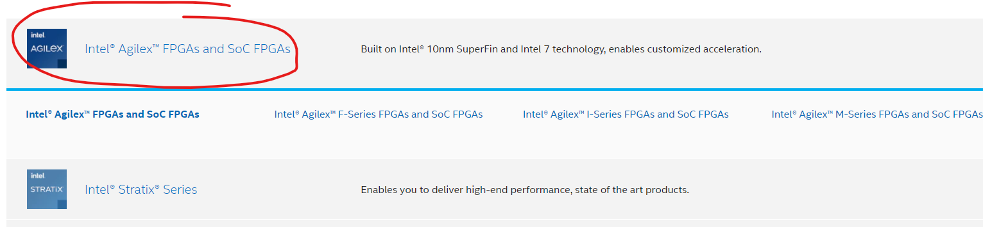
Top –Level ADMM
Take original optimization problem

Slide 5
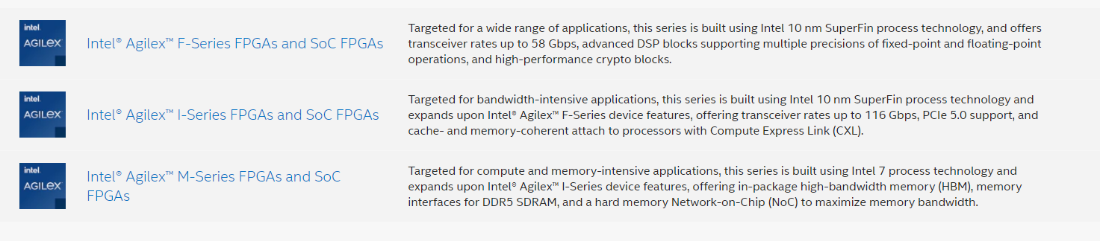
Assumptions
Downscale to 512x1024
file:///C:/Users/14083/Downloads/ag-overview-683458-666707%20(1).pdf

Slide 6
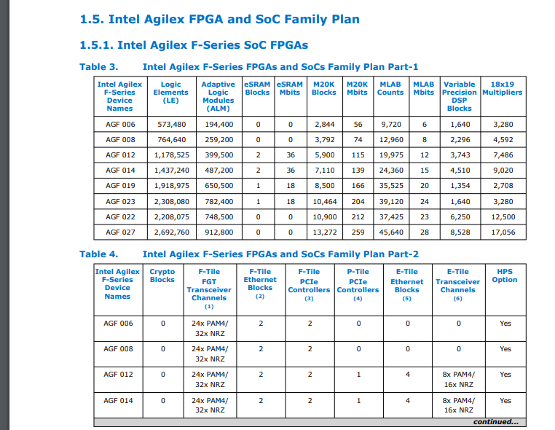
U update

Slide 7
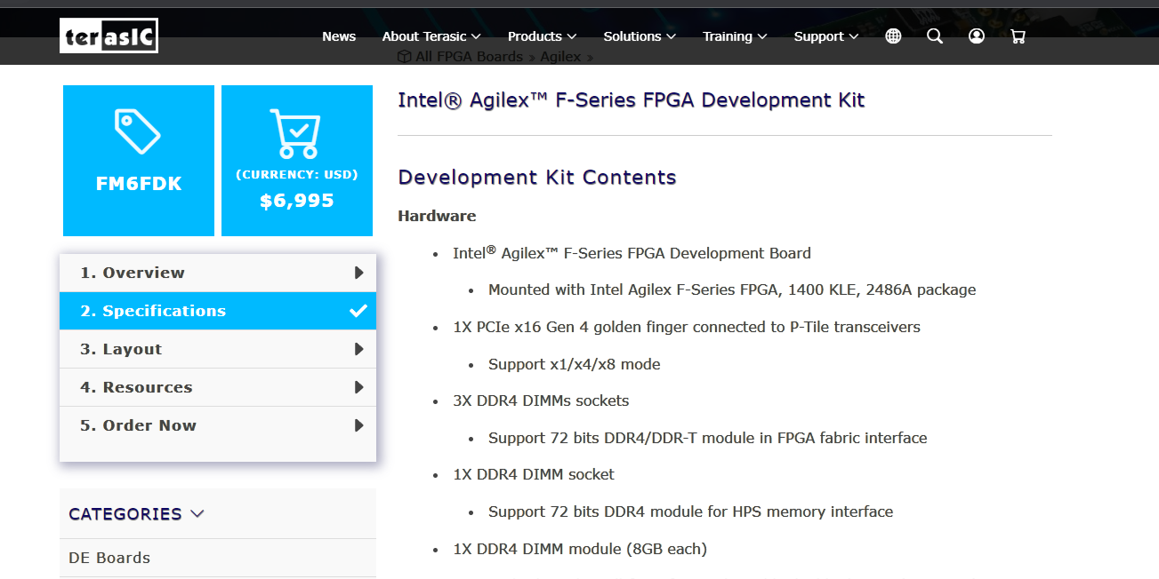
X update
https://www.terasic.com.tw/cgi-bin/page/archive.pl?Language=English&CategoryNo=142&No=1262&PartNo=2#heading

Slide 8
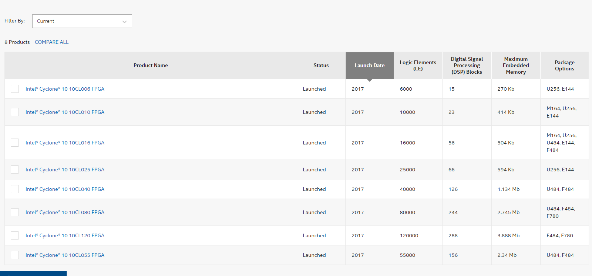
W update

Slide 9
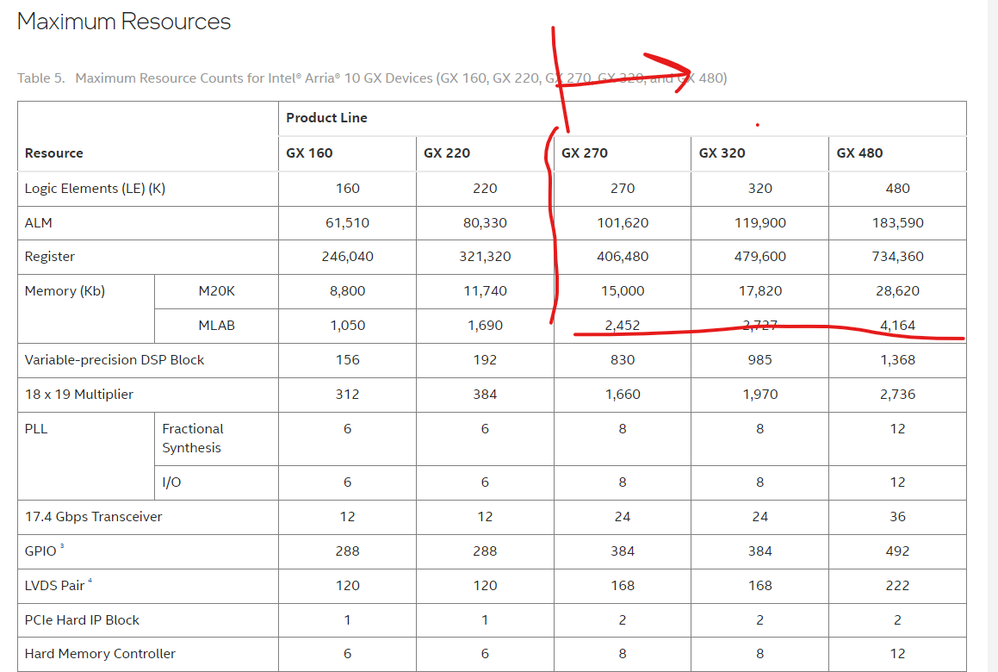
rk update
https://www.intel.com/content/www/us/en/docs/programmable/683332/current/maximum-resources-34722.html

Slide 10
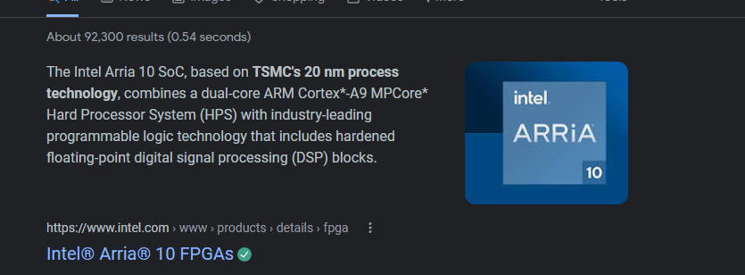
Rdivmat update(pre-compute)

Slide 11
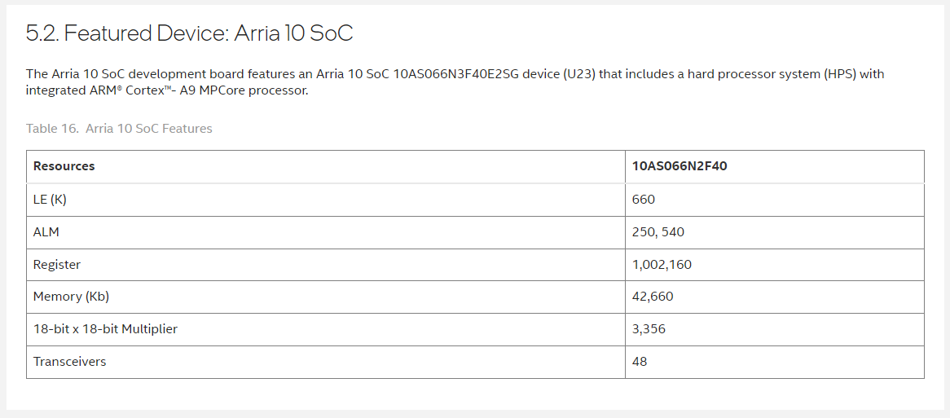
Image update
https://www.intel.com/content/www/us/en/docs/programmable/683227/current/featured-device-arria-10-soc.html

Slide 12
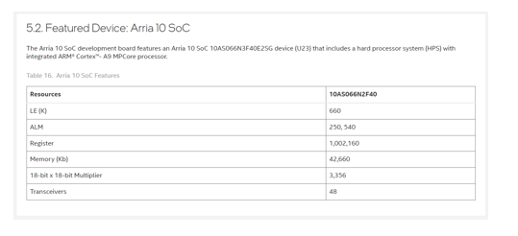
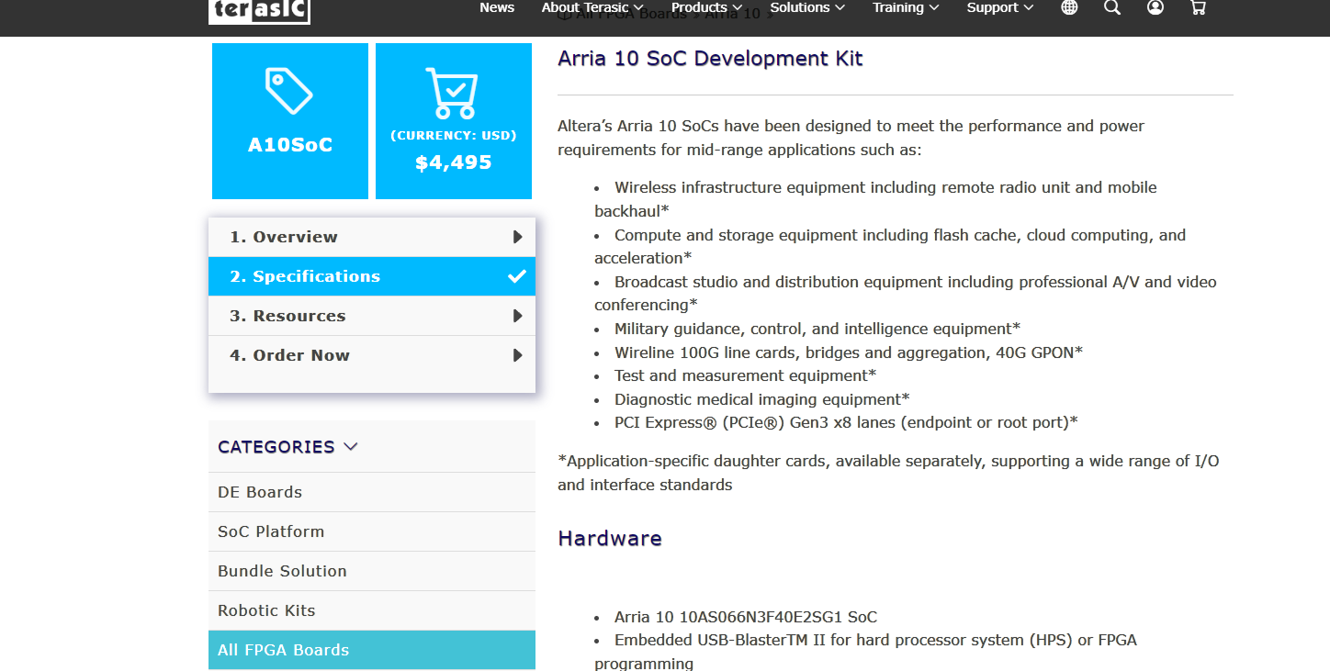
Intel/Altera
https://www.terasic.com.tw/cgi-bin/page/archive.pl?Language=English&CategoryNo=228&No=997&PartNo=2#contents
https://www.intel.com/content/www/us/en/docs/programmable/683227/current/featured-device-arria-10-soc.html

Slide 13
ξ update
https://www.intel.co.uk/content/www/uk/en/products/details/fpga/development-kits/arria/10-sx.html

Slide 14
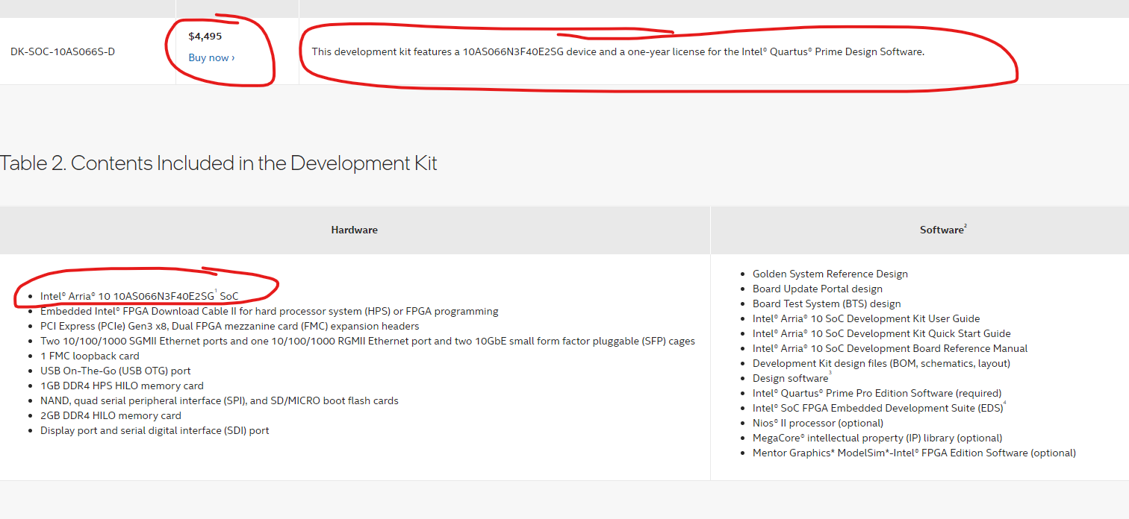
η update
https://www.intel.co.uk/content/www/uk/en/products/details/fpga/development-kits/arria/10-sx.html Lead time ?

Slide 15
ADMM Algorithm
https://www.youtube.com/watch?v=TsBHYRhmDUk
Intel unified fpga ip

Slide 16
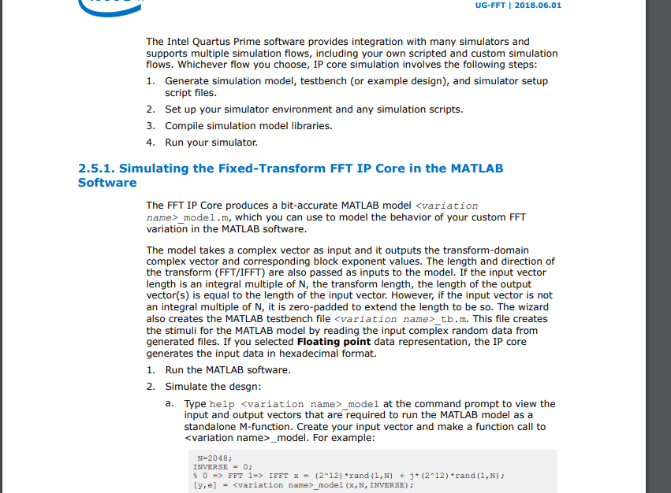
Speed/Latency Calc & Strategy
Bottlenecks FFT2/IFFT2 processing
file:///C:/Users/14083/Downloads/ug_fft%20(1).pdf

Slide 17
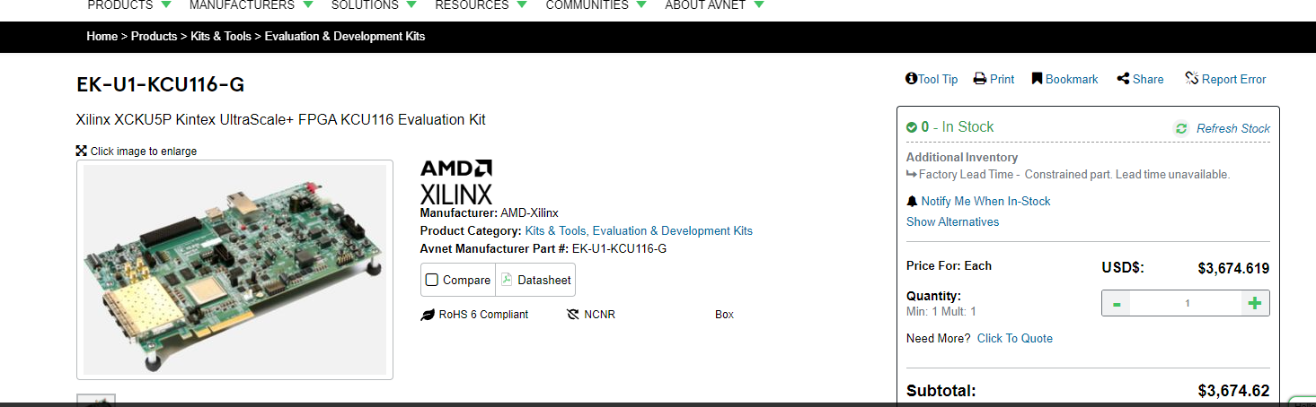
Resource Estimates
Notes:
Here is that medium.; A diffuser can be thought of as a kind of random matrix. So, all we would then need is for our voxels to be sparse in some domain. As we saw earlier in Professor Liang’s lecture on compressive imaging, we are saved as a random matrix multiplied by another matrix is still random. So, if we transpose our solution into a spare domain with some matrix we are still random.

Slide 18
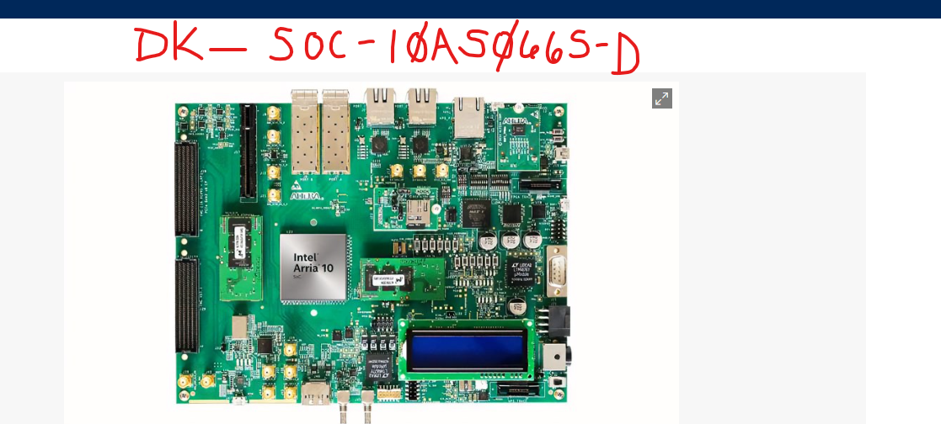
Resource Estimation
Notes:
Here is that medium.; A diffuser can be thought of as a kind of random matrix. So, all we would then need is for our voxels to be sparse in some domain. As we saw earlier in Professor Liang’s lecture on compressive imaging, we are saved as a random matrix multiplied by another matrix is still random. So, if we transpose our solution into a spare domain with some matrix we are still random.

Slide 19
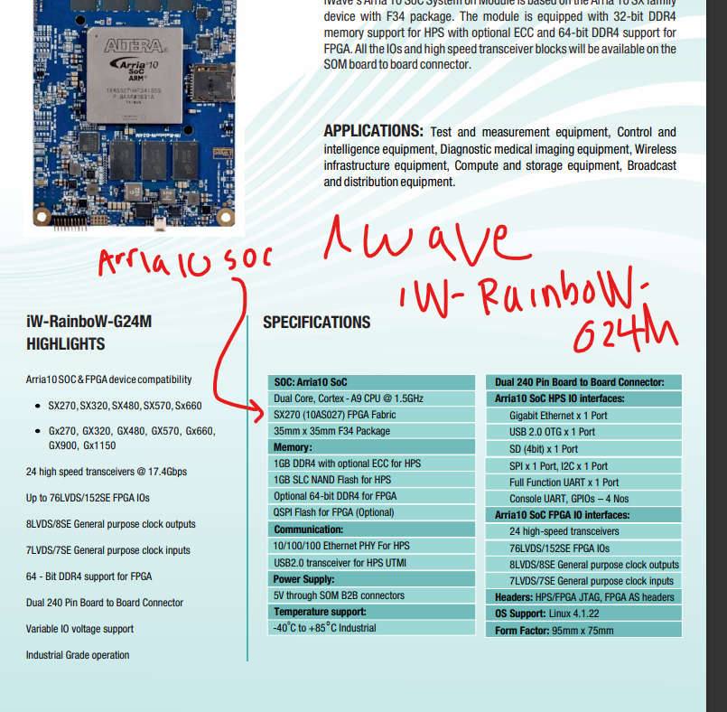
Resource Estimation
Notes:
Here is that medium.; A diffuser can be thought of as a kind of random matrix. So, all we would then need is for our voxels to be sparse in some domain. As we saw earlier in Professor Liang’s lecture on compressive imaging, we are saved as a random matrix multiplied by another matrix is still random. So, if we transpose our solution into a spare domain with some matrix we are still random.

Slide 20
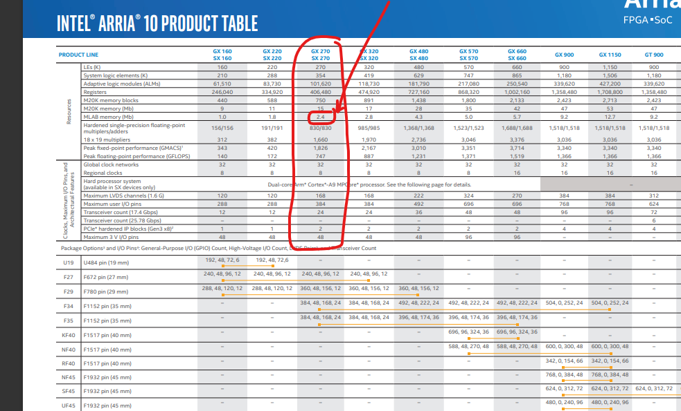
Resource Estimation
Notes:
Here is that medium.; A diffuser can be thought of as a kind of random matrix. So, all we would then need is for our voxels to be sparse in some domain. As we saw earlier in Professor Liang’s lecture on compressive imaging, we are saved as a random matrix multiplied by another matrix is still random. So, if we transpose our solution into a spare domain with some matrix we are still random.

Slide 21
Resource Estimation
Intel® Stratix® 10 SX SoC Development Kits
Notes:
Here is that medium.; A diffuser can be thought of as a kind of random matrix. So, all we would then need is for our voxels to be sparse in some domain. As we saw earlier in Professor Liang’s lecture on compressive imaging, we are saved as a random matrix multiplied by another matrix is still random. So, if we transpose our solution into a spare domain with some matrix we are still random.

Slide 22
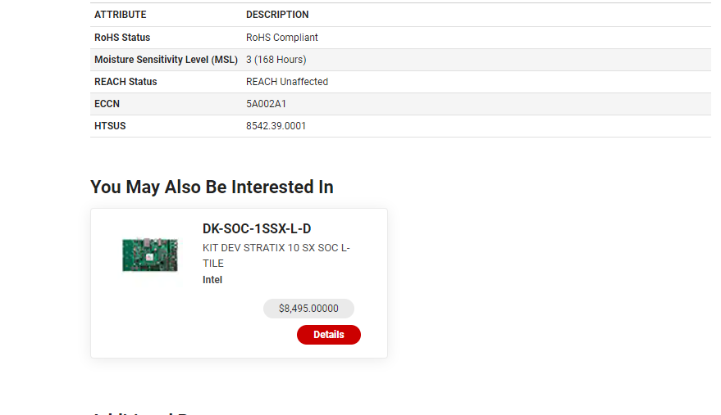
Device
Notes:
Here is that medium.; A diffuser can be thought of as a kind of random matrix. So, all we would then need is for our voxels to be sparse in some domain. As we saw earlier in Professor Liang’s lecture on compressive imaging, we are saved as a random matrix multiplied by another matrix is still random. So, if we transpose our solution into a spare domain with some matrix we are still random.

Slide 23
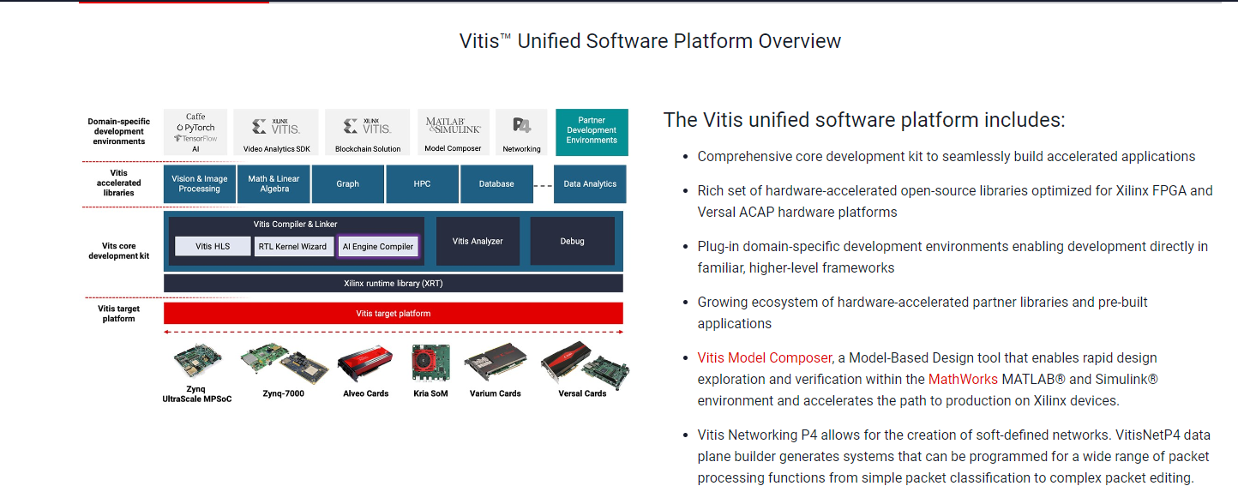
AMD/Xilinx

Slide 24
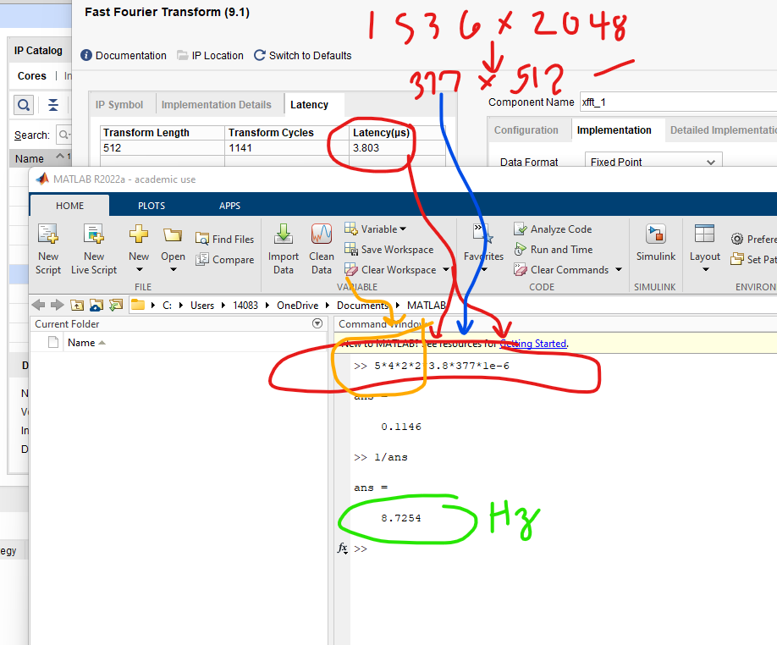
AMD/Xilinx

Slide 25
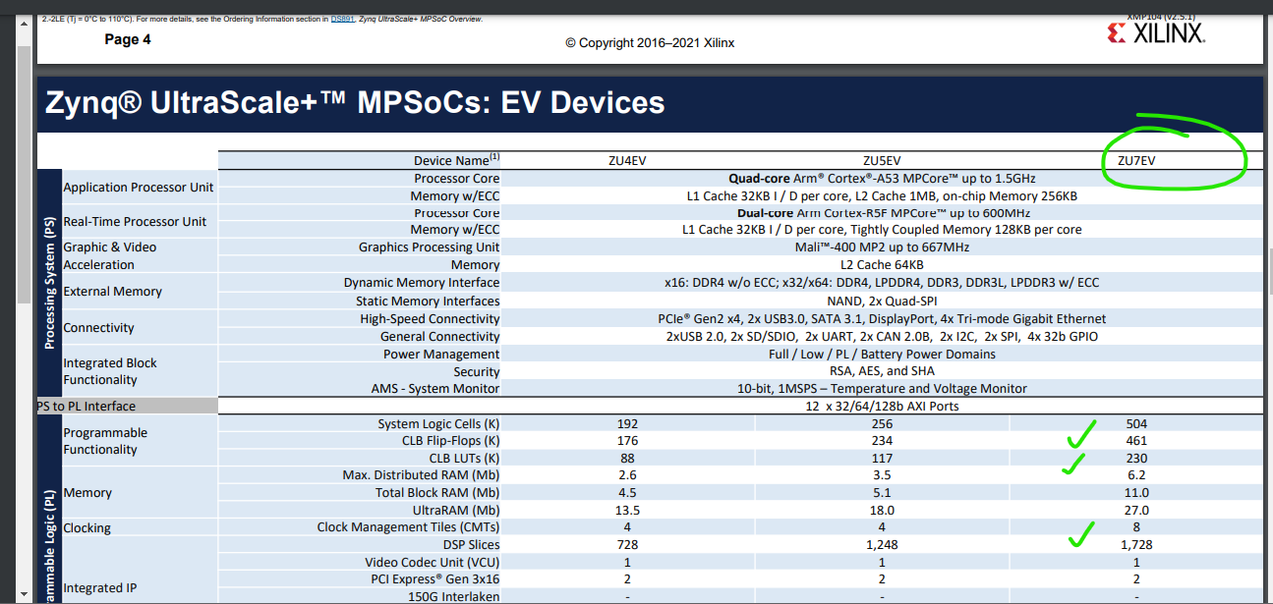
Intel/Altera

Slide 26
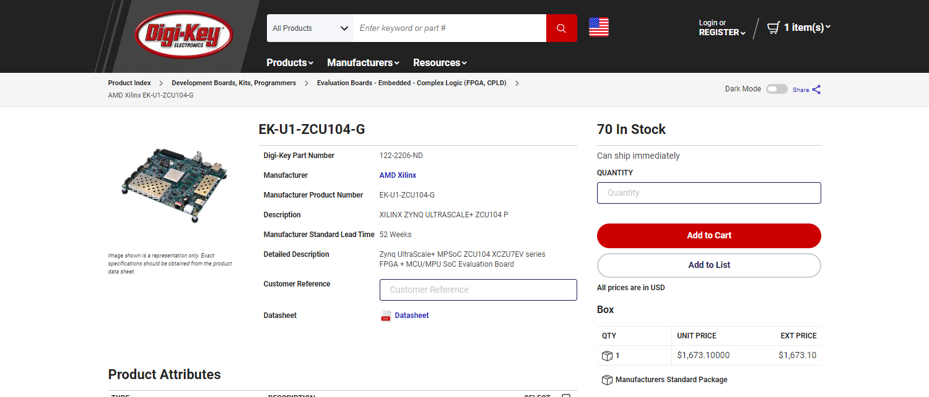
Partial References
https://www.digikey.com/en/products/detail/amd-xilinx/EK-U1-ZCU104-G/9380242

Slide 27
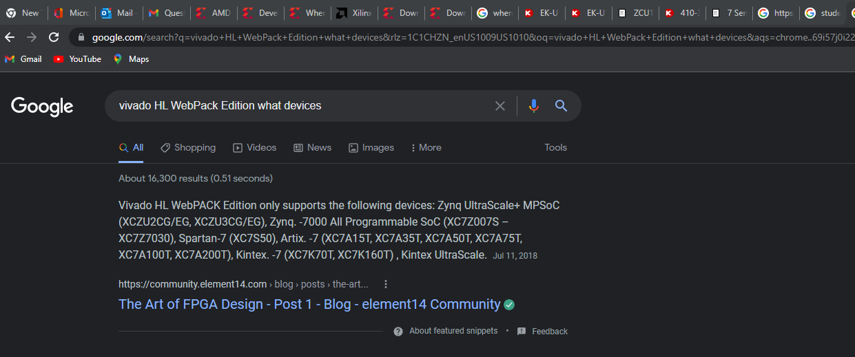
Partial References

Slide 28
Partial References
N. Antipa et al., “DiffuserCam: lensless single-exposure 3D imaging single-shot,” Optica 5,1-9 (2018).
E. Bezzam, et al., “ LenslessPiCam: A Hardware and Software Platform for Lensless Compuational Imaging with a Raspberry Pi,” (2022)
Stephen Boyd, Neal Parikh, Eric Chu, Borja Peleato, and Jonathan Eckstein. Distributed optimization and statistical learning via the alternating direction method of multipliers. Found. Trends Mach. Learn., 3(1):1–122, jan 2011.
K. Monakhova et al.”Learned reconstruction for practical mask-based lensless imaging,Optica Express (2019)
https://www.xilinx.com/htmldocs/ip_docs/pru_files/div-gen.html
https://www.xilinx.com/htmldocs/ip_docs/pru_files/xfft.html

Slide 29
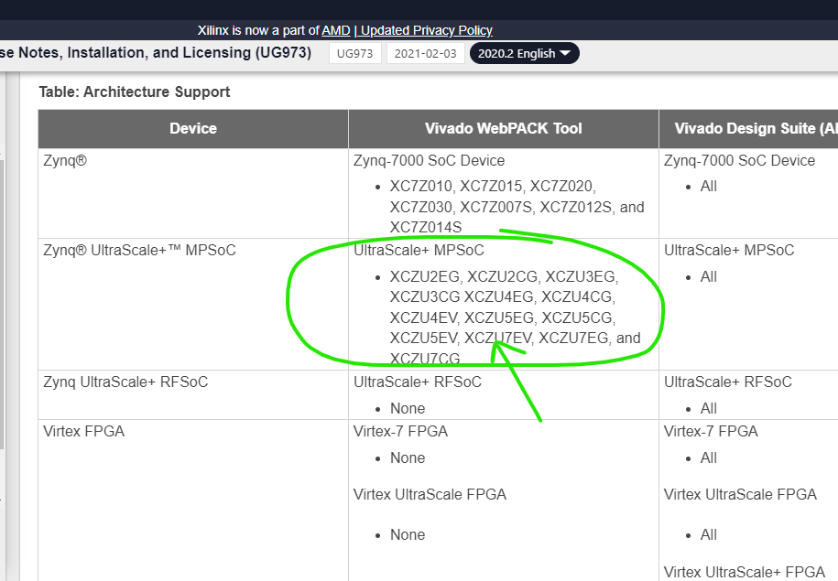
Partial References

Slide 30
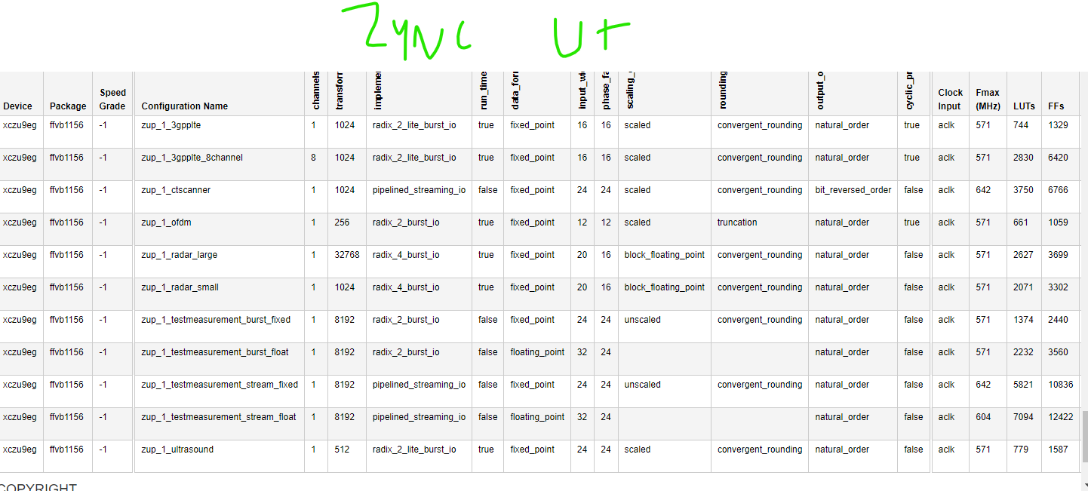
Partial References

Slide 31
Partial References
FMC USB3.0 Adapter Board (xilinx.com)
USB3 FMC (xilinx.com)

Slide 32
Partial References
N. Antipa et al., “DiffuserCam: lensless single-exposure 3D imaging single-shot,” Optica 5,1-9 (2018).
E. Bezzam, et al., “ LenslessPiCam: A Hardware and Software Platform for Lensless Compuational Imaging with a Raspberry Pi,” (2022)
Stephen Boyd, Neal Parikh, Eric Chu, Borja Peleato, and Jonathan Eckstein. Distributed optimization and statistical learning via the alternating direction method of multipliers. Found. Trends Mach. Learn., 3(1):1–122, jan 2011.
K. Monakhova et al.”Learned reconstruction for practical mask-based lensless imaging,Optica Express (2019)
https://www.xilinx.com/htmldocs/ip_docs/pru_files/div-gen.html
https://www.xilinx.com/htmldocs/ip_docs/pru_files/xfft.html

Slide 33
Partial References
N. Antipa et al., “DiffuserCam: lensless single-exposure 3D imaging single-shot,” Optica 5,1-9 (2018).
E. Bezzam, et al., “ LenslessPiCam: A Hardware and Software Platform for Lensless Compuational Imaging with a Raspberry Pi,” (2022)
Stephen Boyd, Neal Parikh, Eric Chu, Borja Peleato, and Jonathan Eckstein. Distributed optimization and statistical learning via the alternating direction method of multipliers. Found. Trends Mach. Learn., 3(1):1–122, jan 2011.
K. Monakhova et al.”Learned reconstruction for practical mask-based lensless imaging,Optica Express (2019)
https://www.xilinx.com/htmldocs/ip_docs/pru_files/div-gen.html
https://www.xilinx.com/htmldocs/ip_docs/pru_files/xfft.html

Slide 34
Partial References
N. Antipa et al., “DiffuserCam: lensless single-exposure 3D imaging single-shot,” Optica 5,1-9 (2018).
E. Bezzam, et al., “ LenslessPiCam: A Hardware and Software Platform for Lensless Compuational Imaging with a Raspberry Pi,” (2022)
Stephen Boyd, Neal Parikh, Eric Chu, Borja Peleato, and Jonathan Eckstein. Distributed optimization and statistical learning via the alternating direction method of multipliers. Found. Trends Mach. Learn., 3(1):1–122, jan 2011.
K. Monakhova et al.”Learned reconstruction for practical mask-based lensless imaging,Optica Express (2019)
https://www.xilinx.com/htmldocs/ip_docs/pru_files/div-gen.html
https://www.xilinx.com/htmldocs/ip_docs/pru_files/xfft.html

Slide 35
Partial References
N. Antipa et al., “DiffuserCam: lensless single-exposure 3D imaging single-shot,” Optica 5,1-9 (2018).
E. Bezzam, et al., “ LenslessPiCam: A Hardware and Software Platform for Lensless Compuational Imaging with a Raspberry Pi,” (2022)
Stephen Boyd, Neal Parikh, Eric Chu, Borja Peleato, and Jonathan Eckstein. Distributed optimization and statistical learning via the alternating direction method of multipliers. Found. Trends Mach. Learn., 3(1):1–122, jan 2011.
K. Monakhova et al.”Learned reconstruction for practical mask-based lensless imaging,Optica Express (2019)
https://www.xilinx.com/htmldocs/ip_docs/pru_files/div-gen.html
https://www.xilinx.com/htmldocs/ip_docs/pru_files/xfft.html

Slide 36
Partial References
N. Antipa et al., “DiffuserCam: lensless single-exposure 3D imaging single-shot,” Optica 5,1-9 (2018).
E. Bezzam, et al., “ LenslessPiCam: A Hardware and Software Platform for Lensless Compuational Imaging with a Raspberry Pi,” (2022)
Stephen Boyd, Neal Parikh, Eric Chu, Borja Peleato, and Jonathan Eckstein. Distributed optimization and statistical learning via the alternating direction method of multipliers. Found. Trends Mach. Learn., 3(1):1–122, jan 2011.
K. Monakhova et al.”Learned reconstruction for practical mask-based lensless imaging,Optica Express (2019)
https://www.xilinx.com/htmldocs/ip_docs/pru_files/div-gen.html
https://www.xilinx.com/htmldocs/ip_docs/pru_files/xfft.html

