Slide 1
Accelerate Reconstruction by Implementing ADMM in FPGA
University of North Dakota EE department
EECSXXX, Ray Duran
Prof Bo Liang
8/19/22

Slide 2
Agenda
Motivation/Applications
Brief Top-Level description ADMM
Assumptions
Engines Flow Diagram
U, X and W update(primal)
Rk and Rdiv(primal)
Image Update(primal)
Rho,Ksee, and eta update(dual)
Algorithm Flow Diagram
Calculations/Speed
Resources
Device
Discussion/Conclusion

Slide 3
Motivation
Problem: In-vivo calcium imaging with a diffuser to improve FoV and resolution tradeoffs, implemented in FPGA
Related work:
Research at UCLA from Jason Cong
Research at UC. Berkeley with Laura Waller
Provide imaging community with a “pluggable” core for further investigations
ADMM faster than gradient methods(FISTA and Nesterov momentum)
Lay foundational FPGA for above applications this semester

Slide 4
Top –Level ADMM
Take original optimization problem
Split into separate minimizations
Add regularization
Augmented Lagrangian
Form dual updates to minimize with one set of engines and maximize with another: “Duality: min-max”
Allows a very optimized approach by divide and conquer

Slide 5
Assumptions
Downscale to 512x1024
Process only Luma
8 bit( Mainstream)
Ultrascale+

Slide 6
U update
Div
ηk
μ2
Τ
uk+1
vk
ψ

Slide 7
X update
C^b
ξk
xk+1
FFT2
IFFT2/SHFT
vk
(C^C + u1I)^-1
H
μ1

Slide 8
W update
vk
Max
wk+1
k
Div
ρ
μ3

Slide 9

rk update
μ3
wk+1
ρk
μ2
uk+1
ψT
rk
ηk
μ1
FFT2
IFFT2/SHFT
xk+1
ξk
H*

Slide 10
Rdivmat update(pre-compute)
H
Abs
H*
μ1
ψtψ
Inv()
Rdivmat
μ2
μ3

Slide 11
Image update
Rdivmat
FFT2
IFFT2
vk+1
rk

Slide 12
ρ update
Vk+1
ρk +1
Z^-1
μ2
wk+1

Slide 13
ξ update
FFT2
IFFT2/SHFT
vk+1
ξk +1
Z^-1
H
μ1
xk+1

Slide 14
η update
vk+1
ψ
ηk+1
Z^-1
μ2
uk+1

Slide 15
ADMM Algorithm
ηk ξk ρk
ηk
u update
rk
xk+1
ξupdate
ξk
vk
Rdivmat
Ctb
vk+1
ξk
x update
FFT2
IFFT2
ηupdate
ηk
vk
uk+1
ρupdate
ρk
w update
ρk
wk+1
vk

Slide 16
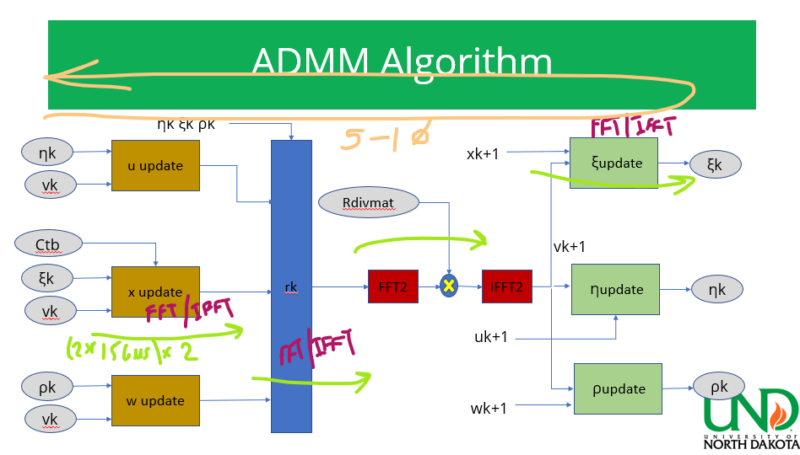
Speed/Latency Calc & Strategy
Bottlenecks FFT2/IFFT2 processing
5*(4*(2*2(156us))) = 1 frame
Fmax = 300 Mhz
156us from Ray Duran Sp,BME690
1 frame = 9.36ms
Can Run over 60Hz!

Slide 17
Resource Estimates
 | u update | x update | w update | rx | Rdiv(pre) | image | rho | xi | eta
xpre |  | 1
div | 1 |  | 1
psiorpsiT | 1 |  |  | 1 |  |  |  |  | 1
adder | 1 | 1 | 1 | 4 | 1 |  | 1 | 2 | 2
mult |  | 3 |  | 4 | 3 | 1 | 1 | 3 | 2
fft/ifft |  | 1 |  | 1 |  | 1 |  | 1
max |  |  | 1
thresh | 1
abs |  |  |  |  | 1
inv |  |  |  |  | 1
psi/psiT |  |  |  |  | 1
Notes:
Here is that medium.; A diffuser can be thought of as a kind of random matrix. So, all we would then need is for our voxels to be sparse in some domain. As we saw earlier in Professor Liang’s lecture on compressive imaging, we are saved as a random matrix multiplied by another matrix is still random. So, if we transpose our solution into a spare domain with some matrix we are still random.

Slide 18
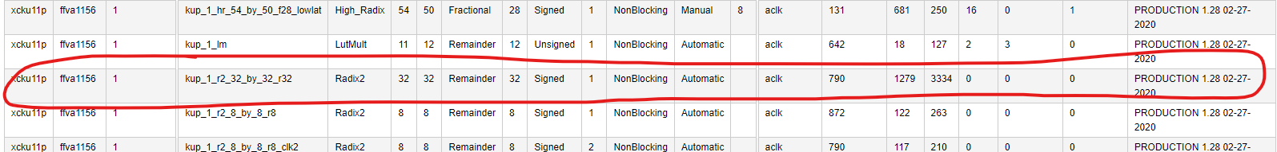
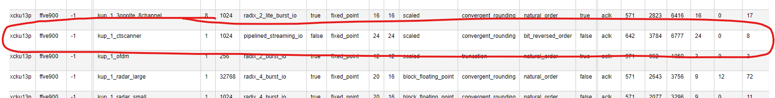
Resource Estimation
Divider:
FFT :
Notes:
Here is that medium.; A diffuser can be thought of as a kind of random matrix. So, all we would then need is for our voxels to be sparse in some domain. As we saw earlier in Professor Liang’s lecture on compressive imaging, we are saved as a random matrix multiplied by another matrix is still random. So, if we transpose our solution into a spare domain with some matrix we are still random.

Slide 19
Resource Estimation
 | LUTS | FF | DSP | 36KBRAM | 18KBRAM
Divider-Uupdate | 1279 | 3334 | 0 | 0 | 0
Divider -Wupdate | 1279 | 3334 | 0 | 0 | 0
FFT-Xupdate | 7568 | 13554 | 48 | 0 | 16
IFFT-Xupdate | 7568 | 13554 | 48 | 0 | 16
FFT-rx | 7568 | 13554 | 48 | 0 | 16
IFFT-rx | 7568 | 13554 | 48 | 0 | 16
FFT-image | 7568 | 13554 | 48 | 0 | 16
IFFT-image | 7568 | 13554 | 48 | 0 | 16
FFT-xi | 7568 | 13554 | 48 | 0 | 16
IFFT-xi | 7568 | 13554 | 48 | 0 | 16
Total | 63102 | 115100 | 384 | 0 | 128
Notes:
Here is that medium.; A diffuser can be thought of as a kind of random matrix. So, all we would then need is for our voxels to be sparse in some domain. As we saw earlier in Professor Liang’s lecture on compressive imaging, we are saved as a random matrix multiplied by another matrix is still random. So, if we transpose our solution into a spare domain with some matrix we are still random.

Slide 20
Resource Estimation
Div & FFT estimate 70% of resources
Notes:
Here is that medium.; A diffuser can be thought of as a kind of random matrix. So, all we would then need is for our voxels to be sparse in some domain. As we saw earlier in Professor Liang’s lecture on compressive imaging, we are saved as a random matrix multiplied by another matrix is still random. So, if we transpose our solution into a spare domain with some matrix we are still random.

Slide 21
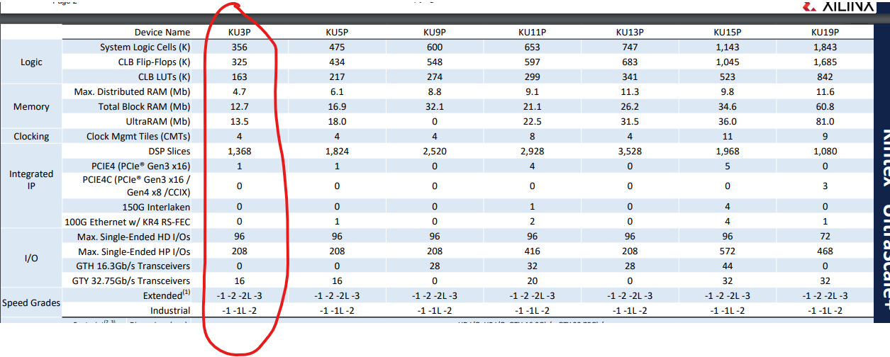
Device
Notes:
Here is that medium.; A diffuser can be thought of as a kind of random matrix. So, all we would then need is for our voxels to be sparse in some domain. As we saw earlier in Professor Liang’s lecture on compressive imaging, we are saved as a random matrix multiplied by another matrix is still random. So, if we transpose our solution into a spare domain with some matrix we are still random.

Slide 22
Discussion/Conclusion
Tools, supplies( matlab, python,modelsim(questa), paid Xilinx(FFT)
Schedule
FFT2 core(AXI-bus)
Use as a IP for future work
Upload to github for community

Slide 23
Partial References
N. Antipa et al., “DiffuserCam: lensless single-exposure 3D imaging single-shot,” Optica 5,1-9 (2018).
E. Bezzam, et al., “ LenslessPiCam: A Hardware and Software Platform for Lensless Compuational Imaging with a Raspberry Pi,” (2022)
Stephen Boyd, Neal Parikh, Eric Chu, Borja Peleato, and Jonathan Eckstein. Distributed optimization and statistical learning via the alternating direction method of multipliers. Found. Trends Mach. Learn., 3(1):1–122, jan 2011.
K. Monakhova et al.”Learned reconstruction for practical mask-based lensless imaging,Optica Express (2019)
https://www.xilinx.com/htmldocs/ip_docs/pru_files/div-gen.html
https://www.xilinx.com/htmldocs/ip_docs/pru_files/xfft.html

