Slide 1
DiffuserCam: lenless single-exposure 3-D Imaging
University of North Dakota EE department
EECS590, Ray Duran
12/2/21

Slide 2
Topics
Background
Compressive Sensing
Diffusers
Point Spread Functions
Algorithms
Principles
Setup & Experiments
Discussion & Conclusions
Applications

Slide 3
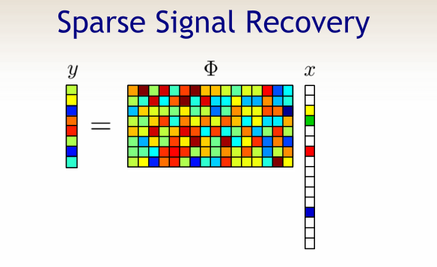
Compressive Sensing
Underdetermined Systems
Candes, Romberg and Tao (2005)

Slide 4
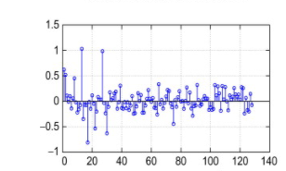
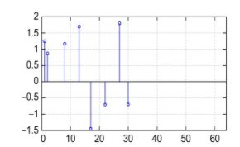
Compressive Sensing
Uncertainty relation( Heisenberg from Quantum Mechanics)
Mutual coherence
place holder

Slide 5
Compressive Sensing
Difficult

Slide 6
Diffusers
Difficult

Slide 7
Diffusers
Difficult

Slide 8
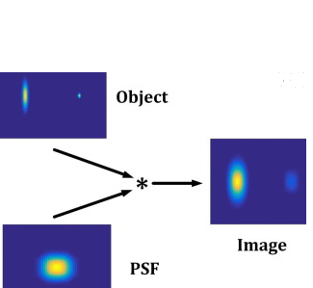
Point Spread Function
Difficult

Slide 9
Point Spread Function
Difficult

Slide 10


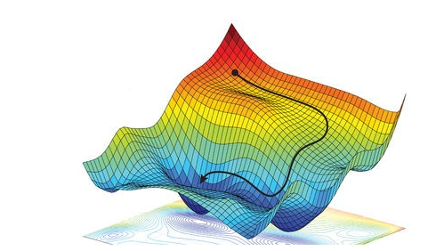

Algorithms
Gradient descent for optimization
Strategy for solving for A

Slide 11
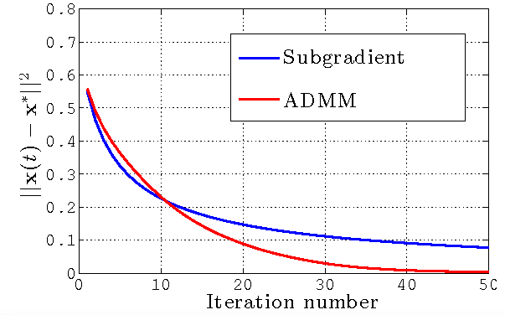
Algorithms
Gradient speed up
Fast Iterative Shrinkage-
Thresholding Algorithm
(FISTA) ( Used for Exper.)
Alternating Direction
Method of Multipliers
(ADMM)
Notes:
Here we would like to have something faster to compute for 3-D imaging. We use the FISTA in our experiments. The ADMM is a popular optimization these days. Basically, if you have a way of separating the problem into two convex functions, and you can then make your constraints linearly then there is a big speedup. This method is related to a penalty of Lagrangian methods. I am not very familiar with ADMM but am familiar with
Lagrangian methods that speed up optimization. I have used such techniques in doing video compression, where the idea is to reduce bit rate but maintain distortion.. This is the classical bitrate distortion problem in information theory.

Slide 12
Principles
Difficult

Slide 13
Principles
Difficult

Slide 14
Setup
Difficult

Slide 15
Setup
Difficult

Slide 16
Experiments
Difficult

Slide 17
Experiments
Difficult

Slide 18
Discussion
Difficult

Slide 19
Discussion
Difficult

Slide 20
Conclusion
Difficult

Slide 21
Applications
Difficult

Slide 22
Applications
Difficult

Slide 23
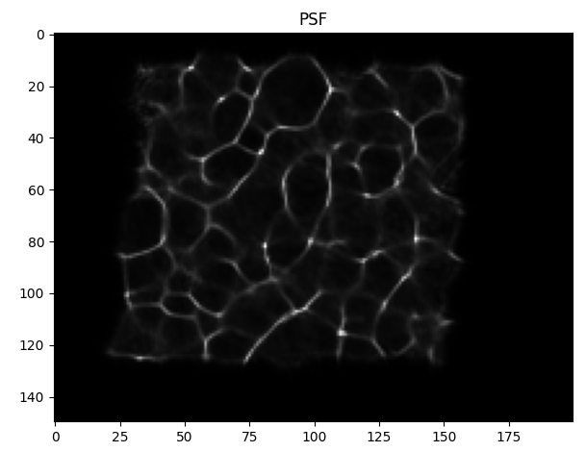
Status Week of 10/26/21(3)
Ran algorithm( Gradient descent) with good known images and working aperture

Slide 24
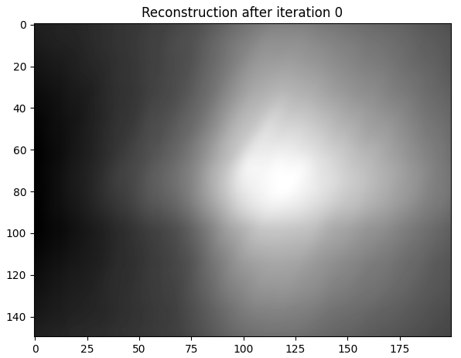
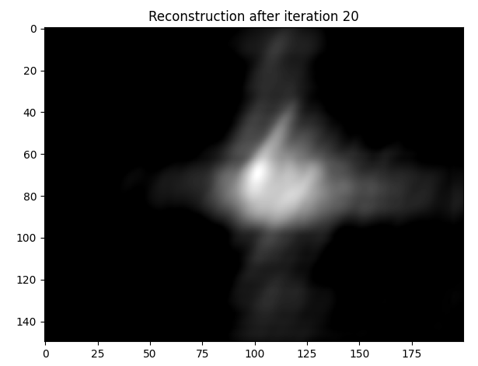
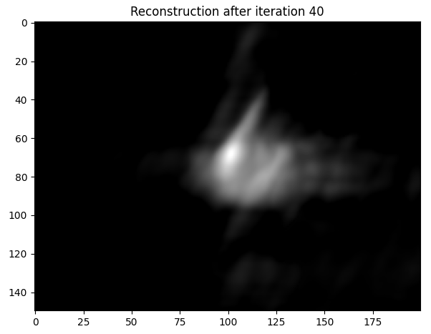
Status Week of 10/26/21(4)

Slide 25
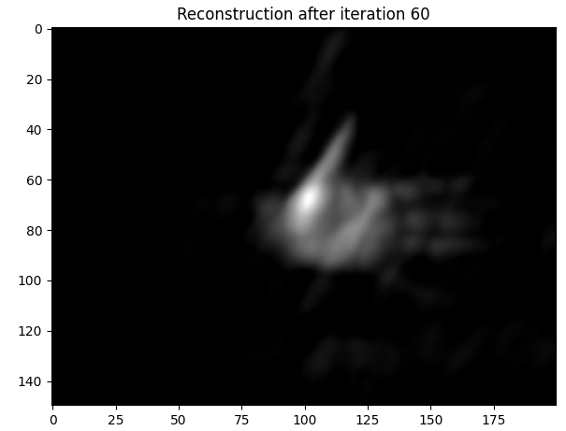
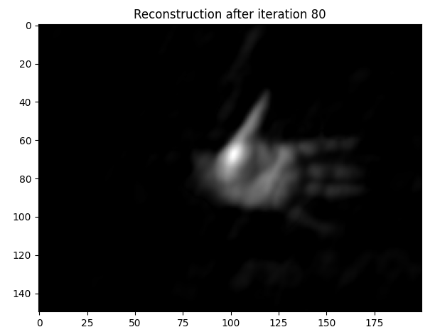
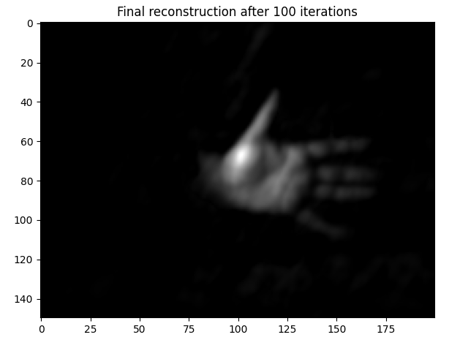
Status Week of 10/26/21(5)

