Slide 1
DiffuserCam: lenless single-exposure 3-D Imaging
University of North Dakota EE department
EECS590, Ray Duran
12/2/21

Slide 2
Topics
Motivation/Applications
Background
Compressive Sensing
Diffusers
Point Spread Functions
Algorithms
Principles
Setup & Experiments
Discussion & Conclusions
Future Work
Notes:
My Name is Ray Duran, and my background is signal processing, video compression and chip design with a severe math bias.

Slide 3
Motivation
Difficult
Notes:
Problems with scattering:1. Light is outside numerical aperture of our system 2. Spatial frequencies of our light are mixed or convolved with our own system and noisy.

Slide 4
Applications
Difficult

Slide 5
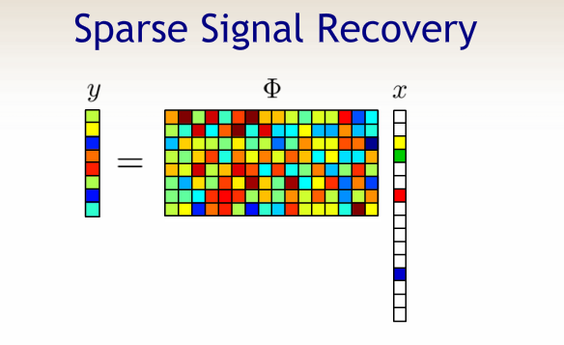
Compressive Sensing
Underdetermined Systems
Candes, Romberg and Tao (2005)
Notes:
b = Hv . You can think of this in our context as b = 2D sensor array M So, b (Mx1) = H(MxN)*V(Nx1); N is 3D voxels; M is 2D sensor array M << N so this is an undetermined system. So, this can’t be solved by pre-2005 understanding of systems of equations, but if we enforce sparsity we do converge to a solution. This is a classical basis pursuit problem in compressive sensing. Also, the H array needs to have undistributed uncorrelated columns.

Slide 6
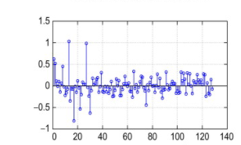
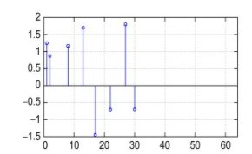
Compressive Sensing
Uncertainty relation( Heisenberg from Quantum Mechanics)
Mutual coherence
Notes:
Besides sparsity we need an extra bit of “magic” for our system matrix H. Let us look at the above

Slide 7
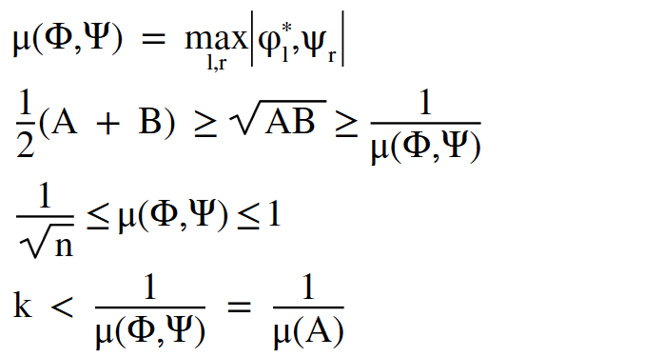
Compressive Sensing
Sensing Matrix Equations
Notes:
So, now what do we have: 1. Satisfied sparsity. But sparsity is not enough, we also satisfied this uncertainty relation dual pair of basis that satisifies this uncorrelatedness. So, if we can just come up with a medium that allows this we are in business.

Slide 8
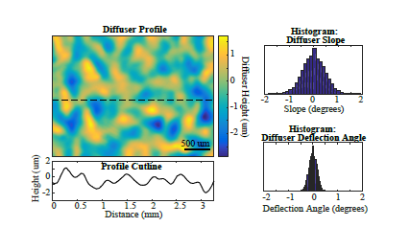
Diffusers
Difficult
Notes:
Here is that medium.; A diffuser can be thought of as a kind of random matrix. So, all we would then need is for our voxels to be sparse in some domain. As we saw earlier in Professor Liang’s lecture on compressive imaging, we are saved as a random matrix multiplied by another matrix is still random. So, if we transpose our solution into a spare domain with some matrix we are still random.

Slide 9
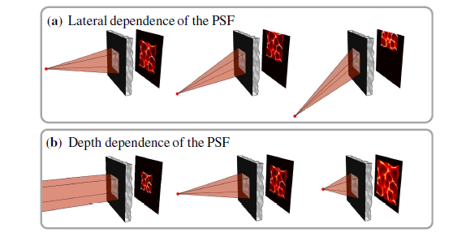
Diffusers
Difficult

Slide 10
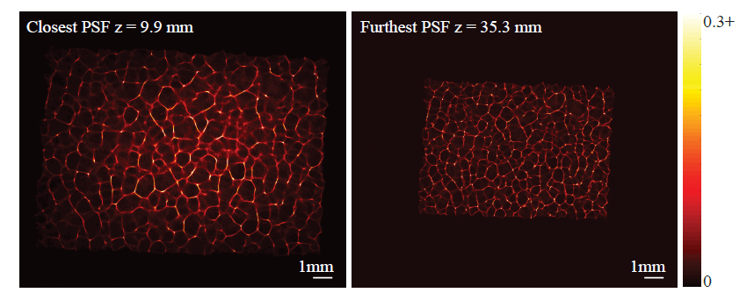
Point Spread Function
Difficult

Slide 11


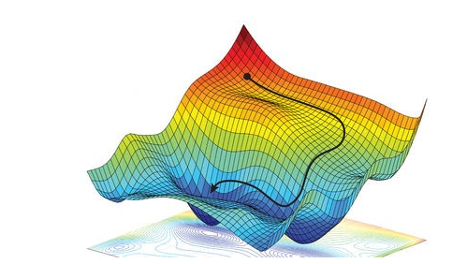

Algorithms
Gradient descent for optimization
Strategy for solving for A

Slide 12
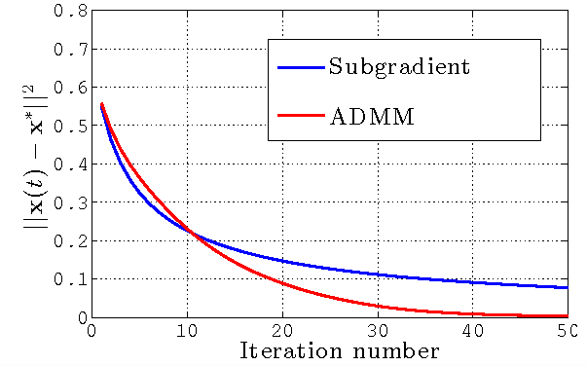
Algorithms
Gradient speed up
Fast Iterative Shrinkage-
Thresholding Algorithm
(FISTA) ( Used for Exper.)
Alternating Direction
Method of Multipliers
(ADMM)
Notes:
Here we would like to have something faster to compute for 3-D imaging. We use the FISTA in our experiments. The ADMM is a popular optimization these days. Basically, if you have a way of separating the problem into two convex functions, and you can then make your constraints linearly then there is a big speedup. This method is related to a penalty of Lagrangian methods. I am not very familiar with ADMM but am familiar with
Lagrangian methods that speed up optimization. I have used such techniques in doing video compression, where the idea is to reduce bit rate but maintain distortion.. This is the classical bitrate distortion problem in information theory.

Slide 13
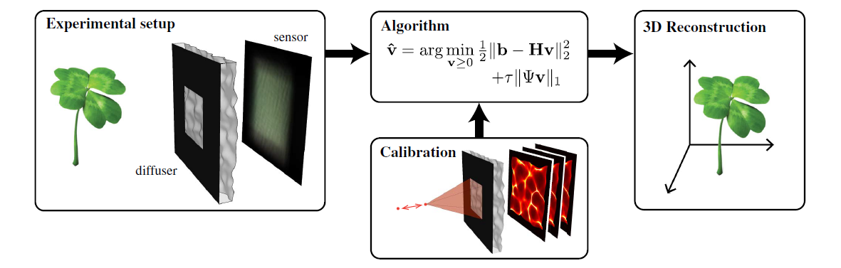
Principles
Difficult
Notes:
In the equation b = Hv; H is the forward model whose columns consist of the caustic patterns

Slide 14
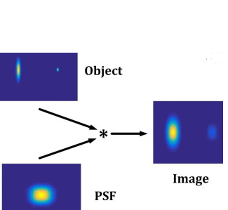
Principles
Difficult

Slide 15
Setup
Difficult

Slide 16
Setup
Difficult

Slide 17
Experiments
Difficult

Slide 18
Experiments
Difficult

Slide 19
Discussion
Difficult

Slide 20
Discussion
Field of View
Off-axis modeling
Number of Calibrations
Resolution
Complexity of object

Slide 21
Conclusion
Difficult

Slide 22
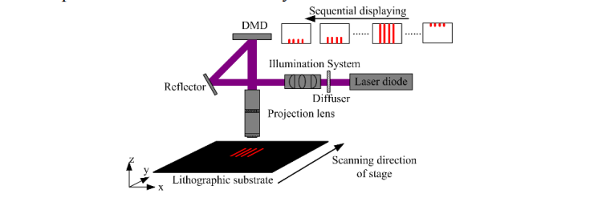
Future Work
Rapid Measurement of PSFs thru diffuser

Slide 23
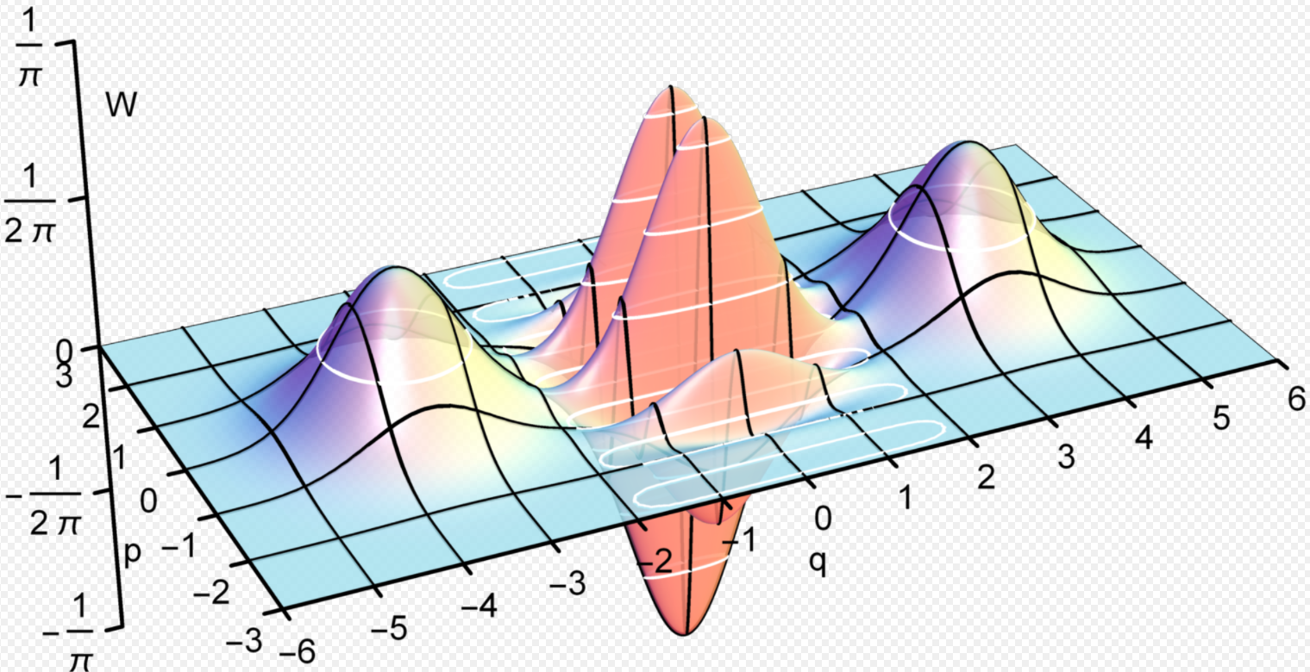
Future Work
Modeling Wigner vs Ray Optics
https://commons.wikimedia.org/wiki/File:Wigner_function_of_a_Schr%C3%B6dinger_cat_state.gif#/media/File:Wigner_function_of_a_Schrödinger_cat_state.gif

Slide 24
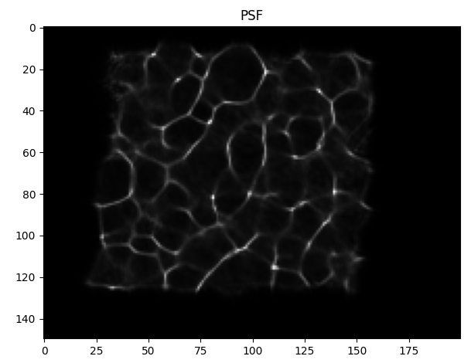
Status Week of 10/26/21(3)
Ran algorithm( Gradient descent) with good known images and working aperture

Slide 25
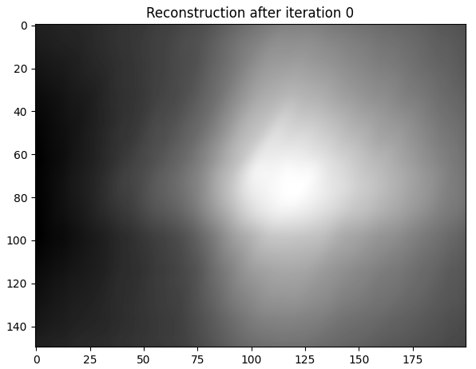
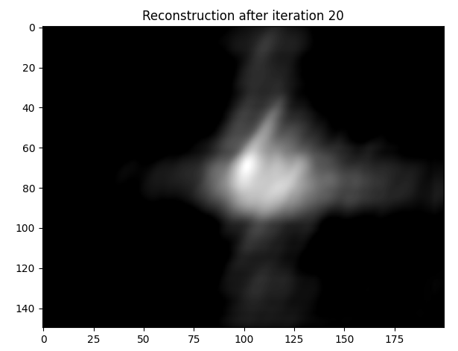
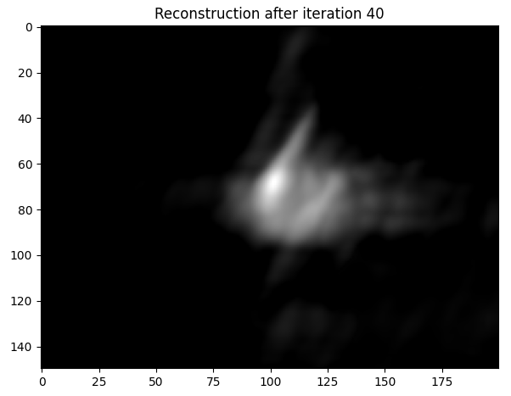
Status Week of 10/26/21(4)

Slide 26
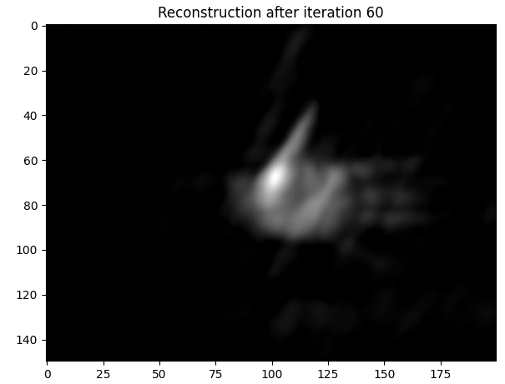
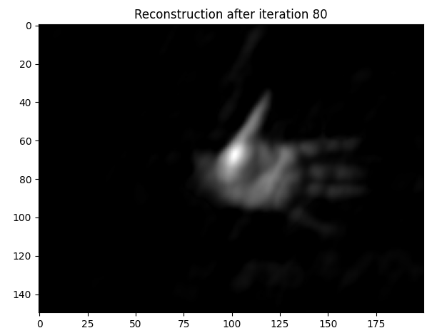
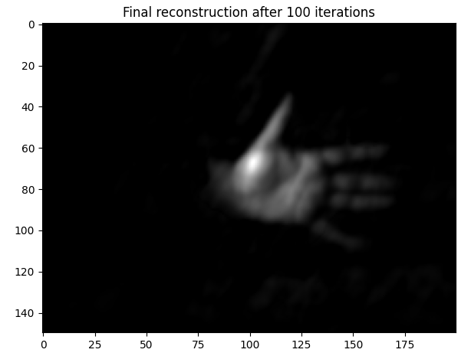
Status Week of 10/26/21(5)

