Slide 1
DiffuserCam: lenless single-exposure 3-D Imaging
University of North Dakota EE department
EECS590, Ray Duran
12/2/21

Slide 2
Agenda
Motivation/Applications
Background
Compressive Sensing
Diffusers
Point Spread Functions
Algorithms
Principles
Setup & Experiments
Discussion & Conclusions
Future Work
Notes:
My Name is Ray Duran, and my background is signal processing, video compression and chip design with a severe math bias.

Slide 3
Motivation
Problem: Provide a light-field representation of 4-D information( plenoptic(2 coordinates and 2 angles) into 2-D sensor
We want system to be inexpensive, flexible and compact
Previous work:
Coded aperture light field… limits amount of light
Microlens….. Does not scale well
Address Field of View vs Resolution imaging
Further develop state of art for scatter models
Notes:
Problems with scattering:1. Light is outside numerical aperture of our system 2. Spatial frequencies of our light are mixed or convolved with our own system and noisy. Since we are all BME’s here or EE’s for the most part then a highly motivating example for us is the field of tissue scattering.

Slide 4
Applications
In Vivo microscopy and neurological imaging
The problem of scattering in biological tissue is a challenging open topic today in microscopy.
How to solve depth problem vs resolution
As an example confocal( low depth and high resolution) vs MRI with high depth but low resolution.
Notes:
In vivo microscopy and the 4th BME seminar.

Slide 5
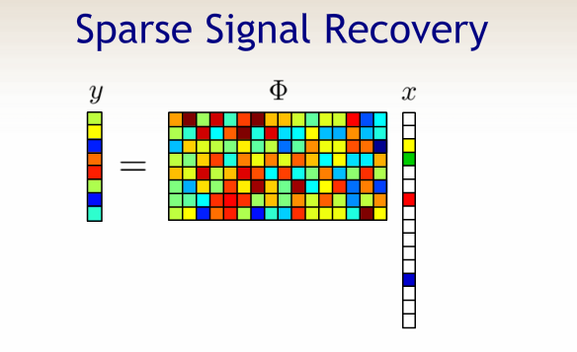
Compressive Sensing
Underdetermined Systems
Candes, Romberg and Tao (2005)
Notes:
b = Hv . You can think of this in our context as b = 2D sensor array M So, b (Mx1) = H(MxN)*V(Nx1); N is 3D voxels; M is 2D sensor array M << N so this is an undetermined system. So, this can’t be solved by pre-2005 understanding of systems of equations, but if we enforce sparsity we do converge to a solution. This is a classical basis pursuit problem in compressive sensing. Also, the H array needs to have undistributed uncorrelated columns.

Slide 6
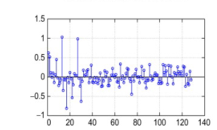
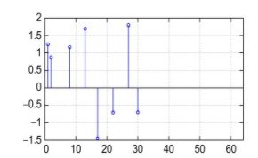
Compressive Sensing
Uncertainty relation( Heisenberg from Quantum Mechanics)
Mutual coherence
Notes:
Besides sparsity we need an extra bit of “magic” for our system matrix H. Let us look at the above

Slide 7
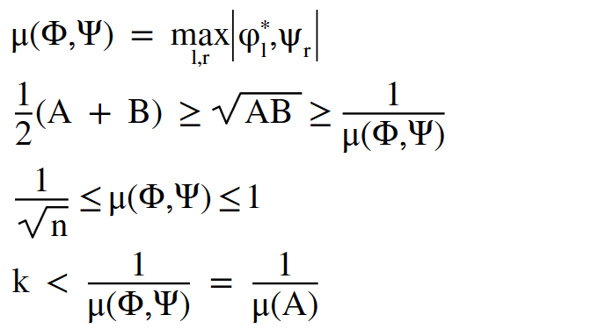
Compressive Sensing
Sensing Matrix Equations
Notes:
So, now what do we have: 1. Satisfied sparsity. But sparsity is not enough, we also satisfied this uncertainty relation dual pair of basis that satisfies this uncorrelatedness. So, if we can just come up with a medium that allows this we are in business.

Slide 8
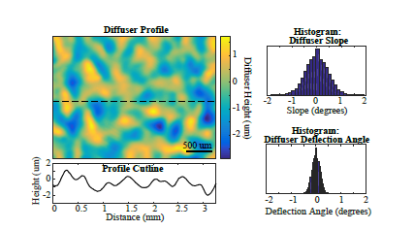
Diffusers
Can be thought of as random matrix
Notes:
Here is that medium.; A diffuser can be thought of as a kind of random matrix. So, all we would then need is for our voxels to be sparse in some domain. As we saw earlier in Professor Liang’s lecture on compressive imaging, we are saved as a random matrix multiplied by another matrix is still random. So, if we transpose our solution into a spare domain with some matrix we are still random.

Slide 9
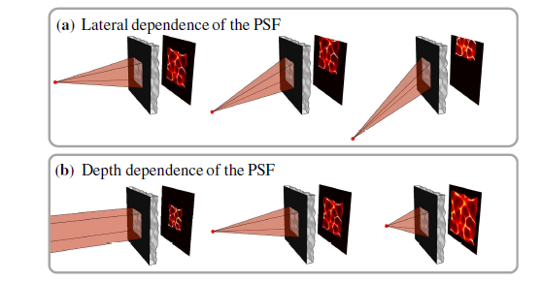
Diffusers
Uniqueness of Patterns
Randomness from diffuser
creates a type of spectral
signature from every point
source in our object
The depth acts as a scaling
function while the lateral is a shift
Notes:
And if you remember from linear systems, a shift is just a re-cyle of data in the convolution matrix

Slide 10
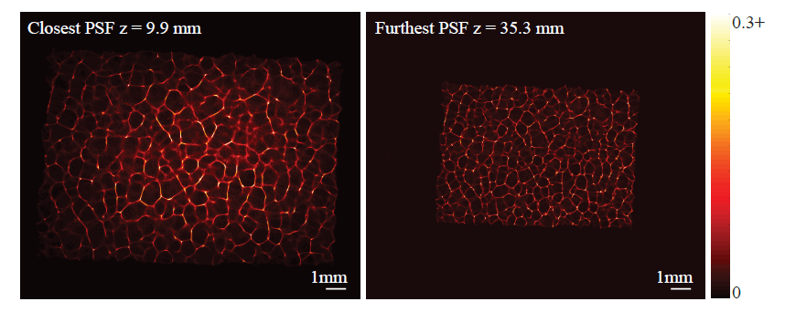
Point Spread Function
Caustics from diffuser
High-frequency in all
directions
This gives us good
resolution at all depths
Highly structured PSF
for deconvolution

Slide 11


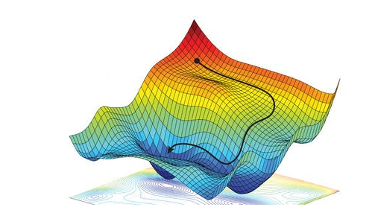

Algorithms
Gradient descent for optimization
Strategy for solving for A
Notes:
Adjoint NOT Adjunct!!

Slide 12
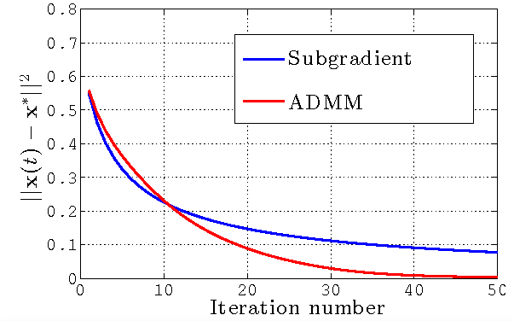
Algorithms
Gradient speed up
Fast Iterative Shrinkage-
Thresholding Algorithm
(FISTA) ( Used for Exper.)
Alternating Direction
Method of Multipliers
(ADMM)
Notes:
Here we would like to have something faster to compute for 3-D imaging. We use the FISTA in our experiments. The ADMM is a popular optimization these days. Basically, if you have a way of separating the problem into two convex functions, and you can then make your constraints linearly then there is a big speedup. This method is related to a penalty of Lagrangian methods. I am not very familiar with ADMM but am familiar with
Lagrangian methods that speed up optimization. I have used such techniques in doing video compression, where the idea is to reduce bit rate but maintain distortion.. This is the classical bitrate distortion problem in information theory.

Slide 13
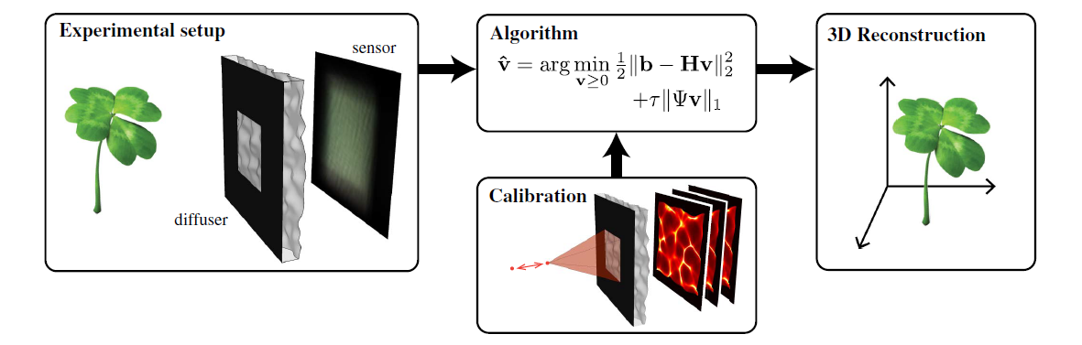
Principles
Overall System
Notes:
In the equation b = Hv; H is the forward model whose columns consist of the caustic patterns

Slide 14
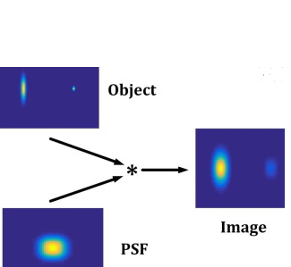
Principles
Antipa builds a forward convolutional model
Incorporates a cropped convolution
Trick of not using H directly
Confirms random matrix
and use of compressed sensing
In Theory allows a simple calibration

Slide 15
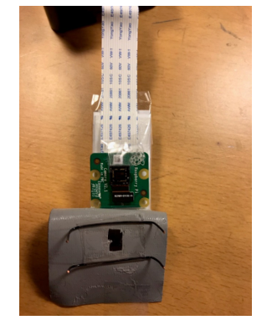
Setup
Diffuser: Single and Double scotch tape
Modified Raspberry Pi Sensor
Aperture, housing, enclosure(black tape)
Processing off-line with Python & Matlab
(for some pre-processing)
Notes:
See diffuse; Raspberry Pi sensor, aperture, calibration.

Slide 16
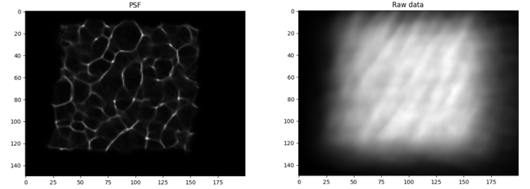
Experiments
Antipa PSF and image

Slide 17
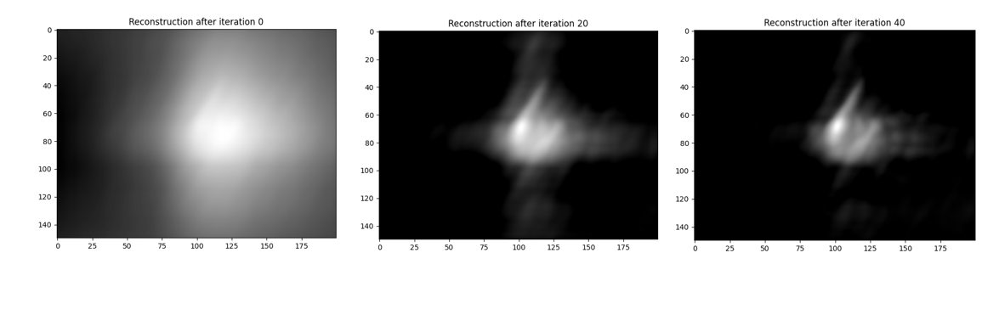
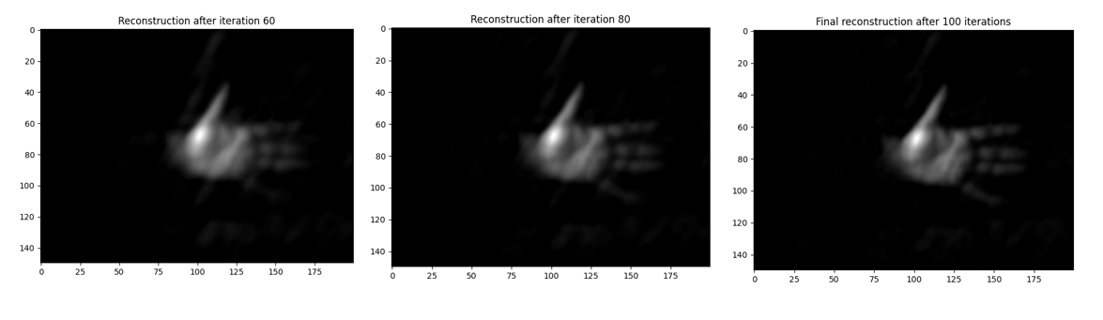
Experiments
Antipa et al. results

Slide 18
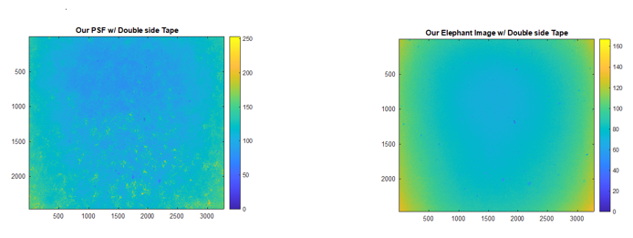
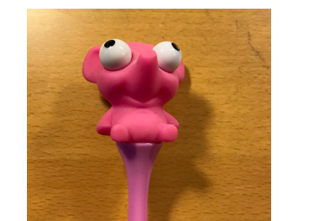
Experiments
Our results( PSF &
Captured Image
Target object

Slide 19
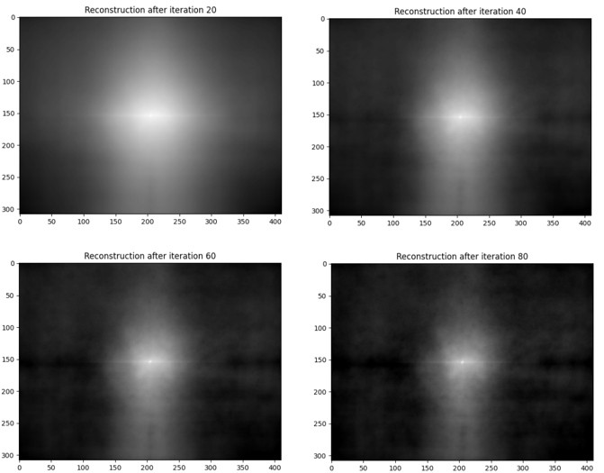
Experiments
Our results

Slide 20
Discussion
Field of View
Off-axis modeling
Number of Calibrations
Resolution
Complexity of object
Notes:
Our voxel size again is our N dimension from earlier determines how fine a resolution we can see that ultimately is related to the complexity of the object and ultimately how much we can process.

Slide 21
Conclusion
Calibration distance problems
Modifying sensor
Problems with saturation
All above contributed to our caustic PSF pattern
No able to reproduce with good results
Notes:
However, this project has opened up some interesting lines of research to continue on.

Slide 22
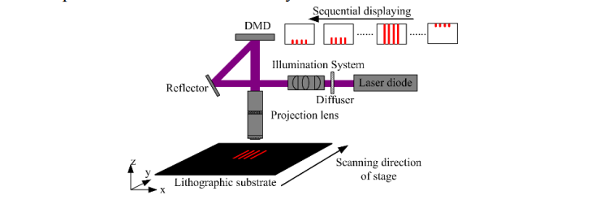
Future Work
Rapid Measurement of PSFs thru diffuser

Slide 23
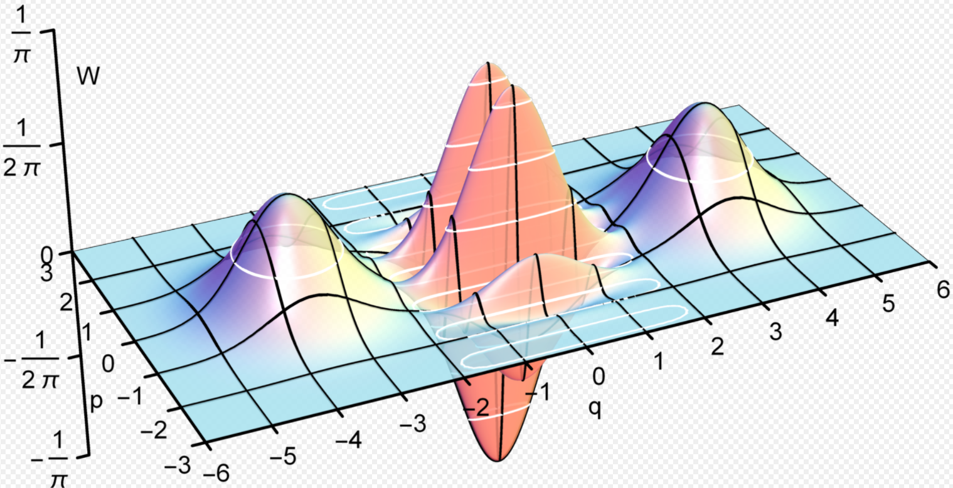
Future Work
Modeling Wigner vs Ray Optics
https://commons.wikimedia.org/wiki/File:Wigner_function_of_a_Schr%C3%B6dinger_cat_state.gif#/media/File:Wigner_function_of_a_Schrödinger_cat_state.gif
Notes:
I’ll end my presentation with my coolest slide. ☺ This is the harmonic oscillator model used in quantum mechanics. The wave function which is related to a Hermite Polynomial,gaussian function and a normalization constant. For us, there is a strong connection to modeling the light field as a Wigner distribution.

Slide 24
Partial References
N. Antipa et al., “DiffuserCam: lensless single-exposure 3D imaging single-shot,” Optica 5,1-9 (2018).
X. Jin, D. Mao,S. Wei,Q. Dai “Point spread function for diffuser camera based on wave propagation and projection model,” Opt. Express 27, 12748-12761 (2019).
M. Cai, J. Chen, G. Pedrini, W. Osten, X. Liu, and X. Peng, “Lensless light-field imaging through diffuser encoding,”Light Science & Applications (2020).
N.C. Pegard et al., “Compressive light-field microscopy for 3D neural activity recording,” Optica 3, 517-524 (2016).
Z. Zhang, M. Levoy, “ Wigner Distributions and how they relate to the light field,”Proceedings of IEEE ICCP (2009).

