Slide 1
Diffuser Cam using Compressive Imaging
University of North Dakota EE department
EECS590, Ray Duran
10/19/21

Slide 2
Determine Focus distance
Removed lens and mount from Raspberry Pi camera
Difficult to measure and stabilize sensor with diffuser
Two videos from : (vid4)3.175 mm and (vid5)1.875 mm
Good enough to build separator?
Suggestions?
Next steps?

Slide 3
Status Week of 10/26/21 (1)
Difficult to get focal distance; Guessed 2mm
Not sure caustic patterns are correct
Do not get calibration with borders correct; No way to control voltage of source to modulate for saturation or to measure for it

Slide 4
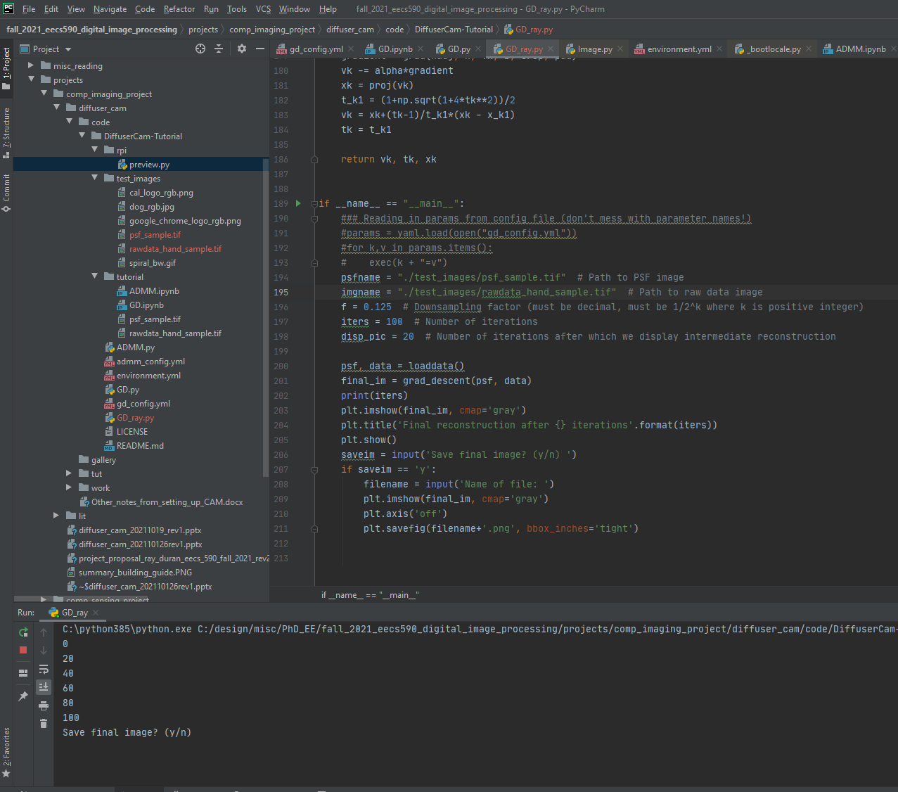
Status Week of 10/26/21(2)
Installed and modified Python for Diffuser Cam algorithm

Slide 5
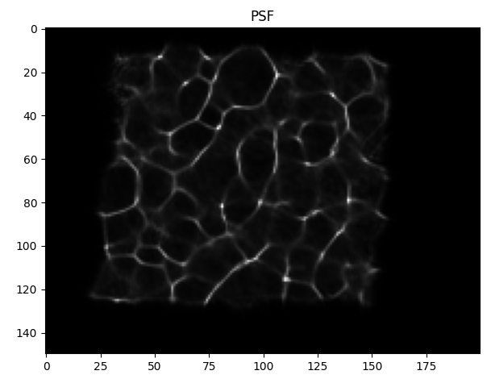
Status Week of 10/26/21(3)
Ran algorithm( Gradient descent) with good known images and working aperture

Slide 6
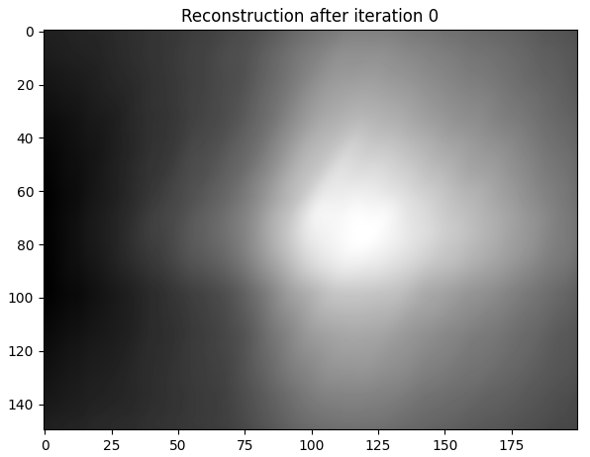
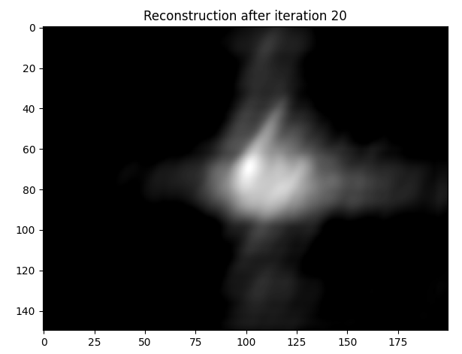
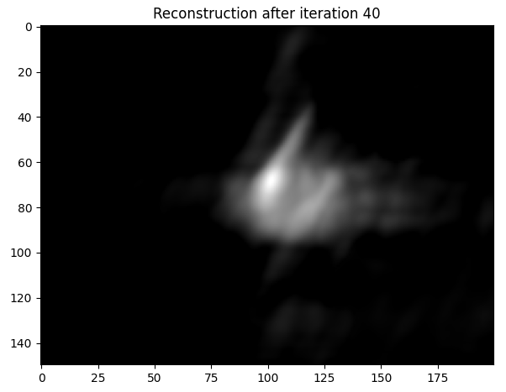
Status Week of 10/26/21(4)

Slide 7
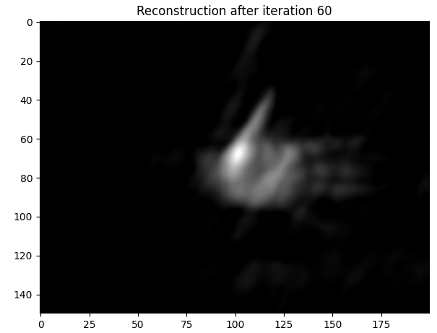
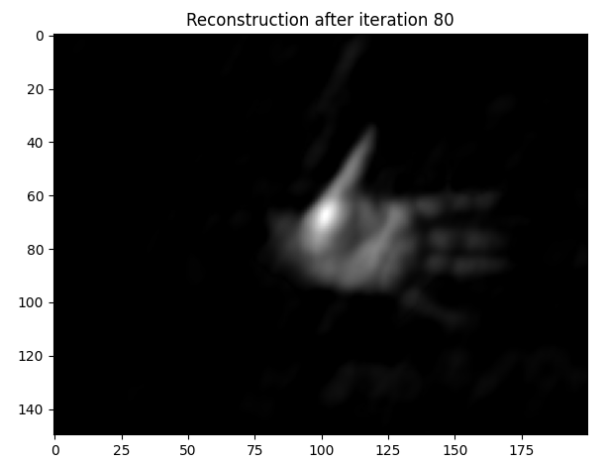
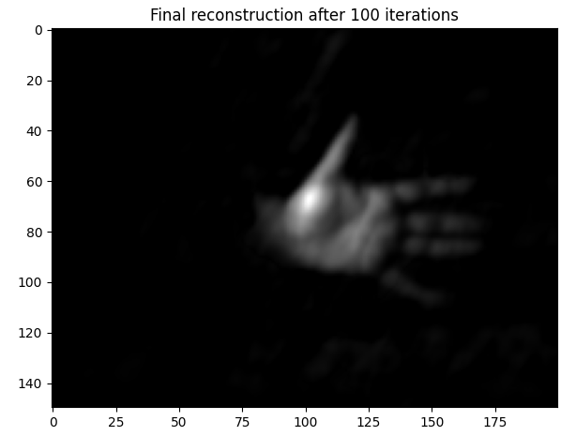
Status Week of 10/26/21(5)

Slide 8
Status Week of 10/26/21 (6) Next Steps
Next will attempt reconstruction with our data, knowing that caustics, focal distance and calibration do not look correct.

