Slide 1
Sales Summary for Colorado
By: Matthew Pena

Slide 2
Agenda
A walkthrough of the analysis process.
The results gathered.
Go over significant findings from the results.
My recommendations for the upcoming quarter.

Slide 3
The Process
I was asked by my Sales Manager, Jim Heck, to find the following:
  The total revenue sales for Colorado, along with the start and end date that that revenue was generated in.
  The revenue breakdown by year and month for Colorado.
  The total revenue comparison between Colorado and other sales territories in the West region.
  The number of transactions per month and the average transaction amount by product category for Colorado.
  An In-store sales performance ranking by each store location in Colorado.

Slide 4
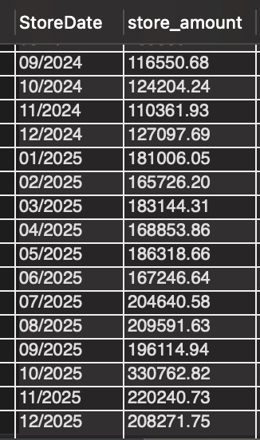
Total Revenue Sales for Colorado and Breakdown
Total Revenue: $6,412,632
From Jan. 01, 2022 to Dec 31, 2025

Slide 5
Comparison of Total Revenue in West Region
In-Store Contribution | Online Contribution
71.48% | 28.52%
As shown, in-store sales contributed the most in total revenue.

Slide 6
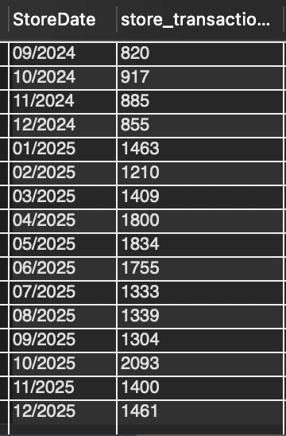
Number of Transactions per Month
Similar to revenue breakdown. But this time, by transaction amount.

Slide 7
Average Transaction by Product Category
Product Category | Average Transaction
Apparel and Merchandise | 92
Textbooks | 56
Art Supplies | 84
Technology & Accessories | 81
Books (General) | 81
Stationery and Supplies | 89
As shown, Apparel and Merchandise has the highest average, followed by Stationery and Supplies, with Textbooks having the lowest average. Note: high transactions don't equate to higher sales.

Slide 8
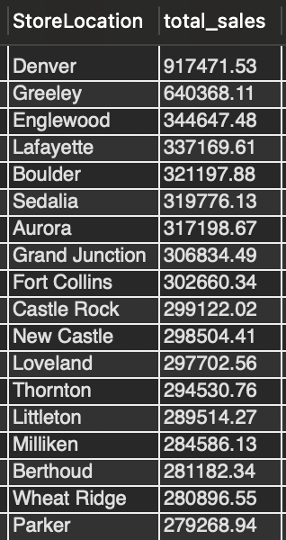
Ranking of In-Store Sales Performance
The top performing store location is in Denver, and the least performing one is in Parker.

Slide 9
Significant Observations (Product Categories)
The best sales-performing product category is Technology & Accessories
The least sales-performing product category is Stationery and Supplies
Textbooks and Books (General) outperformed Stationery and Supplies in total sales despite less transaction amounts.
Total sales for October jumped by 68.7% from September, across all product categories.
Total sales for December dropped by 37.6% from October, across all product categories.

Slide 10
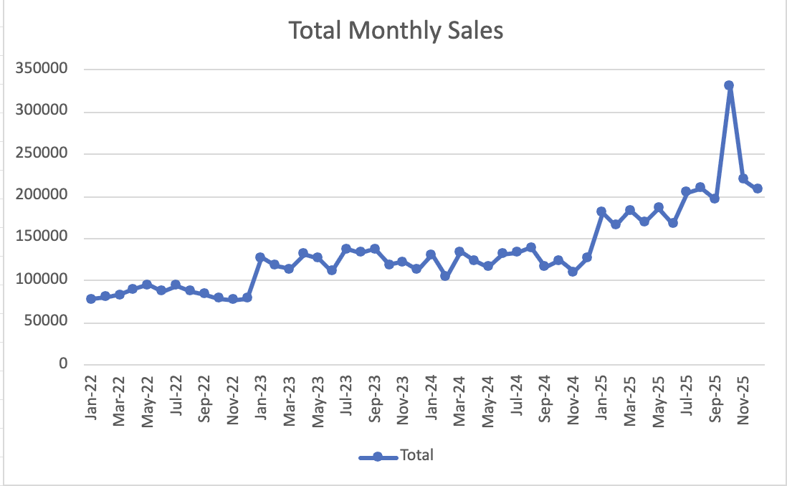
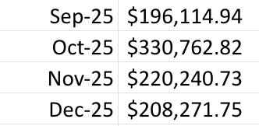
Significant Observations (Product Categories) Cont.

Slide 11
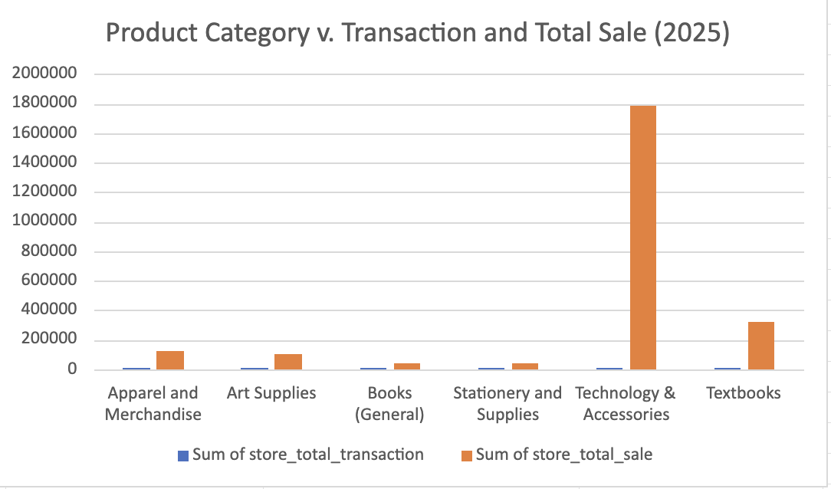
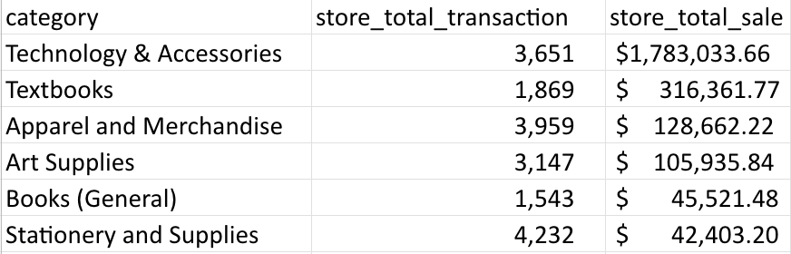
Significant Observations (Product Categories) Cont.

Slide 12
Significant Observations (Store Locations)
During the sales drop from November to December, locations such as Lafayette, Sedalia, and Aurora have experienced sales recovery.
The only store location that didn't suffer in sales loss is in Grand Junction.

Slide 13
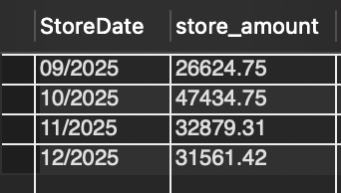
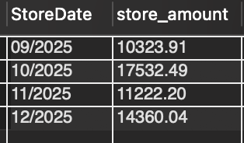
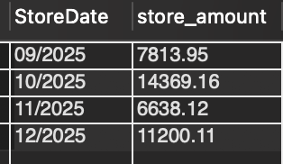
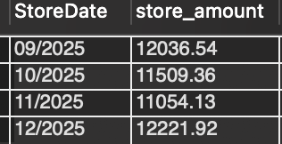
Significant Observations (Store Locations) Cont.
Denver
Sedalia
Lafayette
Grand Junction

Slide 14
My Recommendations
In the next quarter, investigate the cause in total sales drop from October to December.
Focus on top performing product categories and store locations.
Improve promotions for Textbooks and Books (General) because they generate the most sales relative to their transaction amount.
Find out what we did right from September to October that caused the 68.7% increase in sales and how we can replicate that for the next quarter.
Reach out to the store location in Grand Junction and recovering locations, such as Lafayette and Sedalia, and learn what they are doing to revive their sales.

