Slide 1






Webster University
Home Improvement Bank Loan
Decision Making Analytics
Predicting defaults and managing risk isn’t just about numbers; it’s about driving smarter decisions for a more secure future.
Classification
Clustering
Ready to Dive?

Slide 2

Webster University
Business Goals
Goal 1
Automated Loan Default Prediction & Interpretability
Goal 2
Clustering for Defaulter Segmentation
Goal 3
Clustering for Non - Defaulter Segmentation
BAD = 1
BAD = 1
BAD = 0
Ensure transparency by providing clear, interpretable reasons for loan decisions. Comply with legal standards like the Equal Credit Opportunity Act (ECOA).
Identify sub-groups with frequent delinquencies, high debt-to-income ratios, or multiple derogatory reports.
Identify sub-groups with frequent delinquencies, high debt-to-income ratios, or multiple derogatory reports.

Slide 3
Webster University
Analytical Goals
Goal 1
Classification for Loan Default Prediction
Goal 2
Clustering for Defaulter Segmentation
Goal 2
Clustering for Non-Defaulter Segmentation
Develop a model that accurately predicts whether a loan applicant will default (BAD = 1) or not (BAD = 0).
Models :
Logistic Regression
Decision Tree
Random Forest
Segment defaulters (BAD = 1) into distinct sub-groups based on credit stability.
Models :
K-Means
Hierarchical Clustering
Segment non-defaulters (BAD = 0) into distinct sub-groups based on credit stability.
Models :
K-Means
Hierarchical Clustering

Slide 4

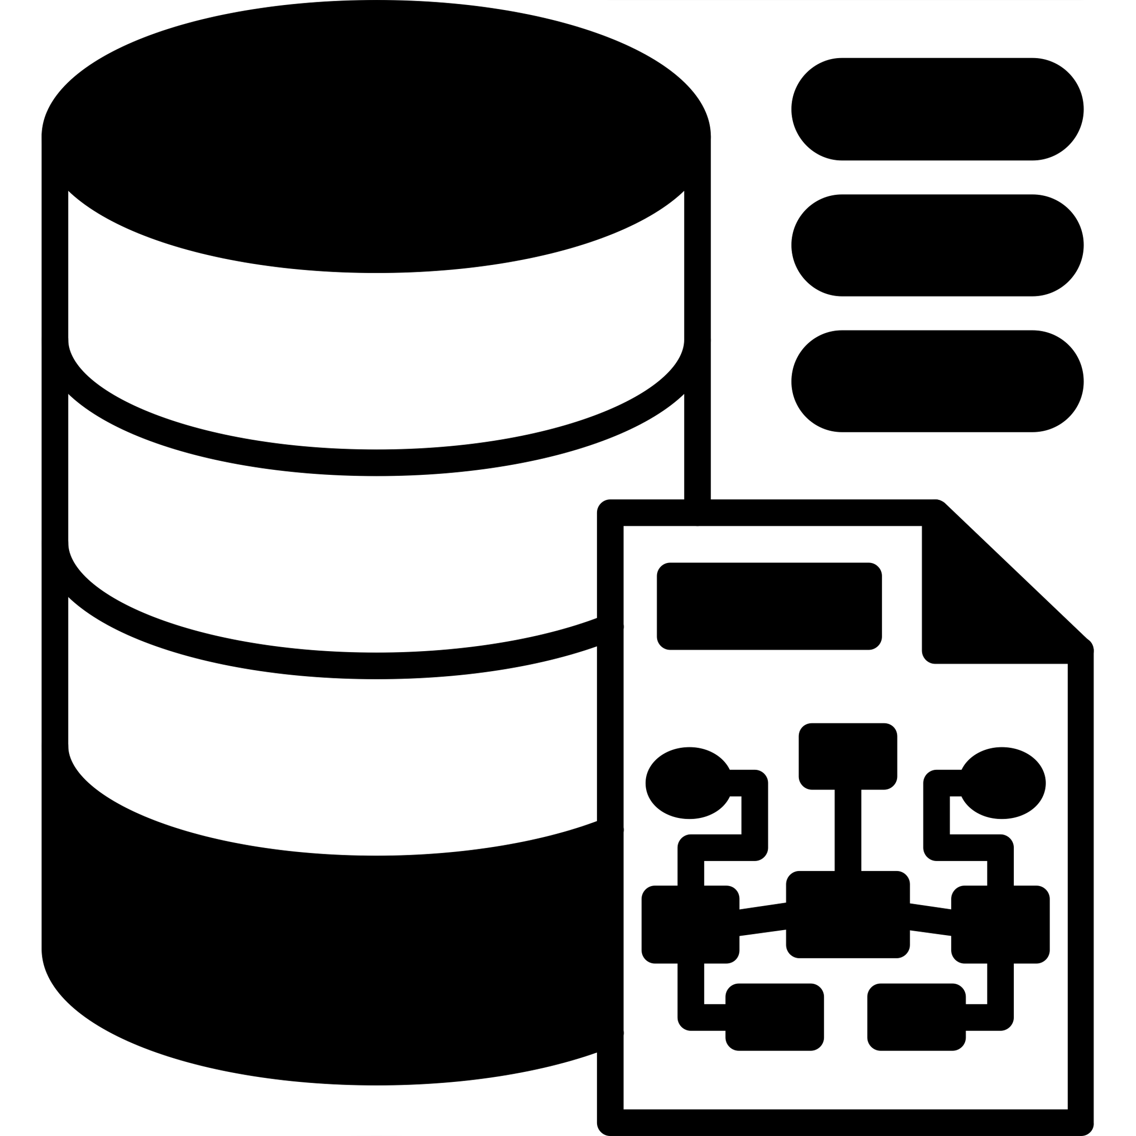
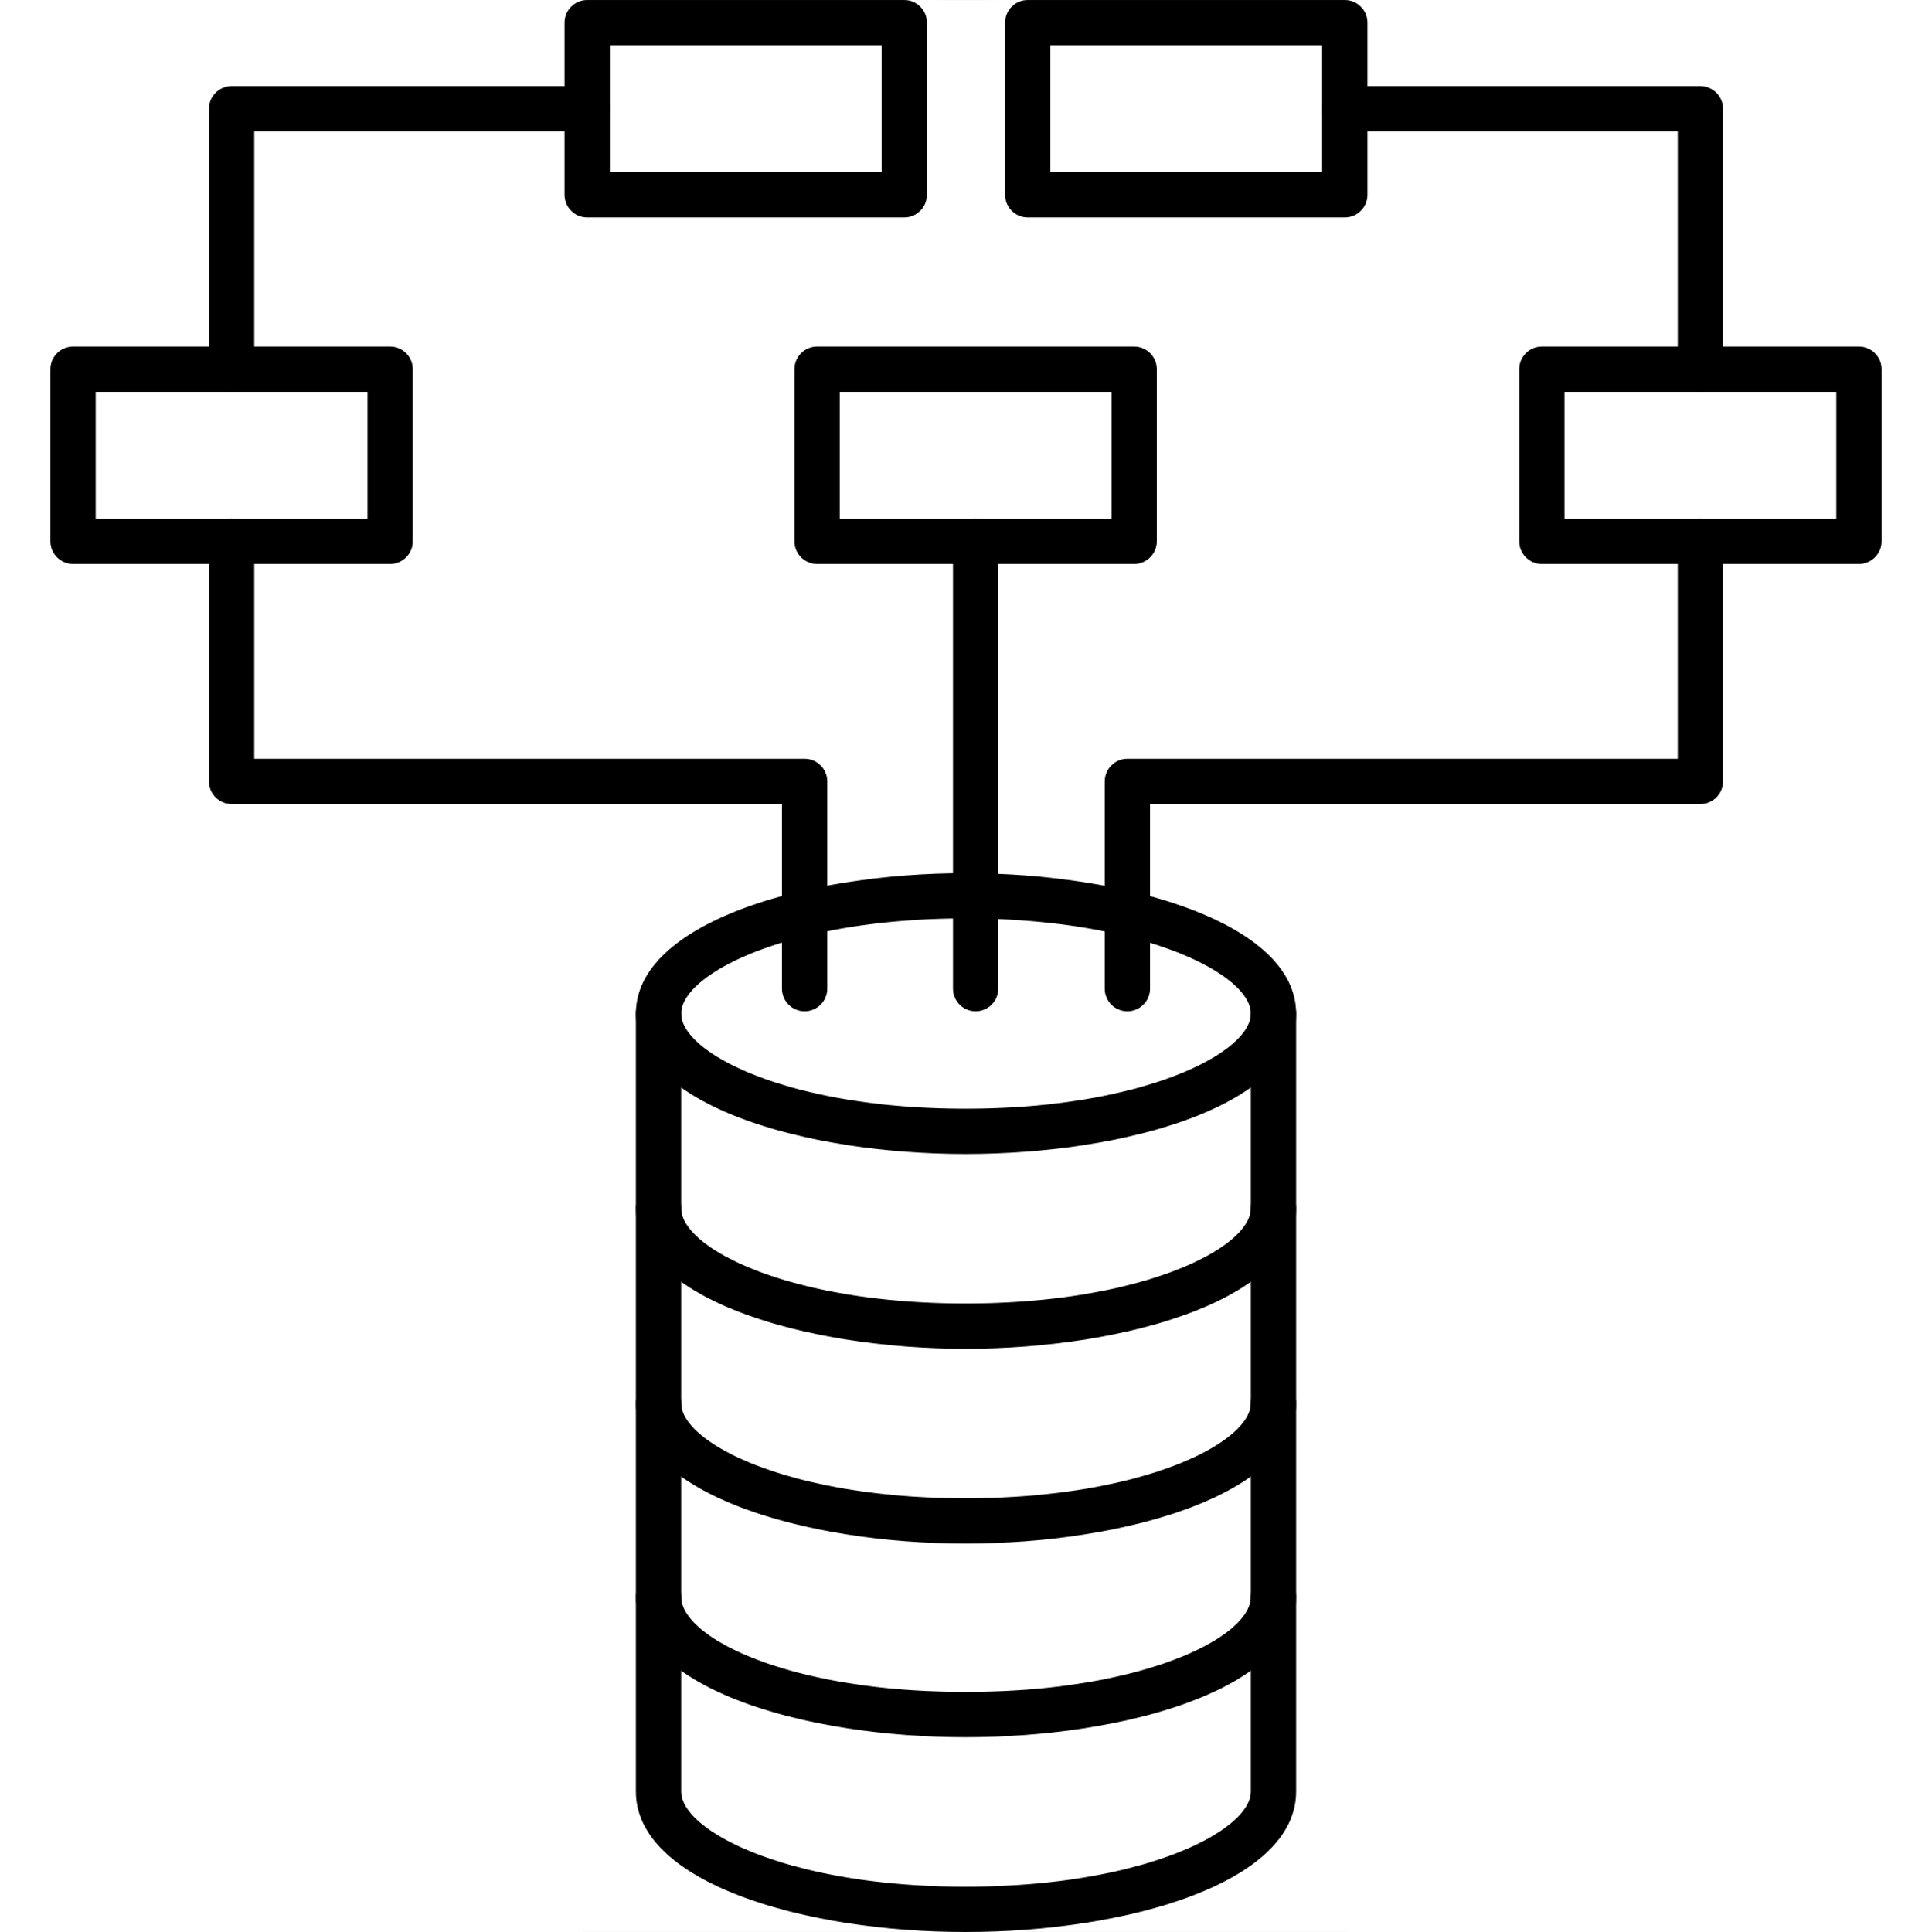
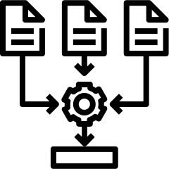

Webster University
Analytical Approach
Data Preprocessing
EDA
Model Building
Model Evaluation
Handled missing values with median and KNN imputation, encoded categorical variables using one-hot encoding,
Analyzed relationships between variables, applied transformations, and performed data partitioning (70-30 split) to prepare datasets for classification and clustering​
Classification Models: Logistic Regression, Decision Tree, and Random Forest models to predict loan defaults.
Clustering Models: K-Means and Hierarchical Clustering separately to segment defaulters and non-defaulters into distinct risk profiles
Evaluated classification models using accuracy, precision, recall, F1 score, and AU
Clustering with Silhouette score.

Slide 5
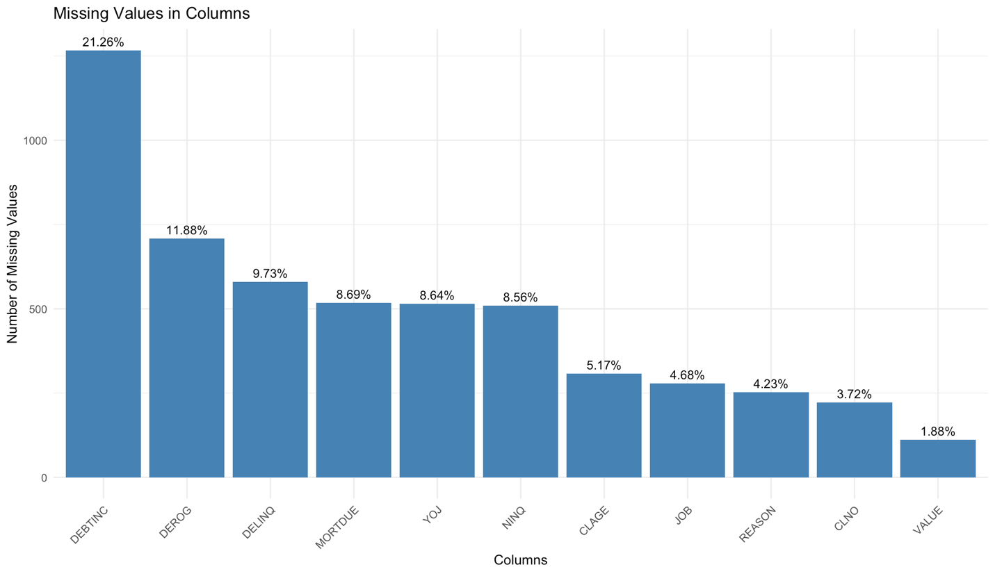
Webster University
Missing Values
Column | Imputation Method | Rationale
MORTDUE | Median Imputation | Skewed financial data, robust to outliers
VALUE | Median Imputation | Skewed property values, appropriate for financial data
DEROG | Median Imputation | Skewed number of derogatory marks, likely to have outliers
DELINQ | Median Imputation | Skewed delinquencies, median is robust
CLNO | Median Imputation | Skewed distribution of credit lines
DEBTINC | Median Imputation | Skewed debt-to-income ratios, best handled with median
YOJ | KNN Imputation | Strong relationships with other variables, better suited to KNN
CLAGE | KNN Imputation | Depends on credit behavior patterns, KNN captures those
NINQ | KNN Imputation | Related to credit behavior, KNN models this well
REASON | Mode Imputation | Categorical data imputed with the most frequent category
JOB | Mode Imputation | Categorical data imputed with the most frequent category

Slide 6
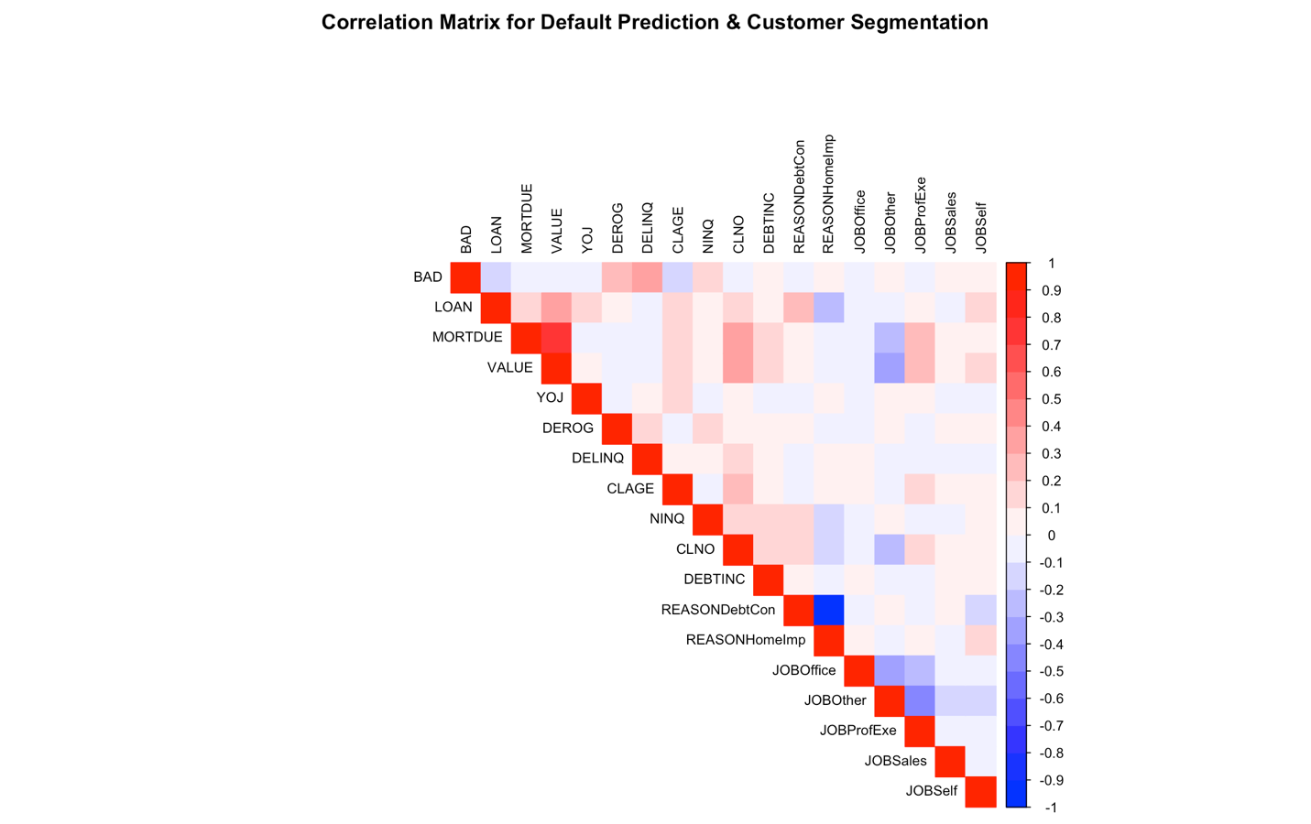
Webster University
Correlation Matrix
Variable | Correlation with BAD | Description | Interpretation
DELINQ | 0.33 | Number of delinquent credit lines | Positive correlation: More delinquencies increase the likelihood of default.
DEROG | 0.27 | Number of major derogatory reports | Positive correlation: More derogatory marks significantly increase default risk.
NINQ | 0.15 | Number of recent credit inquiries | Positive correlation: More recent inquiries correlate with a higher chance of default.
DEBTINC | 0.09 | Debt-to-income ratio | Positive correlation: Higher debt relative to income increases default risk, indicating financial stress.
JOBSales | 0.05 | Applicant's job is in sales | Positive correlation: Applicants with jobs in sales show a slight increase in the likelihood of default.
JOBSelf | 0.05 | Applicant is self-employed | Positive correlation: Self-employed applicants have a slightly higher likelihood of default.
CLAGE | -0.19 | Age of the oldest credit line (in months) | Negative correlation: Older credit lines suggest financial stability, reducing default risk.
LOAN | -0.11 | Loan amount | Slight negative correlation: Higher loan amounts have a weak negative relationship with default risk.
MORTDUE | -0.07 | Remaining mortgage due | Slight negative correlation: Larger mortgages are not strongly correlated with default risk.
VALUE | -0.07 | Property value used as collateral | Slight negative correlation: Higher property values slightly reduce the likelihood of default.
YOJ | -0.06 | Years on the job | Slight negative correlation: Longer job tenure suggests more stability, reducing default risk.

Slide 7
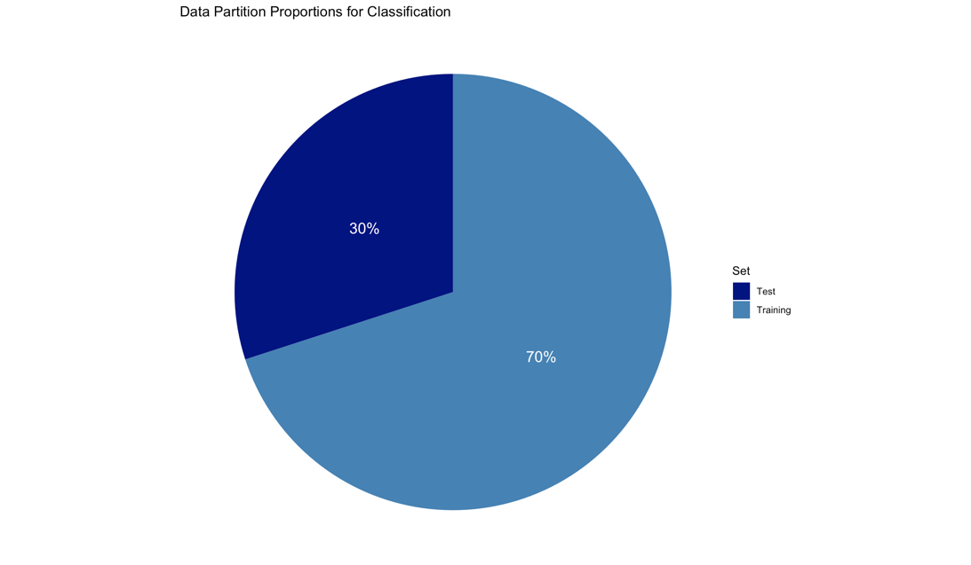
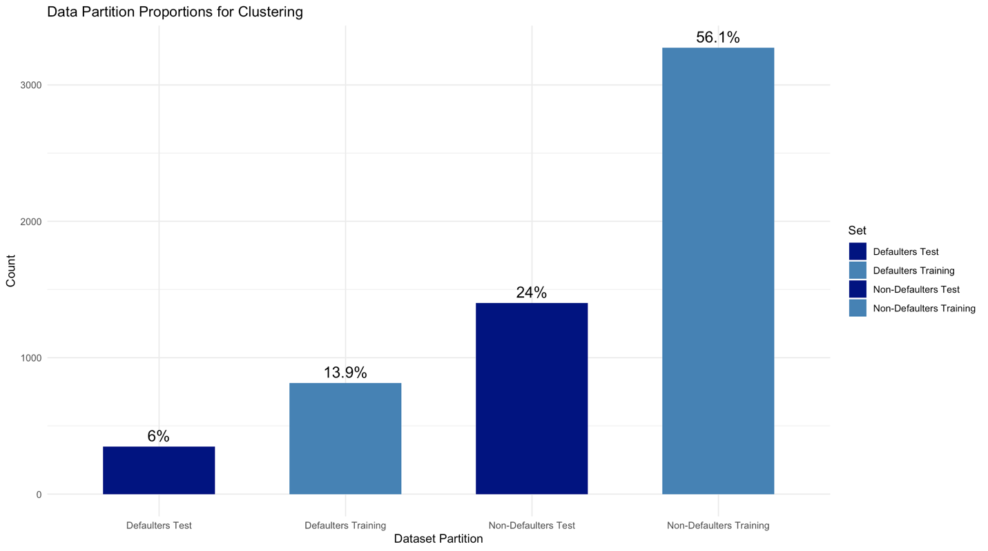
Webster University
Data Partition

Slide 8
Webster University
Classification - Model Comparison
Metric | Logistic Regression | Decision Tree | Random Forest
Accuracy | 84.86% | 89.14% | 93.03%
Sensitivity | 34.68% | 69.04% | 71.83%
Specificity | 96.22% | 93.69% | 97.83%

Slide 9
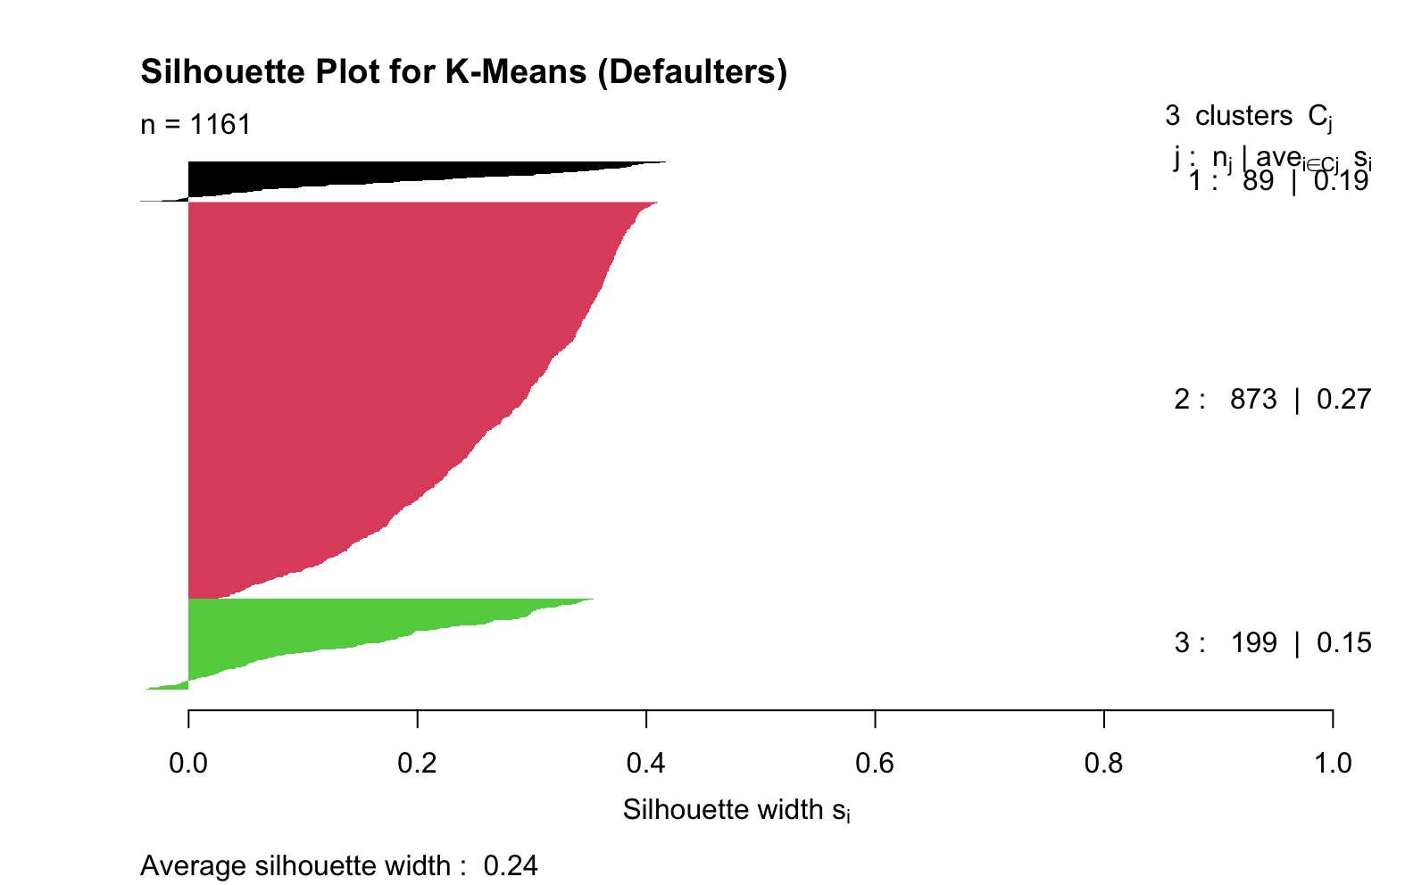
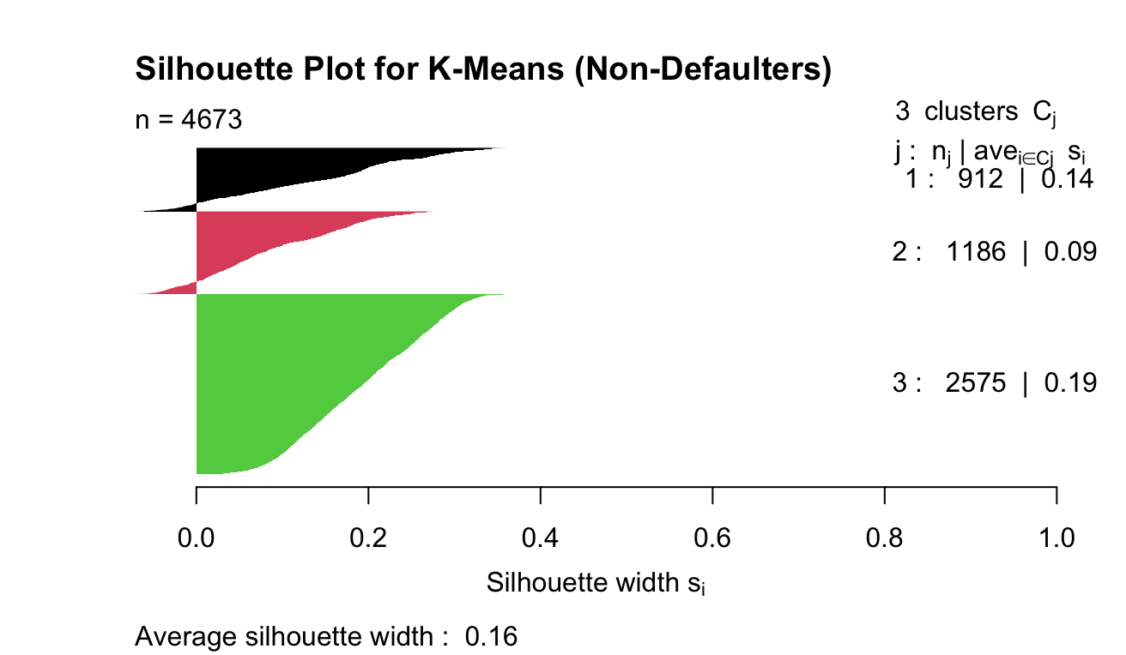
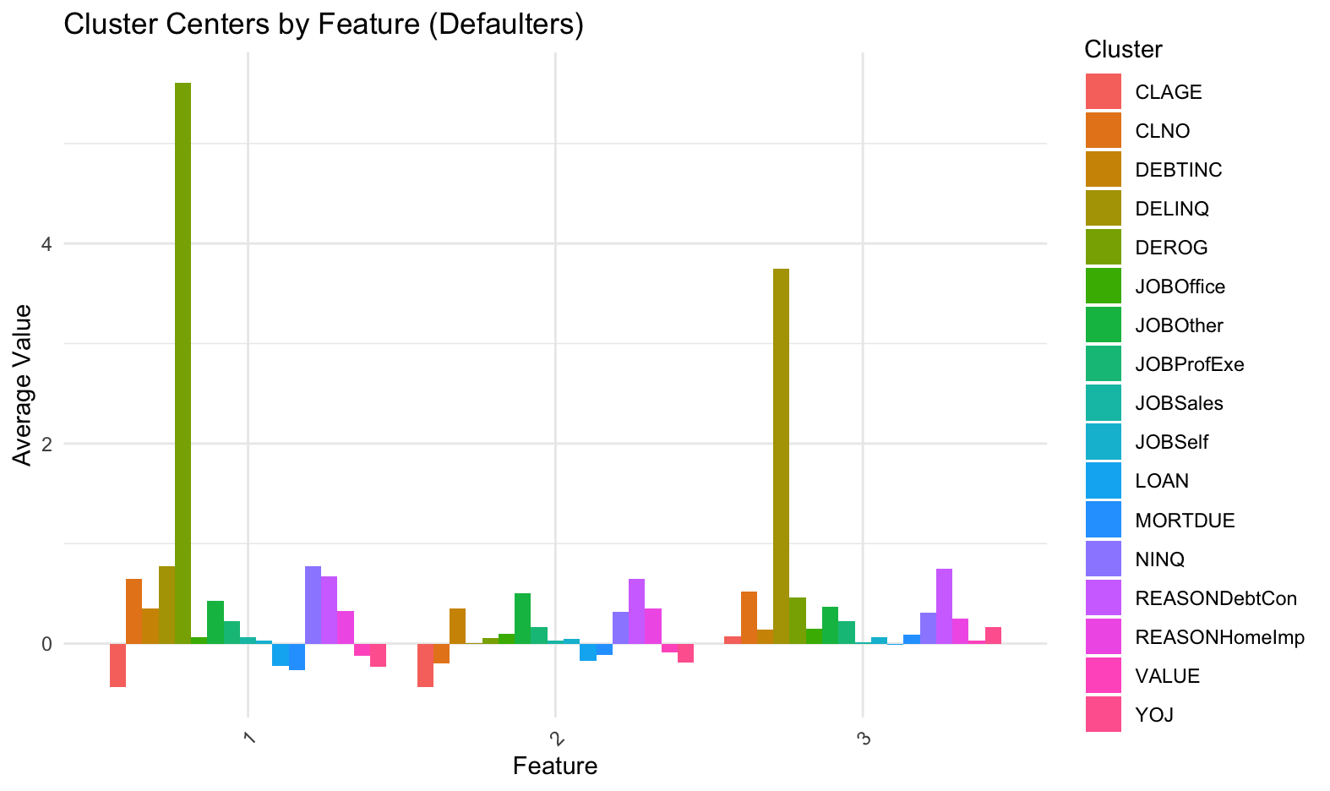
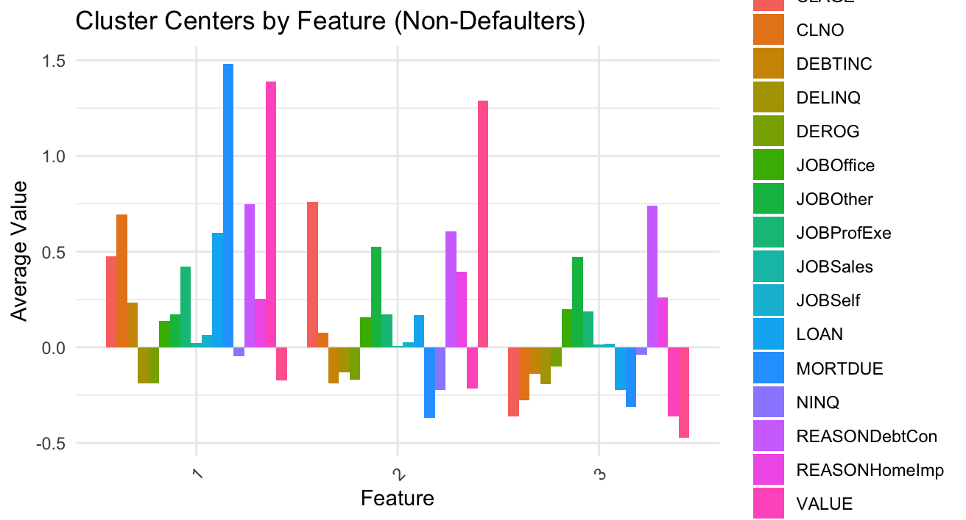
Webster University
Clustering – K-Means

Slide 10
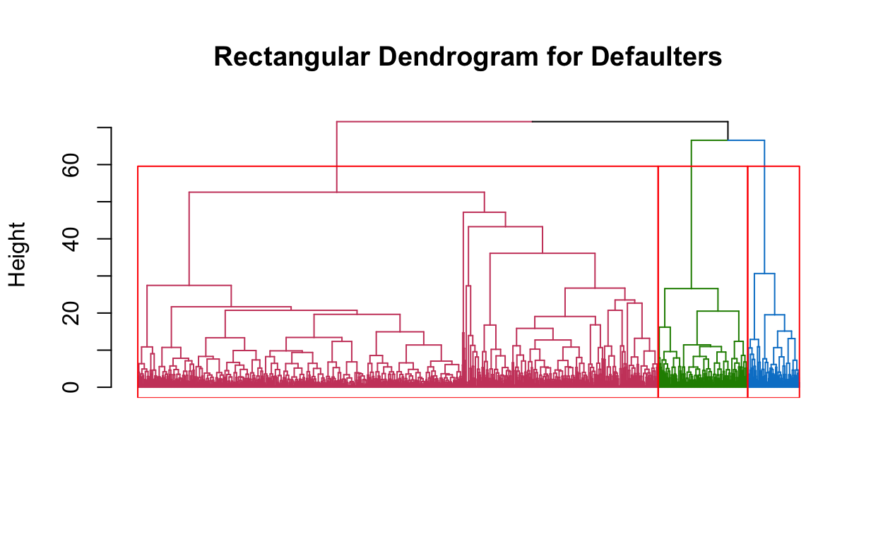
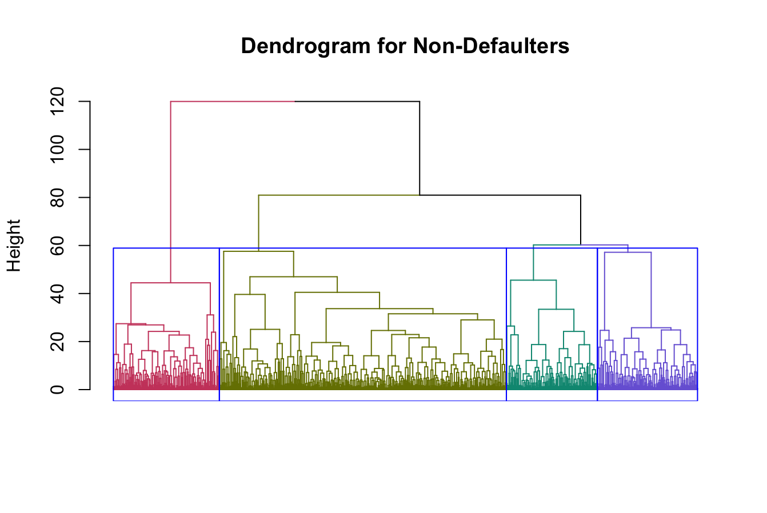
Webster University
Clustering – Hierarchical
Cluster | Size | Description
1 | 913 | Moderate Risk
2 | 91 | High Risk
3 | 157 | Low Risk
Cluster | Size | Description
1 | 2,296 | Stable, Low-Risk Group
2 | 728 | Moderate-Risk Group
3 | 801 | Emerging Credit Segment
4 | 848 | Special Segment, Moderate Volume

Slide 11
Recommendations?
Webster University
Model Deployment: Integrate the tuned Random Forest and K-Means models into the bank’s decision-making workflows for real-time loan approvals and segmentation analysis.
Advanced Risk Profiling: Use insights from defaulter segmentation to design interventions, such as stricter loan terms and financial counseling for high-risk customers. For non-defaulters, leverage segmentation to offer personalized financial products and loyalty rewards.
Continuous Monitoring and Updates: Implement a robust monitoring system to track model performance over time, ensuring alignment with evolving data patterns and regulatory requirements. Recalibrate models as necessary to maintain accuracy and fairness.
Granular Customer Insights: Explore more detailed customer segmentation using advanced clustering methods like Hierarchical Clustering to uncover deeper behavioral patterns and new opportunities for personalized services.
Enhanced Decision Support: Extend the scope of analysis by incorporating additional external data sources, such as market trends or credit bureau data, to improve predictive accuracy and enrich segmentation.

Slide 12

Webster University
Questions?
Thank You !

