Slide 1
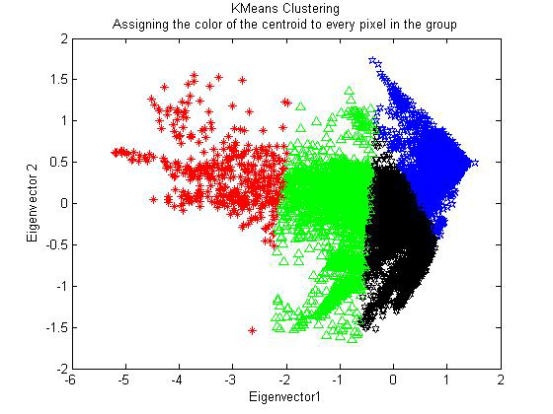
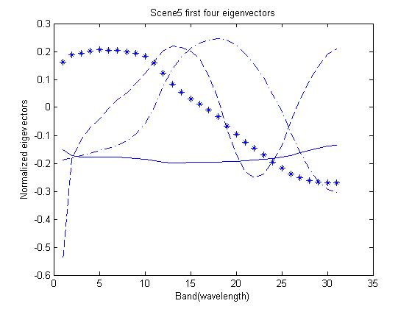
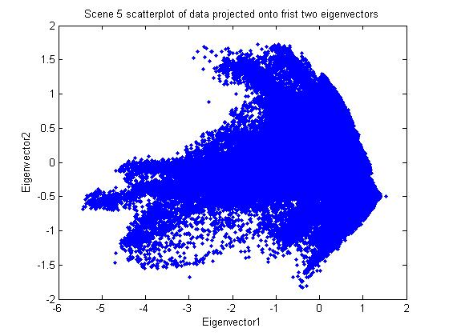


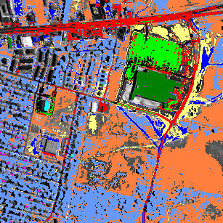
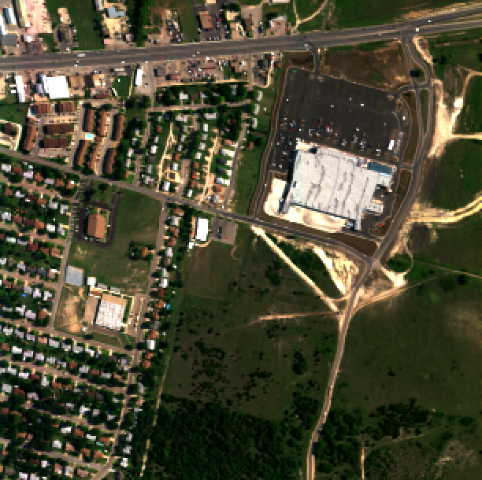
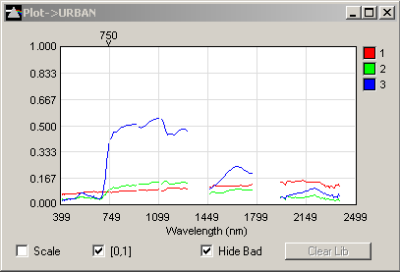
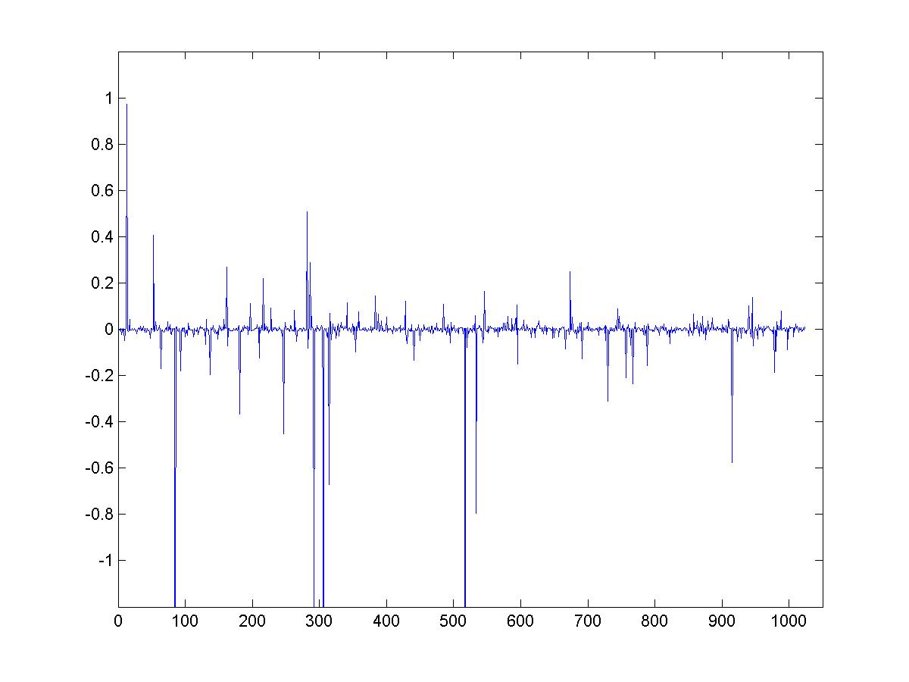
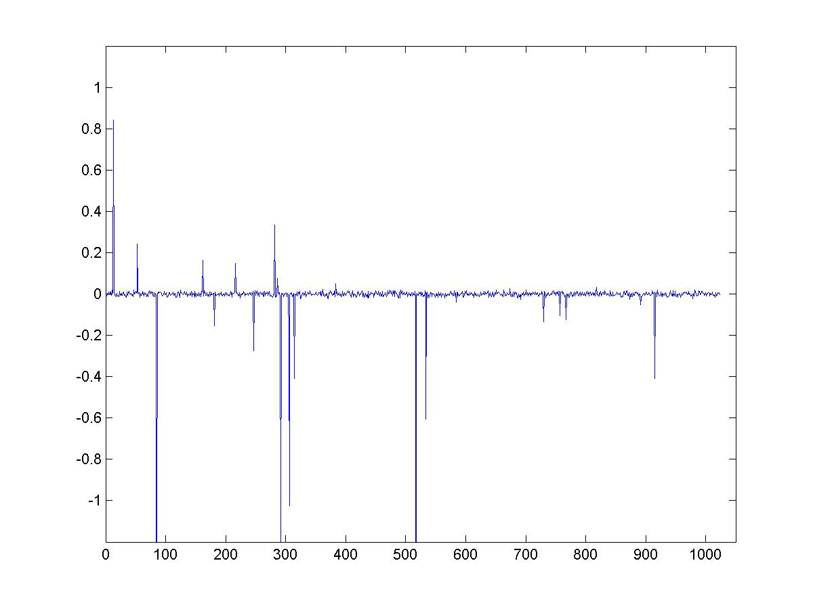
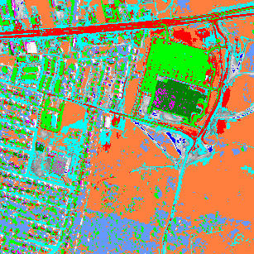
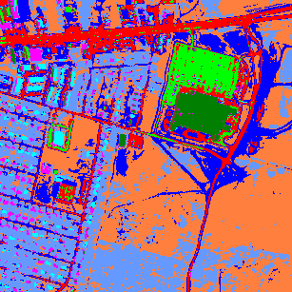
Hyperspectral Imaging
Alex Chen¹, Meiching Fong¹, Zhong Hu¹, Andrea Bertozzi¹, Jean-Michel Morel²
¹Department of Mathematics, UCLA
²ENS Cachan, Paris
Classification of Materials in a Hyperspectral Image
Overview of Hyperspectral Images and Dimension Reduction
A standard RGB color image has three spectral bands (wavelengths of light).
In contrast, a hyperspectral image typically has more than 200 spectral bands that can include not only the visible spectrum, but also some bands in the infrared and ultraviolet spectra as well.
The extra information in the spectral bands can be used to classify objects in an image with greater accuracy.
Applications include the military, mineral identification, and vegetation identification.
However, most meaningful algorithms applied to raw hyperspectral data are too computationally expensive.
Due to the high information content of a hyperspectral image and a large degree of redundancy in the data, dimension reduction is an integral part of analyzing a hyperspectral image.
Techniques exist for reducing dimensionality in both the spatial (principal components analysis) and spectral (clustering) domains.
Principal Components Analysis
K-means Clustering
Principal components analysis (PCA) is a method used to reduce the data stored in the typically more than 200 wavelengths of a hyperspectral image down to a smaller subspace, typically 5-10 dimensions, without losing too much information.
PCA considers all possible projections of data and chooses the projection with the greatest variation in the first component (eigenvector of covariance matrix), second greatest in the second component, and so on.
These experiments ran PCA on hyperspectral data with 31 bands. In all tests (on eight images), the first four eigenvectors accounted for at least 97% of the total variation of the data.
Using the projection of the data onto the first few eigenvectors (obtained from PCA), k-means clustering assigns each data point to a cluster. The color of each point is assigned to be the color of the center of the cluster to which it belongs.
These points can then be mapped back to the original space, giving a new image with k colors.
This significantly reduces the amount of space needed to store the data.
eig1 74.0%
eig2 17.6%
eig3 5.4%
eig4 1.1%
Total 98.1%
  K-means can also be used to find patterns in the data.
  Pixels representing similar items should be classified as being the same. This use of k-means is discussed further in the next section.
  One significant drawback is that the number of clusters k must be specified a priori.
Original Image
Image Reconstructed with 15 colors
Classification of Materials
Interpretation of Results
Stable Signal Recovery
Using Hypercube®, an application for hyperspectral imaging, the following data (210 bands) was classified using different algorithms.
Running the algorithms with Hypercube gives the same problems as k-means, namely, the number of clusters k must be preselected.
Based on results from the previous experiment, adding a point corresponding to “soil” (yellow) gives a better classification.
Using a result of Candes, Romberg, and Tao for (approximate) sparse signal recovery, it may be possible to compress a hyperspectral signature further, before implementing compression techniques such as PCA.
In this method, a hyperspectral signature at a given pixel is converted to the Fourier domain (or in some basis so that the signal is sparse), and a small number of measurements on the signal is taken.
The signal may be reconstructed accurately, given enough measurements.
Significant features considered include roads, vegetation and building rooftops.
Nine points were chosen that seemed to represent best the various materials in the image.
“Correlation Coefficient” with extra “soil” point
Ten algorithms were tested, with “Correlation Coefficient” giving the best results in that most buildings and vegetation are properly classified. However, the main road near the top has many points that are misclassified, unlike with “Absolute Difference,” though “Absolute Difference” does not perform as well in most cases.
One reason for the effectiveness of “Correlation Coefficient” is that brightness is not a factor in classification.
In the spectral signature plot of three points on the right, points 2 and 3 are both vegetation, with 3 being much brighter than 2. Point 1 represents a piece of road.
Example of signal recovery of an approximately sparse signal
“Absolute Difference” considers the difference in amplitude for each wavelength as significant (thus misclassifying 1 and 2 to be the same), while “Correlation Coefficient” considers only the relative shape (thus classifying 2 and 3 together correctly).
Original Signal
Recovered Signal
Classification using “Absolute Difference”: ∑ |ref - sig|
Classification using “Correlation Coefficient”: Cov (ref,sig)/(σ(ref)*σ(sig))
This research supported in part by NSF grant DMS-0601395 and NSF VIGRE grant DMS-0502315.

