Slide 1
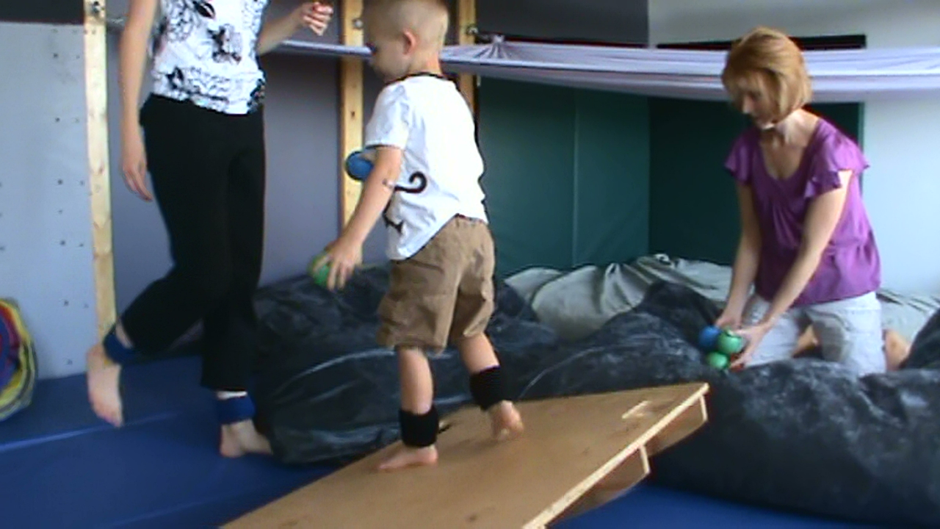
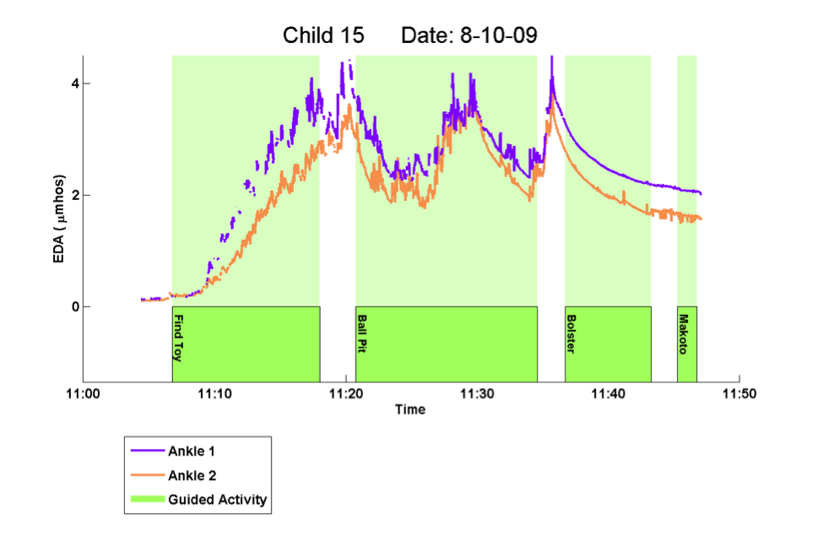
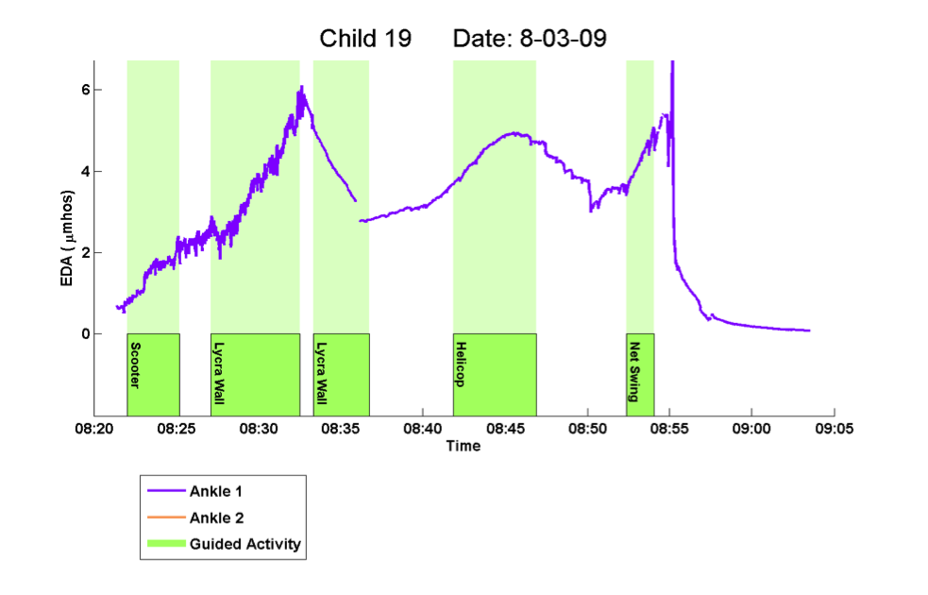
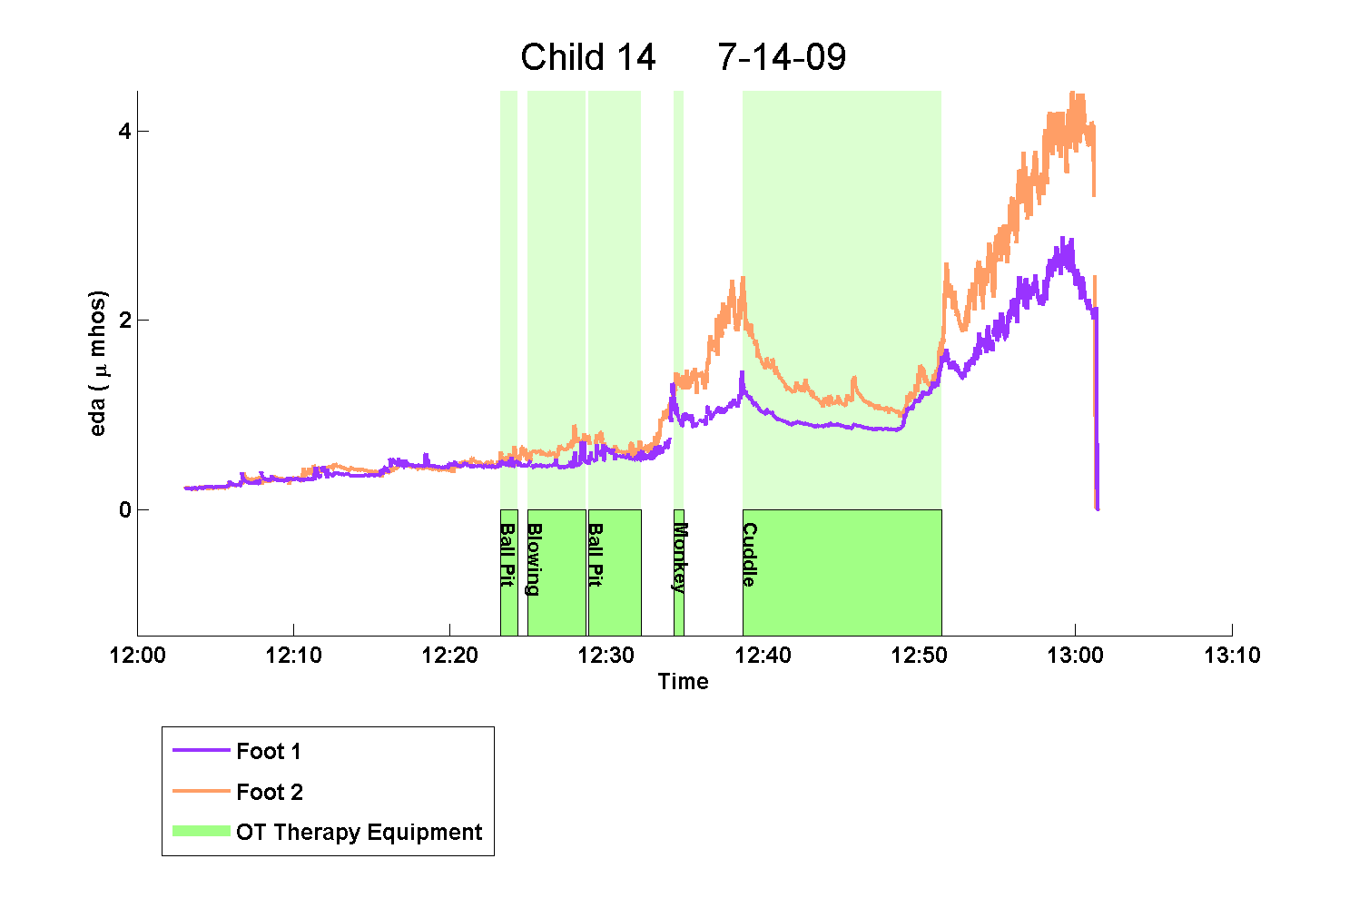

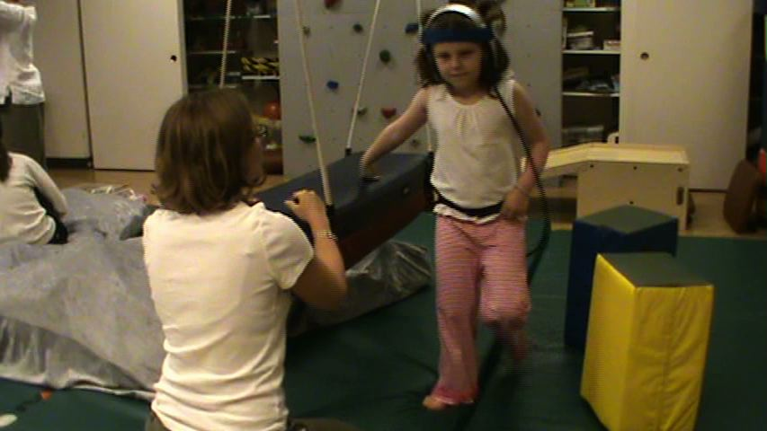
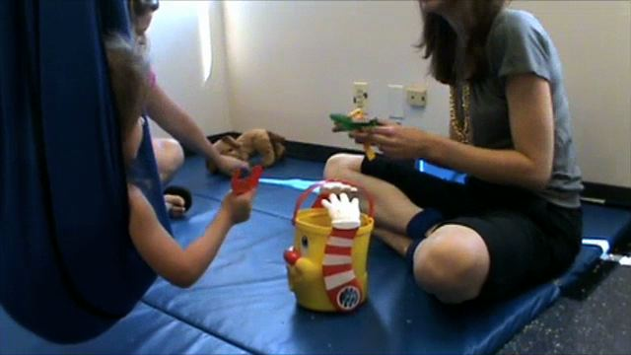
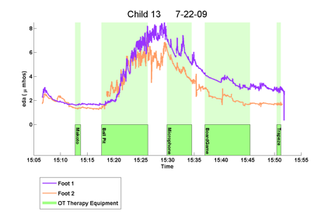

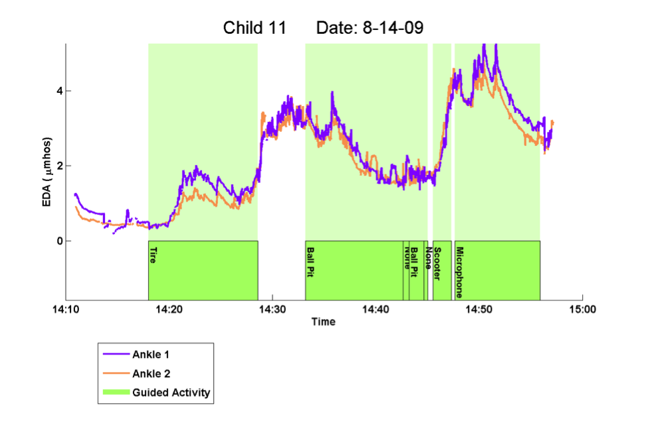
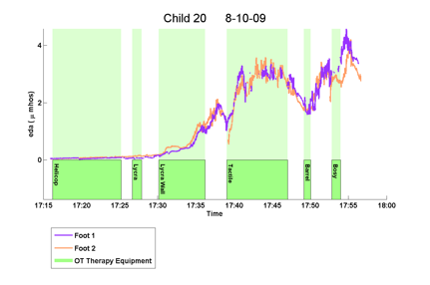
Three Key Factors that Influence EDA in Observational Studies of Occupational Therapy
Elliott Hedman¹, Rosalind Picard¹,Lucy Jane Miller², and Matthew Goodwin¹
1. Media Lab, MIT, Cambridge, Massachusetts
2. Sensory Processing Disorder Foundation, Greenwood Village, Colorado
Accounting for Factors
Motivation
Three Factors that Affect EDA
The below case study provides an example of how a qualitative description of changes in EDA can provide insights into the therapeutic process while accounting for therapeutic intent, environmental influences, and individual differences.
Changing a child’s arousal is an important goal of occupational therapy but therapists do not have a way to objectively measure how therapy affects arousal. We hypothesized that when children with Sensory Processing Disorder (SPD) participate in guided activities within an occupational therapy setting, informative changes in electrodermal activity (EDA) could be detected using iCalm. iCalm is a small, wireless sensor developed at MIT that measures EDA and motion, worn on the wrist or above the ankle¹.
A child with Autism and limited verbal skills attends an hour long therapy session. She spends the first part of therapy moving around and looking in a large room for hidden animals.
1. Therapist’s Intent
2. Environmental Factors
The intent of a therapist helps determine the effect of therapeutic equipment. For example, Child 19 participates in two guided activities on the Lycra Wall and has opposite EDA responses.
Sometimes external stimuli that are separate from the therapeutic activity can influence a child’s EDA response.
While in the ball pit, Child 15’s EDA decreases when she lies still but her EDA then increases when she begins looking for animals buried in the balls.
The therapist intentionally raised Child 19’s arousal– having him climb five levels on the net and play volleyball on his knees.
Child 14 gently rocks in a cuddle swing which decreases her EDA.
Do therapeutic activities create a consistent EDA response?
As Child 15 leaves the ball pit her arousal increases while she approaches an elevated bolster swing. She flaps her arms and verbally moans to the therapist.
When Child 15 is on the Bolster swing and gently rocking she appears calm – she is focused and does not speak. Her EDA decreases during this rocking.
Conversely, in the red section the therapist intentionally calms the child. She annunciates slowly, and has him lie on the bottom level while reflecting on his emotional state.
A noisy robot is introduced at this time. In response, Child 14’s EDA rapidly increases.
In our observation of 77 therapy sessions with 23 children diagnosed with SPD, average changes in EDA, across children and different pieces of equipment, was not statistically different from zero².
Individual therapeutic activities affected EDA changes, but these changes had a high degree of variability.
Figure 3: EDA increases and then decreases without changing equipment.
Figure 4: Introduction of a noisy robot changes child’s EDA response.
From this case study we can see that therapy appears to correspond closely with changes in EDA. Furthermore, we can identify factors that influence Child 15’s EDA – movement, cognitive tasks, body position, and the challenge of moving onto an elevated platform.
Even though the Cuddle Swing itself can help Child 14 lower her arousal, the robot prevented the cuddle swing from being calming – in fact the activity became highly arousing. Many external factors can influence a child’s EDA – noises, smells, flickering lights, people in the room, etc.
While both activities included the same therapeutic equipment, how the therapist intended to use the equipment influenced the direction Child 19’s EDA changed.
For example, Child 13’s EDA extensively increases while playing in the ball pit.
3. Individual Differences
As an opposing example, Child 11’s EDA substantially decreases while playing in the ball pit.
Figure 1: EDA increases when in the ball pit.
Different children may respond differently to the same stimuli
Child 20’s EDA substantially increases when she begins to play with tactile toys. Child 20 has a higher than usual response to touch – one of the reasons she is in therapy.
Conclusion
As expected, not all children’s EDA increased like Child 20’s when working with tactile toys. Statistical averages fail to take into account that some children have unique, individual responses to specific therapeutic activities.
Looking at EDA changes on a group level was inconclusive due to many uncontrolled factors. Therapist’s intent, environmental influences, and individual differences affect interventions but are difficult to account for in a statistical model. By analyzing case studies in conjunction with EDA, we may be able to generate new perspectives on how therapeutic activities work while still taking into account these influential factors.
Figure 2: EDA decreases when in the ball pit.
Figure 5: Child 20’s EDA substantially increases when interacting with tactile toys.
Other unaccounted for factors play a large role in how a child’s EDA changes with therapeutic activity. In the next section we suggest 3 factors that, in part, accounted for these differences.
Elliott Hedman, M.S.
hedman@mit.edu
Cambridge, Ma
Sources
1.Fletcher, R., Dobson, K., Goodwin, M.S., Eydgahi, H., Wilder-Smith, O., Fernholz, D., Kuboyama, Y., Hedman, E., Poh, M. Z., & Picard, R. W., "iCalm: Wearable Sensor and Network Architecture for Wirelessly Communicating and Logging Autonomic Activity," IEEE Transactions on Information Technology in Biomedicine, vol.14, no.2, pp.215-223, March 2010
2.Hedman, Elliott. 2010. In-Situ Measurement of Electrodermal Activity Durring Occupational Therapy. Master's thesis, Massachusetts Institute of Technology.

