Slide 1

PREPARED BY MATHAN KUMAR

Slide 2
CONTENTS
WHAT IS BIG DATA?
5VS
HADOOP
HDFS ARCHITECTURE
YARN ARCHITECTURE
PIG
HIVE
ADVANTAGES

Slide 3
WHAT IS BIG DATA?
Big Data is a phrase used to mean a massive volume of both structured and unstructured data that is so large it is difficult to process using traditional database and software techniques. In most enterprise scenarios the volume of data is too big or it moves too fast or it exceeds current processing capacity.

Slide 4
5V’S OF BIG DATA
VOLUME
VAREITY
VALUE
VELOCITY
VERACITY

Slide 5
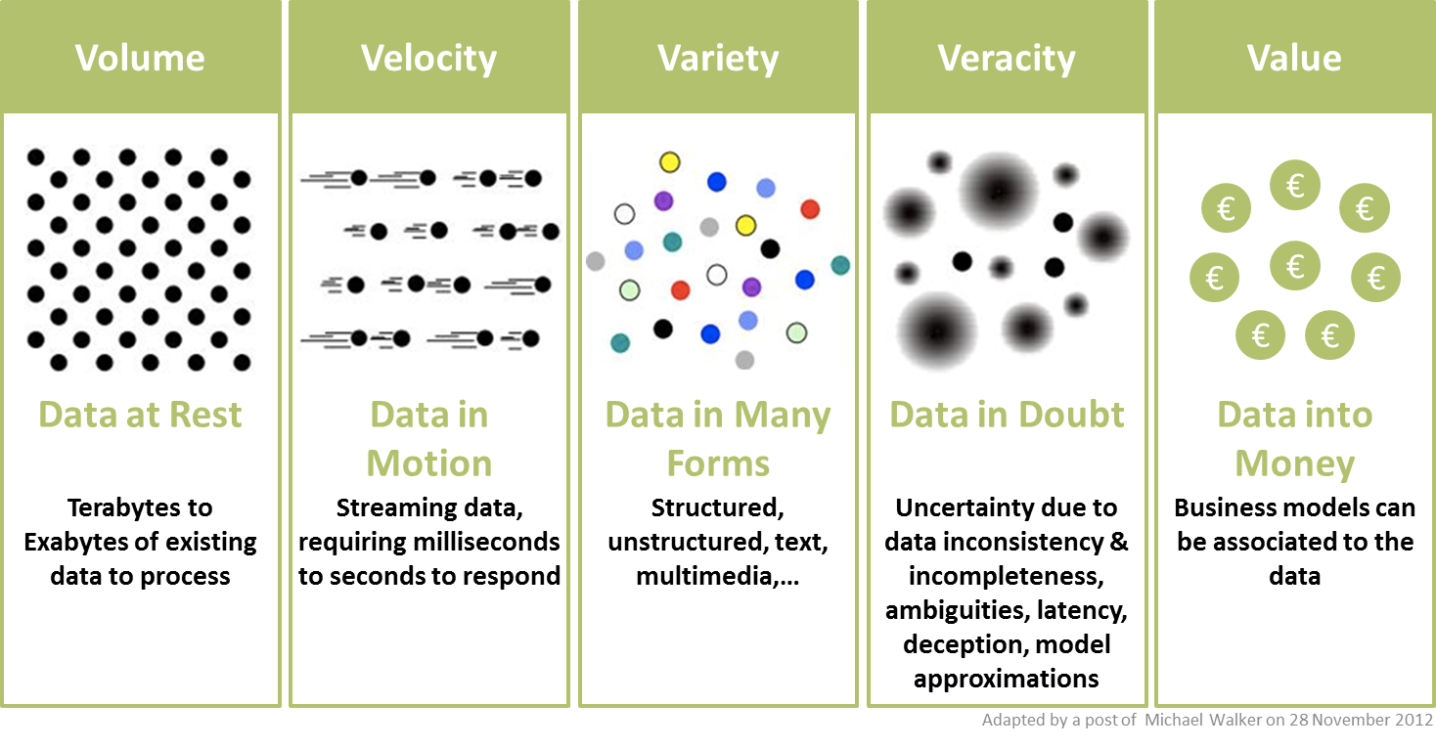

Slide 6
HADOOP
Hadoop is an open source framework that supports the processing and storage of extremely large data sets in a distributed computing environment. It is part of the Apache project sponsored by the Apache Software Foundation.

Slide 7
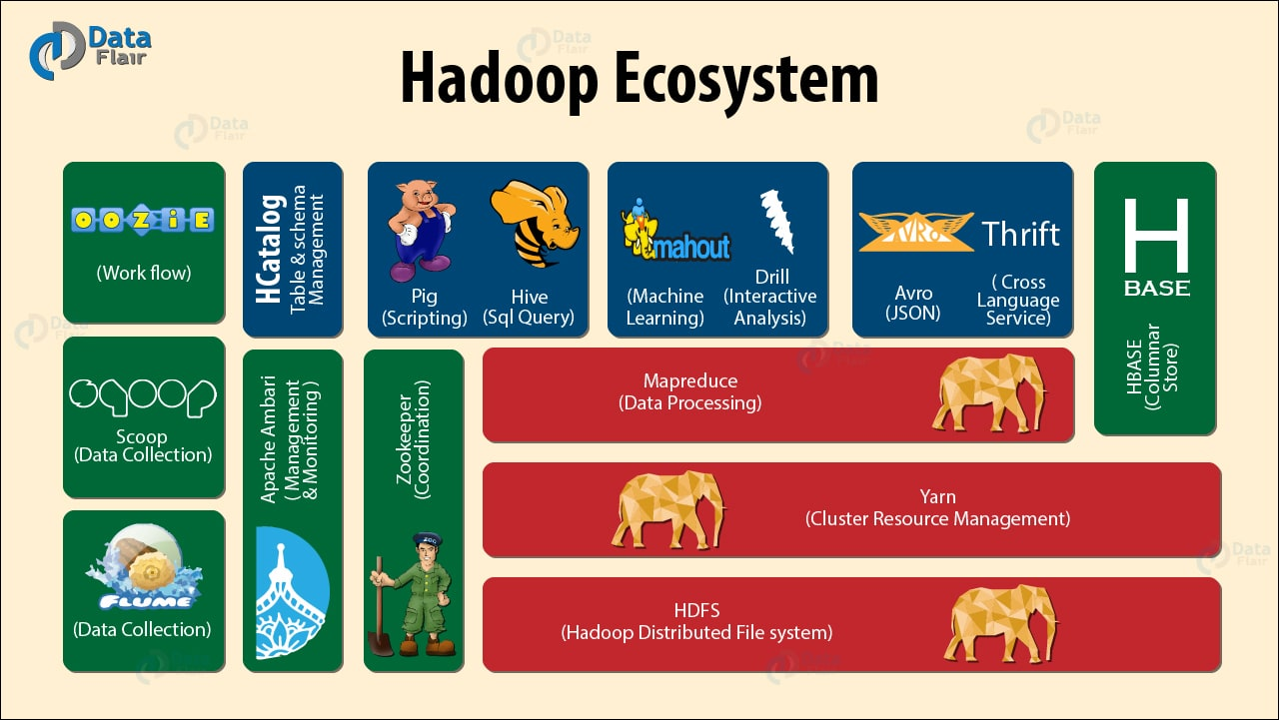

Slide 8
What is rdbms?
All modern database management systems like SQL, MS SQL Server, IBM DB2, ORACLE, My-SQL and Microsoft Access are based on RDBMS.
Relational database is most commonly used database. It contains number of tables and each table has its own primary key.

Slide 9
WHAT IS HDFS?
The Hadoop Distributed File System (HDFS) is the primary storage system used by Hadoop applications. HDFS is a distributed file system that provides high-performance access to data across Hadoop clusters.
HDFS has a master/slave architecture. An HDFS cluster consists of a single NameNode, a master server that manages the file system namespace and regulates access to files by clients. ... Internally, a file is split into one or more blocks and these blocks are stored in a set of DataNodes.

Slide 10
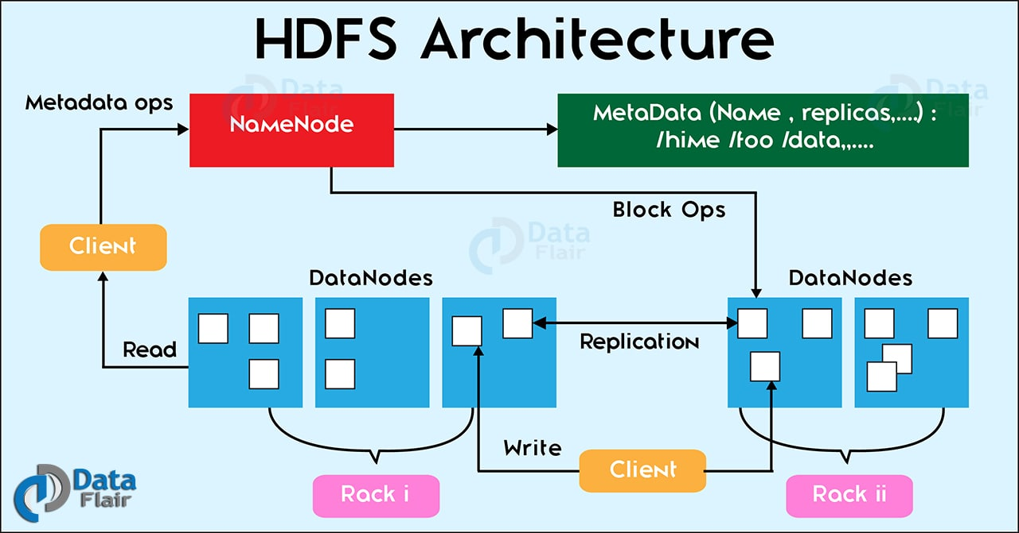

Slide 11
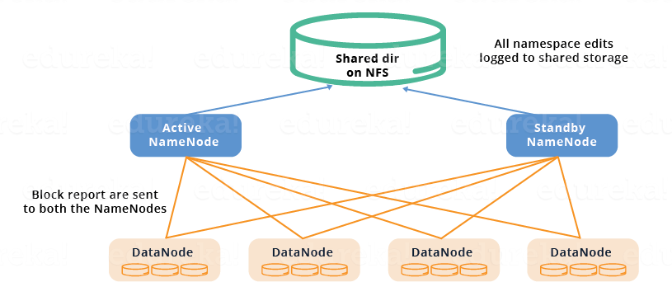

Slide 12
YARN ARCHITECTURE
The MapReduce framework provides its own implementation of an Application Master. The Resource Manager is a single point of failure in YARN. Using Application Masters, YARN is spreading over the cluster the metadata related to running applications.

Slide 13
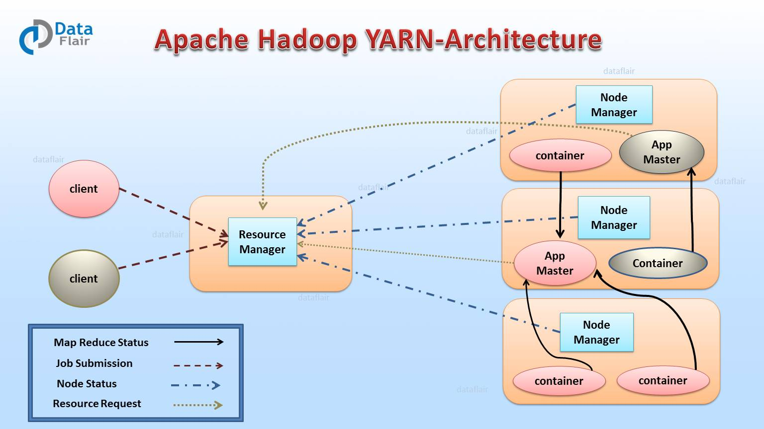

Slide 14
MAP REDUCE
By default, the MapReduce framework gets input data from the Hadoop Distributed File System (HDFS). ... The reduce phase uses results from map tasks as input to a set of parallel reduce tasks. The reduce tasks consolidate the data into final results. By default, the MapReduce framework stores results in HDFS.

Slide 15
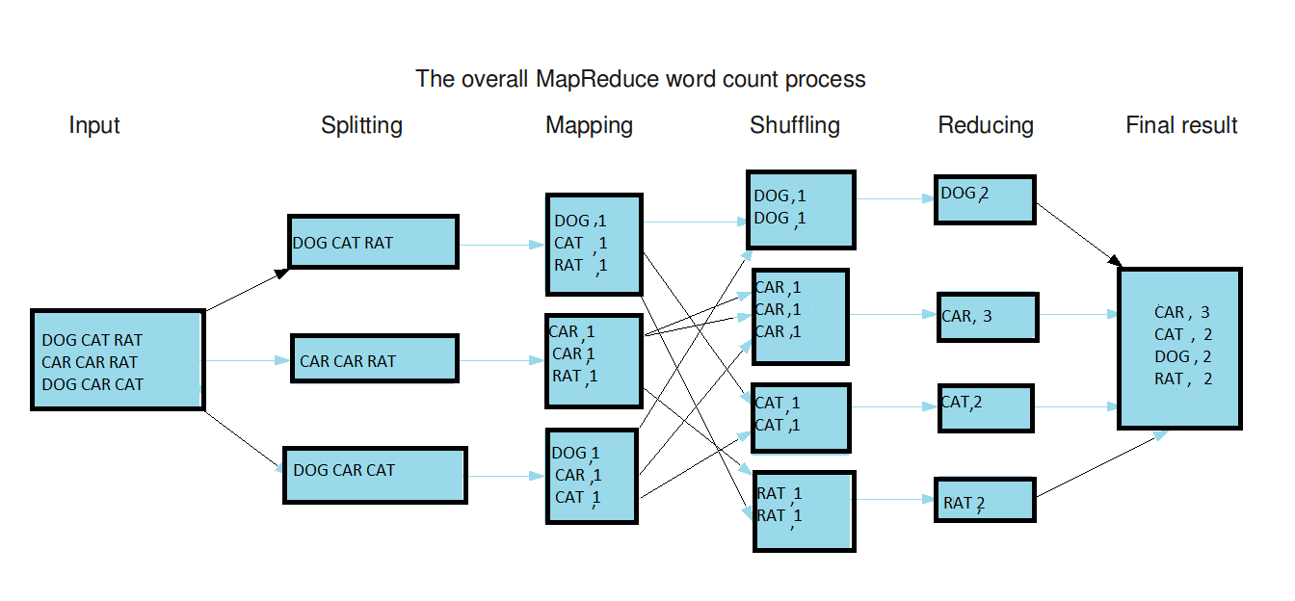

Slide 16
PIG
Pig is a high level data flow platform for executing Map Reduce programs of Hadoop. It is provided by Apache.
The language for Pig is pig Latin.
Local mode
MapReduce Mode

Slide 17
HIVE
Apache Hive is a data ware house system for Hadoop that runs SQL like queries called HQL (Hive query language) which gets internally converted to map reduce jobs. Hive was developed by Facebook.
Hive Query Language is similar to SQL and gets reduced to map reduce jobs in backend.
Hive's default database is derby.

Slide 18
DIFF B/W PIG&HIVE
PIG
HIVE
For Semi-Structured Data.
Used for programming.
Procedural data flow language.
Mainly used by programmers.
For Structured Data.
Used for reporting.
Declarative Sql language.
Mainly used for creating report by data analyst.

Slide 19
SQOOP
Data ingestion is important in any big data project because the volume of data is generally in petabytes or exabytes. Hadoop Sqoop and Hadoop Flume are the two tools in Hadoop which is used to gather data from different sources and load them into HDFS.

Slide 20
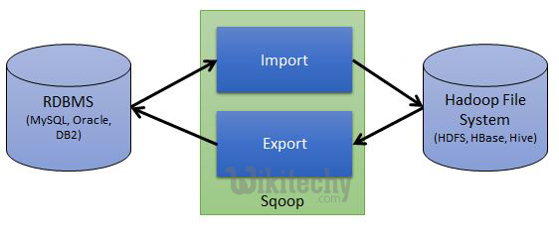

Slide 21
ADVANTAGES
Hadoop Brings Flexibility In Data Processing.
Hadoop Is Easily Scalable.
Hadoop Is Fault Tolerant.
Hadoop Is Great At Faster Data Processing.
Hadoop Ecosystem Is Robust.
Hadoop Is Very Cost Effective.
Hadoop Common.

Slide 22
PROJECT CASE STUDY
The H1B is an employment-based, non-immigrant visa category for temporary foreign workers in the United States. For a foreign national to apply for H1B visa, an US employer must offer a job and petition for H1B visa with the US immigration department. This is the most common visa status applied for and held by international students once they complete college/ higher education (Masters, Ph.D.) and work in a full-time position.

Slide 23
TOOLS USED
MAP REDUCE
HIVE
PIG

Slide 24
THANK YOU

