Slide 1
Analyzing factors impacting cost of House Rentals
Data Exploration and Analysis Approach
Name: Mathan Kumar Thavu Mudaliar Kanagaraj
Course: DSC 530 Data Exploration and Analysis
Professor: Matthew Metzger

Slide 2
Key Variables & Definition
Variable | Description & Objective
Rent | Indicates the cost(in Indian Rupees) involved in renting the home Dependent variable, included to see how below independent variable affects Rent
Area | Indicates the Total Sq. Ft of Living Area of the rental home Included to check if size of the rental home influence the rent of the home and if yes, how much does this factor impact rent
Bedrooms | Indicates the number of bedrooms in the rental home Number of bedrooms directly indicates the number of people residing and the family type that reside (single, couple, couple with children, etc.,) and can affect rent
Bathrooms | Indicates the number of bathrooms in the rental home Number of bathrooms variable helps understand the comfort and may indicate the lifestyle of the family/people residing in the home Included to check how the number of bathroom influence rent
Parking | Indicates the number of parking spaces available for the rental home Number of parking indicates the mode of transportation used by the tenant and help analyzing rent
Power Backup | Indicates if there is availability of backup option in the event of power failure An issue which is still relevant in South Asian Countries, availability of Power back can help understand current status of tenant (elderly, students, working professionals) and can affect rent

Slide 3
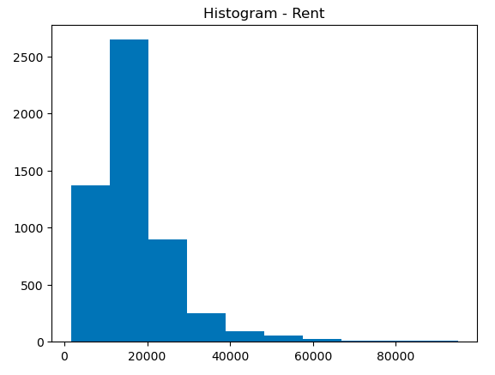
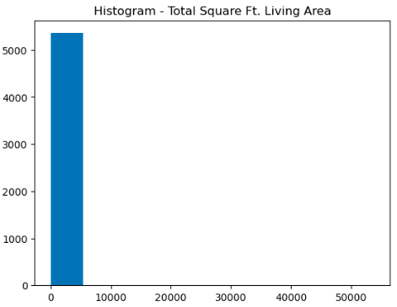
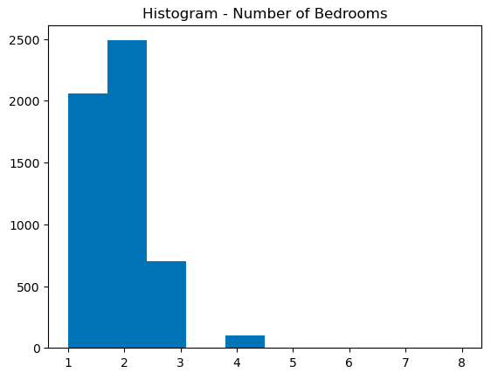
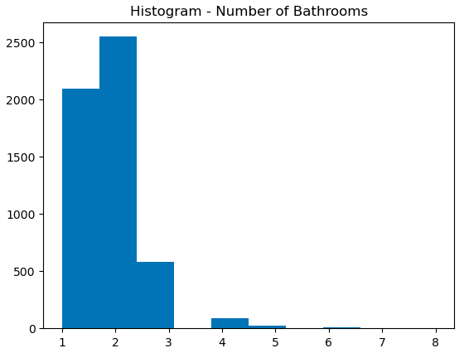
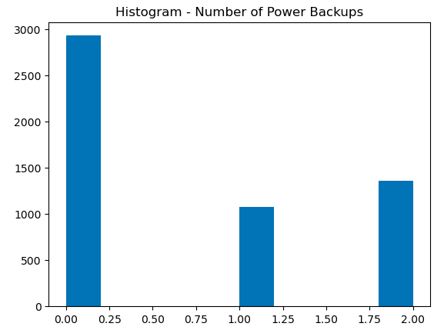
Histograms
Histograms indicates the distribution of variable data and the normality of the distribution
Histograms summarized the discrete variable in the dataset
Histograms highlighted the outliers available in the dataset

Slide 4
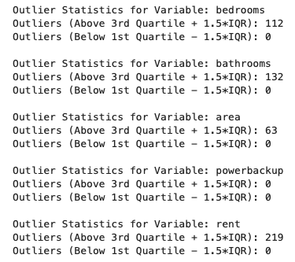
Outliers
There are outliers in the dataset on several variables
All the outliers are above the 3rd Quartile
Analysis of outlier revealed that the outliers are natural variations variations (also called true outliers)
Outliers in the rent could be related to rental properties that are in posh localities
Outliers in the number of bedrooms / number of bathrooms could be related to large rental homes
The optimal solution is to not remove the outliers

Slide 5





Descriptive Statistics
Number of bedrooms
Slight Positive Skewness value
Symmetrical Distribution
Number of bathrooms
Positive Skewness value
Right-skewed Distribution
Right leaning tail
Number of power backup
Slight Positive Skewness value
Symmetrical Distribution
Total Sq. Ft. Living Are
Strong Positive Skewness value
Right-skewed Distribution
Right leaning tail
Total Sq. Ft. Living Are
Positive Skewness value
Right-skewed Distribution
Right leaning tail

Slide 6
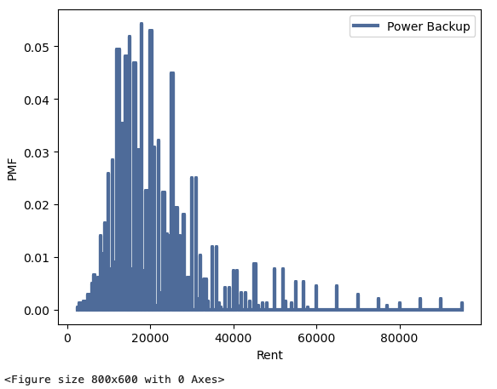
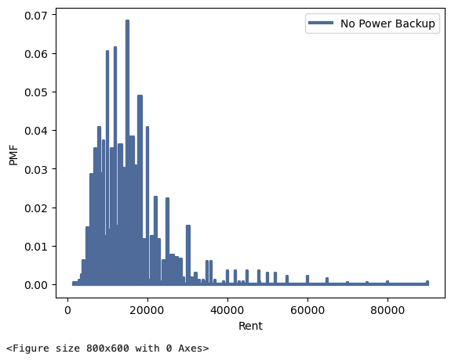
Comparing PMF
The variable, “Number of Power Backup” variable is used for plotting PMF
Filter used is “0”, this means, we are comparing PMFs for homes with Power Backup and the homes without Power backup
It is evident that the “Rent” of homes with power backup is higher when compared to homes without power backup

Slide 7
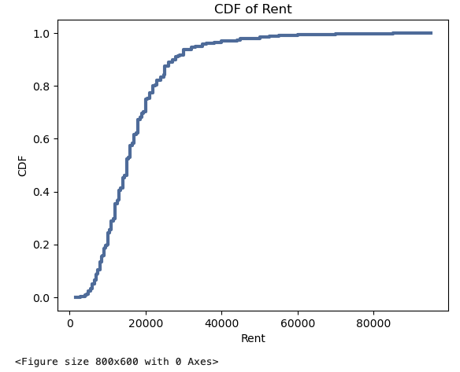
CDF
As per the CDF Plot, roughly 80% of the rental homes have rent less than 20,000 Indian Rupees (240 USD). This tells us that major target for the rental properties are middle class and lower income population who cannot afford bigger homes.

Slide 8
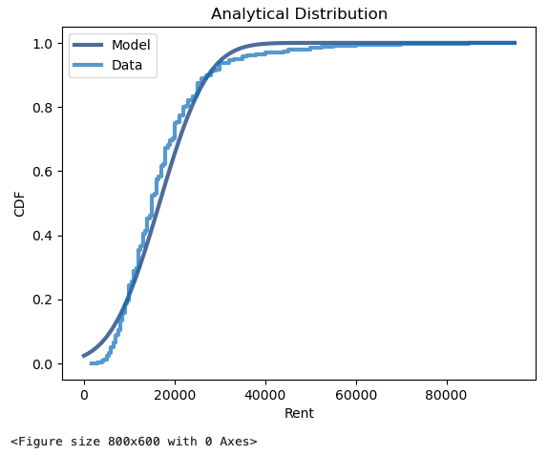

Analytical Distribution
Created a model and plotted the analytical distribution against the model and data
Analytical Distribution, reveals that the model is very closely aligned to actual data.

Slide 9

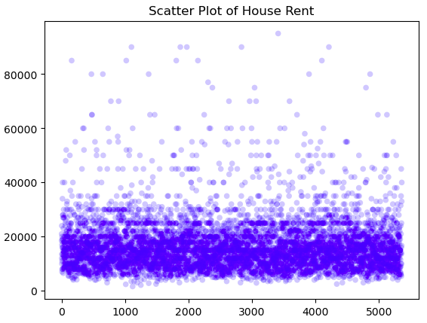
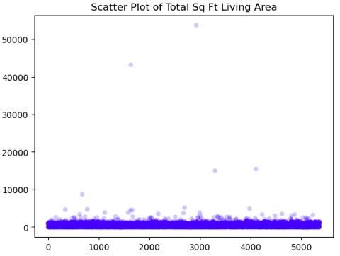
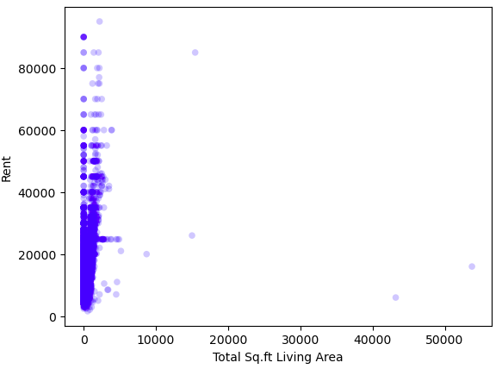
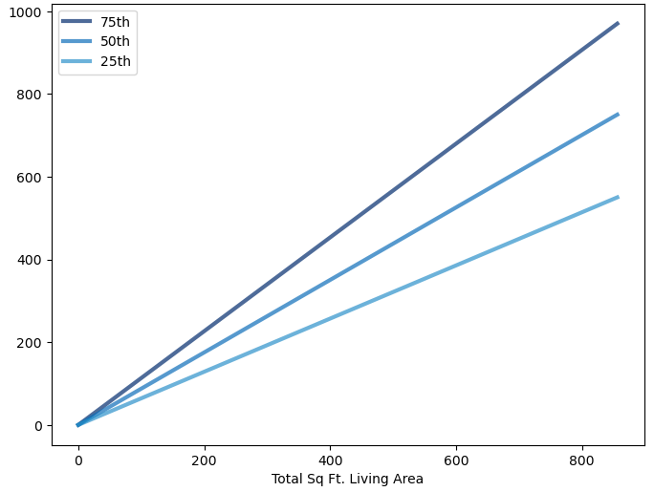
Scatter Plots (Rent Vs Total Sq. Ft. Living Area)
Scatter plots It is clear that the variables "Rent" and "Total Sq Ft Living Area" have positive relationship.
Spearman correlation vs Pearson correlation Spearman correlation has higher value compared to Pearson correlation indicating that variables are less sensitive to outliers and potentially have a stronger association even if the relationship is not perfectly linear.
Percentile plot It is clear that there is a strong positive relationship between Rent and Total Sq.Ft Living Area variables.
Correlation The correlation coefficient of sq.ft living vs price is 0.17, which indicates a positive correlation but not a strong one.

Slide 10

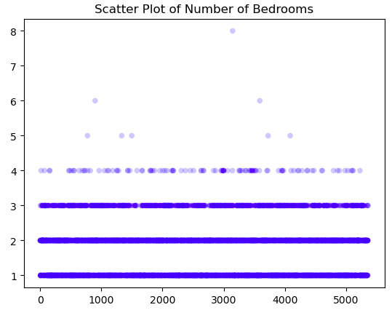
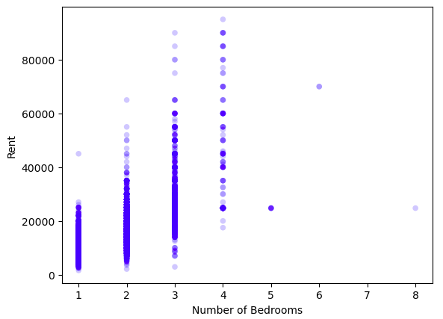
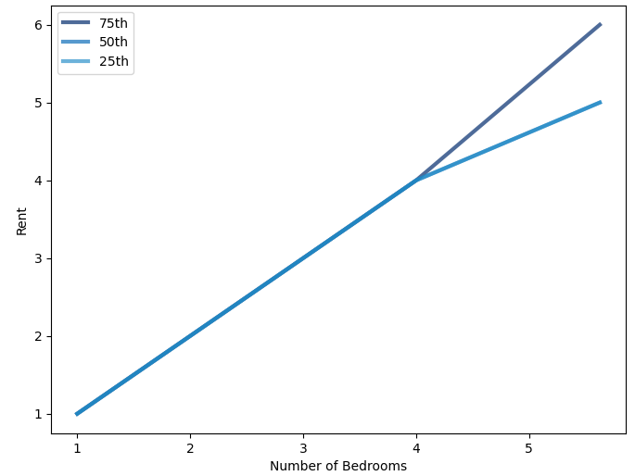
Scatter Plots (Rent Vs Number of Bedrooms)
Scatter plots It is clear that the variables "Rent" and "Number of Bedrooms" have positive relationship.
Spearman correlation vs Pearson correlation Spearman correlation value is almost the same compared to Pearson correlation indicating that variables are in a perfect linear relationship.
Percentile plot It is clear that there is a strong positive relationship between Rent and Number of Bedrooms variables.
Correlation The correlation coefficient of sq.ft living vs price is 0.69, which indicates a strong positive correlation.

Slide 11

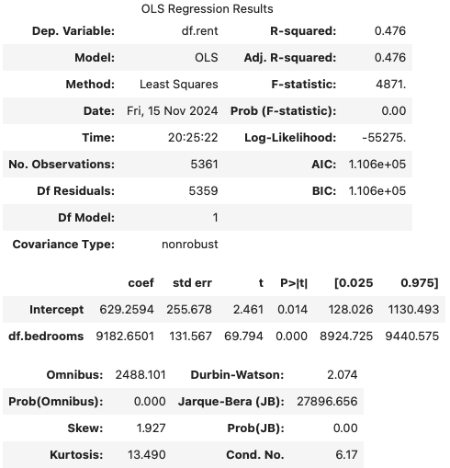
Hypothesis Testing & Regression Analysis (Single Explanatory Variable)
Hypothesis Testing – The p-value is less than 0.05, it suggests that the tested condition is considered statistically significant. In other words, there are no evidence to prove the hypothesis, "Rent is influenced by parking amenities" false.
Regression Analysis – Single Explanatory Variable
R-Squared Value The value 0.476, indicates that around 47.6% of the variability in the dependent variable, "Rent" can be explained by the independent variable, "Number of Bedrooms" in the model.
Skewness Value The value 1.927, indicates positive skewness, that means right-skewed distribution

Slide 12
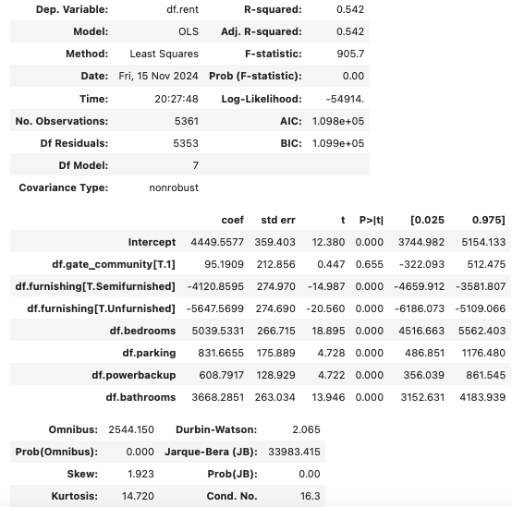
Regression Analysis (Multiple Explanatory Variable)
Regression Analysis – Multiple Explanatory Variable
R-Squared Value The value 0.542, indicates that around 54.2% of the variability in the dependent variable, "Rent" can be explained by combination of independent variables, "Number of bedrooms", "Number of bathrooms", "Power Backup", "Gated community", "furnishing" in the model.
Skewness Value The value 1.923, indicates positive skewness, that means right-skewed distribution

