Slide 1
Annotations in Springboot
Mathanprasath

Slide 2
Annotations
Annotations are used to provide supplementary information which can be used by the framework for various tasks:
Generating code
Validating code
Configuring run time

Slide 3
Uses of Annotations
Dependancy Injection
Validation
Aspect oriented programming (AOP)
Its simplifying the configuration, managing dependencies,ensure data validation In a consistent manner

Slide 4
Configuration and Bean management with Dependancy Injection
@Component
@Controller
@Service
@Repository
@Autowired

Slide 5
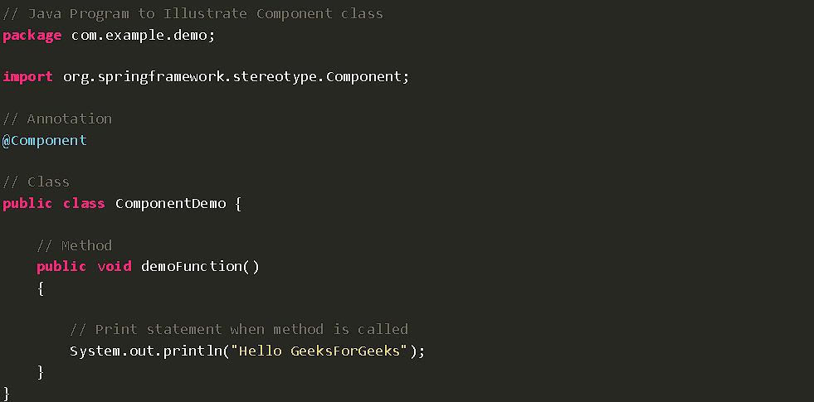

Slide 6
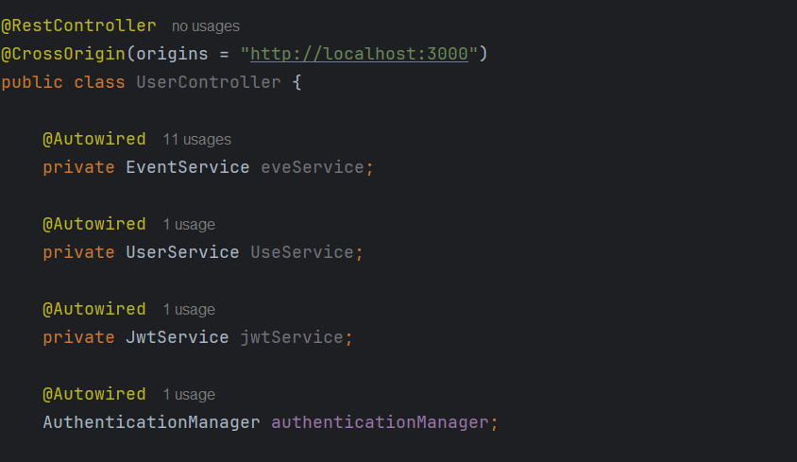

Slide 7
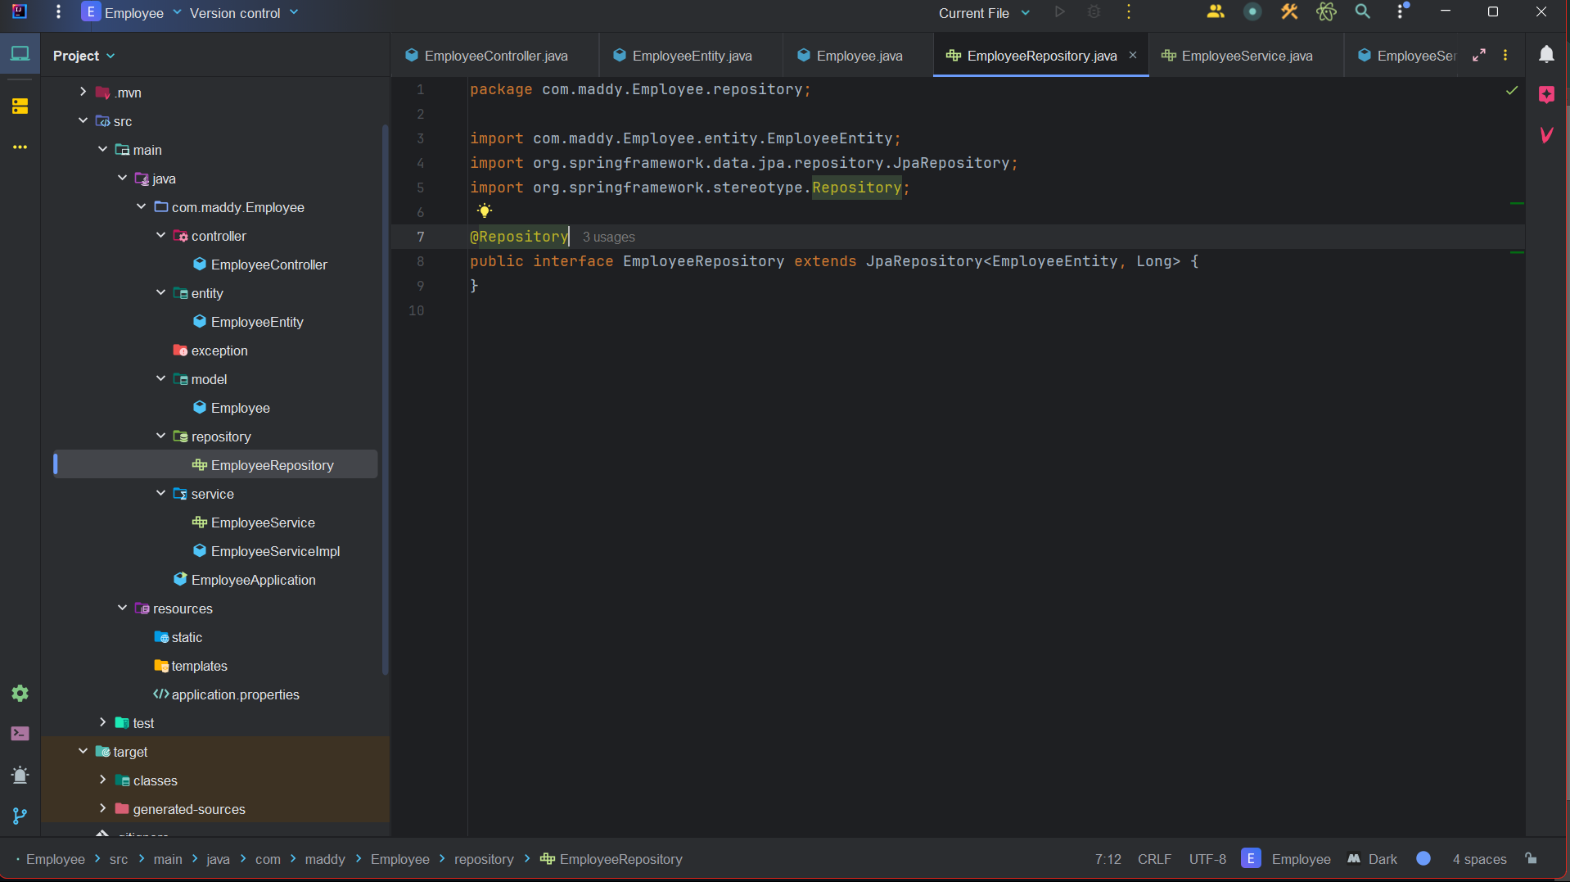

Slide 8
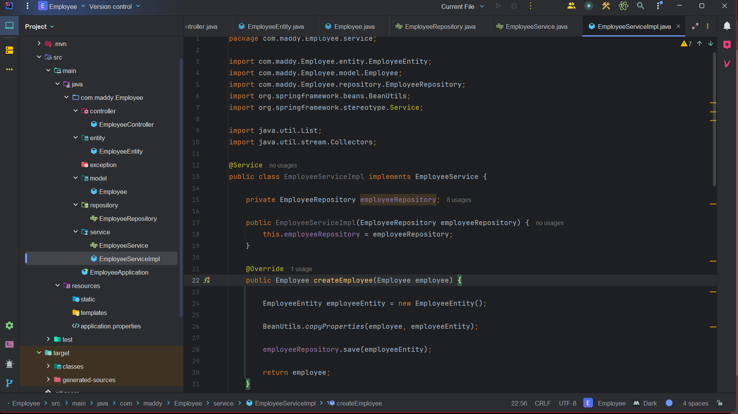

Slide 9
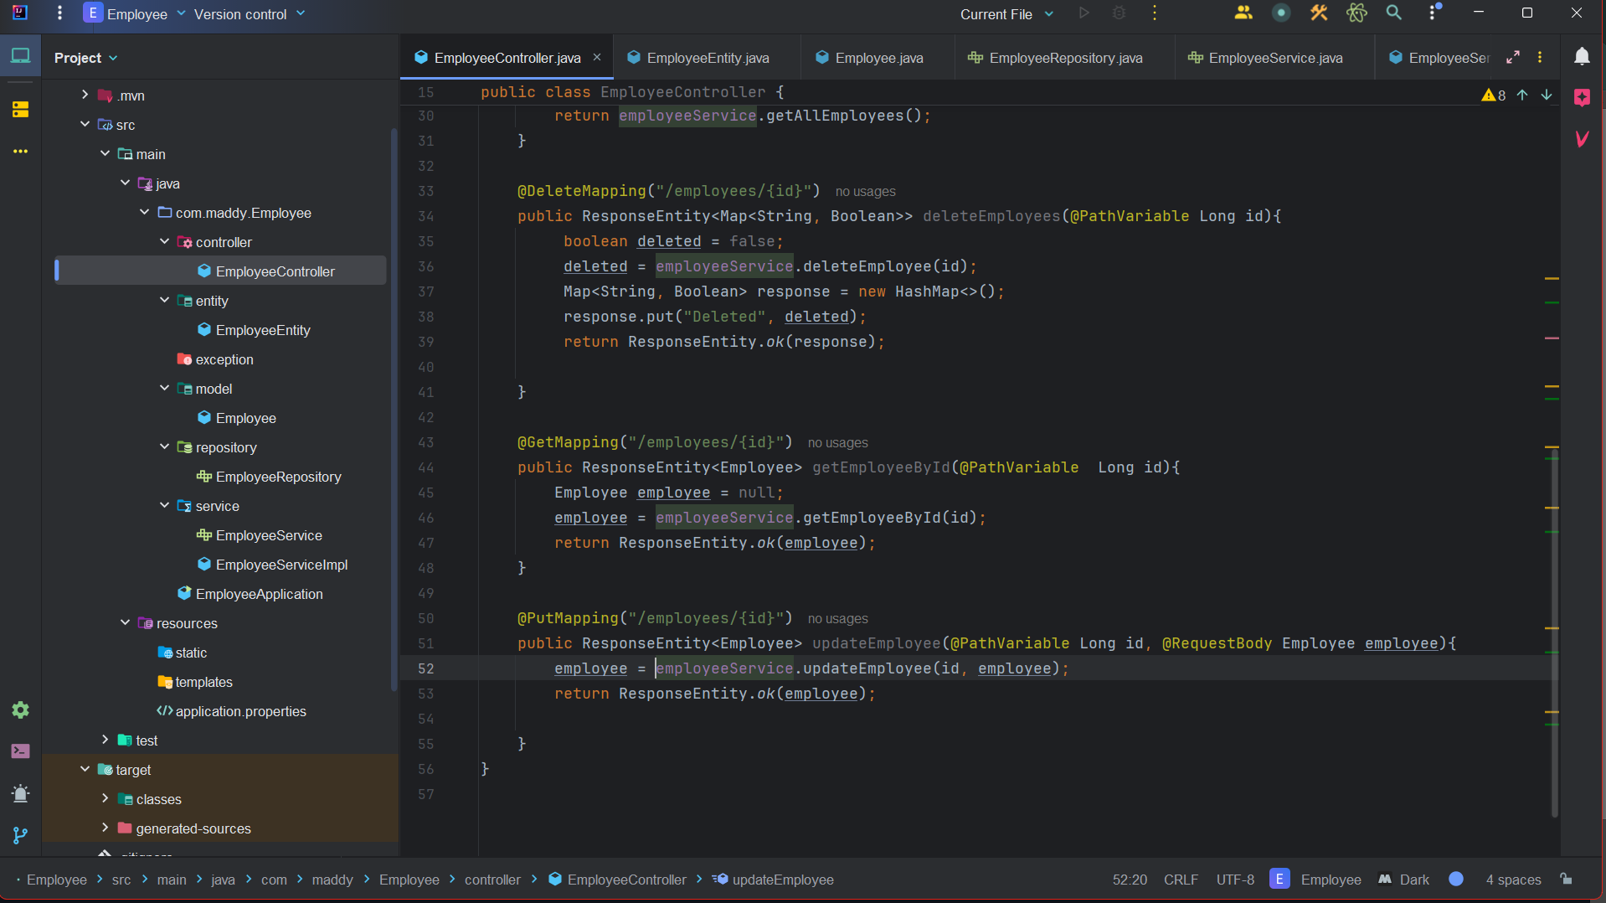

Slide 10
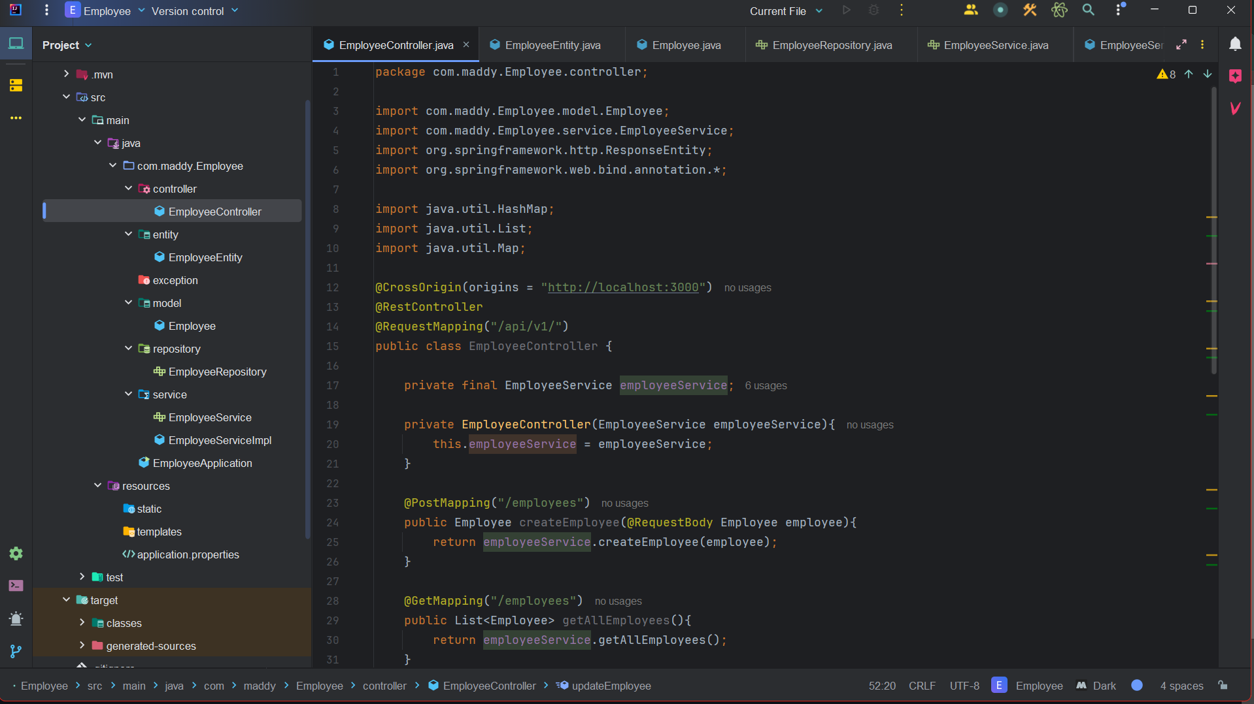

Slide 11
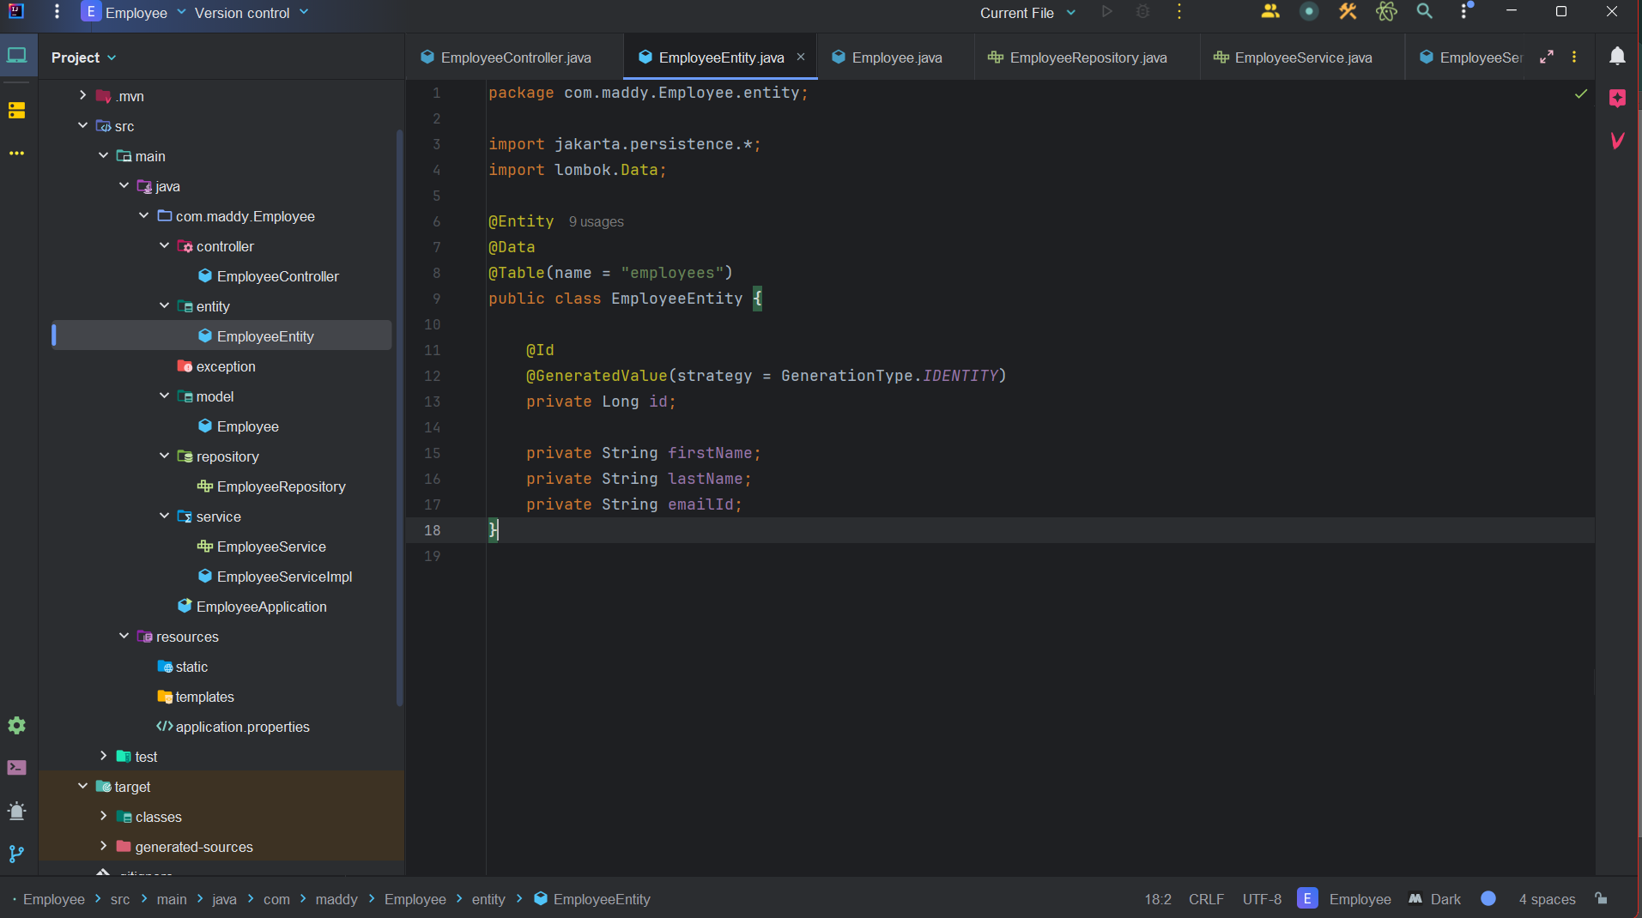

Slide 12
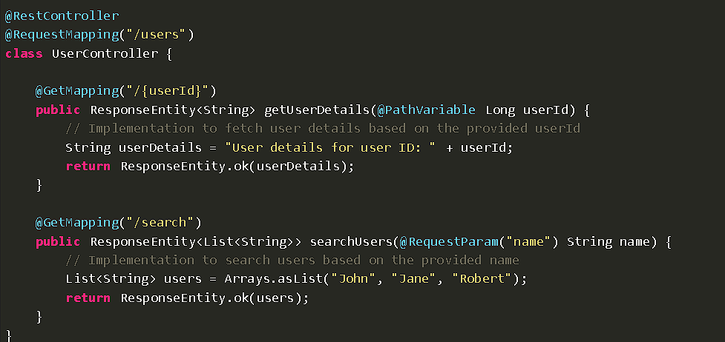

Slide 13
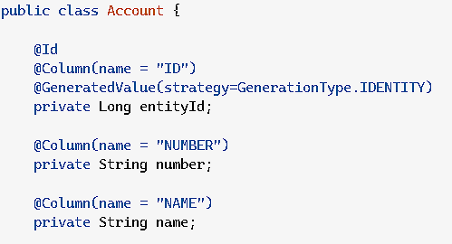

Slide 14
Web Annotations
@RestController
@CrossOrigin
@RequestMapping
@GetMapping,@PutMapping,@PostMapping and @DeleteMapping
@PathVariable
@RequestParam
@ResponseBody
@RequestBody

Slide 15
Data Access
@Entity
@Table
@Id
@GeneratedValue
@Column

Slide 16
Transaction and validation
@Transactional
@Valid
@NotNull
@Size
@Min
@Max
@Pattern

Slide 17
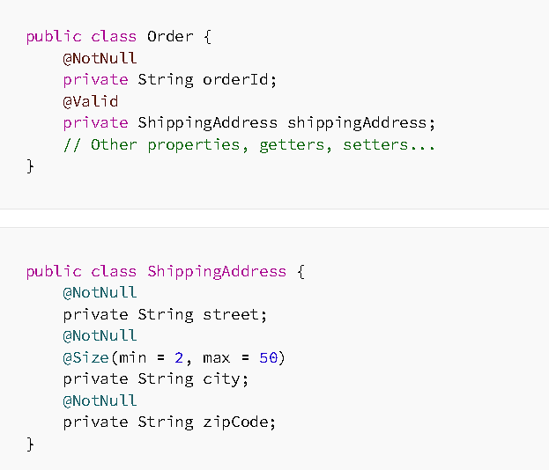

Slide 18
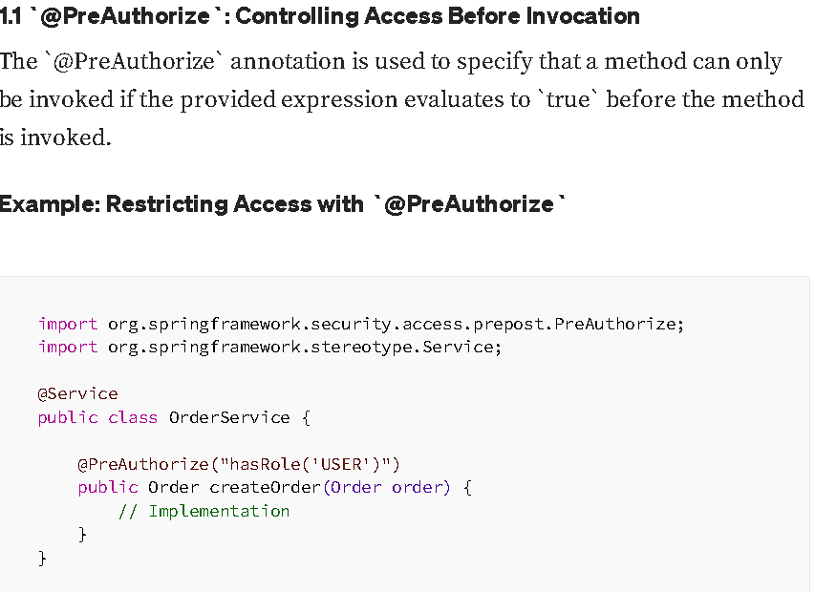

Slide 19
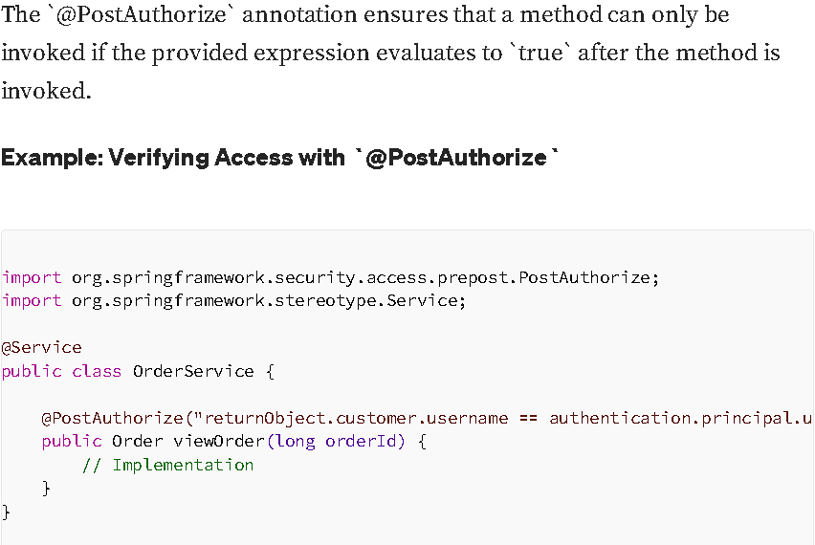

Slide 20
Security
@EnableWebSecurity
@PreAuthorize
@PostAuthorize

Slide 21
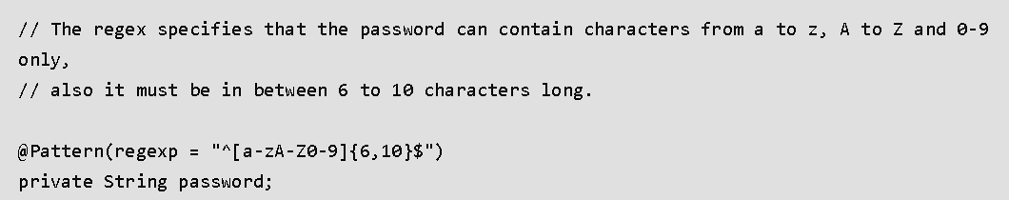

Slide 22
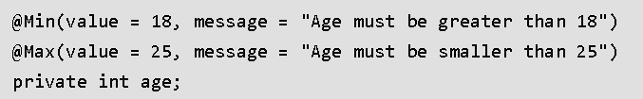

Slide 23
Clarification
Q&A session

Slide 24
Thankyou

