Slide 1


Slide 2



What is JavaScript
Why learn JavaScript
Where to use
CHAPTER 1
Introduction of JS
History JS
Benefits of JS

Slide 3
What is JavaScript
JavaScript was initially created to “make web pages alive”.
The programs in this language are called scripts. They can be written right in a web page’s HTML and run automatically as the page loads.
Scripts are provided and executed as plain text. They don’t need special preparation or compilation to run.
In this aspect, JavaScript is very different from another language called Java.
Why learn JavaScript
Where to use
History JS
Benefits of JS

Slide 4
What is JavaScript
It’s the most popular programming language.
JavaScript is, without question, the default language of the Internet.
JavaScript is Easy to Learn
JavaScript also Affects Big Data and the Cloud “JavaScript Object Notation (JSON) is the go-to standard for data exchanges on today’s internet.”
JavaScript is Versatile Front-end: Angular, React, Vue, etc.. Back-end: Node.js
Why learn JavaScript
Where to use
History JS
Benefits of JS

Slide 5
What is JavaScript
Create Interactivity between web page and User.
A JavaScript can be used to validate form data before it is submitted to a server.
JavaScript manipulate HTML and CSS, creating, removing and changing HTML, dynamically applying new styles to your page.
Dynamic Complex Web Application
Why learn JavaScript
Where to use
History JS
Benefits of JS

Slide 6
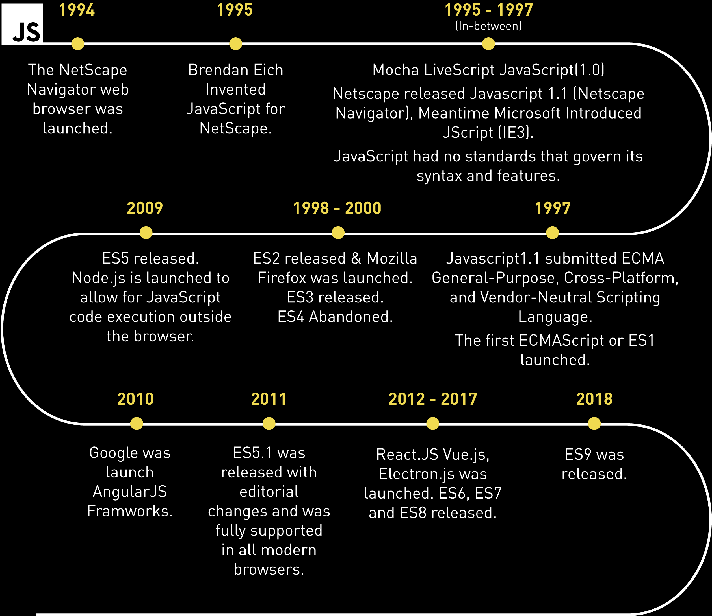
What is JavaScript
Why learn JavaScript
Where to use
History JS
Benefits of JS

Slide 7
What is JavaScript
JavaScript was initially created to “make web pages alive”.
The programs in this language are called scripts. They can be written right in a web page’s HTML and run automatically as the page loads.
Why learn JavaScript
Where to use
History JS
Benefits of JS

Slide 8
Inline JS
External JS
External JS advantage
CHAPTER 2
How to use

Slide 9
Inline JS
Inline JavaScript can be achieved by using Script tag inside the body of the HTML, and instead of specifying the source(src=”…”) of the JavaScript file in the Script tag, we have to write all the JavaScript code inside the Script tag.
Syntax: <script> // JavaScript Code </script>
External JS
External JS advantage

Slide 10
Inline JS
We can create external JavaScript file and embed it in many html page.
It provides code re usability because single JavaScript file can be used in several html pages.
Let's create an external JavaScript file that prints “Hello Code Taleem” in a alert dialog box.
External JS
External JS advantage

Slide 11
Inline JS
It helps in the reusability of code in more than one HTML file.
It allows easy code readability.
It is time-efficient as web browsers cache the external js files, which further reduces the page loading time.
It enables both web designers and coders to work with html and js files parallelly and separately, i.e., without facing any code conflictions.
The length of the code reduces as only we need to specify the location of the js file.
External JS
External JS advantage

Slide 12
Statements
Semicolons
Comments
CHAPTER 3
Code Structure
Syntax

Slide 13
Statements
In HTML, JavaScript statements are "instructions" to be "executed" by the web browser.
Example:
Document.getElementById(“demo”).innerHTML = “Hello Code Taleem”;
This statement tells the browser to write "Hello Code Taleem" inside an HTML element with id="demo”
Most JavaScript programs contain many JavaScript statements. The statements are executed, one by one, in the same order as they are written.
Semicolons
Comments
Syntax

Slide 14
Statements
Semicolons separate JavaScript statements. Add a semicolon at the end of each executable statement:
When separated by semicolons, multiple statements on one line are allowed.
Example:
var a, b, c; a=1; b=2; c=a+b;
Semicolons
Comments
Syntax

Slide 15
Statements
Single Line Comments: Single line comments start with //.
Any text between // and the end of the line will be ignored by JavaScript (will not be executed).
Example: var x = 5; // Declare x, give it the value of 5
Multi-line Comments: Multi-line comments start with /* and end with */.
Any text between /* and */ will be ignored by JavaScript.
Example: /* The code below will set the id = ”name” inner text as a Code Taleem */ document.getElementById(”name").innerHTML = ”Code Taleem";
Semicolons
Comments
Syntax

Slide 16
Statements
Single Line Comments: Single line comments start with //.
Any text between // and the end of the line will be ignored by JavaScript (will not be executed).
Example: var x = 5; // Declare x, give it the value of 5
Multi-line Comments: Multi-line comments start with /* and end with */.
Any text between /* and */ will be ignored by JavaScript.
Example: /* The code below will set the id = ”name” inner text as a Code Taleem */ document.getElementById(”name").innerHTML = ”Code Taleem";
Semicolons
Comments
Syntax

Slide 17
innerHtml
document.write()
console.log()
CHAPTER 4
JS Output
window.alert()
alert(), prompt(), confirm()

Slide 18
innerHtml
JavaScript can display data in many ways, One of the way is innerHTML property.
The innerHTML property sets or returns the HTML content (inner HTML) of an element.
To access an HTML element, JavaScript can use the document.getElementById(id) method.
document.write()
console.log()
window.alert()
alert(), prompt(), confirm()

Slide 19
innerHtml
The document.write() method should only be used for testing.
the document.write() method to write the content to the current document only while that document is being parsed.
Syntax: document.write(”Code Taleem");
document.write()
console.log()
window.alert()
alert(), prompt(), confirm()

Slide 20
innerHtml
console.log() using for debugging purposes.
You can easily output a message or writes data to the browser console using the console.log() method. This is a simple, but very powerful method for generating detailed output.
console.log(”Code Taleem");
document.write()
console.log()
window.alert()
alert(), prompt(), confirm()

