Slide 1

Pokémon Data set analysis
(EDA Project)
by Mathangi Shankar

Slide 2
Problem Statement
Problem Statement: The data set, by reading data is more difficult to understand, Users are unable to know how to win the game, given the Pokémon cards or data. This was overcome by analyzing and visualizing the data and putting the results so that users can better chose the right Pokémon to win the game.
Solution: Is to dig deeper into Pokémon data set to get more insights on the various Pokémon's their comparison, powers, understand correlation, statistics to know the distribution of Pokémon. How relevant their attacks are how they are useful for the users to win the game.

Slide 3
Data analysis approach
Understand the data set, the headers and the data
Looked for discrepancy and ‘Nan’, empty values, duplicates
Data Pre-processing, filtering of values were done.
Planned on what are the major analysis that could be done.
Added a field which was required to perform one of the analysis
Used bar plots, box plots, scatter plots, summary statistics for visuals.

Slide 4
Graphs and packages used
When the data was pre-profiled using Pandas profiling package , Nan values where observed which were replaced by the mode.
Some of the Pokémon's were filtered against Mega and Primal Pokémon's as seen in the notebook which had the highest power were omitted or removed.
Multi variate plotting using heatmap was done among 6 variable points to know the correlation.
Bi variate plotting using scatter plots was done for two variable analysis, Special Defense against Total, Pie charts were also visualized for Legendary and Non Legendary split.
Packages used were numpy, pandas,pandas profiling, matplotlib, seaborn…

Slide 5
Project work
I started by looking at the fields of the data set, to know what kind of analysis and visuals could be produced
I worked on pre-processing the data to remove empty or NaN values.
I also looked to filter the data to get better results and insights
After pre-processing I performed post processing to see if the data is clean enough to perform analysis.
I used Univariate, Bi-variate, Multi variate plots to answer the questions I had on Pokémon data set.
I also worked on summary statistics to know the skewness of the data and for any symmetry if any.

Slide 6
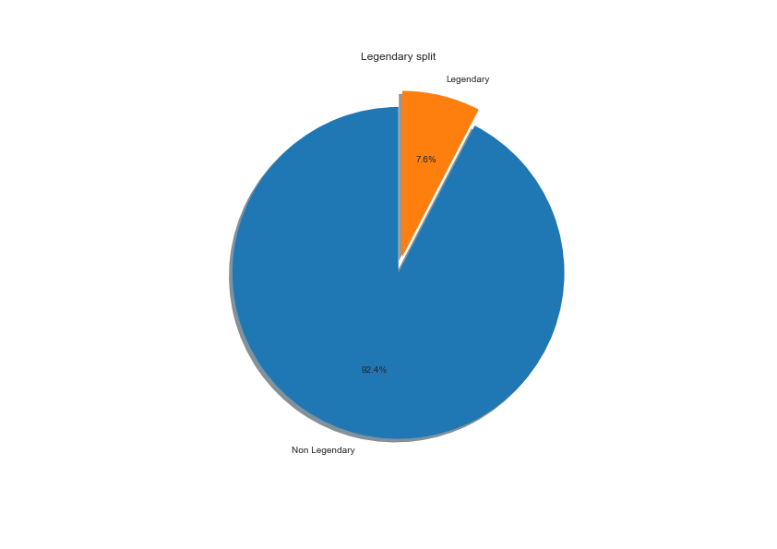
Pie chart – Univariate analysis Objective: To show the Legendary Vs Non Legendary split
Legendary Pokémon's are overpowered than a normal Pokémon. However a well trained with good stats could take down even a Legendary Pokémon, Having said this they have their own weaknesses.
This chart shows there are Non Legendary Pokémon more than the Legendary ones. This set of cards need to be played cautiously by looking at other powers.

Slide 7
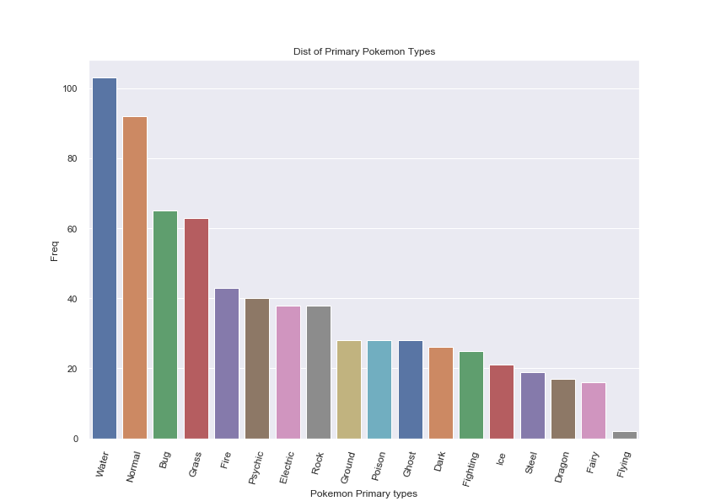
Bar Plot – Univariate analysis Objective: To know the Primary types of Pokémon's
Water Pokémon's are the highest. Play as per the benefits this Pokémon offers like Water type Pokémon are strong against Ground, Rock, Fire; weaker to Water, Grass, Dragon; resistant to Steel, Fire, Water, Ice and vulnerable to Grass, Electric in a gym battle

Slide 8
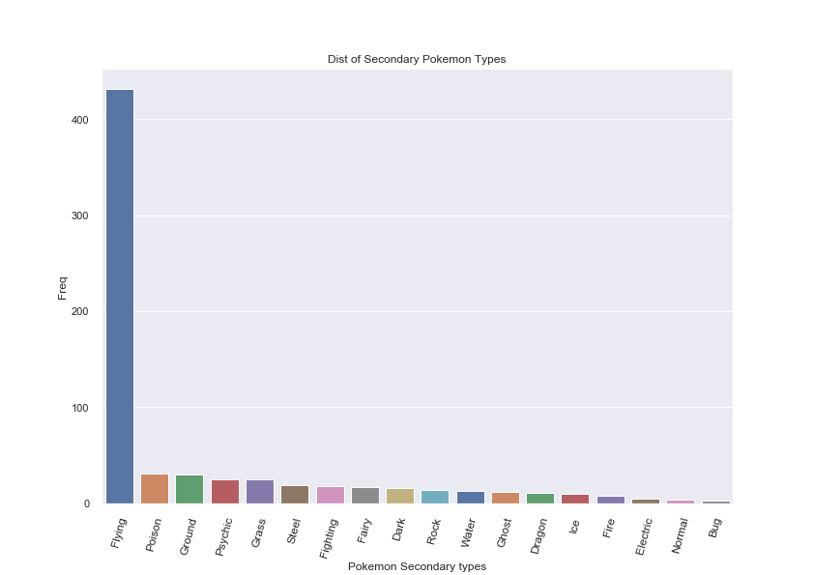
Bar Plot – Univariate analysis Objective: To know the Secondary types of Pokémon's
Flying Pokémon's are again the highest in number. Play as per the benefits this Pokémon offers like they are super effective on bug, grass and fighting also be careful on its weakness
There are Bug and Grass Pokémon's also available as per the chart. Flying along with Fighting may also help
Note: Flying are highest in number in both the charts since we replaced the Nan values with mode value which is Flying only.

Slide 9
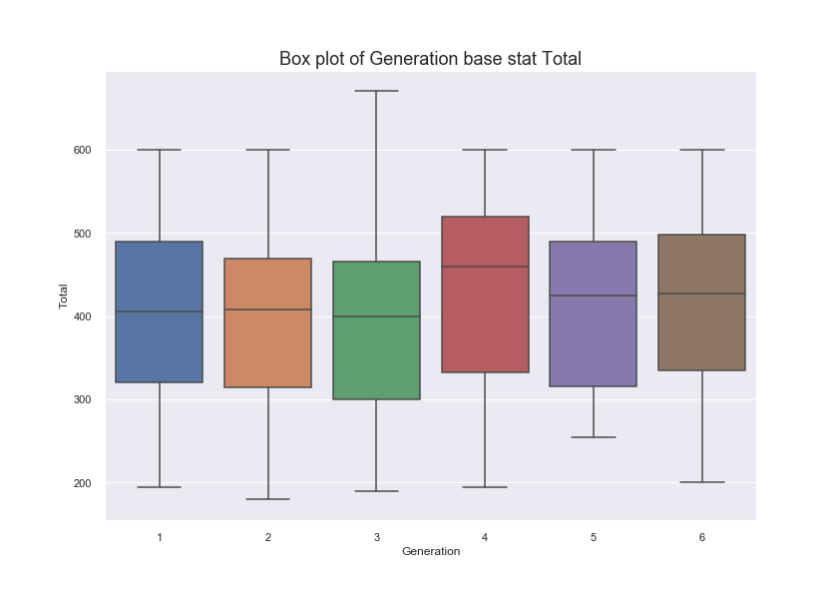
Box Plot – Bivariate analysis Objective: To show which Generation Pokémon has the highest Total stats.
Shows Generation 3 Pokémon's has the highest Total base stat of 670. All the other generations share a base stat of 600. The Pokémon names were also identified.
Total base stat is inclusive all the numerical fields in the data set excluding Stamina which was added to calculate the Combat power CP to know the real strength of the Pokémon
There are additional bar plots for top HP points for Pokémon included in the notebook.

Slide 10
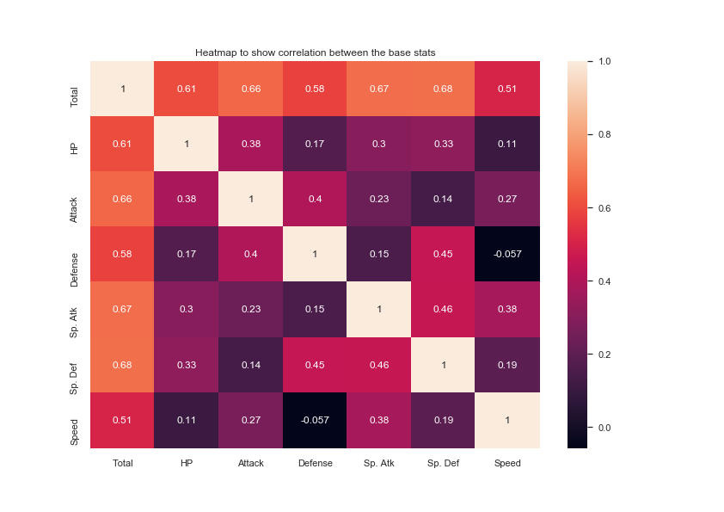
Heat map– Multivariate analysis Objective: To show the correlation among the 7 fields in the data set.
From the heatmap we can see that the highest correlation is between Sp. Def and Total which is 0.68 in the matrix(excluding the diagonal) so we can work on scatter plot between Sp. Def and Total to understand more to know that it has positive correlation .
There is negative correlation between Speed and Defense

Slide 11
Conclusion
With the help of Jupiter notebook we learnt how exploratory data analysis can be carried out using Pandas plotting.
- Also we have seen making use of packages like matplotlib and seaborn to develop better insights about the data.
- We have also seen how preprocessing helps in dealing with missing values and irregularities present in the data. We also learnt how to create new features which will in turn help us to better predict the Pokémon stats.
- We also make use of pandas profiling feature to generate an html report containing all the information of the various features present in the dataset.
- We have seen the type analysis of Pokémon's and analyzed the correlation and skewness in the data set using Pie charts, heat map and scatter plot, as well as seen the real strength of the Pokémon by calculating the combat power.
- The most important inference drawn from all this analysis is, we get to know what are the features on which Sp. Def is highly positively with Total
- We have visualized data using box plot to know the highest Total base stats and know the Pokémon name and Generation.
- This analysis will help us to choose which machine learning model we can apply to predict Pokémon attacks of test dataset.

