Slide 1


Title: Manipulation and Analysis of Data Using Big Data Tools and Technologies.
Program: MSc Data Analytics & Technologies
Course: Big Data Analytics(DAT7302)
Supervisors: Dr. Diareme Kyvele Constantina, Dr. Kyriaki Saiti
Student Name: Matthaios Chatzimichail
Student ID: 2434173

Slide 2

Portfolio 1: Big Data.
Portfolio 2: Appling a Machine Learning Technique to Make Predictions Using a Real-World Dataset.
Portfolio 3: Using Google Colab for Analysis and Visualization of Real-World Data.
Portfolio 4: Retrieving and Exporting Data Using MongoDB Atlas.
References.

Slide 3
Portfolio 1: Big Data: Definitions and Key Characteristics
Although the term “Big Data” is not new, there isn’t a single, widely recognized definition of it (Smirnova et al., 2018).
Big Data as a term was first used to describe “the explosion in the quantity (and occasionally, quality) of available and potentially relevant data, that was the result of recent and unprecedented advancements in data recording and storage technology” in the mid-1990s and early 2000s (Diebold, 2003).

Slide 4
Portfolio 1: Big Data: Definitions and Key Characteristics
Nowadays, Big Data is a term that is increasingly used to describe the process of seriously applying computational power to massively large, highly complex, heterogeneous and growing datasets that have multiple sources (González and Álvarez, 2022).
The characteristics of Big Data are most commonly represented by the “3Vs” (Mir et al., 2021):
Volume (Massive Quantities).
Velocity (Rapid Processing).
Variety (Diversified Data).

Slide 5
Portfolio 1: Big Data: Definitions and Key Characteristics
These characteristics have been expanded by researchers to include further Vs such as (Diareme and Tsiligiridis, 2018):
Veracity (Accuracy).
Variability (A Lack of Fixed Pattern).
Validation (Ensuring the Accuracy and Fit of the Data).
Visualization (The Presentation of Data in Intuitive Formats to Support Decision-Making).
Verification (Confirming the Source of Data and Ensuring Integrity During Processing).

Slide 6
Portfolio 1: Big Data: Definitions and Key Characteristics
In conclusion, working with Big Data means that traditional technologies are inadequate for extracting, gathering, storing, cleaning, loading, and managing the necessary data from a variety of dispersed sources due to their lack of performance, scalability, and flexibility (Wang et al., 2022).
Big datasets are therefore typically processed by supervised or unsupervised machine learning or artificial intelligence algorithms, depending on the situation, in order to produce new knowledge (Diareme et al., 2022).

Slide 7
Portfolio 1: Big Data: An Effective Handling Process
Due to its volume, velocity, and variety, Big Data requires to be specifically handled. The process of handling Big Data consists of various stages:
Collection – Collecting information from sensors, systems, and Internet of Things devices (Fasel and Meier, 2014).
Storage – Storing varied, large amounts of data on scalable platforms.
Cleaning/Preprocessing – Organizing and cleaning data to ensure consistency and accuracy.
Analysis – Obtaining insights by applying statistical or machine learning techniques.
Visualization – Displaying results on charts or dashboards to aid in decision-making.
Security and Ethics – Ensuring the responsible, safe, and lawful use of data.

Slide 8
Portfolio 1: Big Data: Preparing Data for Use
Collection: Digital systems and IoT produce vast amounts of data quickly and in a variety of ways (Mohammadi et al., 2018).
Storage: Large datasets are managed in industries like oil and gas using distributed systems like Hadoop and Cassandra (Nguyen et al., 2020).
Cleaning/Preprocessing: In order to improve reliability, which is crucial in high-noise IoT environments, data is cleaned to eliminate errors and noise.
These procedures guarantee that unstructured, raw data becomes accurate and useful (Rani et al., 2023).

Slide 9
Portfolio 1: Big Data: Interpreting Data
Analysis: Big Data is processed using methods like decision trees, SVMs, and deep learning for tasks like classification and prediction (Nti et al., 2022).
Visualization: Tools transform data into formats that can be read. The data is then used to support in-the-moment decisions in healthcare and climate monitoring (Lin et al., 2018).
This phase transforms Big Data into actionable insight, unlocking its potential (Jaber et al., 2022).

Slide 10
Portfolio 1: Big Data: Secure and Responsible Data Use
Security: In cybersecurity, Big Data is used to identify threats, this calls for robust infrastructure and tools such as Spark (Rawat et al., 2019).
Ethics: Data needs to be transparent, anonymized, and in compliance with regulations (like the GDPR) (Weinhardt, 2021).
Integration: Compatibility and privacy issues must be resolved in order to implement Big Data in legacy systems (Nguyen et al., 2020).
Data Handling to be considered powerful needs to only be powerful but also secure and ethically sound.

Slide 11
Portfolio 2: Appling a Machine Learning Technique to Make Predictions Using a Real-World Dataset
Dataset: Titanic Survival Predictions, sourced from the Kaggle website (train.csv, 891 entries). This Titanic dataset is publicly available, well structured, it contains both numerical and categorical features, it is historically significant, and it is widely used for educational ML purposes.
Objective: Develop a predictive model that determines whether a passenger survived the Titanic disaster based on their characteristics/features.
Methodology: Apply supervised Machine Learning using the Random Forest algorithm to classify survival outcomes and evaluate the model’s performance using standard classification metrics.

Slide 12
Portfolio 2: An Overview of the Dataset
Source: Titanic Survival Predictions (Kaggle).
https://www.kaggle.com/code/nadintamer/titanic-survival-predictions beginner?select=train.csv
Dataset Summary:
Total Records: 891 passengers
Initial features: 12 (including both numerical and categorical).
Target Variable: Survived (1 = survived, 0 = not survived).
Numerical Features: Age, Fare, Pclass, SibSp, Parch.
Categorical Features: PassengerId, Name, Sex, Embarked, Cabin, Ticket.
Selected Features for Modeling: Age, Sex, Pclass, SibSp, Parch, Fare, Embarked.
Dropped Features: Name, Ticket, Cabin, PassengerId (Due to redundancy or low predictive value).

Slide 13
Portfolio 2: Data Preprocessing – Feature Selection
Handling Missing Values:
Age: Filled with the median age of the dataset.
Embarked: Filled with the most frequent port of embarkation (mode).
Encoding Categorical Values:
Sex: Converted to binary (1 = female, 0 = male).
Embarked: One-hot encoded to capture category differences.
Final Feature Set (7 total):
Age, Sex, Pclass, SibSp, Parch, Fare, Embarked.
The Cabin and Ticket features were tested but did not improve the model’s performance, therefore, they were excluded.

Slide 14
Portfolio 2: The Supervised Machine Learning Algorithm (Random Forest)
Random Forest builds multiple random decision trees and combines them to ensure the model’s accuracy and decrease its sensitivity to training data.
A Random Forest model is trained using the bagging method to reduce overfitting, which combines aggregation and bootstrapping (Das et al., 2023).
For this project, a Random Forest-based classification model was trained to predict Titanic passenger survival (Target variable) based on the selected features from the Titanic dataset.
The model was trained on 90% of the data and was tested on the remaining 10% to evaluate performance.

Slide 15
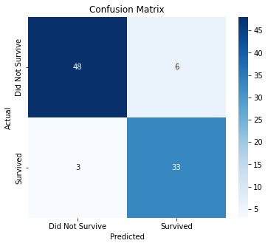
Portfolio 2: Classification Model Performance and Evaluation
Random Forest’s Results:
Accuracy: 90%
Confusion Matrix:
Classification Report:
 | Not Survived | Survived
Precision | 94,11% | 84,61%
Accuracy | 90,00%
Recall | 88,88% | 91,66%
F-Score | 91,42% | 87,99%

Slide 16
Portfolio 2: Evaluation Results Overview and Conclusions
The Random Forest classification model showed excellent predictive performance, attaining 90% accuracy on the test data.
According to the confusion matrix, the model accurately predicted 33 out of 36 survivors and 48 out of 54 non-survivors, demonstrating a balance between sensitivity and specificity.
Both classes had high precision and recall scores (0.94/089 for non-survivors and 0.85/0.92 for survivors), demonstrating the model’s accuracy and consistency in making predictions.
These findings imply that the chosen features are very informative in predicting survival results.
Ultimately, this project illustrates the effectiveness of supervised Machine Learning in uncovering meaningful patterns and making reliable predictions from real-world data.

Slide 17
Portfolio 3: Titanic Dataset – Exploratory Data Analysis
Objective: Utilize Python and Google Colab to conduct exploratory data analysis (EDA) on the Titanic dataset, to reveal patterns and comprehend important aspects of passenger survival.
Google colab is a cloud-based Jupyter notebook environment that is freely provided by Google. Its key features include, its cloud-based nature, user-friendly interface, integration with Google Cloud Platform (GCP) services, sharing and collaboration capabilities, and support for GPU and TPU computing (Sukhdeve and Sukhdeve, 2023).
Dataset: Titanic Survival Predictions (Kaggle). https://www.kaggle.com/code/nadintamer/titanic-survival-predictions beginner?select=train.csv
Python Libraries used: pandas, seaborn, matplotlib.

Slide 18
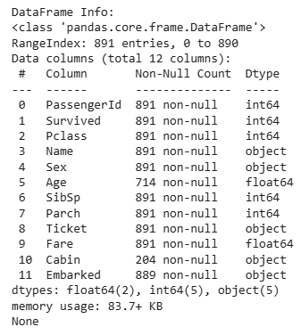
Portfolio 3: An Overview of the Dataset
Features: 12 columns including Age, Sex, Pclass, SibSp, Parch, Fare, Embarked, Survived, PassengerID, Name, Ticket, Cabin.
Target Variable: The survived column where, 0 = not survived and 1 = survived.
Missing Data: Present in the Age, Embarked, and Cabin columns.

Slide 19
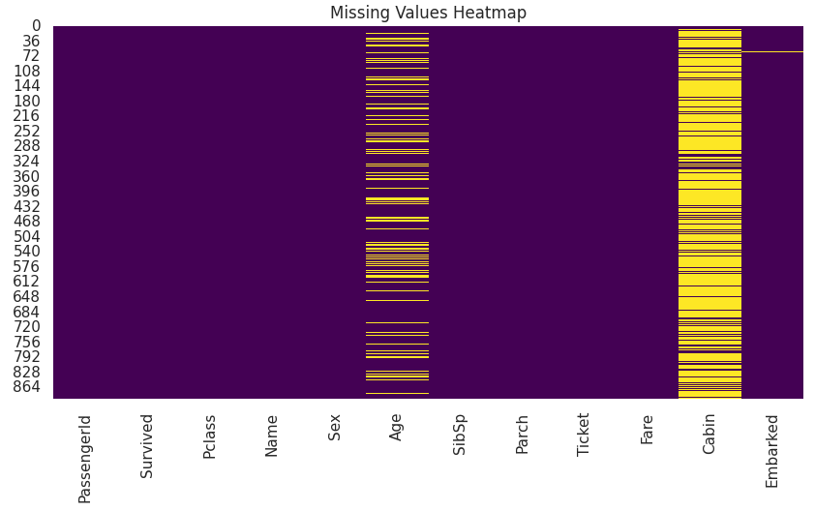
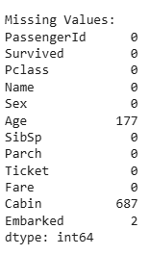
Portfolio 3: Handling Missing Data
The Cabin and Age are the columns that contain the most missing values:
A Heatmap is used to visualize value missingness.
The heatmap reveals that the Cabin column is mostly missing, while the Age column despite its missing entries is still manageable.

Slide 20
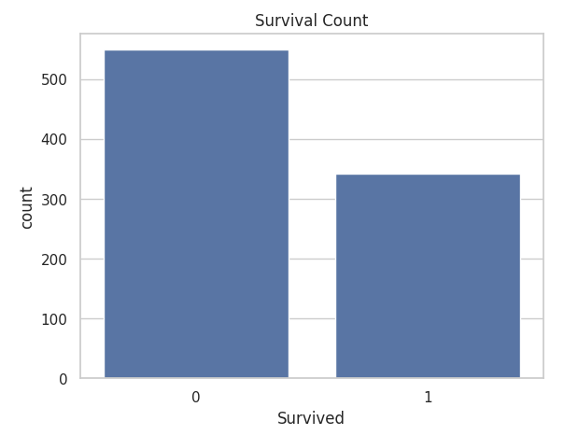
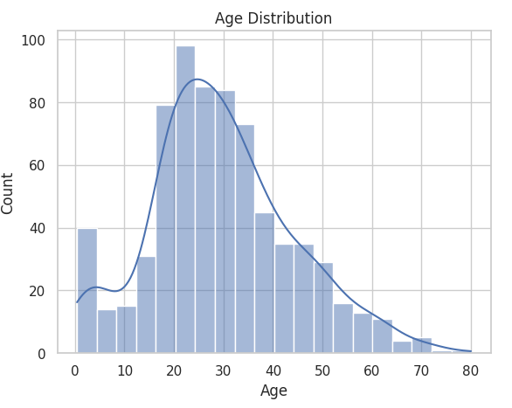
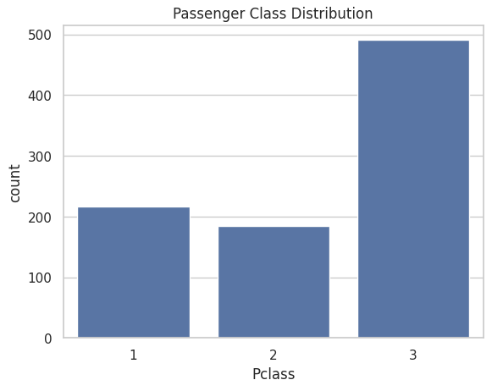
Portfolio 3: Key Univariate Visualizations
Distribution of Survival: A higher number of passengers perished.
Age Distribution: The majority of passengers were in the 20-40 age range.
Distribution of Pclass: Third class is the majority.
The plots indicate a possible correlation between Age, class and Survival.

Slide 21
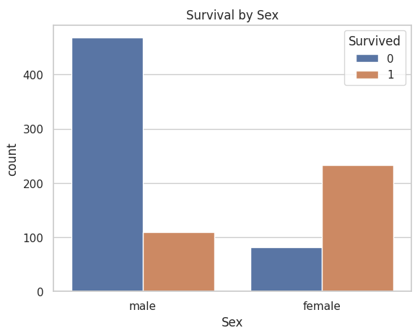
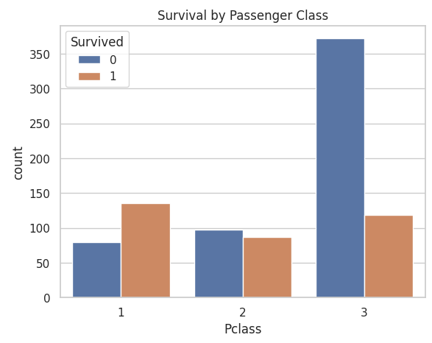
Portfolio 3: Patterns of Survival by Group
Sex: The survival rate was considerably higher for females.
Pclass: The highest survival rate was seen among 1st class passengers.
The plots suggest that class and sex are powerful predictors of survival.

Slide 22
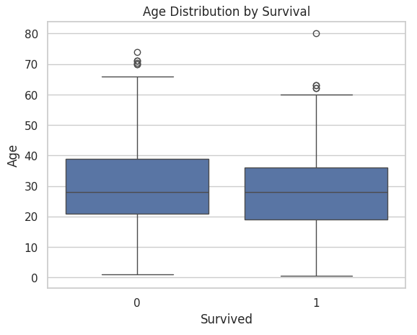
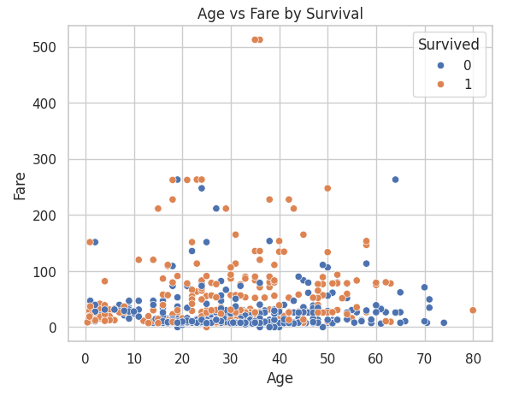
Portfolio 3: Examining Fare & Age
Boxplot (Age vs Survived): Younger people were more likely to have survived.
Scatter (Age vs Fare): Survival is frequently associated with higher fares.
Conclusion: The likelihood of survival is correlated with both Age and Fare.

Slide 23
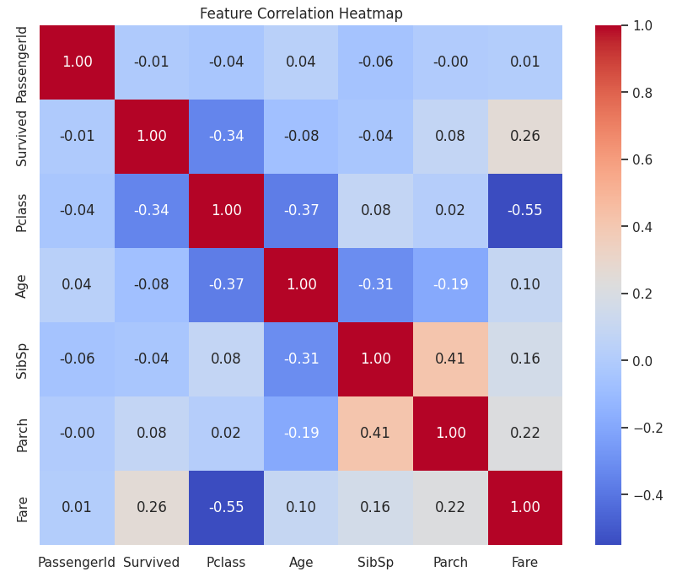
Portfolio 3: Feature Correlation Heatmap
The heatmap visualizes correlations between numerical features.
Sex, Fare, and Pclass features exhibit a strong relationship with the Survived feature.
Therefore, the most predictive features for survival are Fare, Pclass, and Sex.

Slide 24
Portfolio 3: Conclusions – Exploratory Data Analysis Key Insights
The survival rates of women and 1st class passengers were noticeably higher, confirming historical accounts and emphasizing the influence of gender roles and social hierarchy on survival outcomes.
The Age and Fare distributions clearly show that survivors were slightly younger on average and paid higher fares than non-survivors.
Age, Pclass, and Sex are the most significant characteristics, consistently demonstrating a high degree of separation between outcome groups in all visualizations.
These patterns demonstrate that Exploratory Data Analysis, or EDA, not only supports intuition but also identifies significant patterns that guide the development of models.
Full colab notebook:
https://colab.research.google.com/drive/1yFIhd2RIgC0jDg749dR1PqGtAxX0uYp4?usp=sharing

Slide 25
Portfolio 4: Analyzing Airbnb Listings Using MongoDB Atlas
Objective: Utilize NoSQL queries to retrieve, analyze, and export data.
Dataset: Sample Airbnb dataset provided by MongoDB Atlas (approximately 7000 listings).
Platform: MongoDB Atlas, a fully managed cloud NoSQL database service.
Methodology:
Utilize the GUI tool MongoDB Compass to work with the data.
Run filtering queries and aggregation pipelines.
Export relevant query results for reporting.
For flexible and unstructured datasets like Airbnb listings, MongoDB Atlas offers scalable, cloud-based NoSQL data storage and robust querying.

Slide 26
Portfolio 4: MongoDB Atlas - Airbnb Dataset
MongoDB Atlas:
Cloud-hosted database as a service.
Supports data storage that is document-based (similar to JSON) (Győrödi et al., 2022).
Features include analytics, integrations, indexing, aggregation, and clustering.
For this project, accessed through the MongoDB Compass GUI.
Airbnb Dataset (MongoDB Atlas sample dataset):
Dataset name: sample_Airbnb.listingsAndReviews
Structure: approximately 7000 entries, document-oriented.
It includes fields like property_type, bed_type, price, beds, room_type, address, review_scores, etc.
Rich, nested structure that is appropriate for practicing queries in the real world (Harrison and Harrison, 2021).

Slide 27
Portfolio 4: MongoDB Atlas Environment Setup
MongoDB Atlas Setup:
Using the Atlas dashboard, a free cloud cluster was created and put online.
Using Atlas’s “Load Sample Data” function the sample dataset was loaded directly.
MongoDB Compass (GUI):
Used to aggregate, filter, and visually explore data.
Through the GUI query builder, interactions were either minimal or code-free.
The benefits of this Setup:
A realistic representation of querying in a real-world NoSQL setting.
Perfect for nested or non-tabular datasets where adaptability is essential.

Slide 28
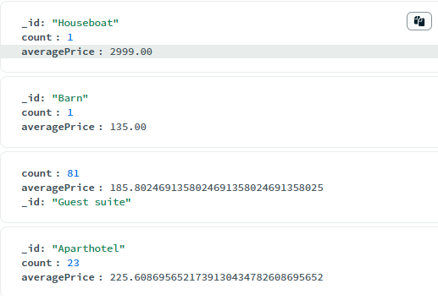
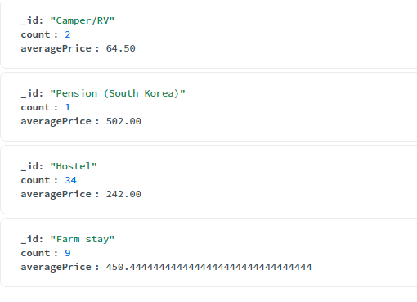
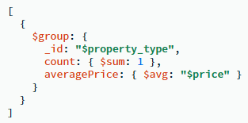
Portfolio 4: Query 1 – Property Type Summary
Query Objective: Group listings by property_type, displaying count and average price for each category.
Observations:
The query identifies the most prevalent kinds of properties (e.g., Condos, Apartments).
It demonstrates how pricing varies across property types.

Slide 29
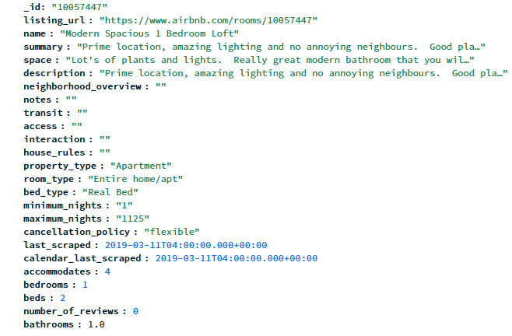
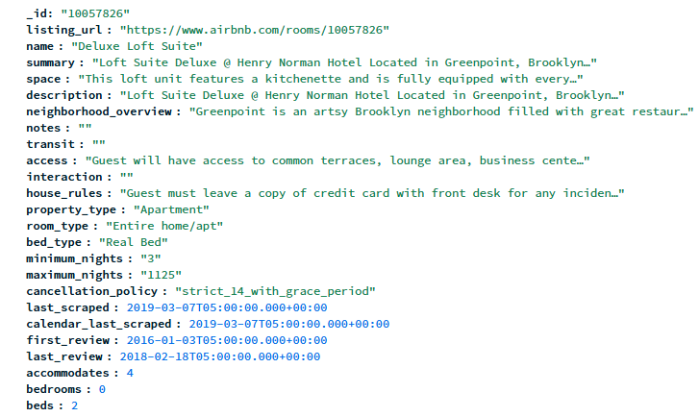
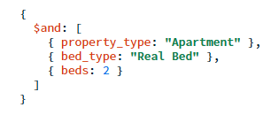
Portfolio 4: Query 2 – Filter by Apartment Type
Query Objective: Find apartments with 2 beds and a real bed setup.
Observations:
The query identifies family-friendly, fully equipped apartments.
It demonstrates how specific listings features can be filtered using MongoDB’s find query.

Slide 30
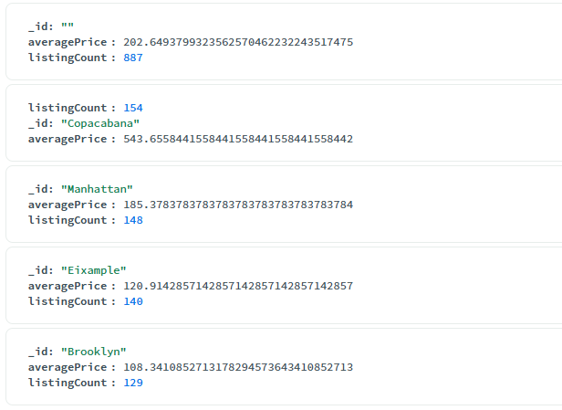
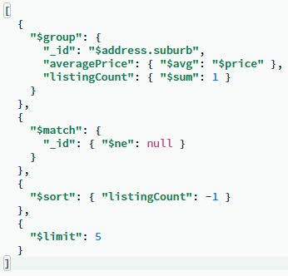
Portfolio 4: Query 3 – Top Neighborhoods by Popularity
Query Objective: Group by neighborhood and identify the top 5 suburbs with the highest listing frequency and average price.
Observations:
The query identifies top-performing suburbs in terms of listing volume.
It shows correlation between popularity and pricing.

Slide 31
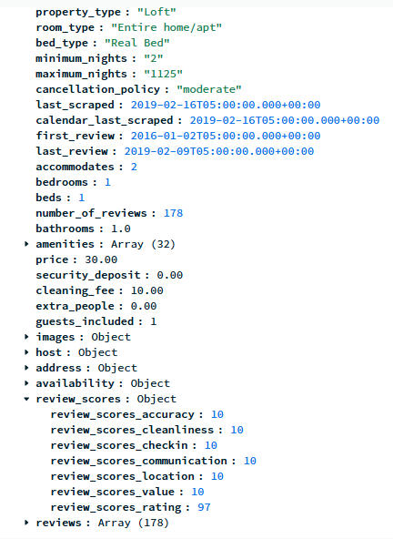
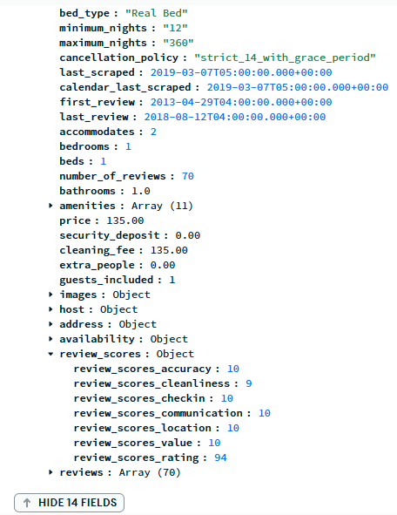
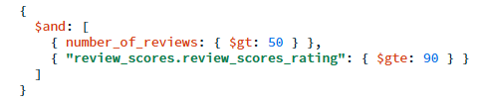
Portfolio 4: Query 4 – High-Reviewed Listings
Query Objective: Find listings with more than 50 reviews and a rating score ≥ 90.
Observations:
The query highlights highly rated and frequently reviewed listings.
It is useful for targeting trusted and top-performing properties.

Slide 32
Portfolio 4: Conclusions
The MongoDB Atlas was effective in analyzing Airbnb’s semi-structured data.
Deep insight into pricing patterns, property types, and visitor preferences was made possible by aggregation pipelines.
JSON queries made it simple to extract high-performing listings, popular property types, and top neighborhoods.
This portfolio ultimately demonstrates how NoSQL tools can be used for real-world data analysis without traditional-based schemas.

Slide 33
REFERENCES
González García, C. and Álvarez-Fernández, E., 2022. What is (not) Big Data based on its 7Vs challenges: A survey. Big Data and Cognitive Computing, 6(4), p.158.
Mohammadi, M., Al-Fuqaha, A., Sorour, S. and Guizani, M., 2018. Deep learning for IoT big data and streaming analytics: A survey. IEEE Communications Surveys & Tutorials, 20(4), pp.2923-2960.
Nguyen, T., Gosine, R.G. and Warrian, P., 2020. A systematic review of big data analytics for oil and gas industry 4.0. IEEE access, 8, pp.61183-61201.
Nti, I.K., Quarcoo, J.A., Aning, J. and Fosu, G.K., 2022. A mini-review of machine learning in big data analytics: Applications, challenges, and prospects. Big Data Mining and Analytics, 5(2), pp.81-97.
Lin, R., Ye, Z., Wang, H. and Wu, B., 2018. Chronic diseases and health monitoring big data: A survey. IEEE reviews in biomedical engineering, 11, pp.275-288.
Jaber, M.M., Ali, M.H., Abd, S.K., Jassim, M.M., Alkhayyat, A., Aziz, H.W. and Alkhuwaylidee, A.R., 2022. Predicting climate factors based on big data analytics based agricultural disaster management. Physics and Chemistry of the Earth, Parts A/B/C, 128, p.103243.
Rawat, D.B., Doku, R. and Garuba, M., 2019. Cybersecurity in big data era: From securing big data to data-driven security. IEEE Transactions on Services Computing, 14(6), pp.2055-2072.
Weinhardt, M., 2021. Big data: Some ethical concerns for the social sciences. Social Sciences, 10(2), p.36.

Slide 34
REFERENCES
Smirnova, E., Ivanescu, A., Bai, J. and Crainiceanu, C.M., 2018. A practical guide to big data. Statistics & probability letters, 136, pp.25-29.
Diareme, K.C. and Tsiligiridis, T., 2018. Multi-criteria optimization methods applied in agricultural touring. Multicriteria Analysis in Agriculture: Current Trends and Recent Applications, pp.267-288.
Diareme, K.C., Liapakis, A. and Efthymiou, I., 2022. Big Data, Sentiment Analysis, and Examples during the COVID-19 Pandemic. HAPSc Policy Briefs Series, 3(2), pp.21-30.
Diebold, F.X., 2003, February. Big data dynamic factor models for macroeconomic measurement and forecasting. In Advances in Economics and Econometrics: Theory and Applications, Eighth World Congress of the Econometric Society,”(edited by M. Dewatripont, LP Hansen and S. Turnovsky) (Vol. 115, p. 22).
Mir, S.A., Bhat, M.S., Rather, G.M. and Mattoo, D., 2022. Role of big geospatial data in the COVID-19 crisis. In Data Science for COVID-19 (pp. 589-609). Academic Press.
Das, S., Imtiaz, M.S., Neom, N.H., Siddique, N. and Wang, H., 2023. A hybrid approach for Bangla sign language recognition using deep transfer learning model with random forest classifier. Expert Systems with Applications, 213, p.118914.

Slide 35
REFERENCES
Sukhdeve, D.S.R. and Sukhdeve, S.S., 2023. Google colaboratory. In Google Cloud Platform for Data Science: A Crash Course on Big Data, Machine Learning, and Data Analytics Services (pp. 11-34). Berkeley, CA: Apress.
Győrödi, C.A., Dumşe-Burescu, D.V., Zmaranda, D.R. and Győrödi, R.Ş., 2022. A comparative study of MongoDB and document-based MySQL for big data application data management. Big Data and Cognitive Computing, 6(2), p.49.
Harrison, G. and Harrison, M., 2021. MongoDB Performance Tuning: Optimizing MongoDB Databases and Their Applications. Berkeley, CA: Apress.
Fasel, D. and Meier, A., 2014. Big data. Springer Vieweg.
Wang, J., Xu, C., Zhang, J. and Zhong, R., 2022. Big data analytics for intelligent manufacturing systems: A review. Journal of Manufacturing Systems, 62, pp.738-752.
Rani, S., Bhambri, P., Kataria, A., Khang, A. and Sivaraman, A.K. eds., 2023. Big Data, Cloud Computing and IoT: Tools and Applications. CRC Press.

