Slide 1



Job Connect : A One-Stop Digital Platform for Finding Jobs
KONGU ENGINEERING COLLEGE
PERUNDURAI ERODE-638060
Department of Computer Science and Engineering
PRESENTED BY :
Arvind M (22CSR023)
Mathav Ra (22CSR117)
Aadhi Pranesh S S (23CSR001
Gowtham C D (23CSR068)
01-03-2025

Slide 2
PROBLEM STATEMENT
In today's competitive job market, job seekers often face difficulties navigating complex, crowded, and expensive job portals, while small businesses struggle to find visibility or manage recruitment efficiently.
Existing platforms are overloaded with features, lack customization, and are often financially inaccessible for startups and small companies.
This results in a fragmented, frustrating hiring experience for both employers and applicants.

Slide 3
PROPOSED WORK
We propose a Job Finding Platform built with Django, offering a clean, user-friendly interface tailored to the essential needs of job seekers and employers.
The platform simplifies job searching and posting through intuitive filtering, secure logins, and role-based dashboards.
By focusing on core functionalities—like job listing, search, and user management—we provide a streamlined, cost-effective alternative to traditional job portals.
Future scalability allows for features like resume uploads, application tracking, and real-time notifications to enhance the experience further.

Slide 4
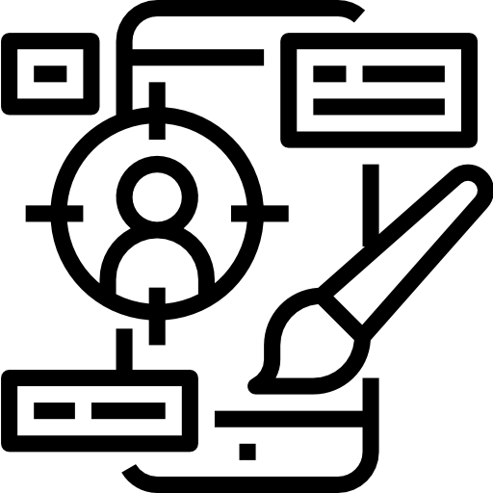

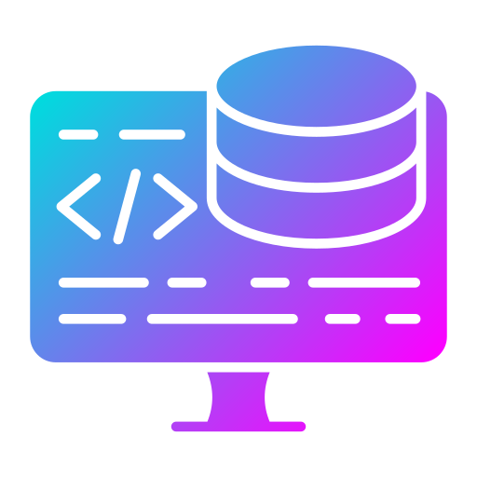
SOFTWARE SPECIFICATION
Frontend
Backend
DataBase
HTML
CSS
JavaScript
Django
MySQL

Slide 5
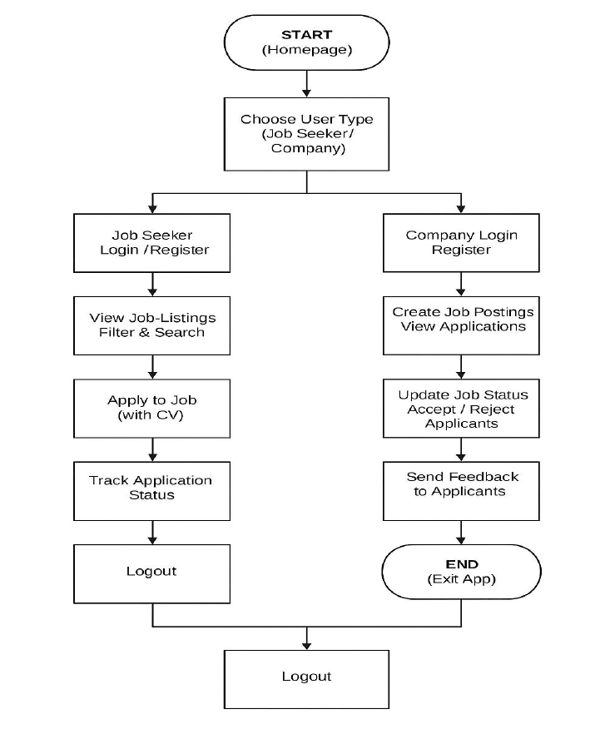
Flow Chart

Slide 6
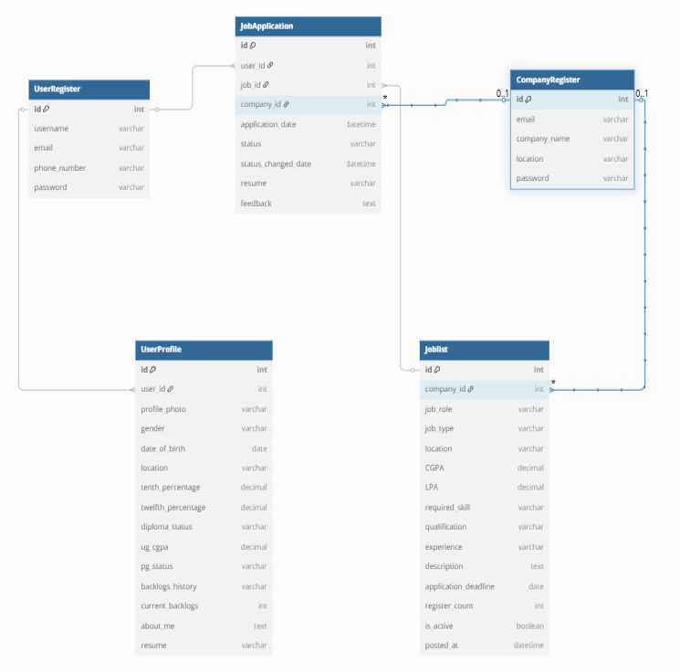
Database Design

Slide 7
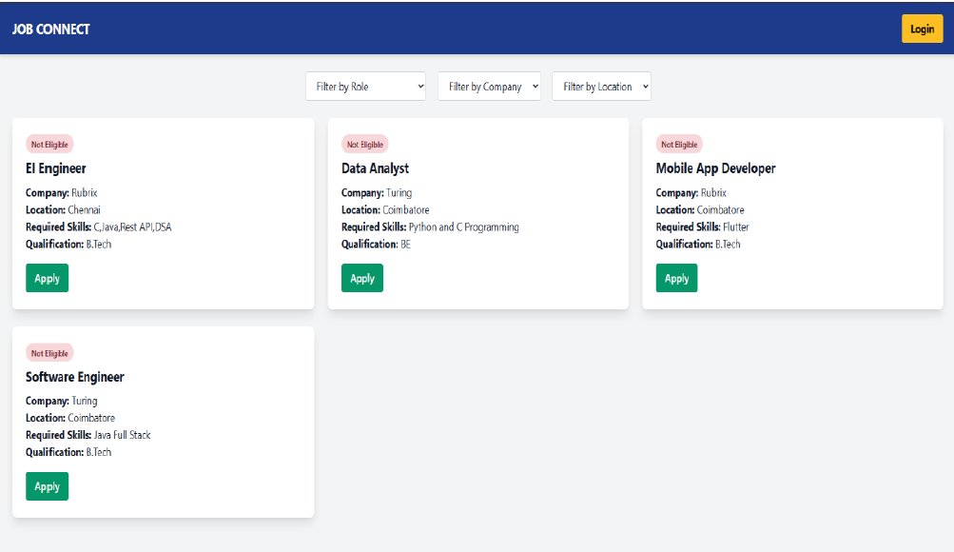
Landing Page

Slide 8
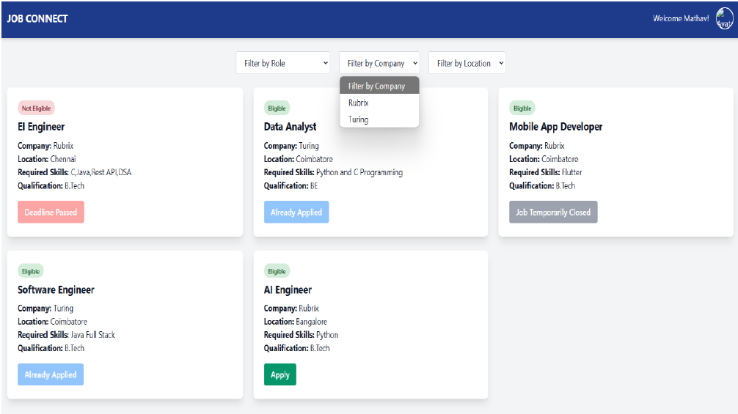
User Dashboard

Slide 9
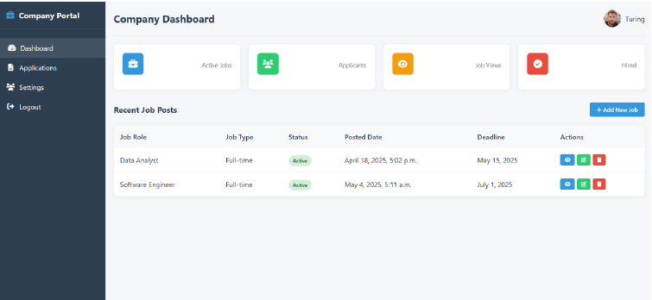
Company Dashboard

Slide 10
Thank You

