Slide 1


SMART INDIA HACKATHON 2024
Problem Statement ID - 1605
Problem Statement Title - Women Safety Analytics – Protecting Women from safety threats
Theme - Miscellaneous
PS Category - Software
Team ID - 7251
Team Name - Technovators

Slide 2
Women Safety Analytics
Technovators
IDEA / SOLUTION:
Implementation of a real-time Women Safety Analytics System designed to detect harassment and unsafe situations in public spaces through CCTV video surveillance. The solution leverages advanced machine learning algorithms and deep learning models for behavior detection and SOS alert triggering.
CCTV-based surveillance monitoring system that analyzes live footage for harassment detection.
AI-powered harassment detection models to classify harmful actions.
The SOS app triggers alerts with a voice code, notifying authorities and contacts via WhatsApp, SMS, email, and calls for quick help.
The Smart Ring triggers immediate alerts when pressed, offering protection by being difficult for intruders to remove.
Detected crimes are uploaded to the cloud, marking hotspots on an interactive map for real-time awareness.
Problem Resolution:
Round-the-Clock Smart Monitoring: Eliminates the need for manual oversight with intelligent, automated tracking of potential threats in real time.
Enhanced Public Safety: Instantly detects risks and sends rapid-response alerts, creating a safer, more protected environment for women.
Unique Value Propositions (UVP):
Real-time Surveillance Analytics: Real-time AI detects harassment instantly with high accuracy.
Multi-channel Alert System: Sends emergency alerts through WhatsApp, SMS, email, phone, and the smart ring ensuring immediate response even if the woman is unable to access her phone.
Low-Network SOS Alerts: The system uses SMS and email efficiently to ensure SOS alerts are sent even in low-signal areas.
Demo video link : GitHub link : Click Here

Slide 3
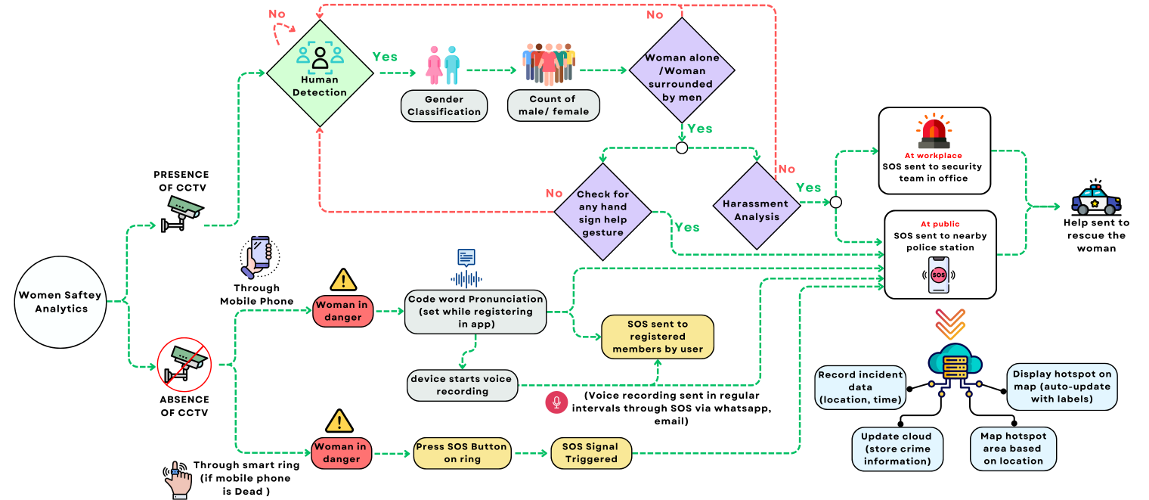
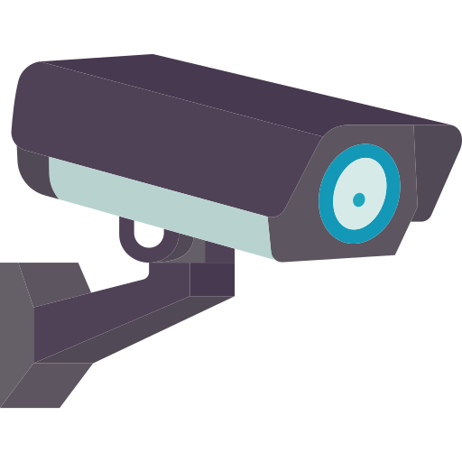
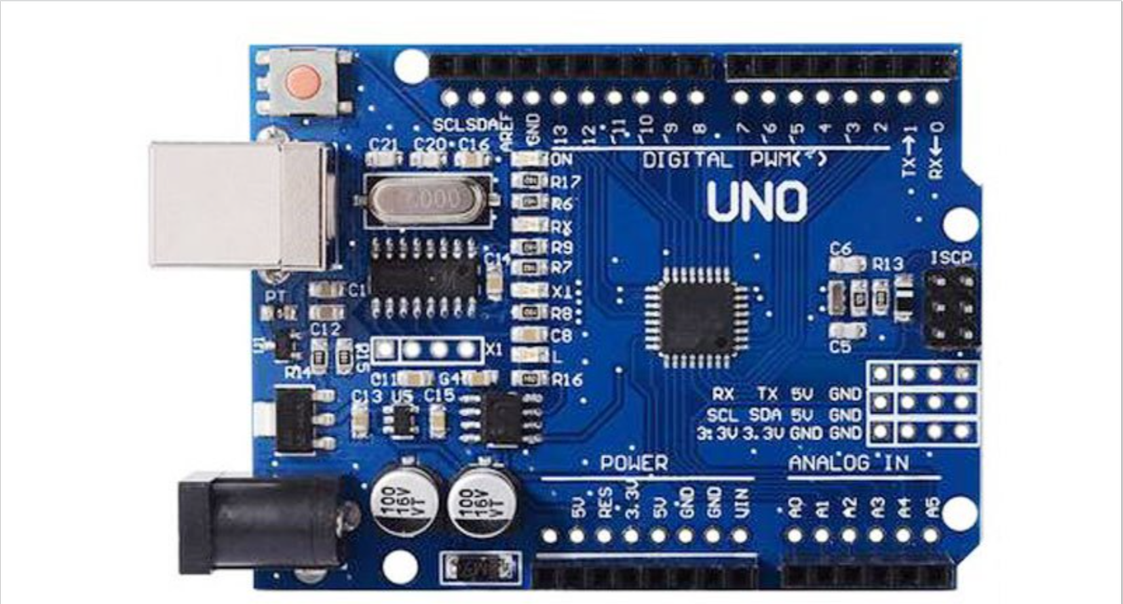












TECHNICAL APPROACH
Technovators
Technological Stack
Flowchart :
Hardware
CCTV Camera
Micro controllers
Software

Slide 4
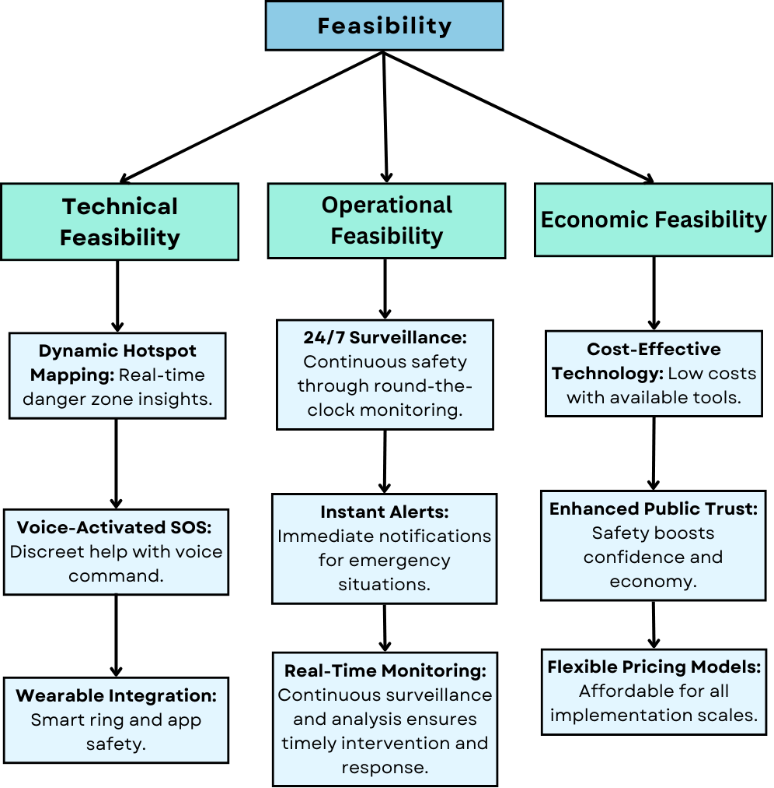
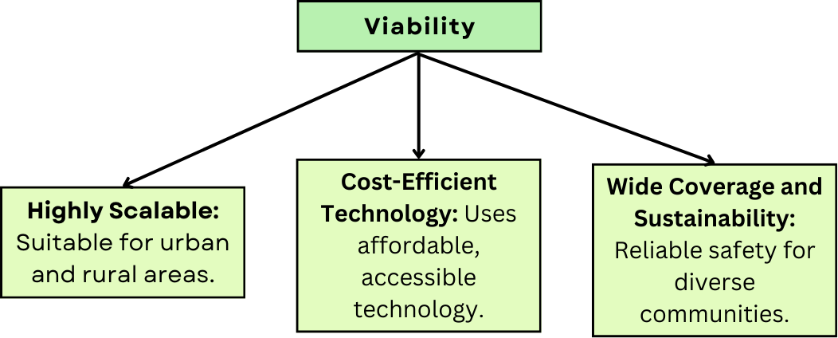
FEASIBILITY AND VIABILITY
Technovators
Potential Challenges and Risks:
User Error in SOS Triggers: Accidental smart ring or app activation might cause undue panic or misallocation of resources.
Low-Quality Footage: Subpar lighting or resolution could obstruct precise human detection and emotion analysis.
False Positives: Erroneous behavior detection may flood authorities with unnecessary alerts and false alarms.

Slide 5
IMPACT AND BENEFITS
Technovators
Impact
Existing Solution
Proposed Solution
Promotes public awareness around safety, encouraging more proactive measures to prevent harassment and assault, leading to boosted awareness in communities.
Provides women with a reliable and accessible tool for immediate help in dangerous situations, enhancing personal safety.
Promotes a safer environment, encouraging more women to feel secure in public spaces, leading to increased public confidence.
Manual CCTV monitoring can cause delays and errors in detecting threats, leading to missed incidents and longer response times.
The new solution employs cutting-edge algorithms to detect threats such as harassment or gender-based violence, enabling fast response.
Most surveillance solutions use basic motion detection or facial recognition but lack the sophistication to identify specific threats like harassment or gender-based violence.
The proposed solution minimizes delays and errors in response by integrating automatic SOS alerts, ensuring quicker intervention.
Our solution offers hands-free voice commands to trigger automatic SOS alerts on mobile phones, combined with a discreet smart ring worn by women. The ring allows users to send an SOS by pressing a button, even if they can't access their phone.
Most current systems lack voice command functionality, leaving women vulnerable when they are unable to physically interact with their device.

Slide 6
RESEARCH AND REFERENCES
Technovators
JOURNALS
Malkari, Mukesh Kumar, S. Maruthuperumal, Ajay Kumar Reddy Duggu, Kruthik Chander Maidamshetty, and Srinivasa Reddy Medagam. "Integrated Women Safety Application." International Journal of Research in Engineering, Science and Management 7, no. 4 (2024): 64-67.
Kohli, Priyanka, Kawaljeet Singh, and Brahmaleen K. Sidhu. "Design of Real Time Intelligent System for Women Safety." Recent Patents on Engineering 18, no. 3 (2024): 77-83.
Rathore, Sagar Singh, Naveen Kumar Dewangan, Ravindra Manohar Potdar, Pradeep Barde, and Pranjali Jumle. "IoT-Based Smart Safety Analyzer for Women." In Impact of AI on Advancing Women's Safety, pp. 185-199. IGI Global, 2024.
LINKS
https://www.researchgate.net/publication/380023278_Detection_and_Classification_of_Human_Gender_into_Binary_Male_and_Female_Using_Convolutional_Neural_Network_CNN_Model
https://www.sciencedirect.com/science/article/pii/S2665917422001441?ref=pdf_download&fr=RR-2&rr=8c57e3b9eeaa7ebc

