Slide 1



KONGU ENGINEERING COLLEGE
PERUNDURAI ERODE-638060
Computer Science And Engineering & Artificial Intelligence and Data Science
Women Safety Analytics - Protecting Women from safety threats
Team Name: Technovators
Team Lead: Bavyadharshini.R
Team Members: Mathav Ra ,
Jahaganapathi S ,
Sreepriyanth N S

Slide 2

PROBLEM STATEMENT
The growing concern for the safety of women and the increase in crimes against women in various cities, highlight the need for advanced surveillance and analytical solutions to protect women from various possible threats. We need a promising approach to address these issues through real-time threat detection software.
Detailed Description: By leveraging advanced analytics through real-time monitoring, Women Safety Analytics should create safer environments for women and assist law enforcement in effectively addressing and preventing crimes against women. The proactive approach of detecting anomalies and generating alerts can play a crucial role in enhancing public safety and fostering a secure atmosphere for women. Women safety analytics software should continuously monitor the scene to count the number of men and women present, offering insights into gender distribution in specific locations and times. It should identify unusual patterns, such as a lone woman at night, unusual gestures and generates alerts to pre-empt potential incidents.
Expected Solution: Women safety analytics should include the following functionalities
Person detection along with Gender Classification
Gender Distribution : Count the number of men and women present in the scene
Identifying a Lone Woman at Night time
Detection of a Woman Surrounded by Men
Recognizing SOS situation through gesture analytics
Identifying hotspots where incidents are more likely to occur, based on the past alerts

Slide 3
PROPOSED SOLUTION
Women Safety Analytics System: Empowering Safety, Anytime, Anywhere Comprehensive Protection, Seamlessly integrates real-time CCTV surveillance and an intuitive mobile app to detect and prevent safety threats.
Instant Threat Detection: Powered by cutting-edge AI analytics, the system identifies harassment and potential dangers in real-time.
Rapid SOS Alerts: Delivers immediate alerts with live location to control rooms, nearby police stations, and trusted contacts for swift intervention .
Actionable Data Insights: Leverages data-driven analytics to continuously enhance safety measures and optimize interventions.
Holistic Safety Network: A unique fusion of advanced CCTV analytics and mobile technology, offering round-the-clock protection.

Slide 4



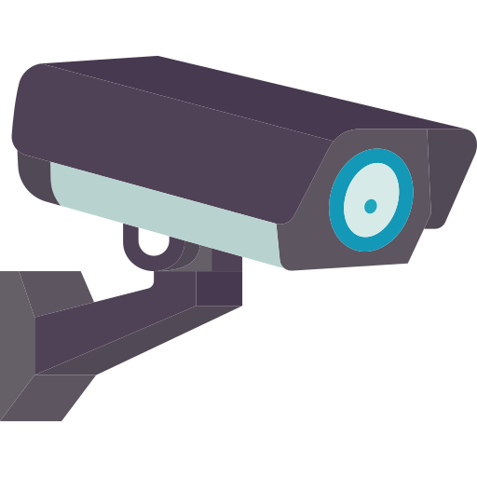

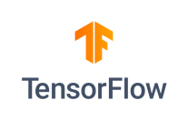





TECHNICAL APPROACH
Technology stack :
CCTV Camera

Slide 5
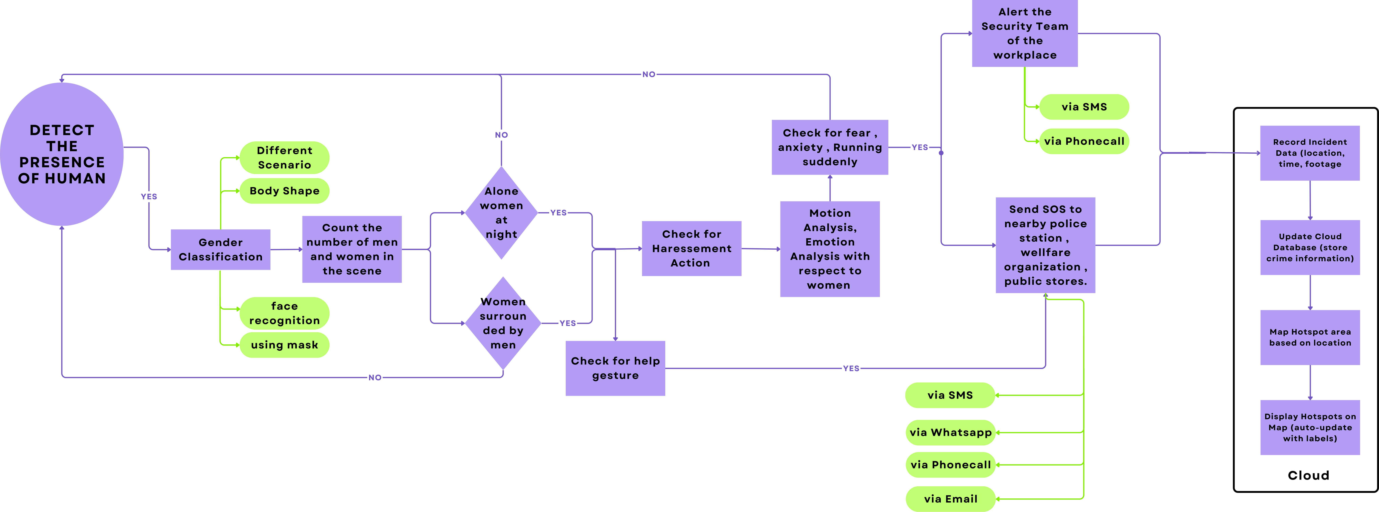
FLOW CHART

Slide 6
Thank You !!

