Slide 1


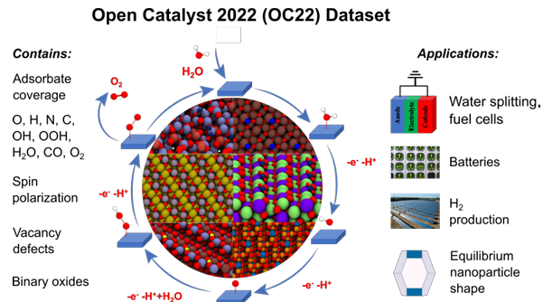
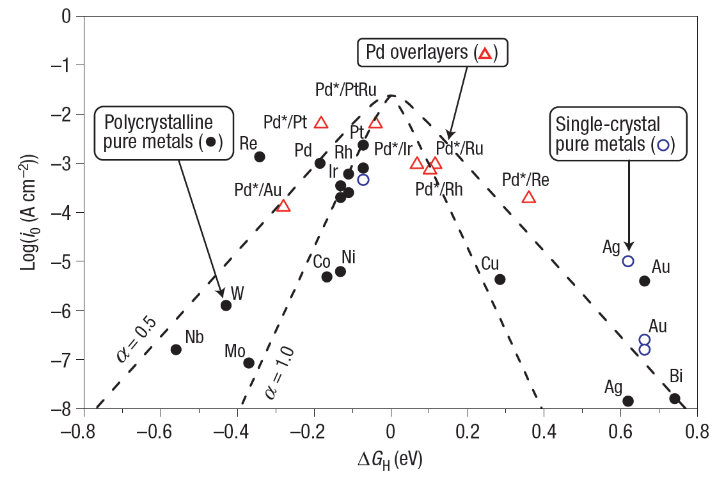

DFT + ML
Reaction
Rates [mol/s]
Time scale
information
?
Thermodynamics
(No time scale information)
Driving Force [V]

Slide 2
Mathematics
Pred. Property
Future Challenges:
- Lifetime Theory
- Implementation
Optimization
Validation
Model
$$j\left(t\right)=f(\vec{k_{0}}, \vec{E_{eq}},\vec{α}, E\left(t\right))$$
KM (S, C, R, K)
Future Challenges:
- From 10 to 1000
- From vitro to vivo
Network Size
Spectra
Denoise
Material
EChem. Data
Algorithm
Chemistry
Timecourse Data
Data Science
Perspective: Bridging Genetics and Metabolism using Control Systems Theory

Slide 3
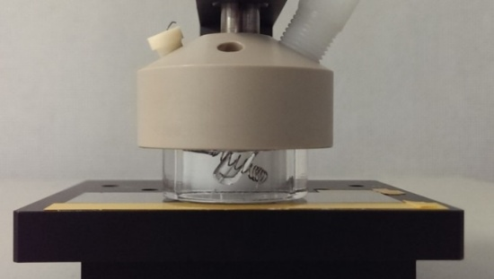
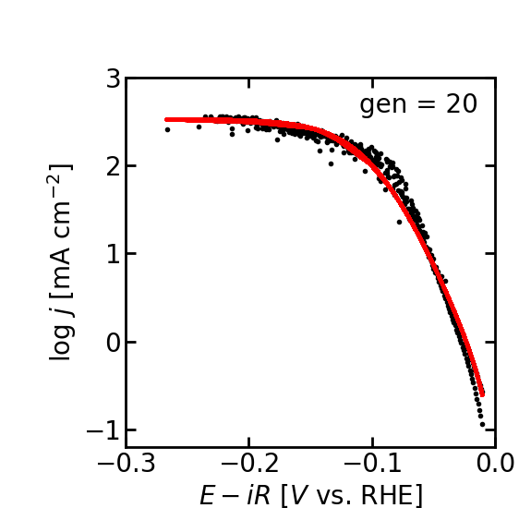
Mathematical Catalysis Research Team
Focusing on Kinetics of Electrocatalytic Reactions
Mathematics
(Predictive Models)
Dissolution
Spectroscopy
X₁
(In-situ・Complex Interface)
X_{n}
X₂
Catalysis
Ref. Electrode
Counter Electrode
X₄
X₃
Quartz Prism
Working
Electrode (IrO₂)
Light
To CCD
Kinetics of
Electrocatalysis
Bubble
Nafion
Correct Theory
Water
Experiments
Catalyst（IrO₂）
Evanescent Wave
ITO Substrate
Quartz
Repeated Total Internal Reflection
Data Science
(Parameter Extraction and Validation)

Slide 4
数理触媒研究チーム：
反応速度論による電極触媒開発
数理
(モデル構築・予測)
X₁
溶出
分光
(In-situ・不均一環境)
X_{n}
X₂
触媒反応
X₄
X₃
参照極 (Ag/AgCl)
対極 (白金線)
石英導波路
作用極 (IrO₂)
入射光
CCD検出器へ
速度論による
触媒開発
気泡
ナフィオン
水
触媒（IrO₂）
染み出し
ITO基板
石英導波路
全反射を繰り返すプローブ光
情報
(速度定数抽出・妥当性検証)

Slide 5
No Photo

Slide 6
Mathematics
Data Science
Spectroscopy
(Predictive Models)
(Parameter Extraction)
(In-situ・Complex Interface)
Dissolution
X₁
Ref. Electrode
Counter Electrode
X_{n}
X₂
Correct Theory
Quartz Prism
Working
Electrode (IrO₂)
Catalysis
Light
To CCD
X₄
X₃
Experiments

Slide 7
(モデル構築・予測)
応用数理
情報科学
光導波路分光法
(モデル構築・予測)
(速度定数抽出・実験検証)
(In-situ・表面高感度)
X₁
溶出
参照極 (Ag/AgCl)
対極 (白金線)
X_{n}
X₂
石英導波路
作用極 (IrO₂)
触媒反応
入射光
CCD検出器へ
X₄
X₃

