Slide 1
The Friendship Theorem

Slide 2



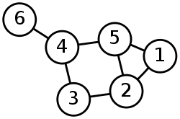
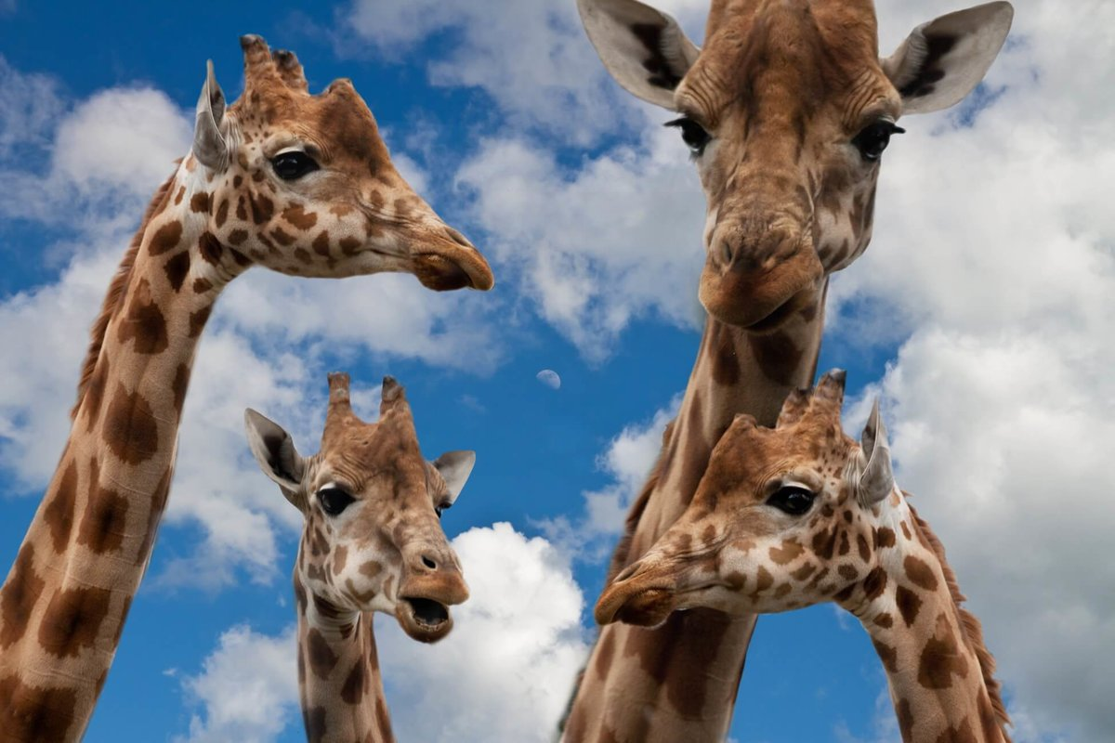
WHAT am I talking about?
Gaffes
B. Graphs
C. Grafts
D. Graphs
E. Giraffes

Slide 3
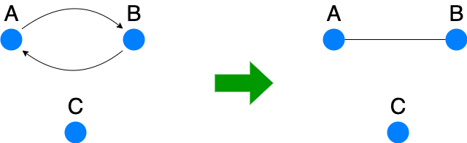
Friendship Graphs … are symmetric

Slide 4
Friendship Theorem
In a * Friendship Graph,
If:
Every pair of people has exactly 1 mutual friend
Then:
There is a “popular” person who is friends with everyone else
*finite, nonempty

Slide 5
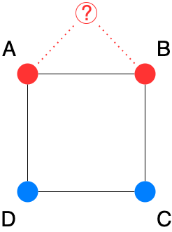
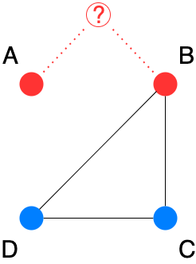
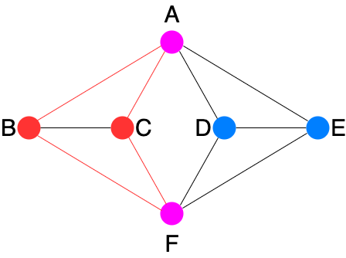
If: Every pair of people has exactly 1 mutual friend Then: There is a “popular” person who is friends with everyone else
Example
Exactly 1 mutual friend between every pair of people?
No
No
No
B and C have 2 mutual friends (A and F)
Reason
A and B have 0 mutual friends
A and B have 0 mutual friends

Slide 6
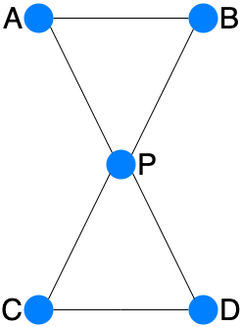
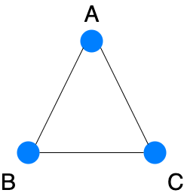
If: Every pair of people has exactly 1 mutual friend Then: There is a “popular” person who is friends with everyone else
Example
Exactly 1 mutual friend between every pair of people?
Yes
Yes
Yes
Popular?
A
A, B, C
P

Slide 7
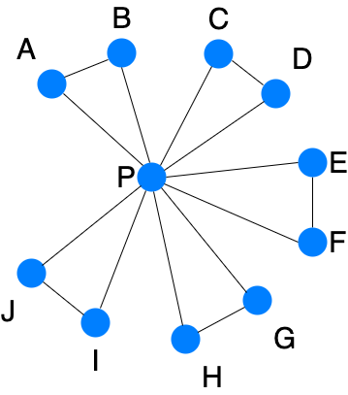
If: Every pair of people has exactly 1 mutual friend Then: There is a “popular” person who is friends with everyone else
Mutual friends:
M(A,B) = P
M(A,G) = P
M(C,F) = P
…
M(A,P) = B
M(B,P) = A
M(C,P) = D
…
Example
Exactly 1 mutual friend between every pair of people?
Yes
Popular?
P

Slide 8

Where’s the Proof?
Strategy: Prove by contradiction
Assume:
Every pair of people has exactly 1 mutual friend
No one is popular
Goal:
Reach a contradiction

Slide 9
Proof?
Every pair of people has
exactly 1 mutual friend
The maximum distance between people is 2
Every person has someone who is distance > 1, thus must be distance 2
No one is popular

Slide 10
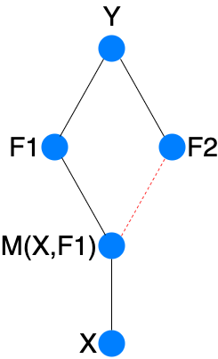
Proof?
Look at any person X
Look at any person Y that is not friends with X
Goal: show that X has at least as many friends as Y

Slide 11
Proof?
Goal: show that X has at least as many friends as Y
Map each of Y’s friends F to one of X’s friends
Show that this map is injective, so different friends of Y map to different friends of X
Y_friend_to_X_friend(F) = M(X,F)
Suppose not. Then M(X,F1) = M(X,F2) != Y.
But then this person has 2 mutual friends with Y
(namely, F1 and F2).
Since each of Y’s friends maps to a unique friend of X,
X has at least as many friends as Y

Slide 12
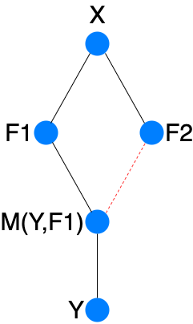
Proof?
The same argument applies from Y to X, so Y has at least as many friends as X
Therefore, X and Y have the same number of friends

Slide 13
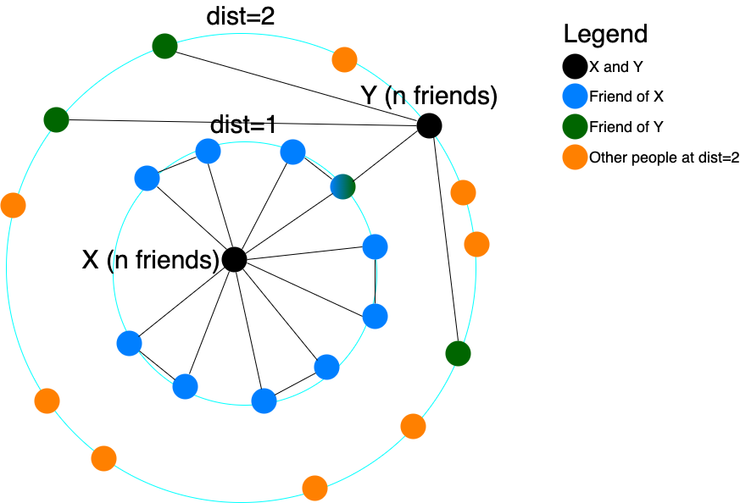
Proof?
So far: every pair of people that aren’t friends with each other have the same number of friends as each other
Next: all people have the same number of friends as each other

Slide 14
Proof?
Show: all people have the same number of friends as each other
Centering on X, count the number of people at dist=1 and dist=2.
Let n be the number of friends of X (and of Y).

Slide 15
Proof?
Show: all people have the same number of friends as each other
Y has n friends:
0 at dist=0 (X and Y aren’t friends)
1 at dist=1 (Y must have exactly 1 mutual friend with X)
n-1 at dist=2 (the rest)

Slide 16
Proof?
Show: all people have the same number of friends as each other
There are n people at dist=1 (X’s friends)
There are at least (n-1)+1 people at dist=2 (Y’s friends at dist=2 + Y itself)

Slide 17
Proof?
Show: all people have the same number of friends as each other
Everyone at dist=0 (just X) and dist=2 (combined, at least n+1 people) has n friends, and there are only n other people at dist=1
A strict majority of people have n friends, including X

Slide 18
Proof?
Show: all people have the same number of friends as each other
The same argument applies if you center the graph on arbitrary person P
A strict majority of people (including P) have the same number of friends

Slide 19
Proof?
The majority when centering on X and the majority when centering on P must intersect, therefore X and P have the same number of friends.
Therefore, all people have the same number of friends as each other.

Slide 20
Proof?
So far: all people have the same number of friends as each other
Still need to find a contradiction!
How? Count something 2 ways and get different results.

Slide 21
Proof?
Count: # of walks from any
vertex to itself of length p,
where p is a fixed prime
dividing n-1.
Ex: XABCDX (p=5)

Slide 22
Proof?
Each cycle appears p times in
this list of walks:
XABCDX
ABCDXA
BCDXAB
CDXABC
DXABCD

Slide 23
Proof?
Each cycle appears p times in
this list…
so the number of walks in
the list is a multiple of p.
In modular arithmetic, this
is 0 mod p.

Slide 24
Proof?
Count another way:
# of walks from any
vertex to itself of length p
Take p-2 arbitrary steps:
n^(p-2) possibilities

Slide 25
Proof?
After p-2 arbitrary steps from
X:
A. At X -> n ways to get to X
in 2 more steps
(any friend then back to X)
B. At Y -> 1 way to get to X
In 2 more steps
(mutual friend of X and Y, then X)

Slide 26
Proof?
After p-2 arbitrary steps from
X:
A. n ways to get to X
B. 1 way to get to X
n and 1 are BOTH 1 mod p
since p divides n-1
# of walks is n^(p-2) = 1 mod p

Slide 27
Proof?
Count: # of walks from any
vertex to itself of length p,
where p is a prime dividing
n-1.
This must be 0 mod p.
This must be 1 mod p.
Contradiction!

Slide 28
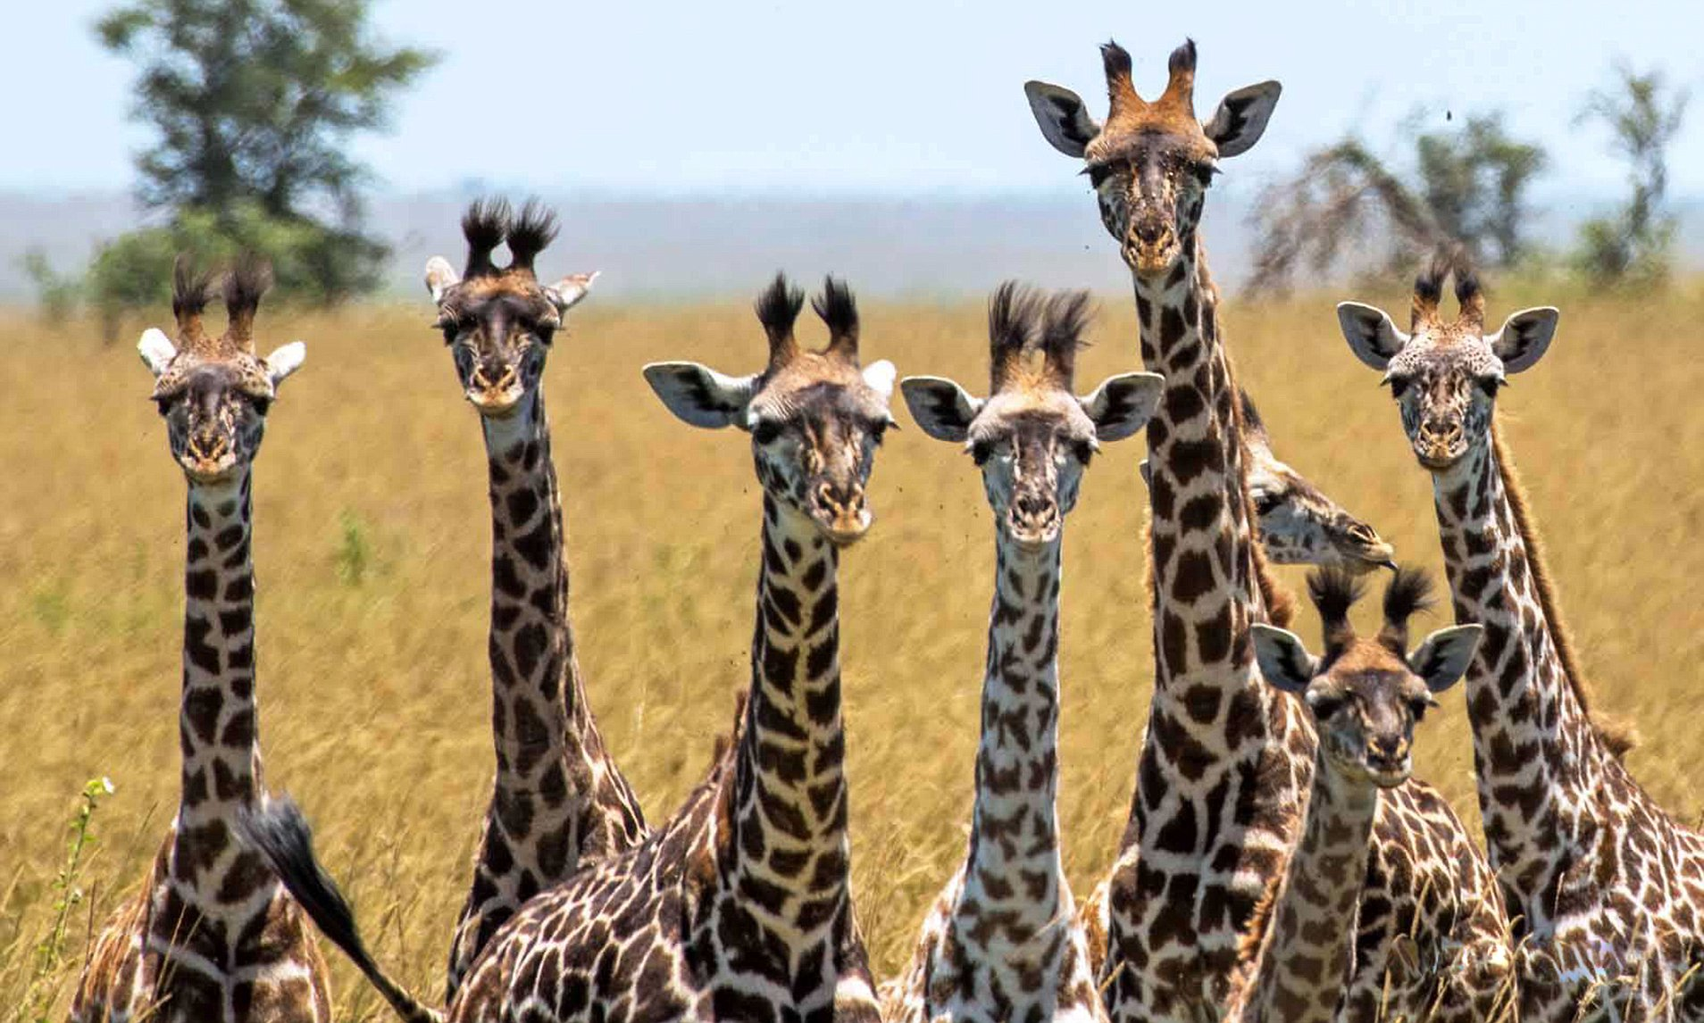
Fun Fact
The Friendship Theorem is FALSE if the graph is allowed to be infinite

Slide 29
Image references
https://assets.mugglenet.com/wp-content/uploads/2021/12/Who-Am-I-by-Gilderoy-Lockhart.jpeg
https://miro.medium.com/v2/resize:fit:1400/1*whbGJw2XvVu44tl5EeObZA.png
https://i.ytimg.com/vi/if-2M3K1tqk/maxresdefault.jpg
https://i0.wp.com/practicalselfreliance.com/wp-content/uploads/2021/03/Grafted-Tree.jpg?resize=1200%2C1800&ssl=1
https://web.cecs.pdx.edu/~sheard/course/Cs163/Graphics/graph1.png
https://site-547756.mozfiles.com/files/547756/catitems/giraffes-627033-39752d179ac95596a04fec46b8c32f7d.jpg
https://static.wikia.nocookie.net/cd574572-7a74-403b-a40e-d4cc879112a7/scale-to-width/755
https://i.dailymail.co.uk/i/pix/2017/07/17/16/4269CC3200000578-0-image-a-5_1500305742675.jpg
draw.io for creating graphs

