Slide 1

The interconnect of everything em, enceladux-1, week2.1
THABO PS, RETSAMAILE CS

Slide 2
COMMUNICATION AND INFORMATION FLOW
Information allows for innovation, and informed decision making
One of the most important things about technology is that allows for easy access to information
For example, access to information about health and education allows people to make better choices for themselves.
Access to information also allows for productivity, growth and innovation.
Technology also allows for easy communication across great distances.
School
University
Work
School
University
Work
Imagine the arrow represents opportunities based on the information you consume
The more you consume information, the more opportunities you can access.
For simplicity, a person who only knows about one university course will only aim for that course. Even if it is not what they like
So, this is the most basic importance of technology.

Slide 3
How does the internet work?
The internet is a global network that connects computers through physical cables, wireless signals, and satellites.
These connected computers are called servers — they store the information we search for online.
We communicate with servers via Internet Service Providers (ISPs), using IP addresses.
These companies that provides us with access to the internet
A unique address that identifies which machines are accessing the internet and what information they need.
A network is a group of computers or devices (like phones or tablets) that are connected together so they can share information.
The information we are talking about is data
Breaking down data
Information is broken into smaller packets
Addressing
Each packet contains information like senders and recipient IP-Address
Reassembly at destination
The packets are reassembled to recreate the data

Slide 4
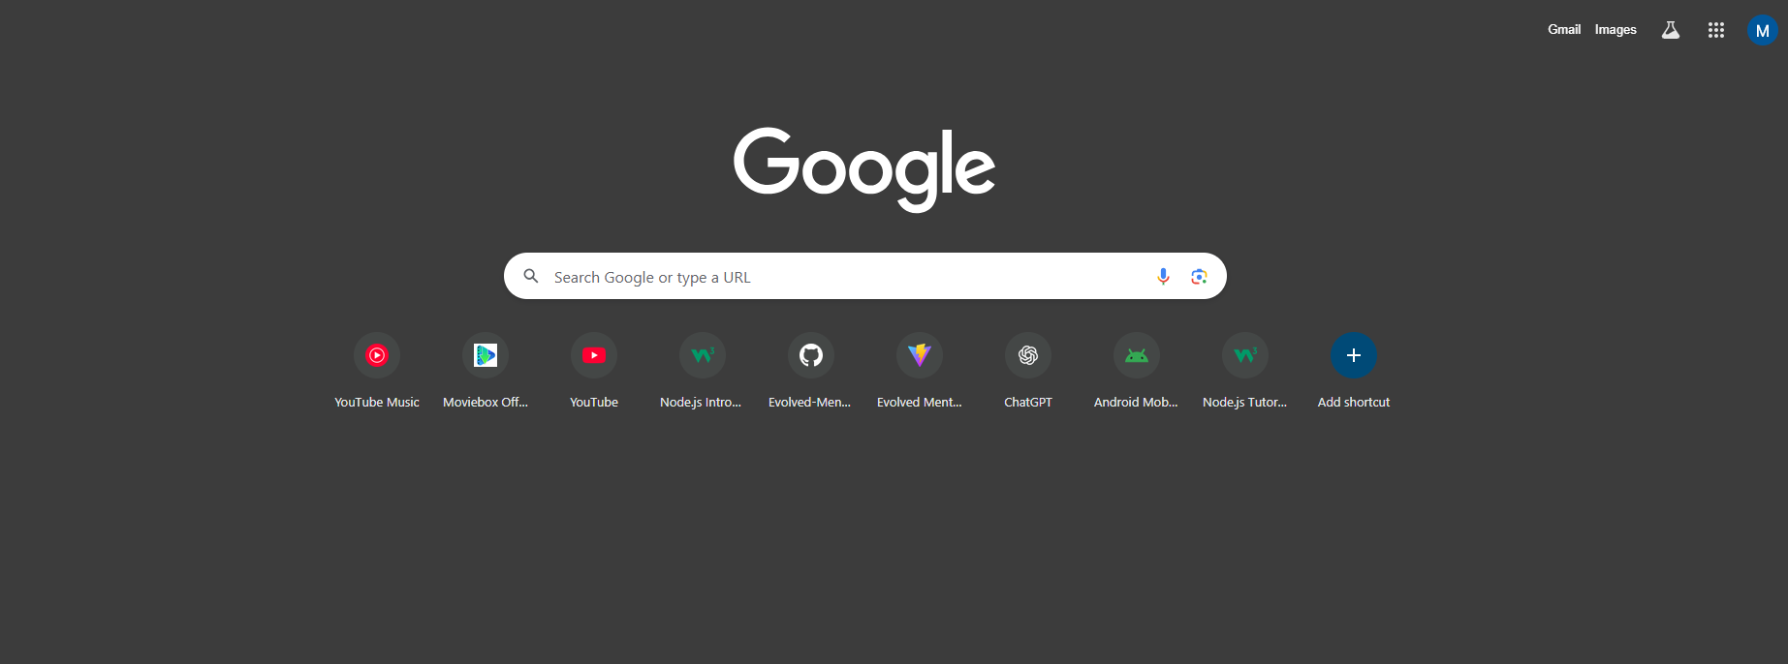
How do we explore the internet?
The internet holds an enormous amount of information — from videos and articles to pictures and websites.
This information is stored on web pages, each with its own URL (Uniform Resource Locator) — which is like the address of that page. But we don’t need to memorize these addresses.
Instead, we use search engines like Google, Bing, or DuckDuckGo to help us find what we’re looking for.
A search engine works like a librarian — you type in what you want, and it searches through millions of web pages to give you the most relevant ones.

Slide 5
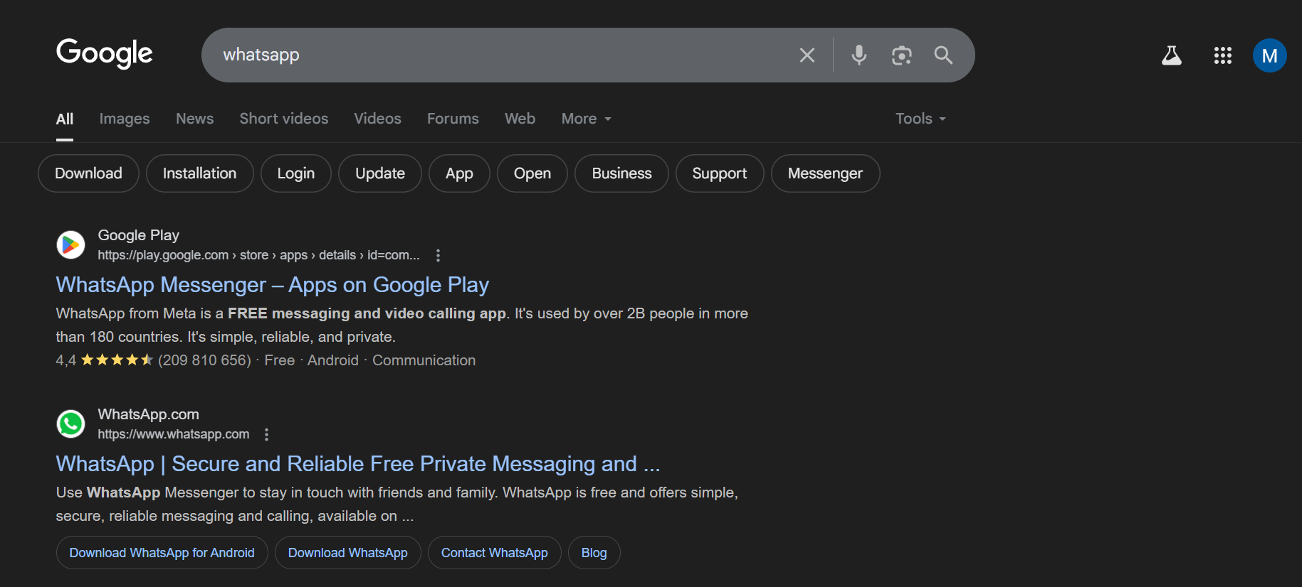
Using the google search engine
Search Bar
Links to webpages

Slide 6

ACTIVITY!!
Using search engines…
Use the google search engine to navigate to the siyavula web page.
Navigate to the textbook pane and choose the mathematics option
Select the grade 7 textbook to access its contents
This activity outlines how easy it is to access resources using the internet!!
CHALLENGE!!
Navigate to the google earth web page.
Interact with the site and try to access the racial stats of Bloemfontein.

