Slide 1

Tools for creaction
Enceladux-1, week3.1

Slide 2
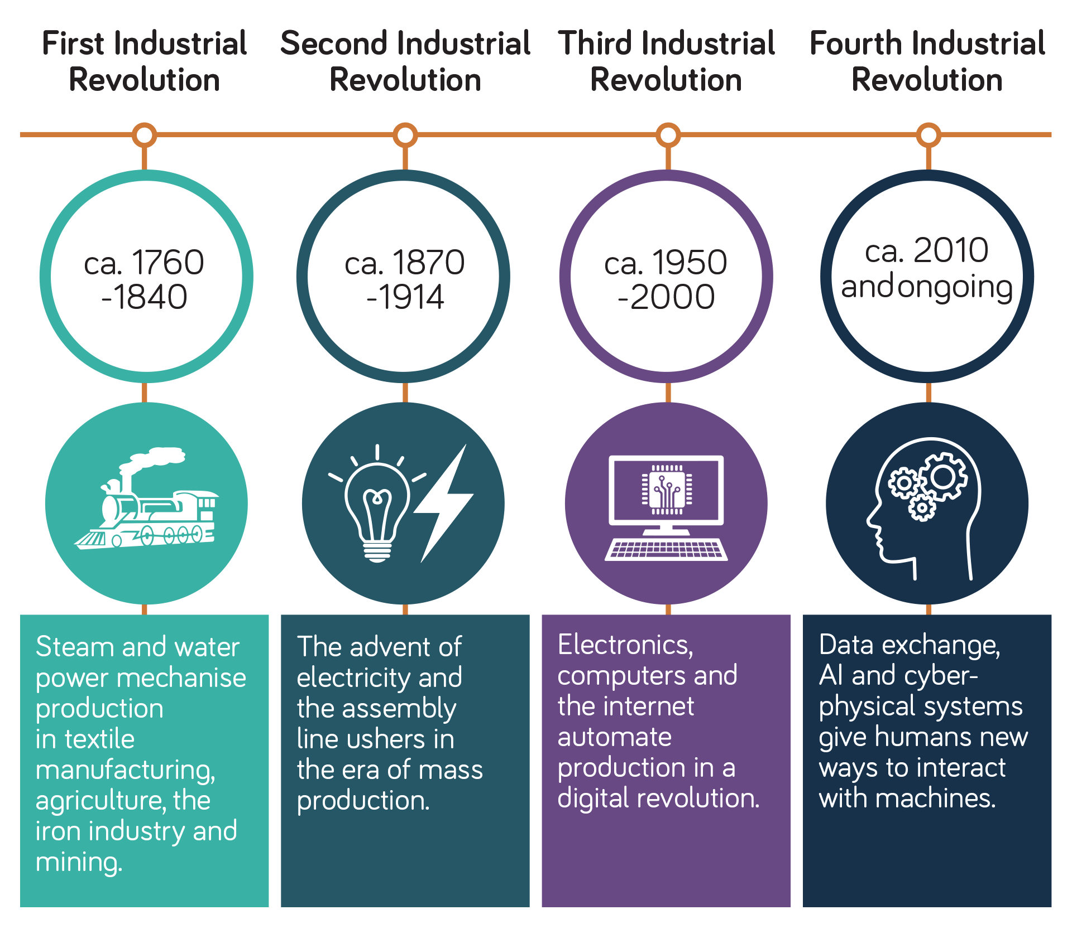
4th industrial revolution

Slide 3
BLOCKLY GAMES AND MONKEY TYPE
Activity:
Use the google search engine to navigate to blockly games and start the challenges.
These games will help us understand how to construct complex units using small components
Help us get an overview of how code is written, and conceled
Activity:
Use the google search engine to navigate to monkey type and start the challenges.
This activity will help us with coordination and coping with the pressure of time constraints

