Slide 1
Using NLP to classify Financial Advice forums
Mathea Stevens

Slide 2
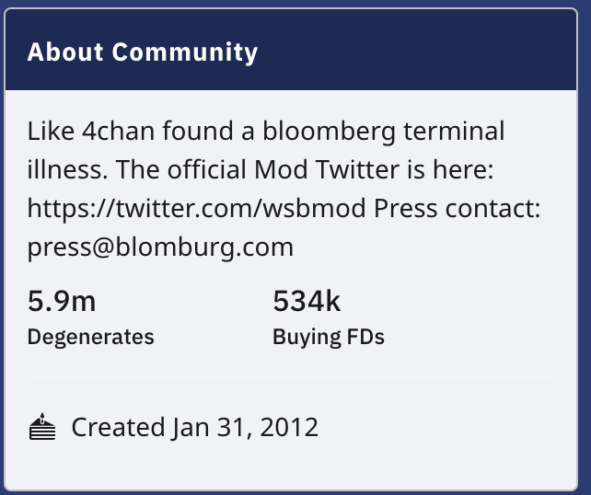
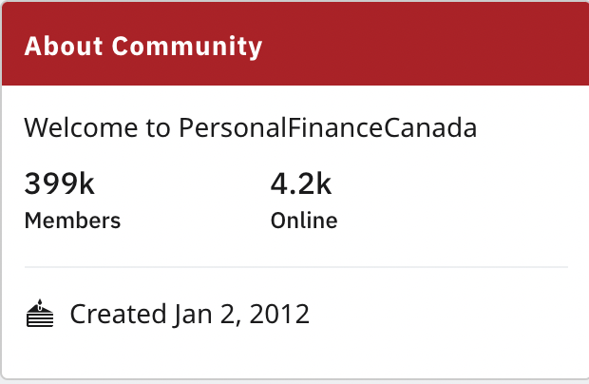
Our Two subreddits: wall street bets and personal finance Canada
Both provide a space to discuss personal investing
While Personal Finance Canada provides a Canadian focus, both discuss investing trends
Can differences in language used allow for machine learning classification between the two subreddits?

Slide 3
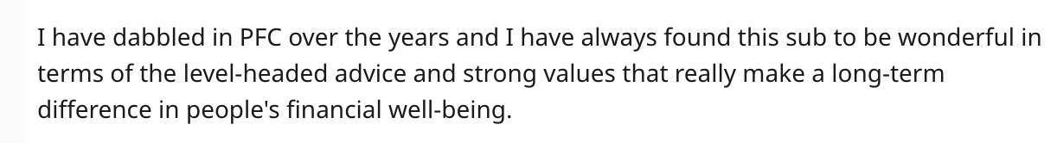
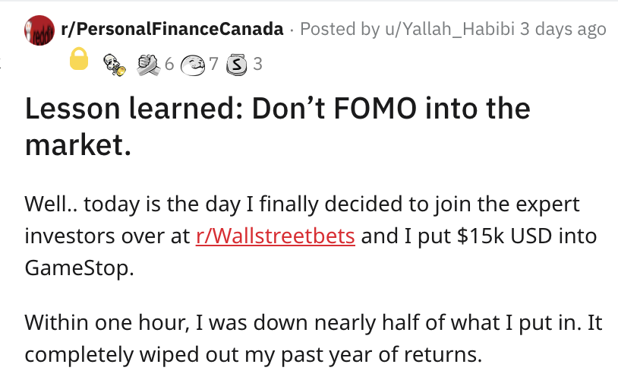
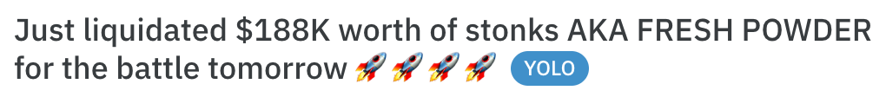
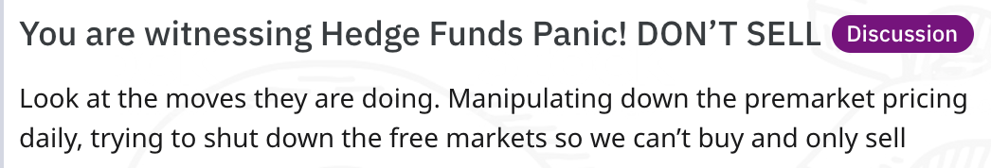
Post Examples

Slide 4
Methodology
Using Pushshift API, scrape the data from both subreddits
Data cleaning and exploration
Selecting features for model development
Testing different vectorizers and models
Analyze results and select top performing model
Recreate top performing model with additional hyper tuning of parameters
Interpret findings

Slide 5
Model Results
KNN
Train: 0.997778
Test: 0.806667
Gaussian Naïve Bayes
Train:
0.969444
Test:
0.940000
Multinomial NB
Train:
0.948889
Test:
0.931667
Logistic Regression
Train:
0.978889
Test:
0.941667
SVC
Train:
0.989444
Test:
0.948333
Random Forest
Train
0.982222
Test:
0.936667
Bernoulli NB
Train:
0.895000
Test:
0.870000

Slide 6
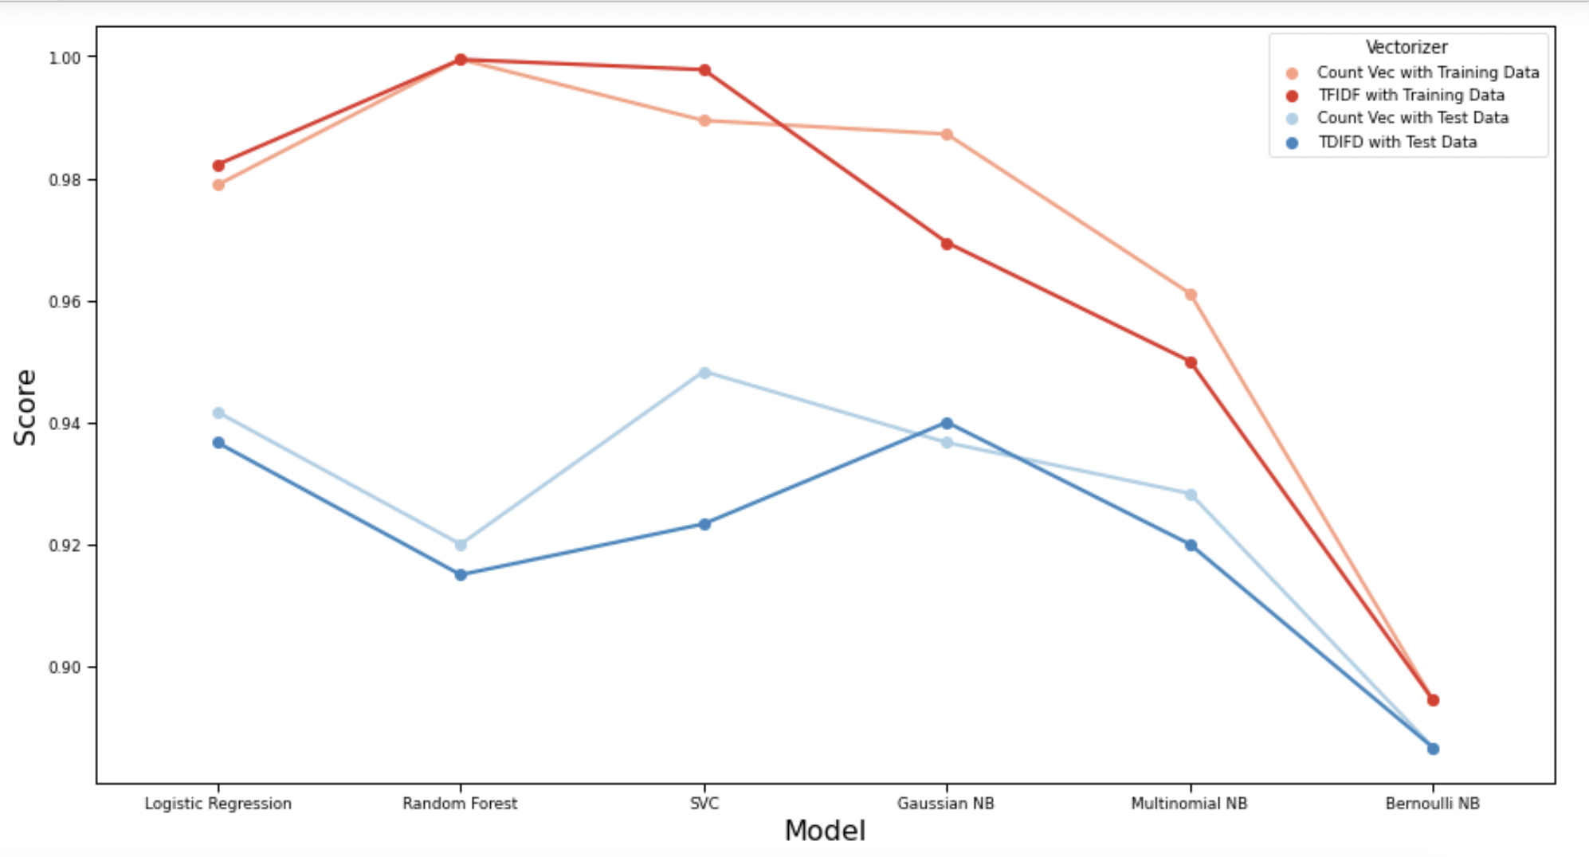

Slide 7
Model Selection
Logistic Regression was chosen as the best model.
Best tradeoff between bias and variance
Second best score on test data
Interpretability of the model compared to SVC
Recall score of 93 and precision score of 95.
Best hyperparameters:
Tfidf vectorizer, maximum features of 2500,
Eliminating English stopwords,
C value of 0.65 for the Logistic regression regularization

Slide 8
Top features
gme
removed
wsb
tfsa
short
stock
squeeze
little
code
play
price
shorts
employer
anyone
ei
plan
dd
currency
feel
save
changed
convert
redd
boomers
institutions
mistakes
undervalued
north
Beginner
oil

Slide 9
Inferences
Model can predict a subreddit origin within 94% accuracy,
With a 1 unit increase in the presence of the word gme, the post is 2.3 times as likely to come from Wall Street Bets subreddit.
Cultural inferences based on feature words
Using modeling to help predict future investing trends

