Slide 1
iBCF, or uBCF?
iBCF
March 9, 2023
Dan Thal

Slide 2
Agenda
Overview of uses of BCF for PCF
Proposed simplification of BCF
Simulation results
Discussion

Slide 3
Goals: uses for iBCF
Estimate impacts
Overall and by subgroup
Scalability analysis
Extrapolating heterogeneity of impacts
Identify exemplars
Based on performance above and beyond what we expect
Payment calibration
Correlating PBA and practice impact

Slide 4
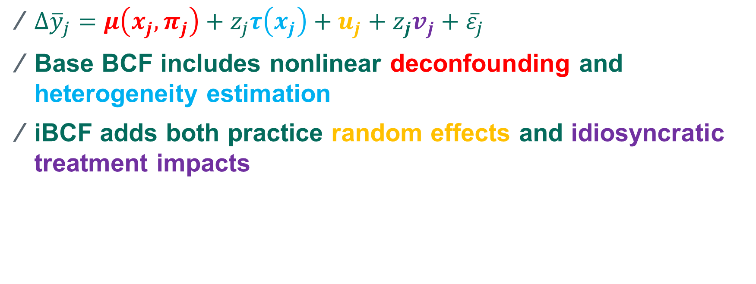
BCF Recap
${Δ\overline{y}}_{j}=μ\left(x_{j},π_{j}\right)+z_{j}τ\left(x_{j}\right)+u_{j}+z_{j}v_{j}+{\overline{ε}}_{j}$
Base BCF includes nonlinear deconfounding and heterogeneity estimation
iBCF adds both practice random effects and idiosyncratic treatment impacts
Notes:
J=practice, z=treatment
mu: e.g. practices with sicker benes have increases
tau: former CPC+ practices have smaller benefit
U: practice is just a super well oiled machine
V: practice has an enthusiastic care coordinator and gets a lot more out of PCF

Slide 5
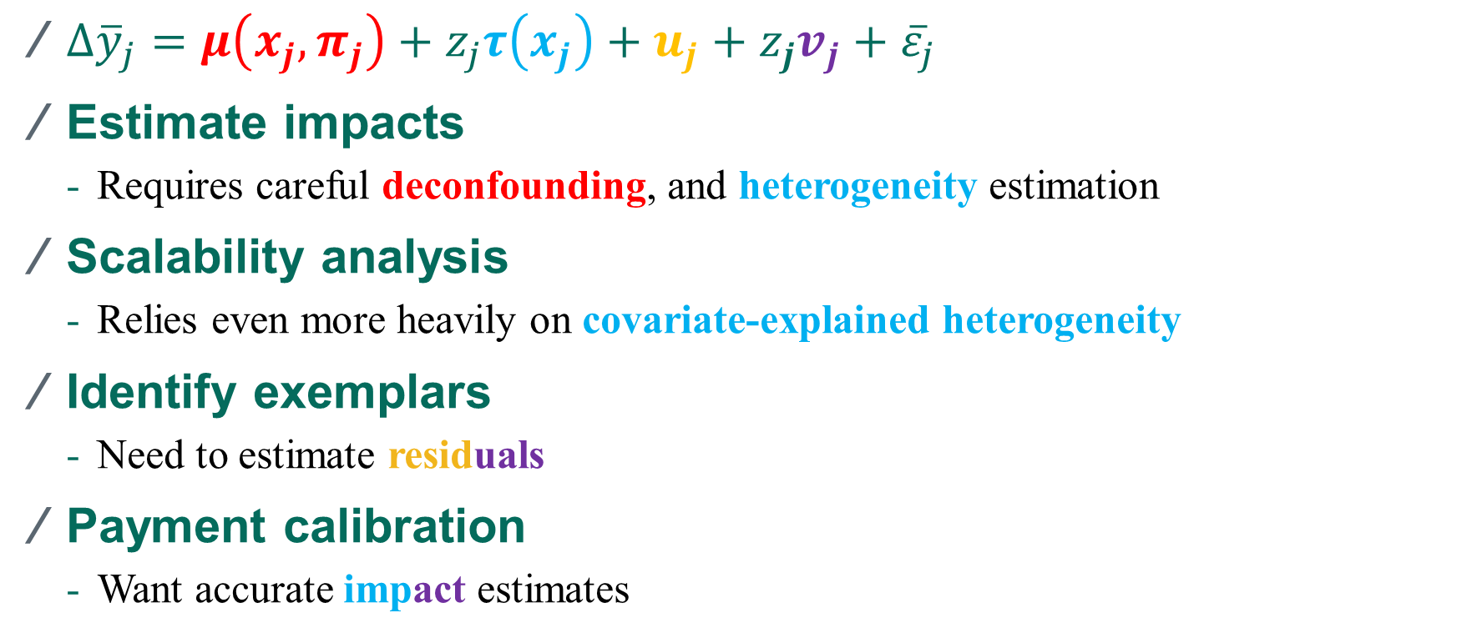
Goals: requirements
${Δ\overline{y}}_{j}=μ\left(x_{j},π_{j}\right)+z_{j}τ\left(x_{j}\right)+u_{j}+z_{j}v_{j}+{\overline{ε}}_{j}$
Estimate impacts
Requires careful deconfounding, and heterogeneity estimation
Scalability analysis
Relies even more heavily on covariate-explained heterogeneity
Identify exemplars
Need to estimate residuals
Payment calibration
Want accurate impact estimates
Notes:
First two bullets: groups of practices
Second 2: practice-specific

Slide 6
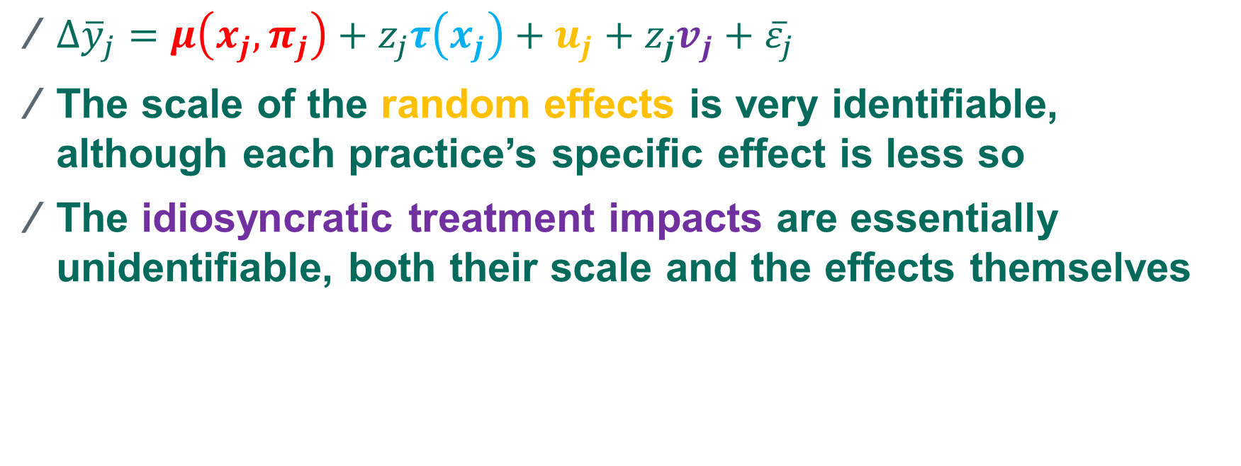
iBCF challenges
${Δ\overline{y}}_{j}=μ\left(x_{j},π_{j}\right)+z_{j}τ\left(x_{j}\right)+u_{j}+z_{j}v_{j}+{\overline{ε}}_{j}$
The scale of the random effects is very identifiable, although each practice’s specific effect is less so
The idiosyncratic treatment impacts are essentially unidentifiable, both their scale and the effects themselves
Notes:
Point out prior sensitivity

Slide 7
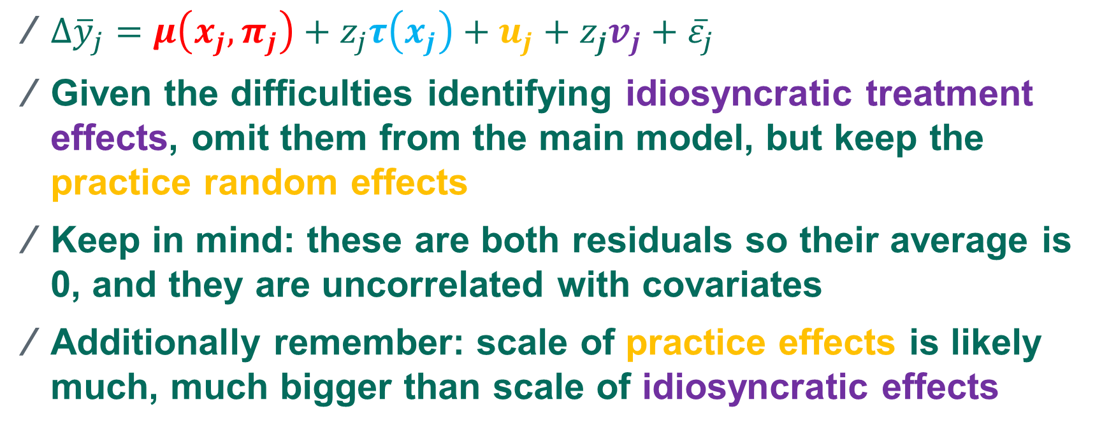
Proposal
${Δ\overline{y}}_{j}=μ\left(x_{j},π_{j}\right)+z_{j}τ\left(x_{j}\right)+u_{j}+z_{j}v_{j}+{\overline{ε}}_{j}$
Given the difficulties identifying idiosyncratic treatment effects, omit them from the main model, but keep the practice random effects
Keep in mind: these are both residuals so their average is 0, and they are uncorrelated with covariates
Additionally remember: scale of practice effects is likely much, much bigger than scale of idiosyncratic effects
Notes:
Practice effect is capturing everything the practice is doing that we can’t see
While the idio term is capturing what we don’t see related to PCF

Slide 8
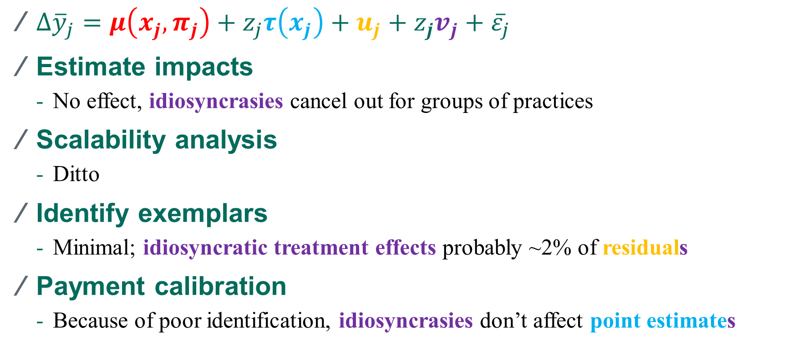
Goals: implications
${Δ\overline{y}}_{j}=μ\left(x_{j},π_{j}\right)+z_{j}τ\left(x_{j}\right)+u_{j}+z_{j}v_{j}+{\overline{ε}}_{j}$
Estimate impacts
No effect, idiosyncrasies cancel out for groups of practices
Scalability analysis
Ditto
Identify exemplars
Minimal; idiosyncratic treatment effects probably ~2% of residuals
Payment calibration
Because of poor identification, idiosyncrasies don’t affect point estimates
Notes:
Scalability: didn’t use iBCF for AR5. Irina compared W and I, and found no difference
ACIC: iBCF didn’t improve RMSE of practice estimates
For payment calibration, EDR is ambiguous. Propose keeping ibcf as a sensitivity check there, but not investing as heavily in it
Separate out: exemplars even in theory v doesn’t matter; calib the vs do matter in theory but in practice no

Slide 9
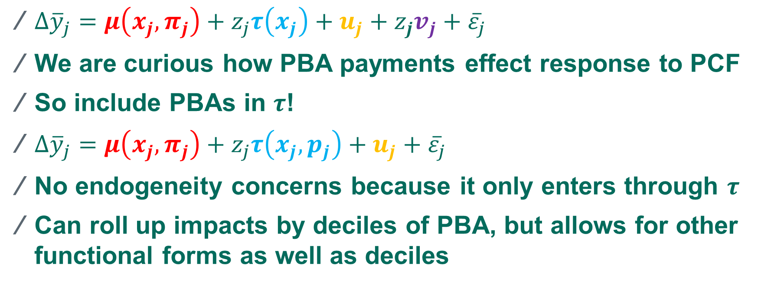
Alternative payment calibration idea
${Δ\overline{y}}_{j}=μ\left(x_{j},π_{j}\right)+z_{j}τ\left(x_{j}\right)+u_{j}+z_{j}v_{j}+{\overline{ε}}_{j}$
We are curious how PBA payments effect response to PCF
So include PBAs in $τ$!
${Δ\overline{y}}_{j}=μ\left(x_{j},π_{j}\right)+z_{j}τ\left(x_{j}, p_{j}\right)+u_{j}+{\overline{ε}}_{j}$
No endogeneity concerns because it only enters through $τ$
Can roll up impacts by deciles of PBA, but allows for other functional forms as well as deciles
Notes:
Scalability: didn’t use iBCF for AR5. Irina compared W and I, and found no difference
ACIC: iBCF didn’t improve RMSE of practice estimates
For payment calibration, EDR is ambiguous. Propose keeping ibcf as a sensitivity check there, but not investing as heavily in it
Separate out: exemplars even in theory v doesn’t matter; calib the vs do matter in theory but in practice no

Slide 10
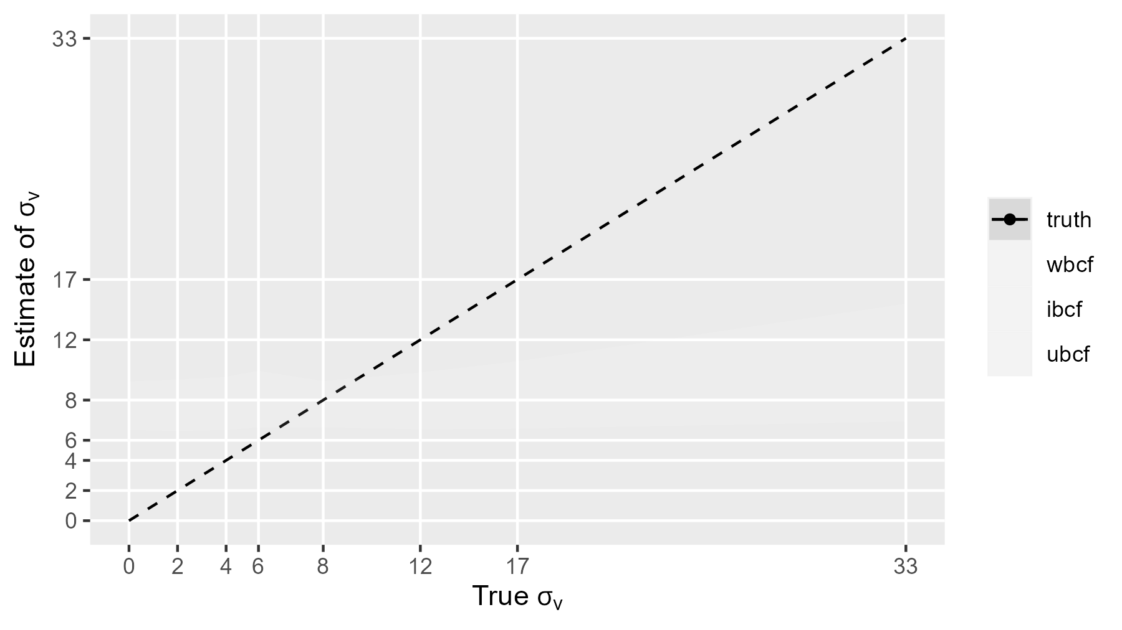
Prior sensitivity: scale of idiosyncrasy

Slide 11
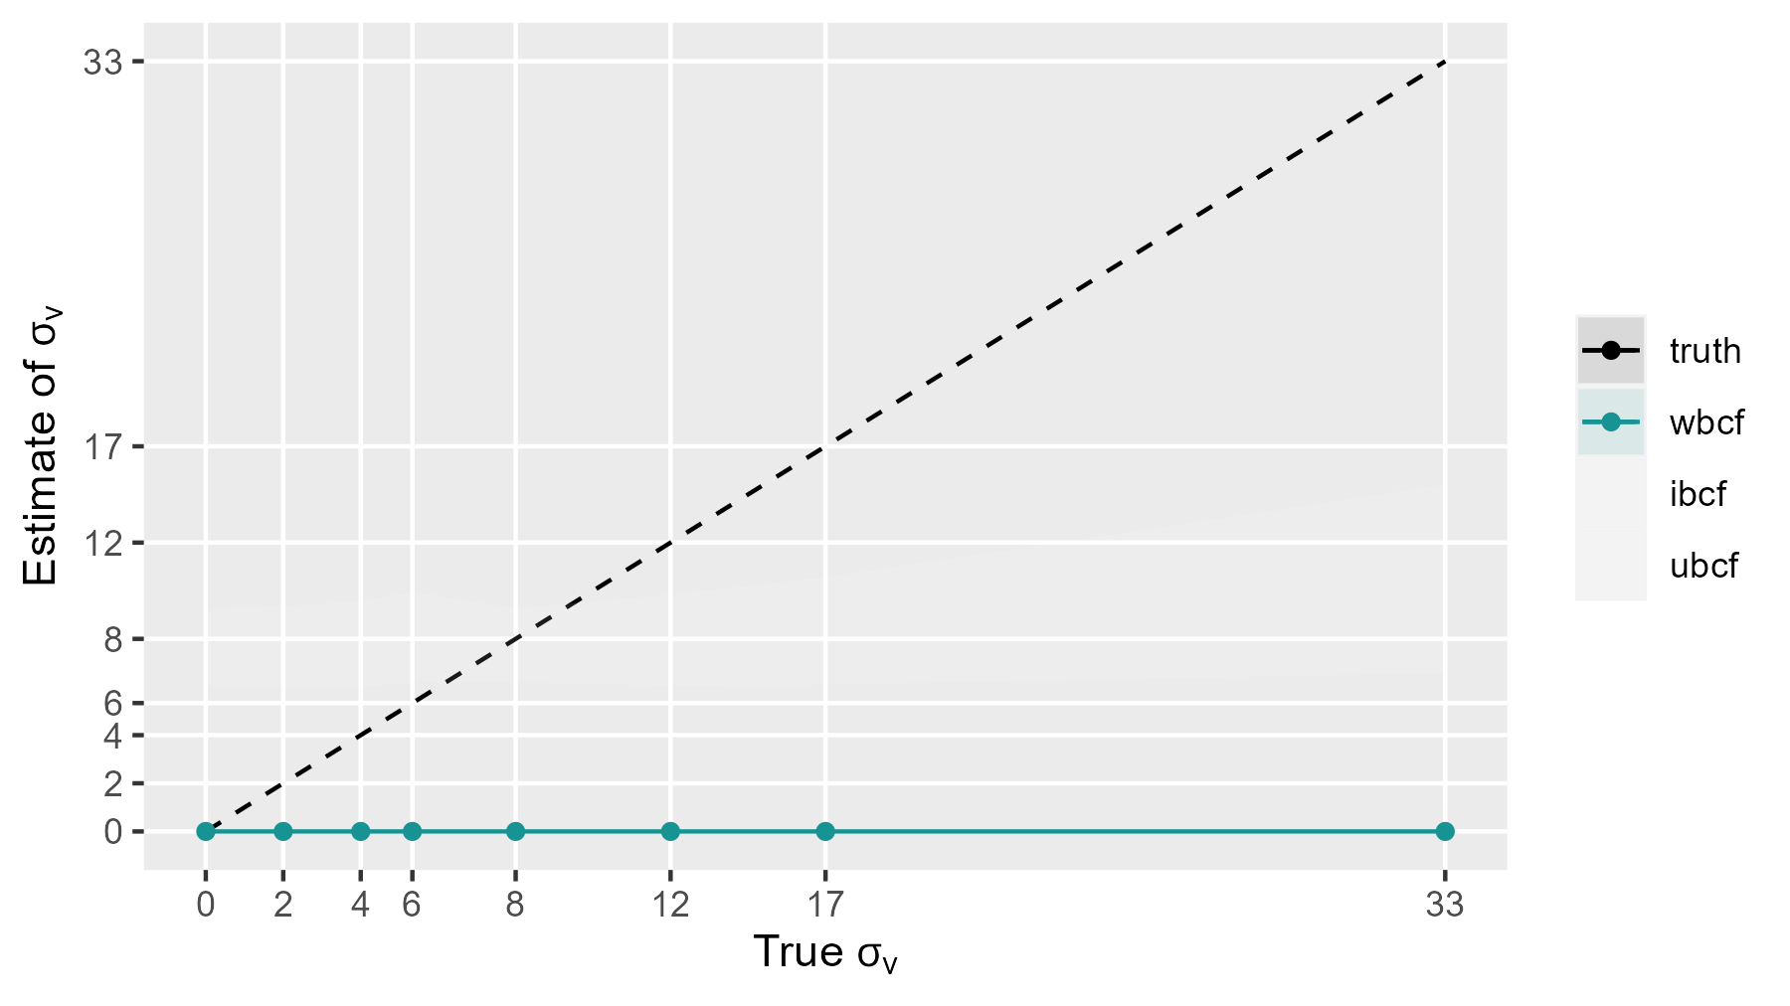
Prior sensitivity: scale of idiosyncrasy

Slide 12
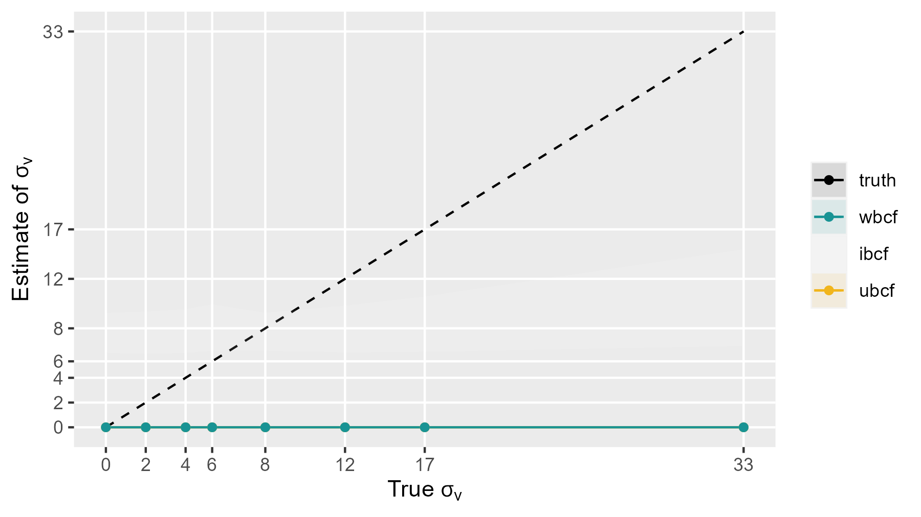
Prior sensitivity: scale of idiosyncrasy

Slide 13
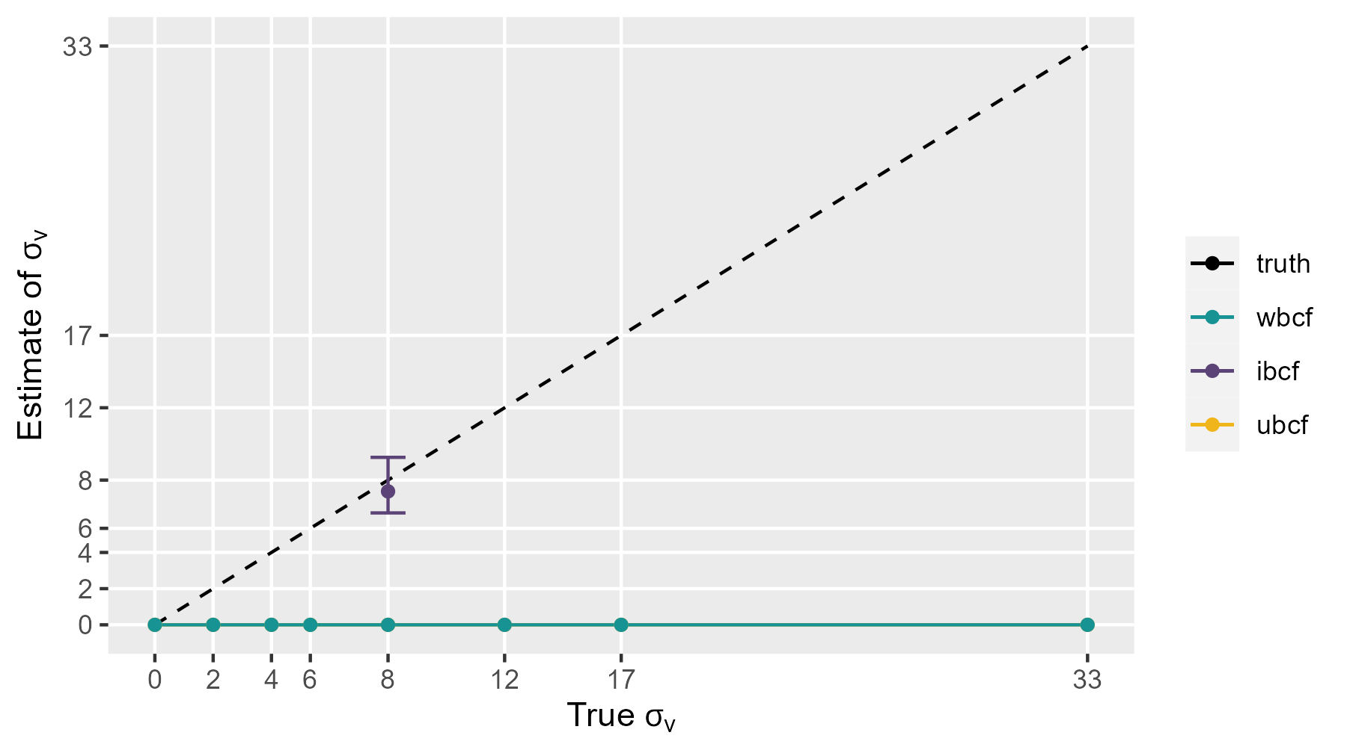
Prior sensitivity: scale of idiosyncrasy

Slide 14
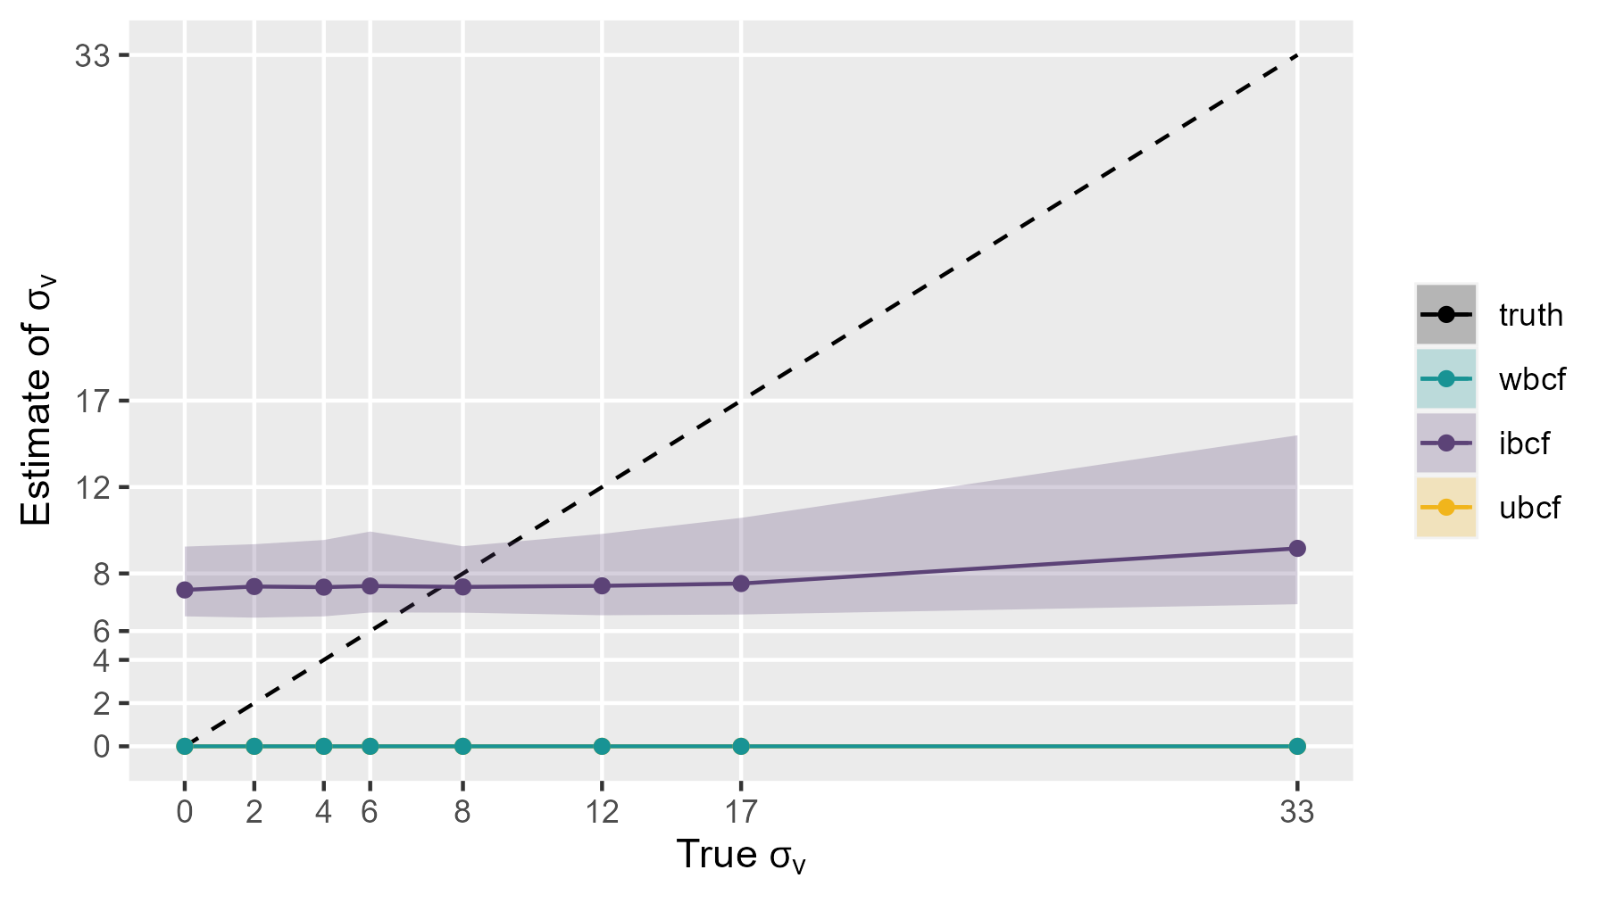
Prior sensitivity: scale of idiosyncrasy
Notes:
Drive home that the insensitivity to the data is prior sensitivity.
Post = data + prior, data changes but post doesn’t

Slide 15
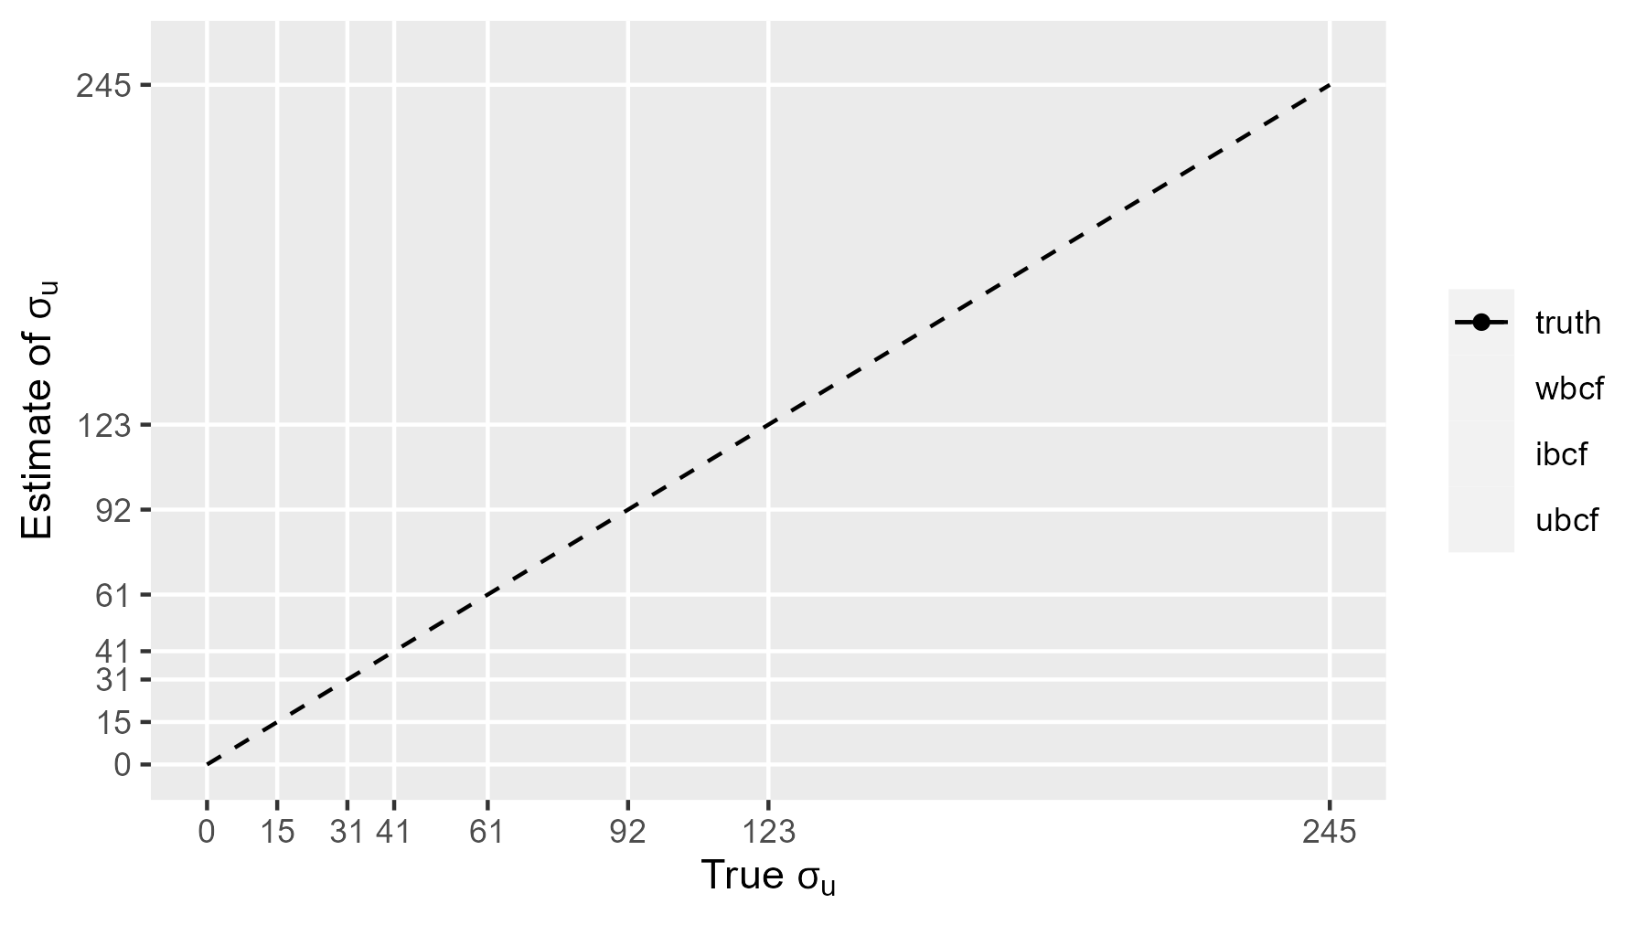
Prior sensitivity: scale of practice effects

Slide 16
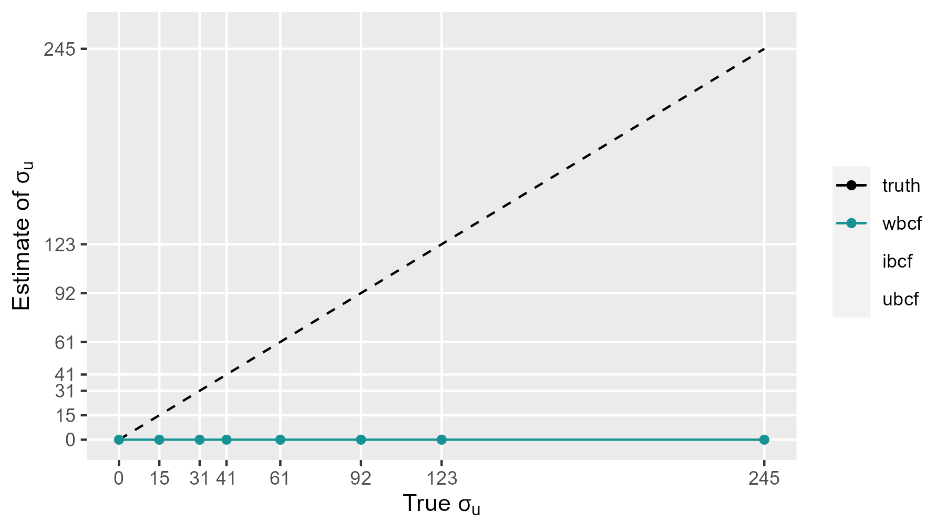
Prior sensitivity: scale of practice effects

Slide 17
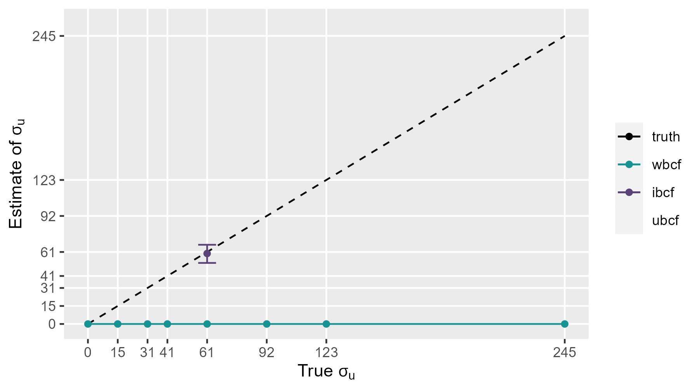
Prior sensitivity: scale of practice effects

Slide 18
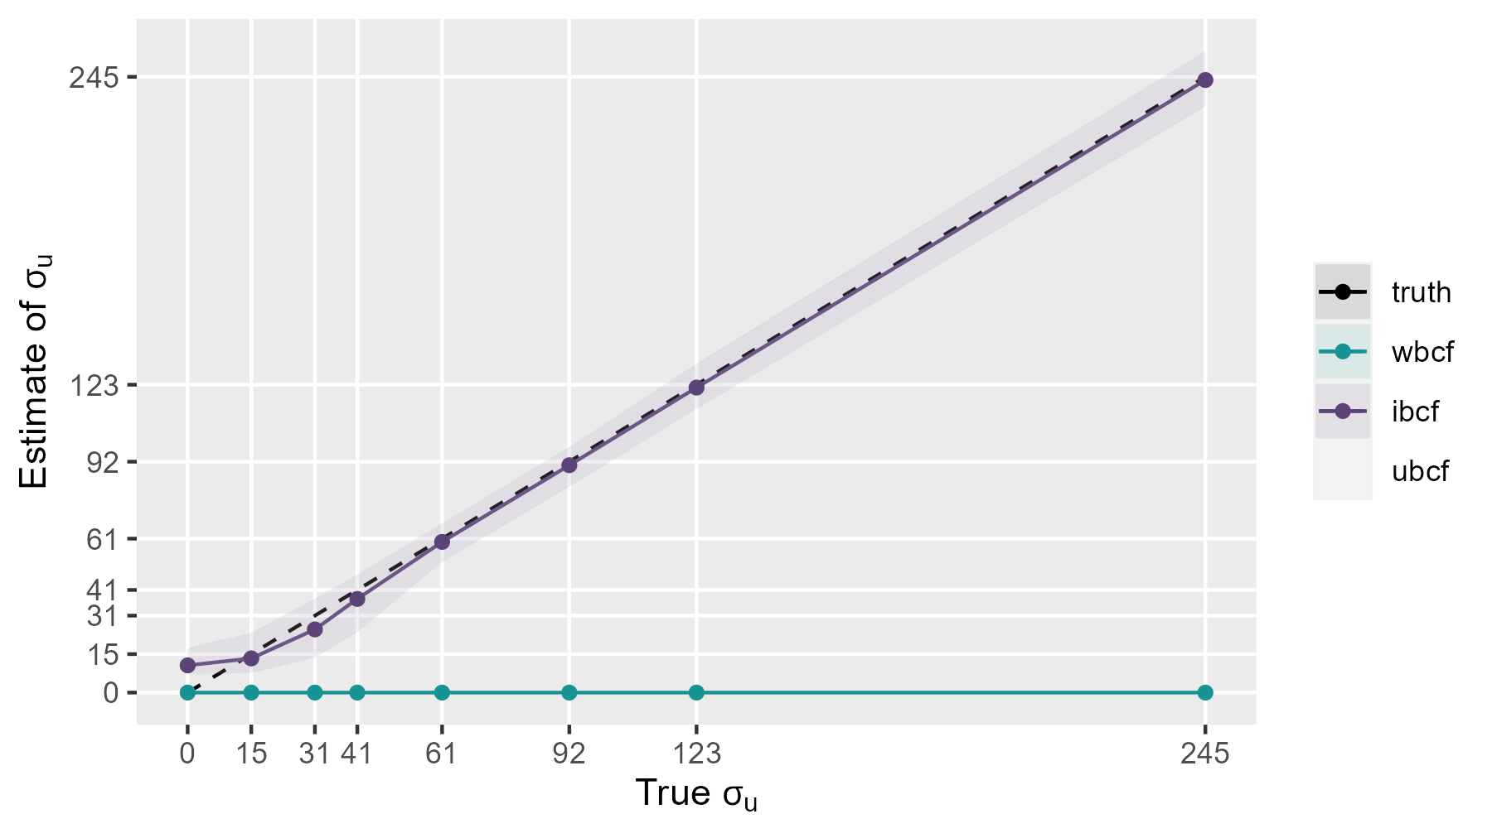
Prior sensitivity: scale of practice effects

Slide 19
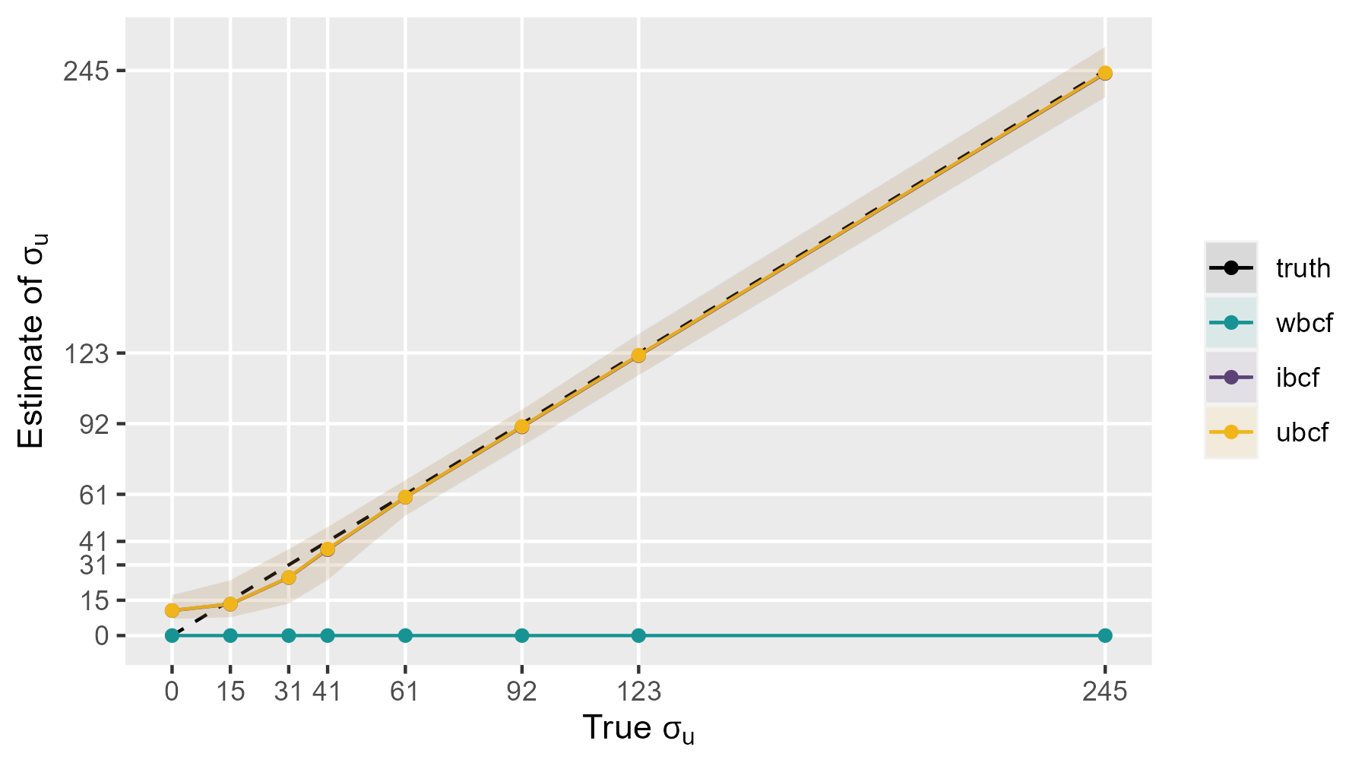
Prior sensitivity: scale of practice effects

Slide 20
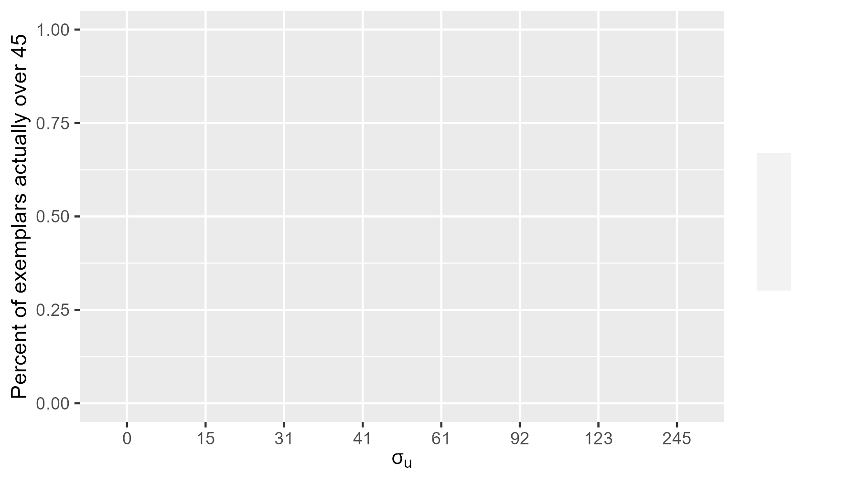
Exemplars: residual > 45 savings

Slide 21
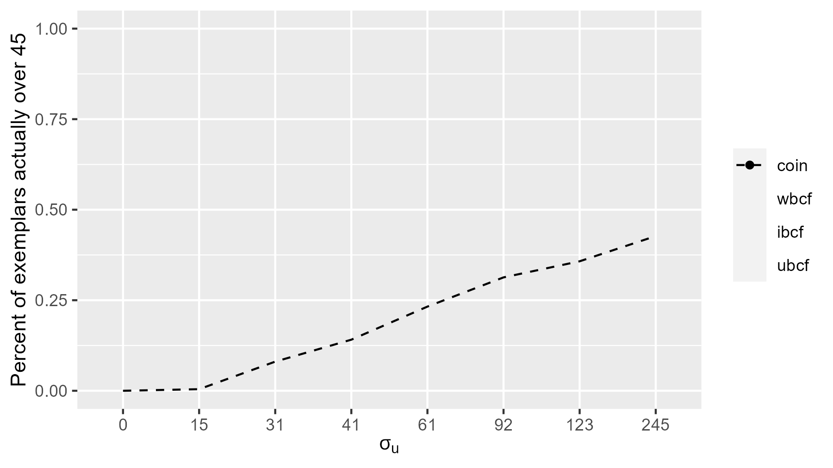
Exemplars: residual > 45 savings

Slide 22
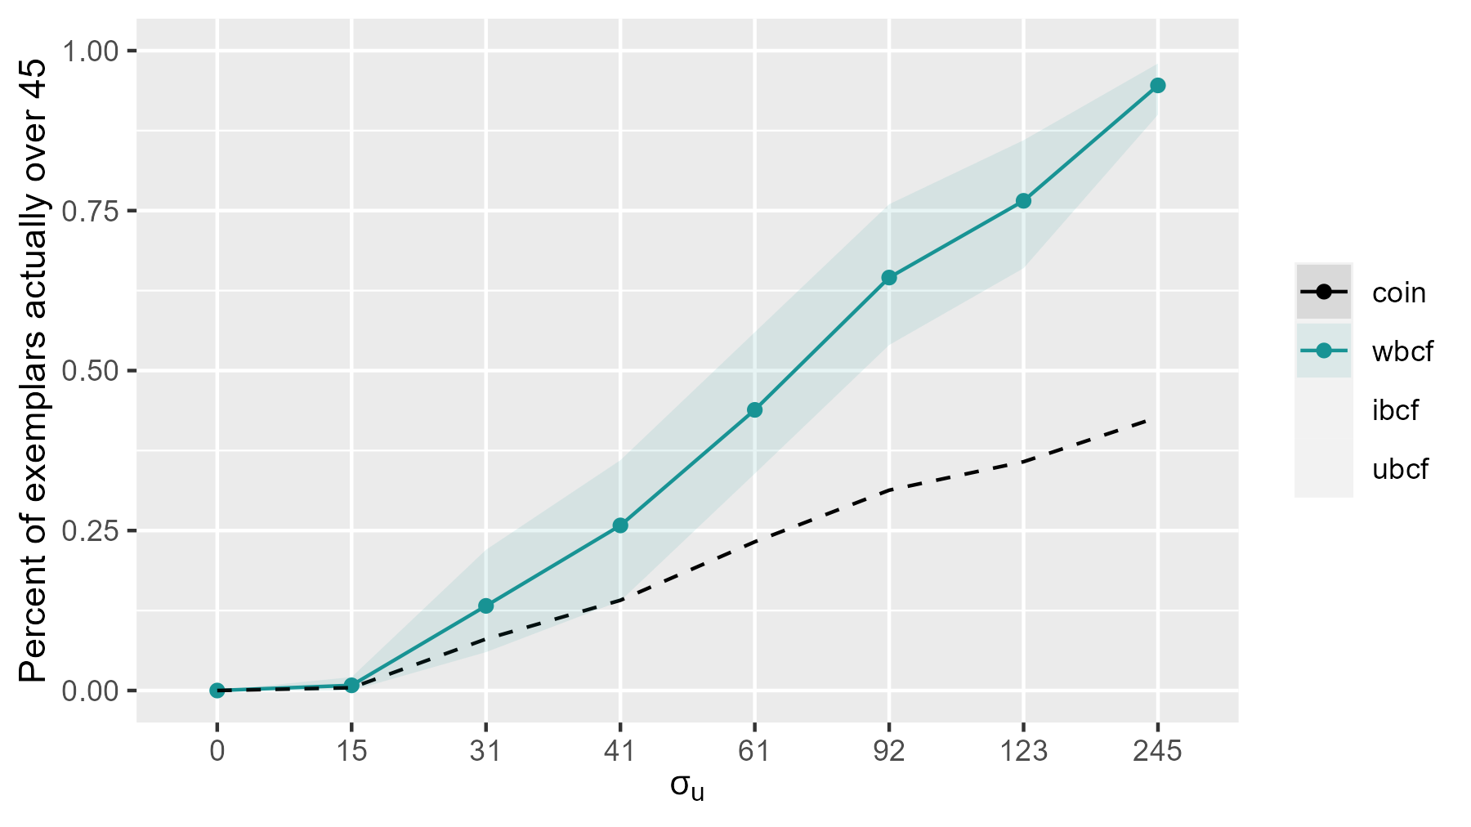
Exemplars: residual > 45 savings

Slide 23
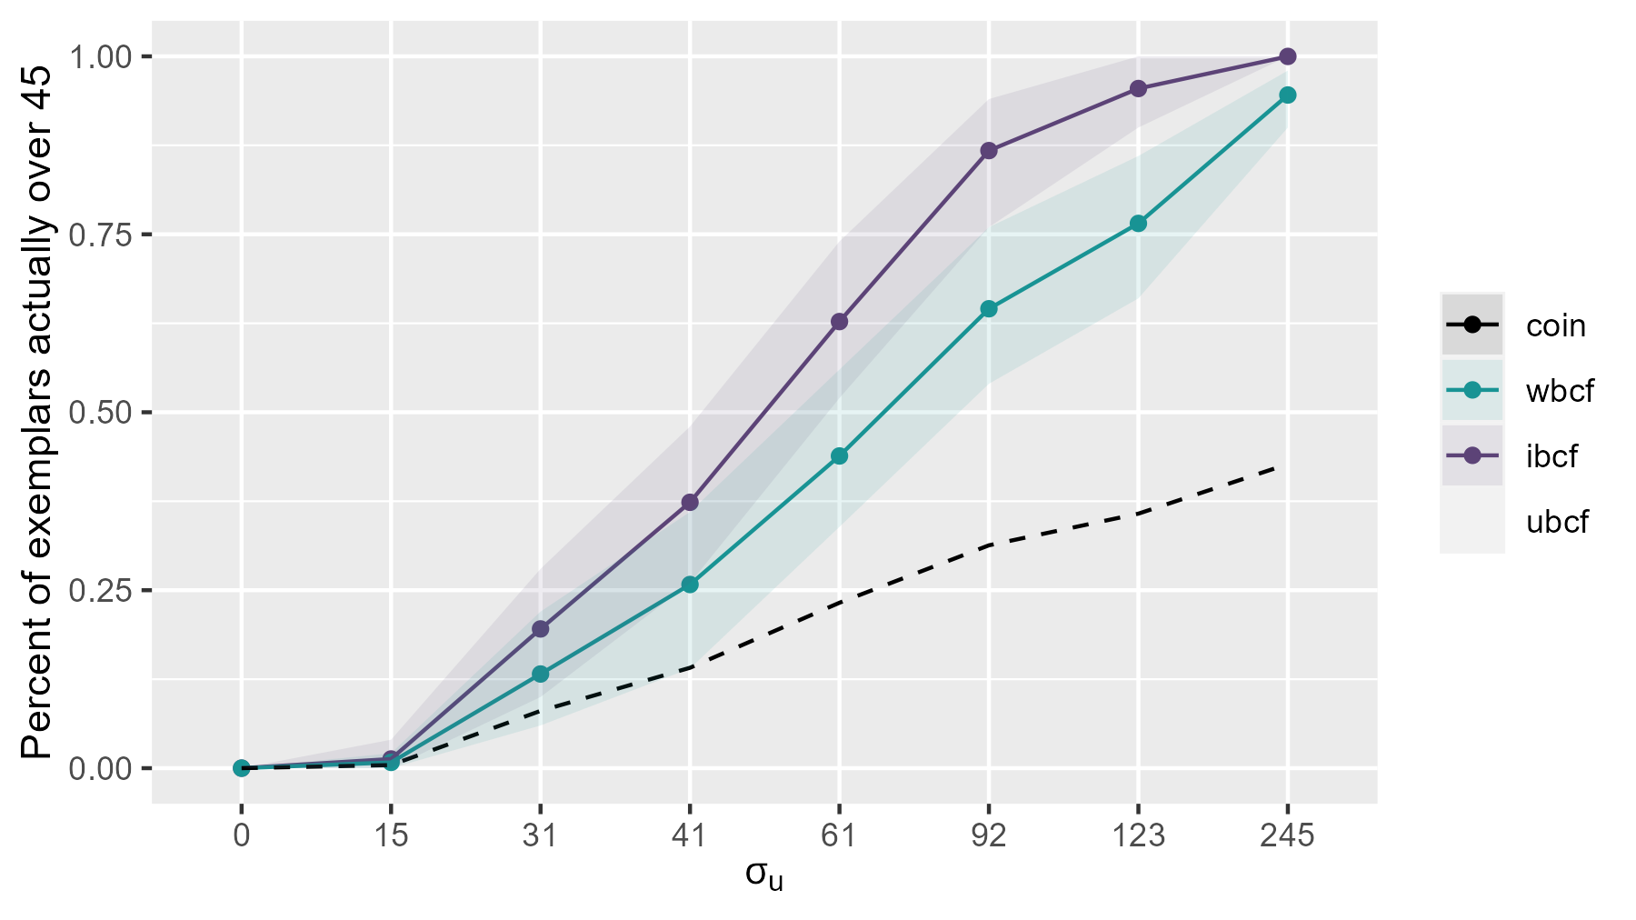
Exemplars: residual > 45 savings

Slide 24
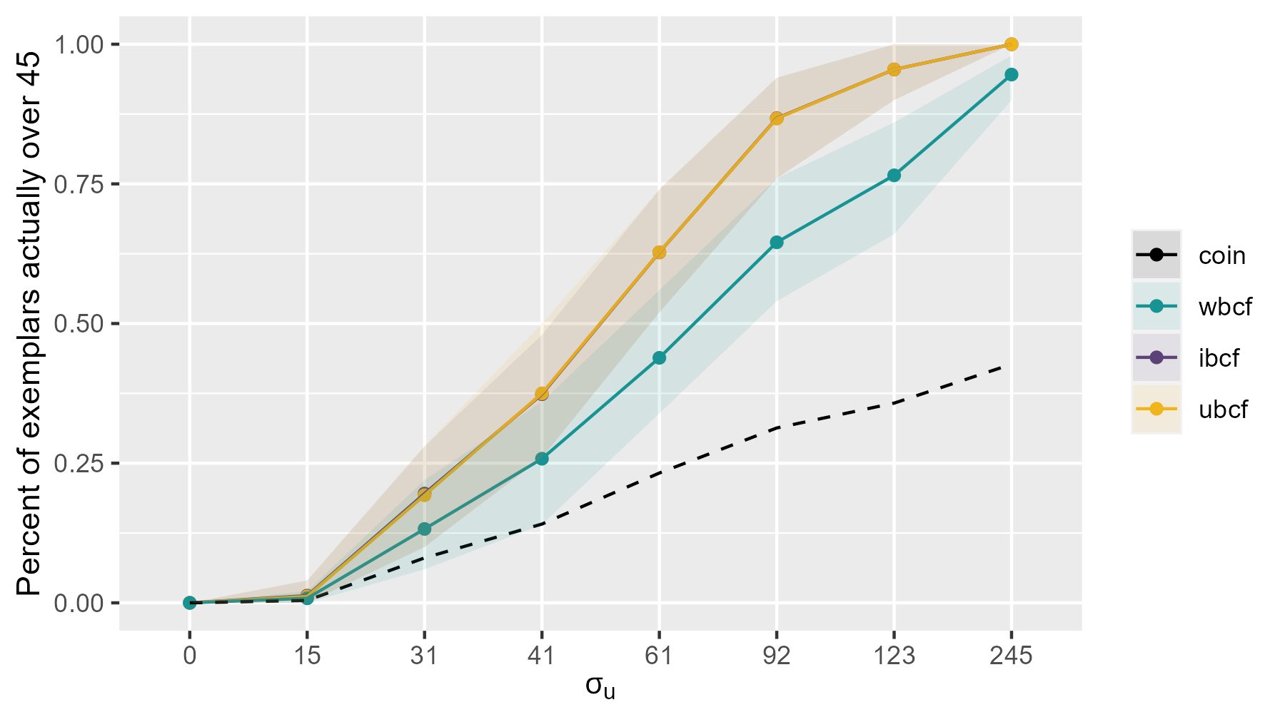
Exemplars: residual > 45 savings

Slide 25
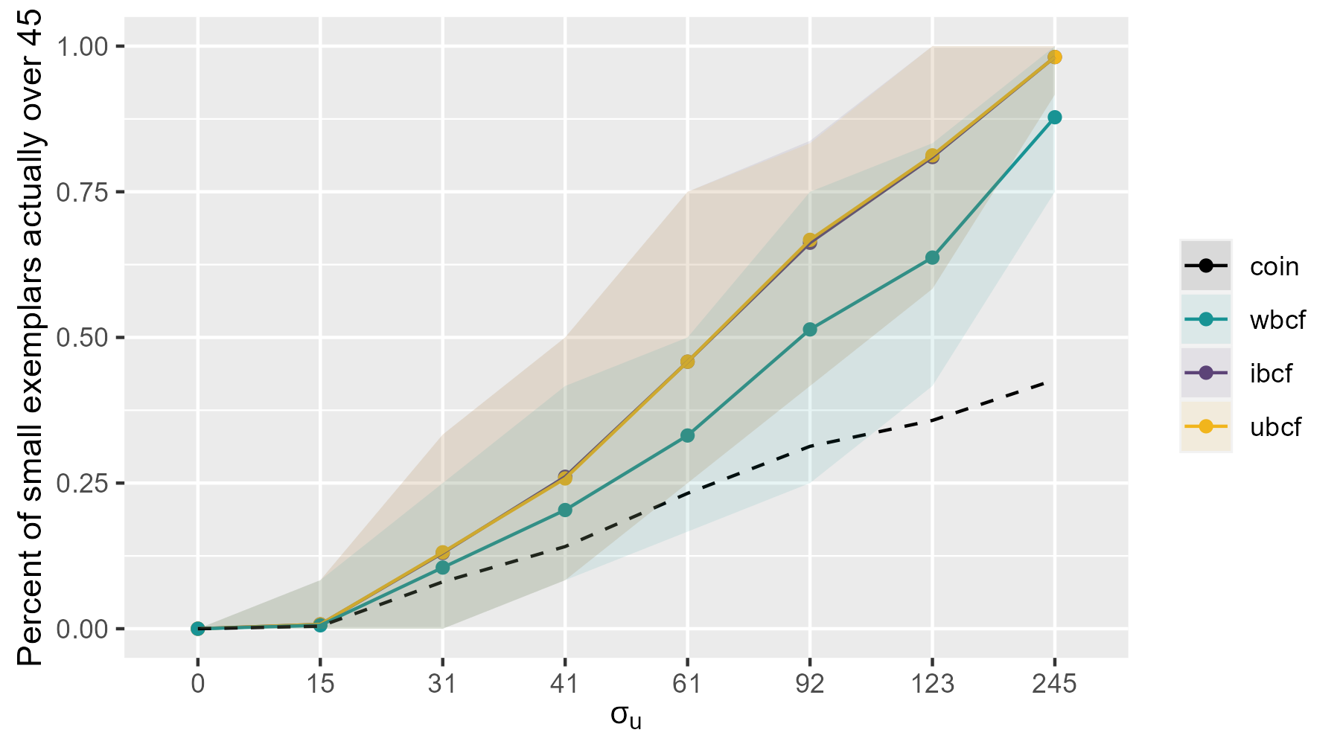
Exemplars: residual > 45 savings

Slide 26
Is the juice of v worth the squeeze?
Juice
Best case approximately 2% of exemplar variance
Conceptually important to payment calibration, but in practice not feasible
Squeeze
Caveating how poorly identified these terms are
Exploration of prior sensitivity
Notes:
Prior sensitivity

Slide 27
Is uBCF alone worth it?
Already have the code
Necessary for exemplar identification
Can help SATT estimation
Easily justified (existing literature, lack of sensitivity)

Slide 28
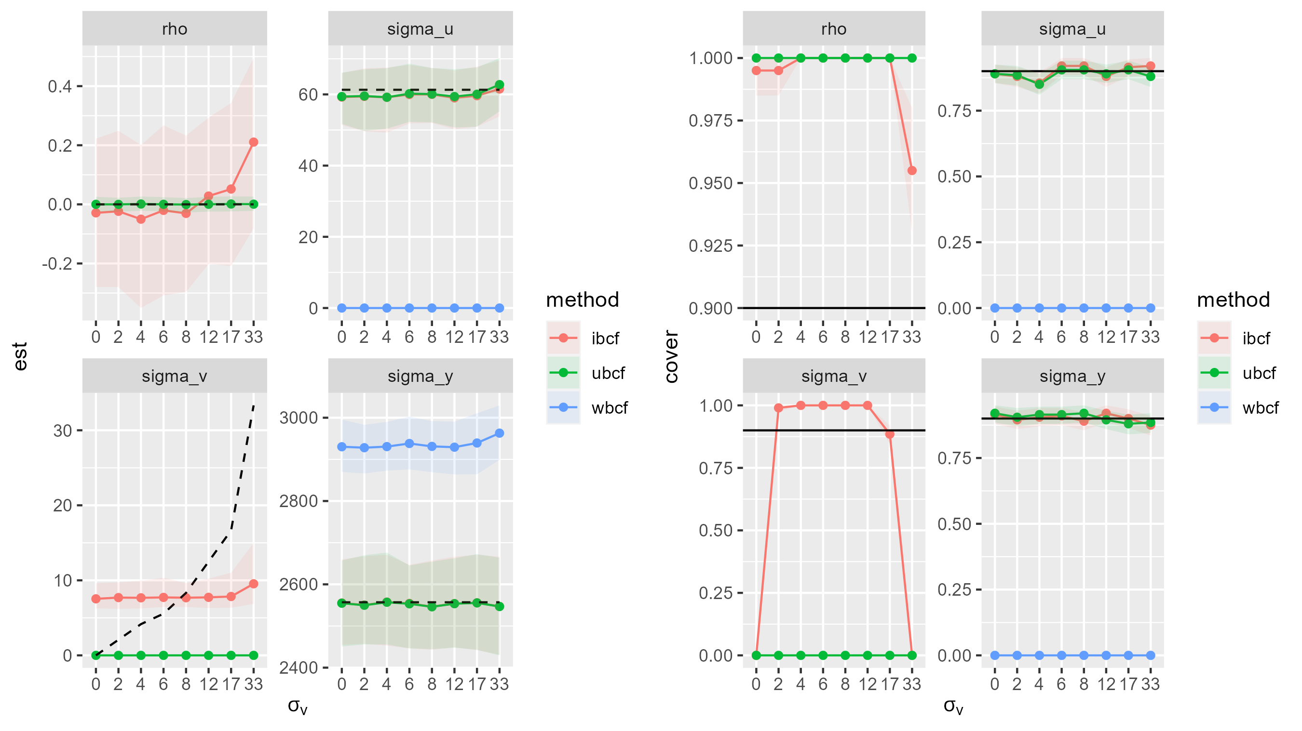
Prior sensitivity – sigma_v

Slide 29
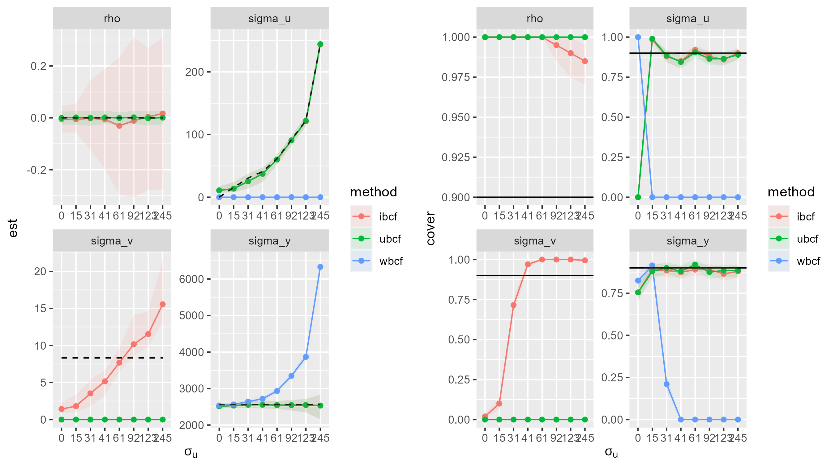
Prior sensitivity – sigma_u

Slide 30
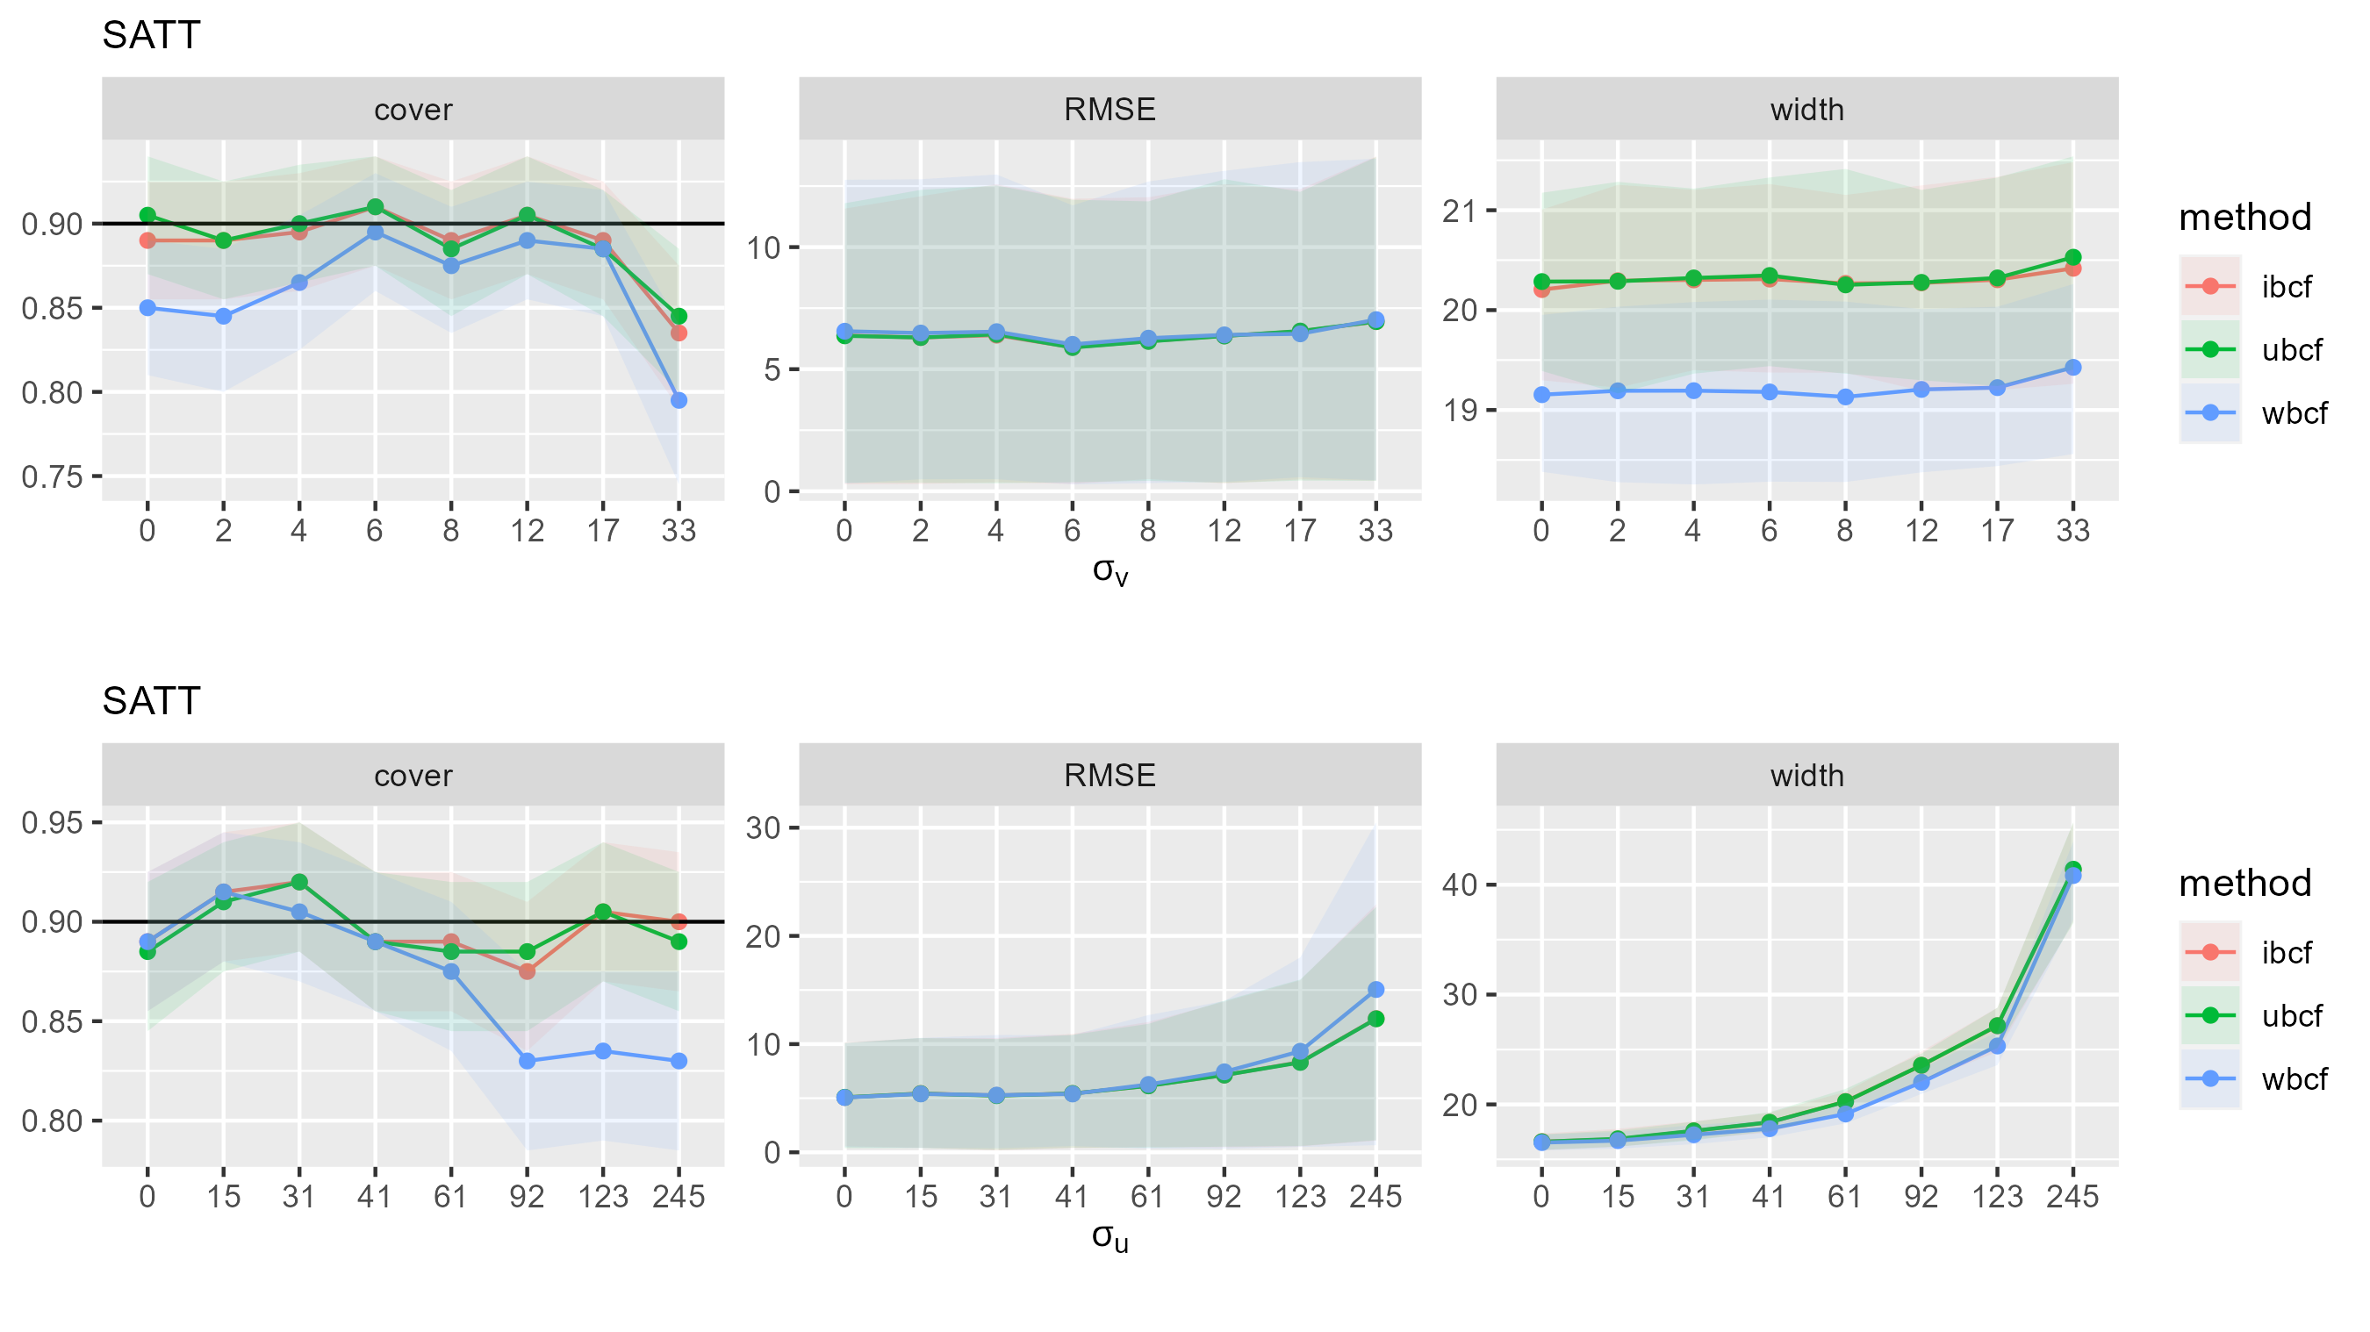
Estimation: SATT

Slide 31
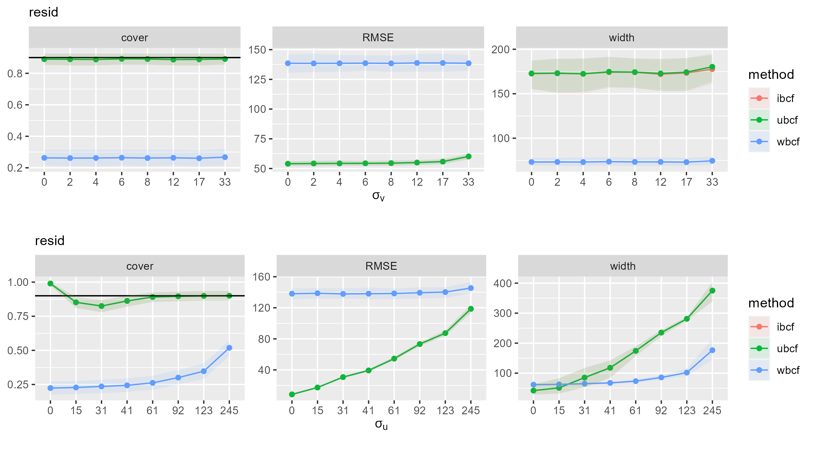
Estimation: Resids

Slide 32
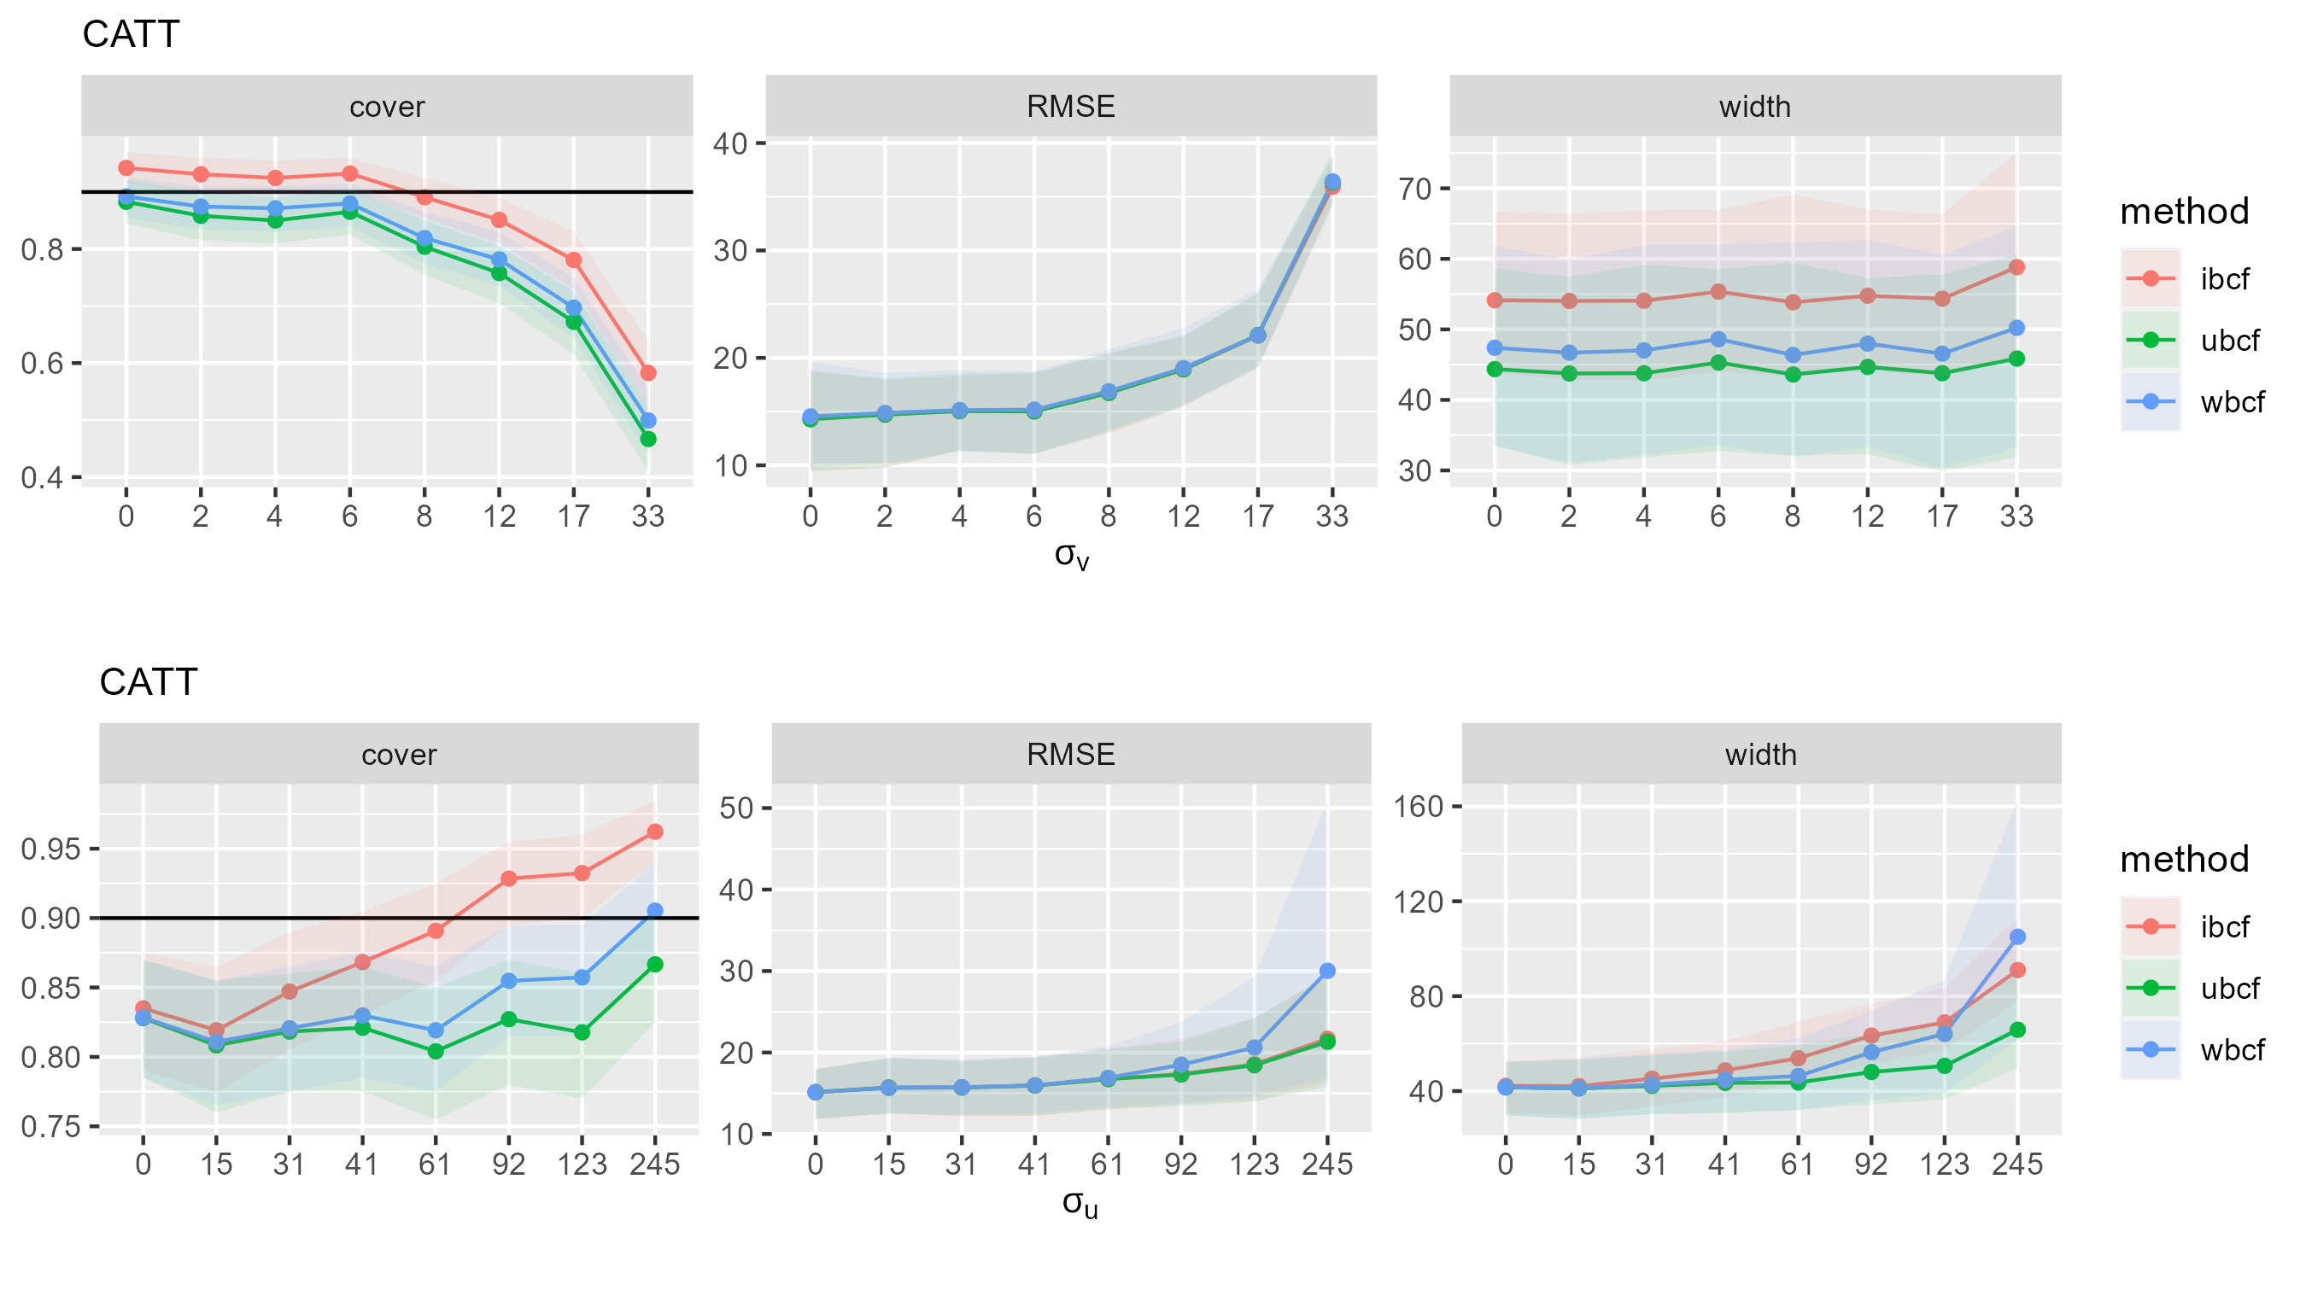
Estimation: CATT

Slide 33
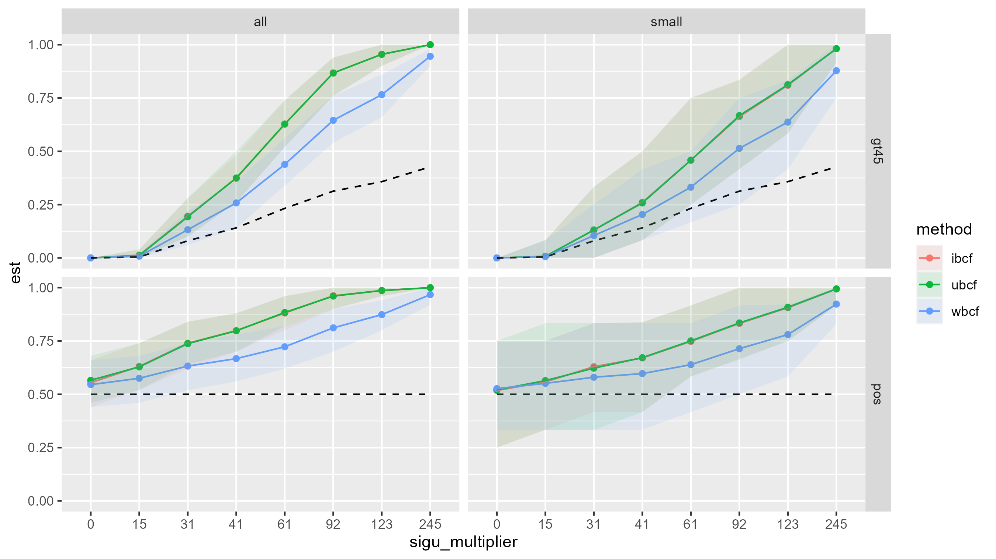
Exemplars: most likely >45

