Slide 1
iBCF updates
iBCF
April 13, 2023
Dan Thal

Slide 2
Agenda
Recap
Simulation
Next steps and messaging

Slide 3
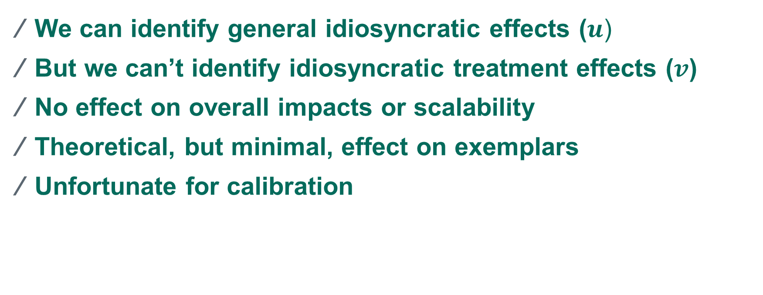
Recap
We can identify general idiosyncratic effects ($u$)
But we can’t identify idiosyncratic treatment effects ($v$)
No effect on overall impacts or scalability
Theoretical, but minimal, effect on exemplars
Unfortunate for calibration

Slide 4

Simulation
We know $u$ matters greatly for exemplars for PCF
But the field will care about whether treatment effects are better estimated
So can $u$ matter to inference?
Notes:
J=practice, z=treatment
mu: e.g. practices with sicker benes have increases
tau: former CPC+ practices have smaller benefit
U: practice is just a super well oiled machine
V: practice has an enthusiastic care coordinator and gets a lot more out of PCF

Slide 5
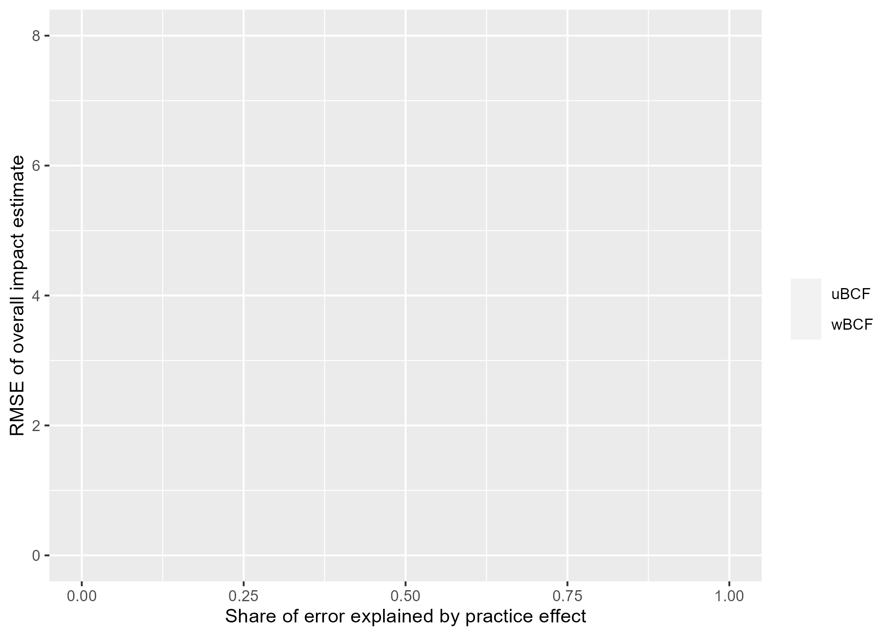
Simulation: SATT RMSE

Slide 6
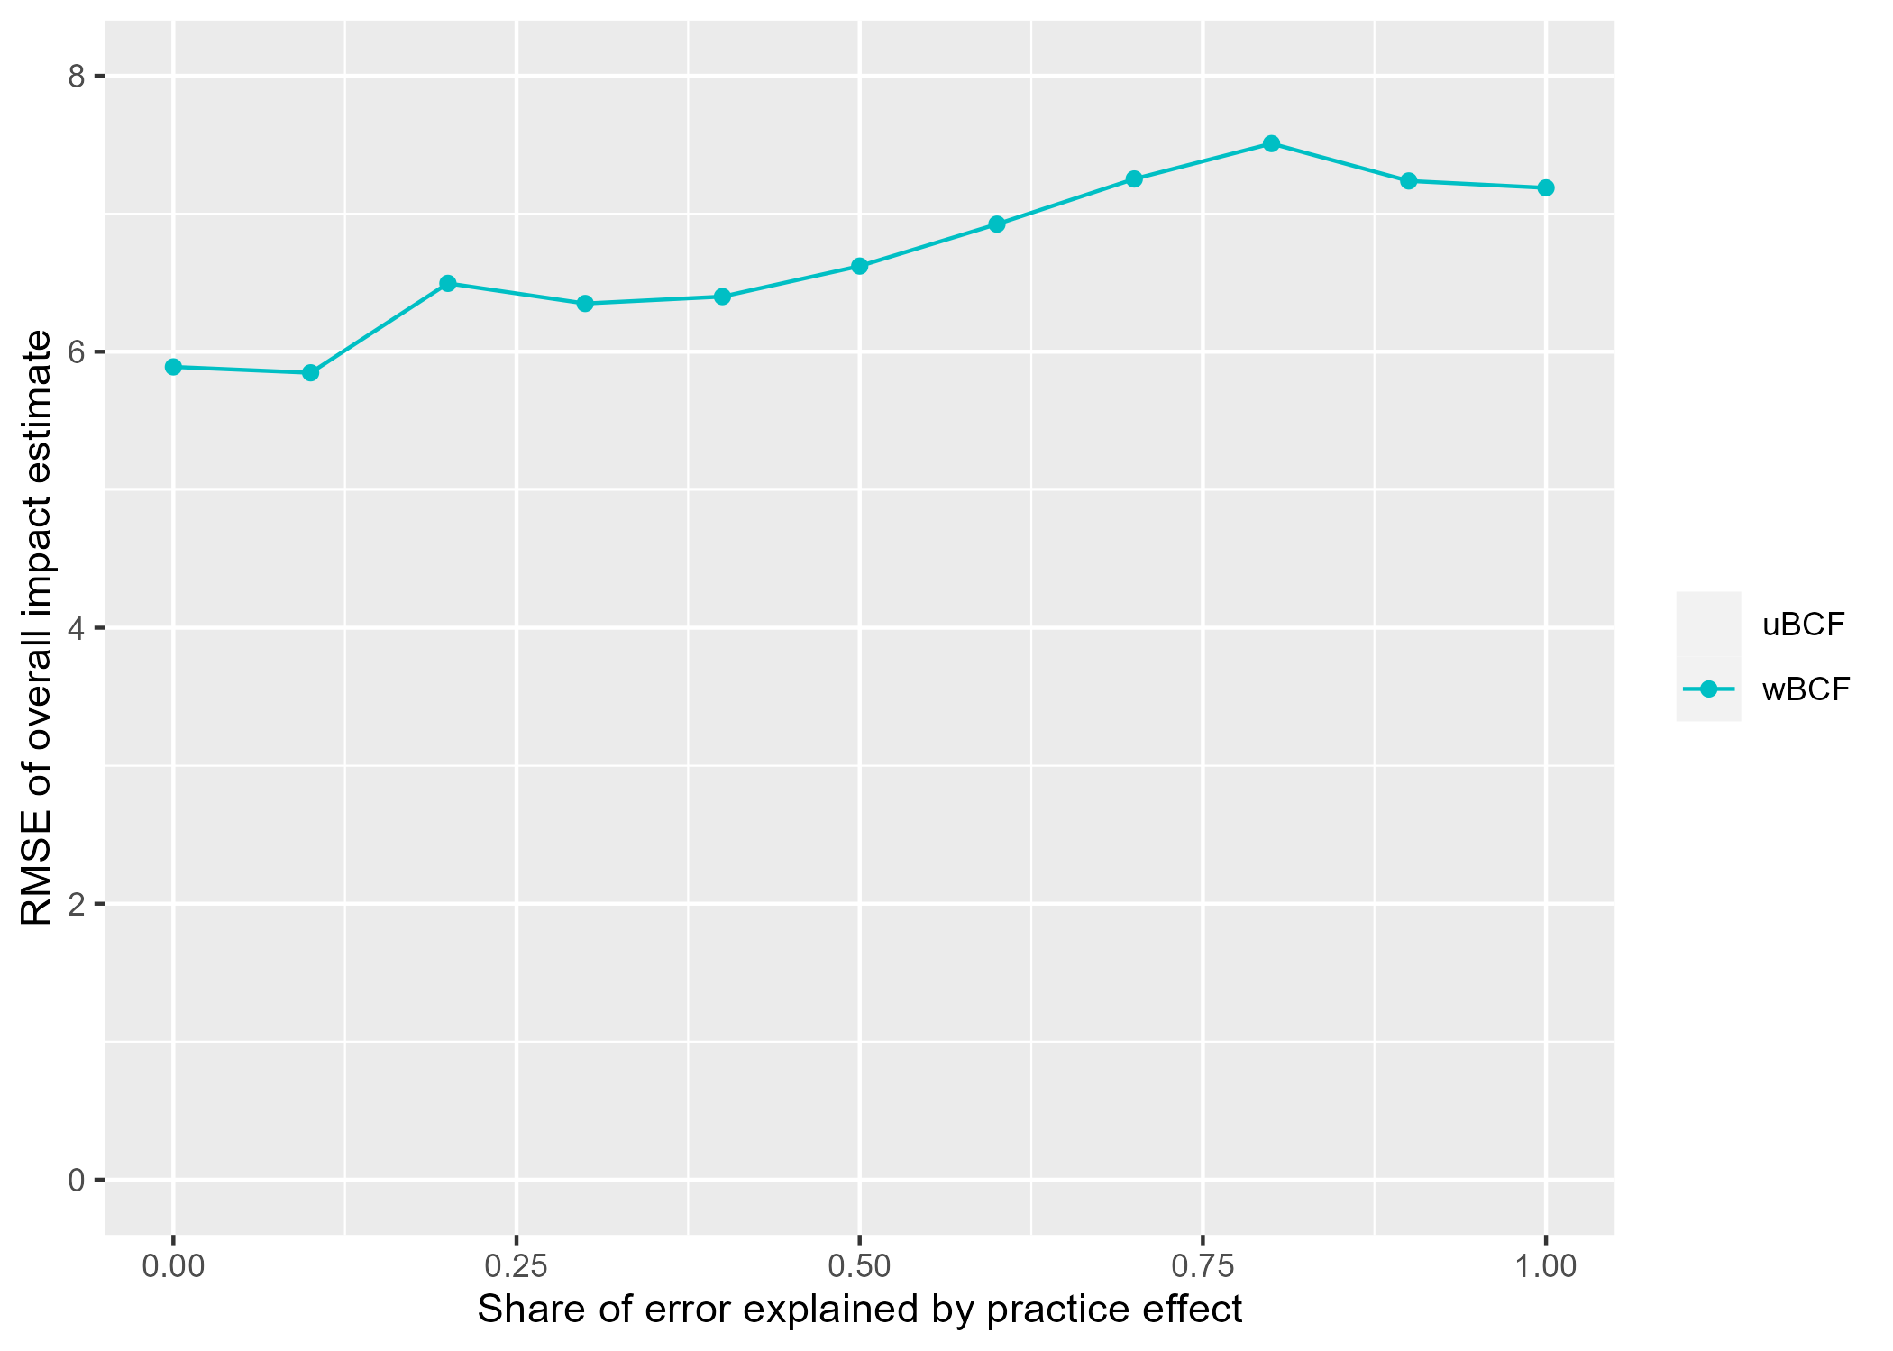
Simulation: SATT RMSE

Slide 7
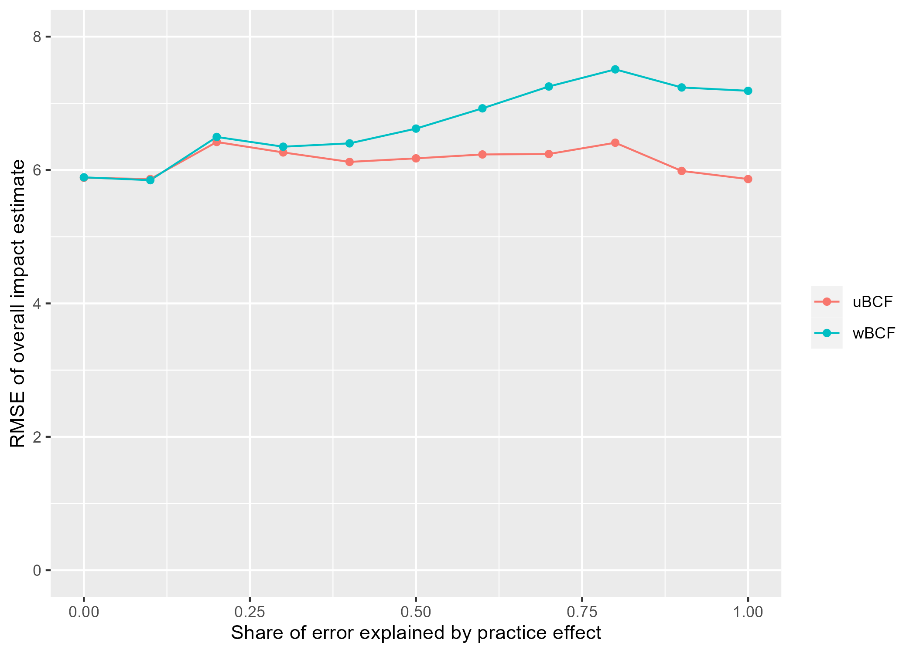
Simulation: SATT RMSE

Slide 8
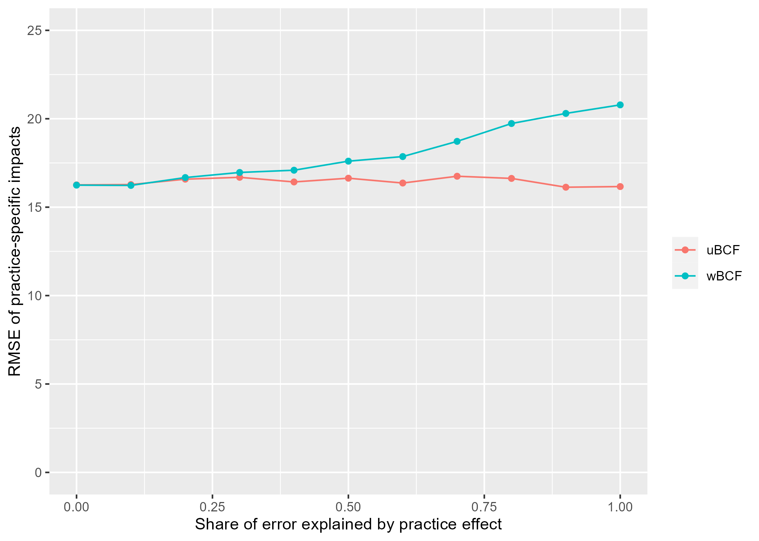
Simulation: Practice impacts

Slide 9
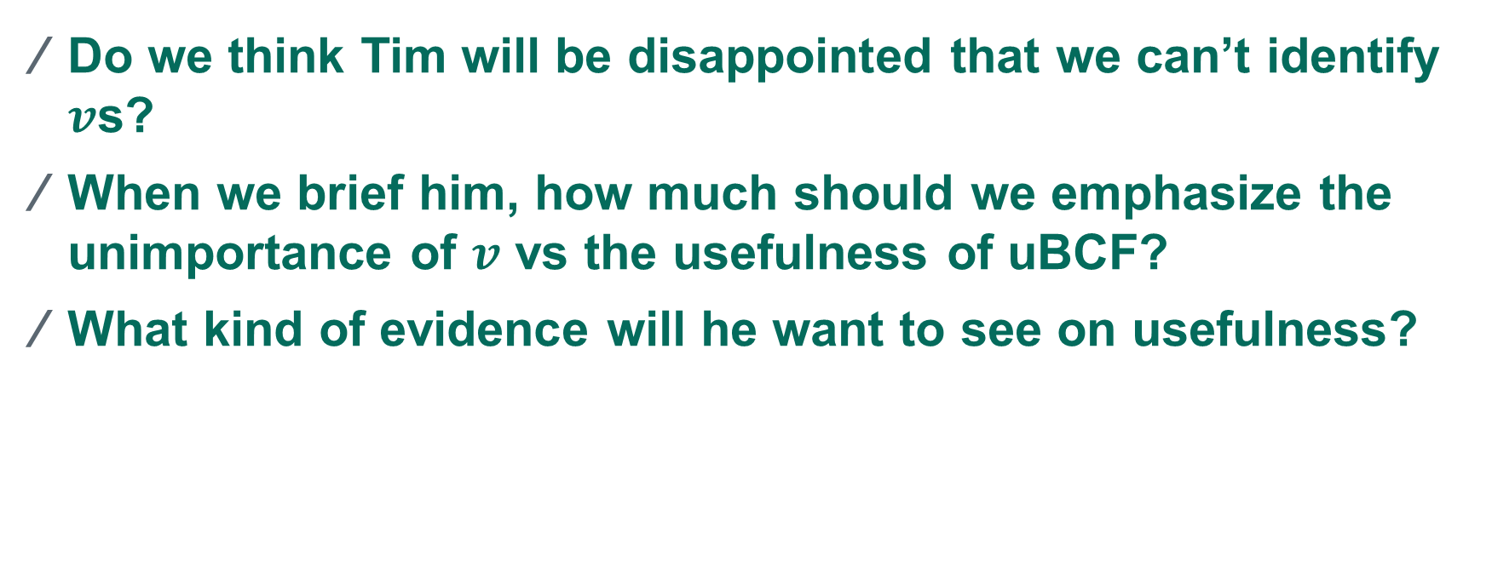
Next steps: communicating with Tim
Do we think Tim will be disappointed that we can’t identify $v$s?
When we brief him, how much should we emphasize the unimportance of $v$ vs the usefulness of uBCF?
What kind of evidence will he want to see on usefulness?
Notes:
Prior sensitivity

