Slide 1

DEPARTMENT OF COMPUTER SCIENCE,
GUJARAT UNIVERSITY
M.Sc AI & ML 2019-20
SEMESTER 1 PROJECT
Sentiment analysis using twitter data
PROJECT SUPERVISOR
PRESENTED BY
DR.JYOTI PAREEK
VATSAL GAMIT (09)
MOHIT TALREJA (32)

Slide 2
1.WHAT IS SENTIMENT ANALYSIS?
INDEX
2.WHY WE USE SENTIMENT ANALYSIS?
3.HOW TO MAKE SENTIMENT ANALYSIS?

Slide 3
1
WHAT IS SENTIMENT ANALYSIS ?

Slide 4
WHAT IS SENTIMENT ANALYSIS ?
“
“ Sentiment analysis is the practice of applying natural language processing and data analysis techniques to identify and extract subjective information from data.”

Slide 5


WHAT IS SENTIMENT ANALYSIS ?
The Process of Analyzing the data in form of text, to extract
Relevant information and transferring it into an useful intelligence
It determines if an information (opinion) is POSITIVE,NEGETIVE OR NEUTRAL based on Normal Human Conversation
This project is an attempt to analyze human emotions to create better experience in different fields

Slide 6
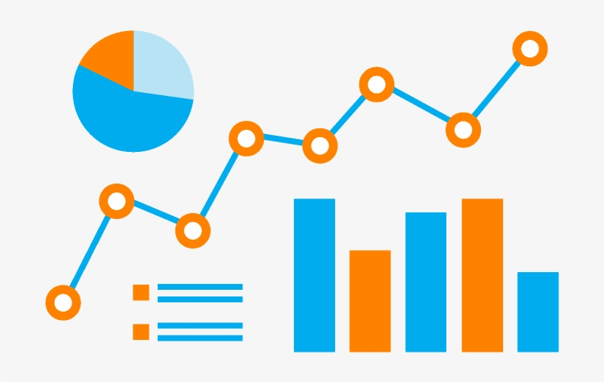
WHAT IS SENTIMENT ANALYSIS ?
This is also called opinion mining because it includes different identifying attributes , emotions , and opinion about the various topics.
During process it gives the value to a word to determine the word’s positivity or negativity.
It helps different sectors by monitoring the sentiments of people about their articles, products or their services
It’s a powerful tool to create trends or to influence the target audience

Slide 7
2
WHY SENTIMENT ANALYSIS ?

Slide 8
WHY SENTIMENT ANALYSIS ?
Its estimated that 80% of the worlds data is unstructured ! Most of this comes from text data, like emails, chats, social media, articles, and documents. These texts are usually difficult to analyze, understand and sort.
Sentiment analysis allows us to make sense of this large sea of data by saving our time of manual data processing.
Social Media Marketing
Brand Monitoring
Trend Making
Customer Services
Market Research
Security Analysis
Prediction Making

Slide 9
WHY WE CHOOSE TWITTER ?
• Popular microblogging site
• Short Text Messages of 140 characters
• 240+ million active users
• 500 million tweets are generated everyday
• Twitter audience varies from common man to celebrities
• Users often discuss current affairs and share personal views on
various subjects
• Tweets are small in length and hence unambiguous

Slide 10
3
HOW TO MAKE SENTIMENT ANALYSIS ?

Slide 11
Challenges
• People express opinions in complex ways
• In opinion texts, lexical content alone can be misleading
• Intra-textual and sub-sentential reversals,negation, topic change common
• Rhetorical devices/modes such as sarcasm, irony, implication, etc.
• Unstructured and also non-grammatical
• Lexical Variation
• Out of Vocabulary Words
• Extensive usage of acronyms like asap, lol, afaik

Slide 12
Process Flow
FETCHING TWEETS
SAVE
TWEETS
file.csv or file.text
TOKENIZATION
(stop words,lexicons)
INPUT
TWEEPY API
TWEET SENTIMENT
SENTIMENT ALGORITHM
FEATURE IDENTIFIER
INPUT
SVM CLASSIFIER
NEW TWEETS
TRAINED MODEL

Slide 13
WORKFLOW
Here we are using the sentiment analysis on Twitter Data using python programming language.
1.COLLECTING DATA FROM TWITTER
2.CLEANING THE DATA(OR PREPOCESSING)
3.APPLYING THE RIGHT SENTIMENT ANALYSIS ALGORITHM
4.PLOTING THE RESULTS ON GRAPH AND ANALYZING THE RESULT
5.IMPROVEMENTS

Slide 14
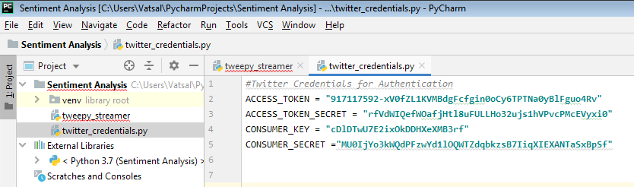
HOW TO GET DATA(TWEETS) FROM TWITTER
We are using the Tweepy API to fetch the twitter data.
ACCESS KEYS FOR TWEEPY AUTHENTICATION

Slide 15
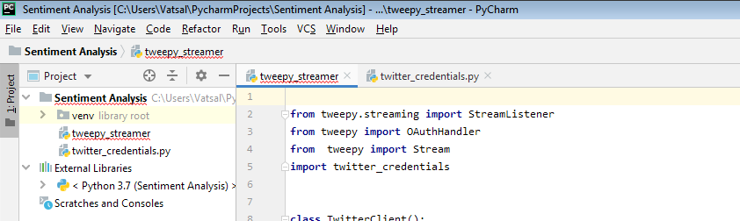
IMPORTING REQUIRED DEPENDENCIES

Slide 16
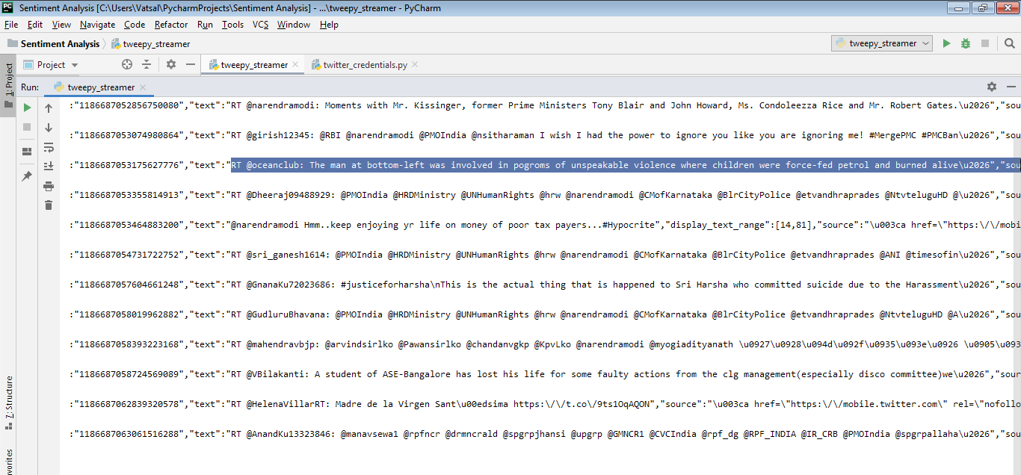
FETCHING TWEETS

Slide 17
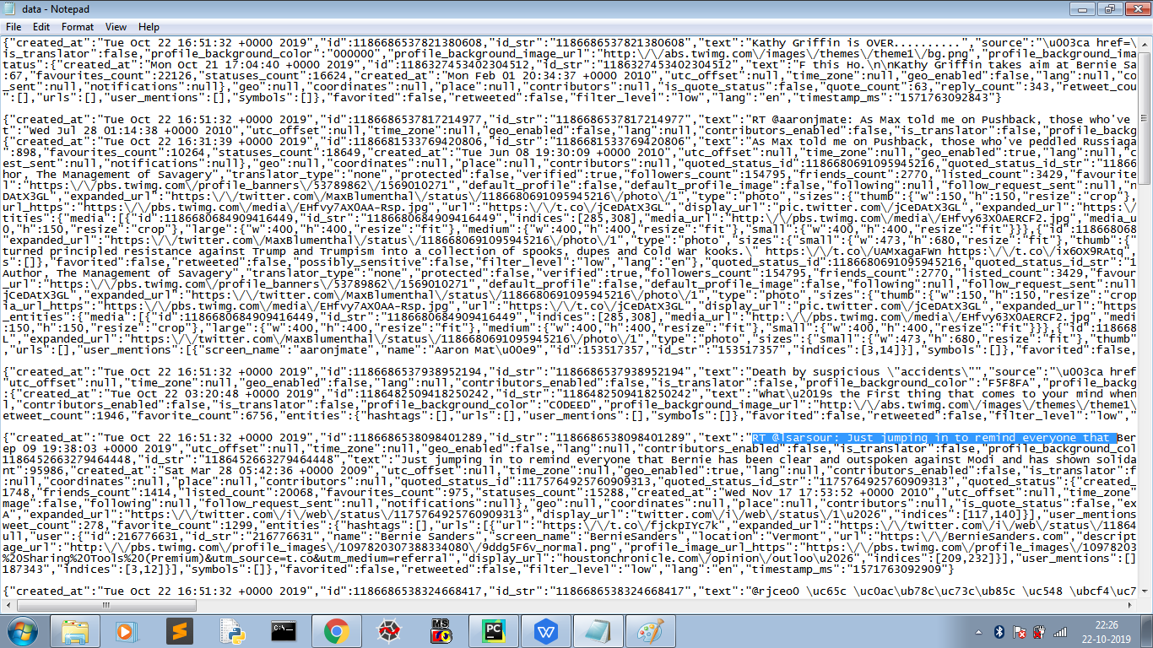
FETCHED DATA IN TEXT FILE

Slide 18
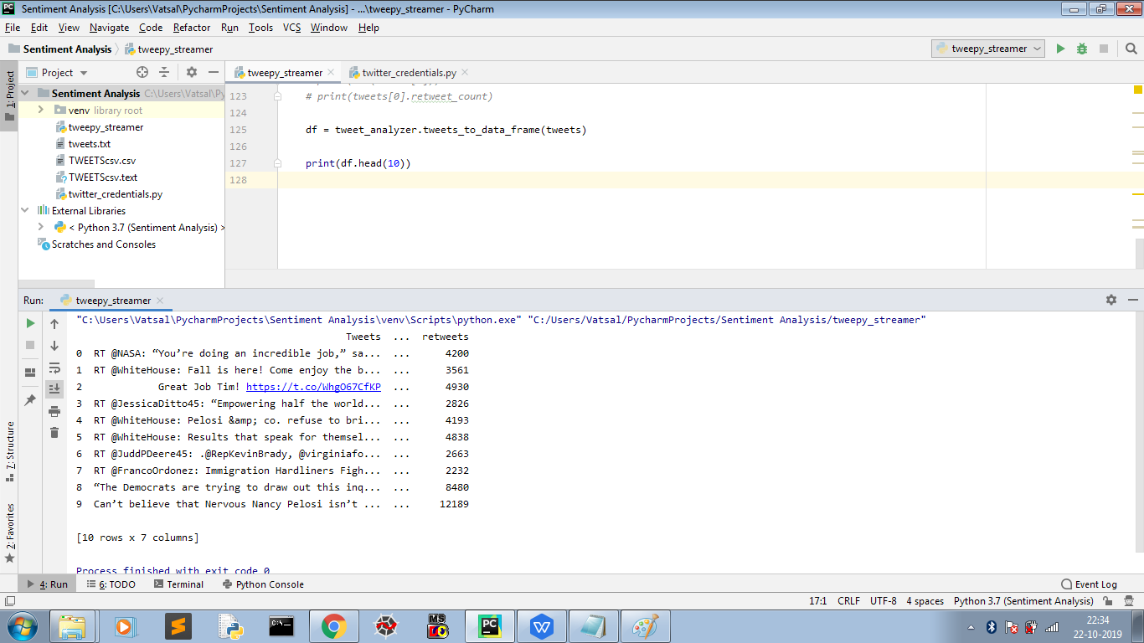
FORMATTING DATA

Slide 19
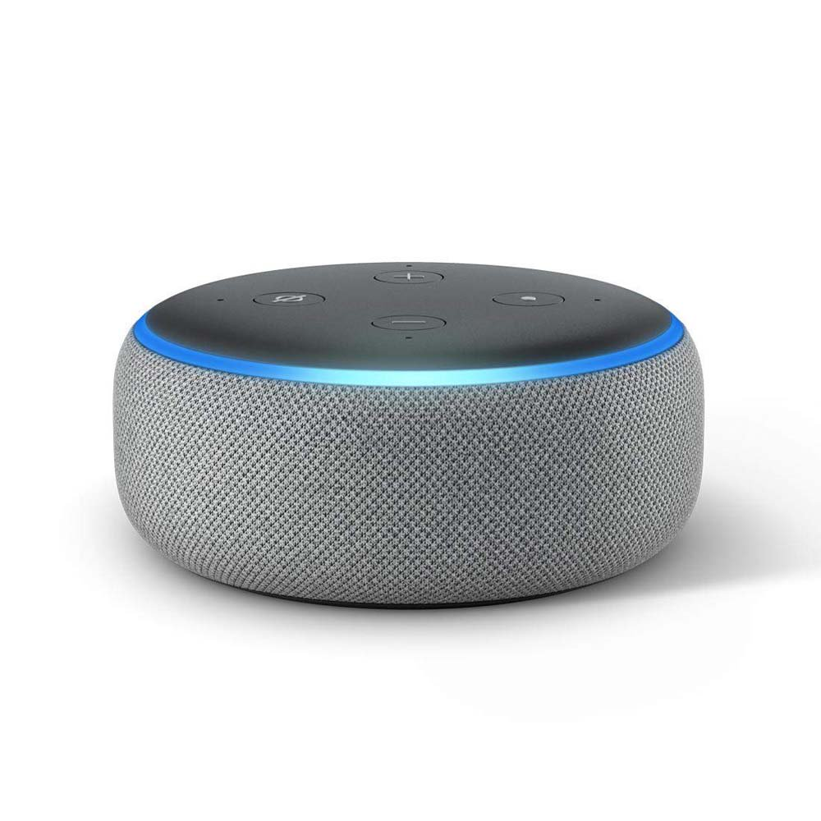
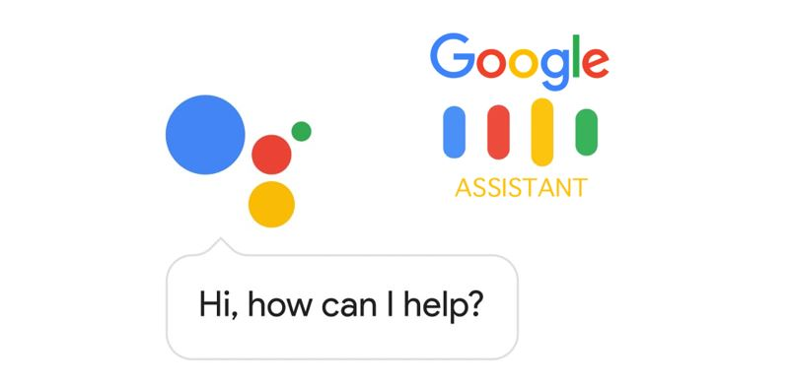
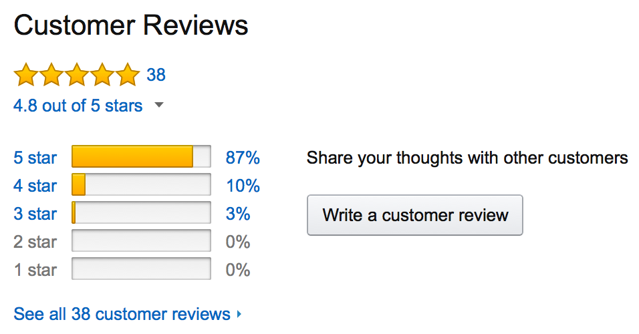
SENTIMENT ANALYSIS IN THE WORLD
The Obama administration used sentiment analysis to gauge public opinion to policy announcements and campaign messages ahead of 2012 presidential election. Being able to quickly see the sentiment behind everything from forum posts to news articles means being better able to strategise and plan for the future.

Slide 20
OUR FUTURE GOALS
1.TO FETCH THE DATA IN DESIRED FORMAT
2.TO TOKENIZE THE DATA WITH DIFFERENT METHODS
3.TO EXTRACT FEATURES
4.IMPROVEMENT OF THE ALGORITHM
5.TO PREDICT DIFFERENT RESULTS USING THIS PROJECT

Slide 21
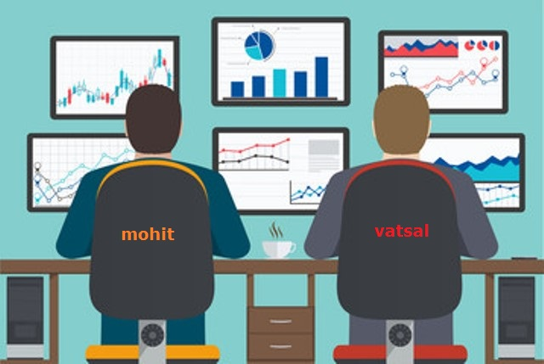
THANK YOU

