Slide 1
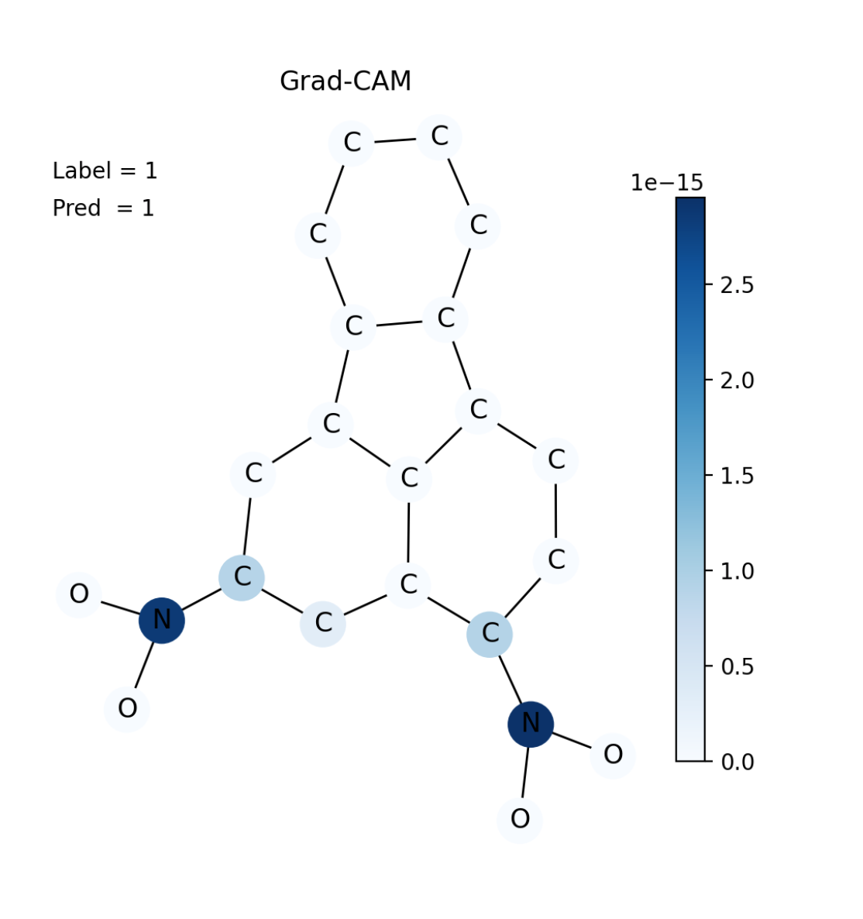
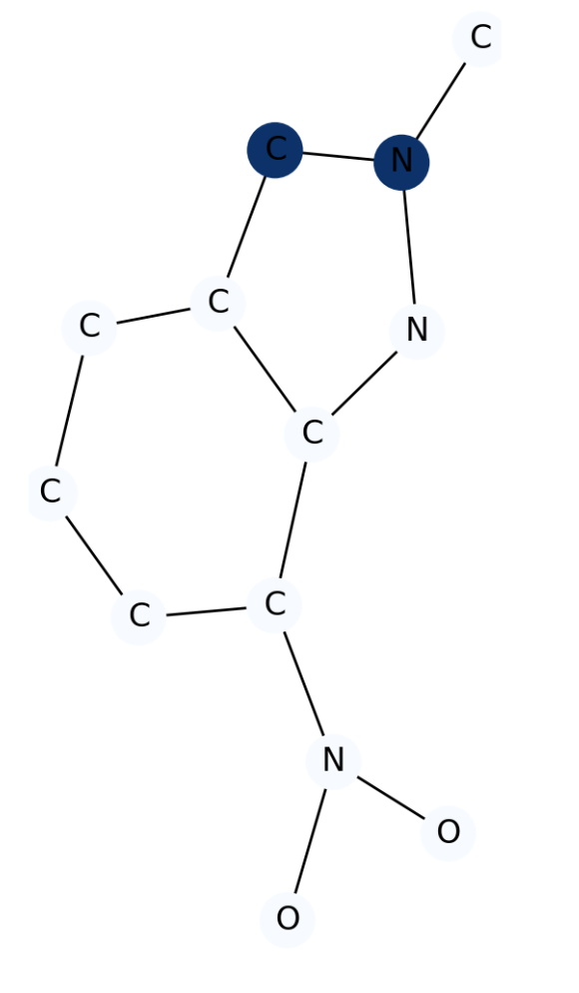
mention actual class names (once finalized) in each GraphXAI component
Graph Machine Learning Predictor
Accuracy
Sensitivity
Specificity
F1-score
…
Rank
F1@k
Faithfulness
Stability
Fairness
…
Graph Input
GML Model
GML model predictions
GML predictor evaluator
GraphXAI metrics
GraphXAI Input:
GML model
Model predictions
Node/graph embeddings
Ground-truth explanation
GraphXAI explanation methods:
gradient-based
perturbation-based
surrogate-based
walk-based
subgraph-based
GraphXAI output explanations:
Node attribute importance
Edge importance
Node importance
K-hop information
GraphXAI Data Loader {training, validation, testing, ground-truth explanation}
GraphXAI Explainer
Graph Dataset
GraphXAI visualizer

