Slide 1
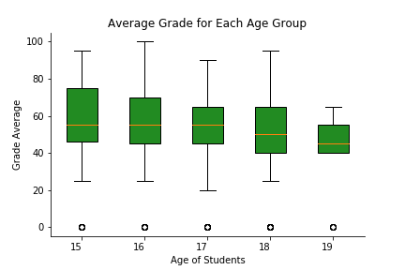
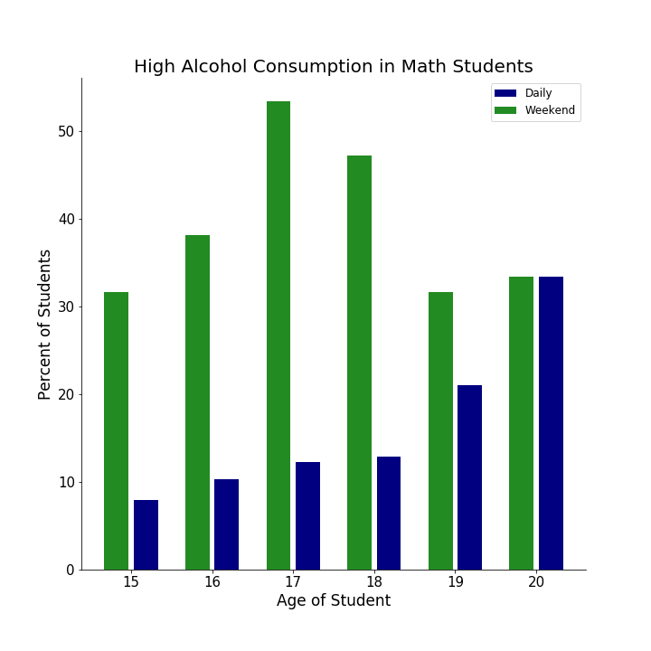
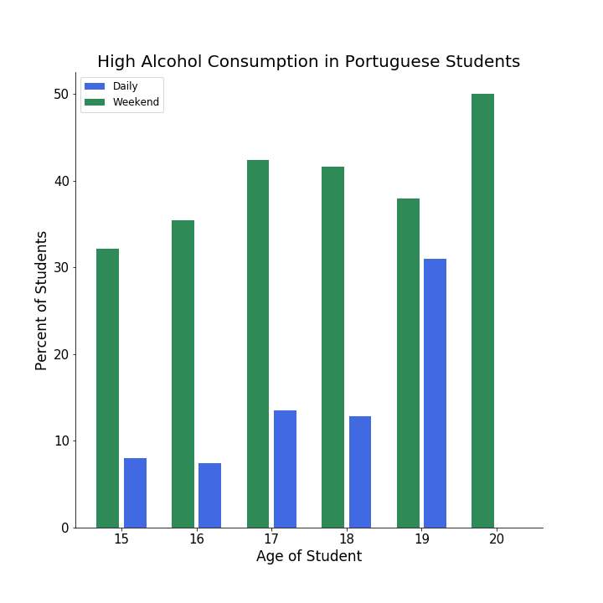
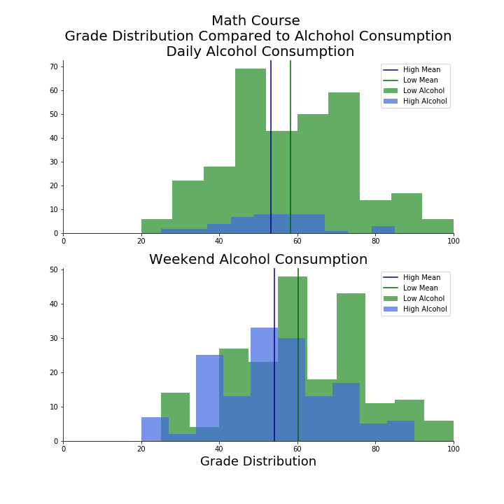
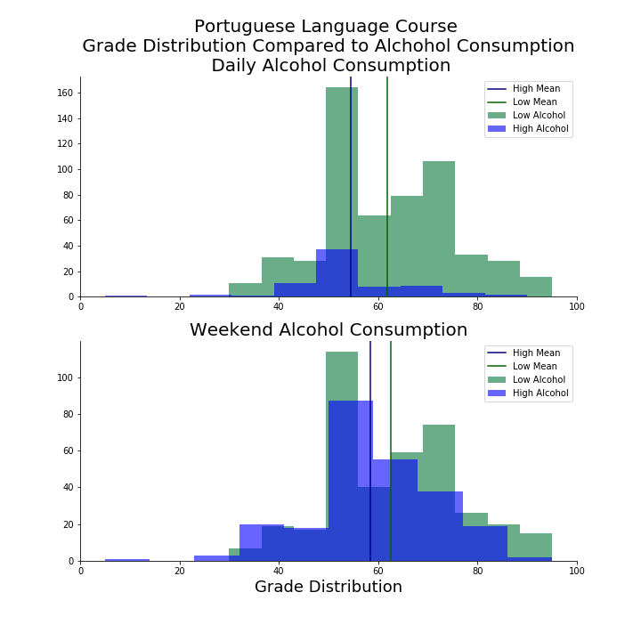
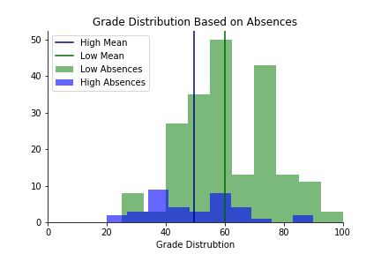
How Alcohol Consumption Affects Student Grades
Dylan Mather
Data Visualization
Purpose
Alcohol Consumption by Age
The goal this work was to convince a student entering high school to not drink since it will have a negative affect on their grades. In order to convince this student three questions were asked of the data. Is there a correlation between absences and grade performance, is there a correlation between alcohol consumption and grade performance, and which of these has a bigger impact on the ending grades.
I first looked at how the amount of alcohol students drank changed with age. I did this by looking at how many students participate in daily alcohol consumption and the number of students who participate in weekend alcohol consumption. The older students seemed to participate more in daily alcohol consumption compared to the younger students. Conversely more of the younger students generally participated in weekend alcohol consumption compared to the older students.
Overview of the Data
The dataset of Student Alcohol consumption I found on Kaggle has information on many different aspects of students lives from the schools Gabriel Pereira and Mousinho da Silveira, both schools in Portugal. I explored a few different angles of this data in order to gather conclusions.
Dimensions I explored:
Column | Information
Sex | 53% Female 47% Male
Age | Range from 15-22
Failures | Number of past class failures
Absences | Numeric
G3 | Final Semester Grade
Daily Alcohol Consumption | Range from 1-5, 1 being low consumption and 5 being high consumption
Weekend Alcohol Consumption | Range from 1-5, 1 being low consumption and 5 being high consumption
The graph above shows the grade distribution of each age group. All ages above 19 were omitted due to an insufficient amount of data to draw a reliable average grade.
Conclusions
Grade Distributions
Based on the graphs made from the data, there is a clear correlation between the amount a student drinks and the grade they receive. On average a student who has a high number of absences will have a final grade ten percent lower than a student who regularly goes to class. When it comes to alcohol consumption, in the Portuguese classes, students who drink during the week will have on average eight percent lower grade compared to those who don’t. In math classes the average difference in grade for those who drink during the week compared to those who don’t is only six percent. This means that not going to class has a bigger affect on your grades compared to drinking, however, regular drinking does have a significant affect on the average grade for students in both courses.
Other Factors on Grades
These graphs show the grade distribution comparing students who have a high alcohol intake vs low alcohol intake for during both workday and weekend and compares the grade distribution in both Portuguese and Math classes.
Since this dataset has many other dimensions on top of the amount the students were drinking, I was able to show how other factors had an impact on the grade distribution on this set of students. The following graph shows that, not surprisingly, students who have lower absences have a higher overall grade compared to students who have higher absences.
References
https://www.kaggle.com/uciml/student-alcohol-consumption

