Slide 1


MCA PROJECT REVIEW
ELECTIFY: A REAL - TIME ELECTIVE REGISTRATION SYSTEM WITH TRANSACTIONAL SEAT MANAGEMENT
PRESENTED BY
UNDER THE GUIDANCE OF
MATHESHWARAN R
Dr. V. NISHA, M.Sc., M.Phil., Ph.D.
One seat, one student — confirmed in a single database transaction.
Register No. RA2532241010311
Assistant Professor, Department of Computer Applications
Department of Computer Applications · Faculty of Science and Humanities
SRM Institute of Science and Technology, Kattankulathur – 603 203
Notes:
Introduce the project title exactly as approved, yourself, and the guide. Electify is a web application for running elective registration in a department: it enforces seat limits exactly, keeps cohorts and academic years separate, and gives each staff role only the access it needs.

Slide 2




ABSTRACT
Fair, exact elective registration for a whole department
The problem
The solution
Verified outcome
Seats are limited and the window is short. Forms and spreadsheets cannot enforce a seat limit at the moment of choice, and several cohorts run at once.
A web application in which every registration, change and cancellation is one PostgreSQL transaction that locks the subject rows and applies capacity and class quotas.
136/136 server-side tests and 36/36 browser tests pass; 0 layout overflows at 7 screen sizes; 0 automated accessibility violations (runs of 15 Oct 2026).
Objectives
Exact seat limits · cohort and Year Server isolation · scoped staff roles · auditable records
Built with Next.js 16 · React 19 · TypeScript · Drizzle ORM · PostgreSQL · optional Supabase Realtime
MCA Project Review · SRM Institute of Science and Technology
02 / 16
Notes:
Summarise the abstract: problem, solution, outcome. The numbers are from the test runs of 15 October 2026 on commit bfd9bd8: 136 server-side tests in 18 suites and 36 browser tests, all passing.

Slide 3




INTRODUCTION
What Electify is and who uses it
Electives let students shape part of their programme. Each semester, every class picks a subject from baskets such as Professional Elective I and Open Elective I, and each subject has a fixed number of seats.
Electify runs that exercise on the department's own web application: the window, the seats, the choices and the records.
System administrator
Year Servers, departments, staff accounts, audit log
Course coordinator
Events, baskets, subjects, class quotas, reports
Class tutor
Why it matters
Class roster, signup codes, live window, password resets
Most students act in the first minutes; popular subjects fill fast
A seat promised twice means one student is moved later
Two cohorts can share a class name such as MCA F
Student
Explores subjects, registers, changes or cancels, receipt
MCA Project Review · SRM Institute of Science and Technology
03 / 16
Notes:
Domain: elective registration in a university department. Four roles use the system. The problem matters because of short windows, scarce seats and several cohorts running at once.

Slide 4

PROBLEM STATEMENT
Read, check, write: how a simple form overbooks a subject
Two students submit at the same moment
Gaps in the current process
Student A
Seat limits are not enforced when the choice is made
Allocation is reconstructed later by staff, by hand
Students cannot see remaining seats; staff cannot see progress
Batches with the same class name can be mixed
A browser value (such as a class cookie) must never widen access
reads
1 seat left
check
passes
writes
0 seats
Student B
reads
1 seat left
check
passes
writes
0 seats
Both are confirmed. One seat, two students: the classic lost update.
Needed: enforce capacity at commit time, isolate cohorts, scope every staff action
MCA Project Review · SRM Institute of Science and Technology
04 / 16
Notes:
Problem statement from Chapter 1.2 of the report. The lost-update anomaly: if an application reads a seat count, checks it and writes a new value in separate steps, two simultaneous requests can both succeed. Electify must also keep cohorts apart and must not trust values sent by the browser.

Slide 5







OBJECTIVES AND SCOPE
What the project set out to deliver
Core objectives — all implemented and verified
In scope
Never exceed a subject's capacity or a class quota, even under simultaneous submissions
Four roles, one department workflow
Year Servers and cohort isolation
Live monitoring, reports, replay
Subject explorer with seat counts
Model faculties → programmes → cohorts → classes; one Year Server per academic year
Onboard students only through a tutor-issued class signup code
Enforce the registration window on the server clock
Out of scope (future work)
Issue a numbered receipt; keep an audit log and a registration replay
Preference-ranked allocation
Central student-system integration
E-mail or SMS notifications
Production deployment and load tests
Limit every staff action to the classes the role and assignments allow
Verify with automated tests against a real PostgreSQL database
MCA Project Review · SRM Institute of Science and Technology
05 / 16
Notes:
Objectives are from section 1.3.1 of the report and are verifiable: each maps to tests in Chapter 8. Allocation is first-come within the window; preference-based allocation, integration and notifications are explicitly future work. The system has not been deployed for a live registration cycle.

Slide 6


EXISTING SYSTEM AND ITS LIMITATIONS
Today: forms, spreadsheets and manual allocation
Paper form or
online form
Shared
spreadsheet
Staff allocate
by hand
Disputes and
manual moves
No limit at the moment of choice
Opaque to students
No live view for staff
A form records a request; whether a seat exists is decided later
Nobody can see how many seats remain before choosing
Who has registered is known only after the window closes
Changes handled informally
Cohorts can mix
All-or-nothing access
Withdrawals leave no reliable record of what changed and when
Different batches end up in the same sheet or form
Anyone who can edit the sheet can alter anyone's entry
MCA Project Review · SRM Institute of Science and Technology
06 / 16
Notes:
Section 3.1 of the report: where a department has no dedicated system, choices are collected on paper, in a shared spreadsheet, or through a general-purpose form. These work for small classes but fail when demand exceeds capacity, when cohorts share subjects and when students change their minds.

Slide 7



PROPOSED SYSTEM AND KEY FEATURES
Enforce the rule where the data lives
Transactional seat allocation
Year Servers and cohort isolation
Class signup codes
Rows locked in id order; capacity and class quotas checked inside one transaction
Each academic year is a workspace; composite keys keep a class inside its cohort
A code names one class; uses are claimed atomically, so the limit holds
Subject explorer
Live monitor and replay
Receipts and audit log
Students read about subjects and see live seat counts before the window opens
Turnout, seat saturation and an ordered replay of who took which seat
Unique receipt numbers, JSON snapshots and an audit trail of staff actions
Status All six features are implemented and covered by automated tests. Planned preference-ranked allocation · notifications
MCA Project Review · SRM Institute of Science and Technology
07 / 16
Notes:
Section 3.2 and Chapter 5–6 of the report. The difference from the existing process: the seat rule is enforced at commit time by the database, not reconstructed afterwards. Realtime seat updates use Supabase Realtime when it is configured; pages also refresh every 30 seconds, so correctness never depends on it.

Slide 8

SYSTEM ARCHITECTURE
Five layers, one rule: the server decides
Browser
Routing proxy
Next.js 16 App Router
Domain modules
Data
Student portal
src/proxy.ts
Server Components
auth · workspace
Drizzle ORM
Staff portal
Verifies JWT
Server Actions
student-events
PostgreSQL
Role route guards
Route handlers
registration-window
Row locks · constraints
seat-ops
HTTPS · httpOnly cookie
Supabase Realtime (optional) database changes pushed to open pages; pages also refresh every 30 s
MCA Project Review · SRM Institute of Science and Technology
08 / 16
Notes:
Every request passes the edge proxy (src/proxy.ts), which verifies the signed session cookie and routes by role. Pages are React Server Components; all changes go through Server Actions that call domain modules in src/lib. Drizzle ORM talks to PostgreSQL, which holds the row locks and constraints. Supabase Realtime is optional and only improves freshness.

Slide 9





TECHNOLOGY STACK AND TOOLS
Verified from package.json and the repository
LANGUAGE
FRAMEWORK
INTERFACE
TypeScript 5
Next.js 16.2 (App Router)
React 19.2
Tailwind CSS 4 · Base UI
Lucide icons · Framer Motion
FORMS AND VALIDATION
DATA
AUTHENTICATION
React Hook Form 7
Zod 4 (server-side)
PostgreSQL
Drizzle ORM 0.45 · drizzle-kit
jose — JWT (HS256)
bcryptjs (cost 12)
LIVE UPDATES AND DOCUMENTS
TESTING
TOOLING
Supabase JS (Realtime)
jsPDF — receipts and reports
node:test via tsx
Playwright 1.64 · axe-core
Git · npm · ESLint
TypeScript compiler (tsc)
Hosting: documented for a Node.js platform with pooled PostgreSQL; not yet deployed for a live registration cycle.
MCA Project Review · SRM Institute of Science and Technology
09 / 16
Notes:
Versions are those declared in package.json. Deployment is documented (docs/deployment.md) but the system has only been run in development environments.

Slide 10
SYSTEM MODULES AND USER ROLES
Each role sees only its own part of the department
Administrator
Coordinator
Class tutor
Student
Every class
Own programme
Assigned classes
Own registration
Year Servers and cohorts
Faculties and departments
Users and invite codes
Audit log, maintenance mode
Registration events
Baskets and subjects
Class seat quotas
Templates, reports, monitor
Class roster and CSV import
Signup codes, password resets
Live window controls
Class reports
Join a class with a code
Subject explorer
Register, change, cancel
Receipt (PDF or print)
Shared server core
Sessions
Staff workspace
Eligibility
Window rule
Seat operations
Audit and replay
MCA Project Review · SRM Institute of Science and Technology
10 / 16
Notes:
Table 4.4 of the report. A tutor can manage classes from any programme of their department, up to a limit set by the administrator (ten by default). The root administrator account cannot be deleted, deactivated or demoted. All roles share the same server core in src/lib.

Slide 11
APPLICATION WORKFLOW
From sign-in to receipt: one registration
STUDENT
Sign in
register no. + password
Event for
my class?
Window open?
(server clock)
Pick one subject
per basket
Review and
confirm
no → class's own events only
no → countdown or closed notice
SERVER — ONE DATABASE TRANSACTION
Re-check eligibility
and window
Lock registration and
subjects (FOR UPDATE,
in id order)
Seat and class
quota available?
Write choice, replay
and audit rows
Receipt number
(advisory lock) →
COMMIT
yes
No: ROLLBACK, code SEAT_TAKEN — nothing is written, picks are kept
Receipt shown;
seats update
MCA Project Review · SRM Institute of Science and Technology
11 / 16
Notes:
registerElectives in src/app/actions/register.ts. Cheap checks happen first without locks. Inside the transaction the registration row and the chosen subjects are locked in a fixed order, so two transactions can never deadlock. takeSeat applies the subject capacity and any class quota. If any step fails the whole transaction rolls back. Changes take the new seat before releasing the old one; cancellations keep the record and return the seat once.

Slide 12
DATABASE DESIGN AND DATA MANAGEMENT
Twelve core tables; integrity enforced by PostgreSQL
academic_sessions
registration_events
elective_groups
electives
Integrity guarantees
Year Server: start / end year, status
FK cohort, session · window, status
FK event · min / max choices
FK group · max / available seats
available_seats ≥ 0 on subjects and quotas
One choice per student, event and basket (unique)
Unique receipt number per registration
Composite keys keep a class, a student and a code inside one cohort
Reviewed SQL migrations with rollback scripts
cohort_session_terms
event_sections
registrations
elective_seat_
allocations
FK cohort, session · year, semester
FK (event, cohort), (class, cohort)
FK student, event · receipt
FK elective, class · quota
academic_batches
sections
users
student_registrations
FK programme · admission year
FK cohort · class label (F, G…)
role · register no. · FK class
FK student, event, group, elective
Lines are foreign keys (one-to-many). Colours: academic structure · events and seats · people and registrations.
MCA Project Review · SRM Institute of Science and Technology
12 / 16
Notes:
Simplified from src/lib/db/schema.ts (about 25 tables in total; login attempts, invite codes, audit logs, templates and subject profiles are omitted here). A cohort is a programme plus admission year; a class is a section of it; a Year Server links cohorts to an academic year with their study year and semester.

Slide 13



SECURITY, VALIDATION AND RELIABILITY
Protections implemented in the code
Passwords
Sessions
Rate limiting
Scoped authorisation
bcrypt (cost 12); policy blocks the register number and common defaults
Signed JWT in an httpOnly cookie, 2 hours; one active session per user
5 failed sign-ins lock the identifier for 15 minutes
Role and class scope re-checked in every action; a cookie never grants access
Validation
Transactions
No double submits
Audit and replay
Zod schemas on input; eligibility re-checked inside the transaction
Row locks in a fixed order; constraints as a final guard
Already-registered and already-cancelled states are refused
Staff actions and every seat change are recorded
Known gap The 8-character, letter-and-number policy falls short of NIST SP 800-63B-4 (15 characters, no composition rules); future work.
MCA Project Review · SRM Institute of Science and Technology
13 / 16
Notes:
Each item is implemented: lib/auth.ts, lib/password-policy.ts, lib/workspace.ts, actions/register.ts. A revoked or replaced session is rejected on the next request and the user is sent to sign in. Root-administrator protection prevents deleting, deactivating or demoting the root account. The NIST gap is stated in section 4.6 of the report.

Slide 14
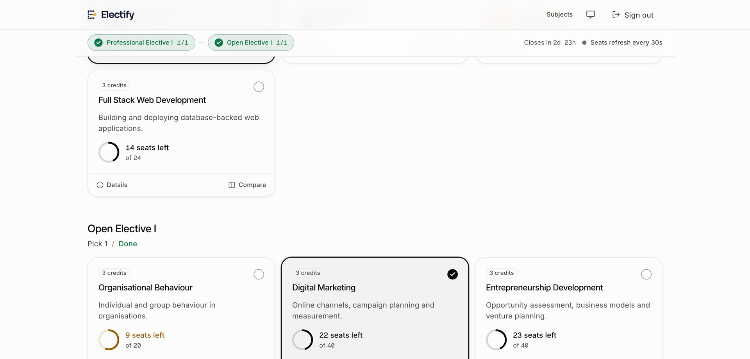
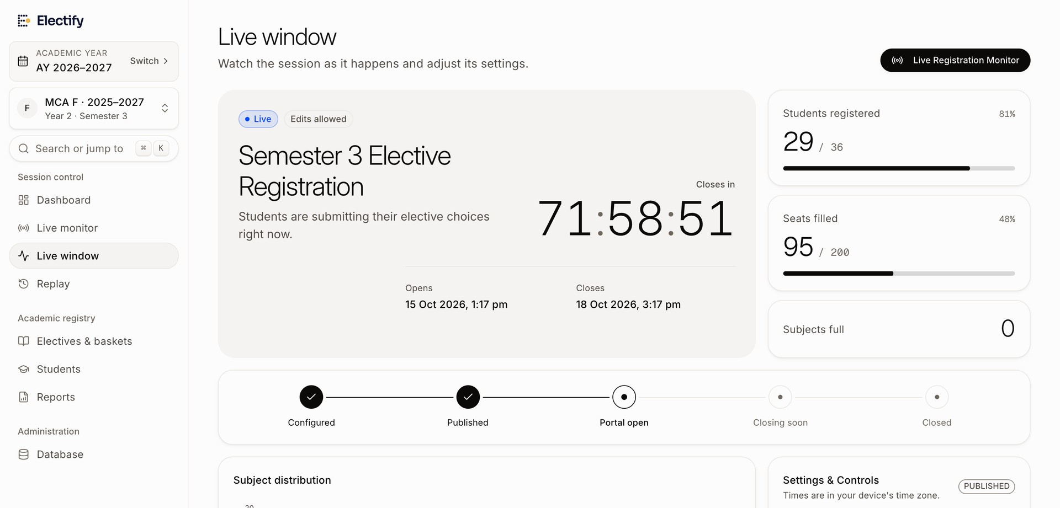
IMPLEMENTATION, TESTING AND OUTCOMES
Verified on 15 October 2026 (commit bfd9bd8)
136 / 136
36 / 36
server-side tests pass
browser tests pass
18 suites, real PostgreSQL
Playwright, every role, with reloads
0
0
Student picker: one subject chosen in each basket
layout overflows
accessibility violations
22 pages × 7 screen sizes
axe-core, WCAG 2.1 A/AA
What testing found
14 defects found, 13 fixed — incl. a crashing countdown page and a session-revocation security fault
Not yet tested: load, realtime with Supabase, other browsers, real users
Tutor live window controlling the registration
MCA Project Review · SRM Institute of Science and Technology
14 / 16
Notes:
All numbers come from the recorded runs (evidence in documentation/final-report/work/evidence). Screenshots show fictional demonstration data. Concurrency tests start several registrations at once for the last seat: exactly one succeeds. The one open defect (D7) is a reduced-motion hydration warning on the sign-in page.

Slide 15
Thank You
Questions are welcome.
STUDENT NAME
REGISTRATION NUMBER
MATHESHWARAN R
RA2532241010311
Department of Computer Applications · Faculty of Science and Humanities
SRM Institute of Science and Technology, Kattankulathur – 603 203
Notes:
Close and invite questions.

