Slide 1


MCA PROJECT REVIEW · OCTOBER 2026
EVENTDECK: A UNIVERSITY EVENT TICKETING SYSTEM WITH TRANSACTIONAL SEAT RESERVATION AND QR CHECK-IN
SUBMITTED BY
UNDER THE GUIDANCE OF
MATHESHWARAN R
RA2532241010311
SUHAS C
RA2532241010312
Dr. V. Nisha, M.Sc., M.Phil., PhD.
Assistant Professor, Department of Computer Applications
NITHYASHREE K
RA2532241010329
DEVANANDA E
RA2532241010332
Master of Computer Applications · Department of Computer Applications · Faculty of Science and Humanities
SRM Institute of Science & Technology, Kattankulathur – 603 203, Chennai, Tamil Nadu
Notes:
Good morning. We are presenting EventDeck, a university event ticketing system with transactional seat reservation and QR check-in, developed by Matheshwaran R, Suhas C, Nithyashree K and Devananda E under the guidance of Dr. V. Nisha, Assistant Professor, Department of Computer Applications.

Slide 2




One system from event publication to admission
ABSTRACT
Problem
EventDeck is a web-based event management and ticketing system for a multi-campus university. Built with Next.js, React, TypeScript and Supabase PostgreSQL, it lets students, faculty, alumni and visitors from other colleges discover campus events, book free or paid tickets and receive QR-coded tickets. Organizers publish events with ticket tiers, seat limits, registration and check-in windows, and audience rules for campuses, institutions or participant categories. Seats are reserved inside database transactions, unpaid seats are held for ten minutes, each person may hold at most four tickets per event, and Razorpay test-mode payments are verified on the server. At the venue, organizers and appointed moderators scan tickets, and each ticket is admitted only once. Administrators review organizer applications, cancellations, refunds and payouts and export reports.
Forms, spreadsheets and payment screenshots cannot enforce seats, eligibility or single entry
Approach
Server-authoritative rules, database transactions and constraints, row-level security
Capabilities
Tiers and audience rules, holds, verified payments, QR tickets, moderators, refunds, payouts
Outcome
No overselling, trustworthy payments, and an auditable record of every booking
Notes:
The abstract in one sentence: EventDeck replaces forms, spreadsheets and payment screenshots with one application where the rules of an event are enforced by the server and the database. The right-hand side summarises the problem, our approach, the implemented capabilities and the outcome.

Slide 3





Campus events outgrew forms and screenshots
INTRODUCTION & PROBLEM STATEMENT
Domain: event management for a multi-campus university. SRM has students, faculty, staff and alumni across Kattankulathur, Ramapuram and Vadapalani, and many events welcome other colleges and the public.
TODAY
Seat limits are not checked when a form is submitted, so events get overbooked
PROBLEM STATEMENT
Design and build a university ticketing system that never issues more tickets than seats, applies audience rules from trusted profiles, verifies payments with the provider, and admits each ticket exactly once, even when several moderators scan at the same time.
Payments are verified from screenshots that can be edited or reused
Campus or college eligibility depends on what applicants type
Passes can be copied and shown twice at different gates
Why it matters: fairness for attendees, trustworthy money handling, and safe, fast entry at the door.
Notes:
Explain the domain first, then the four concrete failures of the existing approach. The problem statement on the right is the one from Chapter 1 of the report. Emphasise 'exactly once' at the door: concurrency is the hard part.

Slide 4



What we set out to build, and where it stops
OBJECTIVES & SCOPE
Primary objectives
Core functional scope
Boundaries
Verified onboarding for SRM campuses, other colleges and guests; organizer access by admin approval
Events with tiers, windows and audience rules
Transactional booking: atomic seats, 4 per person, 10-minute holds
Server-verified payments, QR tickets and PDF passes
Event-scoped moderators; each ticket admitted once
Participant, organizer, moderator and administrator workflows
Discovery, full-text search and poster-led home page
Cancellations with refunds; organizer payouts
In-app realtime notifications and audit log
CSV reports for organizers and administrators
Razorpay Test Mode only; live keys are refused
Payouts are recorded; the bank transfer happens outside the system
Not included: waiting lists, invite-only lists, numbered seat maps, native mobile apps
Notes:
Objectives map to the six objectives in section 1.3.1 of the report. The third column is deliberate: payments are test-mode only and payouts are recorded rather than transferred, so we do not claim production payment handling.

Slide 5
From manual checks to rules the database enforces
EXISTING SYSTEM VS PROPOSED SYSTEM
ASPECT
EXISTING · forms, sheets, screenshots
PROPOSED · EventDeck
Seat limits
Not checked; reconciled by hand afterwards
Atomic conditional update inside a transaction
Payments
Screenshots checked by hand
Razorpay signature verified on the server; webhooks deduplicated
Eligibility
Self-declared in a form
Checked on the server from the stored profile
Entry
Printed lists, copyable passes
Random 192-bit QR token; the first scan wins
Door staff
Access to the whole response sheet
Event-scoped moderators see only the scan result
Cancellations
Informal; refunds untracked
Admin-approved; tickets invalidated; refunds tracked
Visibility
No live view
Dashboards, realtime notifications, audit log
Notes:
Read across each row: the left column is the current practice described in section 3.1, the right column is how EventDeck enforces the same rule. Every right-hand claim is implemented and covered in Chapters 5 and 6 of the report.

Slide 6
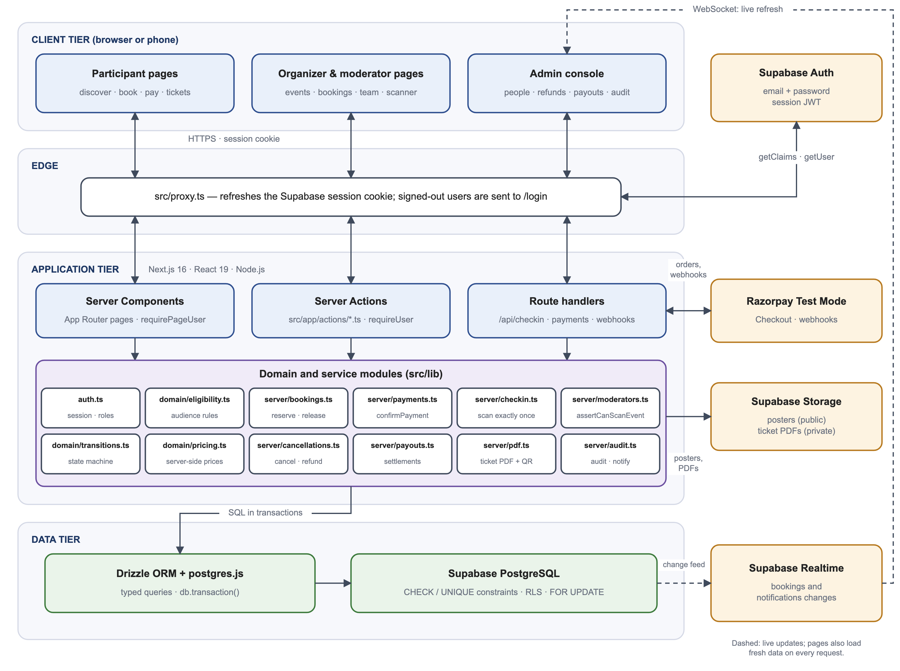




Four tiers, with rules kept on the server
SYSTEM ARCHITECTURE
Client & edge
Browser or phone. src/proxy.ts refreshes the Supabase session and redirects signed-out users.
Application tier
Server Components, Server Actions and route handlers call shared domain modules in src/lib.
Data tier
Supabase PostgreSQL through Drizzle ORM; constraints and row-level security as the final guard.
External services
Supabase Auth, Storage and Realtime; Razorpay Test Mode via server routes and signed webhooks.
Notes:
Walk through the tiers top to bottom. Key point: the proxy only redirects; every page, Server Action and route handler re-checks the user's role, and the database still enforces constraints and row-level security if anything above is bypassed.

Slide 7







Modern, typed and fully managed
TECHNOLOGY STACK
Framework
Interface
Database
Auth & e-mail
Next.js 16.4 (App Router)
React 19 · TypeScript 5
Tailwind CSS 4
shadcn/ui on Base UI
Supabase PostgreSQL
Drizzle ORM 0.45 · postgres.js
Supabase Auth sessions
Brevo SMTP for auth e-mails
Payments
Tickets
Testing
Hosting
Razorpay Test Mode
HMAC-verified checkout & webhooks
qrcode · pdf-lib
html5-qrcode scanner · sharp
Vitest (unit, integration)
Playwright (end-to-end)
Vercel · eventdeck.online
Vercel Cron for hold expiry
Notes:
Versions are those declared in package.json. Everything is managed: Supabase hosts the database, authentication, storage and realtime; Vercel hosts the application. There is no local database server to maintain.

Slide 8



One account, responsibilities that change with context
MODULES & USER ROLES
Participant
Organizer
Event moderator
Administrator
Discovers and searches events, books free or paid tickets or a pass, pays, downloads QR tickets and PDF passes, applies to become an organizer.
Creates and publishes events with tiers, windows and audience rules; reviews pass requests; appoints moderators; scans; views bookings and attendance; requests payouts.
An ordinary account assigned to one event (up to 10 per event). Sees only the scanner for that event; checked on every scan.
Approves organizers, cancellations and payouts; processes refunds; resolves payment exceptions; reads the audit log; exports reports.
Moderators are an assignment, not a role. A student who organizes one event can still book tickets for others and moderate a friend's event from the same account.
Notes:
Three platform roles (participant, organizer, administrator) plus event moderators. Administrator accounts cannot be obtained through the website; they are created with a command-line script.

Slide 9
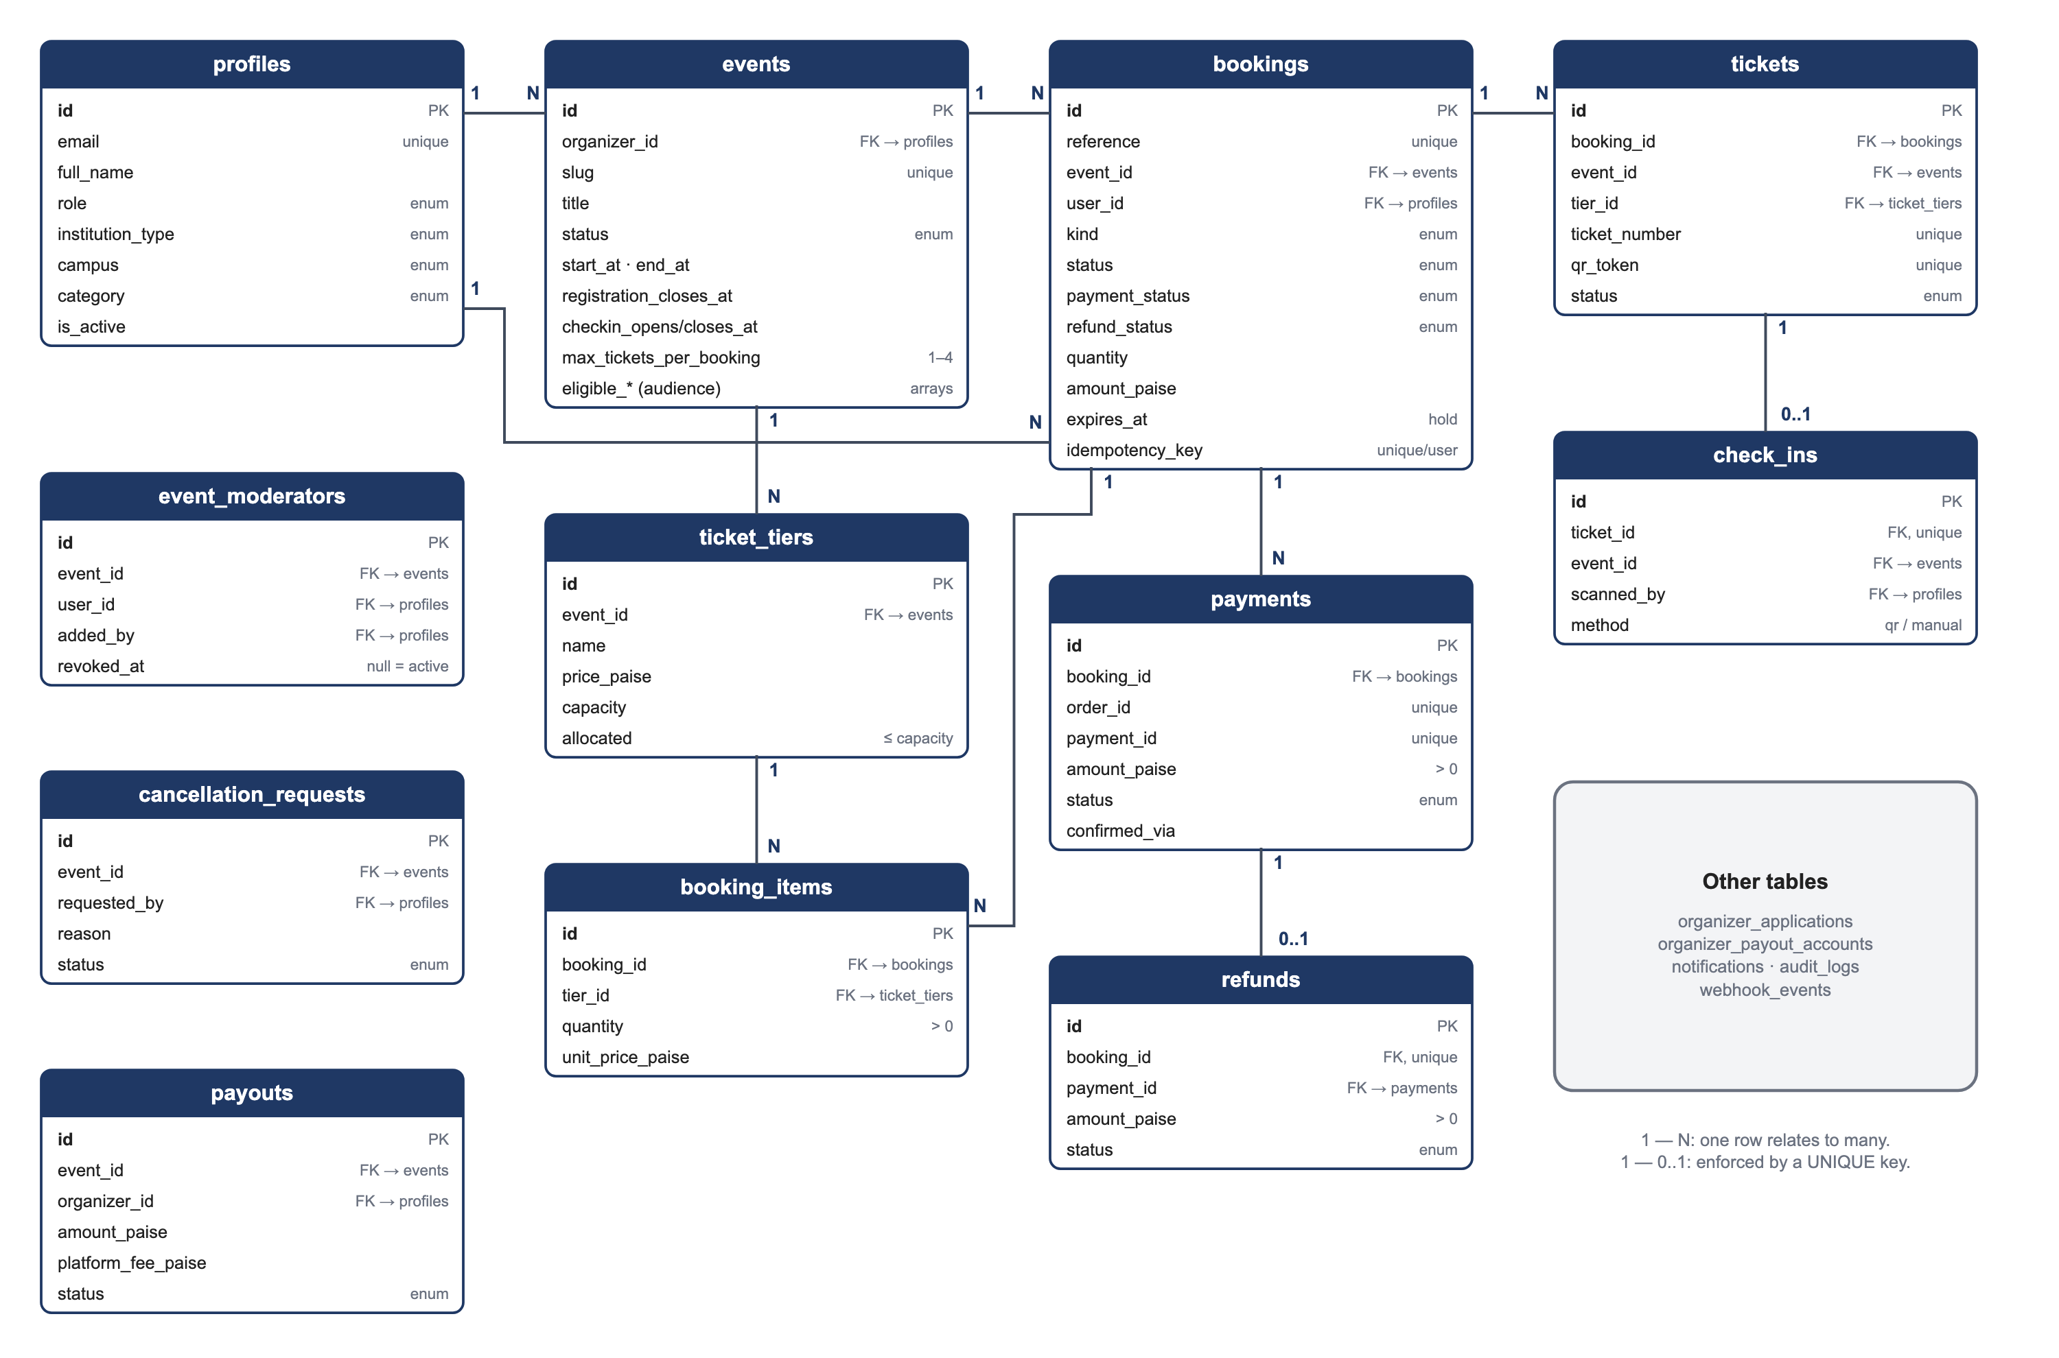



17 tables, constraints and row-level security
DATABASE DESIGN
Core chain
profiles → events → ticket_tiers; bookings → booking_items, tickets → check_ins
Separate status fields
Booking, payment, refund and ticket status are stored independently
Constraints as a safety net
allocated ≤ capacity · 1–4 tickets per person · one check-in per ticket · unique idempotency key
Row-level security
Enabled on all 17 tables; the browser key cannot write, so every write goes through the server
Notes:
The schema lives in src/db/schema.ts with versioned SQL migrations. Point at the core chain, then the constraints: even if application code had a bug, the database would refuse to over-allocate a tier or record a second check-in.

Slide 10

Seats are taken in one transaction, or not at all
CORE WORKFLOW · BOOKING ENGINE
1
2
3
4
5
Idempotency
Release holds
Lock & validate
Reserve atomically
Create booking
A repeated submission returns the original booking
Unpaid seats older than 10 minutes are freed
Profile row locked; event open; eligibility; ≤ 4 tickets
Conditional update succeeds only if seats remain
Free → approved
Paid → 10-min hold
Pass → organizer review
THE RULE THAT PREVENTS OVERSELLING
PAYMENT PATH
Razorpay order created from the booking amount (never from the browser)
Checkout callback and webhook verify the HMAC signature; first one confirms, the second is ignored
Late payment re-takes the seats, or becomes a payment exception for an admin
UPDATE ticket_tiers
SET allocated = allocated + n
WHERE id = :tier
AND allocated + n <= capacity;
Notes:
This is createBooking in src/lib/server/bookings.ts. Step 4 is the heart of the system: the check and the increment are a single SQL statement, so two buyers can never both take the last seat. Tiers are always locked in sorted order to avoid deadlocks.

Slide 11



Every ticket admitted once; every request checked twice
CHECK-IN & SECURITY
CHECK-IN AT THE VENUE
Authorise the scanner
DEFENCE IN DEPTH
Admin, owning organizer, or an active moderator of this event
Edge proxy refreshes session; redirects signed-out users
Parse the QR
Role gate requirePageUser / requireUser on every page and action
Contains only EVD1: plus a 192-bit random token; no personal data
Resource checks assertCanManageEvent · assertCanScanEvent · ownership
Validate from the database
Right event, valid ticket, approved booking, payment, inside the check-in window
Database constraints + row-level security on all tables
Record once
Never trusted from the client: role, price, per-person limit, audience fields, payment success, ticket validity.
INSERT … ON CONFLICT (ticket_id) DO NOTHING; the first scan wins on any device
Notes:
Concurrency at the door is handled by a unique constraint on check_ins.ticket_id, which the QA run verified with four simultaneous scans by two moderators producing exactly one check-in. On the right, the four layers of authorisation described in section 4.7 of the report.

Slide 12
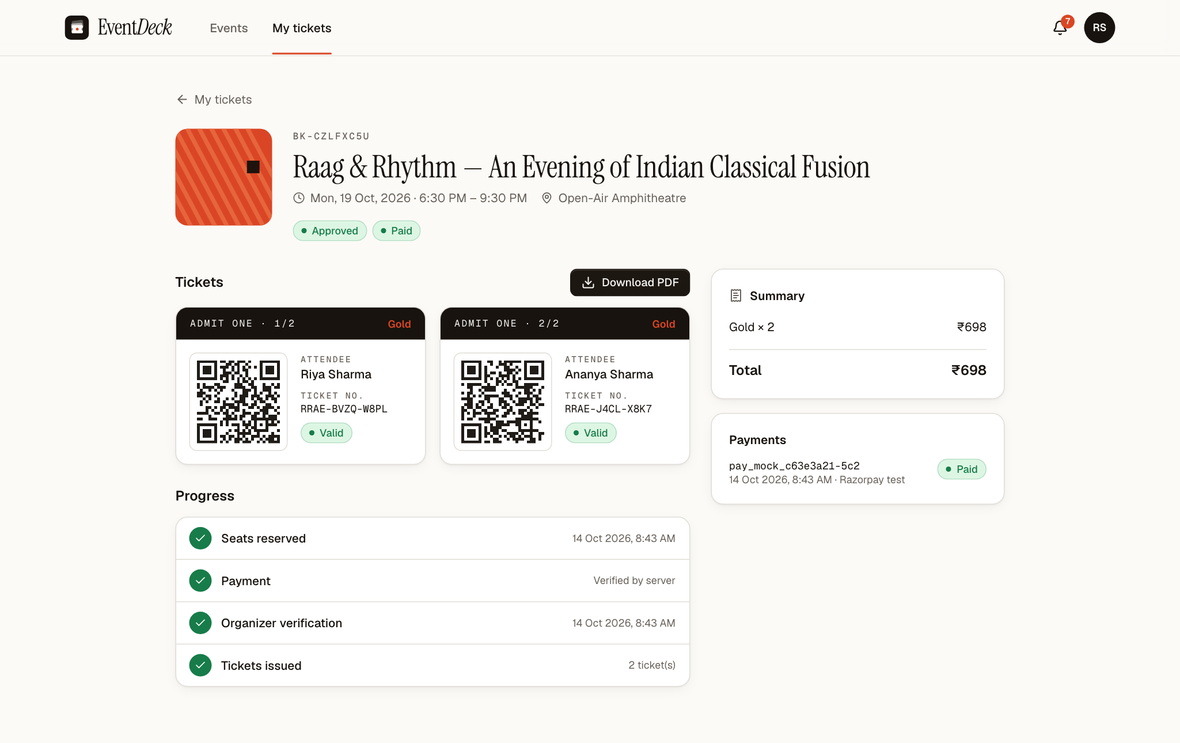
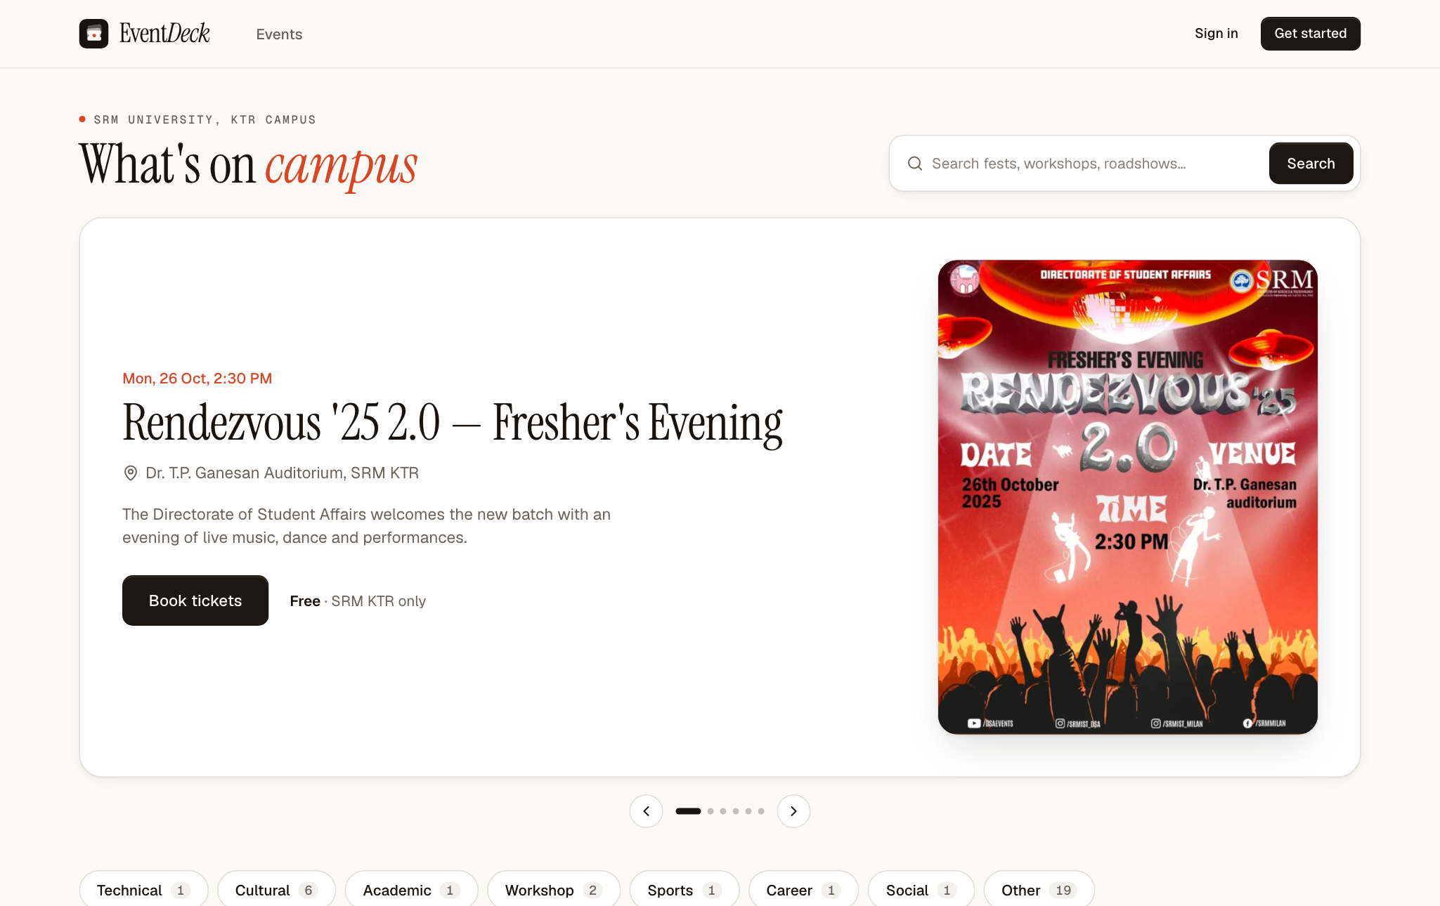
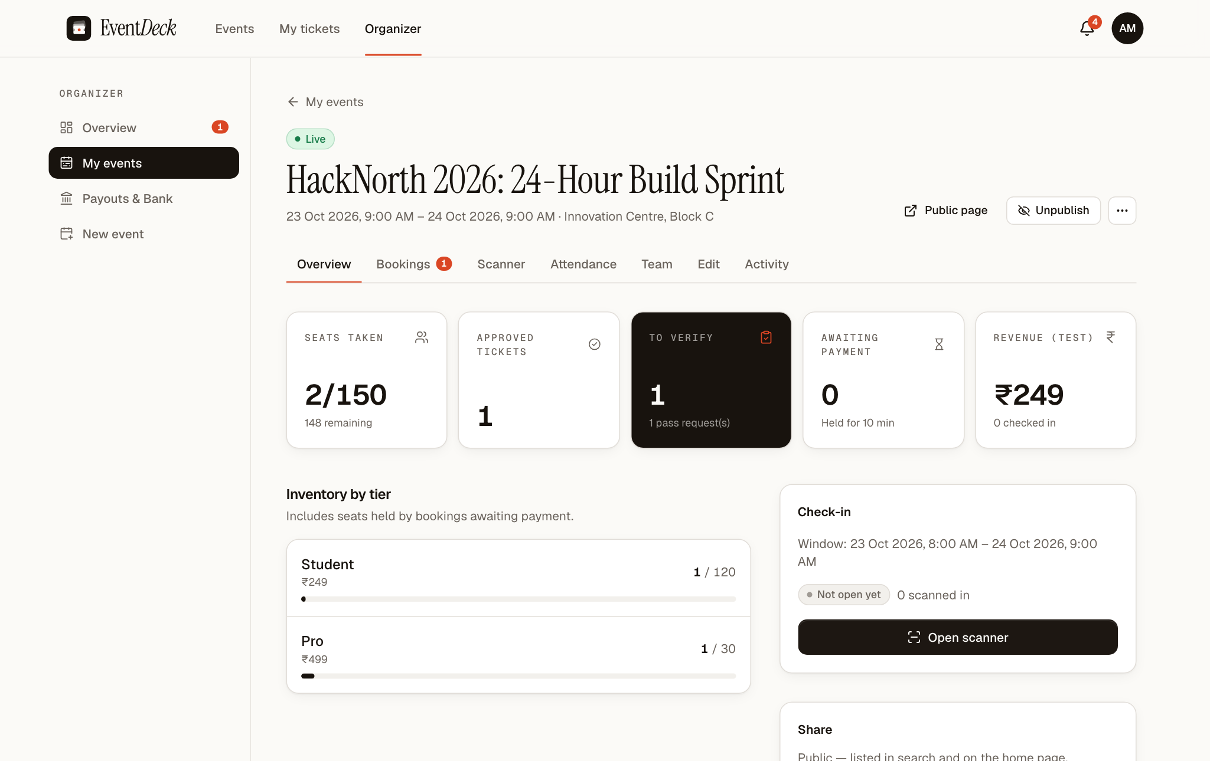
The working application, captured with demo data
IMPLEMENTATION · APPLICATION SCREENS
Home · poster carousel
Participant · QR tickets, payment and progress
Organizer · event overview
Screens captured from the running application on 15 Oct 2026 using fictional demonstration accounts.
Notes:
These are real screenshots of EventDeck, not mock-ups, taken with fictional demo accounts. If a live demo is possible, show the same flow at eventdeck.online: browse, book, open the ticket, then scan it from the organizer's Scanner tab.

Slide 13
Evidence, reported exactly as executed
TESTING & RESULTS
63 / 63
0
46
39 / 39
unit tests passed
type and lint errors
routes built
ticket tiers consistent
15 Oct 2026, current code
tsc --noEmit · ESLint
production build succeeded
allocated = seats in live bookings
CONCURRENCY & ACCESS-CONTROL EVIDENCE · QA RUN, 14 OCT 2026
Not yet re-run on current code
94 / 94 Vitest tests (41 unit + 53 integration) and 26 / 26 Playwright runs passed
20 concurrent buyers for 5 seats: exactly 5 bookings succeeded
4 simultaneous scans by two moderators: exactly 1 check-in
Checkout callback racing two webhooks: exactly 1 confirmation
QA found and fixed 2 critical defects that let users claim SRM membership
The 53 integration and 24 end-to-end tests need a dedicated Supabase test project, not yet created. The 14 Oct results above came from an earlier local stack that has since been removed.
Notes:
Be precise here. The top row was executed on the current code. The middle box is historical evidence from the quality-assurance run on 14 October against a local stack that was later removed; we label it as such. The right box states what remains to be re-run. Also mention: QA found and fixed two critical defects where users could falsely claim SRM membership, and we root-caused an admin-page hang to query pipelining through the database pooler.

Slide 14






The rules of an event belong in the server and the database
CONCLUSION & FUTURE ENHANCEMENTS
FUTURE ENHANCEMENTS
CONCLUSION
Re-run integration and E2E suites on a dedicated test project
EventDeck enforces seat limits, audience rules, per-person limits and single admission in the server and the database, not by hand.
Organizers, moderators and administrators get the tools a university needs, from publication and payments to refunds, payouts and audit.
Testing against a real database exposed defects that unit tests alone would have missed.
Waiting lists for sold-out tiers
Invite-only events with named guest lists
Live payments and automated payouts, after review
Load testing and a pilot with real organizers
Offline-tolerant scanning for door devices
Notes:
Conclusion from section 9.1 of the report; future work from section 9.2. The first enhancement is the most immediate: re-running the integration and end-to-end suites on a dedicated Supabase test project.

Slide 15

Thank you
Questions and discussion
LIVE APPLICATION
eventdeck.online
TEAM
Matheshwaran R · Suhas C · Nithyashree K · Devananda E
Guide: Dr. V. Nisha, Assistant Professor, Department of Computer Applications
Notes:
Close by inviting questions. If time allows, open eventdeck.online for a short live demonstration.

