Slide 1

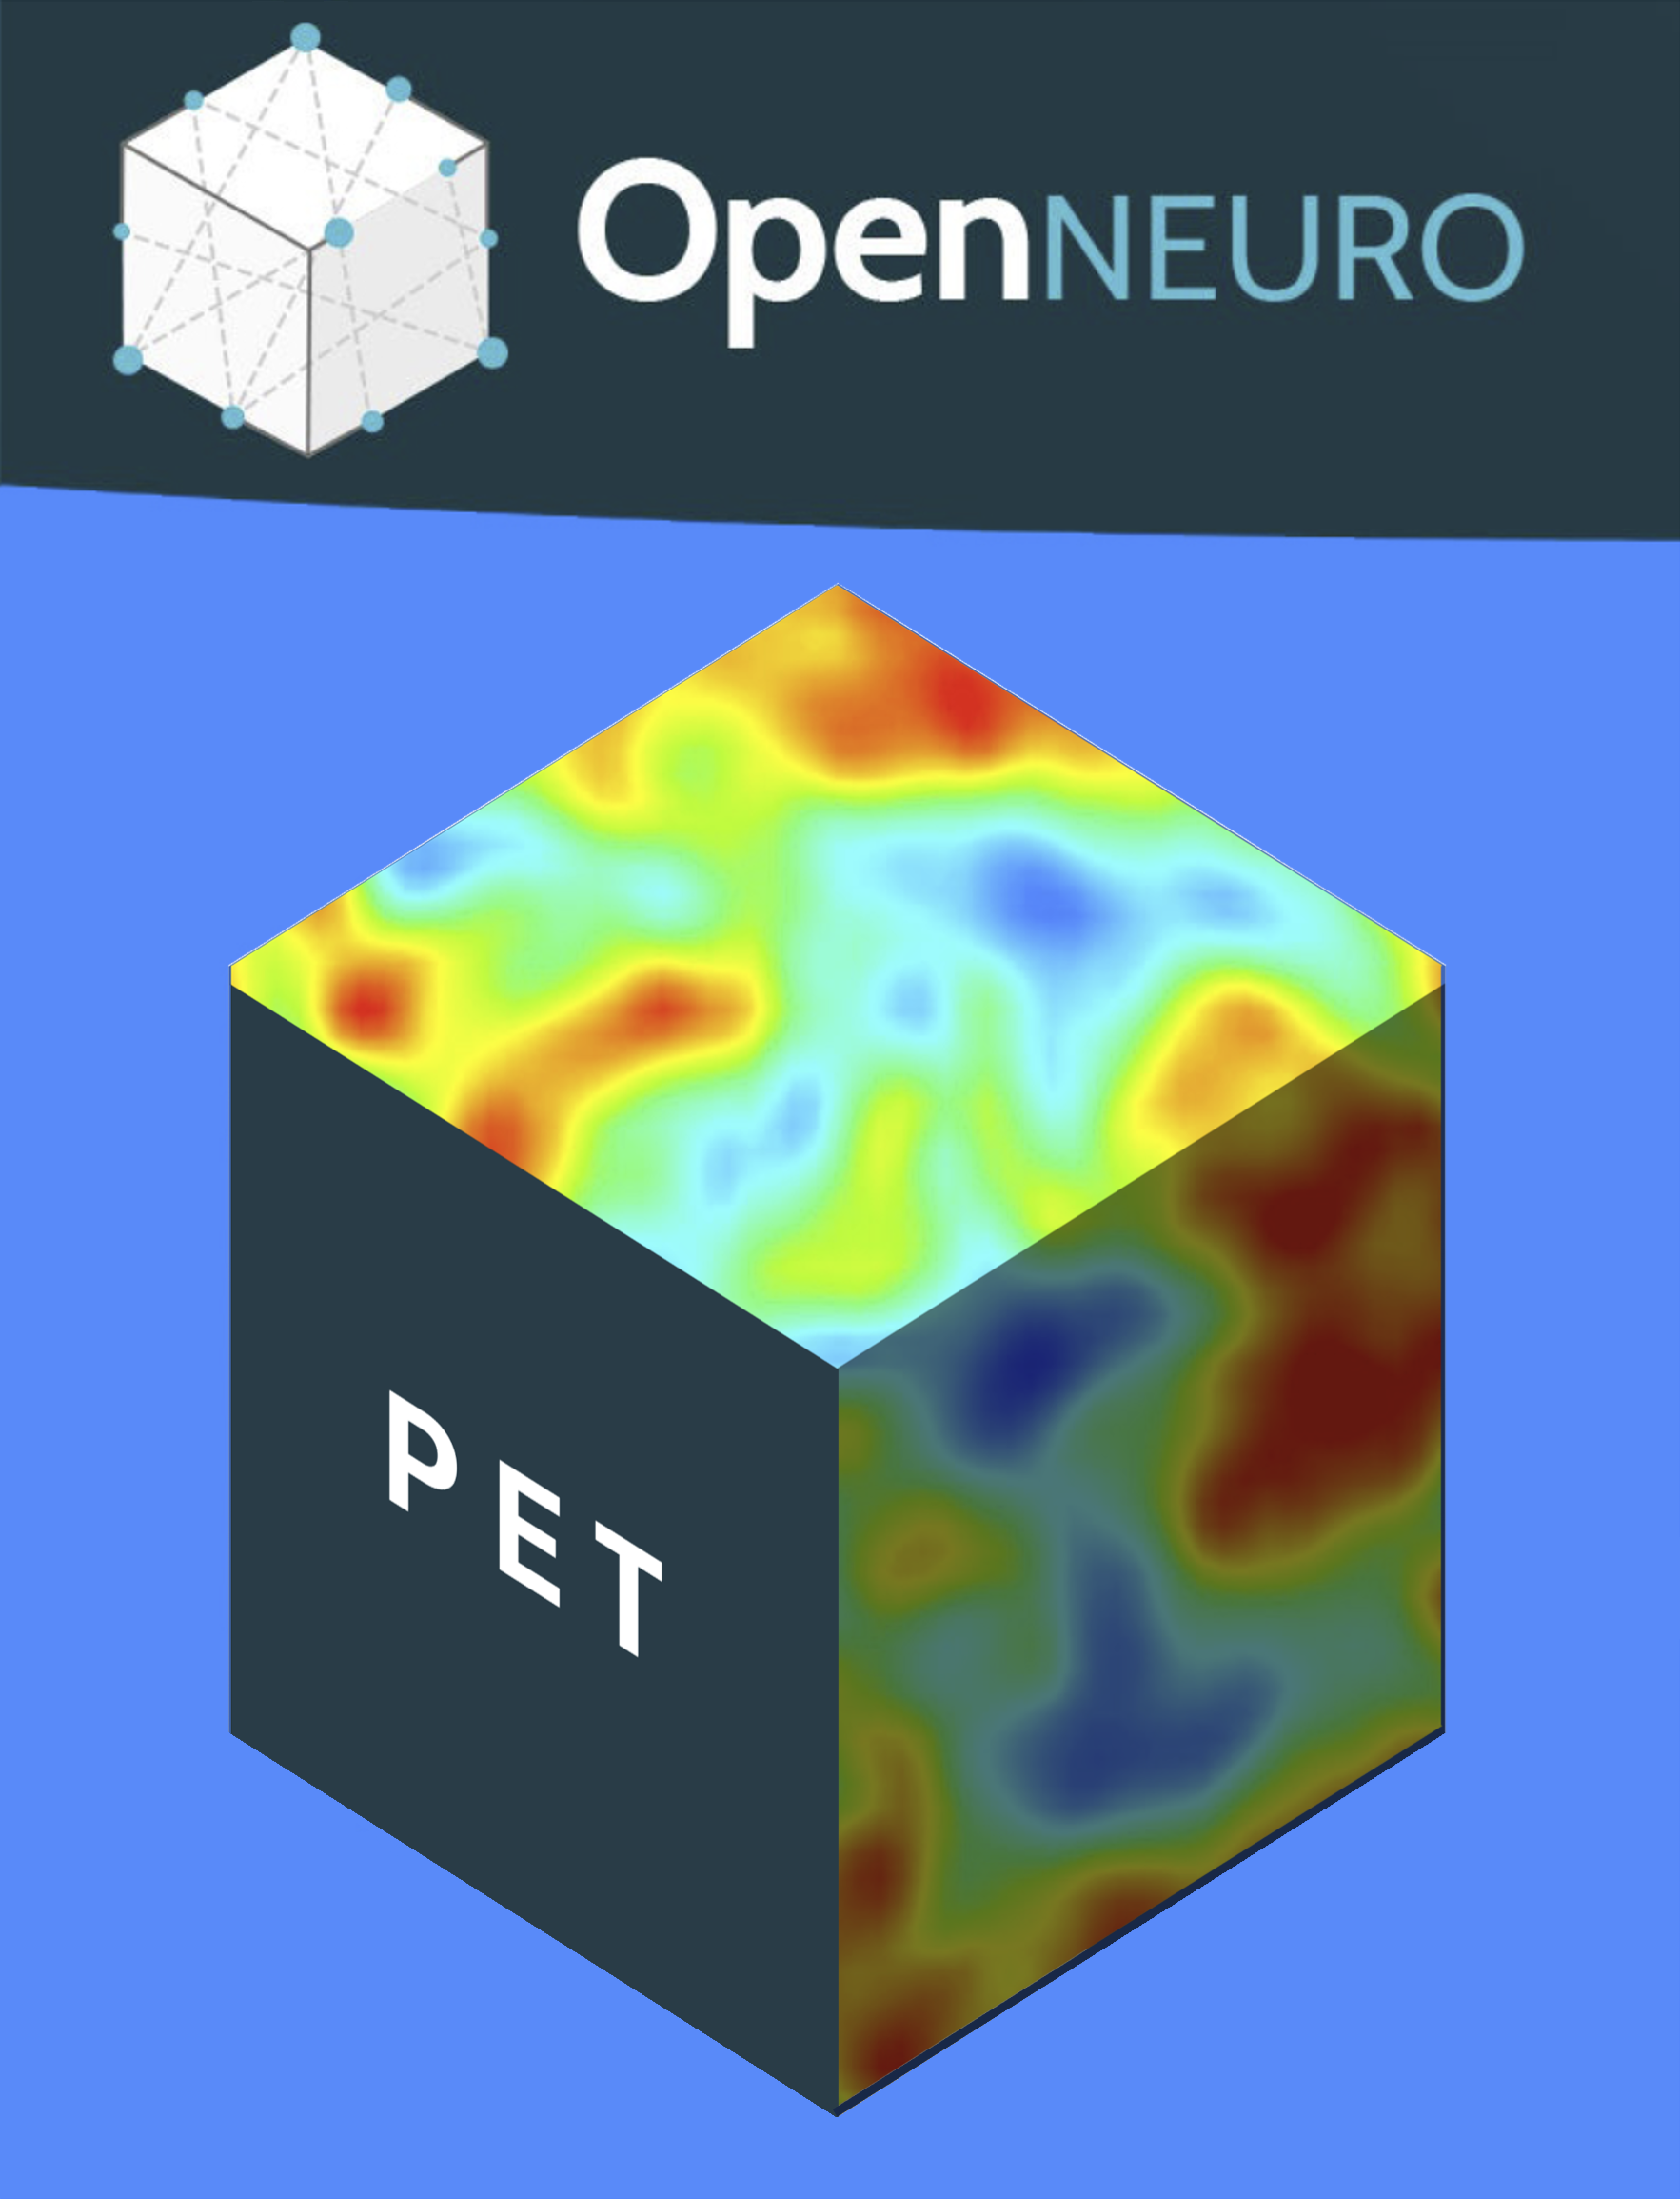





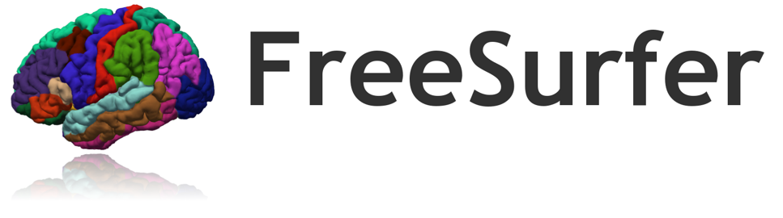
PETsurfer-BIDS: a BIDS App for Voxel- and Vertex-wise Kinetic Modeling of PET Data
Douglas Greve^{1,2} , Paul Wighton^{1,2}, Martin Norgaard^{3,4}, Granville Matheson⁵, Melanie Ganz^{3,6}, Cyril Pernet⁶, Anthony Galassi⁴, Gitte Knudsen^{6,7}, Robert Innis⁴
1 Martinos Center, Massachusetts General Brigham, Boston, MA, USA 2 Harvard Medical School, Boston, MA, USA 3 Department of Computer Science, University of Copenhagen, Denmark 4 Molecular Imaging Branch, National Institute of Mental Health (NIMH), United States 5 Centre for Psychiatry Research, Department of Clinical Neuroscience, Karolinska Institutet & Stockholm Health Care Services, Region Stockholm, Sweden 6 Neurobiology Research Unit, Rigshospitalet, Denmark 7 Department of Clinical Medicine, University of Copenhagen, Denmark

Slide 2
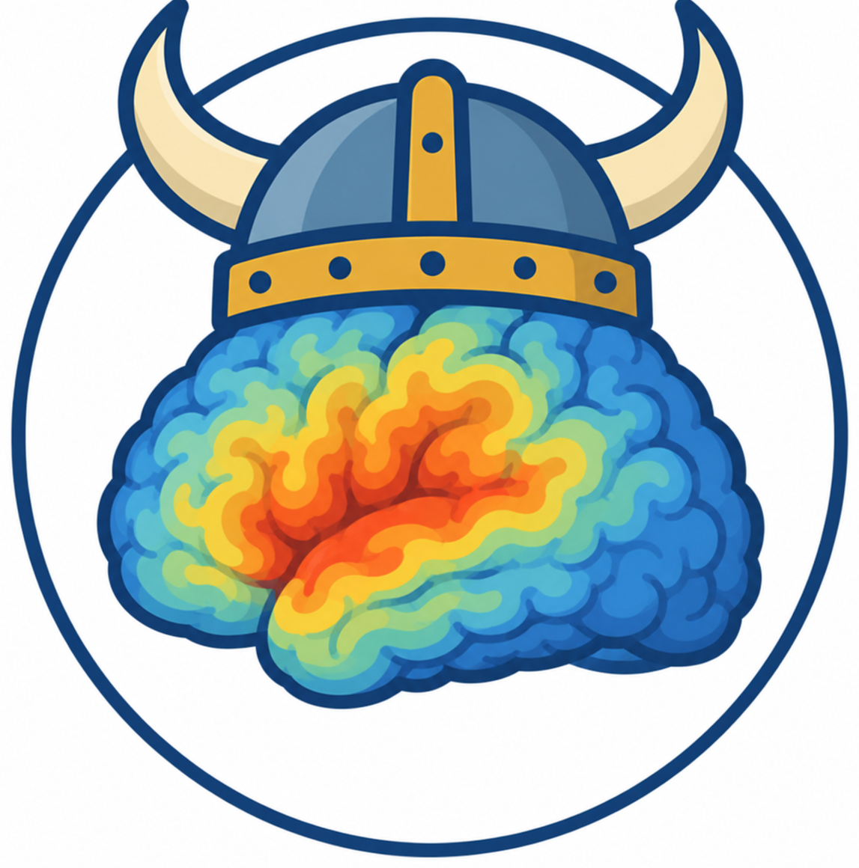
PETsurfer BIDS App Overview
PETsurfer developed in 2014 (FreeSurfer)
Ingests PETprep and Bloodstream BIDS derivatives
Creates BIDS derivatives
Offers voxel-wise KM of PET data
  Volume
  “Pure” Surface
  Easy to use
Benefits of Surface-based Analysis
Individual Analysis in PETsurfer
Group Analysis in PETsurfer

Slide 3
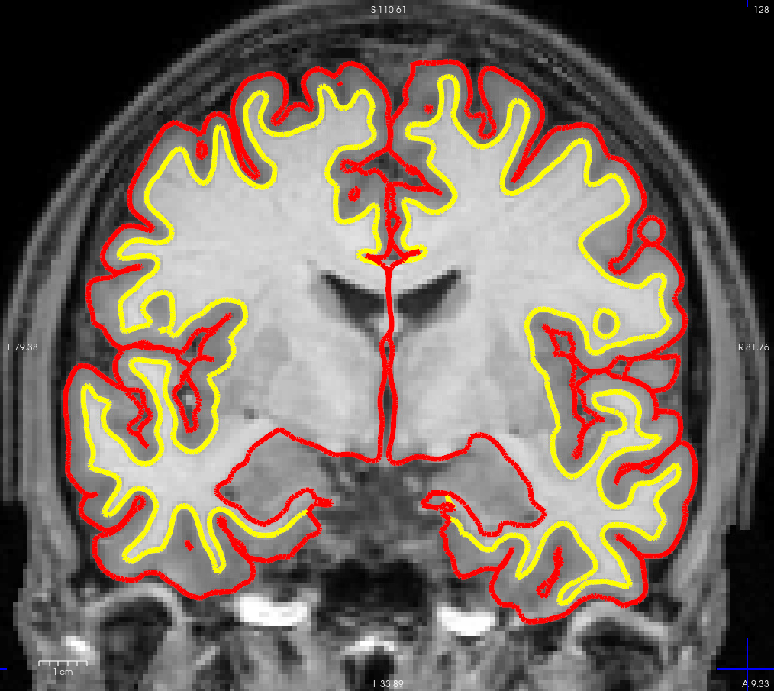
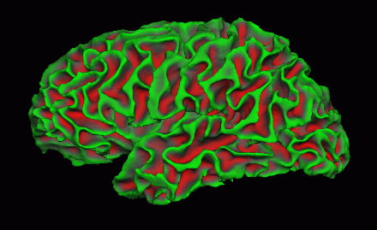
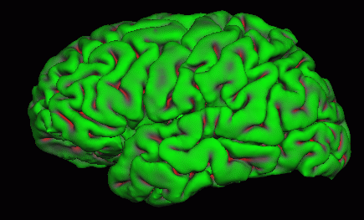
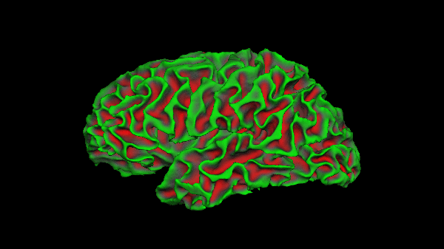
Cortex is a 2D Surface Folded in 3D space
White Surface
Pial Surface
MRI Necessary
3

Slide 4
Benefits of Surface-based Analysis
Visualization of cortical activity and effects
Avoid Adding Partial Volume Effects (PVEs)
  Post-reconstruction smoothing along the surface instead of 3D
  Don’t mix tissue types at group level (vs volume with DARTEL, ANTS FSL, …)
Only valid way to do voxel-wise analysis in cortex with Partial Volume Correction (PVC)
Group Analysis -- better registration of cortex across subjects
Only for cortex (GM) – subcortical still needs traditional volume-based analysis, which can still be done in PETsurfer
PETsurfer can do full whole brain traditional volume-based analysis

Slide 5
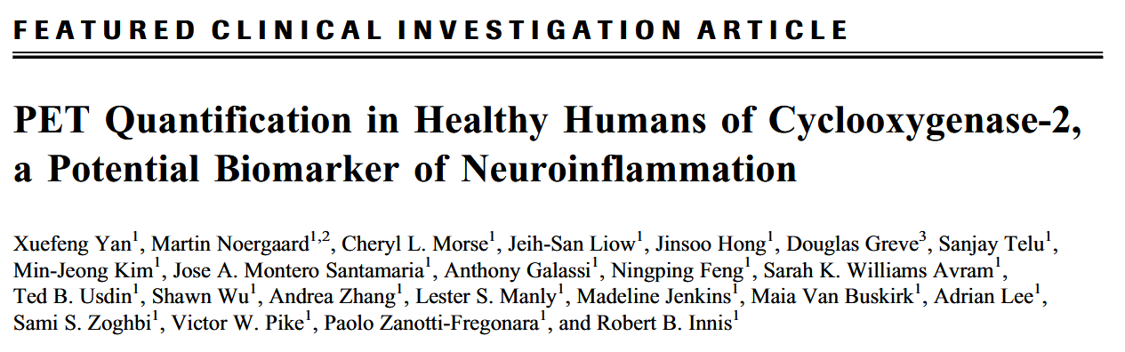
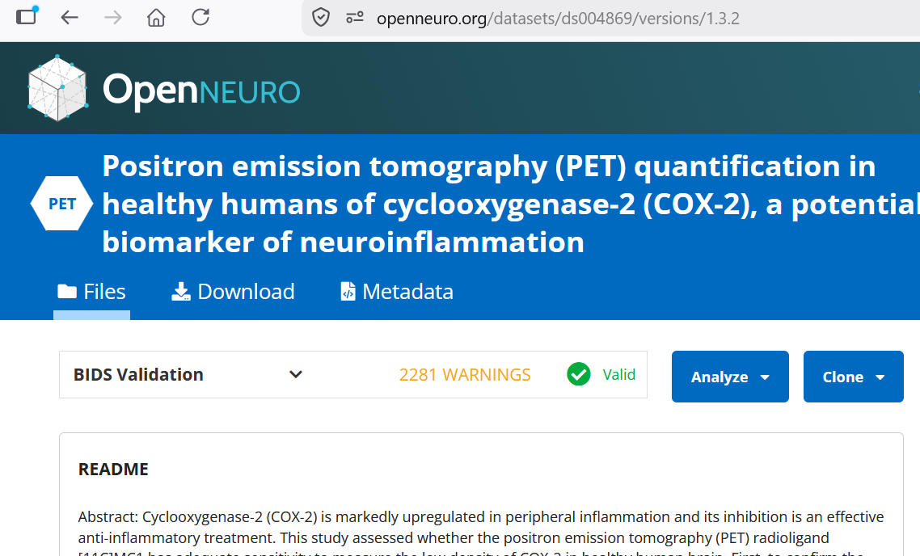
Case Study: Cyclooxygenase-2 (COX-2) [¹¹C]MC1
27 Subjects
10 Subjects
  Baseline
  Blocking
17 Subjects
  Test
  Retest
https://openneuro.org/datasets/ds004869/versions/1.3.2
Journal of Nuclear Medicine Mar 2025, 66 (3) 398-404; DOI: 10.2967/jnumed.124.268525

Slide 6
Case Study: Cyclooxygenase-2 (COX-2) [¹¹C]MC1
Preparation (Once)
Download PETSurfer Container
Download PETsurfer BIDS App
  https://github.com/freesurfer/petsurfer-bids
Get your data into BIDS format
Download from OpenNeuro
  aws s3 sync --no-sign-request s3://openneuro.org/ds004869 cox2-ds004869
Run through PETprep
Run through PETfit/BloodStream (if invasive KM)

Slide 7
Participant/Individual Kinetic Modeling
Original download location
petsurfer-km
cox2-ds004869
cox2-ds004869/derivatives/petsurfer
participant
--surf-fwhm 10
--vol-fwhm 6
--km-method MA1 --tstar 3600
Output Folder
Participant/Individual Level
Preprocessing Options
KM Method and Parameters
Patlak, Logan, MA1, MRTM1, MRTM2
This will run all sessions/time points (baseline, blocked, test, retest) of all participants
All tracers found (Cox2 is MC1)
Volume, surface, and ROI
Download command: aws s3 sync --no-sign-request s3://openneuro.org/ds004869 cox2-ds004869

Slide 8
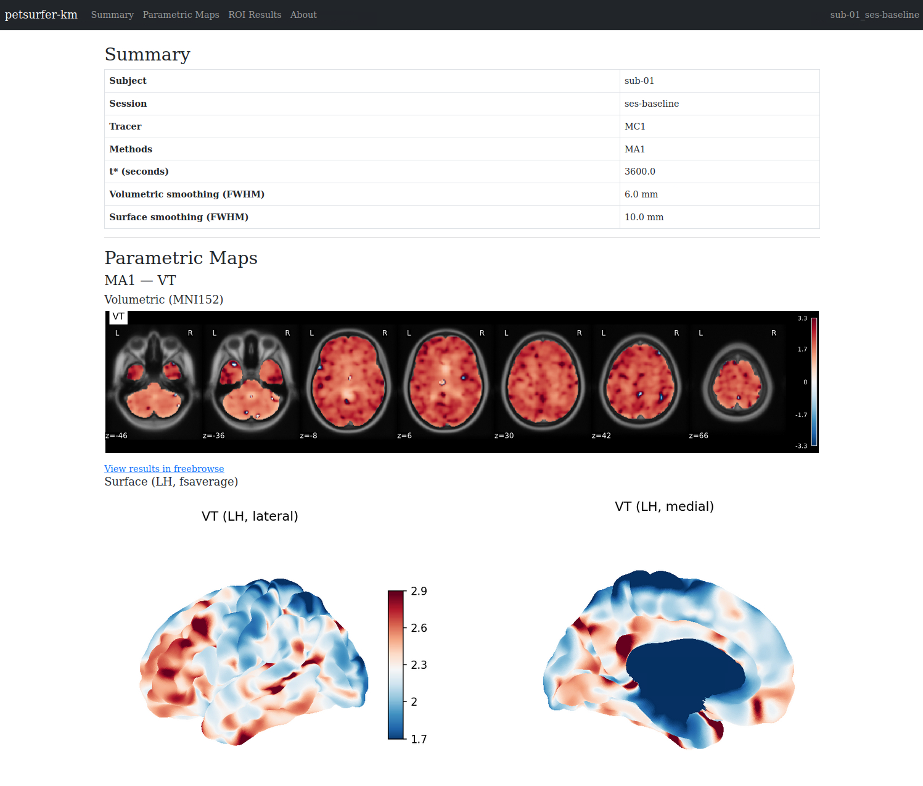
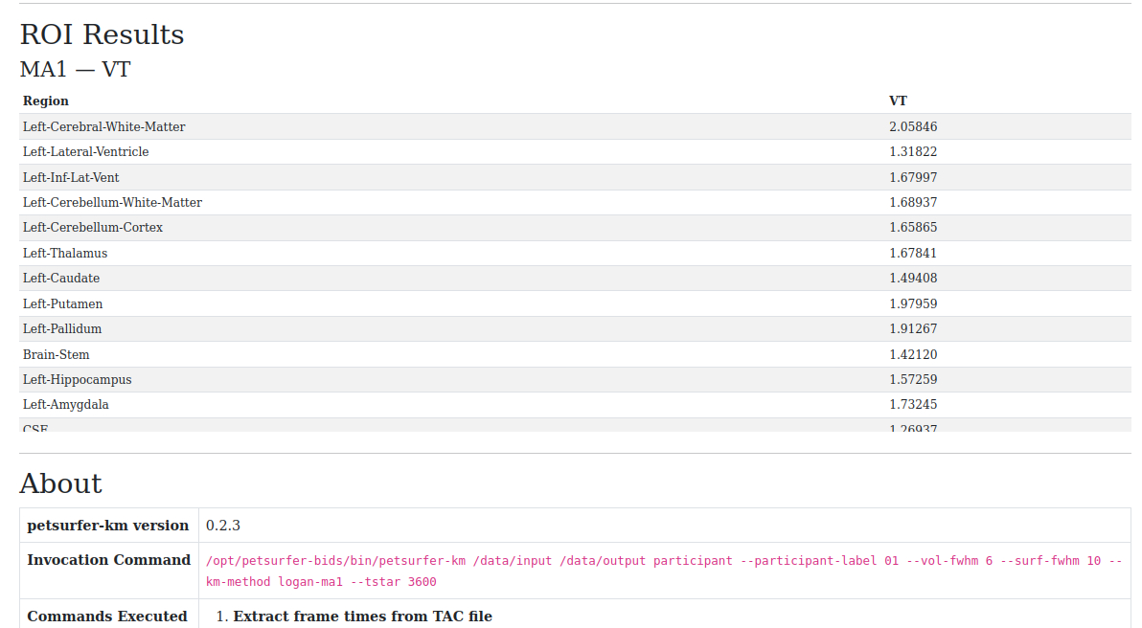
Individual Kinetic Modeling: Summary Web Page

Slide 9
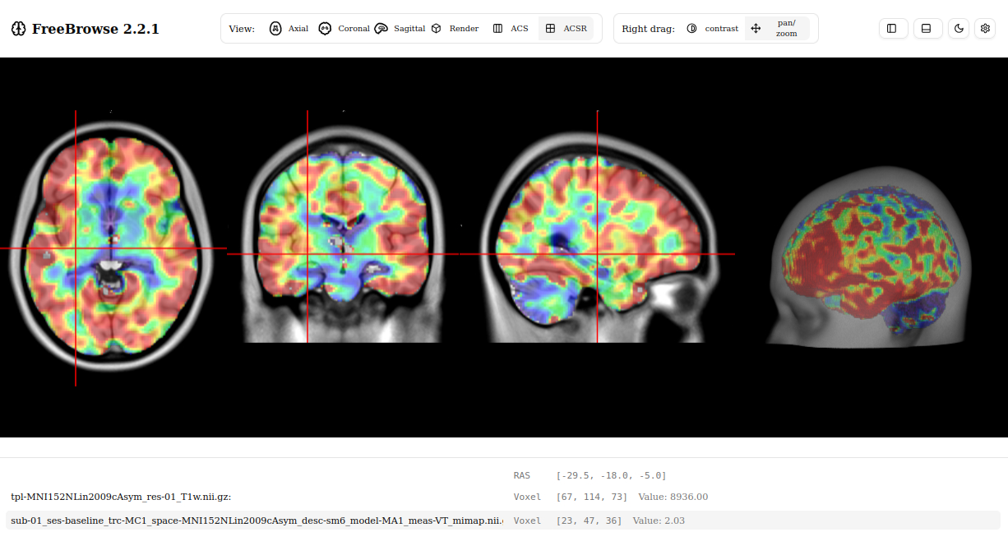
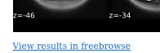
Interactive with FreeBrowse/NiiView
Nothing to install
All data stays local
Acknowledgement to Paul Wighton

Slide 10
Group Analysis
petsurfer-km-group
cox2-ds004869/derivatives/petsurfer
group.analysis
--km-method MA1
--tracer MC1
--spaces fsaverage-lh fsaverage-rh mni ROI
--vol-fwhm 6
--surf-fwhm 10
petsurfer-km
cox2-ds004869
cox2-ds004869/derivatives/petsurfer

Slide 11
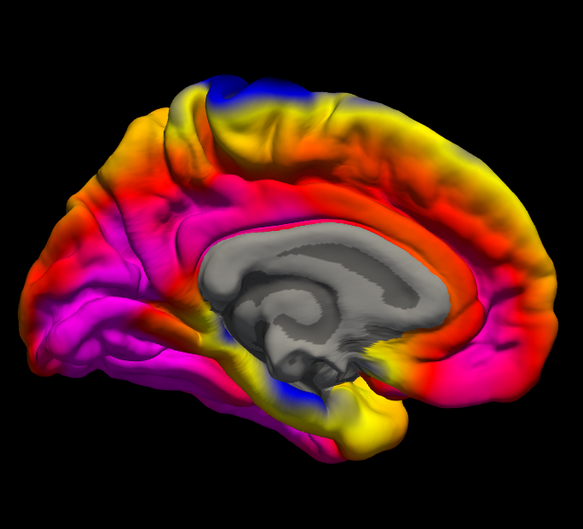
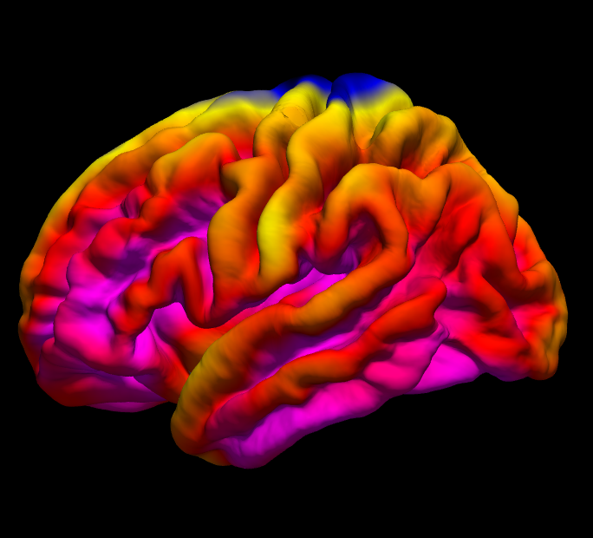
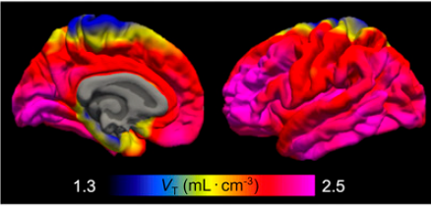
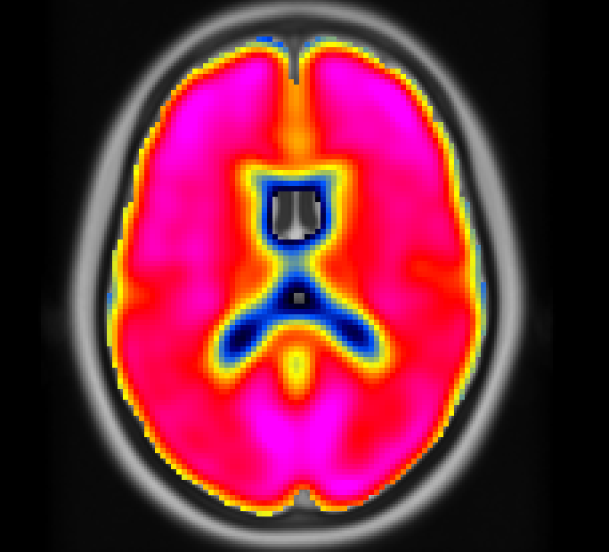
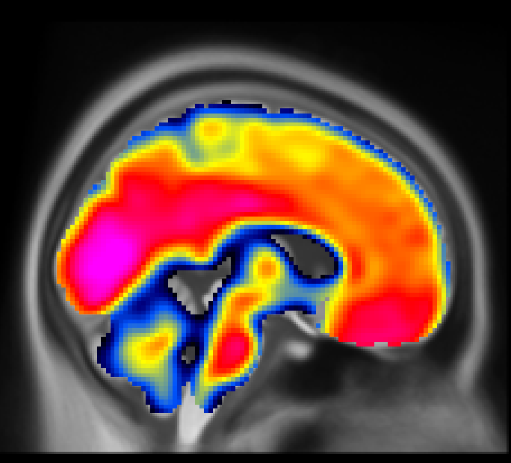
Population Mean Maps of V_{T}
PETsurfer, PETprep, BloodStream
Publication Yan, et al, 2025
Go all the way from BIDS-structured data to publication with 4 BIDS apps

Slide 12
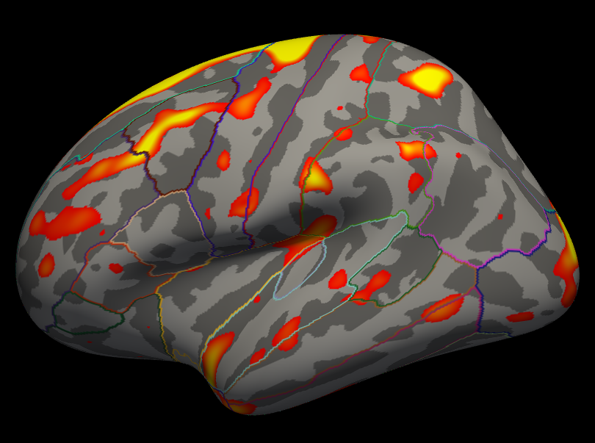
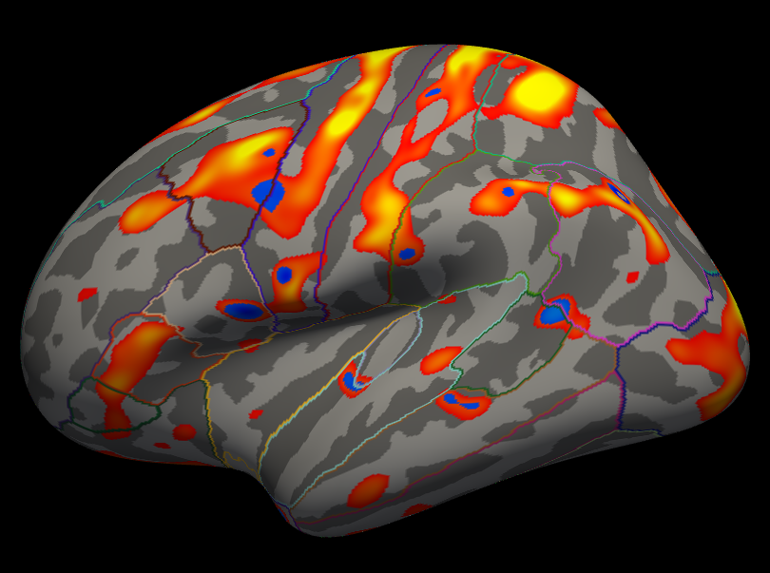
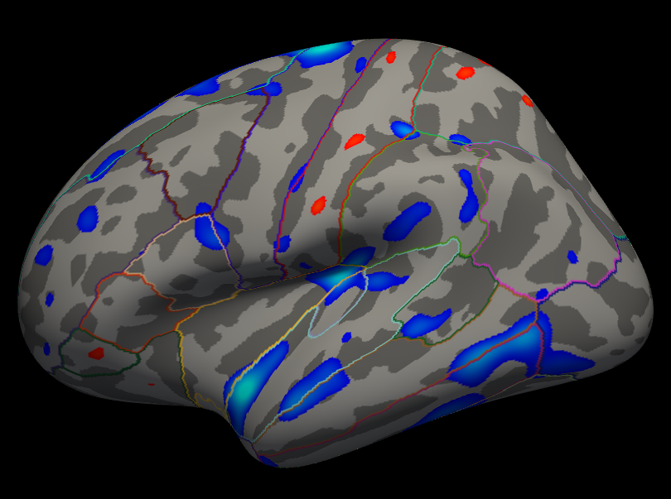
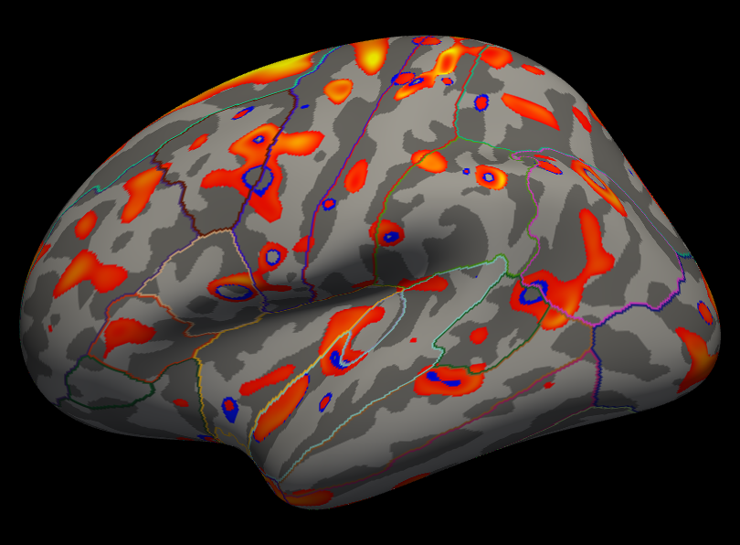
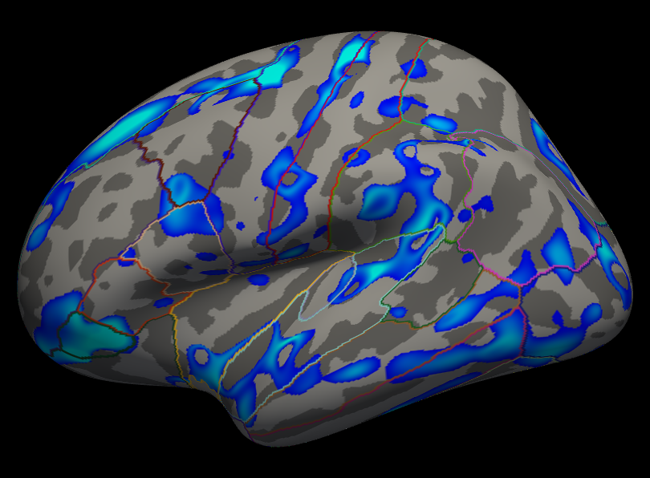
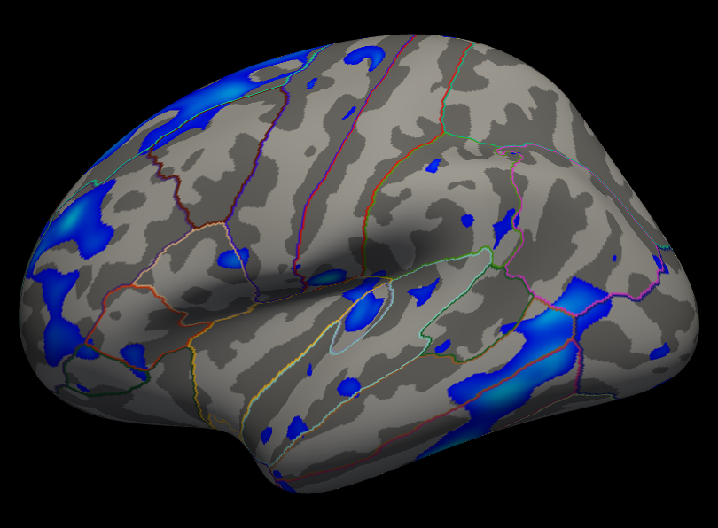
P-value Maps of Group Effects on V_{T}
Age Sex Age-x-Sex
Cross- sectional
(Test N=17)
Longitudinal
(Test-Retest)
Note: thresholds are ridiculously low to show some effects

Slide 13
Group Analysis: Correction for Multiple Comparisons
petsurfer-km-group
cox2-ds004869/derivatives/petsurfer
group.analysis
--km-method MA1
--tracer MC1
--spaces fsaverage-lh fsaverage-rh mni ROI
--vol-fwhm 6
--surf-fwhm 10
--cmc 500 2 abs 2 0.05
Permutation-based Correction for Multiple Comparisons (CMC)
N=500. Cluster-wise. Output table That can be inserted into Results.

Slide 14
Summary: End-to-End Processing with BIDS Apps
PETPrep – motion correction, registration, PVC, resampling to ROI, MNI152, fsaverage
Bloodstream – creates the AIF
PETFit – Advanced ROI analysis (TC models, etc) with web-based configuration
PETsurfer
  Individual KM analysis (ROI, surface, volume) with linear KM analyses (Patlak, Logan, MRTM)
    Web Page + Interactive Map Visualization
  Group Analysis – Population Mean Maps, Elaborate Designs, Longitudinal, Correction for Multiple Comparisons ready for publication

Slide 15
Thanks!
Co-Authors:
Paul Wighton
Martin Norgaard
Granville Matheson
Melanie Ganz
Cyril Pernet
Anthony Galassi
Gitte Knudsen
Robert Innis
NIH Grants
R01EB023281
R01NS083534
R01EB035560
R01AG072056
N95022C00011

Slide 16
End of Presentation

Slide 17
Surface-based Analysis Benefits:
Visualization

Slide 18
Surface-based Analysis Benefits:
Spatial smoothing without PVEs

Slide 19
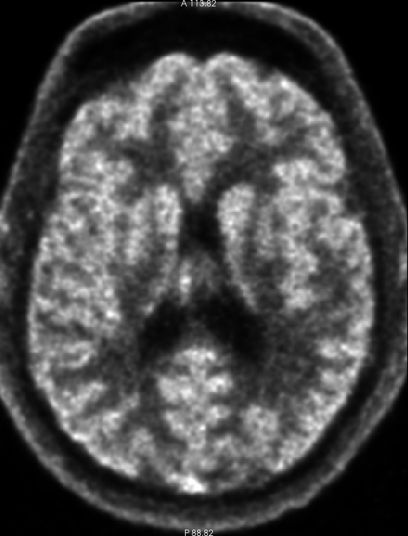
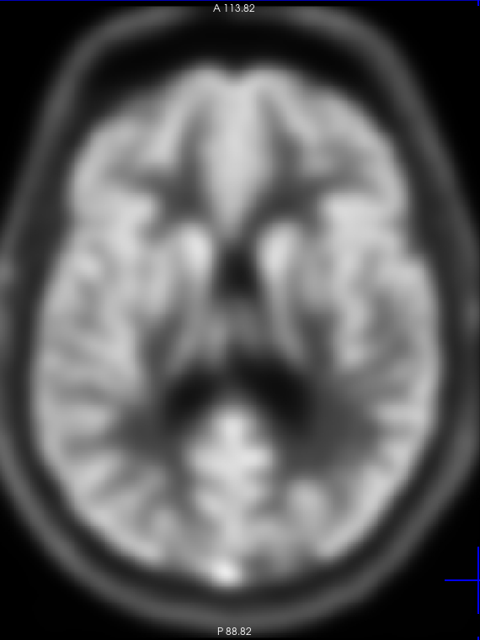
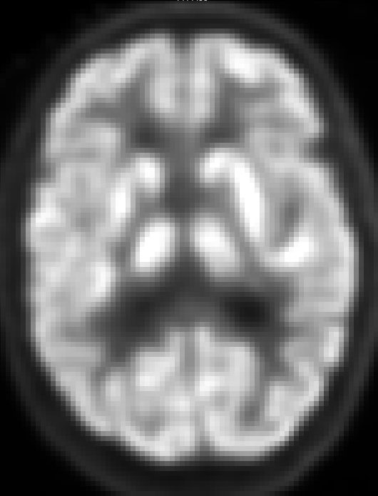
Traditional Volume-based Analysis and Smoothing
Yale NX FDG
~2025
Smoothed by 6mm
Siemens HR+
~1995

Slide 20
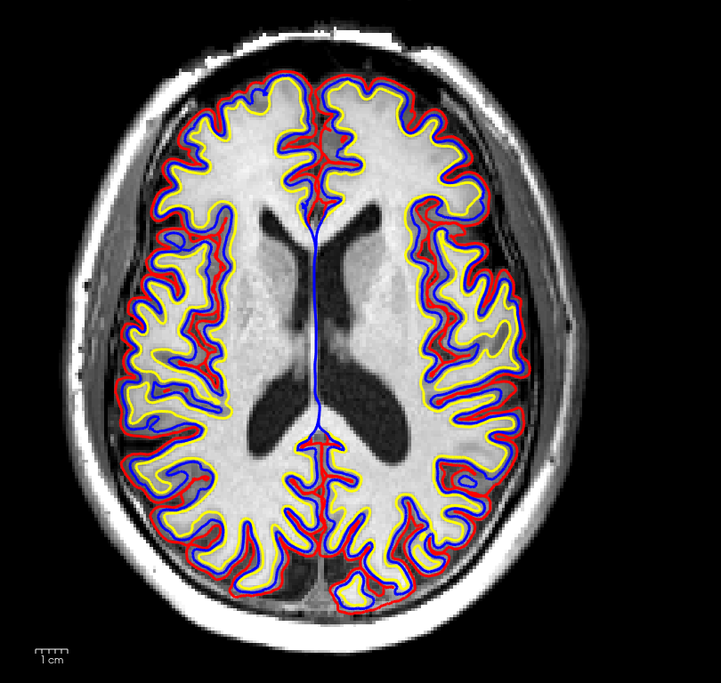
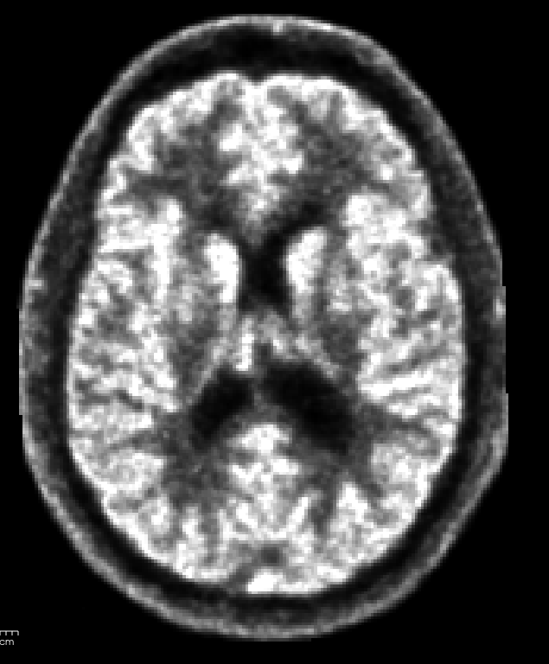
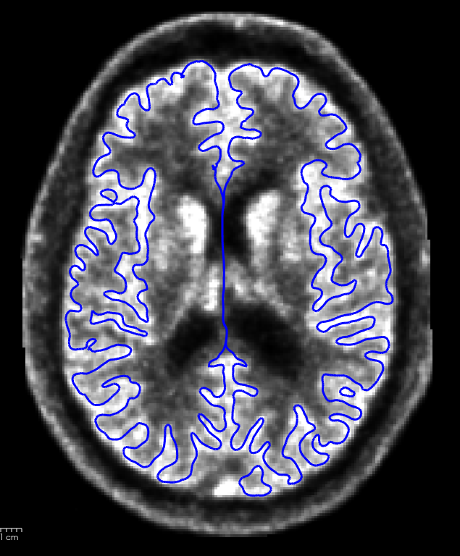
Surface-based Analysis and Smoothing
Blue Line is the middle of the cortical ribbon

Slide 21
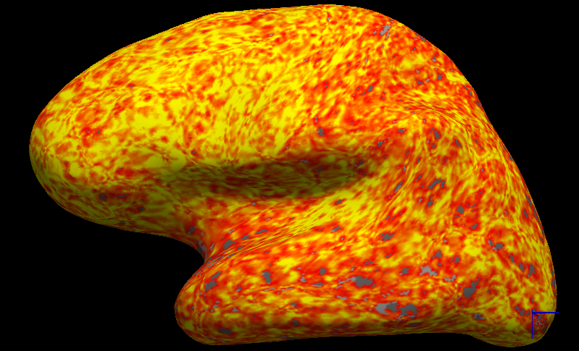
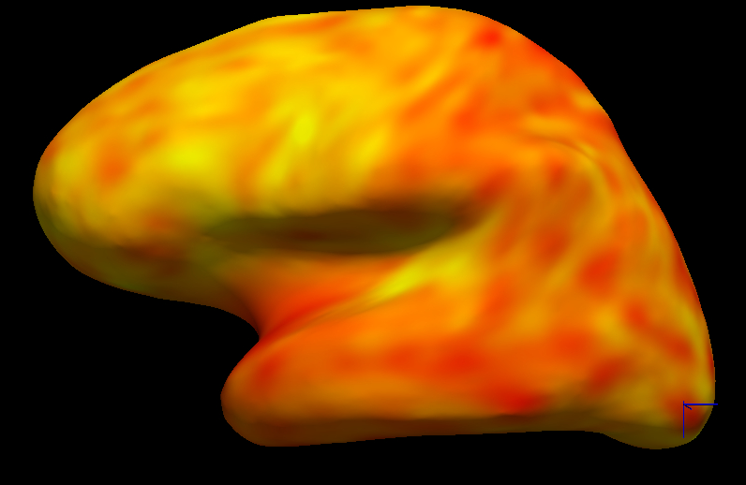
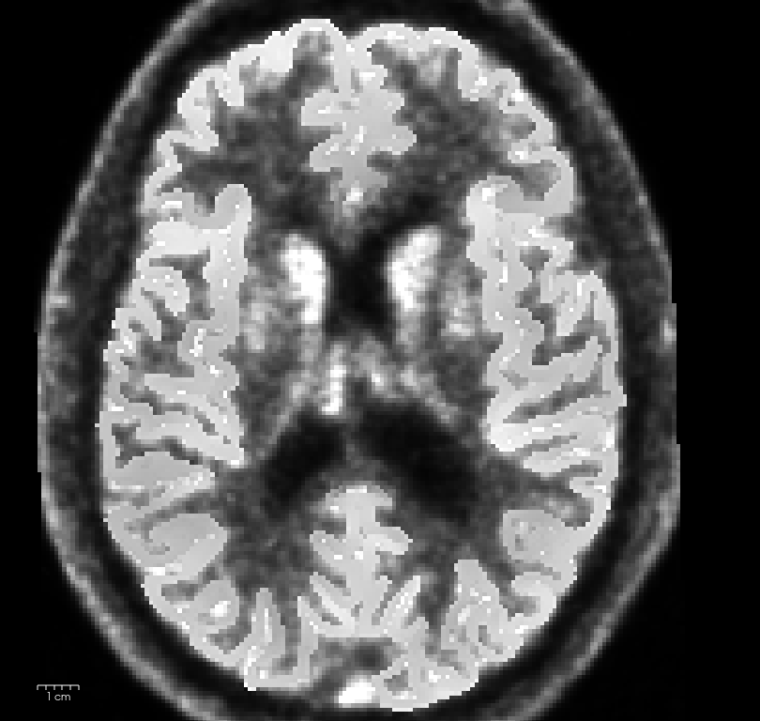
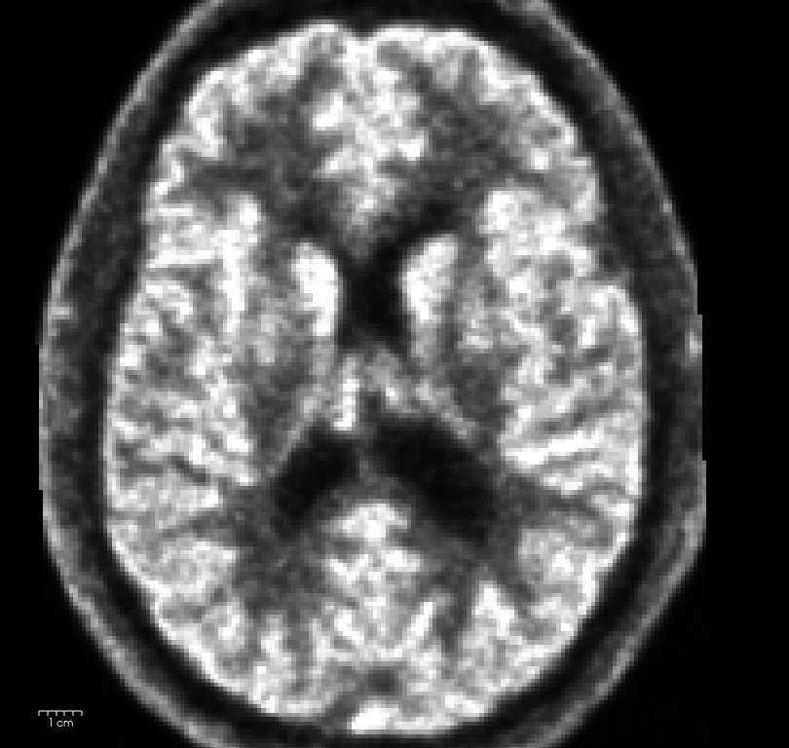
Surface Sampling and Smoothing Without PVEs
Smoothed by 10mm

Slide 22
Surface-based Analysis Benefits:
Inter-Subject Registration

Slide 23
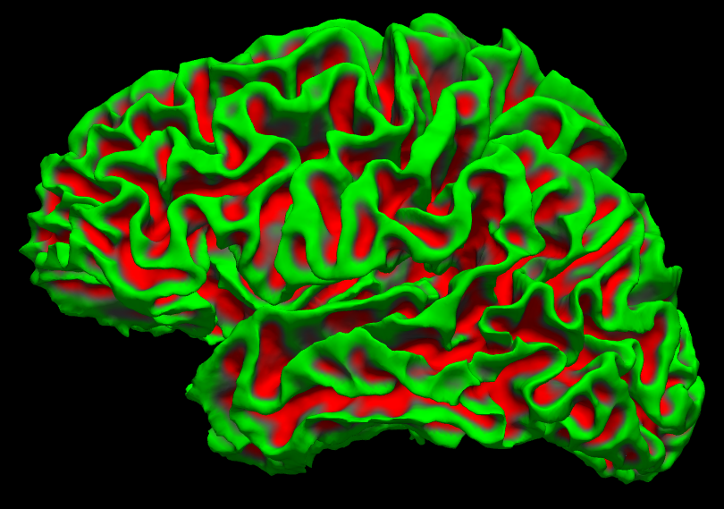
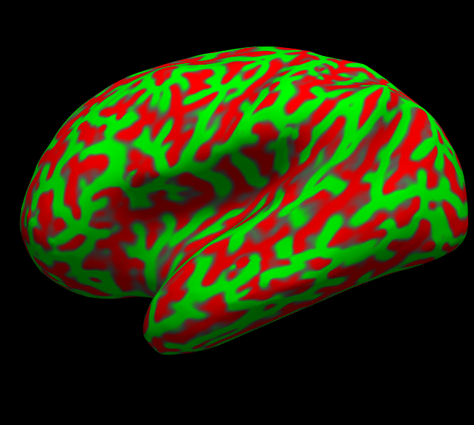
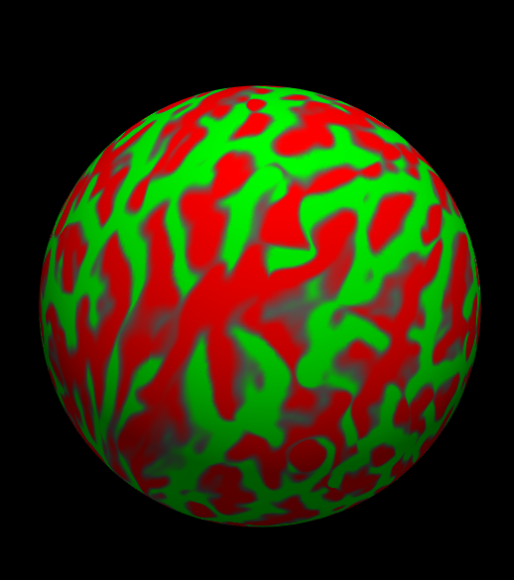
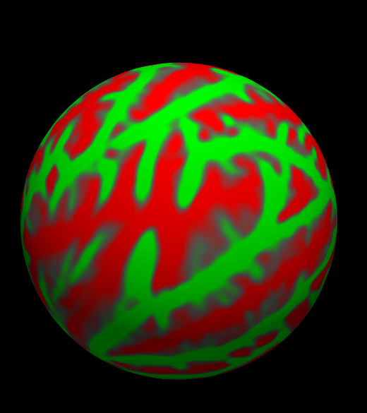
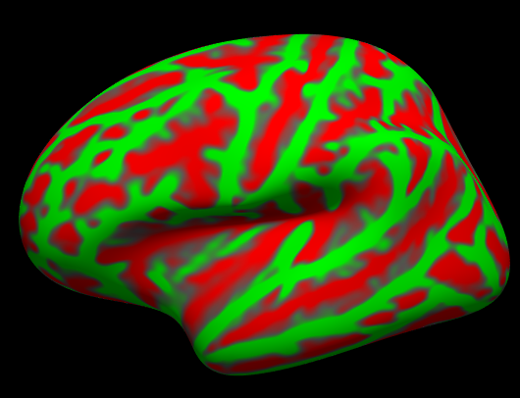
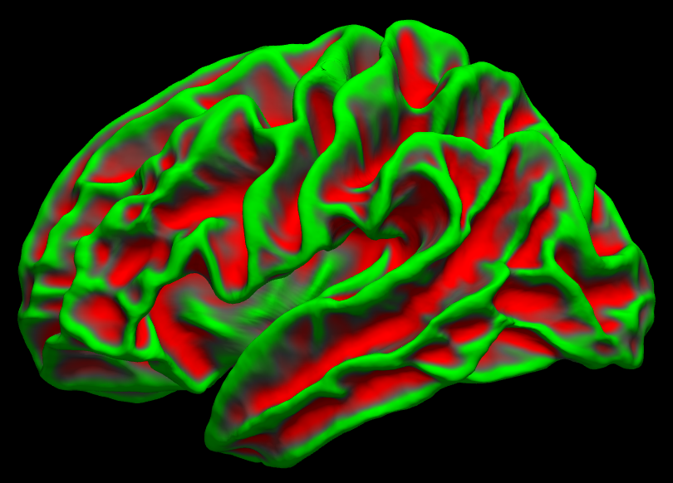
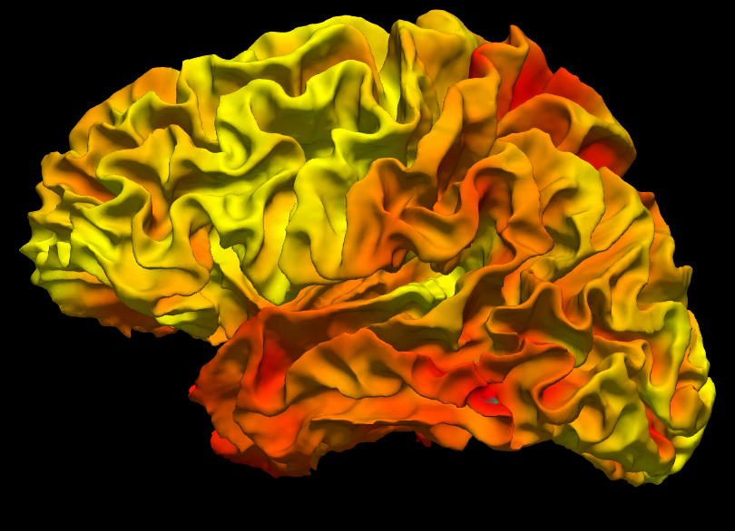
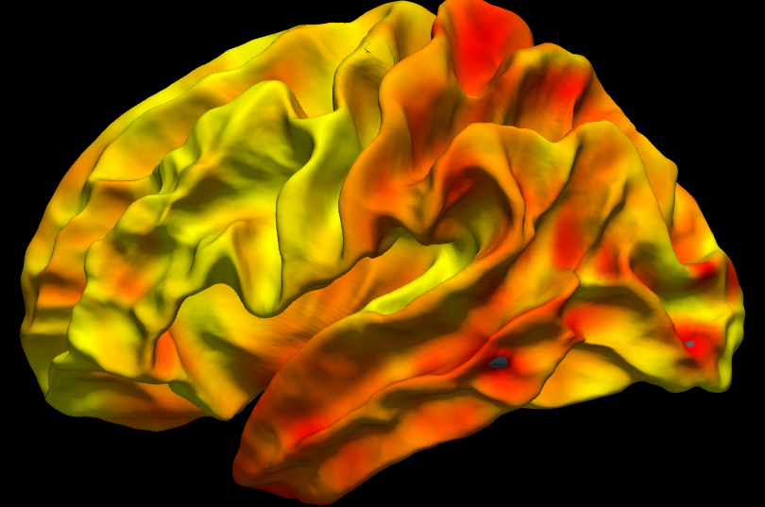
Surface-based Inter-subject Registration
Individual
fsaverage
White Surface
Inflated
Sphere
Sphere
Inflated
White Surface
Registration
Apply
Registration
Yale NX FDG, surface-smoothed by 10mm

Slide 24
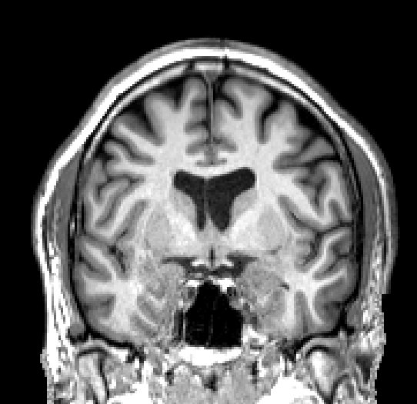
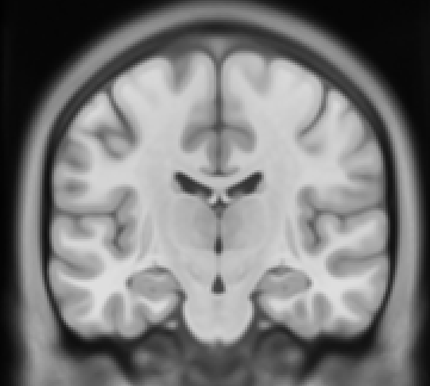
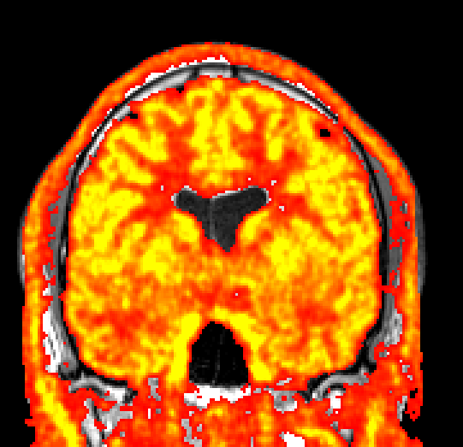
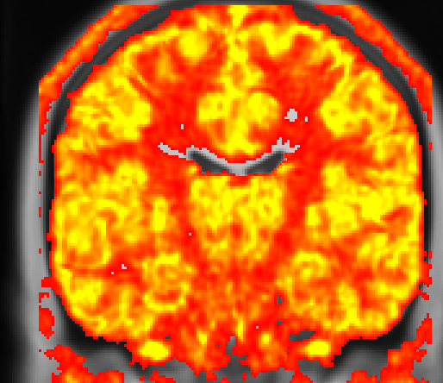
Volume-based Inter-subject Registration
Individual
MNI152
Registration (SynthMorph)
Apply
Registration
Yale NX FDG

Slide 25
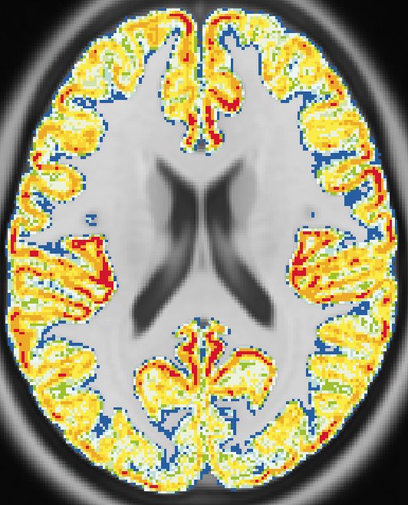
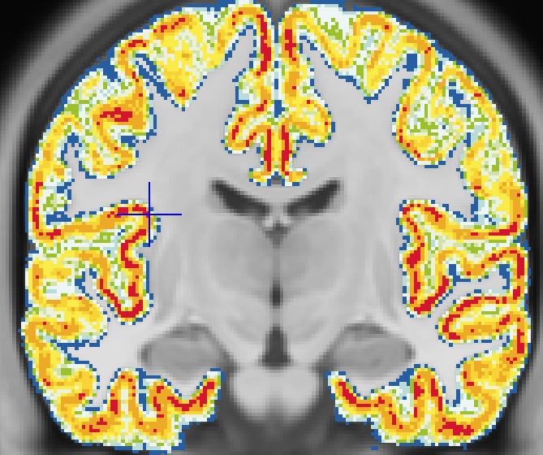
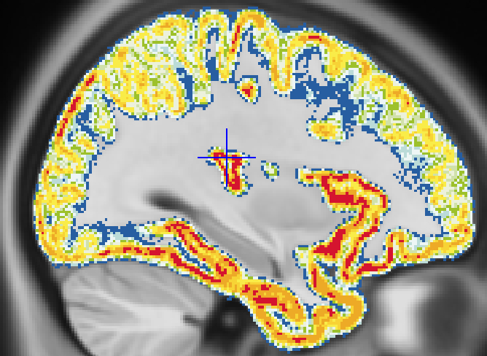
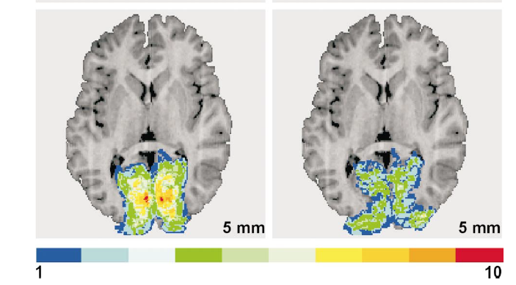
How well does volume-based Inter-subject registration do in cortex?
100%
10%

Slide 26
Benefits of Surface-based Analysis
Visualization of cortical activity and effects
Spatial smoothing without PVEs
Only valid way to do voxel-wise analysis with PVC in cortex
Group Analysis
  Better registration of cortex across subjects
  Gray matter only. Vs volume-based methods (SPM, FSL, ANTS, SynthMorph) will result in GM and WM being at the same voxel.
Only for cortex – subcortical still needs traditional volume-based analysis, which can still be done in PETsurfer

Slide 27
P-value Maps of Group Effects on V_{T}
Age Sex Age-x-Sex
Note: thresholds are ridiculously low to show some effects

Slide 28

Group Analysis of KM: Longitudinal
apptainer run

Slide 29
Surface-based Analysis and Smoothing
Yale NX FDG
Smoothed by 6mm

Slide 30

Case Study: Cyclooxygenase-2 (COX-2) [11C]MC1
27 Subjects
10 Subjects
  Baseline
  Blocking
17 Subjects
  Test
  Retest
https://openneuro.org/datasets/ds004869/versions/1.3.2
Journal of Nuclear Medicine Mar 2025, 66 (3) 398-404; DOI: 10.2967/jnumed.124.268525

Slide 31

Case Study: Cyclooxygenase-2 (COX-2) [11C]MC1
Preparation
Download from OpenNeuro
  aws s3 sync --no-sign-request s3://openneuro.org/ds004869 cox2-ds004869
Run through PETPrep
Run through KinFitr/BloodStream (if invasive KM)
Container
  PETsurfer BIDS App
  https://github.com/freesurfer/petsurfer-bids

Slide 32
Population Mean Maps of V_{T}
PETsurfer, PETprep, BloodStream
Publication Yan, et al, 2025
Go all the way from BIDS-structured data to publication with 4 BIDS apps

Slide 33
Benefits of Surface-based Analysis
Visualization of cortical activity and effects
Spatial smoothing without adding Partial Volume Effects (PVEs)
Only valid way to do voxel-wise analysis in cortex with Partial Volume Correction (PVC)
Group Analysis
  Better registration of cortex across subjects
  Gray matter only. No PVEs at the group level. Vs volume-based methods (SPM, FSL, ANTS, SynthMorph) will result in GM and WM being mixed.
Only for cortex – subcortical still needs traditional volume-based analysis, which can still be done in PETsurfer
PETsurfer can do full whole brain traditional volume-based analysis

