Slide 1


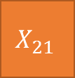
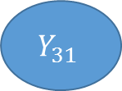
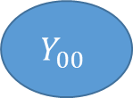

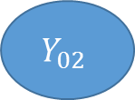
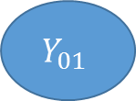





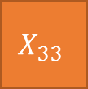




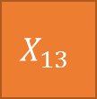

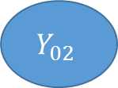
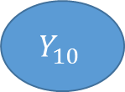
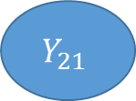



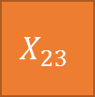

$$X_{00}$$
$$Y_{00}$$
$$X_{01}$$
$$Y_{01}$$
$$X_{02}$$
$$Y_{02}$$
$$X_{03}$$
$$X_{10}$$
$$Y_{10}$$
$$X_{11}$$
$$Y_{01}$$
$$X_{12}$$
$$Y_{02}$$
$$X_{13}$$
$$X_{20}$$
$$Y_{20}$$
$$X_{21}$$
$$Y_{21}$$
$$X_{22}$$
$$Y_{22}$$
$$X_{23}$$
$$X_{30}$$
$$Y_{30}$$
$$X_{31}$$
$$Y_{31}$$
$$X_{32}$$
$$Y_{02}$$
$$X_{33}$$

Slide 2

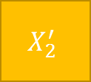
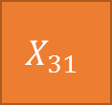

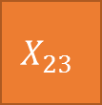





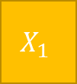

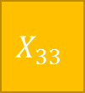

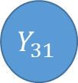


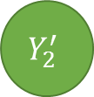
Step 1
$$X_{00}$$
$$X_{03}$$
W
$$X_{1}$$
$$Y$$
$$X_{10}$$
$$X_{13}$$
R
$$X_{33}$$
$$Y_{2}^{′}$$
$$X_{2}^{′}$$
$$Y$$
$$X_{20}$$
$$X_{23}$$
Step 2(Collision Detection)
?
$$X_{30}$$
$$Y_{30}$$
$$X_{31}$$
$$Y_{31}$$
$$X_{30}$$
$$X_{33}$$
Step 3

Slide 3
Cycle
Merge

Slide 4
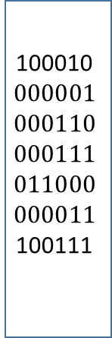
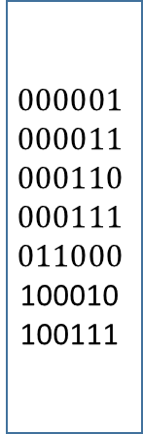
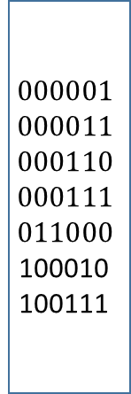
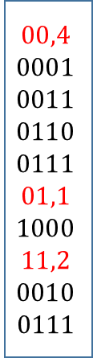
End Points
Index Table
100010
$$000001$$
$$000110$$
$$000111$$
$$011000$$
$$000011$$
100111
$$000001$$
$$000011$$
$$000110$$
$$000111$$
$$011000$$
100010
100111
$$00,4$$
$$0001$$
$$0011$$
$$0110$$
$$0111$$
$$01,1$$
$$1000$$
$$11,2$$
$$0010$$
0111
$$000001$$
$$000011$$
$$000110$$
$$000111$$
$$011000$$
100010
100111
sort
Gen
Re
Gen
Online

Slide 5
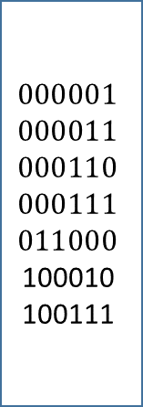
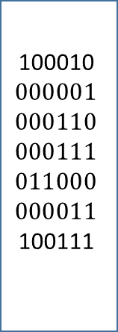
Pseudo-End Points
100010
$$000001$$
$$000110$$
$$000111$$
$$011000$$
$$000011$$
100111
$$000001$$
$$000011$$
$$000110$$
$$000111$$
$$011000$$
100010
100111
Pre-computed Table
sort
Collision
Detect

