Slide 1

Car sales drop
Wich factors explain the car sales drop in the year 2020 and how affect that fact to the US car makers.

Slide 2
Does covid determine car sales in year 2020?
As COVID cases increased…

Slide 3
Questions:
1 – Is COVID affecting directly car sales in 2020?
2 – Is the general economic situation affecting car sales in 2020?
3 – Are the low interest rates affecting the car sales in 2020?
3 – Is every car maker in every price segment dropping sales in 2020?
4 – How is the behavior of the car makers in the stock market related with car sales?

Slide 4
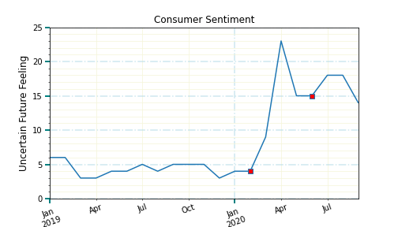
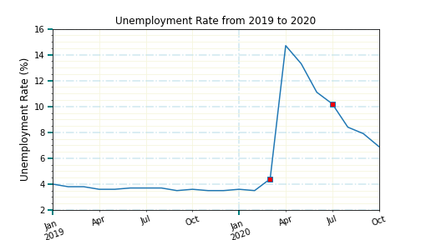
General situation Unemployment vs consumer sentiment
Unemployment Rate
Consumer Sentiment
Uncertain Future
Michigan University Survey

Slide 5
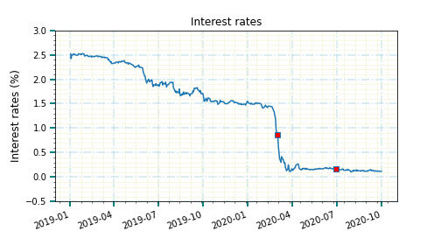
Are the low interest rates affecting car sales? Usually, car sales increased when interest rates are low
Interest Rates 2019-2020
Car sales

Slide 6
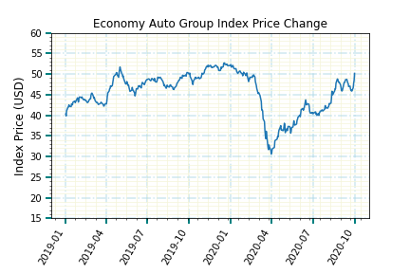
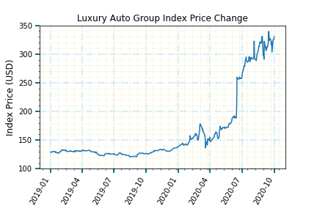
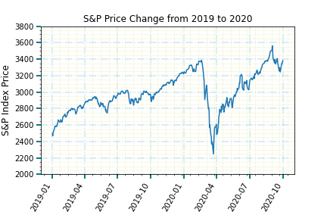
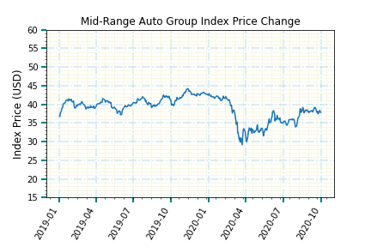
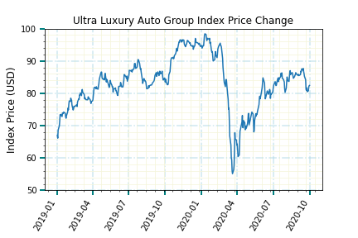
Ultra-Luxury Auto Groups Tracked the S&P 500 performance the best…implying that the stock market is a driving factor in their success. Tesla’s sales skyrocketed their stock price and pulled the luxury index from flat performance to outpacing the S&P.

Slide 7
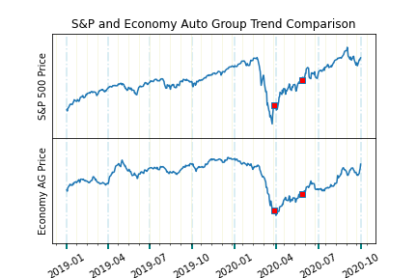
S&P 500 index vs Economy Auto Group index
Implications and observations:
Tracks the S&P closely with slightly less volatility.
Stimulus package on March 27, 2020 (red square) brightened the investor outlook.
Hitting 100,000 COVID deaths on May 27, 2020 (indicated by 2nd red square) had little effect on stock price.
Implication is that investors had a positive outlook on the near future of economy vehicle sales by companies like Hyundai and Kia.

Slide 8
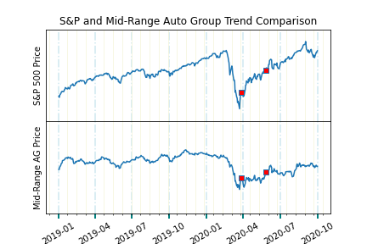
S&P 500 index vs Mid-Range Auto Group index
Implications and observations:
Mid-Range Auto Groups like Ford and Toyota did not enjoy the same rise in stock prices but suffered less severely when the pandemic hit.
Stimulus package on March 27, 2020 (red square) had less effect on Mid-Range Auto Groups.
Hitting 100,000 COVID deaths on May 27, 2020 (indicated by 2nd red square) flattened auto group stock prices.
Implication is that investors had a less positive outlook on the near future of this vehicle segment’s buyers.

Slide 9
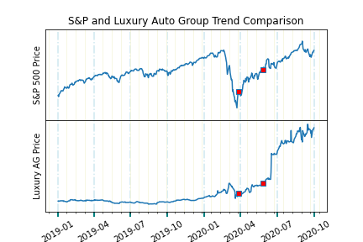
S&P 500 index vs Luxury Auto Group index
Implications and observations:
Luxury Auto Groups like Mercedes and BMW initially look like nothing stood in the way of luxury cars rolling onto the roads... but this is misleading. Tesla sales skyrocketed their stock price and drove the luxury index from flat performance to outpacing the S&P. While relatively flat throughout 2018 and 2019 the stock has increased in value ten times over. This has dominated the index and other broad economic factors though a flattening in the slope is observed in April through June.

Slide 10
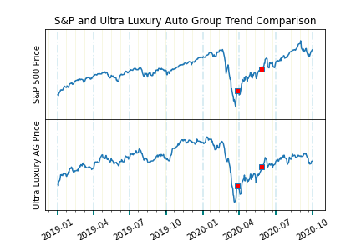
S&P 500 index vs ULTRA Luxury Auto Group index
Implications and observations:
Interestingly, ultra luxury auto groups like Porsche, Ferrari, and McLaren tracked the stock market the most closely of the four segments and only marginally better than Economy auto groups. This implies that stock market performance may factor into car sales which, in turn, supports stock price.

Slide 11




Team 6 Analysts
Luis Fernando Ruiz delves into government data and highlights what we need to know.
Phillecia Qualls is our automotive sector guru and keeps an eye on who is in front of the pack and who has been left on the side of the road.
Team 6 Analytical Group uses data to explain how world and national events affect the financial markets.
Contact us for your next research project.
Karen Pearson is our healthcare sector guru and offers us a prognosis of the factors and the players in this space.
Dana Woodruff tracks the stock market’s reactions to news and events… what happened and why.

