Slide 1
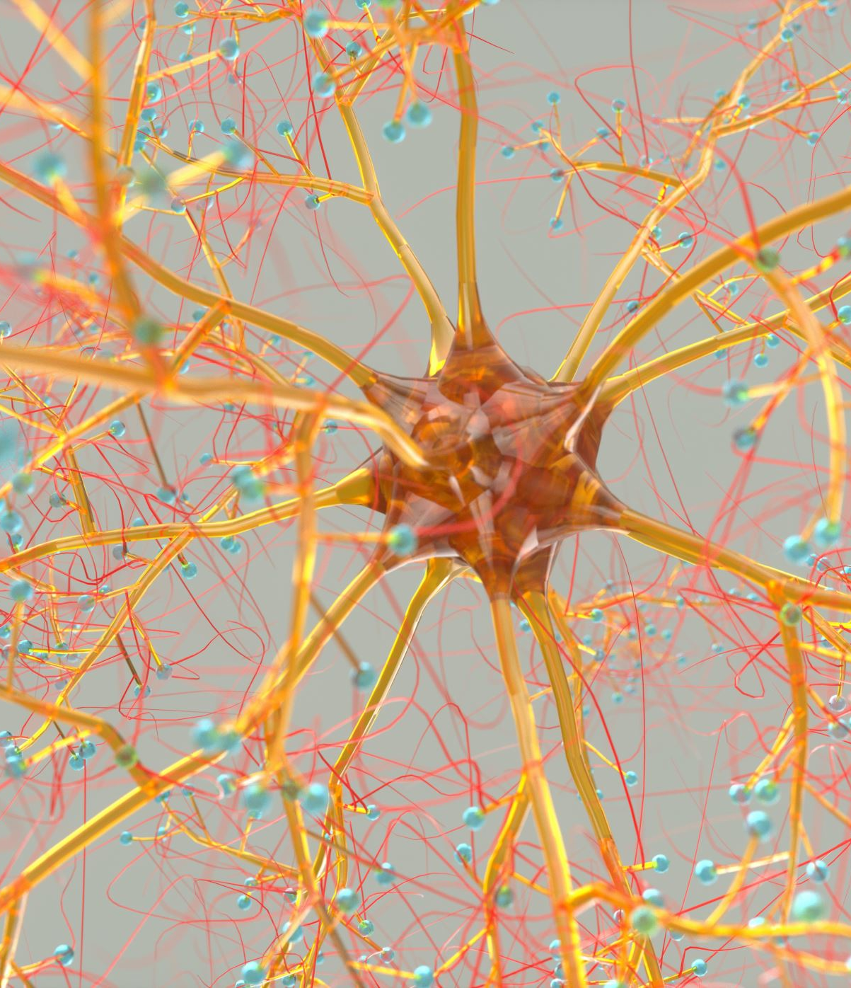

Slide 2
Introduction points
Car manufacturers live and die on consumer sentiment and the consumers ability to buy a car…

Slide 3
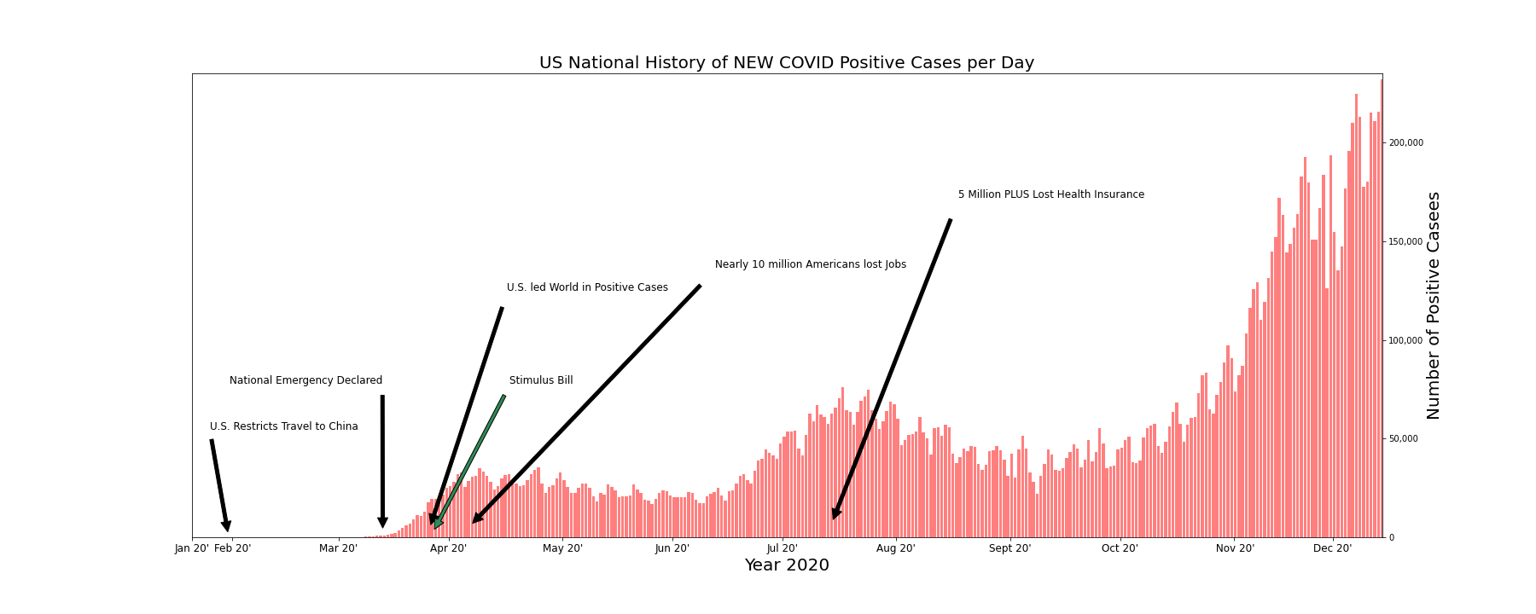

Slide 4
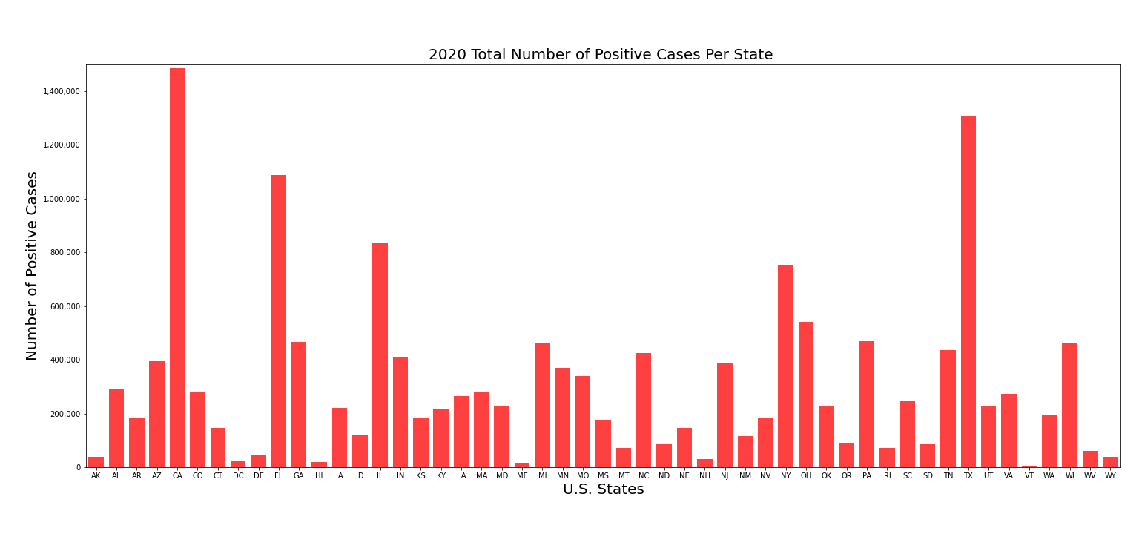

Slide 5
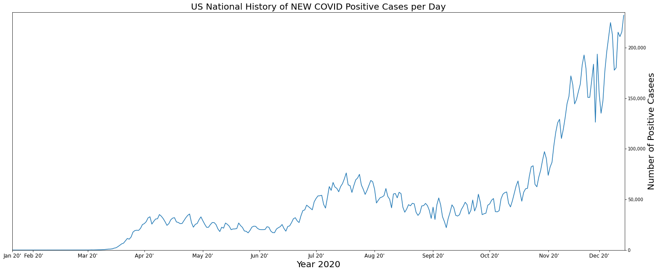

Slide 6
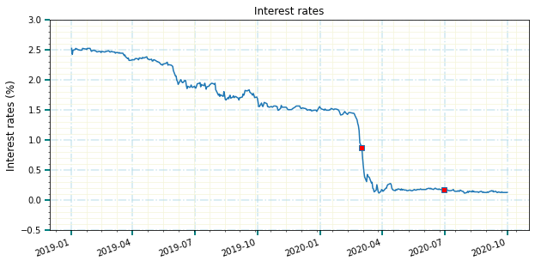

Slide 7
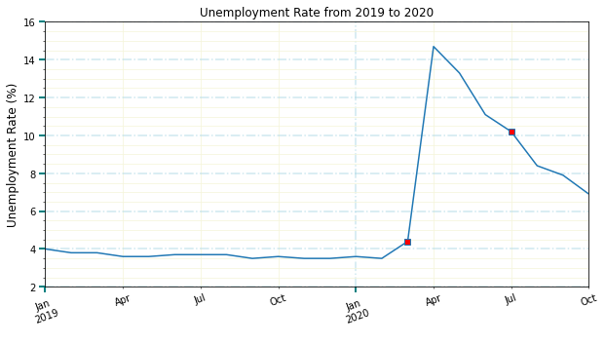

Slide 8
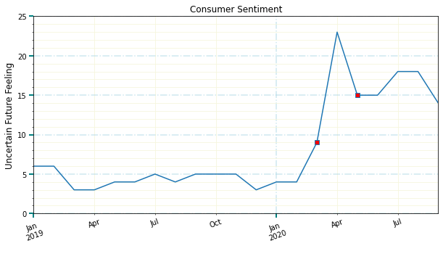

Slide 9
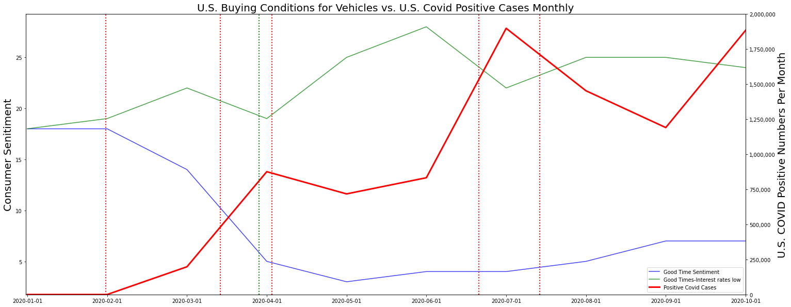

Slide 10
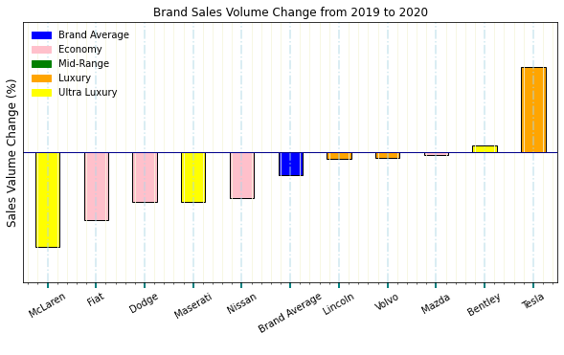

Slide 11
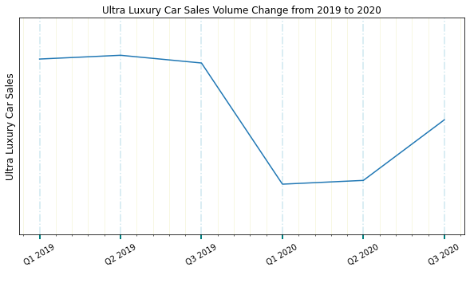
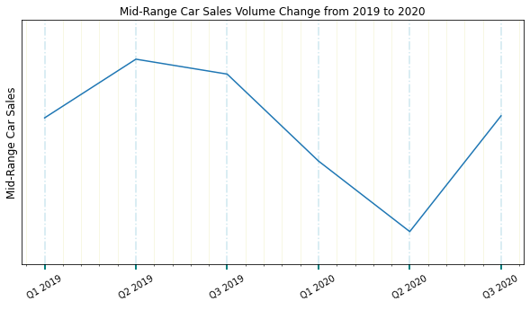

Slide 12
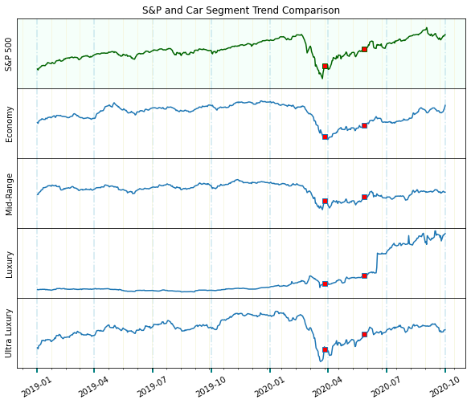
S&P 500 index vs Auto INDEXES
Notes:
Red squares at dates 27 Mar and 27 May 2020 represent the signing of the stimulus package and reaching 100K COVID deaths.
Index comprised of Kia, Mazda, VW, and Mitsubishi weight averaged by stock price.

Slide 13
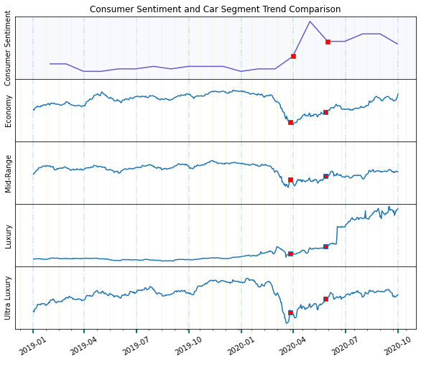
Consumer sentiment vs Auto INDEXES
Notes:
Red squares at dates 27 Mar and 27 May 2020 represent the signing of the stimulus package and reaching 100K COVID deaths.
Index comprised of Kia, Mazda, VW, and Mitsubishi weight averaged by stock price.

Slide 14
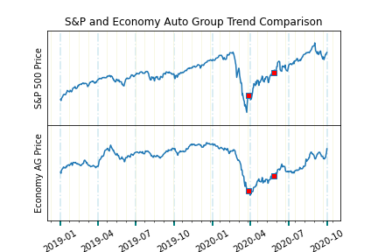
S&P 500 index vs Economy Auto Group index
Implications and observations:
Tracks the S&P closely with slightly less volatility.
Stimulus package on March 27, 2020 (red square) brightened the investor outlook.
Hitting 100,000 COVID deaths on May 27, 2020 (indicated by 2nd red square) had little effect on stock price.
The implication is that investors had a positive outlook on economy vehicle sales in the near future by companies like Kia and Mazda.
Notes:
Red squares at dates 27 Mar and 27 May 2020 represent the signing of the stimulus package and reaching 100K COVID deaths.
Index comprised of Kia, Mazda, VW, and Mitsubishi weight averaged by stock price.

Slide 15
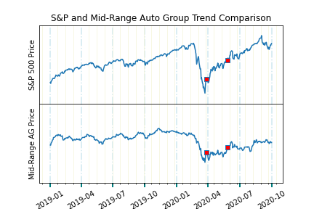
S&P 500 index vs Mid-Range Auto Group index
Implications and observations:
Mid-Range Auto Groups like Ford and Toyota did not enjoy the same rise in stock prices but suffered less severely when the pandemic hit.
Stimulus package on March 27, 2020 (red square) had less effect on Mid-Range Auto Groups.
Hitting 100,000 COVID deaths on May 27, 2020 (indicated by 2nd red square) flattened auto group stock prices.
Implication is that investors had a less positive outlook on the near future of this vehicle segment’s buyers.
Notes:
Red squares at dates 27 Mar and 27 May 2020 represent the signing of the stimulus package and reaching 100K COVID deaths.
Index comprised of Fiat Chrysler, Ford, GM, Honda, Hyundai, Nissan, Subaru, Toyota weight averaged by stock price.

Slide 16
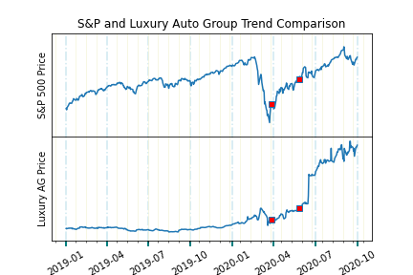
S&P 500 index vs Luxury Auto Group index
Implications and observations:
Luxury Auto Groups like Mercedes and BMW initially look like nothing stood in the way of luxury cars rolling into consumers’ garages... but this is misleading. Tesla sales skyrocketed their stock price and drove the luxury index from flat performance to outpacing the S&P. While relatively flat throughout 2018 and 2019 TSLA stock has increased in value ten times over in 2020. This has dominated the index and other broad economic factors though a flattening in the slope is observed in April through June.
Notes:
Red squares at dates 27 Mar and 27 May 2020 represent the signing of the stimulus package and reaching 100K COVID deaths.
Index comprised of Audi, BMW, Daimler, TaTa, Tesla, and Volvo weight averaged by stock price.

Slide 17
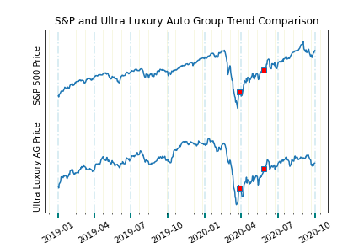
S&P 500 index vs ULTRA Luxury Auto Group index
Implications and observations:
Interestingly, the ultra luxury auto groups index, comprised of brands like Porsche, Ferrari, and McLaren, tracked the S&P 500 the most closely of the four segments and only marginally better than Economy auto groups. This implies that stock market performance may factor into car sales which, in turn, influences stock price.
Notes:
Red squares at dates 27 Mar and 27 May 2020 represent the signing of the stimulus package and reaching 100K COVID deaths.
Index comprised of Porsche, Ferrari, and McLaren weight averaged by stock price.

Slide 18
Summary/data methodology

Slide 19




Team 6 Analysts
Luis Fernando Ruiz delves into government data and highlights what we need to know.
Team 6 Analytical Group uses data to explain how world and national events affect the financial markets.
Contact us for your next research project.
Methodology
Data is sourced from best known origin.
Data cleaned including tasks like removing null values, changing data type, and removing unnecessary rows and columns.
Calculations are made.
Indexes are composed.
Visualizations created.
Phillecia Qualls is our automotive sector guru and keeps an eye on who is in front of the pack and who has been left on the side of the road.
Karen Pearson is our healthcare sector guru and offers us a prognosis of the factors and the players in this space.
Dana Woodruff tracks the stock market’s reactions to news and events… what happened and why.

