Slide 1
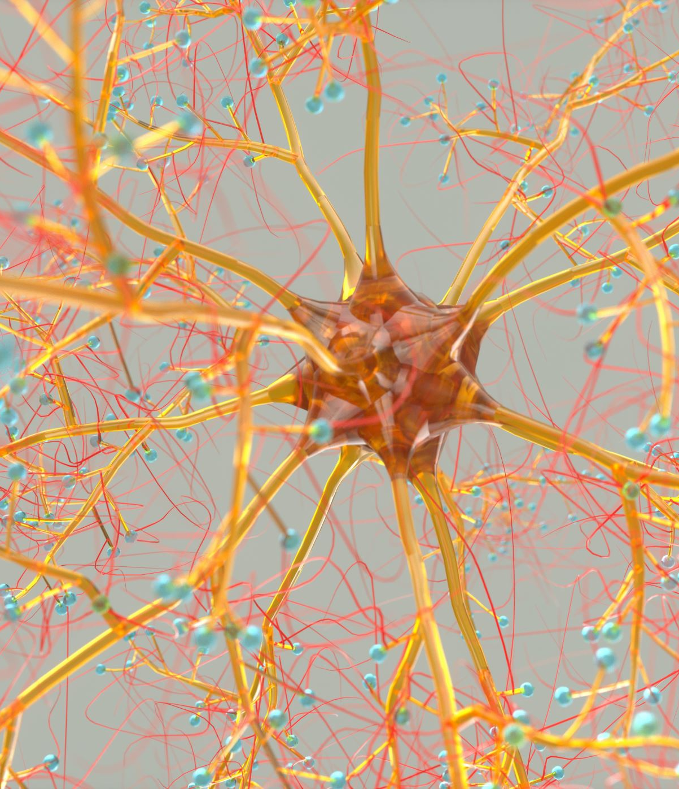

Slide 2
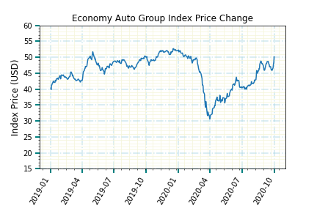
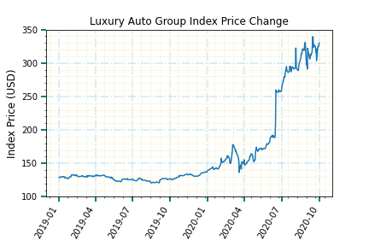
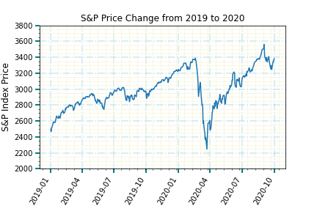
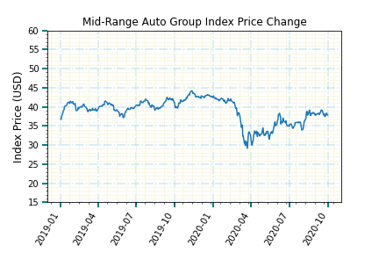
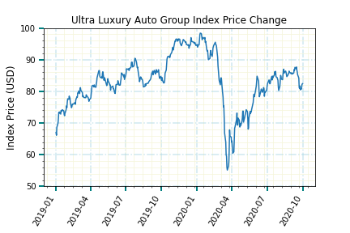
Ultra-Luxury Auto Groups Tracked the S&P 500 performance the best…implying that the stock market is a driving factor in their success. Tesla’s sales skyrocketed their stock price and pulled the luxury index from flat performance to outpacing the S&P.

Slide 3
